Slide 1
Weekly progress
Jing Mai
03/06/2020

Slide 2
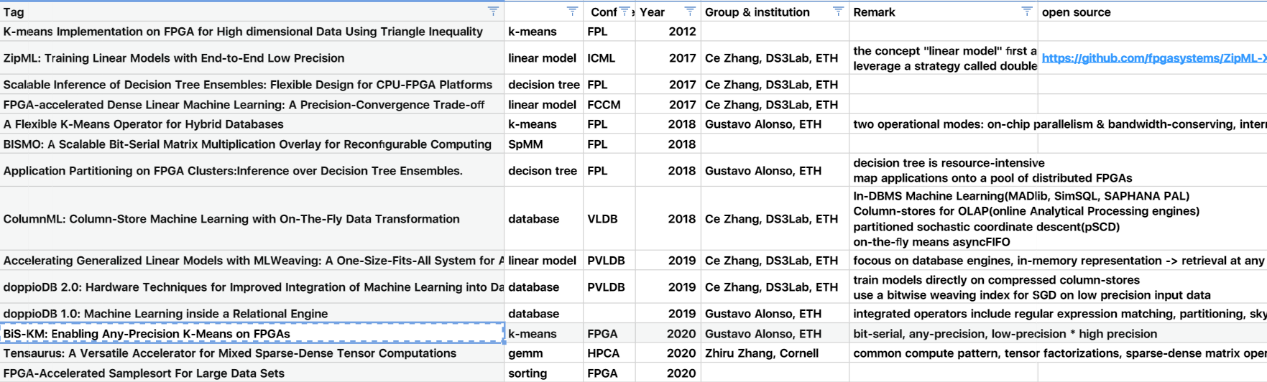

Slide 3
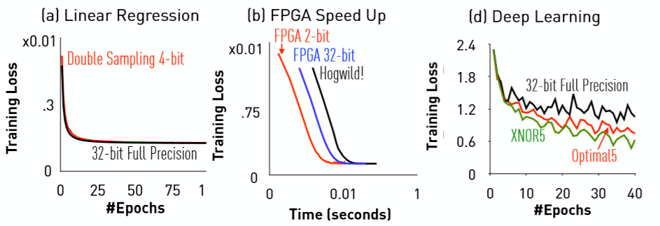
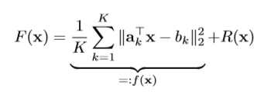
ZipML
- ZipML: Training Linear Models with End-to-End Low Precision, ICML 2017
- concept “linear model”
R(-) is l1-form or l2-form
- leverage a strategy called double sampling, and prove that for linear models, we are able to lower the precision of both computation and communication.

Slide 4
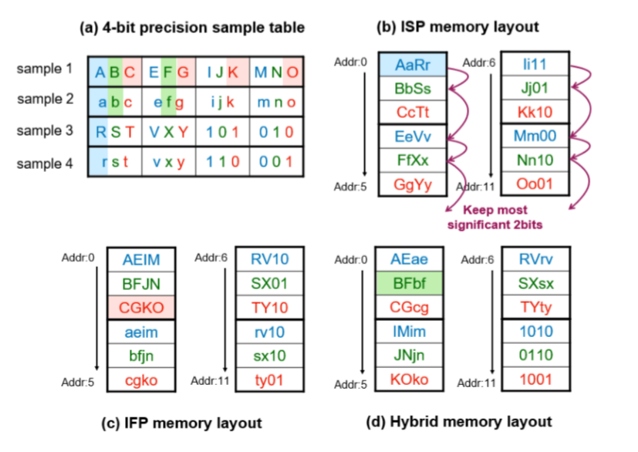
MLWeaving
- Accelerating Generalized Linear Models with MLWeaving: A One-Size-Fits-All System for Any-Precision Learning
- storage format is the same as BiS-KM!
- Low-precision SGD
bit-serial & bit-parallel
- similar paper:

Slide 5
doppioDB 1.0 & 2.0
- doppioDB 1.0: Machine Learning inside a Relational Engine
regular expression matching, partitioning, skyline queries, K-means
column-store database (MonetDB)
- doppioDB 2.0: Hardware Techniques for Improved Integration of Machine Learning into Databases
train models directly on compressed column-stores
use a bitwise weaving index for SGD on low precision input data

