Slide 1

Weekly Progress
03/27/2020

Slide 2
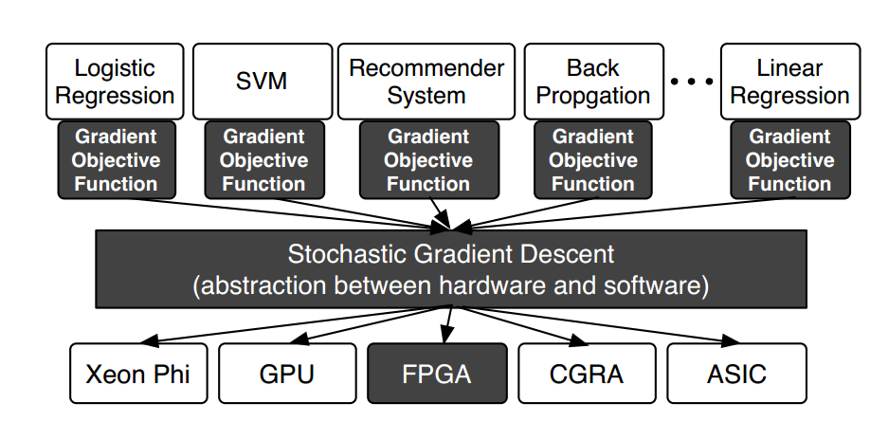

Slide 3
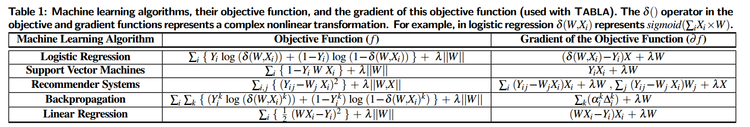

Slide 4
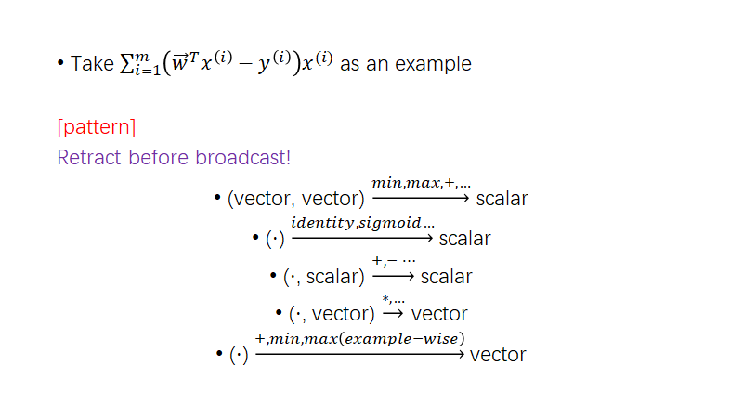

Slide 5
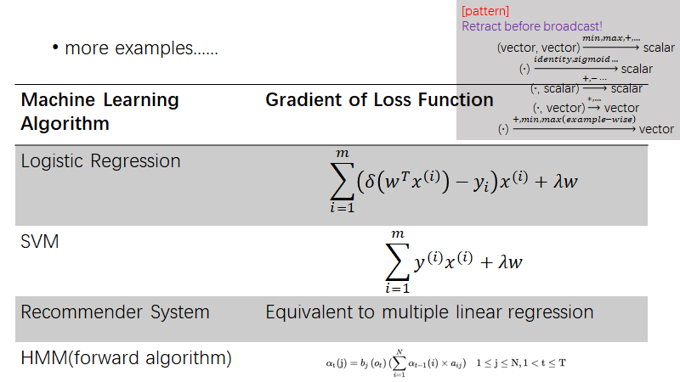

Slide 6
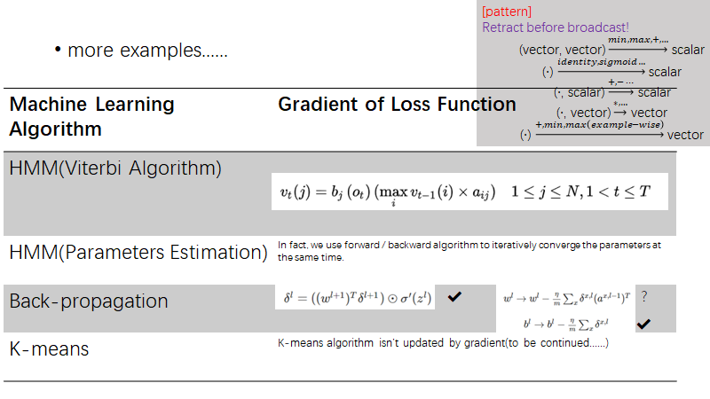

Slide 7
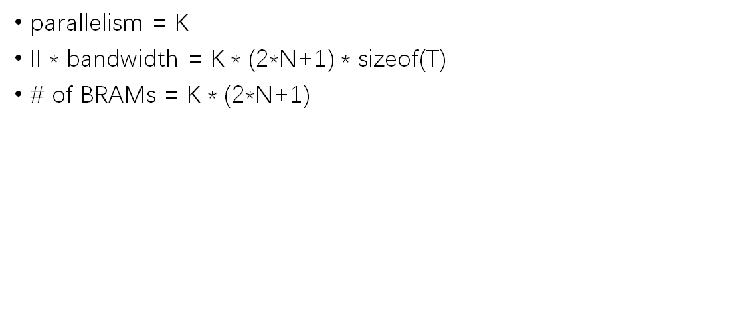
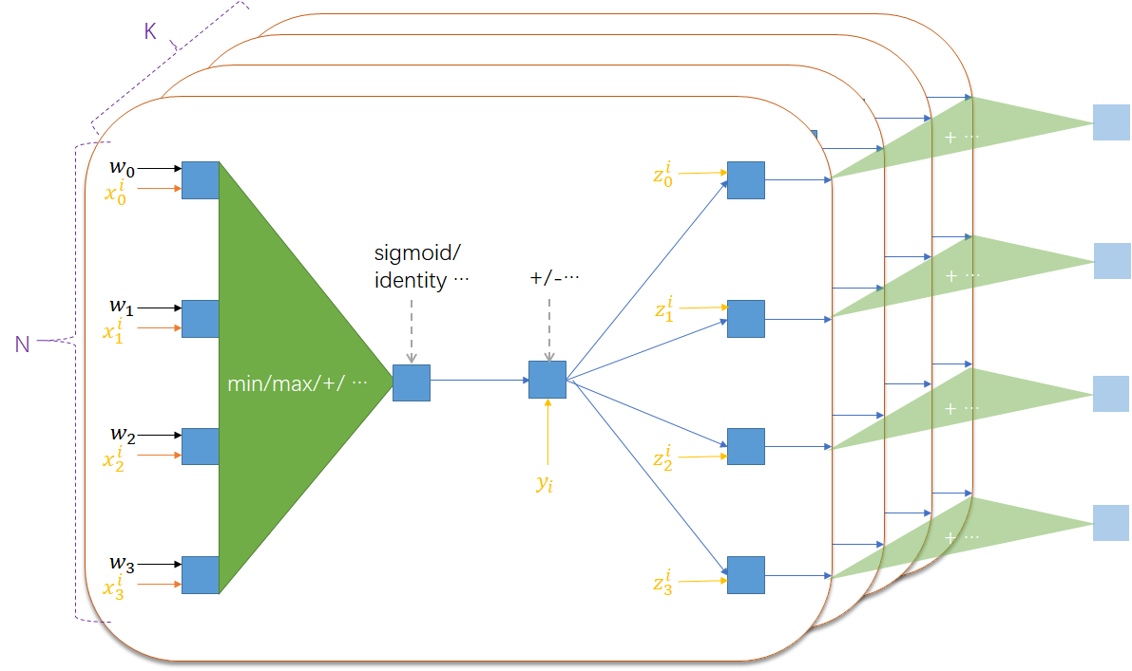
Naive Solution

Slide 8
Personal Insights
pattern of PE or pattern of mathematic formula?
sophisticated pipeline & parallelism design?
resource utilization: BRAM, DSP …
quantization？
bit-serial?

