Slide 1
DuraSpeed Customize SOP ── Android P0/Q0
MTK/Jingen Yu

Slide 2
About DuraSpeed
What is DuraSpeed
DuraSpeed is a system health administrator of MTK platform, which monitors memory and CPU status, and control the Apps behavior when there are so many Apps running in the background.
When DuraSpeed was triggered, it would kill or fore-stop the background processes to get better UX performance and reduce power consumption.
It is very helpful for heavy loading performance, so we suggest to enable by default.
Why need DuraSpeed
As you know, when CPU loading keep high for a long time, the temperature of CPU will rise, then thermal throttling will be enabled, it will reduce CPU frequency. Then CPU frequency drop will affect the UX performance.
When free memory reach the memory reclaim point, the performance will drop.
So we let DuraSpeed control the background processes to improve performance.

Slide 3
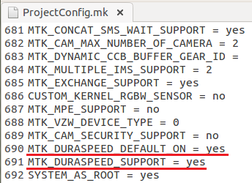
How to enable DuraSpeed by default(1/3)
Please modify ProjectConfig.mk
/device/mediatekprojects/*/ProjectConfig.mk
Ext: /device/mediatekprojects/k39tv1_64_bsp/ProjectConfig.mk
默认打开DuraSpeed
内置DuraSpeed

Slide 4

How to enable DuraSpeed by default(2/3)
If your base line is lower than these version of android P0:
alps-mp-p0.mp1-V5.4 or alps-mp-p0.mp2-V1.49
Please modify Android.mk
/vendor/mediatek/proprietary/frameworks/base/services/Android.mk
将如下Code:
更改为:
For android Q0, not need modify it.

Slide 5
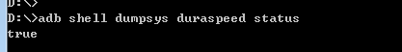
How to enable DuraSpeed by default(3/3)
You can check whether DuraSpeed is enabled:
If return true, it indicate that DuraSpeed is enabled successfully;
If return other info, please help to contact our supporter.

Slide 6
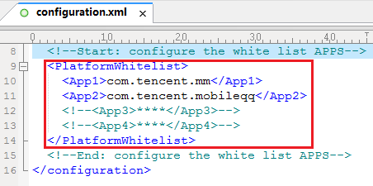
How to customize whitelist(1/4)
客制化configuration.xml
将configuration.xml放置在方便的位置
Ex: frameworks/av/services/audiopolicy/config

Slide 7
How to customize whitelist(2/4)
Copy the file to “/system/etc/duraspeed/configuration.xml”
For Example(<File path>为configuration.xml放置的位置):
In ./device/mediatek/common/device.mk of android P0
In ./device/mediatek/vendor/common/device.mk of android Q0
# Add for Running Booster Feature
ifeq (yes,$(strip $(MTK_RUNNING_BOOSTER_SUPPORT)))
PRODUCT_PROPERTY_OVERRIDES += persist.duraspeed.support=1
PRODUCT_PACKAGES += DuraSpeed
PRODUCT_COPY_FILES += <File path>/configuration.xml:system/etc/duraspeed/configuration.xml
endif

Slide 8
How to customize whitelist(3/4)
Another way is to configure whitelist Apps in “/vendor/mediatek/proprietary/packages/apps/DuraSpeed/res/values/config.xml” file, but all apps must be third-party apps.
vendor/mediatek/proprietary/packages/apps/DuraSpeed/res/values/config.xml
<string-array name=”app_whitelist” translatable=”false”>
<item>com.tencent.mm</item>
<item>com.tencent.mobileqq</item>
</string-array>
Also, you can configure hidden-list Apps in this file, it is same with whitelist and they are not shown in whitelist UI, so end user can’t remove it from whitelist.
<string-array name=”app_hidelist” translatable=”false”>
<item>com.tencent.mm</item>
<item>com.tencent.mobileqq</item>
</string-array>

Slide 9
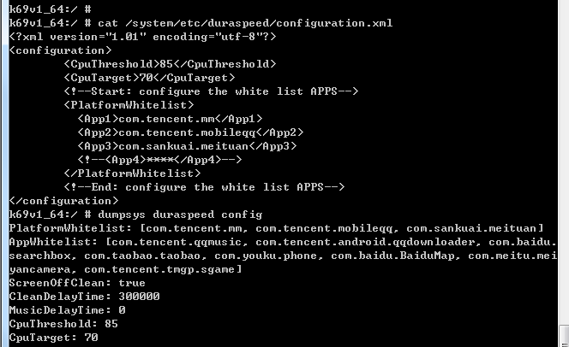
How to customize whitelist(4/4)
Check whitelist

Slide 10
How to judge apps killed by DuraSpeed?
Need userdebug version
Sys_log:
11-26 20:40:23.780242 1129 23259 D DuraSpeed: mMemMaxFree:670514, mMemAvailable:266756
11-26 20:40:23.798017 1129 1164 D DuraSpeed: System unhealthy type: HEALTH_TYPE_MEMORY
11-26 20:40:23.798017 1129 1164 D DuraSpeed: Need release resource: 394.3MB
11-26 20:40:23.863798 1129 1164 I ActivityManager: Killing 32169:com.tencent.news:PushService/u0a118 (adj 995): stop com.tencent.news
11-26 20:40:23.956749 1129 1164 D DuraSpeed: Memory total released about: 375.7MB
11-26 20:40:23.956749 1129 1164 D DuraSpeed: Release com.ss.android.article.news, type: suppress, PSS: 187.0MB
11-26 20:40:23.956749 1129 1164 D DuraSpeed: Release com.tencent.news, type: suppress, PSS: 117.4MB
11-26 20:40:23.956749 1129 1164 D DuraSpeed: Release com.qzone, type: suppress, PSS: 71.2MB
............................................................
kernel log:
11-26 20:40:23.805 <7>[19786.815295] -(6)[1164:DSEventThread][signal][1164:DSEventThread]send death sig 9 to[4286:id.article.news:O]
11-26 20:40:23.864 <7>[19786.874409] -(7)[1164:DSEventThread][signal][1164:DSEventThread]send death sig 9 to[32169:ews:PushService:O]
11-26 20:40:23.866 <7>[19786.876376] -(7)[1164:DSEventThread][signal][1164:DSEventThread]send death sig 9 to[31782:om.tencent.news:O]
11-26 20:40:23.934 <7>[19786.943939] -(7)[1164:DSEventThread][signal][1164:DSEventThread]send death sig 9 to[31156:m.qzone:service:O]
11-26 20:40:23.937 <7>[19786.947276] -(7)[1164:DSEventThread][signal][1164:DSEventThread]send death sig 9 to[31108:com.qzone:O]
Note: The two log time and the issue happened time must match

