Slide 1
Run Coin App
第10组：陈灿辉，蔡滨

Slide 2
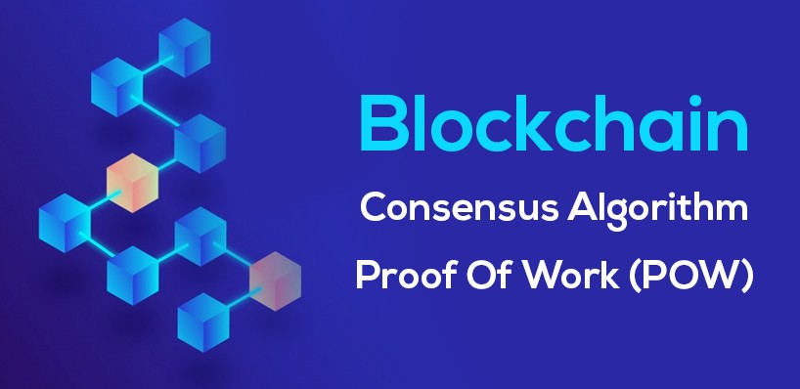
区块链共识机制

Slide 3

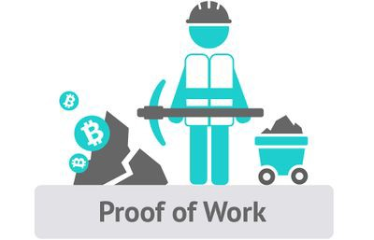
从机器算力到人的体力

Slide 4
账号信息
公钥+私钥+地址
椭圆曲线密码学（Elliptic curve cryptography），简称ECC，是一种建立公开密钥加密的算法，也就是非对称加密。类似的还有RSA，ElGamal算法等。ECC被公认为在给定密钥长度下最安全的加密算法。比特币中的公私钥生成以及签名算法ECDSA都是基于ECC的。

Slide 5
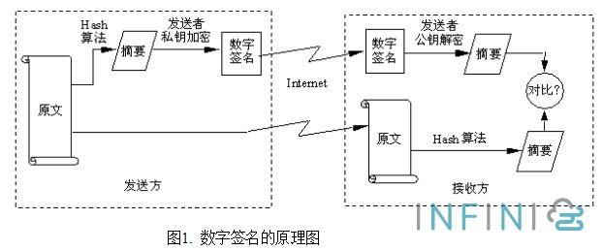
CA 数字签名身份验证
CDSA椭圆曲线数字签名算法

Slide 6
基于博弈论的去中心化交易场 DSCP协议
Bigi, Giancarlo, et al. "Validation of decentralised smart contracts through game theory and formal methods." Programming Languages with Applications to Biology and Security. Springer, Cham, 2015. 142-161.
DSCP, a decentralised smart contract protocol
1. 交易前交易双方先在平台押2倍金额
2. 交易中任何一方以任何形式中断交易，双方押金都直接流失
3. 只有双方都确认并完成交易，押金才会退回

Slide 7
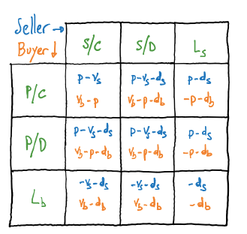
DSCP协议 原理
Comparing the strategies of the buyer, [Lb] dominates [P/D] since the former provides a better pay-o than the latter for any possible strategy of the seller: the buyer would never select [P/D]. Notice that [P/C] dominates [P/D] weakly, that is some payos are equal while none is better for the latter strategy. If p > db, then [Lb] dominates [P/C] as well and the buyer would select the strategy [Lb]: as a consequence, the seller shouldn't have agreed such a price and deposit. The comparison of the strategies of the seller is analogous: [Ls] dominates [S/D],
[S/C] dominates [S/D] weakly; if p > ds, then [Ls] dominates [S/C] as well and the seller would select the strategy [Ls].

Slide 8

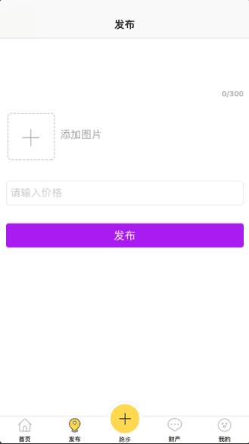
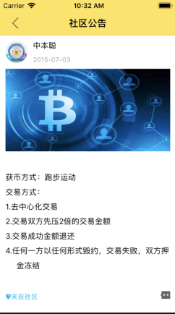

Slide 9
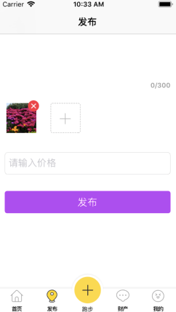
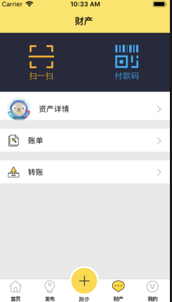


Slide 10
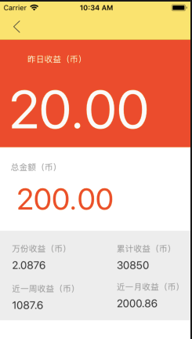

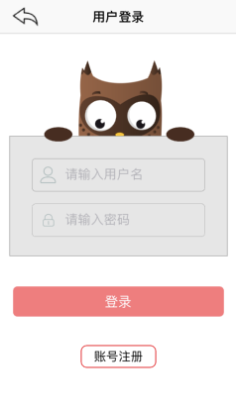

Slide 11
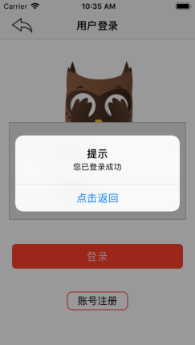
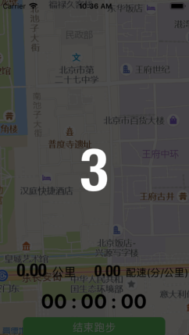
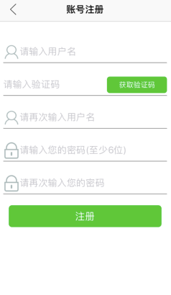

Slide 12
