Slide 1

MACHINE LEARNING END SEMESTER PROJECT (CSE-425)
Title : Predicting and Classifying Euro-Dollar Exchange Rates
Submitted By,
Visweish KM - 125018079
B.Tech, Computer Science and Business Systems
Submitted To,
Swetha Varadarajan

Slide 2
Problem statement
This research addresses the challenge of predicting the EUR/USD exchange rate, which is complicated by market volatility and factors like interest rates and geopolitical events. The goal is to create a machine learning approach to forecast whether the rate will rise or fall the next day, aiding traders in making informed decisions. Models used include Logistic Regression, Random Forest, Naive Bayes, and a Voting Classifier ensemble.

Slide 3
Dataset Description
The dataset comprises nearly two decades of time series data and includes key financial features such as Open, High, Low, and Close (OHLC) prices.
It consists of 4,870 instances, each capturing these essential attributes along with the corresponding date, providing a robust foundation for model training and analysis.

Slide 4
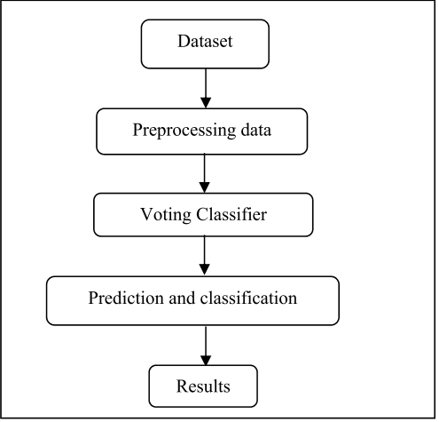
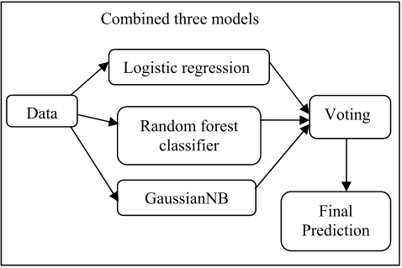
Flow Diagram

Slide 5
Brief Description of all Features
Date: The specific day on which the data is recorded.
Open: The exchange rate at the beginning of the trading period
High: The highest exchange rate reached during the trading period.
Low: The lowest exchange rate reached during the trading period.
Close: The final exchange rate at the end of the trading period.

Slide 6
Data Pre-processing
In the dataset, any missing values are handled by replacing them with the median of their respective feature columns. This approach ensures that the data remains robust without skewing the distribution
Normalization is applied using Min-Max normalization, which scales the data to a range between 0 and 1. This step is crucial for maintaining consistency across features and improving the performance of machine learning models by ensuring that all features contribute proportionately during training.

Slide 7
Feature Engineering
In addition to the original features provided in the dataset, several technical indicators have been integrated to enhance the model's performance. Notably, these include the Relative Strength Index (RSI) and the Exponential Moving Average (EMA).
RSI: A technical indicator used to assess whether a currency is overbought or oversold, giving valuable insights into price reversals.
EMA: A moving average that emphasizes recent prices, helping to identify trends more quickly and improving the model's sensitivity to short-term price changes.

Slide 8
Models Implemented
Logistic Regression: A binary classification model used to predict whether the price will rise or fall.
Decision Trees: A model that captures non-linear relationships by recursively splitting the data based on feature values.
Naive Bayes: A simple probabilistic classifier that performs well even with minimal data preprocessing.

Slide 9
Models Implemented
Adaboost Classifier: A boosting method that combines weak learners to improve performance by focusing on difficult-to-classify data points.
Gradient Boosting Classifier: An advanced boosting technique that sequentially reduces errors to enhance model accuracy on complex datasets.
Voting Classifier: An ensemble model that aggregates predictions from multiple classifiers (e.g., Logistic Regression, Decision Tree, Naive Bayes) using soft voting to improve accuracy.

Slide 10
Results - Accuray and Precision
Models | Accuracy | Precision
Voting Classifier | 85.46 | 86.99
Decision Tree Classifier | 83.59 | 83.05
Logistic Regression | 81.51 | 81.33
Gaussian Naive Bayes | 50.05 | 49.05
AdaBoost Classifier | 58.98 | 56.66
Gradient Boosting Classifier | 77.67 | 75.96

Slide 11
Inferences
The EDA helps us to understand the distribution of data in a visual format.
The preprocessing steps help to refine the data ensuring all the features can be compared on a same scale and not contain missing values.
The GridsearchCV is a hyperparameter tuning techniques which tries of all the possible permutations of the given set of hyperparameters and returns the best result on cross validation with the result of all possibilities.

Slide 12
THANK YOU

