Slide 1
E-Commerce Performance Analysis

Slide 2
Introduction and Executive Summary

Slide 3

Project Overview
Dataset Scope and Contents
  The dataset covers Q4 2023 to October 2025 with detailed transactional fields including sales and payment data.
Analysis Dimensions
  Focus areas include sales KPIs, regional performance, product impact, customer trends, and payment preferences.
Project Goals
  Identify growth opportunities, optimise pricing, enhance profitability, and maintain customer satisfaction.
  The project flows from business problems to data insights and ends with strategic recommendations.

Slide 4

Executive Summary
Financial Performance Overview
  Total revenue reached ₹533.67M with a profit margin of approximately 14.9%, highlighting solid e-commerce growth.
Regional Revenue Leadership
  The North region leads in revenue and profit, showing potential to replicate successful strategies in other regions.
Discount Strategy Impact
  High discount tiers of 20% negatively affect margins, suggesting capping discounts at 10% to improve profitability.
Payment Method Insights
  Net Banking users show the highest average order value, while COD is declining, favouring digital payment incentives.

Slide 5
Data Context and Methodology

Slide 6

Data Coverage and Limitations
Uneven Time Coverage
  Dataset covers Q4 2023, full 2024, and partial 2025, limiting full-year comparisons.
Recommended Comparisons
  Use year-to-date or quarterly comparisons for reliable trend analysis and growth interpretation.
Diverse Data Categories
  Includes Books, Electronics, Furniture, Clothing, Sports, and multiple payment modes for detailed analysis.
Data Validation Needs
  Normalisation and validation are essential for consistency and accuracy in multidimensional analysis.

Slide 7

Methodology and Key Measures
Structured Data Methodology
  The analysis followed structured steps including data import, quality checks, and validation to ensure accuracy.
Feature Engineering
  Created calculated columns like Year, Quarter, Profit Margin, and Average Order Value to enhance insights.
Data Standardization
  Consistent formatting was applied to categorical fields such as Region, Category, and Payment Mode.
Key DAX Measures
  Important DAX calculations include Total Revenue, Total Profit, Number of Orders, AOV, and Profit Margin percentage.

Slide 8
Performance Analysis and Insights

Slide 9
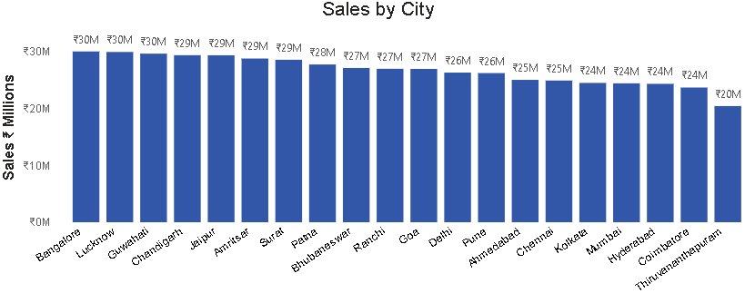
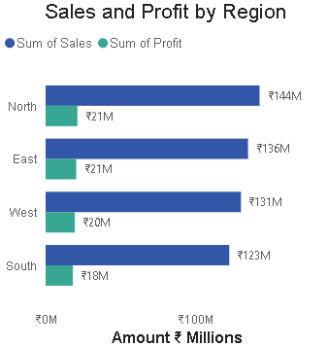
Sales Performance
Regional Sales Leadership
  The North region leads sales with ₹127.10M revenue and ₹18.87M profit, outpacing other regions.
Top City Contributors
  Top cities like Guwahati, Bengaluru (Bangalore), Jaipur, Amritsar, and Lucknow significantly boost overall revenue.
Growth Strategy
  Replicating the North region's successful strategies in East and West can maximize growth potential.
(North ₹127.10M revenue, ₹18.87M profit)

Slide 10
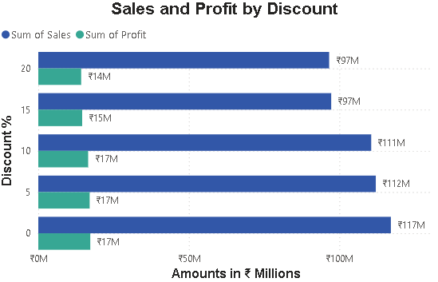
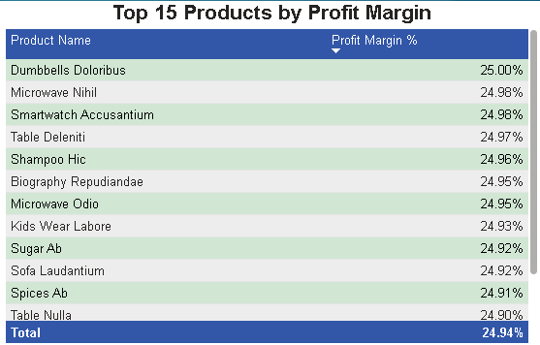
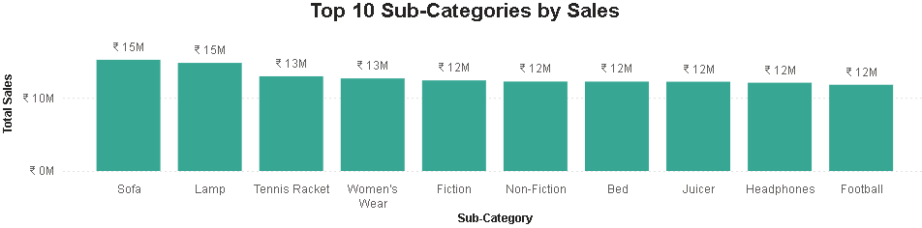
Product Analysis
Top Performing Sub-Categories
  Sofa, Lamp, and Tennis Racket sub-categories lead with sales between ₹12M and ₹15M, showing strong market demand.
High Profit Margin Products
  Products like Dumbbells Doloribus, Microwave Nihil, and Smartwatch Accusantium have profit margins around 25%, highlighting profitability focus areas.
Discount Impact on Sales
  Increasing discount levels lead to declining sales and profits, with zero discounts delivering the best financial performance. Cap at 10% produce ₹9.25M profit in (2024).
Strategic Recommendation
  Focus on limiting high discounts and promoting high-margin products to enhance overall profitability and sustainable growth.

Slide 11
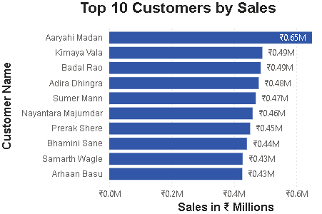
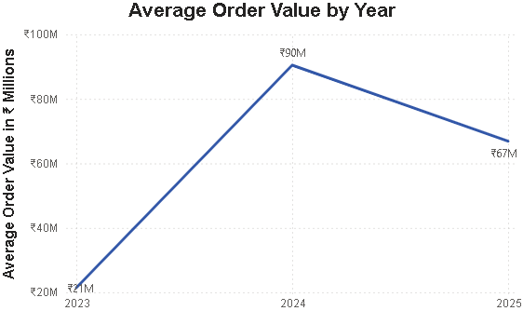
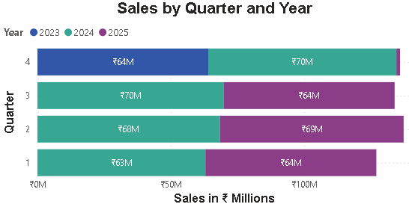
Customer Behaviour
Top Customers by Revenue
  Aaryahi Madan leads with sales above ₹0.5M, followed by Kimaya Vala and Bodal Rao, highlighting key revenue contributors.
Average Order Value Trends
  AOV peaked around ₹0.8M in 2024 but declined in 2025, indicating changes in basket composition or discount strategies.
Seasonal Sales Patterns
  Sales in Q1 and Q2 consistently outperform Q3 and Q4, suggesting strong early-year demand and seasonal buying behavior.
Strategic Actions
  Investigate causes for AOV decline and use seasonal sales peaks for targeted promotions in Q1 and Q2.

Slide 12

Payment Mode Analysis
Payment Method Usage
  Net Banking accounts for 20.89% of transactions and shows a strong upward trend in usage, especially in Q4.
Profit by Payment Mode
  Net Banking generates the highest profit of approximately ₹17 million compared to other payment modes.
Average Order Value Impact
  Net Banking also leads in average order value (~₹37 million), showing larger basket sizes compared to others.
Changing Payment Preferences
  Cash on Delivery usage is declining, while digital payments like Net Banking rise sharply, with UPI and cards steady.

Slide 13
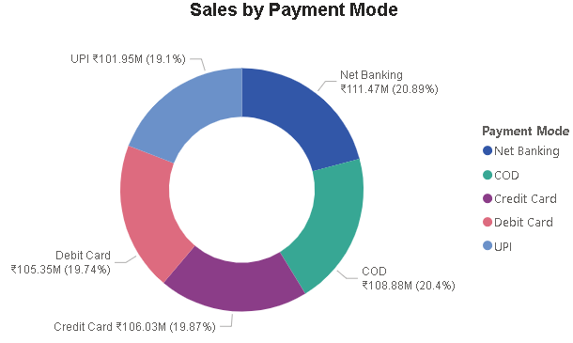
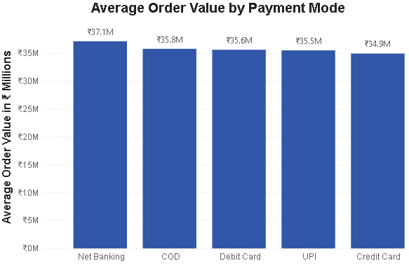
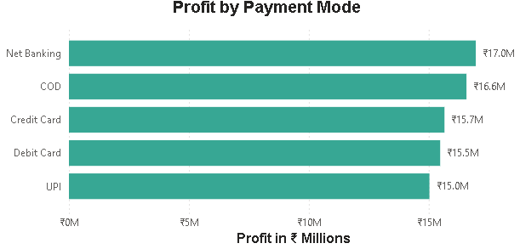
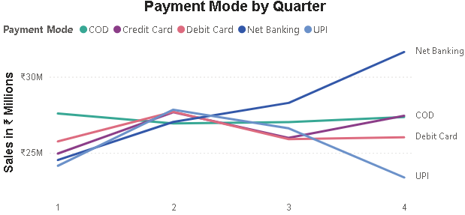

Slide 14
Recommendations

Slide 15

Strategic Recommendations
Regional Promotion Strategy
  Focus marketing efforts by doubling down on the Northern region and replicating strategies in the East and West.
Product Marketing Priorities
  Emphasise high-margin products like Dumbbells Doloribus and Microwave Nihil in marketing campaigns.
Optimised Discounting
  Avoid broad 20% discounts; implement smaller 5-10% discount tiers with uplift analysis to maximise impact.
Customer Loyalty and Payments
  Develop loyalty programs for top customers and encourage digital payments to increase average order value and reduce costs.

Slide 16
Appendix

Slide 17
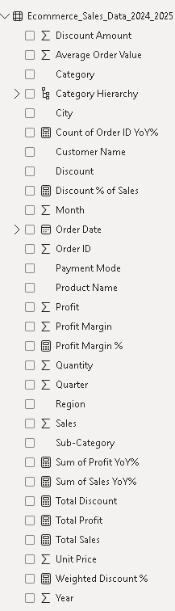
Calculated Columns and DAX Formulas
Date Calculations
  Using YEAR, FORMAT, and QUARTER functions extracts time periods from order dates for trend analysis.
Profit Margin Calculation
  Profit Margin is calculated by dividing Profit by Sales to measure profitability efficiently.
Average Order Value
  Average Order Value is computed by dividing Sales by Quantity, indicating sales efficiency.
Discount Amount Calculation
  Discount Amount is derived by applying the discount percentage to sales using division for accuracy.

