Slide 1

Hospital Management SQL Project
Schema Build and Analytics
Designing databases and analysing hospital data efficiently
Notes:
---

Slide 2
Data Definition & Schema Setup
Notes:
Initial Raw Schema, SQL Script: Primary Keys, Schema Progress After PKs

Slide 3

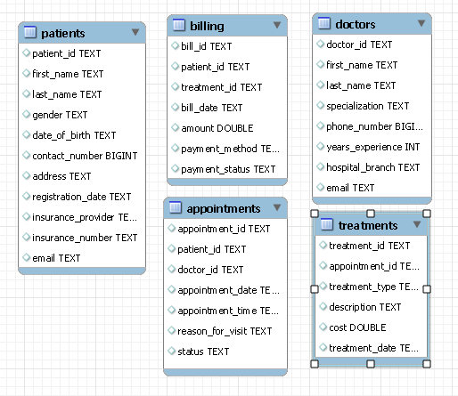
Initial Raw Schema
Baseline Raw Schema
  The raw schema contains tables with TEXT columns limiting indexing and constraints.
Missing Keys and Constraints
  No primary or foreign keys exist, preventing uniqueness and referential integrity enforcement.
Data Quality Risks
  Lack of structure causes risks like duplicate records and orphaned rows affecting reliability.
Need for Schema Improvement
  Applying enhancements is necessary to add constraints and standardise data types for consistency.

Slide 4
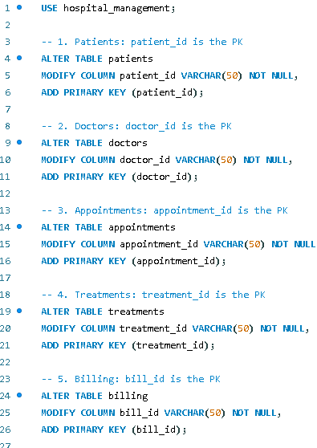
SQL Script: Primary Keys
Definition of Primary Keys
  Primary keys uniquely identify each record and are essential for relational integrity in databases.
Role in Data Relationships
  Primary keys enable foreign keys, allowing accurate joins and enforcing referential integrity.
Performance Benefits
  Indexed primary keys improve query performance and data retrieval efficiency in relational databases.
Foundation for Schema Design
  Creating primary keys before foreign keys ensures a robust and well-structured relational schema.

Slide 5
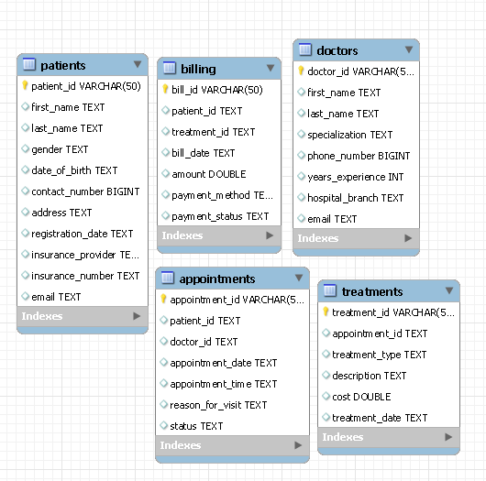
Schema Progress After PKs
Primary Key Assignment
  Assigning primary keys structures the schema and reduces duplicate records, enhancing database reliability.
Logical Table Linking
  Primary keys enable logical linking of tables reflecting real-world relationships like patients, doctors, and appointments.
Improved Data Integrity
  Structural improvements from primary keys prepare the schema for referential constraints and stronger data integrity.

Slide 6
Data Standardisation & Cleaning
Notes:
SQL Script: Data Typing & Foreign Keys, Final ERD Diagram

Slide 7
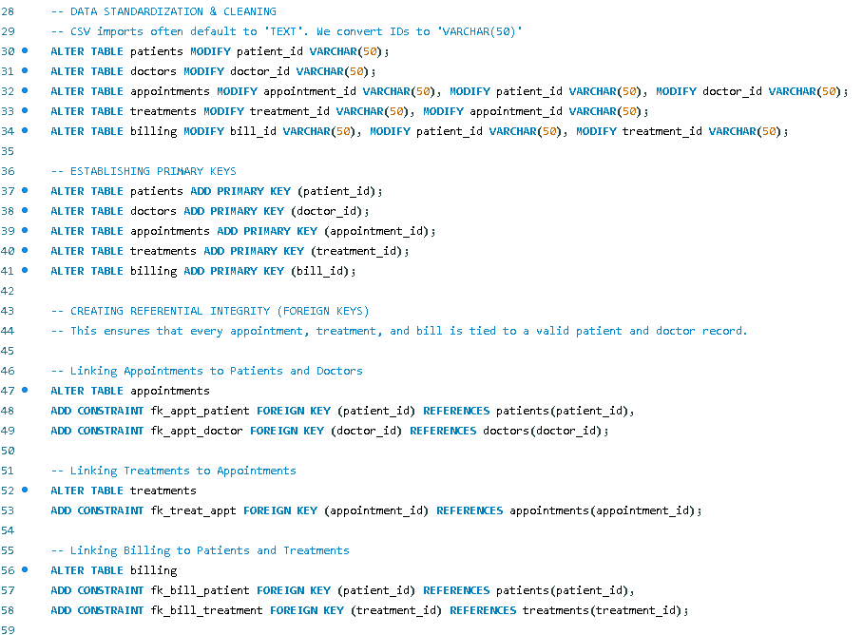
Data Typing & Foreign Keys
Standardising Data Types
  Converting ID columns from TEXT to VARCHAR(50) ensures type compatibility for relational integrity.
Establishing Foreign Keys
  Foreign key constraints link related tables, such as appointments to patients and doctors, ensuring data consistency.
Maintaining Data Integrity
  Constraints prevent orphan records and enable automatic validation during data insert and update operations.

Slide 8
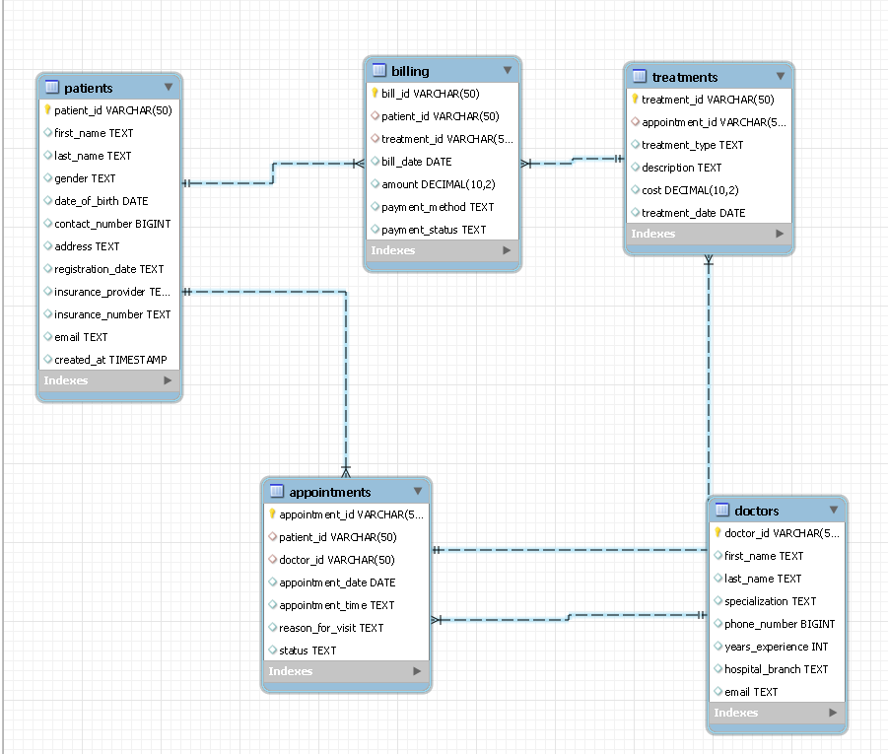
Final ERD Diagram
Relational Schema Representation
  The Entity Relationship Diagram visually illustrates interconnected tables via primary and foreign keys modeling hospital workflows.
Workflow Integration
  Patients, doctors, appointments, treatments, and billing entities are logically connected representing real hospital processes.
Database Robustness and Analytics
  The structured schema supports reliable joins, accurate reports, and advanced analytics for clinical and financial insights.

Slide 9
Data Transformation
Notes:
SQL Script: Type Conversion

Slide 10
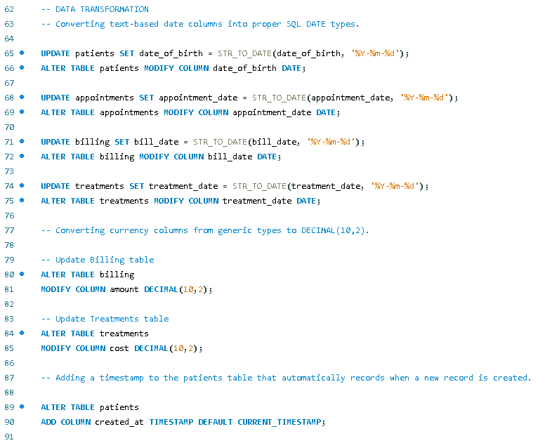
SQL Script: Type Conversion
Date Type Conversion
Converting string dates to DATE type enables accurate filtering and time-based analysis.
Currency Precision
Currency fields use DECIMAL(10,2) to avoid rounding errors and ensure financial accuracy.
Audit Timestamps
Added timestamps like created at support traceability and enable trend analysis in data.
Notes:
Data transformation ensures that stored values are meaningful and suitable for analysis. This step converts string-based dates into DATE types, enabling accurate filtering, sorting, and time-based calculations. Currency fields are converted to DECIMAL(10,2) to avoid floating-point rounding errors and ensure financial precision. Additionally, audit fields like created_at timestamps are added to support traceability and trend analysis. These transformations make the database analytics-ready, allowing for reliable reporting and decision-making based on clean, structured data.

Slide 11
Operational Efficiency & Hospital Performance
Notes:
Analysis: Peak Busy Days, Analysis: Doctor Workload, Analysis: No-Show Impact, Analysis: Departmental Success

Slide 12
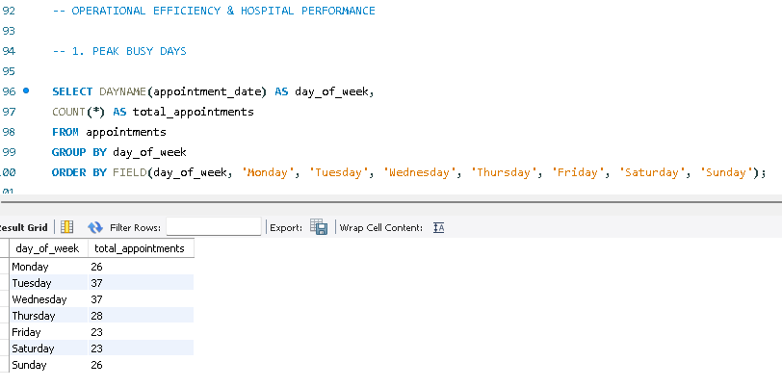
Analysis Peak Busy Days
Identifying Peak Days
Analyse appointment data to pinpoint the busiest days of the week for patient visits and service demand.
Optimising Staffing and Rooms
Use peak day insights to allocate staff and rooms efficiently, reducing patient wait times and improving care quality.
Supporting Forecasting and Planning
Leverage analysis for seasonal planning and forecasting to ensure operational capacity meets patient demand effectively.

Slide 13
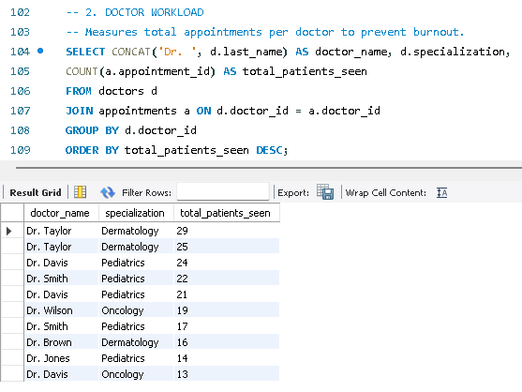
Analysis Doctor Workload
Workload Distribution
  Analysing appointment distribution helps balance workloads and prevent physician burnout for better healthcare delivery.
Capacity and Recruitment
  Identifying high-demand doctors supports addressing capacity issues and guides recruitment planning effectively.
Optimising Resource Use
  Monitoring workload patterns allows hospitals to optimise resources and maintain high-quality patient care.
Notes:
Doctor workload analysis reveals the distribution of appointments across physicians. This information is crucial for balancing workloads, preventing burnout, and ensuring fair rota planning. Identifying high-demand doctors helps address capacity constraints and informs recruitment strategies. By monitoring workload patterns, hospitals can maintain quality care and optimize resource utilization.

Slide 14
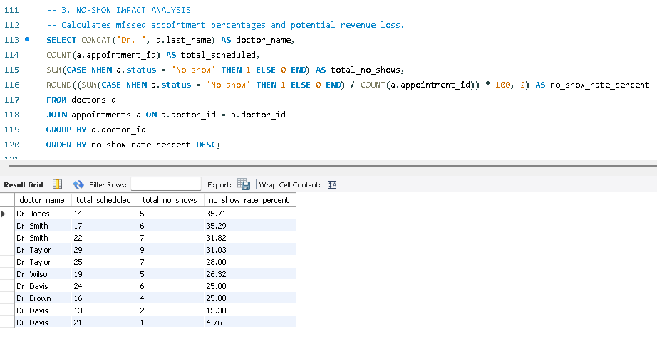
Analysis
No-Show Impact
Operational Efficiency Impact
No-shows and cancellations disrupt hospital operations and reduce efficiency in patient scheduling and resource allocation.
Quantifying Missed Appointments
Analyzing missed appointments per physician helps identify problem areas for targeted intervention and improvement.
Improving Financial Performance
Reducing no-shows through reminders or overbooking optimizes resource use and boosts hospital revenue.
Notes:
No-show and cancellation rates significantly affect operational efficiency and revenue. This analysis quantifies missed appointments per physician, highlighting areas where interventions like reminders or overbooking may be necessary. Reducing no-shows improves resource utilization and financial performance, making this metric a key component of hospital management strategies.

Slide 15
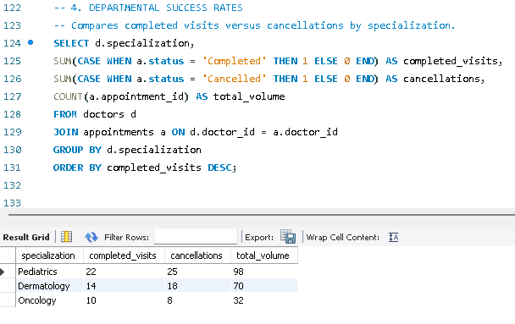
Analysis Departmental Success
Visit Completion Comparison
  Comparing completed versus cancelled visits by specialisation highlights departmental performance variations.
Causes of High Cancellation
  High cancellation rates suggest inefficiencies or communication gaps impacting patient scheduling.
Improvement Opportunities
  Analysis enables targeted improvements, resource prioritization, and service redesign to optimize operations.
Notes:
Comparing completed versus cancelled visits by specialization provides insights into departmental performance. High cancellation rates may indicate process inefficiencies or patient communication gaps. This analysis supports targeted improvements, resource prioritization, and service redesign to enhance patient flow and operational effectiveness.

Slide 16
Financial & Insurance Performance
Notes:
Insurance Revenue Streams, Aging Accounts Receivable, Treatment Profitability

Slide 17
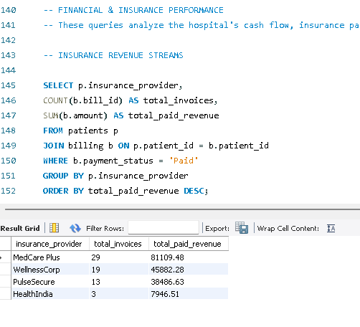
Insurance Revenue Streams
Ranking Insurance Providers
  The analysis ranks insurers by total payments and claim counts to identify major revenue sources.
Revenue Contribution Insights
  Understanding payer mix helps hospitals manage contracts and reimbursement strategies effectively.
Financial Planning Support
  Insights from insurer data assist in financial planning and risk management for hospitals.
Notes:
This analysis ranks insurance providers by total payments and claim counts, offering a clear view of payer mix and revenue contribution. Understanding which insurers generate the most revenue helps hospitals negotiate contracts, manage reimbursement strategies, and monitor cash flow stability. Insights from this query support financial planning and risk management.

Slide 18
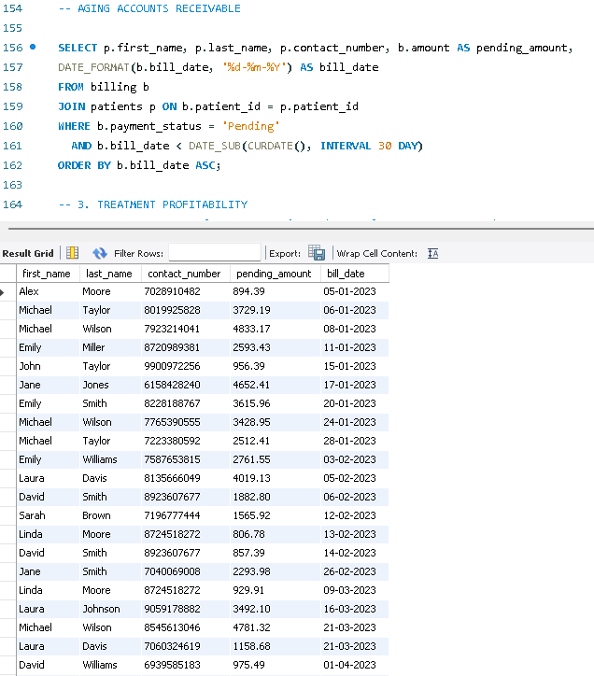
Aging Accounts Receivable
Importance of Tracking Overdue Bills
Monitoring bills older than 30 days helps manage outstanding debt effectively and improve collection rates.
Prioritising Follow-Up Actions
The report helps prioritise accounts for follow-up to reduce aging receivables and enhance cash flow.
Mitigating Financial Risk
Hospitals can mitigate financial risks by closely monitoring overdue accounts and maintaining strong revenue cycles.
Notes:
Tracking pending bills older than 30 days is essential for managing outstanding debt and improving collections. This report prioritizes follow-up actions, reduces aging receivables, and strengthens cash flow. By monitoring overdue accounts, hospitals can mitigate financial risk and maintain healthy revenue cycles.

Slide 19
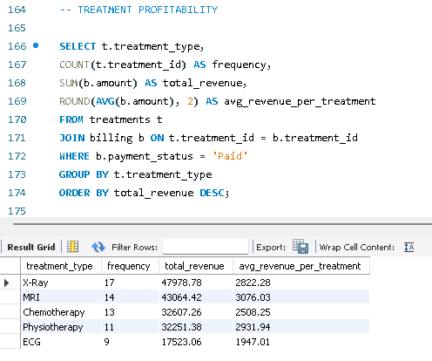
Treatment Profitability
Revenue Analysis by Treatment
  Reviewing income streams from different treatments highlights the most profitable medical services offered.
Strategic Resource Allocation
  Data-driven insights support better pricing, staff deployment, and equipment investment decisions.
Optimising Service Mix
  Identifying high-margin procedures helps hospitals refine services to maximize overall profitability.
Notes:
Analyzing revenue by treatment type reveals which medical services generate the highest returns. This insight supports strategic decisions on pricing, resource allocation, and investment in equipment or staff. Identifying high-margin procedures enables hospitals to optimize their service mix and improve overall profitability.

Slide 20
Patient & Clinical Insights
Notes:
Patient Retention (Loyalty), Age Group Demographics, Gender Distribution

Slide 21
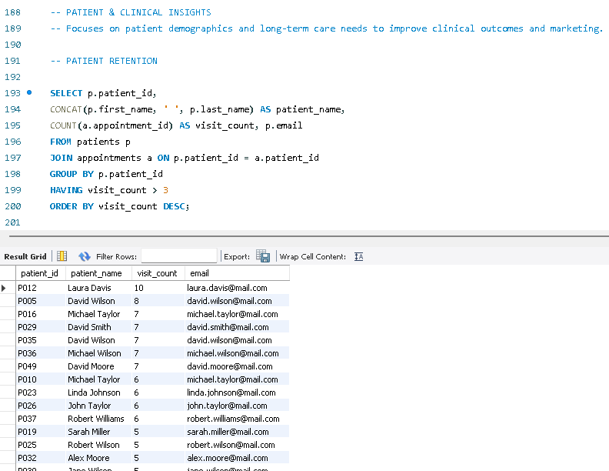
Patient Retention (Loyalty)
Targeted Care Management
  Frequent-visit patients with chronic conditions provide opportunities for personalized, targeted care management.
Resource Allocation
  Identifying frequent patients helps hospitals allocate resources more effectively to improve care quality.
Proactive Engagement
  Proactive patient engagement and continuity of care enhance long-term health outcomes for loyal patients.
Notes:
Frequent-visit patients, often those with chronic conditions, represent an opportunity for targeted care management. Identifying these patients helps hospitals design personalized care pathways, allocate resources effectively, and improve long-term health outcomes. This analysis supports proactive engagement and continuity of care.

Slide 22
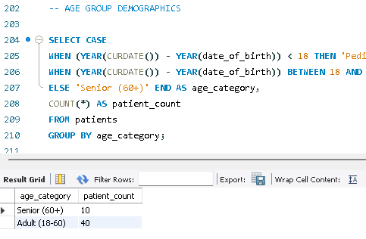
Age Group Demographics
Patient Age Segmentation
  Patients are categorised into Pediatric, Adult, and Senior groups to better understand demographic needs and trends.
Resource and Staff Allocation
  Segmented demographics guide effective allocation of staff and resources tailored to each age group’s needs.
Strategic Clinical Planning
  Age demographics analysis supports forecasting future healthcare demand and informs strategic clinical decisions.
Notes:
Segmenting patients into age groups such as Pediatric, Adult, and Senior provides valuable insights for resource planning. Understanding demographic distribution helps tailor services, allocate staff appropriately, and anticipate future demand trends. This analysis informs strategic decisions in clinical operations.

Slide 23
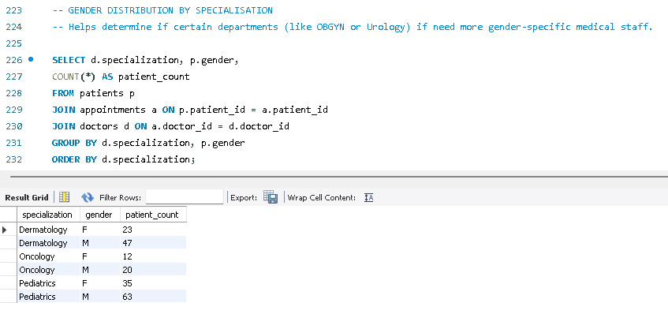
Gender Distribution
Equitable Care and Staffing
Analysing gender distribution ensures fair staffing and equitable care in various medical specializations.
Aligning Services with Demographics
Gender insights help hospitals tailor services to meet diverse patient needs effectively.
Supporting Diversity and Inclusion
Gender-based analysis supports compliance with diversity and inclusion goals in healthcare.
Notes:
Analyzing gender distribution across medical specializations ensures equitable care and staffing. This insight helps hospitals align services with patient demographics, identify potential gaps, and improve patient experience. Gender-based analysis also supports compliance with diversity and inclusion goals.

Slide 24
Strategic Planning & Quality Control
Notes:
Doctor–Patient Ratio, Unbilled Treatments (Revenue Leakage), Treatment Recurrence

Slide 25
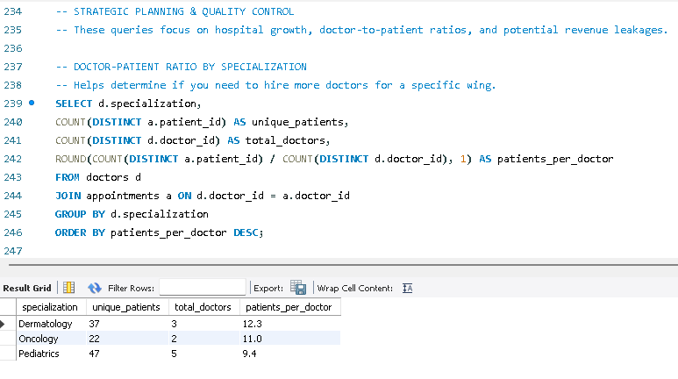
Doctor–Patient Ratio
Measuring Patient Load
  Tracking unique patients per doctor by specialisation reveals workload and capacity pressures in healthcare settings.
Staffing Implications
  High doctor–patient ratios may require additional hires or schedule adjustments to maintain care quality.
Quality Care and Burnout Prevention
  Managing doctor–patient ratios helps prevent physician burnout and ensures consistent quality care.
Notes:
Calculating the number of unique patients per doctor by specialization highlights capacity pressures and informs staffing decisions. High ratios may indicate the need for additional hires or scheduling adjustments. This metric is critical for maintaining quality care and preventing physician burnout.

Slide 26
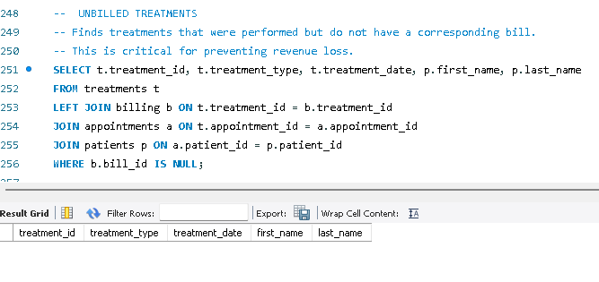
Unbilled Treatments (Revenue Leakage)
Identifying Unbilled Treatments
  Detecting treatments not billed is crucial for protecting hospital revenue and closing financial gaps.
Process Gaps in Billing Workflow
  The audit query helps uncover inefficiencies in the treatment-to-billing workflow to prevent revenue loss.
Improving Profitability and Compliance
  Addressing revenue leakage enhances hospital profitability and ensures regulatory compliance.
Notes:
Identifying treatments performed but not billed is essential for revenue protection. This audit query detects process gaps in the treatment-to-billing workflow, enabling hospitals to recover missed charges and strengthen financial governance. Addressing revenue leakage improves profitability and compliance.

Slide 27
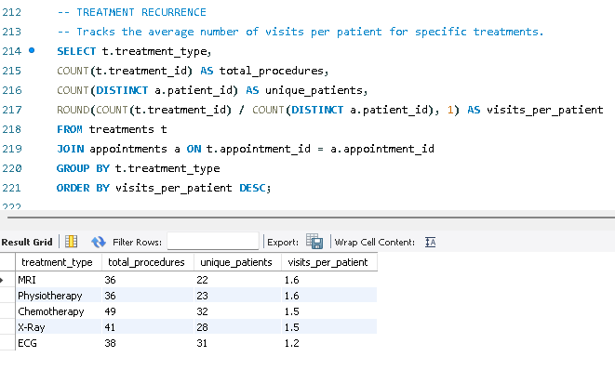
Treatment Recurrence
Measuring Treatment Recurrence
  Tracking repeated treatments per patient reveals patterns in clinical effectiveness and helps identify overuse or inefficiencies.
Implications of High Recurrence
  High recurrence rates may indicate the need to review treatment protocols or consider alternative therapies for better outcomes.
Supporting Quality Improvement
  Analyzing treatment recurrence data aids in quality improvement initiatives and supports long-term healthcare planning.
Notes:
Measuring how often specific treatments are repeated per patient provides insights into clinical effectiveness and resource utilization. High recurrence rates may signal the need for protocol review or alternative therapies. This analysis supports quality improvement initiatives and long-term planning.

