Slide 1
Coral Protect
Software + hardware solution for preventing damage to Coral Reefs around the world and thus protecting 50% of marine life

Slide 2
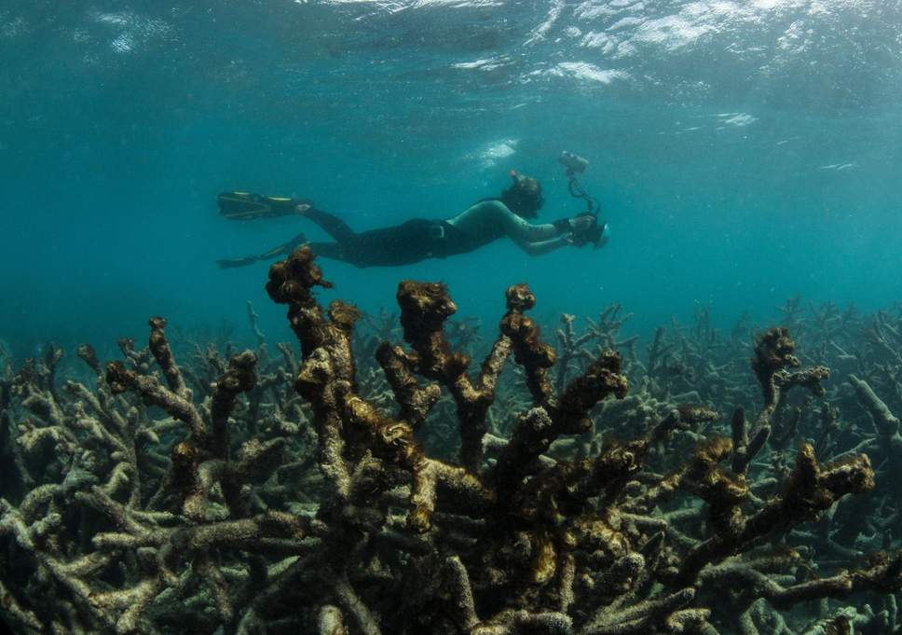
A diver in Great Barrier Reef, Australia across dead coral

Slide 3
Functions of Coral Reefs
Coral reefs are important for many different reasons aside from supposedly containing the most diverse ecosystems on the planet. They:
protect coastlines from the damaging effects of wave action and tropical storms
provide habitats and shelter for many marine organisms
are the source of nitrogen and other essential nutrients for marine food chains
assist in carbon and nitrogen fixing
help with nutrient recycling.

Slide 4
Why do we need Coral Protect?
The world has already lost roughly half its coral reefs in the last 30 years
More than 90 percent of world's coral reefs will die by 2050
By 2050: 25% of Marine Species Will be lost too & Half a Billion People without a job
If a drastic intervention is not provided, huge economic and societal impacts

Slide 5
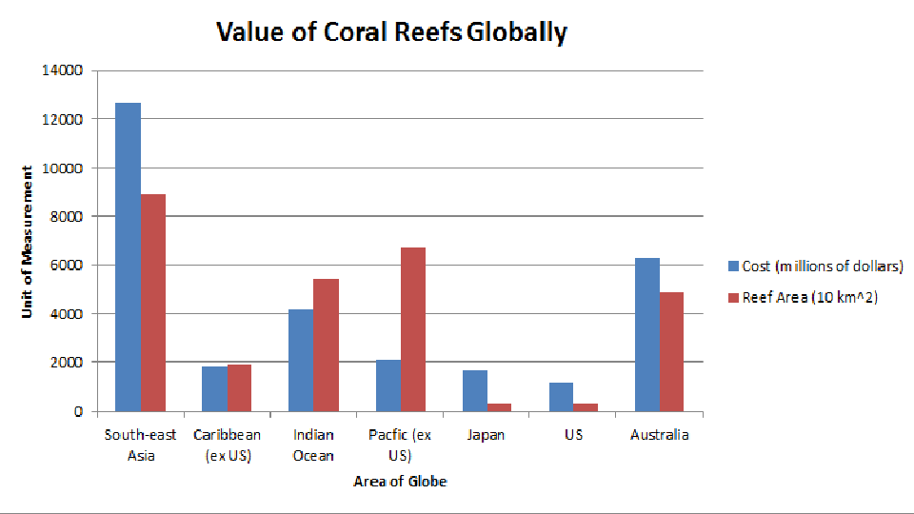
Value of Coral and why it is misused?

Slide 6
What does the product do?
Deploys slave cameras for detection that are radially located and are positioned in a specified and constant distance from the Raspberry Pi device that uses image classifiers to detect whether any slave camera is transmitting video feed of dead or bleached coral reefs.
The model will be running on the Raspberry Pi using a Convolutional Neural Network that runs on TensorFlow Lite and then fires the labels(0 or 1) to the cloud.
The mobile application provides two main features:
Ability to help clean litter by diving and earning credits that can be monetarized by government or NGO funds
Ability to report illicit activities by tourists or locals, for instance, selling shells or illicit fishing

Slide 7
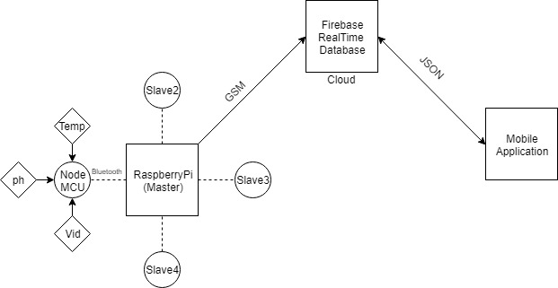
System Architecture

Slide 8
Strengths
- Better Governance
- Eco system Restoration
- Illicit activities reduction
Threats
- Aquatic Interference
- False Claims
Opportunities
- Youth Crowdsourcing
- Travel Hotspots
- Individual responsibilities
Weaknesses
- Water Proofing
- Environmental Issues
Business Model

