Slide 1
Solving Integer (Linear) Programs
Danielius Sukys

Slide 2
Topics
Section 1: Solving ILPs
  What are ILPs?
  What are Linear Programs?
  Which one is harder? Why?
  Branch-and-Bound
Section 2: Formulating your problem
  Is there only one way to solve a problem using an ILP?
  Quick intro to Kidney Exchange Problem (KEP)
  Edge Formulation
  Cycle Formulation
  Analysis: which one is better?
Section 3: Solving large ILPs
  Constraint Generation
  Example: Edge Formulation

Slide 3
Section 1: Solving ILPs

Slide 4
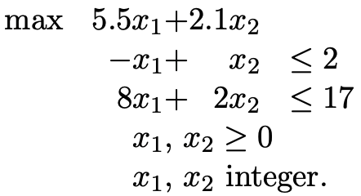
What is Linear Programming?
Objective
Function
Constraints
Variables

Slide 5
What is Integer (Linear) Programming?
Objective
Function
Constraints
Variables
Some of them are integral

Slide 6
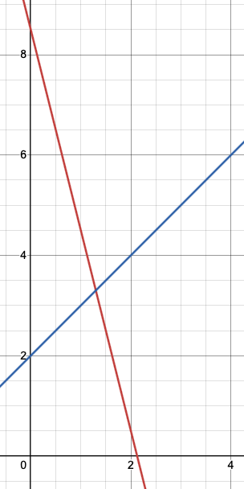
Which one is harder?
x₂
Fact: OPT in some extreme point of the polytope surrounding the solution space
-x₁+x₂>2
-x₁+x₂<2
8x₁+2x₂>17
An algorithm needs to visit these extreme points. Worst case exponential, but very fast in practice (read about smoothed analysis). There are also polynomial algorithms but some of them are extremely slow!
8x₁+2x₂<17
x₁

Slide 7
Which one is harder?
x₂
No known polynomial time algorithm here!
x₁

Slide 8
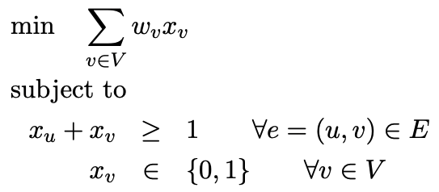
Which one is harder?
This formulation can be shown to solve vertex cover
So, solving ILPs is NP-hard
Can we use Linear Programming relaxations (LPRs) – where integrality constraint is dropped?

Slide 9
How can we solve ILPs?
We know that solution to a LPR gives an upper/lower bound to the solution of ILP
  Why?
  Integers are a subset of rationals, so every integral solution is a valid linear solution
  But a fractional solution can potentially be better
  So, for maximization problems LPRs provide upper bounds and for minimization problems they provide lower bounds

Slide 10
What can we do with a fractional solution?
Idea 1: round the variables up/down?
  Can we expect this to work?
  In some cases, this gives an approximation!
Idea 2: use the bounds and branch on fractional variables
  Need to do this in the way that so that we do not discard valid integral solutions
  Hope that LPR will result in a fractional assignment in reasonable time

Slide 11
Branch-and-bound [1]
LPR = 14.08
X₁=1.3
X₂=3.3
=> OPT ≤ 14.08
What can we branch on??

Slide 12
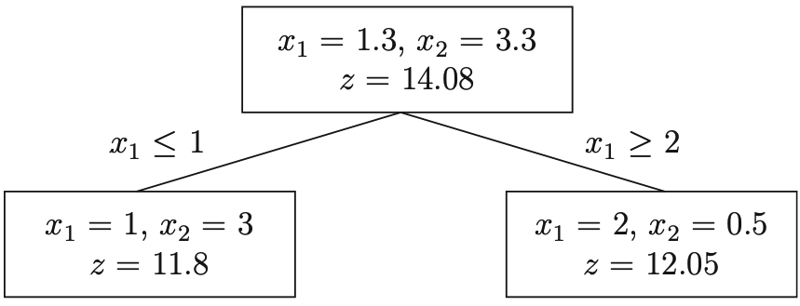
Branch-and-bound [1]
What is interesting here?
Do we need to explore this branch?
LPR is integral. What can we deduce?
=> 11.8 ≤ OPT ≤ 14.08
Tree is ”Pruned by integrality”

Slide 13
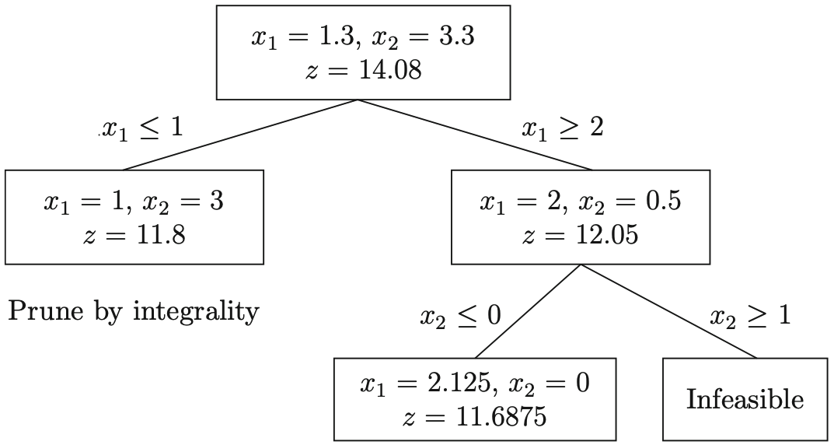
Branch-and-bound [1]
What is interesting
here?
”Pruned by infeasibility”
11.6875 ≤ 11.8
So ”Pruned by bound”

Slide 14
Section 2: Formulating problems

Slide 15
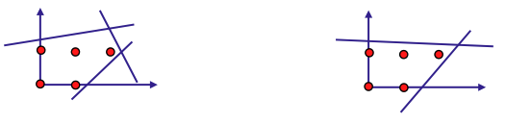
Is an ILP formulation unique? [2]
Observe: integral solutions are the same

Slide 16
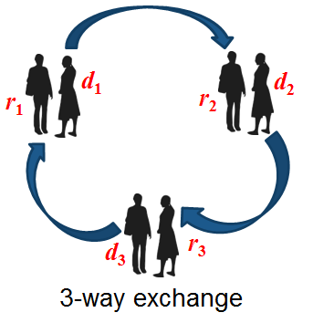
Example: Kidney Exchange Problem
Image borrowed from [3]

Slide 17
Example: Kidney Exchange Problem
Problem: Kidney Exchange Problem with Cycles at most length-K
Abbreviation: KEP(K)
Input: Directed compatibility graph G=(V,A), integer T
Question: What is the largest number of vertices covered by a vertex-disjoint packing of cycles of length at most K?

Slide 18
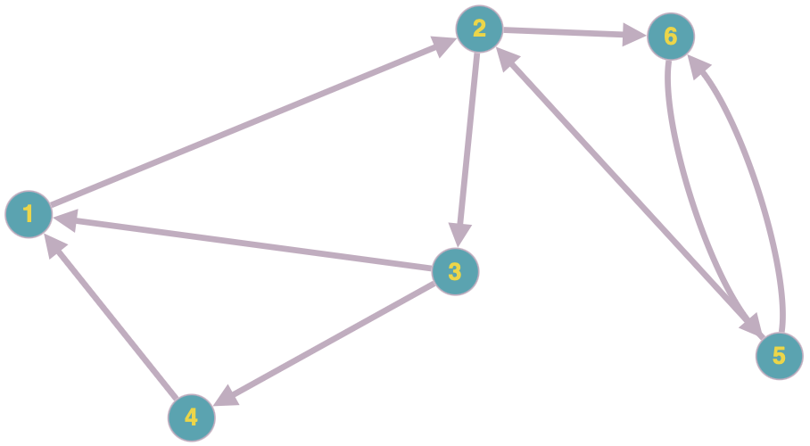
KEP(3) (graph created using [4])

Slide 19
KEP(3) (graph created using [4])
A valid vertex-disjoint cycle packing
that covers 5 vertices

Slide 20
KEP(3) (graph created using [4])
A maximum vertex-disjoint cycle packing
that covers 6 vertices

Slide 21
KEP(3) (graph created using [4])
An invalid packing (donor 2 donates both kidneys and now requires a kidney)

Slide 22
KEP(3) (graph created using [4])
An invalid packing (length-4 cycles are disallowed in KEP(3))

Slide 23
Hardness of KEP(K)
KEP(K) is NP-hard for any 3 ≤ K
So ILP models are used in practice.
No approximation algorithms – suboptimal solutions are not welcome since they can cost lives
How can we model the problem as an ILP?

Slide 24
Idea 1: A literal cycle packing
Enumerate every feasible cycle.
Create a variable per cycle
Create a constraint per vertex saying “select at most one cycle that I am involved in”
Known as the Cycle Formulation introduced independently by [5] and [6]

Slide 25
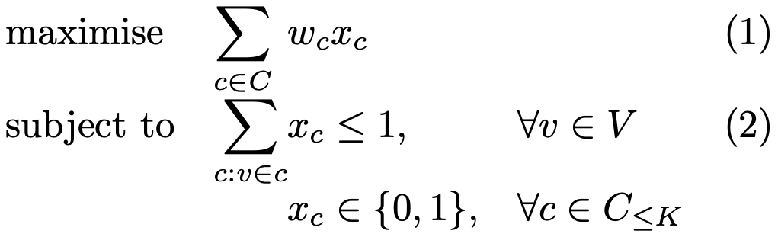
Cycle Formulation
Allows weight. What weight should we use to model standard KEP(K)?
A set of all cycles no longer than K

Slide 26
Idea 2: Consider arcs individually and ensure flow conservation
Create a variable per arc
For each vertex create a constraint saying “At most the flow of one going out of me (i.e. at most one donation)”
For each vertex create a constraint saying “Flow goes out if and only if the same amount of flow comes in (i.e. I donate if and only if my partner gets a donation)”
For each path in a graph of length K create a constraint saying that at most K-1 edges can be part of the solution – why?

Slide 27
KEP(3) (graph created using [4])
Here if every arc in the path [1,2,3,4] is a part of solution, it implies the cycle (1,2,3,4) or a longer cycle is selected, so violates the constraint

Slide 28
KEP(3) (graph created using [4])
If the arc (3,4) is not in solution, that implies cycle (1,2,3) is selected due to flow conservation constraints which is fine

Slide 29
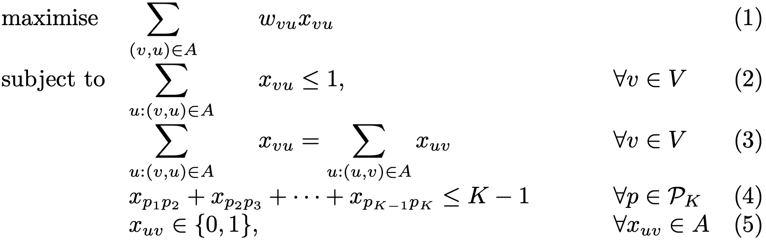
Edge Formulation
Allows weight. What weight should we use to model standard KEP(K)?
A set of all paths of length K
A set of all arcs

Slide 30
Analysis: which one is better?
How can we compare two models?

Slide 31
Analysis: model size
n – number of vertices
m - number of arcs
O(n)
n(n-1)/2 + n(n-1)(n-2)/3 + ... + n(n-1)(…)(n-k)/k =O(n^{K})

Slide 32
Analysis: model size
n – number of vertices
m - number of arcs
O(n)
O(n)
O(n^{K+1})
O(m)
Variables: O(m)
Constraints: O(n + n + n^{K+1})= O(n^{K+1})

Slide 33
Analysis: model size
Model size = (number of constraints) x (number of variables)
  CF: O(n^{K+1})
  EF: O(n^{K+1}) x O(m) = O(n^{K+1}m)
CF seems to be better here
But it is possible to improve the model size of EF to O(n^{K}m) (tutorial exercise) which is clearly still worse in dense graphs but does not seem much worse in sparse graphs
Also, one O(n^{K}) comes from the number of paths whereas the other O(n^{K}) comes from the number of cycles, so does not necessarily feel right to compare

Slide 34
Analysis: strength of linear relaxations
Suppose OPT=100
Formulation 1
Formulation 2
Z = 100
(fractional variable assignment)
Z = 200
(fractional variable assignment)
Z = 100
(integral variable assignment)
Do not need to explore
Z = 100
(integral variable assignment)
Must explore, maybe 101-200 are possible

Slide 35
Analysis: strength of linear relaxations
LPR1 dominates LPR2 if
  For every feasible solution s of LPR1 we can construct a feasible solution in LPR2 maintaining the objective value
  There exists a solution p of LPR2 for which we cannot construct an equivalent feasible solution in LPR1.
It is known that LRP of CF dominates LPR of EF [5]. We will prove the first condition, and you will have to give an example showing the second condition in the tutorial
  In fact, you will show that LPR of EF is arbitrarily worse than LRP of CF, i.e., for any natural number c it is possible to construct an instance such that when modelled using EF, its LPR is at least c away from the LPR of cycle formulation

Slide 36
Analysis: strength of linear relaxations
Can there be another integral solution in
EF that is not present in CF?
EF-R
CF-R

Slide 37
Analysis: strength of linear relaxations
Suppose X is an assignment of variables that satisfies constraints in CF and every x_{c}∊X is assigned a value w_{c}.
To form the assignment of variables in EF, simply set each variable Y_{uv} to be the sum of all w_{c} such that (u,v)∊c

Slide 38
Analysis: strength of linear relaxations
Objective value:
  For every cycle variable x_{c} of size k, we will add its value exactly once per edge so will add it k times so clearly satisfied
Correctness:
  Clearly flow and capacity constraints are satisfied; otherwise, the set of cycles would violate CF constraints
  Need to prove that no path constraints are violated

Slide 39
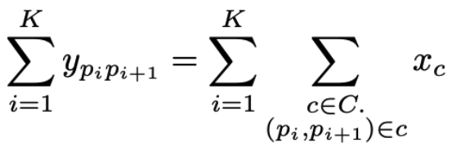
p₁
Y_{p1p2}
p₂
Y_{p2p3}
p₃
…
p_{K}
Y_{pKpK+1}
p_{K+1}
p:

Slide 40
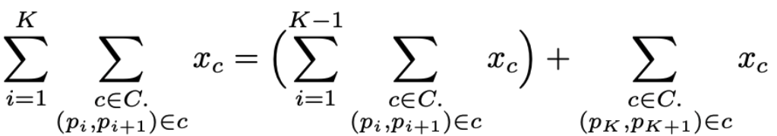
p₁
Y_{p1p2}
p₂
Y_{p2p3}
p₃
…
p_{K}
Y_{pKpK+1}
p_{K+1}
p:

Slide 41
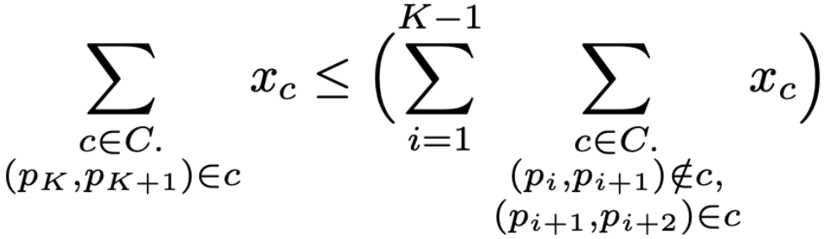
If (p_{K-1},p_{K}) ∉ c, added as part of K-1’th term in summation
c : (p_{K},p_{K+1}) ∈ c
If (p_{K-2},p_{K-1}) ∉ c, added as part of K-2’th term in summation
Else
Else …
Cannot include all edges in P, why?
p₁
Y_{p1p2}
p₂
Y_{p2p3}
p₃
…
p_{K}
Y_{pKpK+1}
p_{K+1}
p:

Slide 42
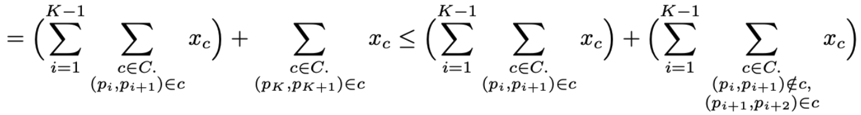
p₁
Y_{p1p2}
p₂
Y_{p2p3}
p₃
…
p_{K}
Y_{pKpK+1}
p_{K+1}
p:

Slide 43
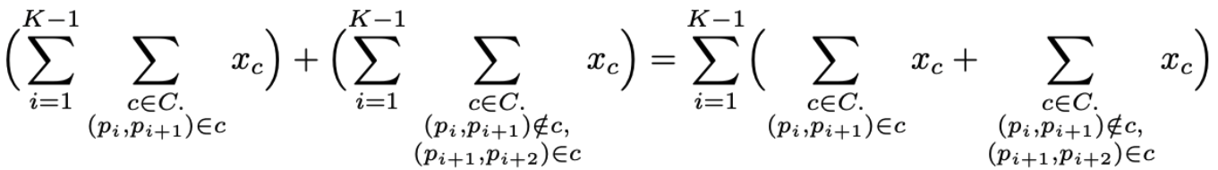
p₁
Y_{p1p2}
p₂
Y_{p2p3}
p₃
…
p_{K}
Y_{pKpK+1}
p_{K+1}
p:

Slide 44
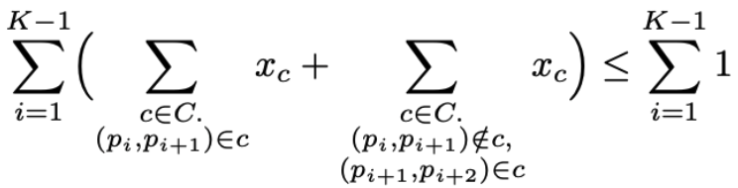
p₁
Y_{p1p2}
p₂
Y_{p2p3}
p₃
…
p_{K}
Y_{pKpK+1}
p_{K+1}
p:

Slide 45
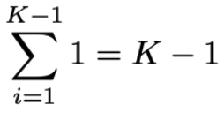
p₁
Y_{p1p2}
p₂
Y_{p2p3}
p₃
…
p_{K}
Y_{pKpK+1}
p_{K+1}
p:

Slide 46
Analysis: strength of linear relaxations
The other direction is not true: we cannot (in general) take a valid assignment of variables satisfying constraints in EF and convert it to a solution satisfying constraints in CF

Slide 47
Section 3: Solving large ILPs

Slide 48
Idea: Using only a subset of constraints
Can we avoid using all of the constraints?
  In general, no
  In practice – sure
Constraint generation approach:
  Begin by a small subset of constraints C and solve the ILP
  Find a set of violated constraints, V
  If V is empty, done
  Else, add some or all constraints of V to C and go back to step 1
Simple idea but powerful technique

Slide 49
KEP(3) (graph created using [4])
Are length-3 path constraints necessary
for the edge formulation here?

Slide 50
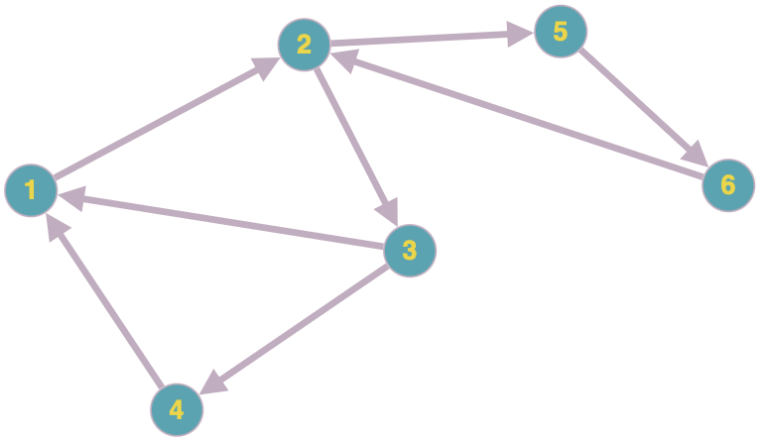
KEP(3) (graph created using [4])
Are length-3 path constraints necessary
for the edge formulation here?

Slide 51

Feedback??
Please leave feedback using the QR code above!

Slide 52
References
[1] - https://cjhb.site/Files.php/Books/Book%20Series/GTM/271%20Integer%20Programming%20by%20Michele%20Conforti%2C%20Gérard%20Cornuéjols%2C%20Giacomo%20Zambelli.pdf
[2] - https://amaldi.faculty.polimi.it/SlidesFOR-19-20/ILP-cutting-planes-FOR-18.pdf
[3] - https://www.dcs.gla.ac.uk/research/algorithms/IP-MATCH/kidney_exchange_game/index.html
[4] - https://graphonline.top/en/

