Slide 1

Better tests.
Better results.

Slide 2
Topics
Unit test criteria
Great test attributes
Dependencies
Valuable test
Integration tests
Antipatterns
Testing database
Logging
Styles of unit testing

Slide 3
To test or not to test?
That is NOT a question now
HOW to write valuable test with low cost? – Not easy, code design knowledges needed
HOW to recognize a valuable test? - Easy
* Which value does test provide?
* Test’s cost. What does it mean?

Slide 4

Goal of automation testing
Ensuring the application’s correctness
Sustainable project growth: extensibility + maintainability + scalability
To maintain development speed in the long run

Slide 5
Test types
Unit test
Integration test (any not unit test)
End-to-end test (subset of integration tests)
Unit tests
London defines this boundary
Integration tests
E2E tests

Slide 6
Successful test suite
Integrated into the development cycle
Covers the most important parts of code
Maximum value with minimum maintenance costs (?)
Code
Tests

Slide 7
Unit test
isolates small piece of code (code under test or unit)
verifies single (atomic) unit of behavior
fast
* What does “isolation” mean?
* What does define a size of code under test?
* Is system under test (SUT) the same as code under test?
* Is class under test the same as system under test?
* ‘unit under test’ = ‘code under test under test’ and is not used in these slides
Unit test

Slide 8
Metrics
Code coverage
Branch coverage
Coverage metrics are a good negative indicator, but a bad positive one.
It is good to have high level of coverage for core part, but bad to have it as requirement.

Slide 9
Branch coverage
(1)
(2)
int sum = 0;
if (a)
sum += 1;
else
{
if (b)
sum += 2;
else
sum += 4;
}
int sum = 0;
if (a)
sum += 1;
if (b)
sum += 2;
* Which case has more “branches”: 1 or 2?

Slide 10
Branch coverage
(1)
(2)
int sum = 0;
if (a)
sum += 1;
else
{
if (b)
sum += 2;
else
sum += 4;
}
int sum = 0;
if (a)
sum += 1;
if (b)
sum += 2;
sum : 1, 2, 4
sum : 0, 1, 2, 3
What is the number of tests to get 100% branch coverage? What is the number of different outcomes?

Slide 11
100% coverage is a fake
No metric can ensure that tests verify ALL outcomes of the SUT (assertion-free tests).
No coverage metric considers code paths in external libraries.
Tests are code, too. Bad tests increase entropy => it’s better to not write a test than to write a bad test.

Slide 12
Questions?

Slide 13
Great test attributes
Protection from regression (unnoticed bugs – false negative)
Resistance to refactoring (false positive)
Fast feedback (ideally as soon as code is broken)
Maintainability (short/clear/easy to run)
* Which attribute must dominate at the project start?
* Why does resistance to refactoring become important as time goes on?
* Which type of project can do not take care of RtR attribute?

Slide 14
Resistance to refactoring
Case: failed tests after refactoring – false alarm or false positive
Test fragility: it should not matter how the SUT generates the result, if result is correct
Solution: cover observable result by test asserts, DO NOT couple test to the SUT’s implementation!

Slide 15
Observable behavior
Method meets one of the following criteria:
Have an immediate connection to one of the client’s goals (all invariant conditions are true)
Incur a side effect in an out-of-process dependency that is visible to external applications
* What does protect code against inconsistencies (invariant violations)?

Slide 16
public class SystemUnderTestClass
{
public void SendGreetingEmail(Guid userId)
{
var user = userRepository.Read(userId);
emailSender.SendEmail(user.Email);
}
}

Slide 17
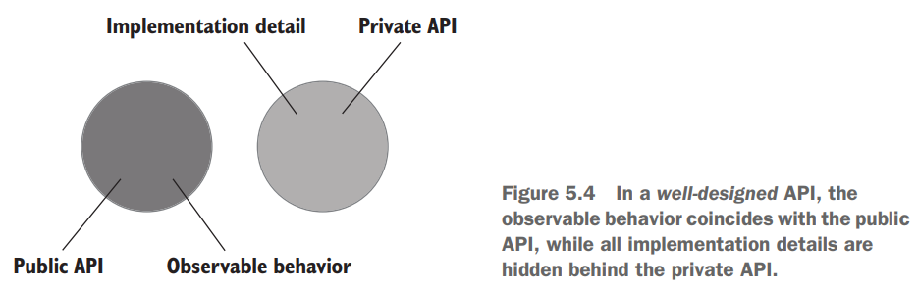
Public API & Observable behavior
* Public API and YAGNI
* Does well-designed API affect unit tests quality?
* What can be a reason of //Act-section with 2+ lines of code?

Slide 18
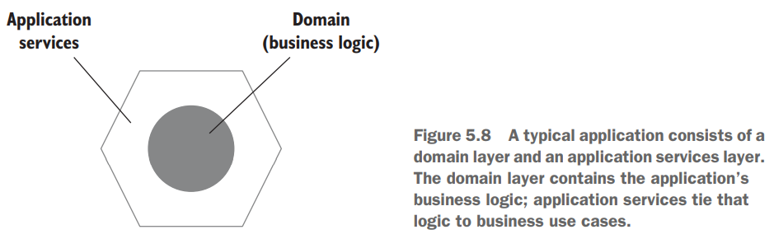
Hexagonal architecture
* Which layer is a set of business use cases?
* Which separation of concerns is emphasized here? (1)
* How to illustrate one-way flow of dependencies? (2)
* Which line dictates how external systems communicate with the system? (3)

Slide 19
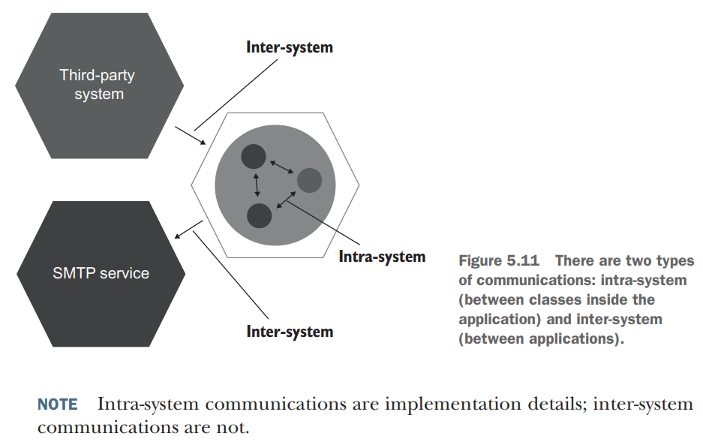
* Should we examine intra-communications between classes inside our system?
* Inter-system communications of external system accessible only for your app are implementation details too.

Slide 20
Number of bugs found ------------------------------ Number of false alarms
Test accuracy =
A test is accurate insofar as it generates a strong signal (can find bugs) with as little noise (false alarms) as possible.

Slide 21

Test’s score
In order to be valuable, the test needs to score at least something in all
four attributes
Score = PfR * RtR * FF * M
0 <= any attribute <= 1

Slide 22
Test score
Protection from Regression (how good is protection?)
Resistance to Refactoring (how cheap is maintenance?)
Fast Feedback (how fast your test suite is?)
Select 2 of 3 (mutually exclusive, like ‘good / fast / cheap’)

Slide 23
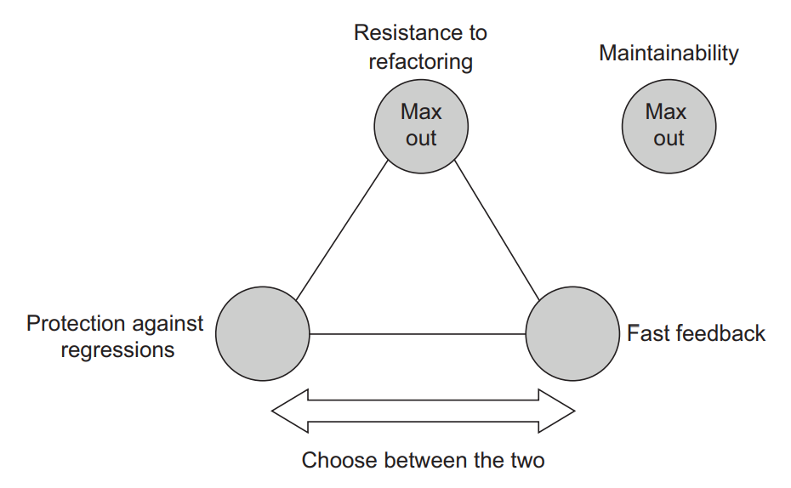
* RtR is mostly a binary choice
* How does RtR affect FF?
* How does PaR affect FF?

Slide 24
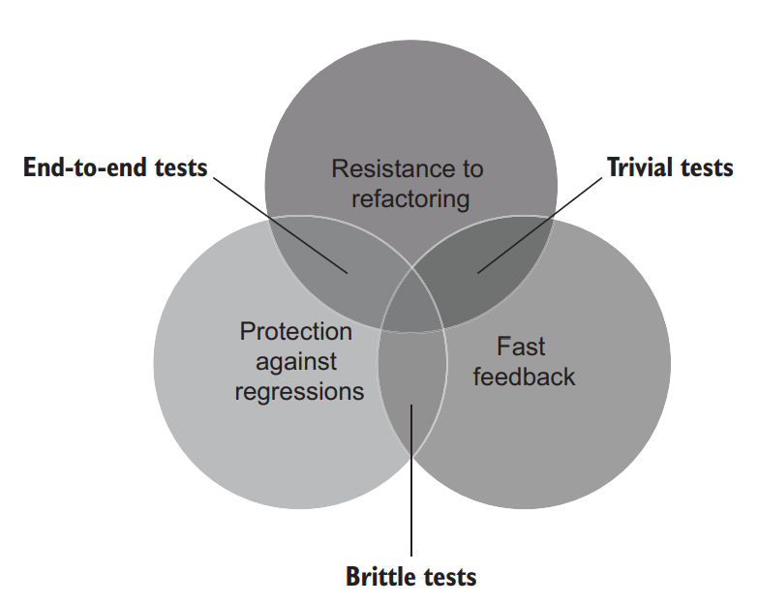
Edge cases
* Ideal test is unreachable. Trade-offs are needed

Slide 25
Questions?

Slide 26


Test Automation Concepts
Test Pyramid
White-box vs black-box

Slide 27
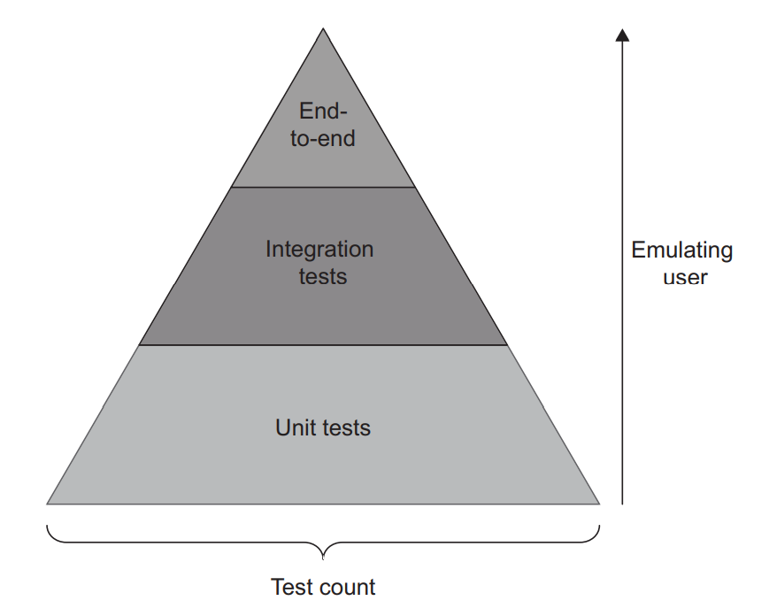
Test Pyramid
Concept which advocates for a certain ratio of different tests in the test suite

Slide 28
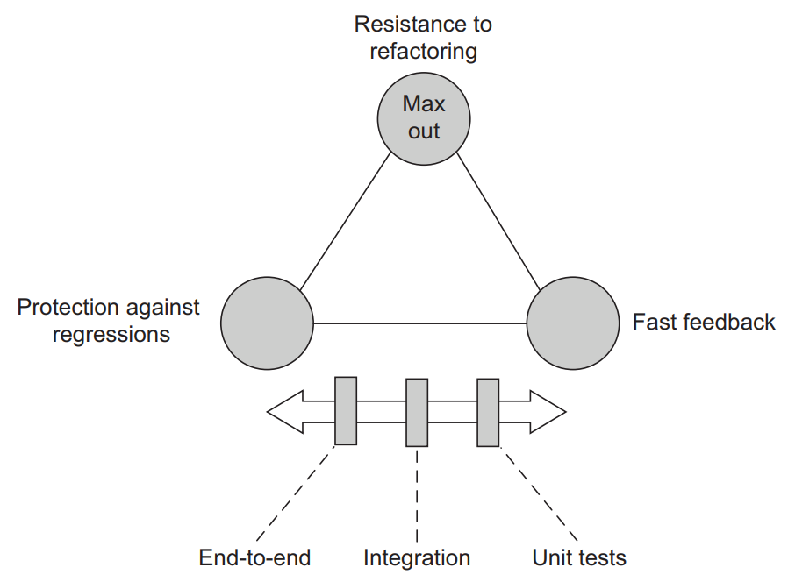

Slide 29
End-to-end tests are ~ 100% assurance from regressions. But they are almost as slow as a user and lack maintainability. And hence their count is limited to the most critical functionality where other types of tests are useless
Unit tests are fast, so you can have them unlimited count
Integration tests are somewhere between

Slide 30
Black and white boxes
Black-box tests derive from specification & requirements => observable behavior is tested
White-box tests derive from source code => tricky cases can be found
* Are black tests a subset of white tests?
* TIP: start from black-box testing. Use white-box testing when analyzing the tests. Code coverage tools can show uncovered branches

Slide 31
Which box does … ?
… protect better from regressions?
… provide better resistance to refactoring?

Slide 32
Questions?

Slide 33
Dependencies classification
*By isolation levels:
Shared/private
Private: mutable/immutable
Volatile (nondeterministic or need some system pre-setup)
* Is database shared or private dependency?

Slide 34
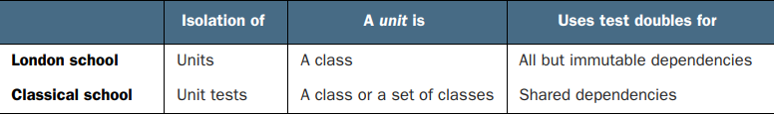
Isolation approaches
Classic (or Chicago, or Detroit) – substitutes only shared dependencies. Isolates unit test from another unit test. Bonus: run tests in parallel
London – Classic approach + mutable dependencies are substituted. The highest unit isolation from another code. Bonus: better granularity

Slide 35
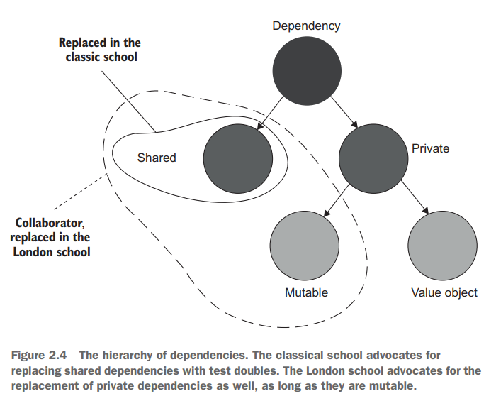

Slide 36
Classic vs London
What does define a size of code under test (unit)?
– Isolation approach
Is system under test the same as code under test?
– No. SUT is an instance of class (C#, Java) – owner of method under test. Code under test is all code (with libraries) executed on test run
Is class under test the same as system under test?
– No. Sample: JS
Classical school is good in its treatment of intra-system communications
London school is good for inter-system communications

Slide 37
Dependencies classification
*By interaction types between the SUT and its dependencies:
Stubs – for incoming interactions, only help to emulate
Mocks – for outcoming interactions, help to emulate and examine
STUB
SUT
MOCK

Slide 38
Stubs thoughts
Maximize resistance to refactoring (minimize false positives and redundant test changes)
Stub emulates incoming interactions which are not observable behavior => stub emulates implementation detail => do not assert interactions with stub!
Assert only outcoming interactions (observable behavior) with mocks
* Over specification – verifying behavior that is not a part of final result

Slide 39
Command/query separation
Statement: Every method must be a command or query whenever it is possible
Command has side effect and returns nothing
Query is side effect free, but returns a value (asking a question doesn’t change an answer)
Commands are emulated by mocks and examined by asserts
Queries are emulated by stubs and not examined

Slide 40
Questions?

Slide 41
Toward valuable unit tests
4 types of code by complexity / domain significance / number of collaborators
Code complexity is defined by the number of decision-making points (if/loop in the code and libraries)
Collaborator – shared or mutable dependency

Slide 42
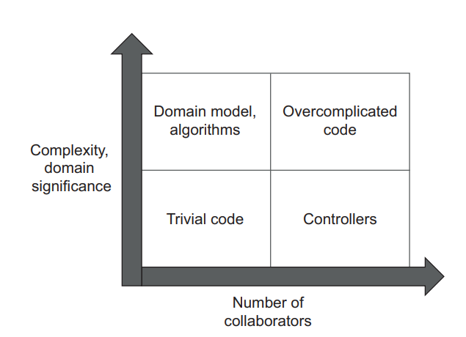
* Complexity != domain significance

Slide 43
The best return on unit testing effort – cover domain model and algorithms
Trivial code (default constructors, properties) MUST not be tested
Controllers – integration tests
Overcomplicated code must be refactored: decrease complexity/domain significance and reduce number of collaborators
*What about repositories?

Slide 44
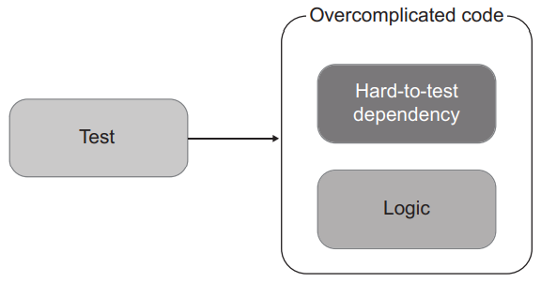
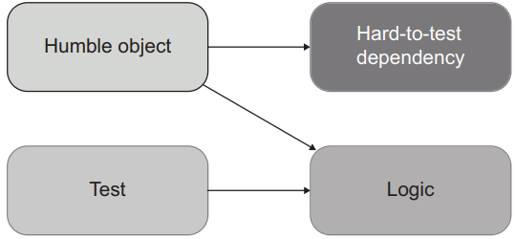
Humble objects
MVC – Controller
MVP – Presenter
* For DDD it is …

Slide 45
Find a balance
Few collaborators
Decision-making points
“Read-decide-act”
Domain testability
Controller complexity
Performance

Slide 46
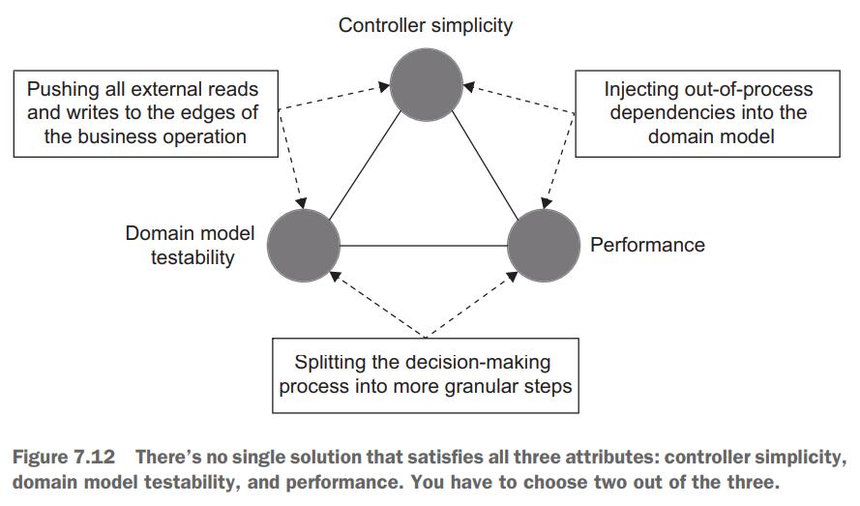
CanExecute / Execute pattern
Domain events
How to keep controller’s complexity manageable?

Slide 47
Avoid overcomplicated code
Code should be complex (depth) OR work with many collaborators (width), never both
Humble object pattern
How to avoid leaking of business logic from the domain model into controllers?
How to remove the decision-making responsibility from controller?
* It’s easier to test abstractions than the things they abstract
* What does abstract calls to out-of-process dependencies here?

Slide 48

Guards / validation
Test only preconditions that have domain significance
* Are constructor arguments injected by DI container worth to be tested against null?
This Photo by Unknown Author is licensed under CC BY-NC

Slide 49
Questions?

Slide 50
Integration testing

Slide 51
Just facts
Integration test – any test, that is not a unit test
When all unit tests are passed but system has an issue
Better protection from regression and resistance from refactoring
High cost
Integration tests almost always verify how your system works in integration with out-of-process dependencies

Slide 52
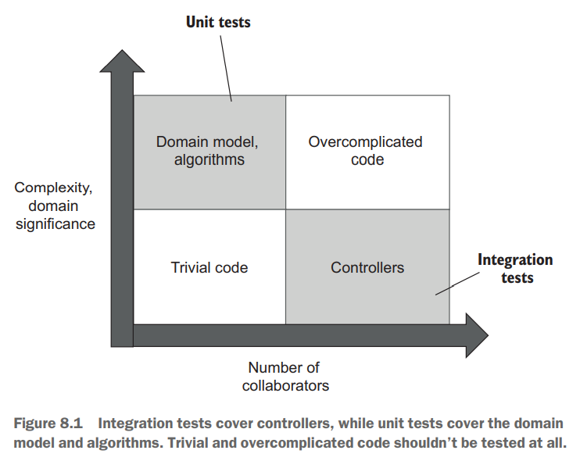

Slide 53
Out-of-process dependencies
Managed dependencies
Unmanaged dependencies
 | Managed dependency | Unmanaged dependency
Accessibility | Only through your application | Other applications have access to
Sample | Database | SMTP service , message bus
Interactions visibility | Not observable externally | Observable externally
Communication type | Implementation details | Observable behavior
Treatment in integration tests | Use real instance | Use mock

Slide 54
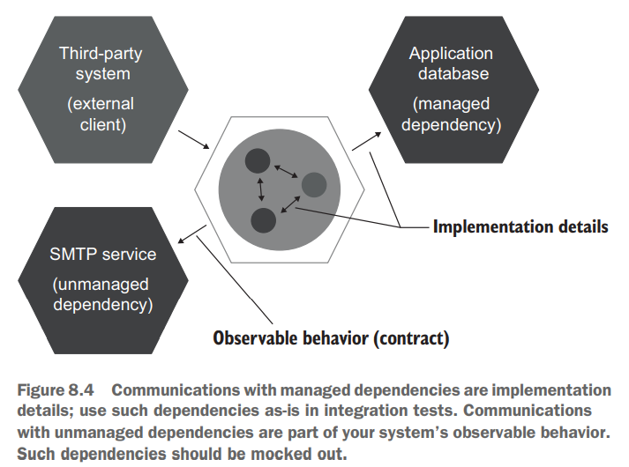

Slide 55

Mocking best practices
Write own adapters on top of unmanaged dependencies (abstract complexity) which will be called at the very edge of a system. Use mocks only* for this adapters in integration tests (improve* PfR and RtR)
Use REAL managed dependency in integration tests – implementation details must be verified and not be mocked (improve PfR)
No mocks in unit tests (lack of out-of-process interactions verification)
Skip integration test if real managed dependency can not be used
Verify exact number (or absence) of calls made to the mock
*Consider spies (handwritten mocks) were possible

Slide 56
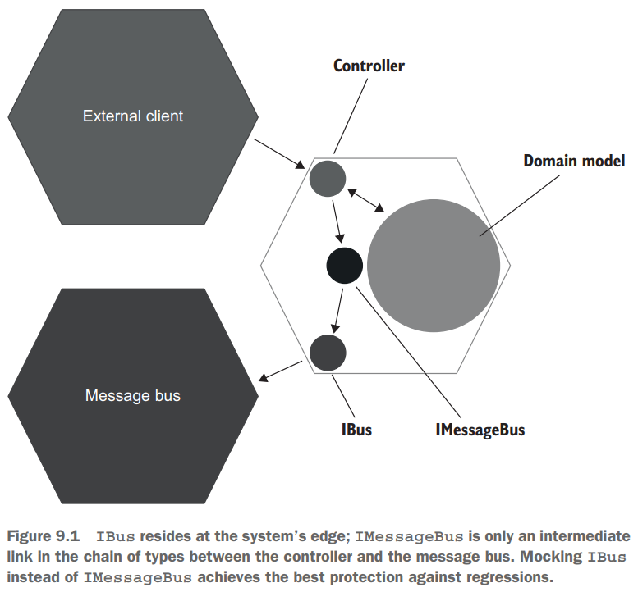

Slide 57
Best practices
Making domain model boundaries explicit (assembly or namespace)
Reducing the number of layers in the application
Eliminating circular dependencies (redundant cognitive loading)
All problems in computer science can be solved by another layer of indirection, except for the problem of too many layers of indirection. —David J. Wheeler

Slide 58
Integration tests best practices
Use unit tests to cover all possible edge cases (Fail Fast Principle)
Use integration tests to verify interactions with ALL out-of-process dependencies
The longest happy path* and any edge case which can not be covered by unit tests (set cover problem)
Unit test’s name sometime helps to distinguish unit and integration test*
Classic vs London – which school does solve set cover problem more efficiently? Why do we use London school?

Slide 59
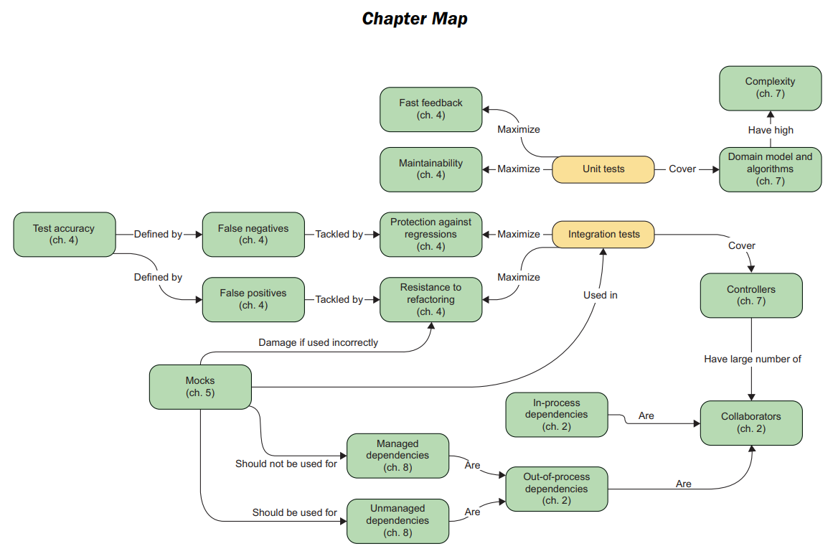

Slide 60
Questions?

Slide 61
Anti patterns
Testing private methods / Exposing private state for testing
Leaking domain knowledge to tests
Code pollution
Mocking classes with combined logic and out-of-process dependency
Working with current time

Slide 62
Logic in private methods/private state
Indication of a missing abstraction
Test it indirectly, the same way as it is used in production
Do not change ‘private’ accessor to ‘public’ (antipattern, bad API)
Don’t worry: testing implementation details will suffer from resistance to refactoring
Solution: extract new abstraction if needed (calculator, builder, …)

Slide 63
Leaking domain knowledge to tests
… - reimplementation in test: Assert.IsTrue(sut.Sum(1, 2) == 1+2)
Coupling to implementation details
Do not copy unnoticed errors from code to tests (*wrong error messages)
Solution: hardcode expected result into tests

Slide 64
Code pollution
… - adding production code that’s only needed for testing
… - mixing up testing and production code
Increases the maintenance costs
Solution: use separate implementations

Slide 65
Mocking specific class
Is it a combined logic and out-of-process communication?
Possible SRP violation
Avoid width & depth code: a lot of collaborators + high complexity
Solution: split class

Slide 66
Working with time
Ambient context introduces hidden dependency [antipattern]
Inject time explicitly: a service or a plain value
Prefer injecting the time as a plain value whenever possible
Inject service at the beginning of business operation (in controllers)

Slide 67
Questions?

Slide 68
Practical part

Slide 69
Test structure
AAA
Given – When – Then
Use ‘sut’ variable name to differentiate your unit of behavior from its dependencies
Drop AAA comments if you can separate sections with empty line

Slide 70
Test name tips
Tells a story
Can be w/o method name (except of utility-classes)
Use ‘is’ instead of ‘should_be’ (anti pattern)
Avoid ‘Verify’

Slide 71
Reducing Arrange section
Extract technical, non-business-related bits into private methods
Object mother pattern
Test data builder pattern

Slide 72
Reducing Act section
Eliminate ‘invariant violation’ in your code via better encapsulation
Use decorator methods (more applicable for integration tests)

Slide 73
Reducing Assert section
Split observable behavior and test atomic behavior
Consider ‘Equals’ overloads for object instead of separate asserts for its fields
Introduce a fluent interface

Slide 74
Bonus slides

Slide 75
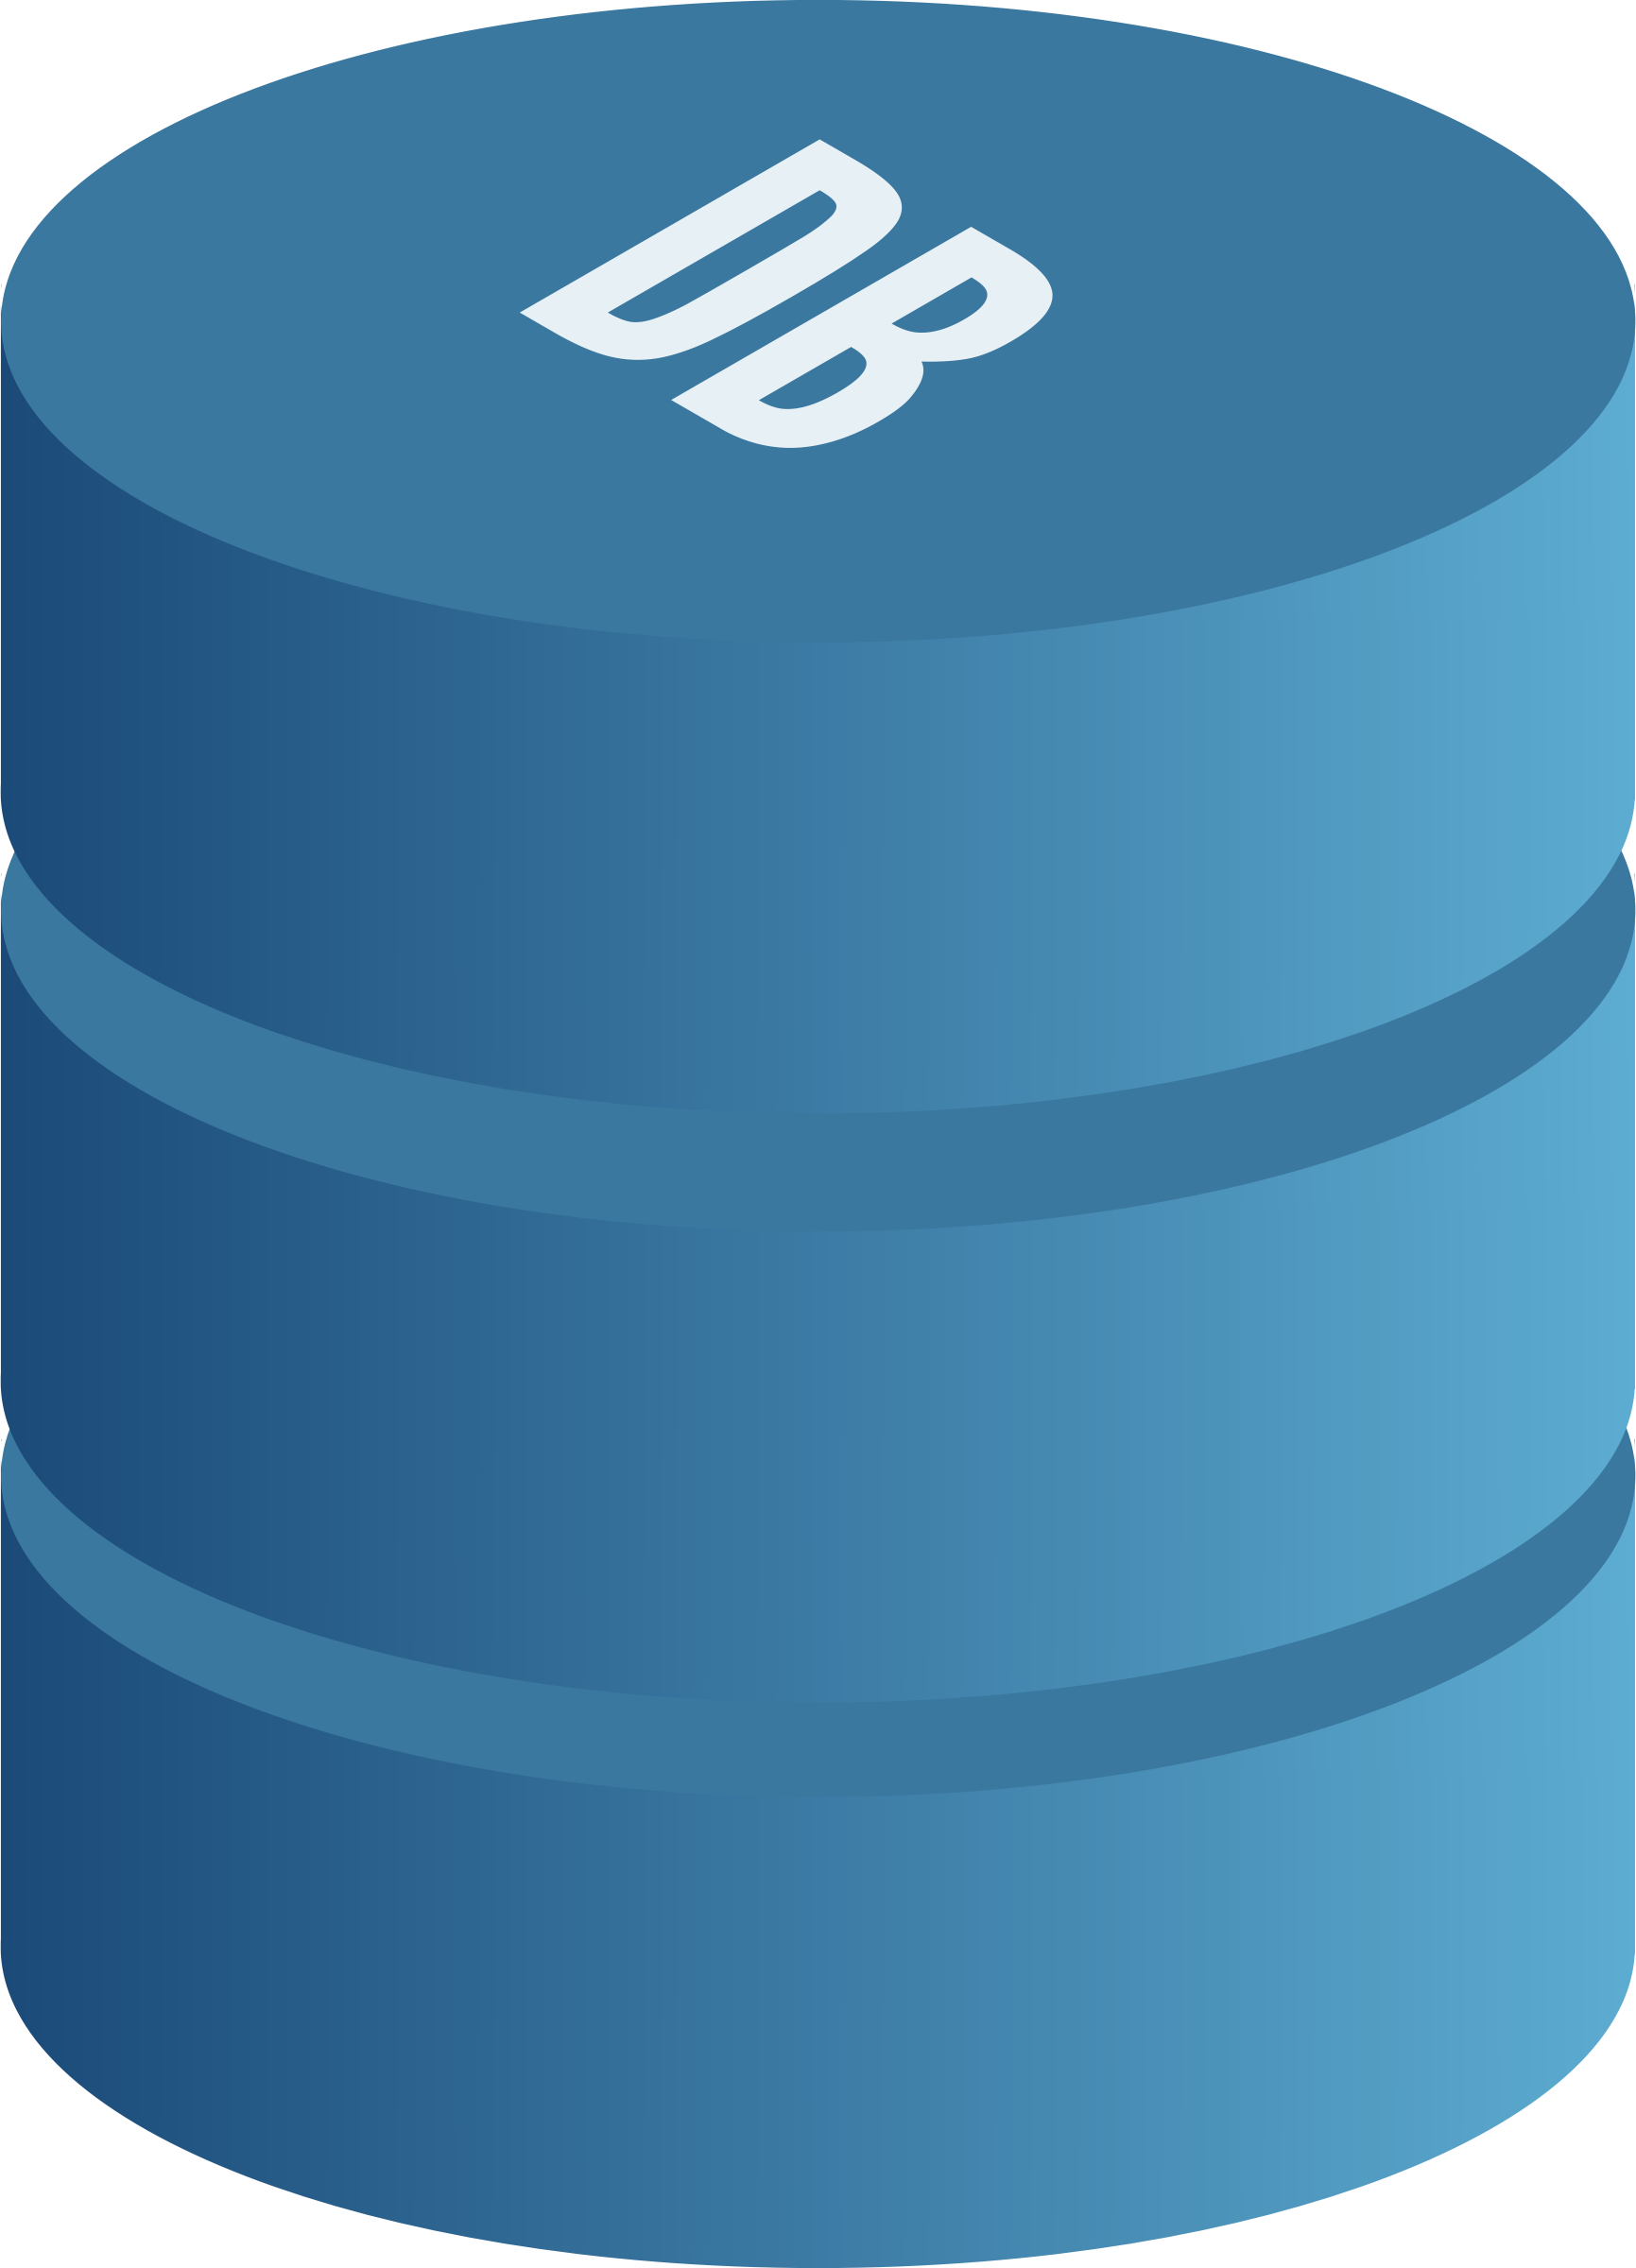
Application database
Prerequisites for testing the database
Database testing best practices
Test data life cycle
Managing database transactions in tests

Slide 76
Testing the database
Database in the source control system
Separate database instance for every developer
Migration-based approach to database delivery
Points above improve database health even w/o integration testing

Slide 77
Best practices
Use the same database management system (DBMS) in tests as in production
Do not reuse UoW/transaction between sections of the test
Execute integration tests sequentially
Remove leftover data between test runs
Do not test repositories directly
Test only writes and the most complex reads

Slide 78
Questions?

Slide 79

Logging
Should you test logging at all?
If so, how should you test it?
How much logging is enough?
How do you pass around logger instances?
*Why this image?

Slide 80
Should you test logging at all?
Logs are
Skip testing
Use mock
Implementation details
Observed by customer

Slide 81
Two types of logging
Diagnostic logging
Support logging (domain events in the domain model + special DomainLogger in controller)
Note: structured logging

Slide 82
How much to log?
Logs’ signal-to-noise ratio a is key: maximize the signal, minimize the noise
Try not to use diagnostic logging in the domain model – write valuable unit tests!
Use diagnostic logging for unhandled exceptions only
Ambient context for logger is a certain sign of trouble
*Why IDomainLogger can be mocked in integration test although it is a wrapper over Ilogger (located at the very edge of your system)?

Slide 83
Questions?

Slide 84
Styles of unit testing
Output-based testing
State-based testing
Communication-based testing

Slide 85
Output-based style (functional)
Check the output SUT produces
High-quality unit test (in terms of cost / benefit)
Applicable only to code written in a purely functional way: the only outcome is a return value
High resistance to refactoring
Low maintainability cost

Slide 86
State-based style
Verifies the state of the system after an operation is completed
Preferrable in classic school

Slide 87
Communication-based style
Uses mocks to verify communications between the system under test
Preferrable in London school
Low resistance to refactoring
High maintainability cost

Slide 88
Functional architecture
Methods with no hidden inputs and outputs (no exceptions & no side effects)
Functional core (decisions) – immutability instead of encapsulation
Mutable shell (actions)
Shell works with collaborators, core – with the product of collaborator’s work
High maintainability
!!! = hexagonal architecture taken to an extreme (difference is in treatment of side effects)
Cost
Performance
Size of the code base
Initial investment
Testing goals
Functional core: output-based unit tests
Mutable shell: integration tests

Slide 89
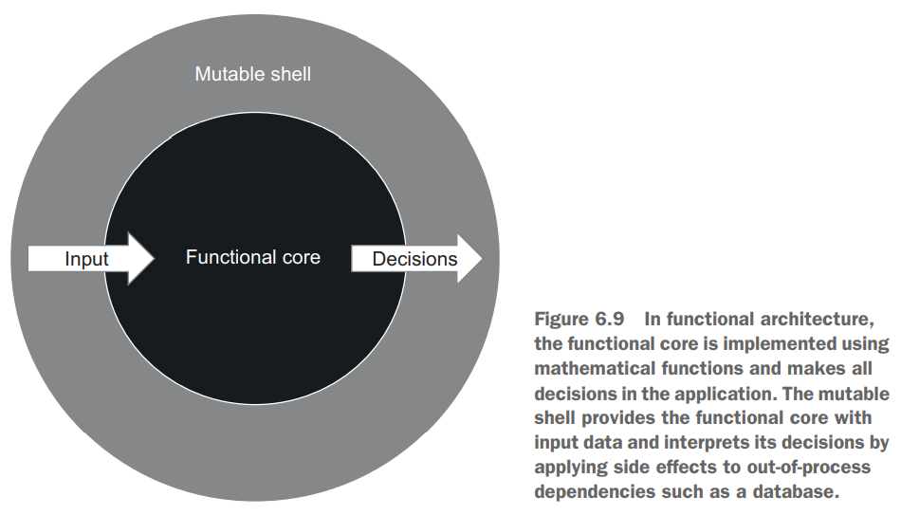
Separation between business logic & side effects (all collaborators)

Slide 90
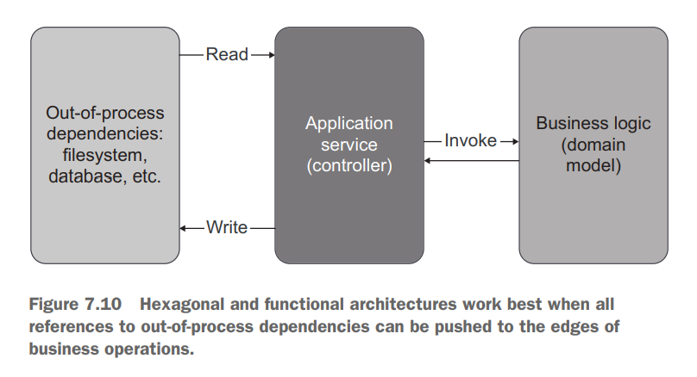

Slide 91
Approaches
Classic: Classicist, prefers state-based style over communication-based, Inside-out, black-box testing
London: Mockist, prefers communication-based style over state-based, Outside-in testing, white-box testing
Hexagonal & Functional architecture separates domain from collaborators
Classic & London styles separates SUT from collaborators in the same way (only out-of-process/shared OR all collaborators)

Slide 92
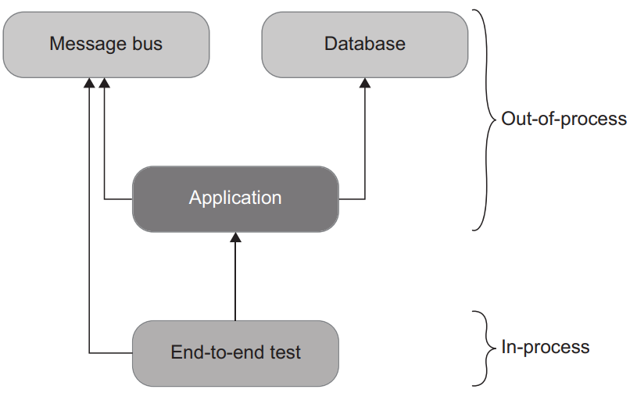
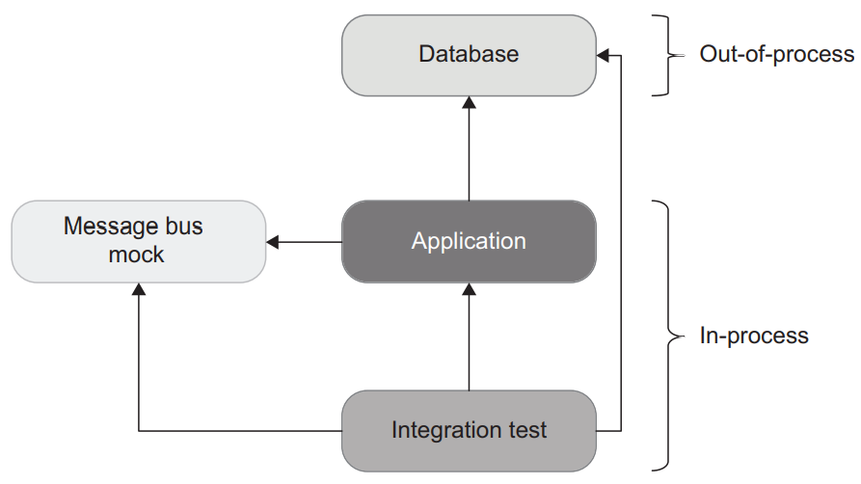
End-to-end vs integration tests

Slide 93

Thank you

