Slide 1
Better tests - better results

Slide 2

Sources:
“Unit Testing. Principles, Practices, and Patterns” by Vladimir Khorikov
https://blog.devgenius.io/detroit-and-london-schools-of-test-driven-development-3d2f8dca71e5
https://devlead.io/DevTips/LondonVsChicago

Slide 3
Covered topics
Unit test criteria & metrics
How to recognize great test
Test automation concepts
What is a dependency
Valuable test
Integration testing
Anti patterns & tips
Testing database
Testing logs
Styles of unit testing
E2E vs integration tests

Slide 4
To test or not to test?
That is NOT a question now
HOW to write valuable test with low cost? – Not easy, code design knowledges needed
HOW to recognize a valuable test? - Easy
* Which value does test provide?
* Test’s cost. What does it mean?

Slide 5
Unit test criteria & metrics
Goal of automation testing
Test types
Successful test suite
Unit test criteria
Metrics (code-, branch- coverage)

Slide 6

Goal of automation testing
Ensuring the application’s correctness*
Sustainable project growth: extensibility + maintainability + scalability
To maintain development speed in the long run

Slide 7
Test types
Unit tests
Unit test
Integration test (any not unit test)
End-to-end test (subset of integration tests)
London defines this boundary
Integration tests
E2E tests

Slide 8
Successful test suite
Integrated into the development cycle
Covers the most important parts of code
Maximum value with minimum maintenance costs
Code
Tests

Slide 9
Unit test
isolates small piece of code (code under test or unit)
verifies single (atomic) unit of behavior
fast
* What does “isolation” mean?
* What does define a size of code under test?
* Is system under test (SUT) the same as code under test?
* Is class under test the same as system under test?
* ‘unit under test’ = ‘code under test under test’ and is not used in these slides
Unit test

Slide 10
Metrics
Code coverage
Branch coverage
Coverage metrics are a good negative indicator, but a bad positive one.
It is good to have high level of coverage for core part, but bad to have it as requirement.

Slide 11
Branch coverage
(1)
(2)
int sum = 0;
if (a)
sum += 1;
else
{
if (b)
sum += 2;
else
sum += 4;
}
int sum = 0;
if (a)
sum += 1;
if (b)
sum += 2;
* Which case has more “branches”: 1 or 2?

Slide 12
Branch coverage
(1)
(2)
int sum = 0;
if (a)
sum += 1;
else
{
if (b)
sum += 2;
else
sum += 4;
}
int sum = 0;
if (a)
sum += 1;
if (b)
sum += 2;
NOT a AND not b = 0
a AND NOT b = 1
NOT a AND b = 2
a AND b = 3
sum : 1, 2, 4
sum : 0, 1, 2, 3
What is the number of tests to get 100% branch coverage? What is the number of different outcomes?

Slide 13
100% coverage is a fake
No metric can ensure that tests verify ALL outcomes of the SUT (assertion-free tests).
No metric considers code paths in external libraries.
Tests are code, too. Bad tests increase entropy => it’s better to not write a test than to write a bad test.

Slide 14
How to recognize great test
Test attributes
Observable behavior
Public/private API
Intra- , inter- system communications
Test score

Slide 15
Test attributes
Protection against bugs (unnoticed bugs – false negative)
Resistance to refactoring (false positive)
Fast feedback (ideally as soon as code is broken)
Maintainability (short/clear/easy to run)
* Why does resistance to refactoring become important as time goes on?

Slide 16
Resistance to refactoring
Case: failed tests after refactoring – false alarm or false positive
Test fragility: it should not matter how the SUT generates the result, if this result is correct
Solution: cover observable result by test asserts, DO NOT couple test to the SUT’s implementation!

Slide 17
Observable behavior
Method meets one of the following criteria:
Have an immediate connection to one of the client’s goals (all invariant conditions are true)
Incur a side effect in an out-of-process dependency that is visible to external applications

Slide 18
Let’s imagine ideal code…
System under test
public class GreetingsService
{
public void SendGreetingEmail(Guid userId)
{
var user = userRepository.Read(userId);
emailSender.SendEmail(user.Email);
}
}
Method under test
Implementation details
Observable behavior

Slide 19
Public/private API & Observable behavior
Observable behavior = Public API
Implementation detail
= Private API
Well-designed API
* Public API and YAGNI

Slide 20
Intra-system communications
Third-party system
Application
SMTP service
1
2
3
4
Inter-system communications
Type | Between | Treated as
Intra-system | Classes inside the application | Implementation details
Inter-system | Applications | Observable behavior
* Should we examine intra-communications between classes inside our system?
Inter-system communications of external system accessible only for your app are implementation details too.

Slide 21
Number of bugs test can found ----------------------------------------- Number of false alarms
Let’s introduce the following characteristic to assess test:
Test accuracy =
A test is accurate insofar as it generates a strong signal (can find bugs) with as little noise (false alarms) as possible.

Slide 22

Test score
In order to be valuable, test needs to score at least something in all four attributes (0 <= any attribute <= 1)
Score = <Protection against bugs> *
<Resistance to refactoring> *
<Fast feedback> * <Maintenance>

Slide 23
Test score
Protection against bugs (how good is protection?)
Resistance to refactoring (how cheap is maintenance?)
Fast Feedback (how fast your test suite is?)
Select 2 of 3 (mutually exclusive, like ‘good / fast / cheap’)

Slide 24
Resistance to refactoring
How does it affect feedback?
Mostly a binary choice
Maintainability
Max out
Max out
Protection against bugs
Fast
feedback
How does it affect feedback?
Choose between them

Slide 25
Edge cases
Resistance
to refactoring
E2E tests
Trivial tests
Protection
against bugs
Fast
feedback
Brittle tests
* Ideal test is unreachable. Trade-offs are needed

Slide 26
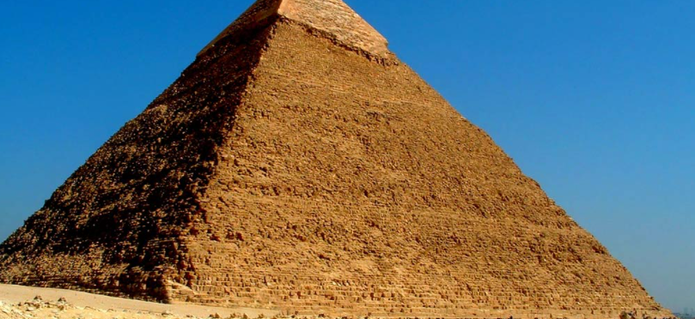

Test Concepts
Test Pyramid
White-box vs black-box

Slide 27
Test Pyramid
E2E
Integration
tests
Concept which advocates for a certain ratio of different tests in the test suite
Emulating
user
Unit tests
Tests count

Slide 28
Resistance
to refactoring
Max out
Protection
against bugs
Fast
feedback
E2E
Integration
Unit tests

Slide 29
End-to-end tests are ~ 100% assurance from bugs. But they are almost as slow as a user and lack maintainability. And hence their count is limited to the most critical functionality where other types of tests are useless
Unit tests are fast, so you can have them unlimited count
Integration tests are somewhere between

Slide 30
Black and white boxes
Black-box tests derive from specification & requirements => observable behavior is tested
White-box tests derive from source code => tricky cases can be found
TIP: start from black-box testing. Use white-box testing when analyzing the tests. Code coverage tools can show uncovered branches

Slide 31
What is a dependency
Dependencies classification
Isolation approaches
Dependencies hierarchy
Stubs/mocks
Command/query separation

Slide 32
Dependencies classification
*By isolation level:
Shared/private
Private: mutable/immutable (value object)
Volatile (nondeterministic or need some system pre-setup)

Slide 33
Isolation approaches
Substitution of shared dependencies. Isolates unit test from another unit test (bonus: run tests in parallel) – Detroit school
Substitution of shared and mutable dependencies. The highest unit isolation from another code – London school
School | Isolation of | A unit is | Uses test doubles for
London | Units | A class | All but immutable dependencies
Detroit | Unit tests | A set of classes (1+) | Shared dependencies

Slide 34
The hierarchy of dependencies
Dependency
Replaced in the
Detroit school
Private
Shared
Mutable
Replaced in the
London school
Immutable

Slide 35
Detroit vs London
What does define a size of code under test (unit)?
– Isolation approach
Is system under test the same as code under test?
– No. SUT is an instance of class (C#, Java) – owner of method under test. Code under test is all code (with libraries) executed on test run
Is class under test the same as system under test?
– No. Sample: JS
Detroit school is good in its treatment of intra-system communications
London school is good for inter-system communications

Slide 36
Dependencies classification
*By interaction types between the SUT and its dependencies:
Stubs – for incoming interactions, only help to emulate
Mocks – for outcoming interactions, help to emulate and examine
STUB
SUT
MOCK

Slide 37
Stubs thoughts
Maximize resistance to refactoring (minimize false positives and redundant test changes)
Stub emulates incoming interactions which are not observable behavior => stub emulates implementation detail => do not assert interactions with stub!
Assert only outcoming interactions (observable behavior) with mocks
* Over specification – verifying behavior that is not a part of final result

Slide 38
Command/query separation
Every method must be a command or query whenever it is possible
Command has side effect and returns nothing
Query is side effect free, but returns a value (asking a question doesn’t change an answer)
Commands are emulated by mocks and examined by asserts
Queries are emulated by stubs and not examined

Slide 39
Valuable test
4 types of code
Humble object
Controller’s complexity management

Slide 40
Toward valuable unit tests
4 types of code by complexity / domain significance / number of collaborators
Code complexity is defined by the number of decision-making points (if/loop in the code and libraries)
Collaborator – shared or mutable dependency

Slide 41
Complexity +
domain
significance
Domain model,
algorithms
Overcomplicated
code
Trivial code
Controllers
Number of collaborators

Slide 42
The best return on unit testing effort – cover domain model and algorithms
Trivial code (default constructors, properties) MUST not be tested
Controllers – cover by integration tests
Overcomplicated code must be refactored: decrease complexity/domain significance and reduce number of collaborators

Slide 43
Humble objects
Overcomplicated code
Hard-to-test
dependency
Test
Logic
MVC – Controller
MVP – Presenter
Humble object
Hard-to-test
dependency
Test
Logic

Slide 44
Find a balance
Few collaborators
Decision-making points
“Read-decide-act”
Domain testability
Controller complexity
Performance

Slide 45
public string JoinMedicalPlan(int employeeId, int medicalPlanId)
{
var employee = db.GetEmployeeBy(employeeId); // DB call
var medicalPlan = db.GetMedicalPlanBy(medicalPlanId); // DB call
var error = employee.Join(medicalPlan); // Join if probation period is over
if (error == null)
{
db.Save();
return "OK";
}
else
{
return error;
}
}
External reads at the beginning of business operation
Free of decision-making
Simple controller + testable domain
with
performance drawback

Slide 46
Controller simplicity
Pushing all external reads and writes to the edges of the business operation
Injecting out-of-process dependencies into
the domain model
?
Domain model
testability
Performance
Splitting the decision-making process into more granular steps
Can do ? / Do separation
Domain events
How to keep controller’s complexity manageable?

Slide 47
public string JoinMedicalPlan(int employeeId, int medicalPlanId)
{
var employee = db.GetEmployeeBy(employeeId); // DB call
if (employee.IsInProbationPeriod)
{
return "Can't join medical plan during probation period";
}
else
{
var medicalPlan = db.GetMedicalPlanBy(medicalPlanId); // DB call
employee.Join(medicalPlan);
db.Save();
return "OK";
}
}
Decision-making in controller
Only if needed
Encapsulation is violated
We still can join
during probation period
by mistake

Slide 48
Can do ? / Do separation
When? – Conditional logic in controller
Why? – To avoid leaking of business logic from the domain model to controllers

Slide 49
public string JoinMedicalPlan(int employeeId, int medicalPlanId)
{
var employee = db.GetEmployeeBy(employeeId);
if (employee.CanJoinMedicalPlan())
{
return "Can't join medical plan during probation period";
}
var medicalPlan = db.GetMedicalPlanBy(medicalPlanId);
employee.Join(medicalPlan);
db.Save();
return "OK";
}
All validations/decisions are away from the controller
public bool CanJoinMedicalPlan()
{
return IsInProbationPeriod;
}
public void Join(MedicalPlan medicalPlan)
{
Ensure.That(CanJoinMedicalPlan());
// Join medical plan logic
}
All decisions are in domain layer +
can not join medical plan during probation period

Slide 50
Domain events
Track important changes in the domain model
Convert those changes into calls to out-of-process dependencies
Remove the decision-making responsibilities from the controller

Slide 51
Avoid overcomplicated code
Code should be complex (depth) OR work with many collaborators (width), never both
Humble object
Can Do?/Do separation
Domain events
Recap: it’s easier to test abstractions than the things they abstract

Slide 52

Guards / validation
Test only preconditions that have domain significance
* Are constructor arguments injected by DI container worth to be tested against null?
This Photo by Unknown Author is licensed under CC BY-NC

Slide 53
Integration testing
Managed / unmanaged out-of-process dependencies
Best practices for code, mocking and integration test

Slide 54
Just facts
Integration test – any test, that is not a unit test
When all unit tests are passed but system has an issue
Better protection against bugs and resistance to refactoring
High cost
Integration tests almost always verify how your system works in integration with out-of-process dependencies

Slide 55
Unit tests
Complexity +
domain
significance
Domain model,
algorithms
Overcomplicated
code
Integration tests
Controllers
Trivial code
Number of collaborators

Slide 56
Out-of-process dependencies
Managed dependencies
Unmanaged dependencies
 | Managed dependency | Unmanaged dependency
Accessibility | Only through your application | Other applications have access to
Sample | Database | SMTP service , message bus
Interaction's visibility | Not observable externally | Observable externally
Communication type | Implementation details | Observable behavior
Treatment in integration tests | Use real instance | Use mock

Slide 57
Is it application dependency?
Integration test with real DB
Third-party system
(external
Client)
Application
Database
(managed
dependency)
1
2
3
4
SMTP service
(unmanaged dependency)
Implementation details
Observable behavior
Unit test to verify interaction with mock

Slide 58
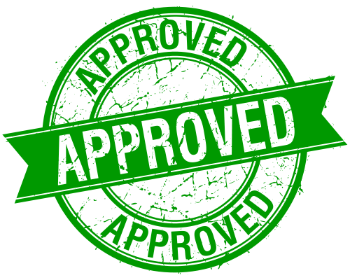
Mocking best practices
Use REAL managed dependency in integration tests – implementation details must be verified and not be mocked (protection against bugs)
No mocks in unit tests (lack of out-of-process interactions verification)
Skip integration test if real managed dependency can not be used
Verify exact number (or absence) of calls made to the mock
Write own adapters on top of unmanaged dependencies. Use mocks only for this adapters (see the next slide)
Consider spies (handwritten mocks) to improve test’s readability
by reducing its size and reusing code in the assertion phase

Slide 59
External
client
Controller
Domain
IMessageBus (intermediate)
Application
Message bus
IBus
System’s edge
Mocking IBus achieves the best protection against bugs and resistance to refactoring

Slide 60
Best practices
Making domain model boundaries explicit (assembly or namespace)
Reducing the number of layers in the application
Eliminating circular dependencies (redundant cognitive loading)
All problems in computer science can be solved by another layer of indirection, except for the problem of too many layers of indirection. —David J. Wheeler

Slide 61
Integration tests best practices
Use unit tests to cover all possible edge cases (Fail Fast Principle)
Use integration tests to verify interactions with ALL out-of-process dependencies
The longest happy path and any edge case which can not be covered by unit tests (set cover problem)
Test’s name sometime helps to distinguish unit and integration test
Detroit vs London – which school does solve set cover problem more efficiently? Which school do you practice?

Slide 62
Anti patterns & tips
Logic in private methods
Leaking domain knowledge
Code pollution
Mocking specific class
Working with current time
Tips
Reducing Arrange/Act/Assert sections

Slide 63
Logic in private methods / private state
Indication of a missing abstraction
Test it indirectly, the same way as it is used in production
Do not change ‘private’ accessor to ‘public’ (exposing private state for testing is an anti pattern – bad API)
Don’t worry: testing implementation details will suffer from resistance to refactoring
Solution: extract new abstraction if needed (calculator, builder, …)

Slide 64
Leaking domain knowledge
… - reimplementation in test: Assert.IsTrue(sut.Sum(1, 2) == 1+2)
Coupling to implementation details
Do not copy unnoticed errors from code to tests (*wrong error messages)
Solution: hardcode expected result into tests

Slide 65
Code pollution
… - adding production code that’s only needed for testing
… - mixing up testing and production code
Increases the maintenance costs
Solution: use separate implementations

Slide 66
Mocking specific class
Is it a combined logic and out-of-process communication?
Possible SRP violation
Avoid width & depth code: a lot of collaborators + high complexity
Solution: split class

Slide 67
Working with current time
Ambient context introduces hidden dependency (antipattern)
Inject time explicitly: a service or a plain value
Prefer injecting the time as a plain value whenever possible
Inject service at the beginning of business operation (in controllers)
Some logic can consider number of days in month (28-31) and must be covered

Slide 68
Test structure
AAA
Given – When – Then
Use ‘sut’ variable name to differentiate your unit of behavior from its dependencies
Drop AAA comments if you can separate sections with empty line

Slide 69
Test name tips
Tells a story
Can be w/o method name (except of utility-classes)
Use ‘is’ instead of ‘should_be’ (anti pattern)
Avoid ‘Verify’
Prefer Active voice (ThrowsException instead of ExceptionIsThrown)
Name tests clearly, don’t be afraid of long names

Slide 70
Reducing Arrange section
Extract technical, non-business-related bits into private methods
Object mother pattern
Test data builder pattern

Slide 71
Reducing Act section
Eliminate ‘invariant violation’ in your code via better encapsulation
Use decorator methods (more applicable for integration tests)

Slide 72
Reducing Assert section
Split observable behavior and test atomic behavior
Consider ‘Equals’ overloads for object instead of separate asserts for its fields
Introduce a fluent interface

Slide 73
Bonus slides

Slide 74
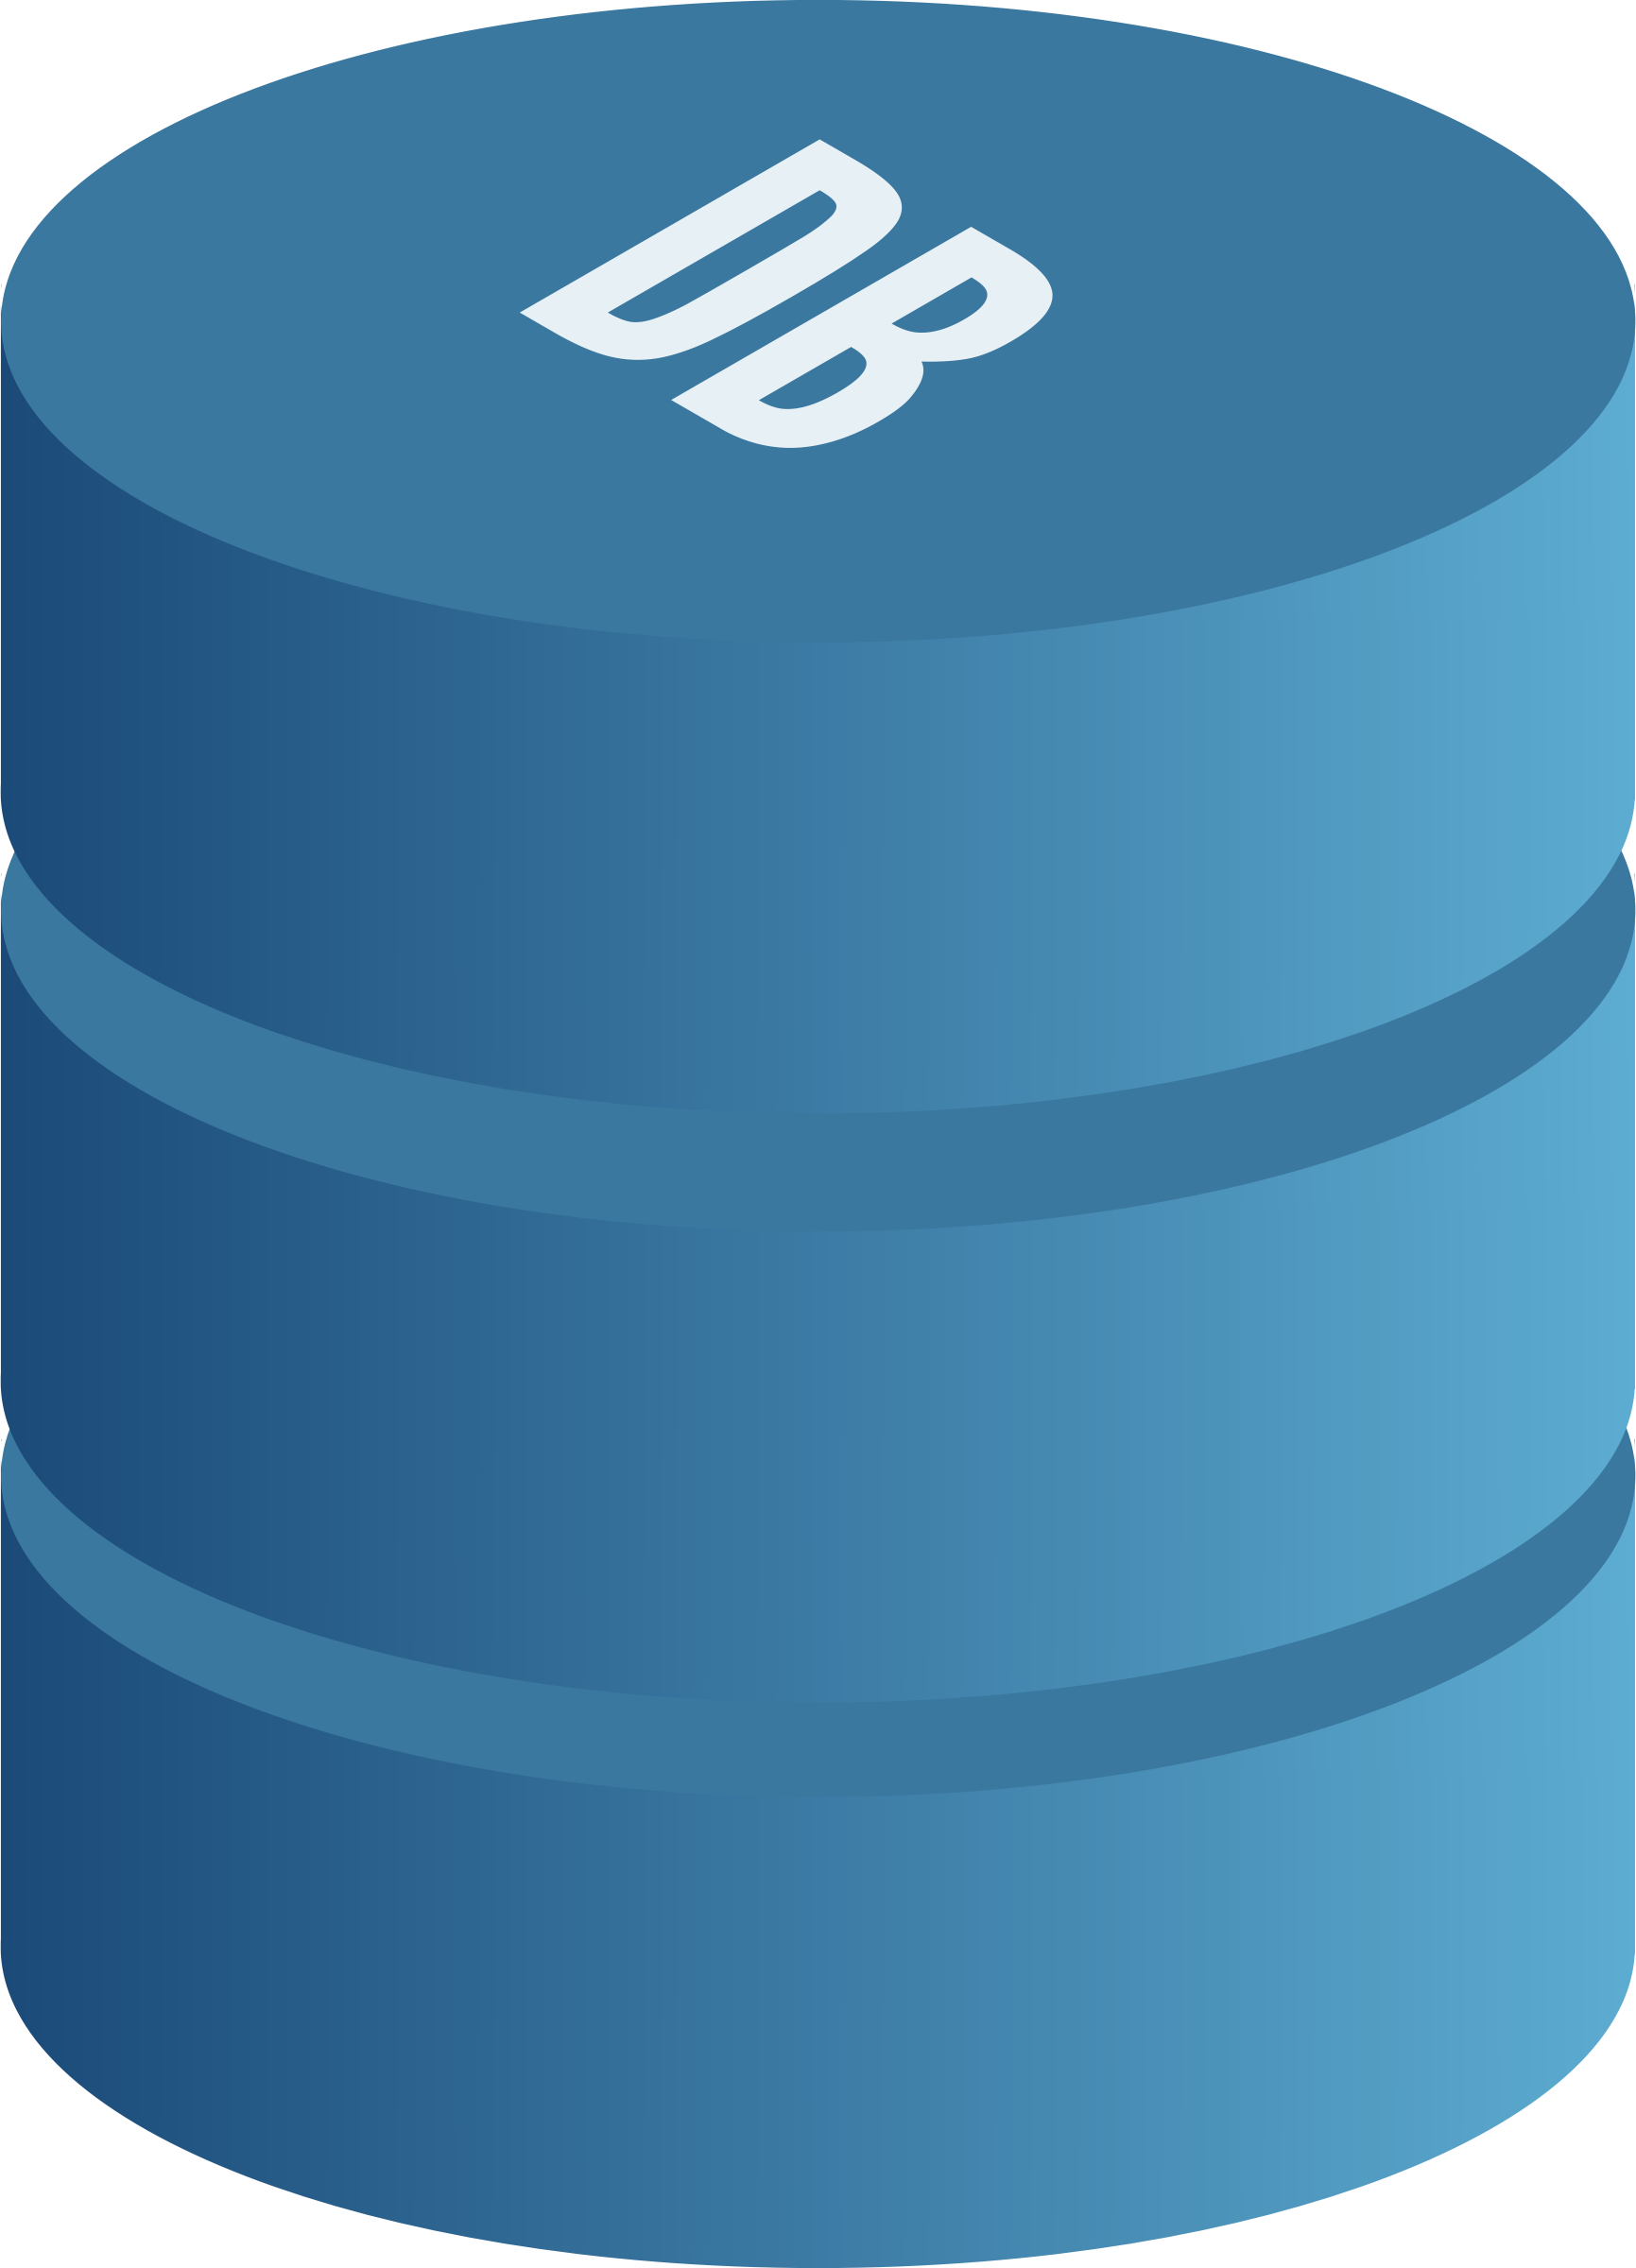
Application database
Prerequisites for testing the database
Database testing best practices
Test data life cycle
Managing database transactions in tests

Slide 75
Testing the database
Database in the source control system
Separate database instance for every developer
Migration-based approach to database delivery
Points above improve database health even w/o integration testing

Slide 76
Best practices
Use the same database management system (DBMS) in tests as in production
Do not reuse UoW/transaction between sections of the test
Execute integration tests sequentially
Remove leftover data between test runs
Do not test repositories directly
Test only writes and the most complex reads

Slide 77
Questions?

Slide 78

Logging
Should you test logging at all?
If so, how should you test it?
How much logging is enough?
How do you pass around logger instances?
*Why is this image here?

Slide 79
Should you test logging at all?
Implementation details
Observed by customer
Logs are
Skip testing
Use mock

Slide 80
Two types of logging
Diagnostic logging
Support logging (domain events in the domain model + special DomainLogger in controller)
Note: structured logging

Slide 81
How much to log?
Logs’ signal-to-noise ratio a is key: maximize the signal, minimize the noise
Try not to use diagnostic logging in the domain model – write valuable unit tests!
Use diagnostic logging for unhandled exceptions only
Ambient context for logger is a certain sign of trouble
*Why IDomainLogger can be mocked in integration test although it is a wrapper over Ilogger (located at the very edge of your system)?

Slide 82
Questions?

Slide 83
Styles of unit testing
Output-based testing
State-based testing
Communication-based testing

Slide 84
Output-based style (functional)
Check the output SUT produces
High-quality unit test (in terms of cost/benefit)
Applicable only to code written in a purely functional way: the only outcome is a return value
High resistance to refactoring
Low maintainability cost

Slide 85
State-based style
Verifies the state of the system after an operation is completed
Preferrable in the Detroit school

Slide 86
Communication-based style
Uses mocks to verify communications between the system under test
Preferrable in London school
Low resistance to refactoring
High maintainability cost

Slide 87
Approaches
Detroit: Classicist, prefers state-based style over communication-based, Inside-out, black-box testing – Uncle Bob and Kent Beck
London: Mockist, prefers communication-based style over state-based, Outside-in testing, white-box testing - Sandi Metz, J.B Rainsberger or Steve Freeman
Hexagonal & Functional architecture separates domain from collaborators
Detroit & London styles separates SUT from collaborators in the same way (only out-of-process/shared OR all collaborators)

Slide 88
End-to-end vs integration tests
Message bus
Database
Out-of-process
Database
Application
Message bus mock
Application
E2E test
In-process
Integration test

Slide 89

Thank you

Slide 90
Hexagonal architecture
* Which layer is a set of business use cases?
* Which separation of concerns is emphasized here? (1)
* How to illustrate one-way flow of dependencies? (2)
* Which line dictates how external systems communicate
with the system? (3)
Application services (ties use cases to logic)
Domain (business logic)

Slide 91
Functional architecture
Methods with no hidden inputs and outputs (no exceptions & no side effects)
Functional core (decisions) – immutability instead of encapsulation
Mutable shell (actions)
Shell works with collaborators, core – with the product of collaborator’s work
High maintainability
Hexagonal architecture taken to an extreme (difference is in treatment of side effects)
Cost
Performance
Size of the code base
Initial investment
Testing goals
Functional core: output-based unit tests
Mutable shell: integration tests

Slide 92
Separation between business logic & side effects (all collaborators)
Mutable shell
Functional core
Input
Decisions
The functional core is implemented
using math functions and makes all
decisions in the application.
The mutable shell provides the
functional core with input data and interprets its decisions by applying side effects to out-of-process
dependencies such as a database.

Slide 93
Out-of-process dependencies: filesystem, database, etc.
Application service (controller)
Business logic (domain model)
Read
Invoke
Write
Hexagonal and functional architectures work best when all references to
out-of-process dependencies can be pushed to the edges of business operations.

