Slide 1
Correlation.c
HPC PROJECT – PART 1 OPENMP PARALLELIZATION

Slide 2
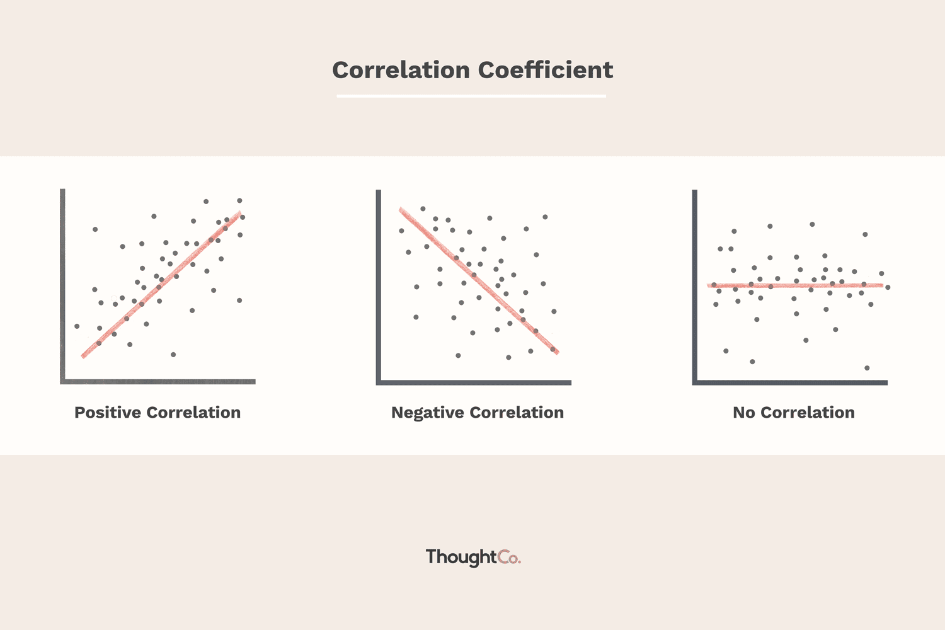
Problem
Correlation is a statistical relationship between two variables such that each value of the first correspond to a value of the second following a certain regularity. It is used to determine the degree to which a pair of variables are related, and it provides a value between -1 and 1
1: indicates perfect positive correlation (both increase proportionally)
-1: indicates perfect negative correlation (one variable decreases as the other increases)
0: indicates non-linear relationship (variables don't change proportionally)
In the C++ implementation, the correlation is computed by:
Calculating the mean of each column of the input data matrix
Calculating the standard deviation of each column
Normalizing the data by subtracting the mean and dividing by the standard deviation
Computation: dot product between the normalized vectors of each pair of columns

Slide 3
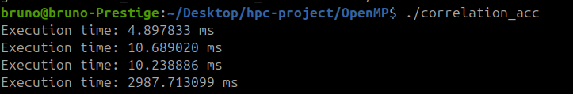
Profiling
Identified 4 key sections
Mean calculation
Standard deviation calculation
Data normalization
Correlation matrix computation
The most expensive section, using polybench instruments, was the Correlation matrix computation
# Mean
# Standard Deviation
# Data Normalization
# Correlation Matrix

Slide 4
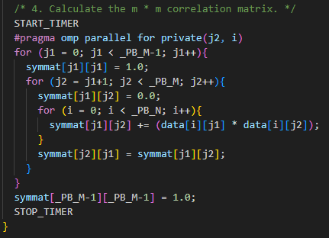
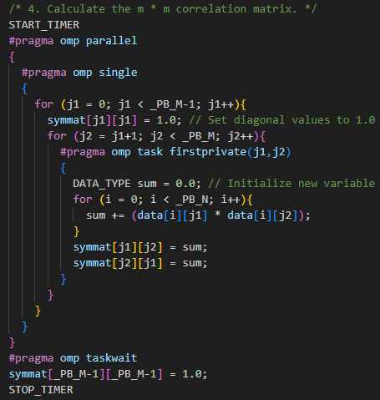

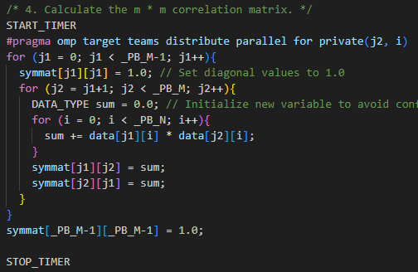
Parallelization methods
PARALLEL_ FOR
PARALLEL_ TASK
PARALLEL_ TARGET
[…]

Slide 5
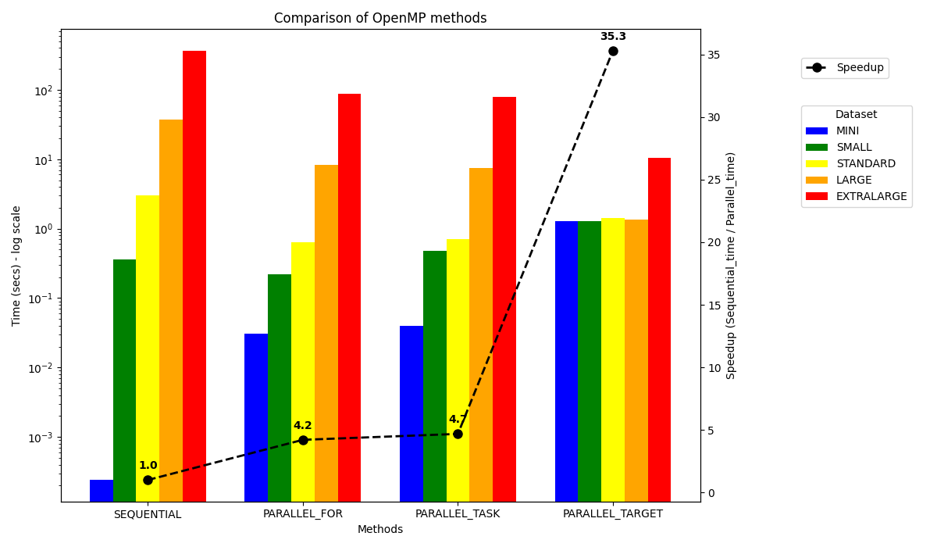
Measures
The best speedup is reached using the PARALLEL_TARGET method with a x35 factor
Other methods of parallelization give a speedup of about x4.5, but are better for smaller dataset

Slide 6
Considerations
This project demonstrated the effectiveness of using OpenMP to parallelize computational workloads efficiently. Among the tested approaches, GPU offloading (PARALLEL_TARGET) proved to be the most performant, especially on large datasets, due to its ability to massively parallelize operations
However, for smaller datasets, the overhead introduced by transferring data between the host (CPU) and the device (GPU) becomes a significant bottleneck. In these cases, parallelization across CPU threads (e.g.PARALLEL_FOR and PARALLEL_TASK) is generally more efficient and easier to manage.
For very small datasets, the sequential implementation remains the best option. In such scenarios, the overhead introduced by task distribution and thread management in parallel execution can outweigh the benefits.

Slide 7
Correlation.cu
HPC PROJECT – PART 2 CUDA PARALLELIZATION

