Slide 1
Correlation.c
HPC PROJECT – PART 1 OPENMP PARALLELIZATION

Slide 2

Problem
Correlation is a statistical relationship between two variables such that each value of the first correspond to a value of the second following a certain regularity. It is used to determine the degree to which a pair of variables are related, and it provides a value between -1 and 1
1: indicates perfect positive correlation (both increase proportionally)
-1: indicates perfect negative correlation (one variable decreases as the other increases)
0: indicates non-linear relationship (variables don't change proportionally)
In the C implementation, the correlation is computed by:
Calculating the mean of each column of the input data matrix
Calculating the standard deviation of each column
Normalizing the data by subtracting the mean and dividing by the standard deviation
Computation: dot product between the normalized vectors of each pair of columns

Slide 3

Hardware
MSI Prestige 15 A10SC
CPU: Intel Core i7-10710U, 1.1Ghz, 6 core (2 threads per core)
RAM: 16GB DDR4
GPU: Nvidia GeForce GTX 1650 Mobile, 4GB GDDR5
OS: Ubuntu 24.04 LTS
Floating-point operations per second (FLOPS)
CPU: 105.6 GFLOPS GPU: 3.195 TFLOPS

Slide 4
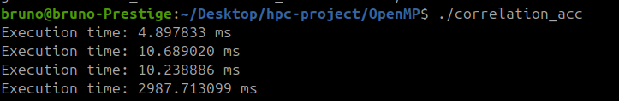
Profiling
Identified 4 key sections
Mean calculation
Standard deviation calculation
Data normalization
Correlation matrix computation
The most expensive section, using polybench instruments, was the Correlation matrix computation
# Mean
# Standard Deviation
# Data Normalization
# Correlation Matrix

Slide 5
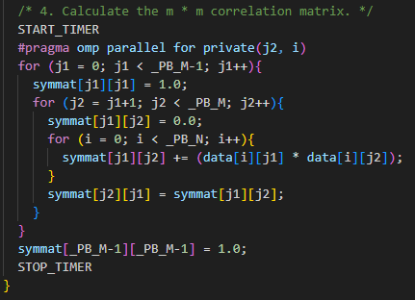
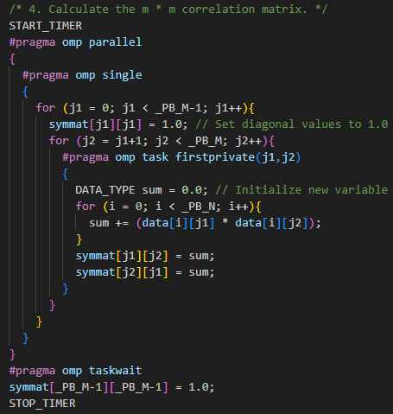

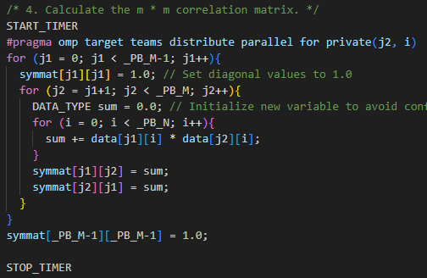
Parallelization methods
PARALLEL_ FOR
PARALLEL_ TASK
PARALLEL_ TARGET
[…]

Slide 6
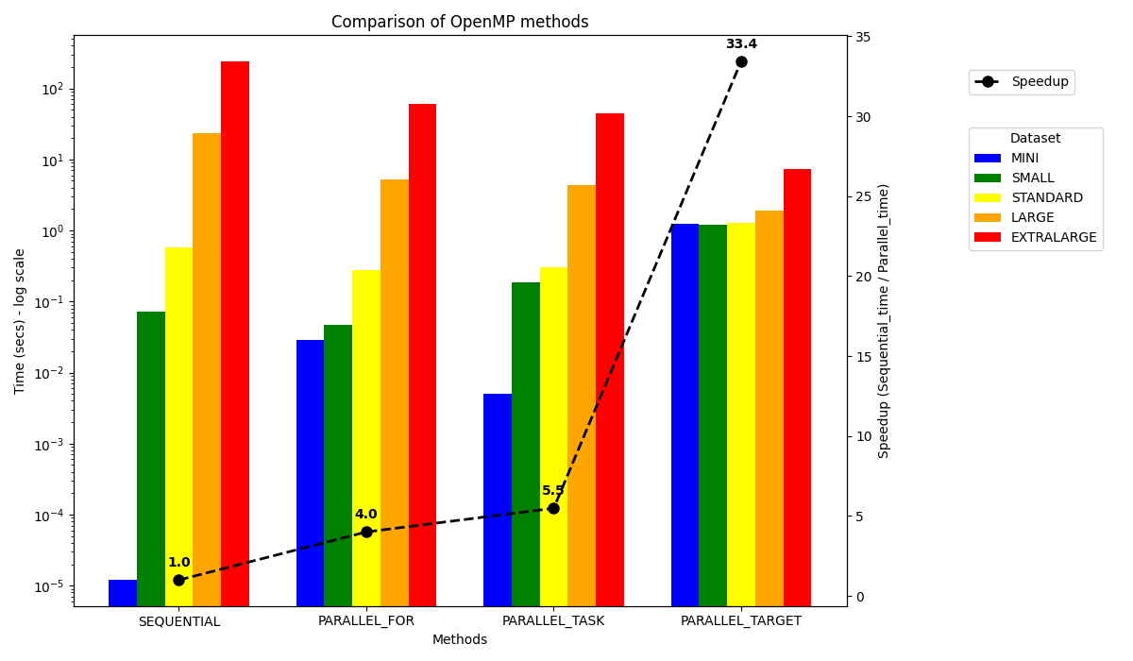
Measures
The best speedup is reached using the PARALLEL_TARGET method with a x33 factor
Other methods of parallelization give a speedup of about x5, but are better for smaller dataset

Slide 7
Considerations
This project demonstrated the effectiveness of using OpenMP to parallelize computational workloads efficiently. Among the tested approaches, GPU offloading (PARALLEL_TARGET) proved to be the most performant, especially on large datasets, due to its ability to massively parallelize operations on device
However, for smaller datasets, the overhead introduced by transferring data between the host (CPU) and the device (GPU) becomes a significant bottleneck. In these cases, parallelization across CPU threads (e.g.PARALLEL_FOR and PARALLEL_TASK) is generally more efficient and easier to manage.
For very small datasets, the sequential implementation remains the best option. In such scenarios, the overhead introduced by task distribution and thread management in parallel execution can outweigh the benefits.

Slide 8
Correlation.cu
HPC PROJECT – PART 2 CUDA PARALLELIZATION

Slide 9
Idea
The calculation of mean and standard deviation for each column does not depend on the others
The normalization of each value is independent
Each element of the correlation matrix can be computed separately, since it only requires data from those columns
To simplify memory transfers from host to device, and to facilitate index calculations within kernels, matrices could be represented as 1D arrays.
Use 256 threads per block due to recommendations because it is supported by the most of GPUs*
* https://docs.nvidia.com/cuda/cuda-c-programming-guide/index.html#thread-hierarchy

Slide 10
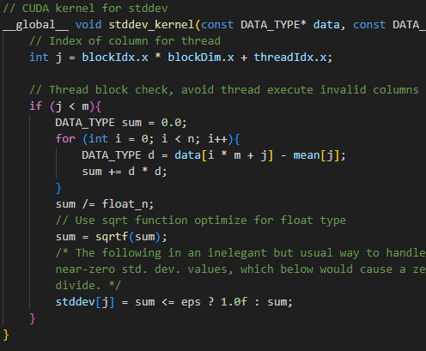
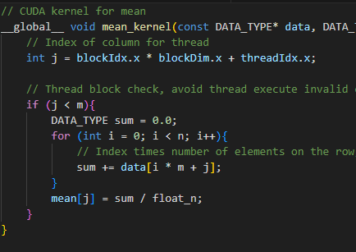
Parallelization (1)

Slide 11
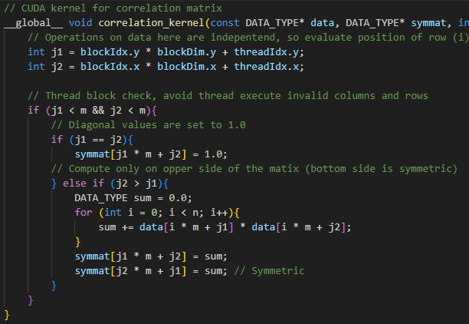
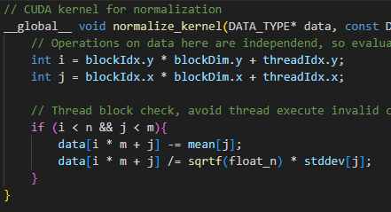
Parallelization (2)

Slide 12
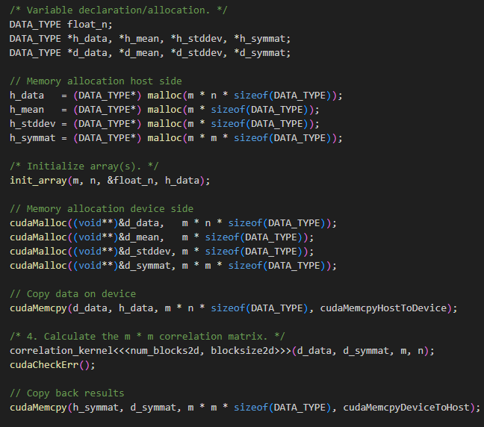


Parallelization (3)

Slide 13
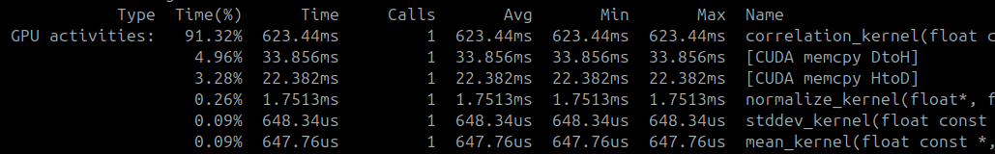
Profiling CUDA
Kernel execution and memory transfer timings were profiled using nvprof.
Using this pageable solution, the data transfer overhead was minimal and not notably affected total execution time (same as pinned and UVM).
The pageable memory solution was chosen because it is the simplest to implement (and the execution time is the same).

Slide 14
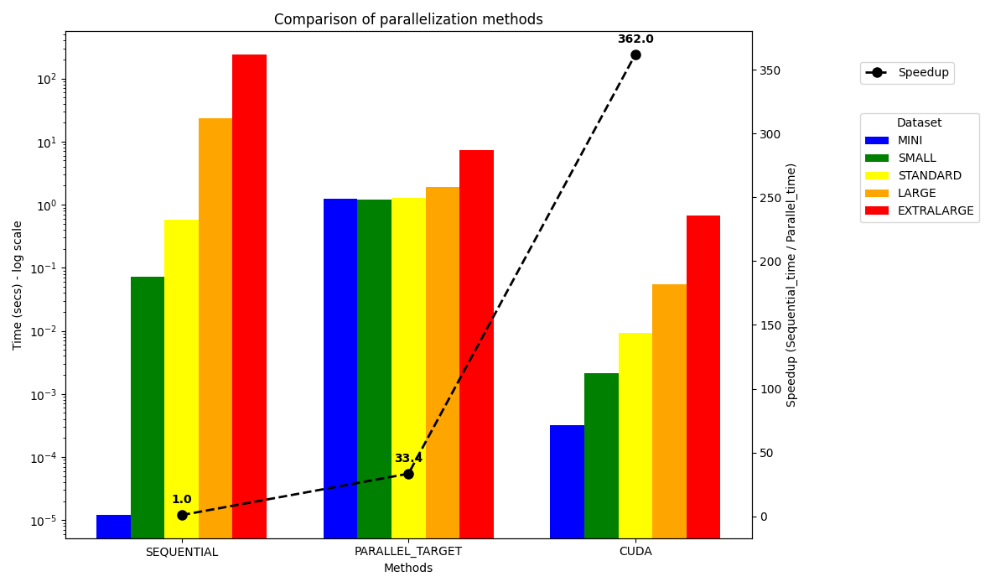
Measures
The best speedup is reached using the CUDA method with a x362 factor!
Other methods of parallelization with OpenMP give a good speedup, but CUDA is better for each dataset

Slide 15
OpenMP vs CUDA
Near the execution time, is indicated relative speedup
DATASET | SEQUENTIAL | PARALLEL_TASK | PARALLEL_TARGET | CUDA
MINI | 0.000012 | 0.005 [x0.002] | 1.254* [x0.00001] | 0.000316 [x0.4]
SMALL | 0.0718 | 0.184 [x0.39] | 1.194* [x0.06] | 0.002146 [x35.9]
STANDARD | 0.5736 | 0.304 [x1.9] | 1.126* [x0.45] | 0.00932 [x63.7]
LARGE | 23.41 | 4.31 [x5.4] | 1.887* [x12.4] | 0.05428 [x433]
EXTRALARGE | 241.43 | 44 [x5.5] | 7.22 [x33.5] | 0.667 [x365]
*
MINI | SMALL | STANDARD | LARGE
0.5875 [x0.00002] | 0.73 [x0.098] | 0.15425 [x3.7] | 0.7755 [x30]

Slide 16
Conclusions
The CUDA implementation achieved an impressive speedup of up to x362 compared to the sequential version. Thanks to its ability to execute thousands of threads concurrently, CUDA is the best choice for most of datasets from small one.
OpenMP delivered good results (up to x33 speedup), with lower development complexity while CUDA is ideal in high-performance environments and large datasets, where NVIDIA GPUs are available, but the implementation is more complex.
In this case, identify which parts to parallelize was partial helpful because only one of four functions was the most time-consuming. However, in general, this is the key to achieve efficient parallelization. In this project in particular, the choice of parallelize also faster parts, makes the parallelization more scalable

