Slide 1
Weather and Clothes
Identify sun and rain and name a shirt, shoes and a hat; choose a sun hat for shade and shoes to cover feet.
A1 • Ages 5-7 • 45 min • Listening • + Vocabulary

Slide 2
Weather and Clothes
Look.
Listen.
Speak.
What do you already know about this topic?
1

Slide 3
Today’s goal
Name the pictures.
Choose clothes for a walk.
Try one sentence.
2

Slide 4

Sun
The bright light in the sky.
I see the sun.
Say the word.
3

Slide 5

Rain
Water that falls from clouds.
I see the rain.
Say the word.
4

Slide 6

Shirt
Clothes for the top of your body.
My shirt is blue.
Say the word.
5

Slide 7
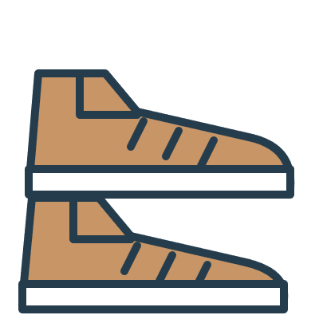
Shoes
Clothes for your feet.
My shoes are brown.
Say the word.
6

Slide 8

Hat
Something you wear on your head.
My hat is yellow.
Say the word.
7

Slide 9
Read and notice
Mia Gets Ready
What does Mia see first?
8

Slide 10
Listen for details
A Walk with Leo
Listen. Then answer.
9

Slide 11
Useful language
I see the ___.
Say a sentence.
10

Slide 12
Useful language
I wear a ___.
Say a sentence.
11

Slide 13
Useful language
I wear shoes on my feet.
Say a sentence.
12

Slide 14
Pack for a walk · 1
A sunny walk: choose a picture that shades your head.
Take turns.
13

Slide 15
Pack for a walk · 2
Getting dressed: choose a picture for your feet.
Take turns.
14

Slide 16
Pack for a walk · 3
Rain starts: decide where to wait safely.
Take turns.
15

Slide 17
Your final response
Name two things you wear.
Say it by yourself.
16

Slide 19
Sun

Slide 21
Rain

Slide 23
Shirt

Slide 25
Shoes

Slide 27
Hat

