Slide 1
Teen Life and Free Time
Compare two free-time activities and explain a preference with at least two reasons, then respond to a different view.
B1 • Ages 13-15 • 60 min • Speaking • + Vocabulary

Slide 2
Teen Life and Free Time
Compare two hobbies, explain a preference, and negotiate a club choice.
What do you already know about this topic?
1

Slide 3
Today’s goal
Compare two free-time activities and explain a preference with at least two reasons, then respond to a different view.
Explain the goal in your own words.
2

Slide 4
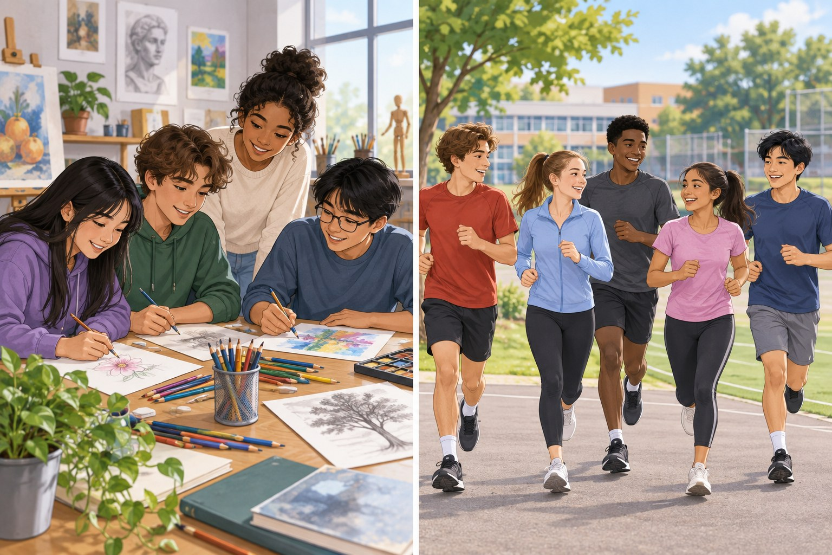
Look and discuss
Compare the two clubs.
Which would you choose, and why?
3

Slide 5
Hobby
Hobby
An activity you enjoy in your free time.
"Drawing is my favorite hobby."
Use the word in a new example.
4

Slide 6
Relax
Relax
Become calmer after effort or stress.
"I read to relax."
Use the word in a new example.
5

Slide 7
Practice
Practice
Repeat something to improve.
"I practice guitar twice a week."
Use the word in a new example.
6

Slide 8
Prefer
Prefer
Like one choice more than another.
"I prefer chess to running."
Use the word in a new example.
7

Slide 9
Challenge
Challenge
Something difficult that tests your ability.
"Learning a new song is a challenge."
Use the word in a new example.
8

Slide 10
Read and notice
Two Ways to Spend Friday
Why do art members not need to buy supplies?
9

Slide 11
Listen for details
Choosing a New Hobby
Listen once for the situation, then again for details.
10

Slide 12
Useful language
I prefer ___ to ___ because ___.
Both activities ___, but only ___ .
I see your point; however, ___ .
Adapt one frame to the situation.
11

Slide 13
Design our Friday club · 1
Choice 1: Art. Shared supplies; quiet room; individual or paired work.
Discuss your choice and explain your reason.
12

Slide 14
Design our Friday club · 2
Choice 2: Running. Small groups; personal pace; covered space if it rains.
Discuss your choice and explain your reason.
13

Slide 15
Design our Friday club · 3
Decision: Choose a club trial for your group. Give two reasons and one reason another group might choose differently.
Discuss your choice and explain your reason.
14

Slide 16
Your final response
State your choice. Give evidence. Recognize a limitation.
What would make you change your response?
15

