Slide 1

stella
Your star that guides you proper in social content.
The AI content studio that takes Filipino businesses from first idea to published post.
ParallelOS Hackathon 2026 · Kevin Robert Ochoa, Solutions Architect · stella.saile.asia
Notes:
Hi, we're Stella. Stella is an AI content studio built for Filipino small businesses and content studios. In the next few minutes: the problem, what we built, how it compares with Hootsuite, and why it matters for PH communities.

Slide 2



Filipino small businesses post every day, mostly on their own.
THE PROBLEM
Out of ideas
Risky posts
No time to plan
“What do we post today?” is asked every single morning.
A raffle with no DTI permit or an unapproved health claim can break PH ad rules.
Owners run the shop, the orders and the page. Planning a week never happens.
Notes:
Most small businesses here don't have a marketing team. The owner is the marketer. They run out of ideas, they post things that can quietly break Philippine ad rules, like a raffle without a DTI permit number, and they never have time to plan ahead.

Slide 3
Stella is built for them: small studios, SMEs and people starting their first business.
WHO WE SERVE
99.63%
66.97%
of business enterprises in the Philippines are MSMEs.
of the country’s total employment comes from MSMEs.
Source: DTI, 2023 Philippine MSME Statistics (PSA 2023 List of Establishments)
Notes:
Ninety-nine point six three percent of Philippine businesses are micro, small and medium enterprises, and they provide about two thirds of all jobs. These are exactly the businesses with no marketing team. That's who Stella is for.

Slide 4
One AI studio, from first idea to published post.
WHAT WE BUILT
START
PLAN
MAKE
SHIP
Start a business
Ideas and trends
Create and check
Plan the week
Idea, strength or what you have, turned into a business plan.
AI calendar, scheduling, publishing and alerts.
Post ideas, “Why it worked” and rising trends.
AI posts and images, plus a PH pre-flight check.
Built in PHP and MySQL, running on Claude or Grok for text and OpenAI or xAI for images. Live at stella.saile.asia.
Notes:
Stella follows the journey of a small business. Start: turn an idea into a business. Plan: know what to post and why. Make: create the post and check it against Philippine rules. Ship: plan the whole week and publish.

Slide 5
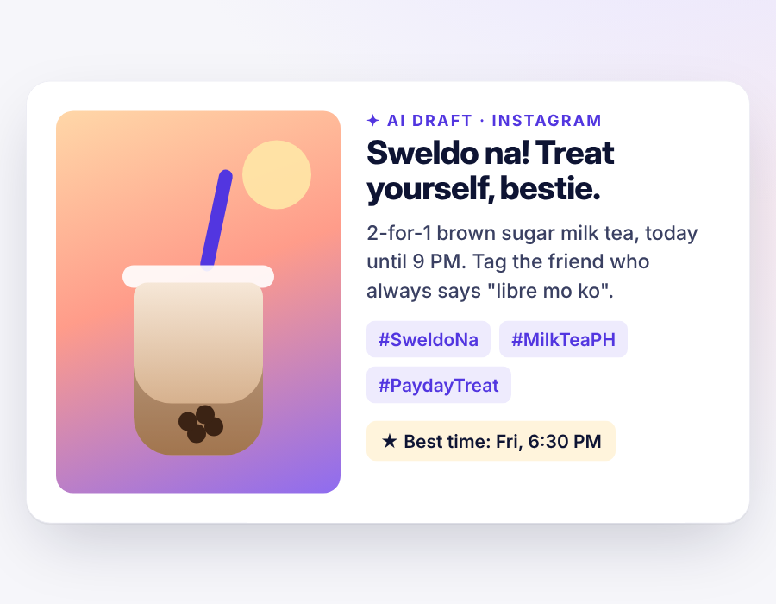
A full post in one tap.
CREATE WITH AI
Pick what you need (title, body, hashtags, timing, images) and press the big button.
“What’s your peg?”
Upload a reference photo and say the outcome you want. Stella keeps your product, copies the layout or matches the mood.
Product screen · sample content for a fictional milk tea shop
Notes:
Create New Post writes the caption, hashtags and best time, and generates the image. The new part is the peg: upload a photo that looks like what you want, say the outcome, and Stella recreates it. Keep my product, copy the layout, or match the look and mood.

Slide 6
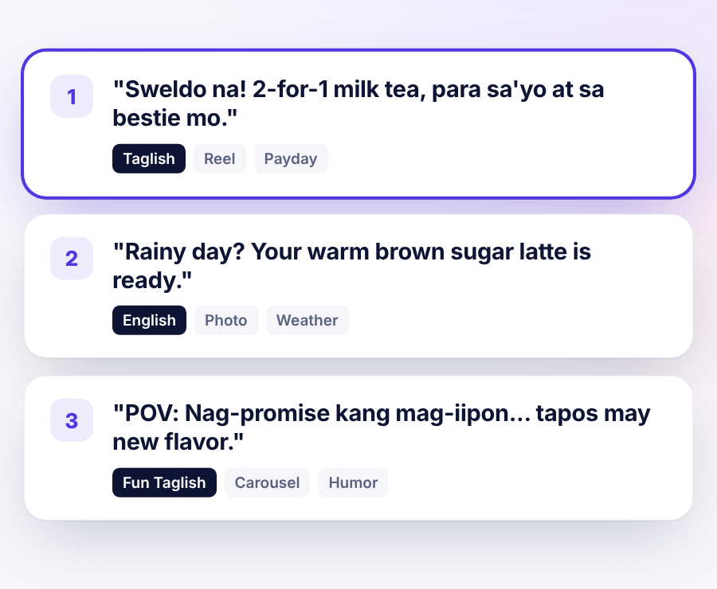
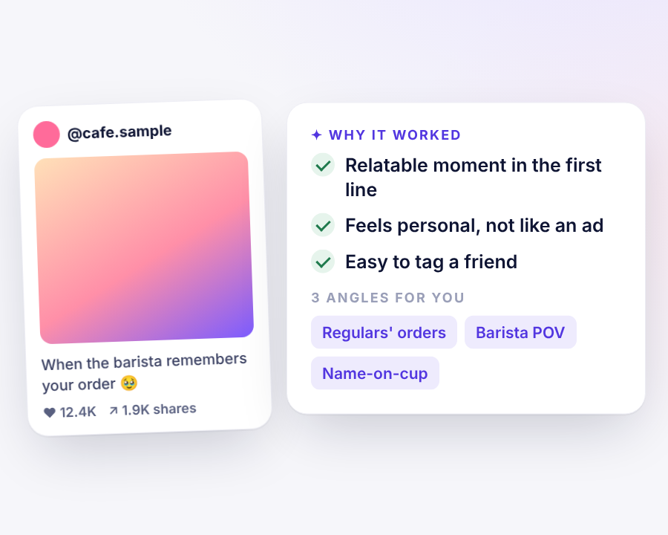
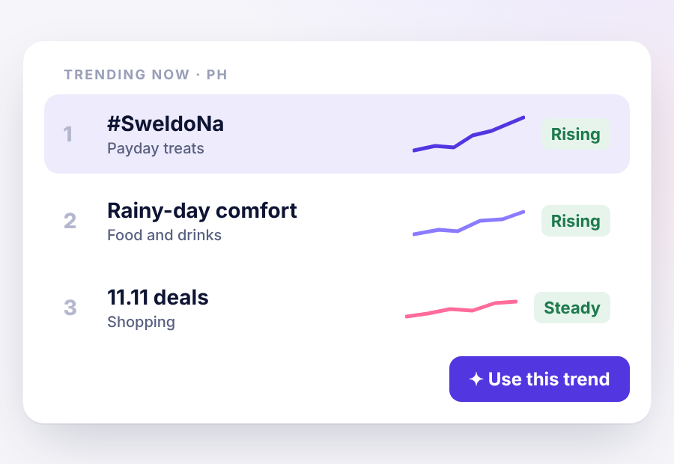
Know what to post, and why it works.
PLAN
Post ideas
Why it worked
Trends
1 to 5 ideas in English, Taglish or Fun Taglish.
Paste any winning post. Get the reasons and 3 angles.
See what’s rising and turn it into your next post.
Product screens · sample content and sample trends
Notes:
Three planning tools. Post ideas, written the way Filipino brands actually talk, including Taglish. Why it worked: paste anyone's winning post and learn why. And trends, which Stella never invents: they're imported, real data.

Slide 7
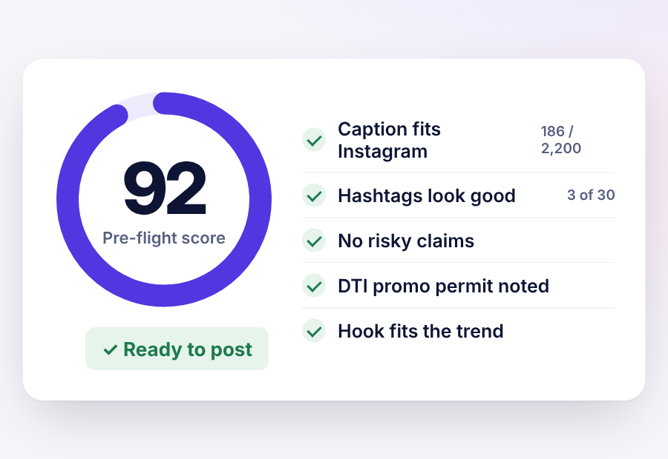
Checked against Philippine rules before it goes live.
PRE-FLIGHT CHECK
Consumer Act (RA 7394)
FDA rules
DTI promo permits
Data Privacy Act (RA 10173)
Ad Standards Council
Platform limits and risky words, plus an AI review. Verdict: ready, fix or hold, and “Fix it for me” rewrites per platform. Always optional.
Product screen · sample content · a heads-up, not legal advice
Notes:
This is our biggest differentiator. Before a post goes live, Stella checks platform limits and risky words, then an AI reviews it against Philippine rules: the Consumer Act, FDA rules, DTI promo permits, the Data Privacy Act and Ad Standards. You get a score and a verdict, and one tap fixes the caption.

Slide 8
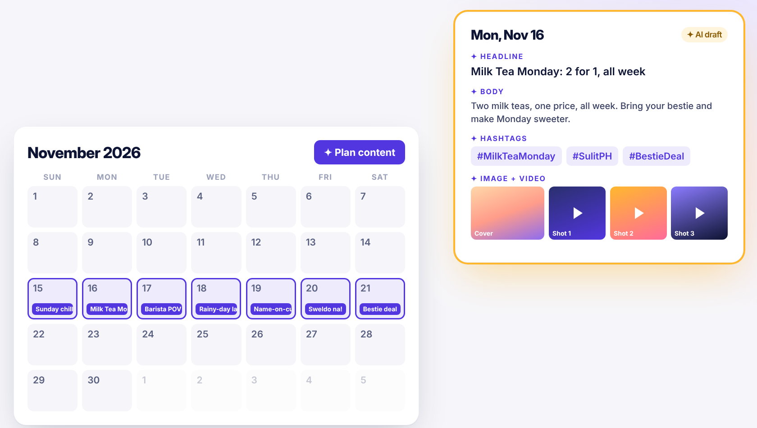
Plan a week. AI drafts it all.
THE STAR FEATURE
Pick up to 7 dates, choose platforms, language and theme. Stella drafts the headline, body, hashtags and images for every date, then suggests the best time.
Product screen · sample content
Notes:
Here's the star feature. Select up to seven dates on the calendar, pick platforms, language and a theme, and Stella drafts a full post for each date: headline, body, hashtags and images, with a best time to post. Edit, check, schedule. A week of content in minutes.

Slide 9
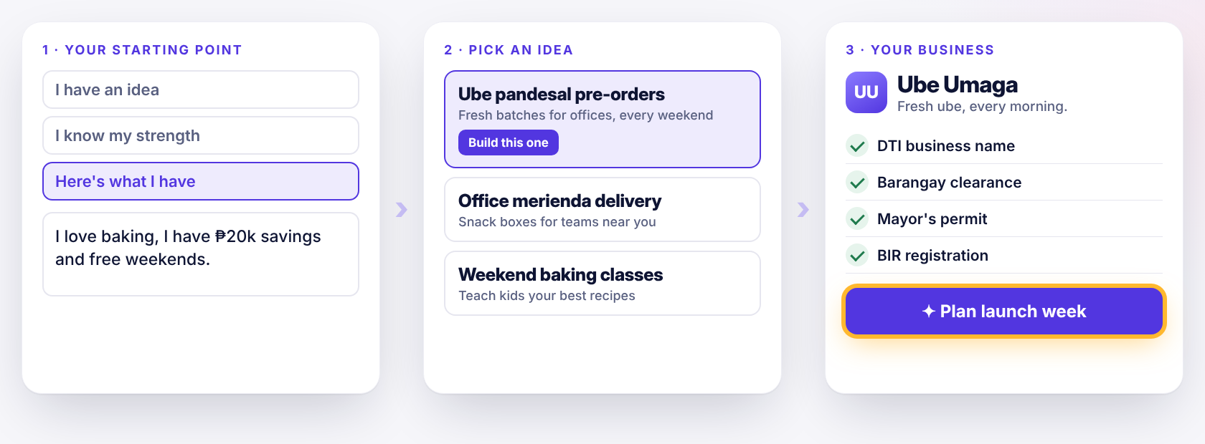
Not just posting: from idea to real business.
START A BUSINESS
Product screen · sample business · registration list is general guidance, not legal advice
Notes:
Stella isn't only for people who already have a business. Start from an idea, a strength, or simply what you have. Stella suggests three business concepts, shapes the one you pick into a profile with a name, offer and pricing approach, lists the first registrations like DTI, barangay clearance, mayor's permit and BIR, then plans the launch week on the calendar.

Slide 10
Both write posts with AI. Stella is built for the Philippines.
STELLA VS HOOTSUITE
Capability | Stella | Hootsuite
PH ad-rule pre-flight check | Yes: Consumer Act, FDA, DTI, privacy | Approvals are a human sign-off
English, Taglish, Fun Taglish | Yes, in every AI feature | Not mentioned
“Why it worked” on any post | Yes, with 3 angles for you | Remixes your own past posts
Recreate from a reference photo | Keeps product, layout or mood | Turns images into posts
Plan a week from one brief | A draft per date, with images | “Plan weeks of content”
Start a business from an idea | Yes, with PH registration steps | No
Publishing across networks | Facebook live; others in demo | Yes, many networks
Listening and deep analytics | Basic post insights | Yes, its core strength
Hootsuite: hootsuite.com/platform/publish and SocialRails “Hootsuite Review 2026”, checked November 2026
Notes:
Hootsuite is excellent, and its AI also writes posts and images. Where Stella is different: the Philippine pre-flight check, Taglish, breaking down anyone's winning post, recreating from a reference photo, and helping people start a business. Where Hootsuite is ahead, and we say it openly: publishing to many networks today, social listening and deep analytics. Hootsuite helps you post more. Stella helps Filipino businesses post right.

Slide 11
Helping more Filipinos start, and post right.
IMPACT ON PH COMMUNITIES
New founders
Safer feeds for consumers
An idea or a skill becomes a business plan, with the DTI, barangay, mayor’s permit and BIR steps listed.
Misleading promos and unapproved health claims get flagged before they reach buyers.
A local voice
Honest by design
Taglish and Fun Taglish keep posts sounding Filipino, not translated.
Stella never invents trends, prices or numbers. Sample data is always labelled.
Notes:
What this means for Philippine communities. New founders get a guided path from idea to registered business. Consumers see fewer misleading ads. Small brands keep their own Filipino voice. And Stella is honest by design: it never makes up numbers, so owners don't make money decisions on invented data.

Slide 12

From first idea to first sale.
WHAT’S NEXT
LIVE NOW
MILESTONE 2
MILESTONE 3
Content studio
Business builder
Website and store
AI posts and images, pre-flight check, AI calendar, Facebook publishing.
Idea to business, with marketing guidance from day one. First version built.
Build a website or online store from the same business profile.
Stella, your star that guides you proper in social content.
Try it live: stella.saile.asia · Real Instagram, TikTok and YouTube publishing needs each platform’s approved developer app
Notes:
Today Stella is a working content studio, live at stella.saile.asia. The business builder, milestone two, already has its first version. Milestone three lets the same business profile build a website or an online store. Stella: your star that guides you proper in social content. Thank you.

Slide 13





Kevin Ochoa
ABOUT THE BUILDER
CONNECT
LinkedIn
Scan the code
Solutions Architect
WhatsApp / Viber
+63 995 653 2346
A solutions architect with a decade of experience. Kevin is the author and principal developer of Saile, a business process management platform now used by National Government Agencies in the Philippines.
Email
info.kevinochoa@gmail.com
Recent MVPs, used today in the Philippine market
Your whole workday in one place: notes, reminders, meetings, files and PDF signing.
Business process management that routes every document to the right desk.
bell.com.se
saile.asia
Notes:
A quick word about me. I'm Kevin Ochoa, a solutions architect for a decade, and the author and principal developer of Saile, a business process management platform used by national government agencies in the Philippines. Stella builds on what I've shipped before: Bell and Saile are both live and used in the Philippine market today. Scan the codes to try them, or to connect with me on LinkedIn.

