Slide 1
ENGI 301 DealerBot Proposal
September 26, 2022
Abinand Parthasarathy

Slide 2
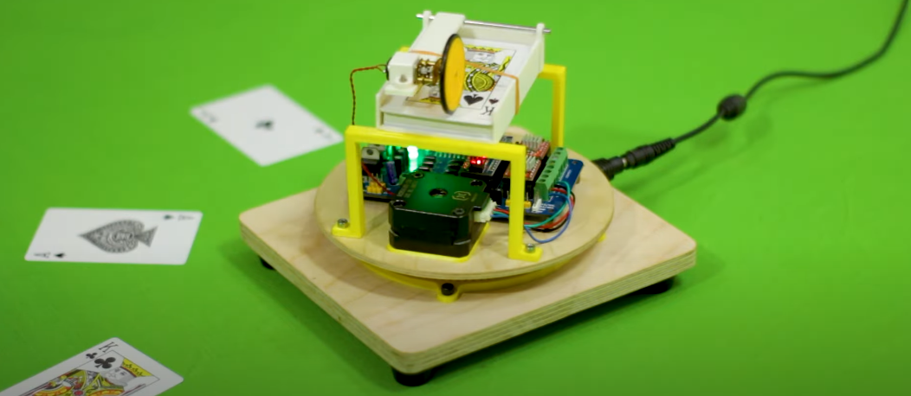
Background Information
As someone who loves watching magic tricks and playing card games with my friends and family, I’ve always been fascinated by inventions related to cards. In many games from War to Poker, there must be a dealer that hands out cards before or in the middle of each game. Many times, it’s important that cards are dealt in the right order and right way to ensure fairness and consistency. If you don’t, serious players will get mad! The DealerBot removes all thinking and perfectly deals your favorite games for you so you can focus on the playing.
This project is based off of a similar dealing robot project created with an Arduino. I envision the structure and parts of my project to be designed in almost the same manner but with some key improvements. I want to add an LCD screen with buttons so users can choose the number of players and game being played. The device will be preprogrammed to deal out certain games according to the correct rules. The device will also deal cards in a complete circle to accommodate users playing around a circular table and will include additional hall effect and light sensors to ensure proper positioning.

Slide 3
System Block Diagram
Hall Effect Sensor
US5881LUA
PocketBeagle
USB
I2C
GPIO
Light Sensor
LTR-303ALS-01
Resistive Touch Screen
TSC2007
LCD Screen
ILI9341
Stepper Motor
XY42STH34-0354A
LCD293D
DC Motor

Slide 4
Power Block Diagram
12V Power Adapter
PocketBeagle
5V
5V
5V USB
3.3V
1.8V
Stepper Motor
(12V)
12V-5V Converter
LCD293D
DC Motor
LCD Screen
Hall Effect Sensor
Light Sensor

Slide 5
Components / Budget
Component | Need to Buy | Cost
Stepper Motor | 1 | $14.00
12V-5V Step Down Converter | 1 | $9.95
DC Motor | 1 | $2.95
L293D Motor Driver | 1 | $8.99
Wheel | 1 | $1.50
Rubber Sheet | 1 | $7.00
SPI LCD Screen | 1 | $29.95
Resistive Touch Screen Controller | 1 | $4.95
Hall Effect Sensor | 1 | $2.00
Magnet | 1 | $2.50
Light Sensor | 1 | $4.50
 |  | $88.29 + tax

