Slide 1
Baluns
How they work
How they are made

Slide 2
What is a balun?
A Balun is special type of transformer that performs two functions:
  Impedance transformation
  Balanced to unbalanced transformation
The word balun is a contraction of “balanced to unbalanced transformer”

Slide 3
Why do we need a balun?
Baluns are important because many types of antennas (dipoles, yagis, loops) are balanced loads, which are fed with an unbalanced transmission line (coax).
Baluns are required for proper connection of parallel line to a transceiver with a 50 ohm unbalanced output
The antenna’s radiation pattern changes if the currents in the driven element of a balanced antenna are not equal and opposite.
Baluns prevent unwanted RF currents from flowing in the “third” conductor of a coaxial cable.

Slide 4
Balanced vs Unbalanced Transmission Lines
A balanced transmission line is one whose currents are currents are symmetric with respect to ground so that all current flows through the transmission line and the load and none through ground.
Note that line balance depends on the current through the line, not the voltage across the line.

Slide 5
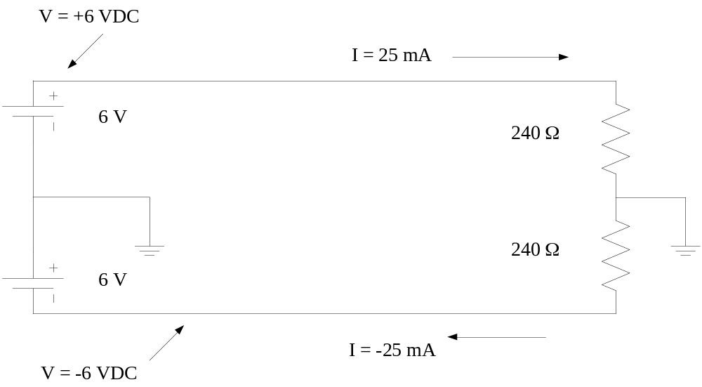
An example of a Balanced Line
Here is an example of a balanced line. DC rather than AC is used to simplify the analysis:
Notice that the currents are equal and opposite and the that the total current flowing through ground = 25mA-25mA = 0

Slide 6
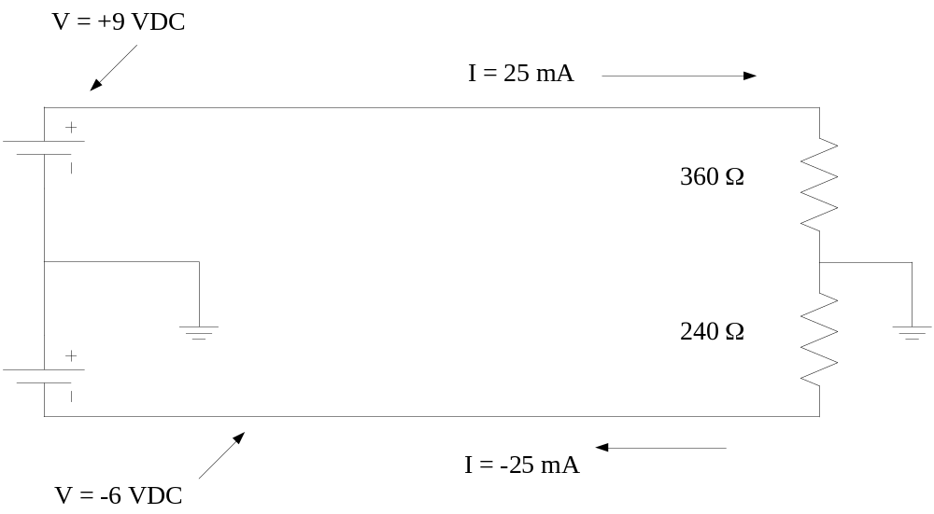
Another Balanced Line Example
Here is another example:
Note that the total current flowing through ground is again 0
Because the ground current is 0, the ground is not required

Slide 7
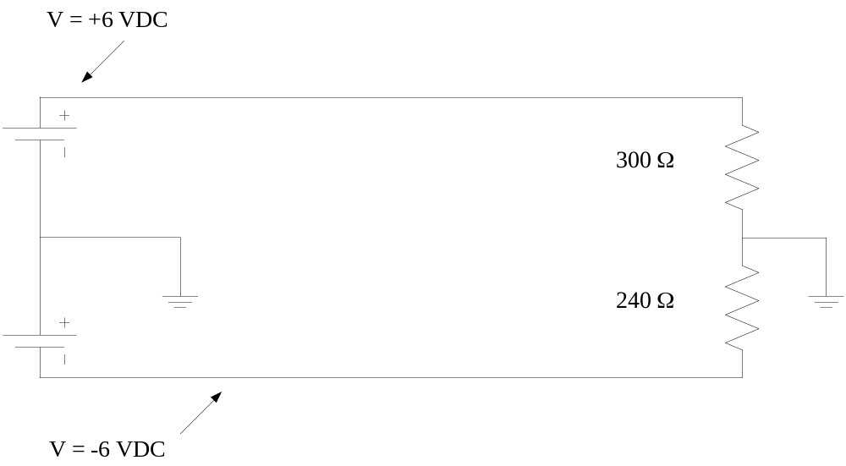
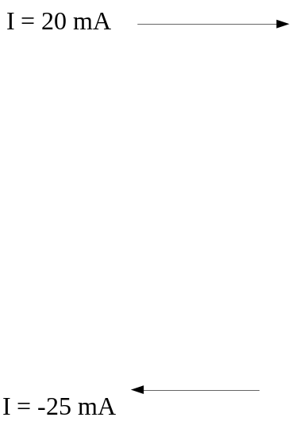
Another Balanced Line Example
Here is another example. Is the line balanced?
No – although the voltages are equal and opposite, the currents are not!

Slide 8
Voltage Baluns
A Voltage Balun is one whose output voltages are equal and opposite (balanced with respect to ground).
True balance occurs only if the balun’s load is symmetric with respect to ground.
Voltages baluns are easily constructed and commonly used in spite of their inability to provide true current balance.

Slide 9
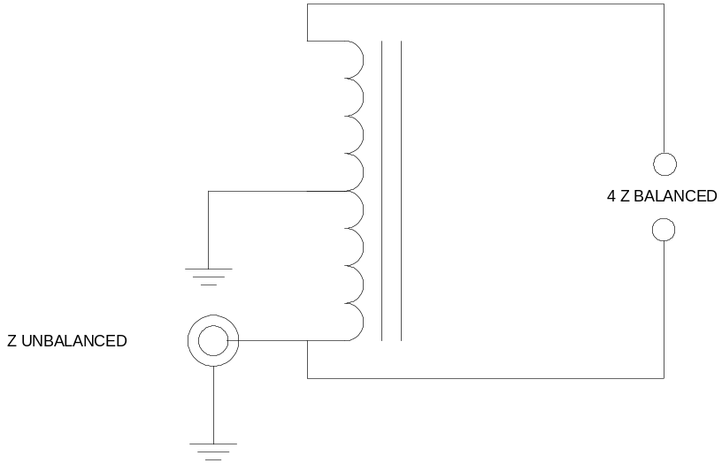
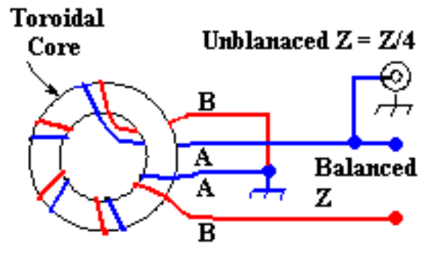
4:1 Voltage Balun
This is the simplest voltage balun, consisting of two coils of wire connected as shown.
The coils may use an air core or a ferrite core.
Current flowing through the lower coil induces an equal and opposite voltage in the upper coil.
The primary circuit contains N turns and the secondary 2N, so the input impedance is Z_{L}(N/2N)²= ¼ Z_{L}

Slide 10
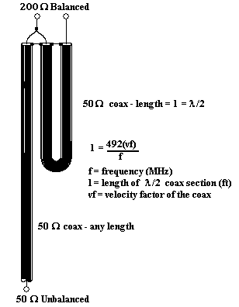
4:1 Transmission Line Voltage Balun
This voltage balun is constructed solely from transmission line and requires to cores.
Unlike the transformer-type baluns, this balun may be used only over a narrow range of frequencies.
The extra half wave section causes the voltage at its output to be equal and opposite to the voltage at the input

Slide 11
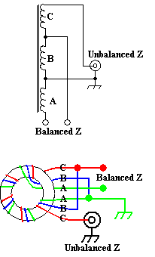
1:1 Voltage Balun
This voltage balun is similar to the 4:1, but uses 3 windings connected in series.
The coils may use an air core or a ferrite core.
Current flowing through the lower coil induces an equal and opposite voltage in the upper coil.
The primary circuit contains N turns and the secondary N, so the input impedance is Z_{L}(N/N)²= Z_{L}

Slide 12
Current Baluns
A Current Balun is one whose output currents are equal and opposite (balanced with respect to ground).
With the exception of the 1:1 current balun, current baluns are more expensive to construct than voltage baluns and thus are les widely used.
Current baluns may be made with RF transformers on ferrite cores or with lengths of transmission line.

Slide 13
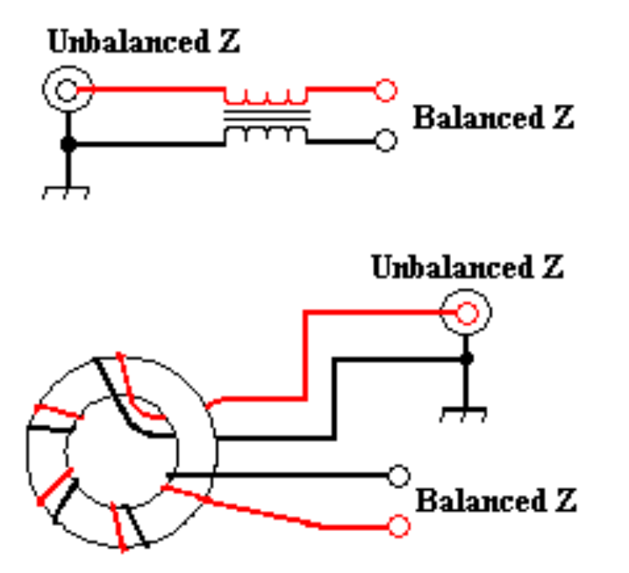
1:1 Current Balun
This is the simplest current balun, consisting of two coils of wire connected as shown.
The coils may use an air core or a ferrite core.
Often a current balun is made by winding coaxial cable into a coil, with or without a ferrite core.
The load impedance is not changed by the balun.
The inductive reactance of the windings prevents common mode currents from flowing and ensures a balanced output
The inductive reactance should be 10 times the load impedance at the lowest frequency of operation

Slide 14
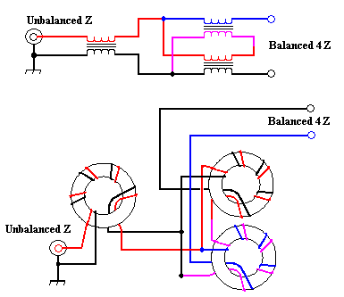
4:1 Current Balun
6 windings on 3 cores are required to construct a 4:1 current balun.
This balun consists of a 1:1 balun followed by a 4:1 balanced-to-balanced current transformer.
The windings on the 1:1 balun should have at least an inductive reactance at least 10 times greater than the input impedance
The windings on the 4:1 current transformer should have an inductive reactance at least 10 times greater than the output impedance (40 times Zin)

Slide 15
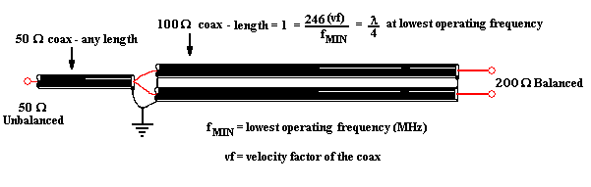
4:1 transmission line current balun
Only transmission line is needed to construct this current balun.
The two lengths of transmission line that comprise the balun need to have a characteristic impedance of ~ 100 ohms. RG-62 (Z = 95 ohms) works very well.
The length of the two sections of 100 ohm coax must be at least ¼ wavelength at the lowest frequency (approx 47 feet at 3.5 MHz) and a this type of balun should work over a 8 to 1 frequency range.
This type of balun is often used at higher frequencies where ferrite cores are lossy and short lengths of coax are required.

Slide 16
Notes about Balun Construction
Transformer Baluns
  Use solid wire, preferrably enameled, for the windings.
  For transmitting applications the wire should be #14 or larger
  A 1.5 inch diameter ferrite/powdered iron core is sufficient for powers to 100 W. For QRO operation, use a 2.5 – 3 inch diameter core. Select the proper core material for the desired frequencies of operation
  For HF baluns, 6 – 8 turns of wire around a toroidal core is sufficient. Air core baluns will need 10 – 20 turns
Transmission line baluns
  Coiling the coax sections improves common-mode rejection

Slide 17
FAQ’s
Do I really need a balun?
  Not necessarily. If you feed a balanced antenna with unbalanced line and you don’t want feed line radiation, use a balun!
What kind of balun is best?
  There is no best balun for all applications. The choice of balun depends on the type of antenna and the frequency range.
Will you make a Balun for me?
  No. However, I will be happy to show how to make your own.

