Slide 1
Cybersecurity using machine learning and deep learning
Represented by : sudhanshu shekhar
roll no.-26
semester : s8
branch : information technology
registration no. : 14170234

Slide 2
Content:
INTRODUCTION
EXISTING SYSTEM AND DRWABACK
NEW SYSTEM
DESIGN AND IMPLEMENTATION
DISADVANTAGES
CONCLUSION
REFERENCE

Slide 3
ABSTRACT:
Machine learning (ML) and Deep Learning (DL) is adopted in a wide range of domains where it shows its superiority over traditional rule-based algorithms. These methods are being integrated in cyber detection systems with the goal of supporting or even replacing the first level of security analysts. Although the complete automation of detection and analysis is an enticing goal, the efficacy of machine learning in cyber security must be evaluated with the due diligence. I present an analysis, addressed to security specialists, of machine learning techniques applied to the detection of intrusion, malware, and spam. The goal is twofold: to assess the current maturity of these solutions and to identify their main limitations that prevent an immediate adoption of machine learning cyber detection schemes. Our conclusions are based on an extensive review of the literature as well as on experiments performed on real enterprise systems and network traffic.

Slide 4
INTRODUCTION:
Cybersecurity is a set of technologies and processes designed to protect computers, networks, programs and data from attacks and unauthorized access, alteration, or destruction.
A network security system consists of a network security system and a computer security system. Each of these systems includes firewalls, antivirus software, and intrusion detection systems (IDS).
Security breaches include external intrusions and internal intrusions. There are three main types of network analysis for IDSs: misuse-based, also known as signature-based, anomaly-based, and hybrid.

Slide 5
cyber security:
A DEFINITION OF CYBER SECURITY:
Cyber security refers to the body of technologies, processes, and practices designed to protect networks, devices, programs, and data from attack, damage, or unauthorized access. Cyber security may also be referred to as information technology security.
THE IMPORTANCE OF CYBER SECURITY:
Cyber security is important because government, military, corporate, financial, and medical organizations collect, process, and store unprecedented amounts of data on computers and other devices.
A significant portion of that data can be sensitive information, whether that be intellectual property, financial data, personal information, or other types of data for which unauthorized access or exposure could have negative consequences.

Slide 6
CHALLENGES OF CYBER SECURITY:
Network security
Application security
Endpoint security
Data security
Cloud security
Mobile security

Slide 7
Intrusion detection:
Intrusion detection systems help discover, determine and identify unauthorized system behavior such as use, copying, modification and destruction.
Security breaches include external intrusions and internal intrusions.
Three main types of network analysis for IDSs:
Misuse-based also known as signature-based
Anomaly-based
Hybrid

Slide 8
Machine learning and deep learning:
DEFINATION OF MACHINE LEARNING:
Machine learning is an application of artificial intelligence (AI) that provides systems the ability to automatically learn and improve from experience without being explicitly programmed.
Machine learning focuses on the development of computer programs that can access data and use it learn for themselves.
DEFINATION OF DEEP LEARNING:
Deep learning is part of a broader family of machine learning methods based on artificial neural networks with representation learning.
Learning can be supervised, semi-supervised or unsupervised.

Slide 9
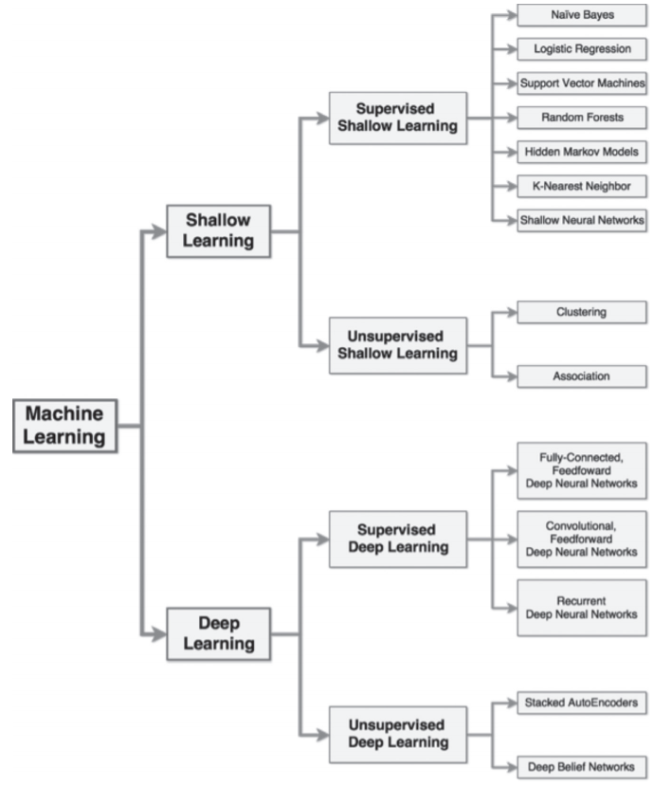

Slide 10
DIFFERENCE BETWEEN MACHINE LEARNING AND DEEP LEARNING:
The difference between ML and DL include the following:
Data dependencies:
Deep learning algorithms do not perform as well when the data volumes are small, because deep learning algorithms require a large amount of data to understand the data perfectly.
The traditional machine-learning algorithm uses the established rules, the performance will be better.
Hardware dependencies:
The DL algorithm requires many matrix operations. The GPU is largely used to optimize matrix operations efficiently. Therefore, the GPU is the hardware necessary for the DL to work properly.
DL relies more on high-performance machines with GPUs than do traditional machine-learning algorithms.

Slide 11
3. Feature processing:
The performance of most ML algorithms depends upon the accuracy of the features extracted.
DL reduces the effort of designing a feature extractor for each problem.
4. Problem-solving method:
machine learning usually breaks down the problem into multiple sub-problems and solves the sub-problems, ultimately obtaining the final result.
In contrast, deep learning advocates direct end-to-end problem solving.
5. Execution time:
deep learning algorithm takes a long time to train.
machine learning algorithm takes short test time.

Slide 12
Network security data set:
Data constitute the basis of computer network security research. The size of the dataset also affects the training effects of the ML and DL models.
Computer network security data can usually be obtained in two ways: 1) directly and 2) using an existing public dataset.
Direct access is the use of various means of direct collection of the required cyber data. This approach is highly targeted and suitable for collecting short-term or small amounts of data, but for long-term or large amounts of data, acquisition time and storage costs will escalate.
The use of existing network security datasets can save data collection time and increase the efficiency of research by quickly obtaining the various data required for research.

Slide 13
Types of network security data set:
DARPA INTRUSION DETECTION DATA SETS:
The dataset provides a large amount of background traffic data and attack data. It can be downloaded directly from the website.
2. KDD CUP 99 DATASET:
The KDD Cup 99 dataset is one of the most widely used training sets; it is based on the DARPA 1998 dataset.
NSL-KDD DATASET:
The NSL-KDD dataset is a new version of the KDD Cup 99 dataset. The NSL-KDD dataset improves some of the limitations of the KDD Cup 99 dataset.
This model identifies features between intrusive and normal connections for building network intrusion detectors. In the NSL-KDD dataset, each instance has the characteristics of a type of network data.
ADFA DATASET:
The ADFA data set is a set of data sets of host level intrusion detection system, which is widely used in the testing of intrusion detection products.

Slide 14
EXISTING SYSTEM:
A network security system consists of a network security system and a computer security system i.e., firewalls, antivirus software.
FIREWALL :
A firewall is a network security device, either hardware or software-based, which monitors all incoming and outgoing traffic and based on a defined set of security rules it accepts, rejects or drops that specific traffic.
Accept : allow the traffic Reject : block the traffic but reply with an “unreachable error” Drop : block the traffic with no reply
Most traffic which reaches on the firewall is one of these three major Transport Layer protocols- TCP, UDP or ICMP

Slide 15
ANTIVIRUS SOFTWARE:
Antivirus software is a class of program designed to prevent, detect and remove malware infections on individual computing devices, networks and IT systems.
Antivirus software, originally designed to detect and remove viruses from computers, can also protect against a wide variety of threats, including other types of malicious software, such as keyloggers, browser hijackers, Trojan horses, worms, rootkits, spyware, adware, botnets and ransomware.
How antivirus software works :
Antivirus software usually performs these basic functions:
2. Scanning directories or specific files for known malicious patterns indicating the presence of malicious software;
3. Allowing users to schedule scans so they run automatically;
4. Allowing users to initiate new scans at any time; and
5. Removing any malicious software it detects. Some antivirus software programs do this automatically in the background, while others notify users of infections and ask them if they want to clean the files.

Slide 16
DISADVANTAGES:
Disadvantages of Using a Firewall:
Firewalls cannot protect a network or pc from viruses, Trojans, worms and spyware which spread through flash drives, potable hard disk and floppy etc.
They may restrict authorized users from accessing valuable services.
it cannot protect the network from attacks from the inside.

Slide 17
DISADVANTAGES OF ANTIVIRUS: 1. Limited Detection Techniques 2. Slows Down PC or Network 3. Doesn’t Fully Protect

Slide 18
NEW SYSTEM:DESIGN AND IMPLEMENTATION:
ML AND DL ALGORITHM FOR CYBERSECRITY:
This section is divided into two parts i.e.
Traditional machine-learning algorithms in network security
i). K-Nearestneighbor
ii). Decision Tree
Deep learning in the field of cybersecurity
i). Deep belief network
ii). Recurrent neural networks
iii). Convolutional neural networks

Slide 19
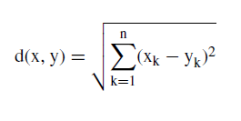
K-NEARESTNEIGHBOR:
The kNN classier is based on a distance function that measures the difference or similarity between two instances. The standard Euclidean distance d(x, y) between two instances x and y is defined as:
KNN are used for classification and can be used for multi-class problems. However, both their training and test phase are computationally demanding as to classify each test sample, they compare it against all the training samples.
ii. DECISION TREE:
A decision tree is a tree structure in which each internal node represents a test on one property and each branch represents a test output, with each leaf node representing a category.
In machine learning, the decision tree is a predictive model; it represents a mapping between object attributes and object value.

Slide 20
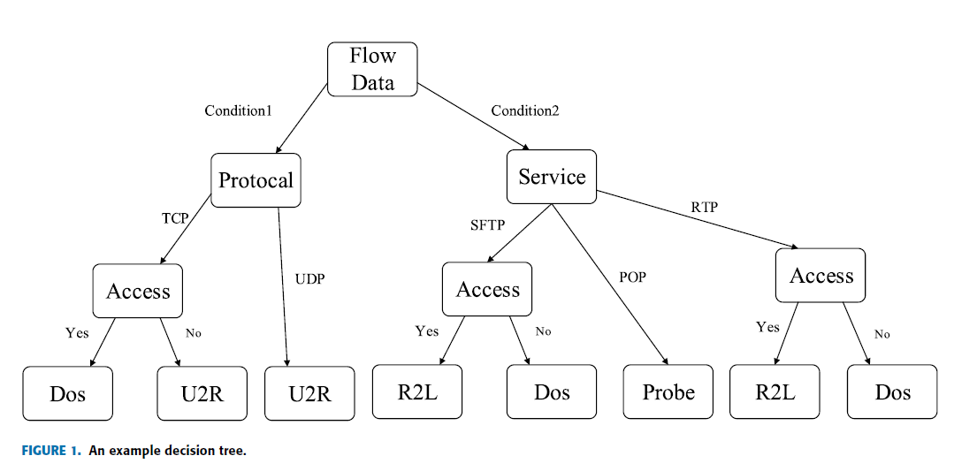

Slide 21
DEEP BELIF NETWORK:
They are modelled through a composition of Restricted Boltzmann Machines (RBM), a class of neural networks with no output layer.
DBN can be successfully used for pre-training tasks because they excel in the function of feature extraction. They require a training phase, but with unlabeled datasets.
RECURRENT NEURAL NETWORKS:
The recursive neural network (RNN) is used to process sequence data. In the traditional neural network model, datafrom the input layer to the hidden layer to the output layer; The layers are fully connected and there is no connection between the nodes between each layer.
The reason that RNN is a recurrent neural network is that the current output of a sequence is also related to the output before it.

Slide 22
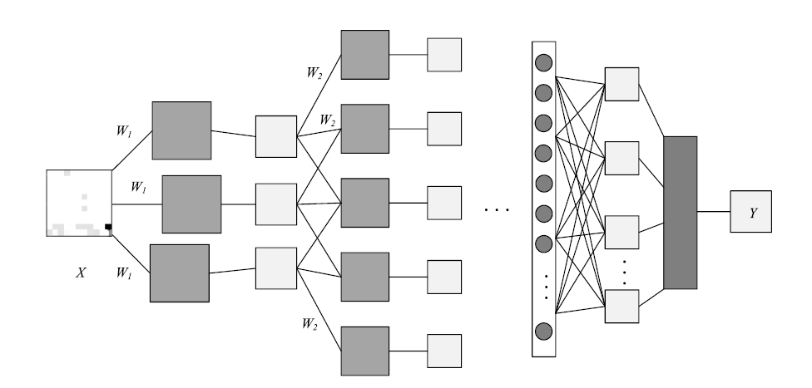
CONVOLUTIONAL NEURAL NETWORKS;
Convolutional Neural Networks (CNN) is a type of artificial neural network that has become a hotspot in the field of speech analysis and image recognition.
Its weight-sharing network structure makes it more similar to a biological neural network, thus reducing the complexity of the network model and reducing the number of weights.
CNN is the first truly successful learning algorithm for training multi-layer network structures.

Slide 23
Disadvantages:
The ML and DL methods do not work without representative data, and obtaining such a dataset is difficult and time-consuming.
There are many problems with the existing public dataset, such as uneven data, outdated content.

Slide 24
Conclusion:
Machine and deep learning approaches are increasingly employed for multiple applications and are being adopted also for cyber security, hence it is important to evaluate when and which category of algorithms can achieve adequate results.
We analyze these techniques for three relevant cyber security problems: intrusion detection, malware analysis and spam detection.
Our takeaway is that machine learning techniques can support the security operator activities and automate some tasks, but pros and cons must be known.

Slide 25
References:
https://ieeexplore.ieee.org/document/8359287
https://www.geeksforgeeks.org/
https://www.wikipedia.org/
https://www.javatpoint.com/cyber-security-technology

Slide 26
THANK YOU!!

