Slide 1
Агенти SQL Server та ETL-процеси. ETL+Cube (STG-, ODS-, DW-бази) на прикладі
-
SQL Server Integration Services
SQL Server Analysis Services
+

Slide 2
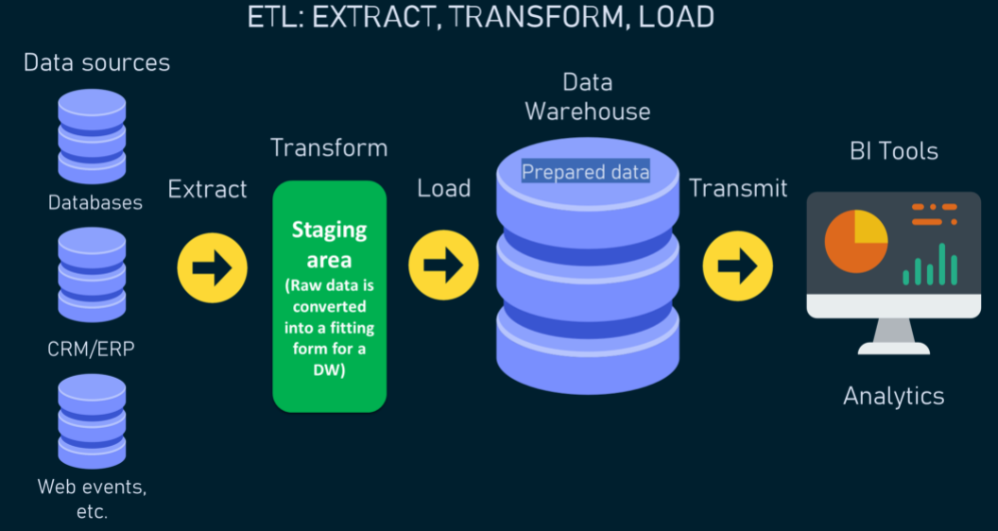
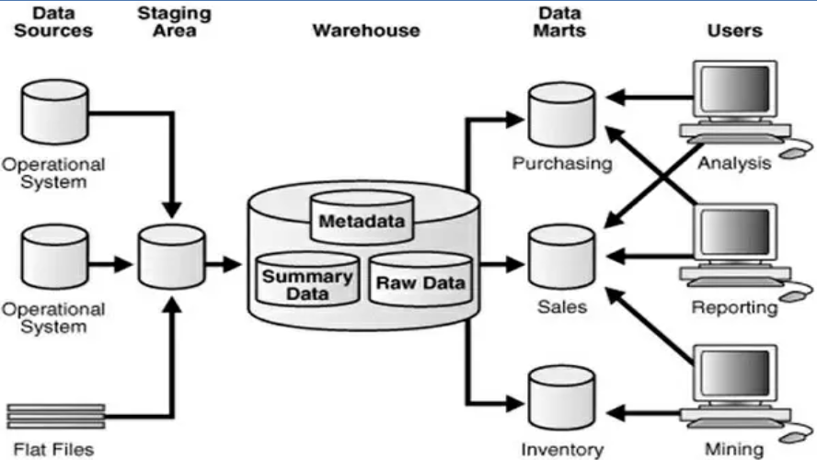
https://www.altexsoft.com/blog/etl-vs-elt/
https://www.hebergementwebs.com/cognos-tutorial/data-warehouse-etl-and-reporting-tools

Slide 3
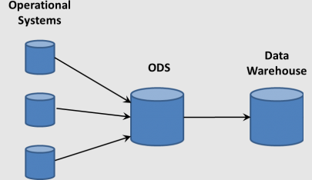
https://www.altexsoft.com/blog/etl-vs-elt/
SQL Server Integration Services
SQL Server Analysis Services
SQL Server Reporting Services

Slide 4
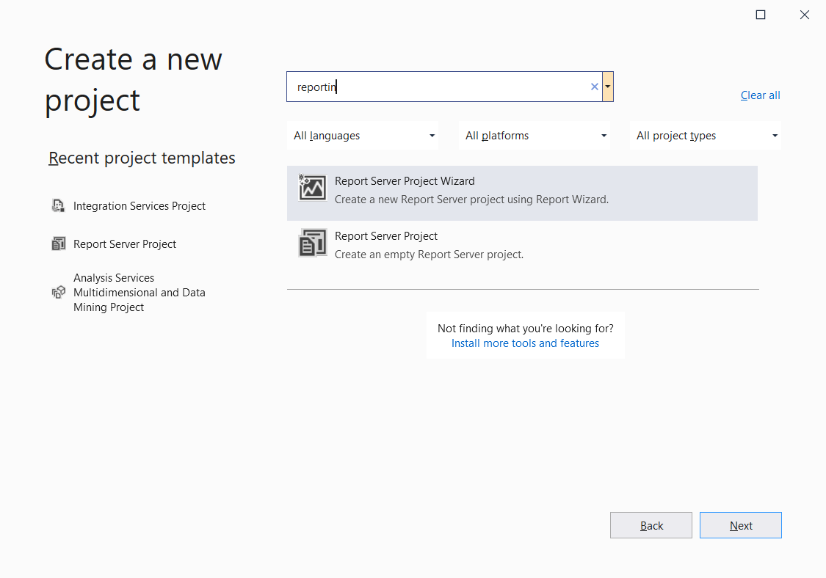
SQL Server Integration Services
SQL Server Analysis Services
SQL Server Reporting Services

Slide 5
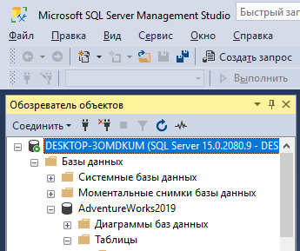
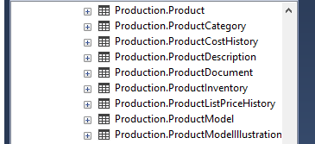
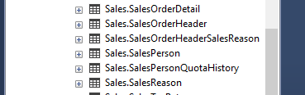
Adventure Works. Обрані таблиці

Slide 6
Бази STG, ODS, DW

Slide 7

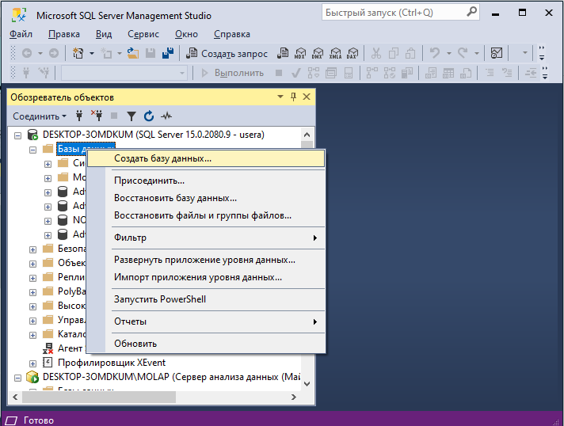
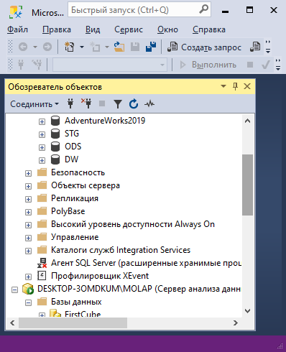
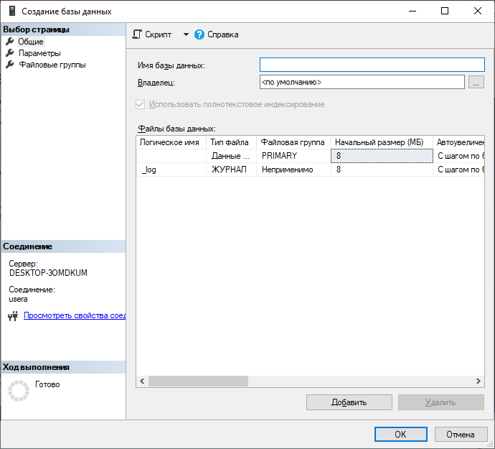
New Bases: STG, ODS, DW
ПКМ
https://www.youtube.com/watch?v=enahePzYT6E

Slide 8
Таблиці бази STG

Slide 9
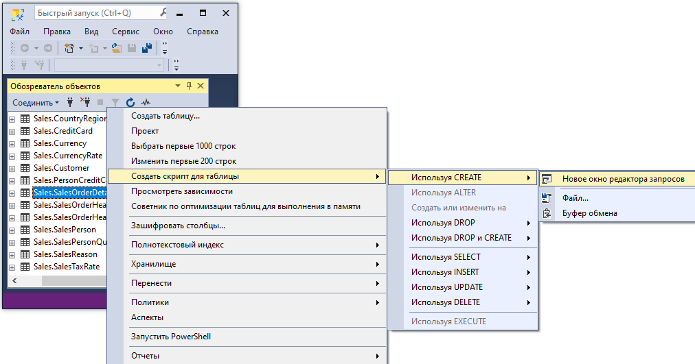
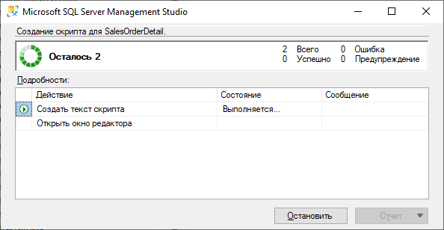
Sales.SalesOrderDetail (Script CREATE)
ПКМ

Slide 10
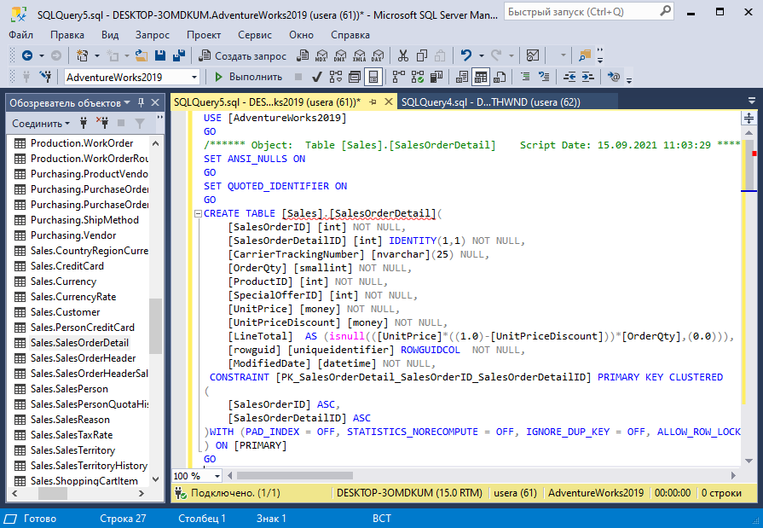
Sales.SalesOrderDetail (Script CREATE)

Slide 11
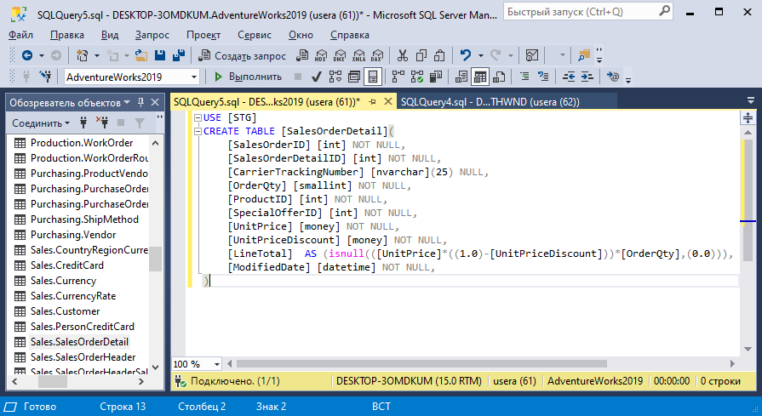
Script CREATE. [STG].SalesOrderDetail

Slide 12
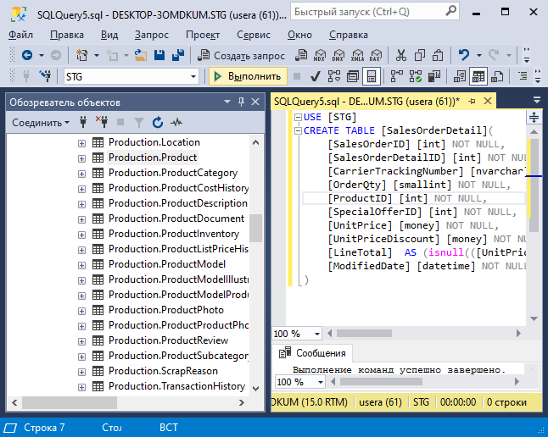
Run Script CREATE. [STG].SalesOrderDetail

Slide 13
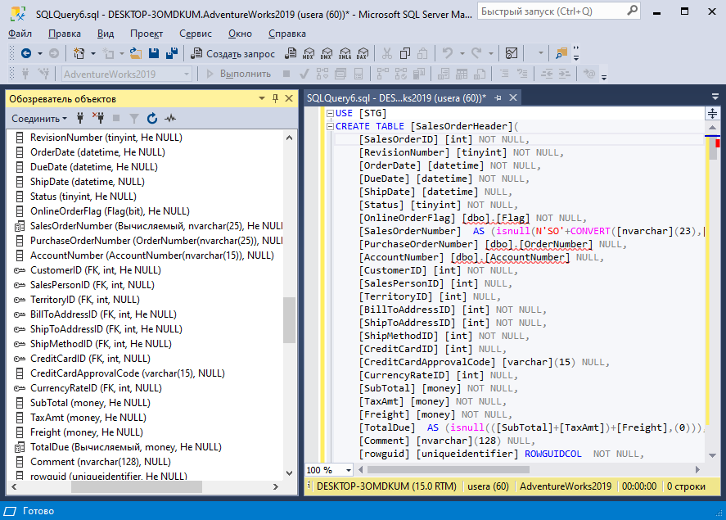
SalesOrderHeader. Script CREATE
Підправити роботу майстра!

Slide 14
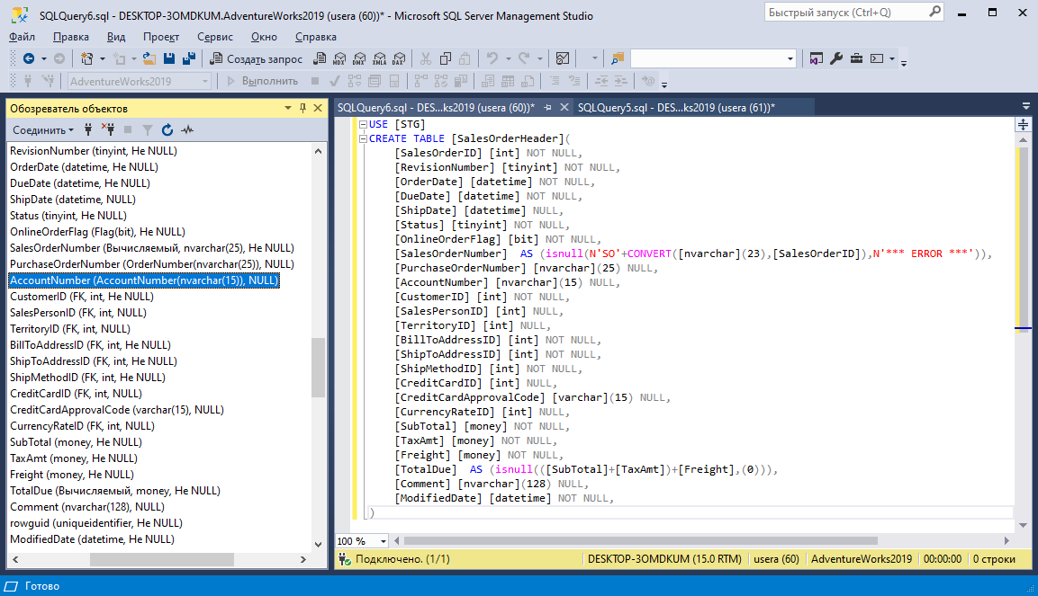
SalesOrderHeader. Script CREATE
Після правки

Slide 15
STG scripts
Для Production. Product
USE [STG]
CREATE TABLE [Product](
[ProductID] [int] NOT NULL,
[Name] [nvarchar](50) NOT NULL,
[ProductNumber] [nvarchar](25) NOT NULL,
[MakeFlag] [bit] NOT NULL,
[FinishedGoodsFlag] [bit] NOT NULL,
[Color] [nvarchar](15) NULL,
[SafetyStockLevel] [smallint] NOT NULL,
[ReorderPoint] [smallint] NOT NULL,
[StandardCost] [money] NOT NULL,
[ListPrice] [money] NOT NULL,
[Size] [nvarchar](5) NULL,
[SizeUnitMeasureCode] [nchar](3) NULL,
[WeightUnitMeasureCode] [nchar](3) NULL,
[Weight] [decimal](8, 2) NULL,
[DaysToManufacture] [int] NOT NULL,
[ProductLine] [nchar](2) NULL,
[Class] [nchar](2) NULL,
[Style] [nchar](2) NULL,
[ProductSubcategoryID] [int] NULL,
[ProductModelID] [int] NULL,
[SellStartDate] [datetime] NOT NULL,
[SellEndDate] [datetime] NULL,
[DiscontinuedDate] [datetime] NULL,
[ModifiedDate] [datetime] NOT NULL
)
USE [STG]
CREATE TABLE [SalesOrderDetail](
[SalesOrderID] [int] NOT NULL,
[SalesOrderDetailID] [int] NOT NULL,
[CarrierTrackingNumber] [nvarchar](25) NULL,
[OrderQty] [smallint] NOT NULL,
[ProductID] [int] NOT NULL,
[SpecialOfferID] [int] NOT NULL,
[UnitPrice] [money] NOT NULL,
[UnitPriceDiscount] [money] NOT NULL,
[LineTotal] AS (isnull(([UnitPrice]*((1.0)-[UnitPriceDiscount]))*[OrderQty],(0.0))),
[ModifiedDate] [datetime] NOT NULL,
)
USE [STG]
CREATE TABLE [SalesOrderHeader](
[SalesOrderID] [int] NOT NULL,
[RevisionNumber] [tinyint] NOT NULL,
[OrderDate] [datetime] NOT NULL,
[DueDate] [datetime] NOT NULL,
[ShipDate] [datetime] NULL,
[Status] [tinyint] NOT NULL,
[OnlineOrderFlag] [bit] NOT NULL,
[SalesOrderNumber] AS (isnull(N'SO'+CONVERT([nvarchar](23),[SalesOrderID]),N'*** ERROR ***')),
[PurchaseOrderNumber] [nvarchar](25) NULL,
[AccountNumber] [nvarchar](15) NULL,
[CustomerID] [int] NOT NULL,
[SalesPersonID] [int] NULL,
[TerritoryID] [int] NULL,
[BillToAddressID] [int] NOT NULL,
[ShipToAddressID] [int] NOT NULL,
[ShipMethodID] [int] NOT NULL,
[CreditCardID] [int] NULL,
[CreditCardApprovalCode] [varchar](15) NULL,
[CurrencyRateID] [int] NULL,
[SubTotal] [money] NOT NULL,
[TaxAmt] [money] NOT NULL,
[Freight] [money] NOT NULL,
[TotalDue] AS (isnull(([SubTotal]+[TaxAmt])+[Freight],(0))),
[Comment] [nvarchar](128) NULL,
[ModifiedDate] [datetime] NOT NULL,
)

Slide 16
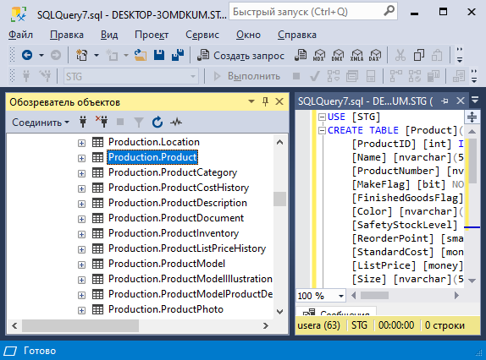
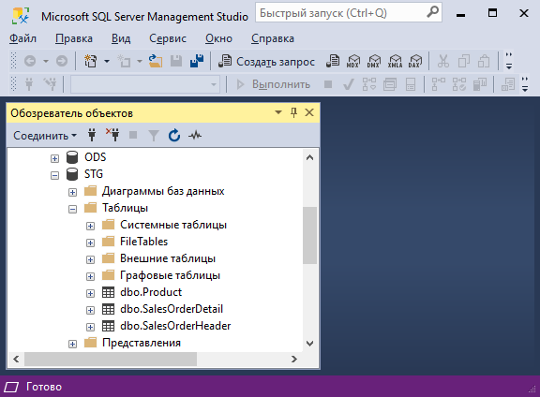
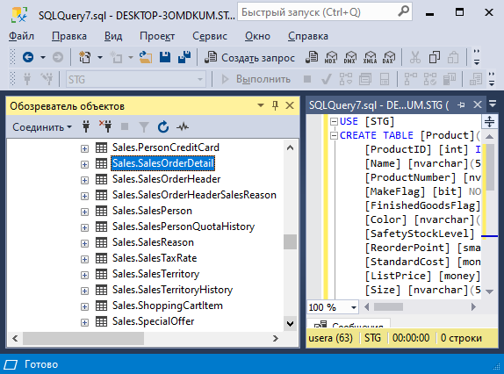
Creating three tables

Slide 17
INSERT INTO [STG].[dbo].[SalesOrderHeader](
[SalesOrderID],
[RevisionNumber],
[OrderDate],
[DueDate],
[ShipDate],
[Status],
[OnlineOrderFlag],
[PurchaseOrderNumber],
[AccountNumber],
[CustomerID],
[SalesPersonID],
[TerritoryID],
[BillToAddressID],
[ShipToAddressID],
[ShipMethodID],
[CreditCardID],
[CreditCardApprovalCode],
[CurrencyRateID],
[SubTotal],
[TaxAmt],
[Freight],
[Comment],
[ModifiedDate]
)
SELECT [SalesOrderID],
[RevisionNumber],
[OrderDate],
[DueDate],
[ShipDate],
[Status],
[OnlineOrderFlag],
[PurchaseOrderNumber],
[AccountNumber],
[CustomerID],
[SalesPersonID],
[TerritoryID],
[BillToAddressID],
[ShipToAddressID],
[ShipMethodID],
[CreditCardID],
[CreditCardApprovalCode],
[CurrencyRateID],
[SubTotal],
[TaxAmt],
[Freight],
[Comment],
[ModifiedDate] FROM [AdventureWorks2019].[Sales].[SalesOrderHeader]
WHERE ModifiedDate =
(SELECT max(ModifiedDate) FROM [AdventureWorks2019].[Sales].[SalesOrderHeader])
STG. Перенесення даних з трьох таблиць
INSERT INTO [STG].[dbo].[Product](
[ProductID],
[Name],
[ProductNumber],
[MakeFlag],
[FinishedGoodsFlag],
[Color],
[SafetyStockLevel],
[ReorderPoint],
[StandardCost],
[ListPrice],
[Size],
[SizeUnitMeasureCode],
[WeightUnitMeasureCode] ,
[Weight],
[DaysToManufacture],
[ProductLine],
[Class],
[Style],
[ProductSubcategoryID],
[ProductModelID],
[SellStartDate],
[SellEndDate],
[DiscontinuedDate],
[ModifiedDate]
)
SELECT [ProductID],
[Name],
[ProductNumber],
[MakeFlag],
[FinishedGoodsFlag],
[Color],
[SafetyStockLevel],
[ReorderPoint],
[StandardCost],
[ListPrice],
[Size],
[SizeUnitMeasureCode],
[WeightUnitMeasureCode] ,
[Weight],
[DaysToManufacture],
[ProductLine],
[Class],
[Style],
[ProductSubcategoryID],
[ProductModelID],
[SellStartDate],
[SellEndDate],
[DiscontinuedDate],
[ModifiedDate] FROM [AdventureWorks2019].[Production].[Product]
WHERE ModifiedDate =
(SELECT max(ModifiedDate) FROM [AdventureWorks2019].[Production].[Product])
INSERT INTO [STG].[dbo].[SalesOrderDetail](
[SalesOrderID],
[SalesOrderDetailID],
[CarrierTrackingNumber],
[OrderQty],
[ProductID],
[SpecialOfferID],
[UnitPrice],
[UnitPriceDiscount],
[ModifiedDate]
)
SELECT [SalesOrderID],
[SalesOrderDetailID],
[CarrierTrackingNumber],
[OrderQty],
[ProductID],
[SpecialOfferID],
[UnitPrice],
[UnitPriceDiscount],
[ModifiedDate] FROM [AdventureWorks2019].[Sales].[SalesOrderDetail]
WHERE ModifiedDate = (SELECT max(ModifiedDate) FROM [AdventureWorks2019].[Sales].[SalesOrderDetail])
...
[UnitPriceDiscount],
[ModifiedDate]
FROM [AdventureWorks2019].[Sales].[SalesOrderDetail]
WHERE ModifiedDate = GetDate()-1
3
Варіант для регулярного щоденного додавання
1
2

Slide 18
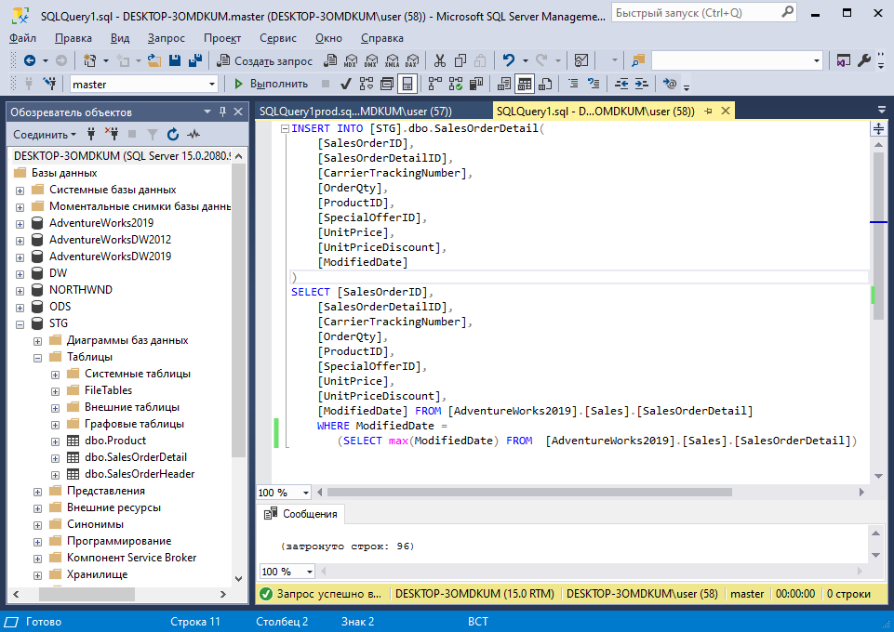
Перенесення даних (SalesOrderDetail)

Slide 19
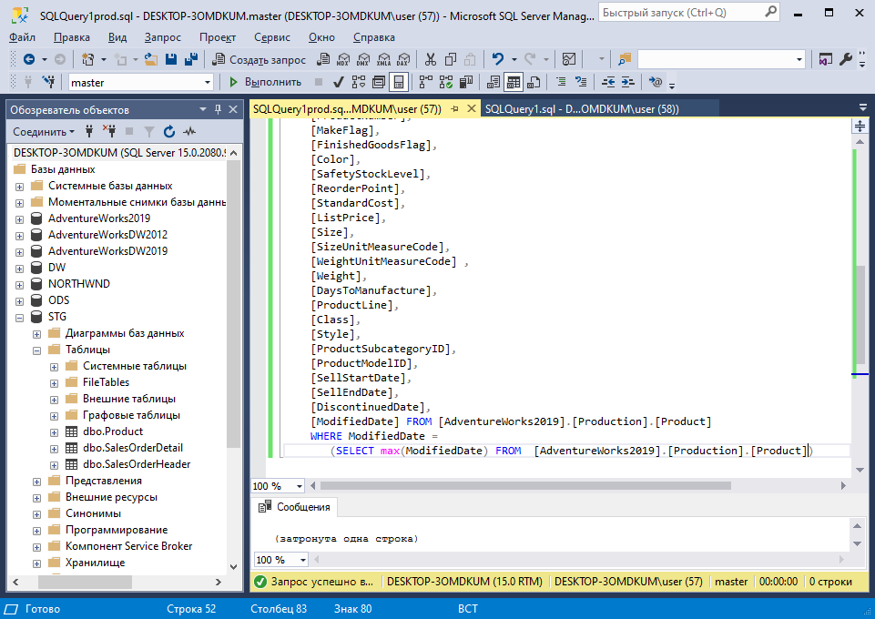
Перенесення даних (Product)

Slide 20
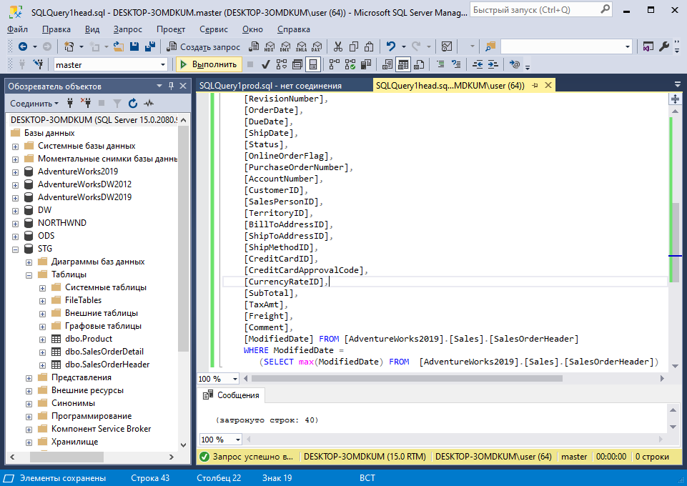
Перенесення даних (SalesOrderHeader)

Slide 21
Агент SQL Server. Завдання та розклад їх виконання

Slide 22
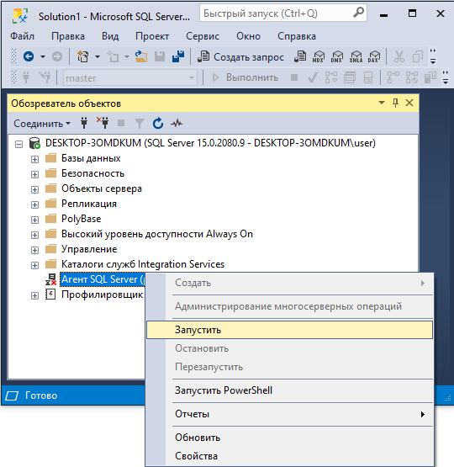
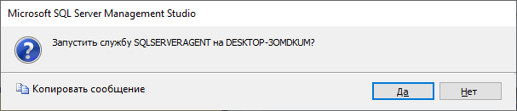
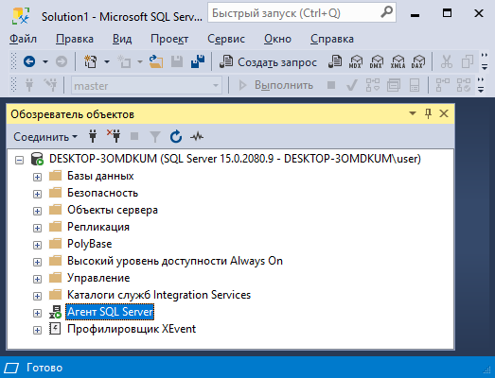
Агент SQL Server
ПКМ

Slide 23
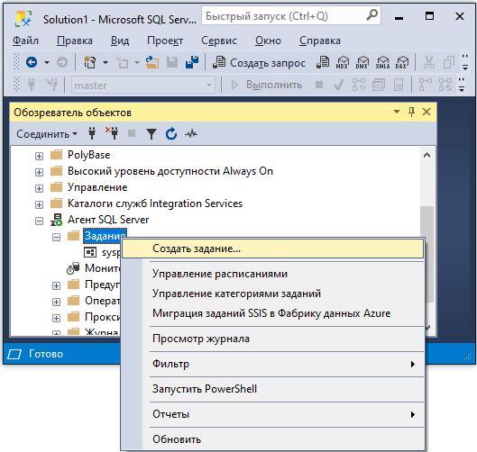
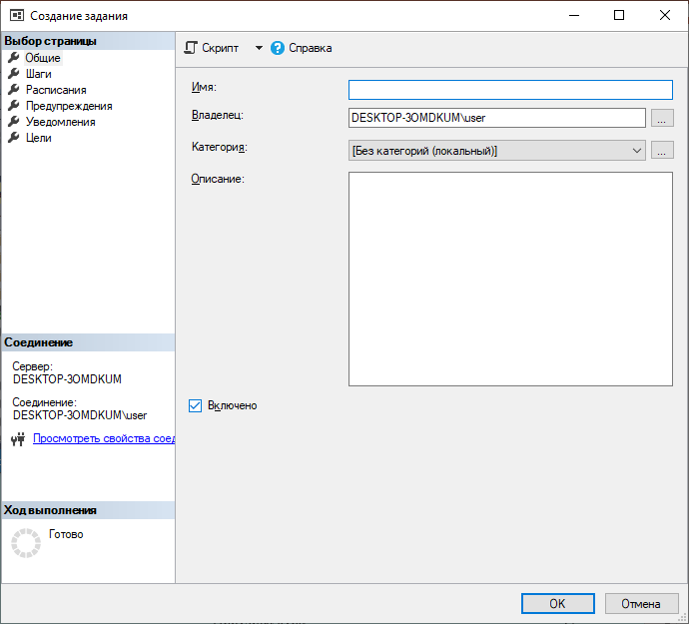
JOB
ПКМ

Slide 24

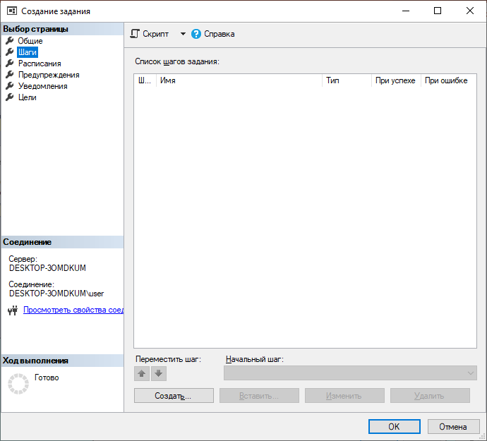
Job. Steps. Create step
ПКМ

Slide 25
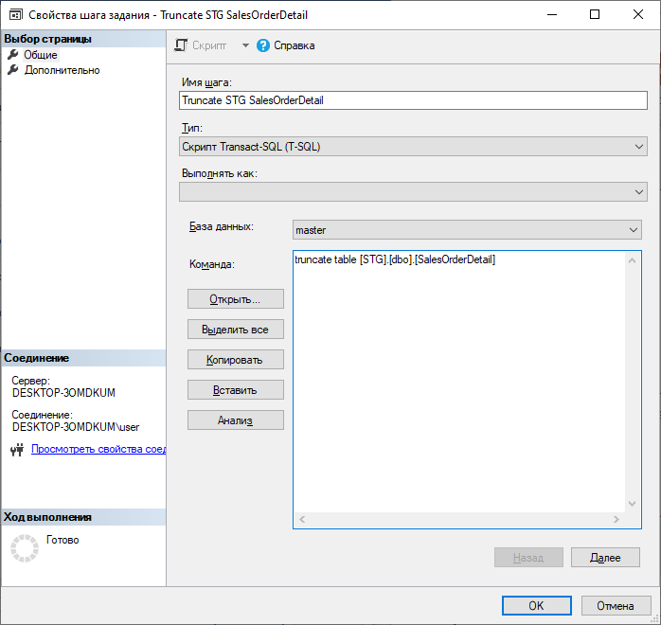
STG. New step (1): Truncate… SalesOrderDetail

Slide 26
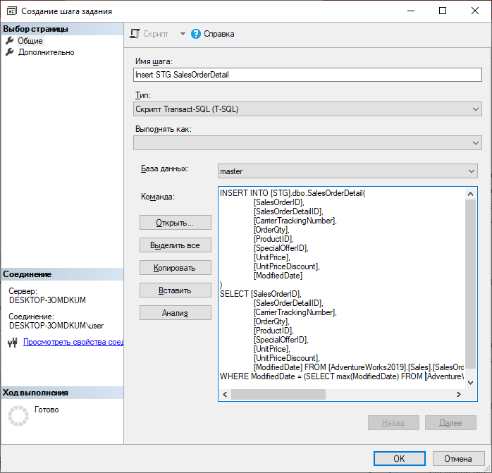
STG. New step (2): Insert… SalesOrderDetail

Slide 27
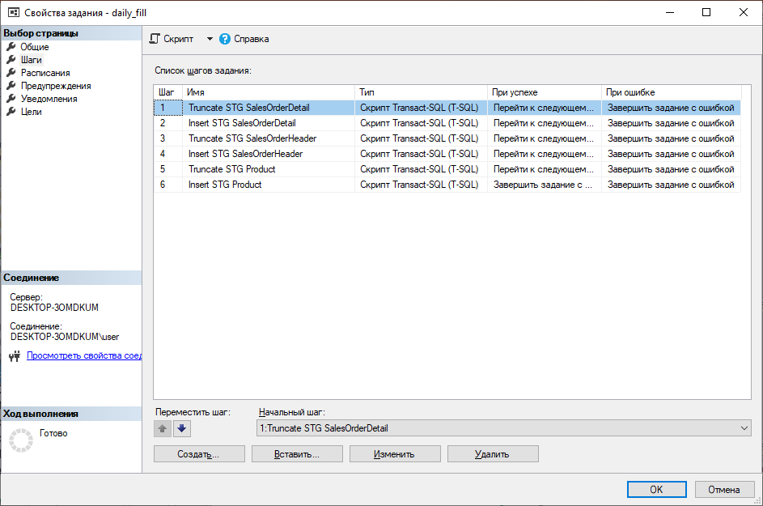
Job. STG Steps

Slide 28
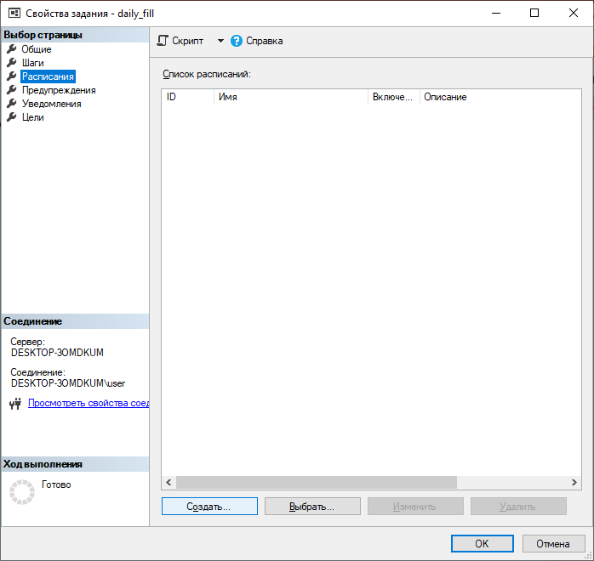
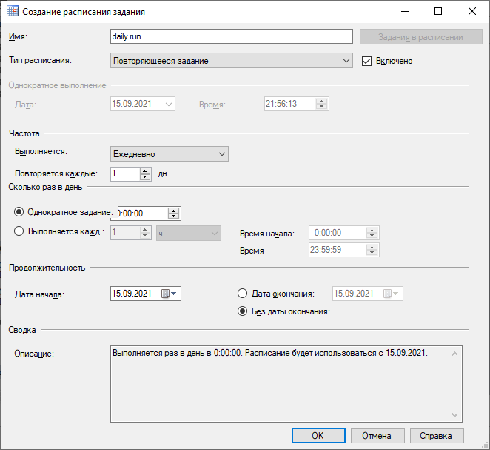
Schedule

Slide 29
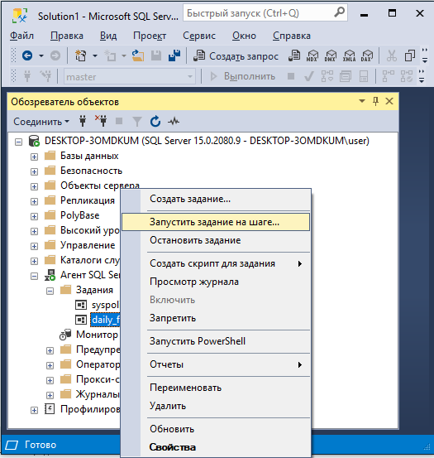
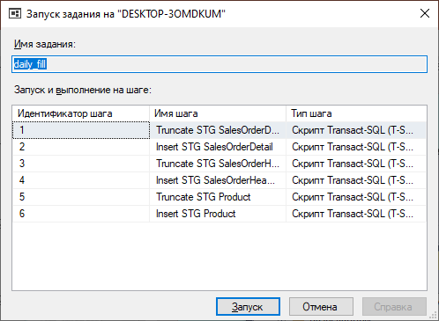
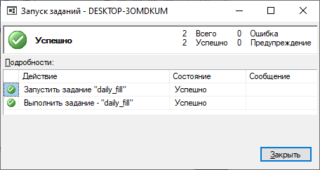
Job (Test)
ПКМ

Slide 30
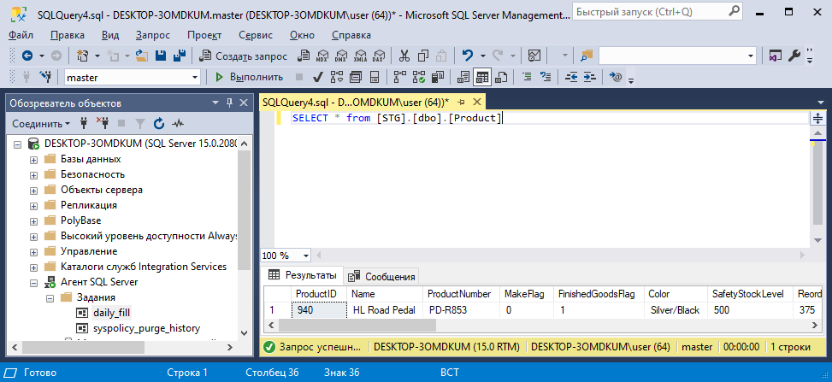
Datas… Чи ж вони є?

Slide 31
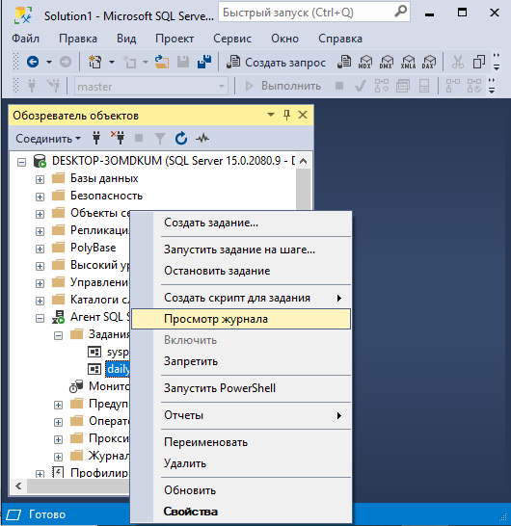
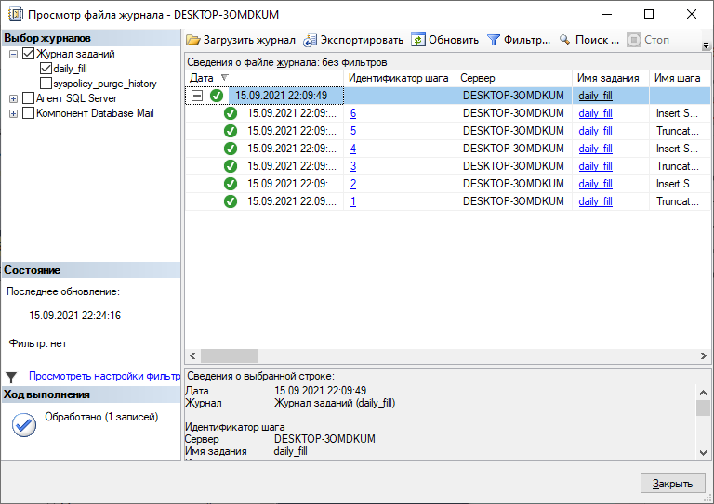
Log
ПКМ

Slide 32
Таблиці бази ODS

Slide 33
CREATE TABLE [ODS].[dbo].[DimProduct](
[ProductID] [int] NOT NULL,
[Name] [nvarchar](50) NOT NULL,
[ProductNumber] [nvarchar](25) NOT NULL,
[ModifiedDate] [datetime] NOT NULL)
INSERT INTO [ODS].[dbo].[DimProduct](
[ProductID], [Name],[ ProductNumber],
[ModifiedDate])
SELECT ProductID, Name, ProductNumber,
ModifiedDate
FROM [STG].[dbo].[Product]
ODS (Create + Insert)
CREATE TABLE [ODS].[dbo].[DimOrder](
[SalesOrderID] [int] NOT NULL,
[SalesOrderNumber] [nvarchar](25) NOT NULL,
[AccountNumber] [nvarchar](15) NULL,
[CreditCardID] [int] NULL,
[OrderDate] [datetime] NOT NULL,
[ModifiedDate] [datetime] NOT NULL)
INSERT INTO [ODS].[dbo].[DimOrder](
[SalesOrderID],
[SalesOrderNumber],
[AccountNumber],
[CreditCardID],
[OrderDate],
[ModifiedDate]
)
SELECT SalesOrderID,
SalesOrderNumber,
AccountNumber,
CreditCardID,
OrderDate,
ModifiedDate
FROM [STG].[dbo].[SalesOrderHeader]
CREATE TABLE [ODS].[dbo].[FactSales](
[ProductID] [int] NOT NULL,
[SalesOrderID] [int] NOT NULL,
[OrderQty] [smallint] NOT NULL,
[UnitPrice] [money] NOT NULL,
[ModifiedDate] [datetime] NOT NULL)
INSERT INTO [ODS].[dbo].[FactSales](
[ProductID], [SalesOrderID], [OrderQty],
[UnitPrice], [ModifiedDate])
SELECT ProductID, SalesOrderID, OrderQty,
UnitPrice, ModifiedDate
FROM [STG].[dbo].[SalesOrderDetail]

Slide 34
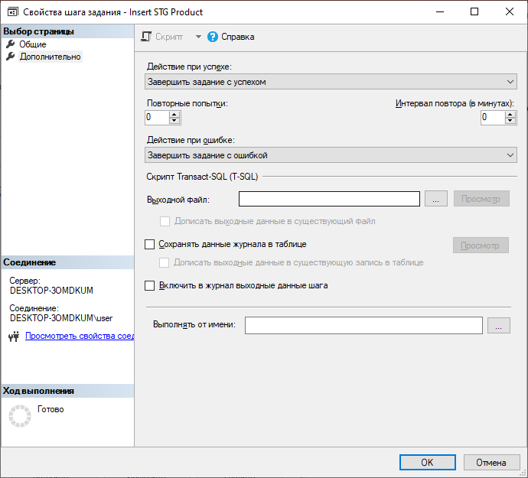
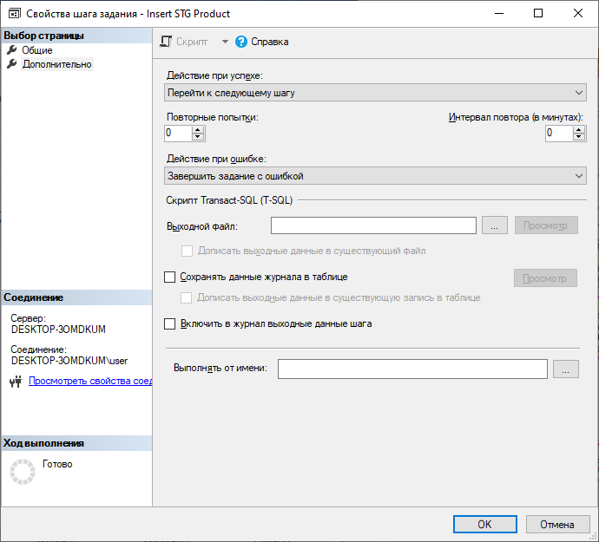
Job … next steps
Для продовження подальших кроків

Slide 35
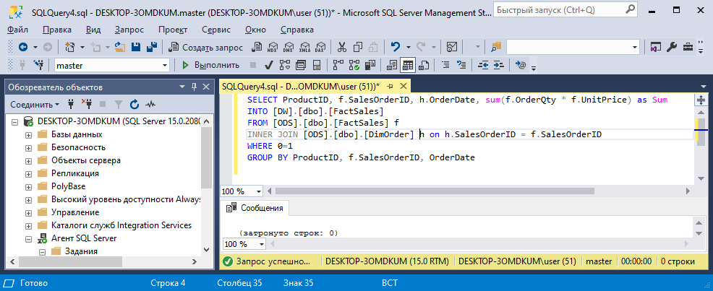
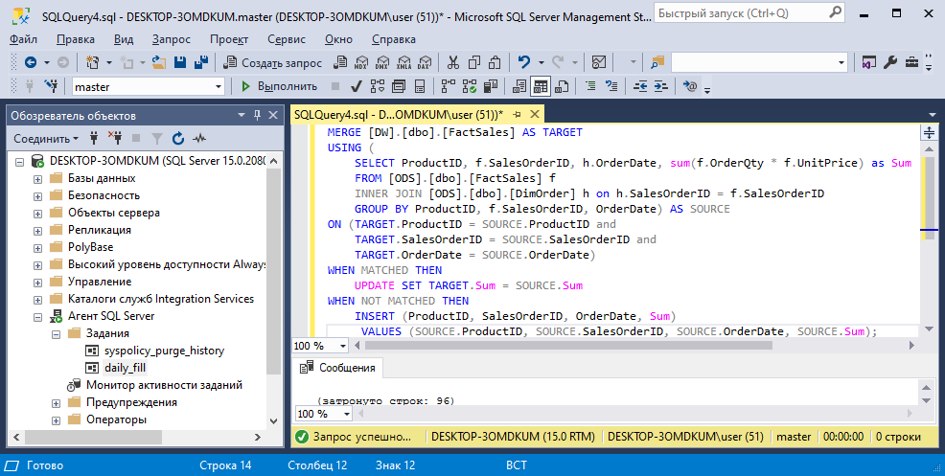
DW: Create (SELECT), MERGE

Slide 36
DW. CREATE FactSales
SELECT ProductID, f.SalesOrderID, h.OrderDate, sum(f.OrderQty * f.UnitPrice) as Sum
INTO [DW].[dbo].[FactSales]
FROM [ODS].[dbo].[FactSales] f
INNER JOIN [ODS].[dbo].[DimOrder] h on h.SalesOrderID = f.SalesOrderID
WHERE 0=1
GROUP BY ProductID, f.SalesOrderID, OrderDate

Slide 37
DW. MERGE FactSales
MERGE [DW].[dbo].[FactSales] AS TARGET
USING (
SELECT ProductID, f.SalesOrderID, h.OrderDate, sum(f.OrderQty * f.UnitPrice) as Sum
FROM [ODS].[dbo].[FactSales] f
INNER JOIN [ODS].[dbo].[DimOrder] h on h.SalesOrderID = f.SalesOrderID
GROUP BY ProductID, f.SalesOrderID, OrderDate) AS SOURCE
ON (TARGET.ProductID = SOURCE.ProductID and
TARGET.SalesOrderID = SOURCE.SalesOrderID and
TARGET.OrderDate = SOURCE.OrderDate)
WHEN MATCHED THEN
UPDATE SET TARGET.Sum = SOURCE.Sum
WHEN NOT MATCHED THEN
INSERT (ProductID, SalesOrderID, OrderDate, Sum)
VALUES (SOURCE.ProductID, SOURCE.SalesOrderID, SOURCE.OrderDate, SOURCE.Sum);

Slide 38
DW. FactSales. CREATE, MERGE
SELECT ProductID, f.SalesOrderID, h.OrderDate, sum(f.OrderQty * f.UnitPrice) as Sum
INTO [DW].[dbo].[FactSales]
FROM [ODS].[dbo].[FactSales] f
INNER JOIN [ODS].[dbo].[DimOrder] h on h.SalesOrderID = f.SalesOrderID
WHERE 0=1
GROUP BY ProductID, f.SalesOrderID, OrderDate
MERGE [DW].[dbo].[FactSales] AS TARGET
USING (
SELECT ProductID, f.SalesOrderID, h.OrderDate, sum(f.OrderQty * f.UnitPrice) as Sum
FROM [ODS].[dbo].[FactSales] f
INNER JOIN [ODS].[dbo].[DimOrder] h on h.SalesOrderID = f.SalesOrderID
GROUP BY ProductID, f.SalesOrderID, OrderDate) AS SOURCE
ON (TARGET.ProductID = SOURCE.ProductID and
TARGET.SalesOrderID = SOURCE.SalesOrderID and
TARGET.OrderDate = SOURCE.OrderDate)
WHEN MATCHED THEN
UPDATE SET TARGET.Sum = SOURCE.Sum
WHEN NOT MATCHED THEN
INSERT (ProductID, SalesOrderID, OrderDate, Sum)
VALUES (SOURCE.ProductID, SOURCE.SalesOrderID, SOURCE.OrderDate, SOURCE.Sum);
SOURCE.CreditCardID);

Slide 39
DW. DimOrder. CREATE, MERGE
SELECT SalesOrderID, SalesOrderNumber, AccountNumber, CreditCardID
INTO [DW].[dbo].[DimOrder]
FROM [ODS].[dbo].[DimOrder]
WHERE 0=1
MERGE [DW].[dbo].[DimOrder] AS TARGET
USING (
SELECT SalesOrderID, SalesOrderNumber, AccountNumber, CreditCardID
FROM [ODS].[dbo].[DimOrder]) AS SOURCE
ON (TARGET.SalesOrderID = SOURCE. SalesOrderID)
WHEN MATCHED THEN
UPDATE SET TARGET.SalesOrderNumber = SOURCE.SalesOrderNumber,
TARGET.AccountNumber = SOURCE.AccountNumber,
TARGET.CreditCardID = SOURCE.CreditCardID
WHEN NOT MATCHED THEN
INSERT (SalesOrderID, SalesOrderNumber, AccountNumber, CreditCardID)
VALUES (SOURCE.SalesOrderID, SOURCE.SalesOrderNumber, SOURCE.AccountNumber,
SOURCE.CreditCardID);

Slide 40
DW. DimProduct. CREATE, MERGE
SELECT ProductID, Name, ProductNumber
INTO [DW].[dbo].[DimProduct]
FROM [ODS].[dbo].[DimProduct]
WHERE 0=1
MERGE [DW].[dbo].[DimProduct] AS TARGET
USING (
SELECT ProductID, Name, ProductNumber
FROM [ODS].[dbo].[DimProduct]
) AS SOURCE
ON (TARGET.ProductID = SOURCE.ProductID)
WHEN MATCHED THEN
UPDATE SET TARGET.Name = SOURCE.Name,
TARGET.ProductNumber = SOURCE.ProductNumber
WHEN NOT MATCHED THEN
INSERT (ProductID, Name, ProductNumber)
VALUES (SOURCE.ProductID, SOURCE.Name, SOURCE.ProductNumber);

Slide 41
DW. DimDate. CREATE, MERGE
SELECT distinct OrderDate,
YEAR(OrderDate) as Year,
MONTH(OrderDate) as Month,
DATENAME(month, OrderDate) as MonthName,
Day(OrderDate) as Day
INTO [DW].[dbo].[DimDate]
FROM [ODS].[dbo].[DimOrder]
WHERE 0=1
Створення часового виміру DimDate!
MERGE [DW].[dbo].[DimDate] AS TARGET
USING (
SELECT distinct OrderDate,
YEAR(OrderDate) as Year,
MONTH(OrderDate) as Month,
DATENAME(month, OrderDate) as MonthName,
Day(OrderDate) as Day
FROM [ODS].[dbo].[DimOrder]
) AS SOURCE
ON (TARGET.OrderDate = SOURCE.OrderDate)
WHEN MATCHED THEN
UPDATE SET TARGET.Year = SOURCE.Year,
TARGET.Month = SOURCE.Month,
TARGET.MonthName = SOURCE.MonthName,
TARGET.Day = SOURCE.Day
WHEN NOT MATCHED THEN
INSERT (OrderDate, Year, Month, MonthName, Day)
VALUES (SOURCE.OrderDate, SOURCE.Year, SOURCE.Month, SOURCE.MonthName, SOURCE.Day);

Slide 42
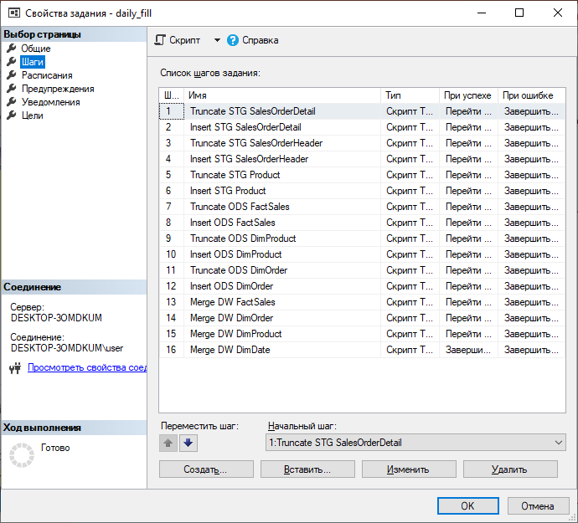
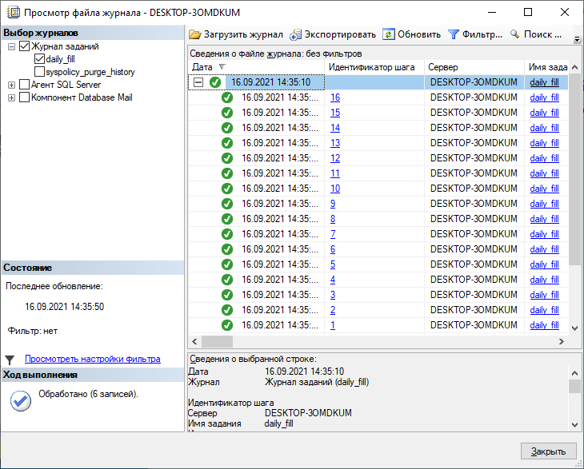
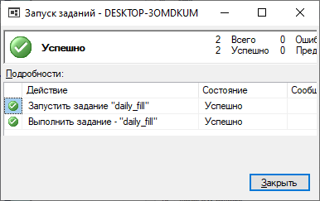
Job. All steps

Slide 43
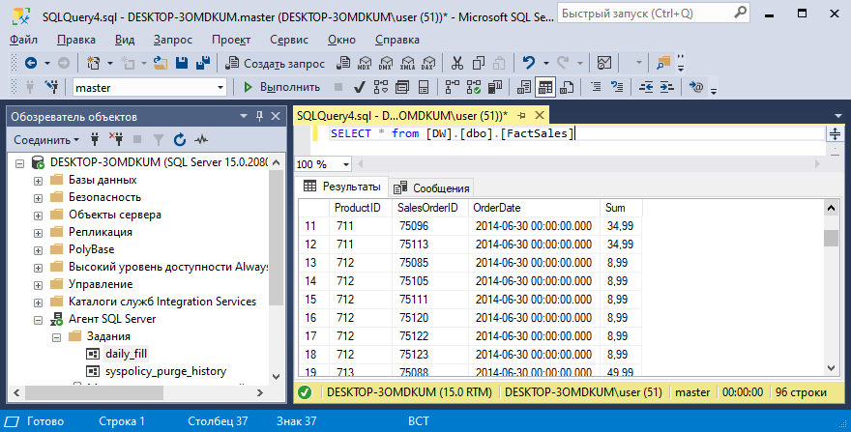
Datas… Чи ж вони є?

Slide 44
До ініціалізації таблиць вимірів

Slide 45
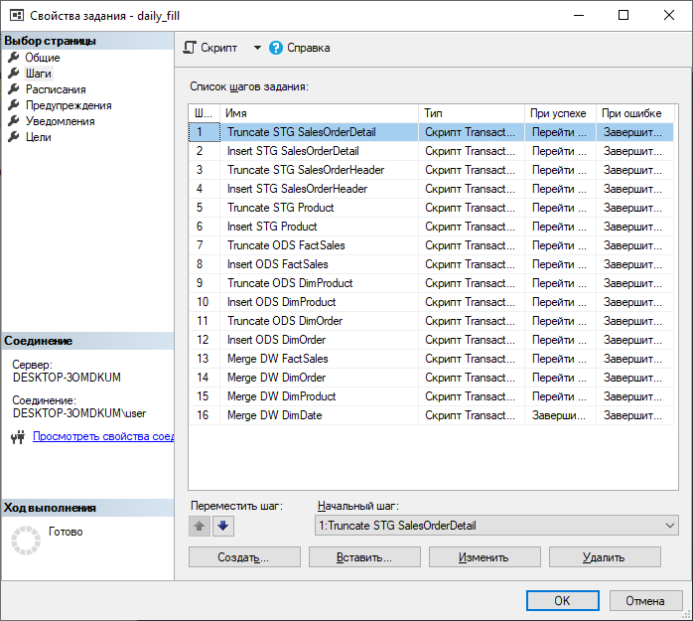
До ініціалізації таблиць вимірів. DW.DimProduct)
INSERT INTO [STG].[dbo].[Product](
[ProductID],
[Name],
[ProductNumber],
[MakeFlag],
[FinishedGoodsFlag],
[Color],
[SafetyStockLevel],
[ReorderPoint],
[StandardCost],
[ListPrice],
[Size],
[SizeUnitMeasureCode],
[WeightUnitMeasureCode] ,
[Weight],
[DaysToManufacture],
[ProductLine],
[Class],
[Style],
[ProductSubcategoryID],
[ProductModelID],
[SellStartDate],
[SellEndDate],
[DiscontinuedDate],
[ModifiedDate]
)
SELECT [ProductID],
[Name],
[ProductNumber],
[MakeFlag],
[FinishedGoodsFlag],
[Color],
[SafetyStockLevel],
[ReorderPoint],
[StandardCost],
[ListPrice],
[Size],
[SizeUnitMeasureCode],
[WeightUnitMeasureCode] ,
[Weight],
[DaysToManufacture],
[ProductLine],
[Class],
[Style],
[ProductSubcategoryID],
[ProductModelID],
[SellStartDate],
[SellEndDate],
[DiscontinuedDate],
[ModifiedDate] FROM [AdventureWorks2019].[Production].[Product]
WHERE ModifiedDate =
(SELECT max(ModifiedDate) FROM [AdventureWorks2019].[Production].[Product])
STG.
Перенесення даних з таблиць
Step 6
..
[ModifiedDate] FROM [AdventureWorks2019].[Production].[Product]
WHERE ModifiedDate =
(SELECT max(ModifiedDate) FROM [AdventureWorks2019].[Production].[Product])

Slide 46
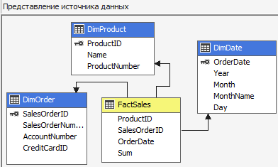

DW. До таблиць додано зв'язки!
Cube

Slide 47


DW. До таблиць додано зв'язки!
Приклади

Slide 48

Приємний сюрприз від майстра кубів
? !!!
2
1
Обрана черговість кроків

Slide 49


Cube

