Slide 1
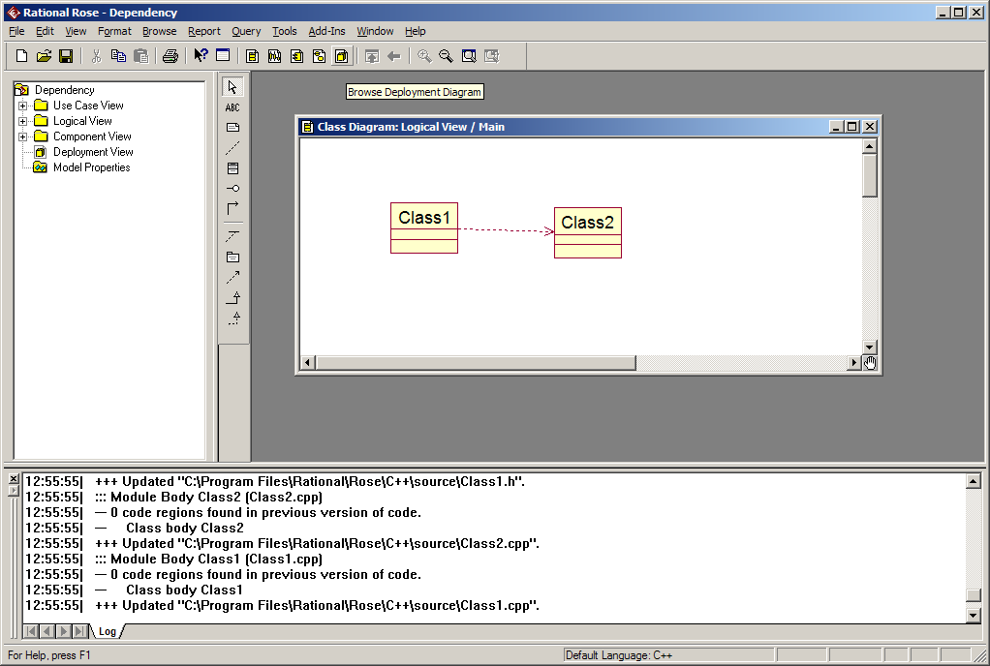
Dependency

Slide 2
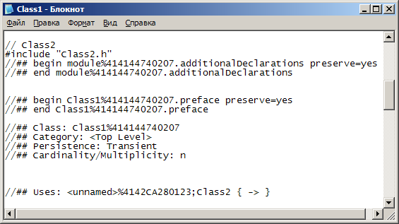
Dependency

Slide 3
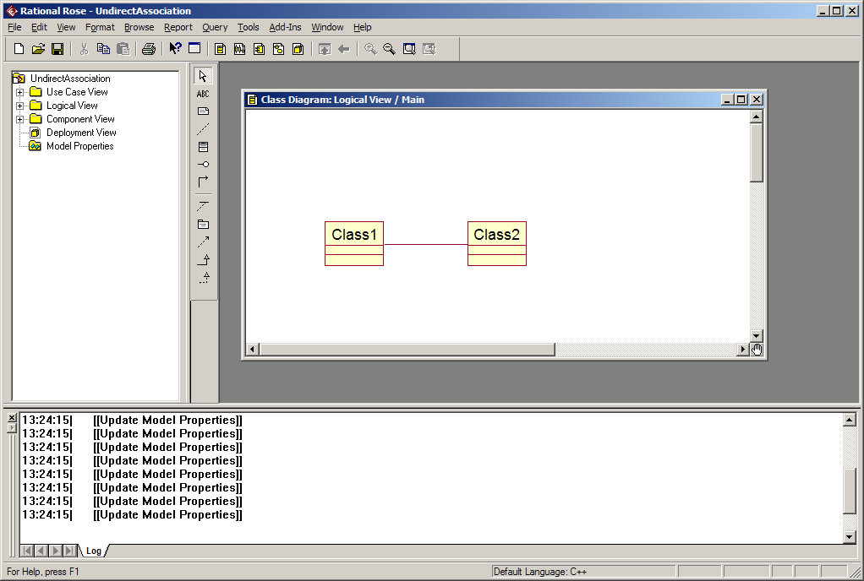
UndirectAssociation

Slide 4
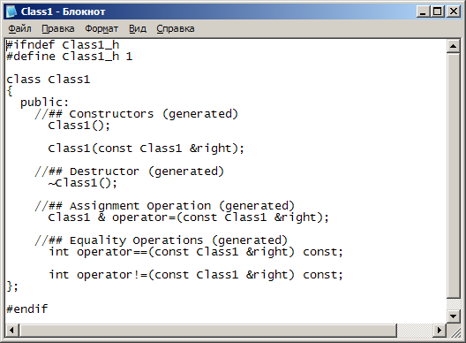
UndirectAssociation
Class1.h

Slide 5
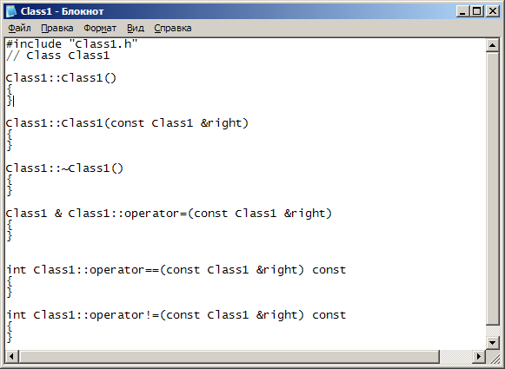
UndirectAssociation
Class1.cpp

Slide 6
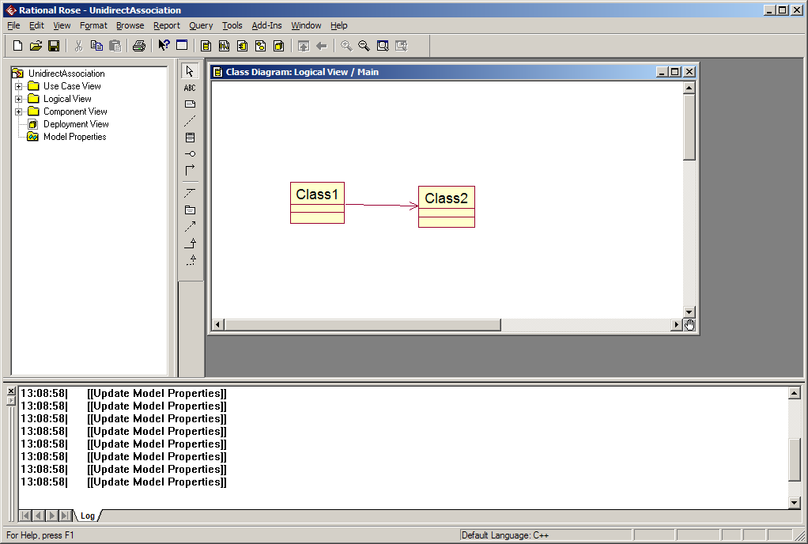
UnidirectAssociation

Slide 7
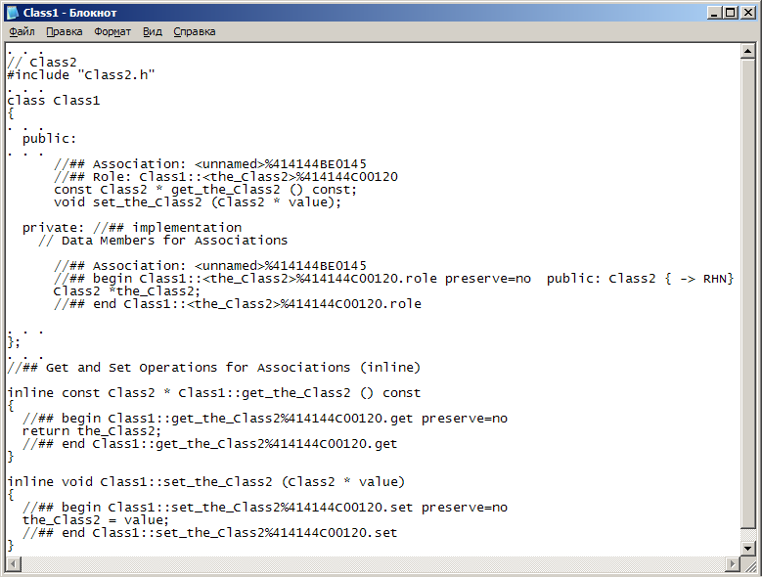
UnidirectAssociation
Class1.h

Slide 8
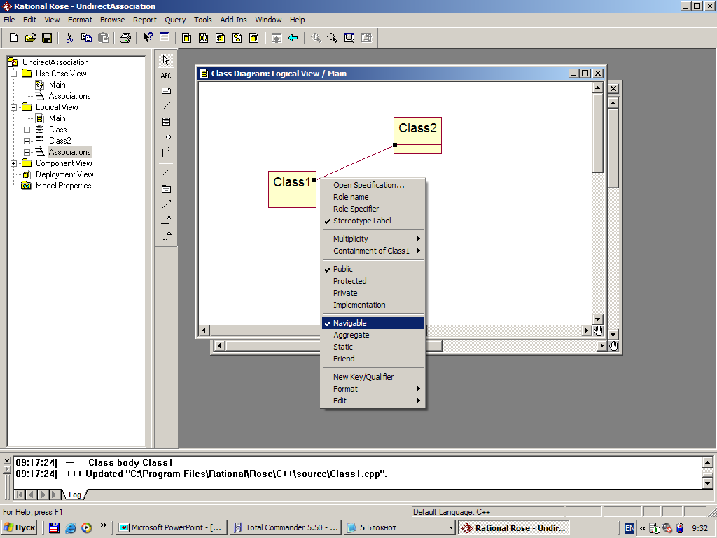
BothDirectAssociation

Slide 9
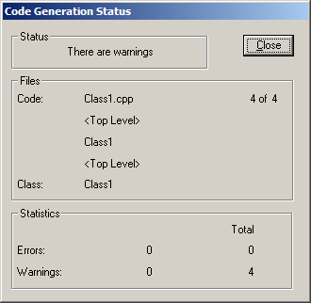
BothDirectAssociation

Slide 10
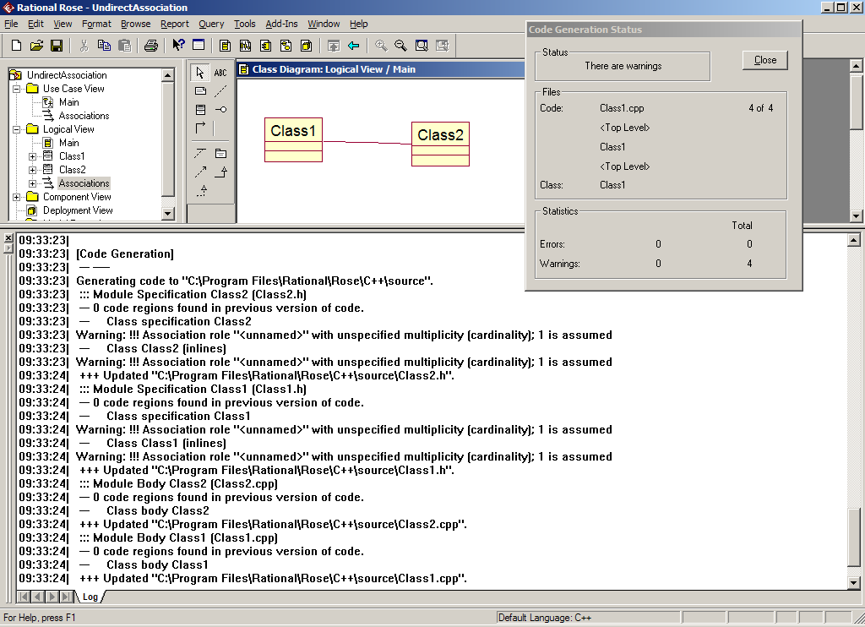
BothDirectAssociation

Slide 11
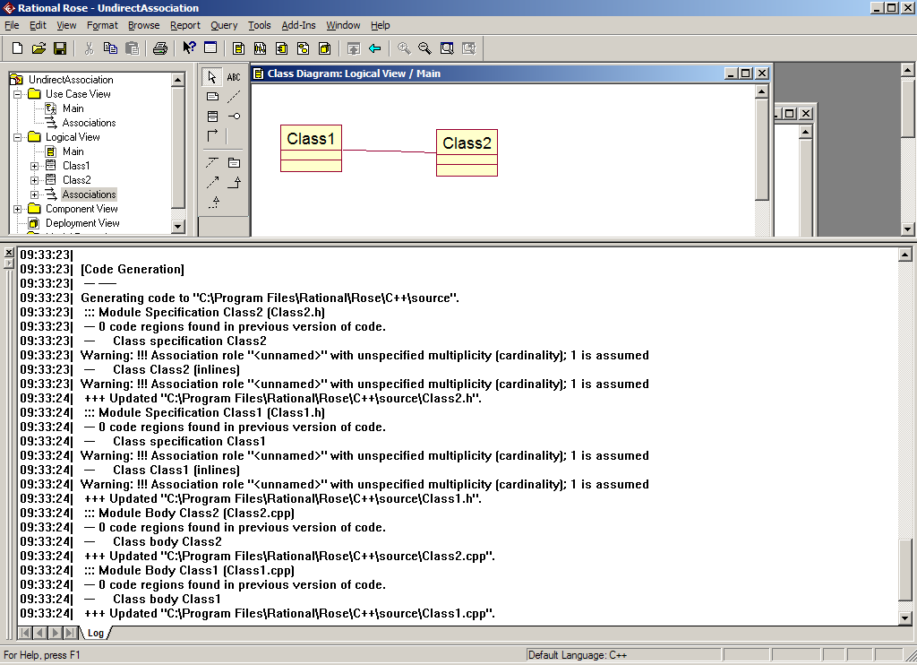
BothDirectAssociation

Slide 12
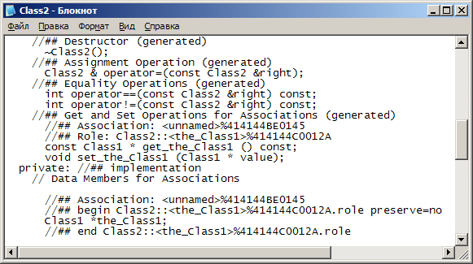
BothDirectAssociation
Class2.h

Slide 13
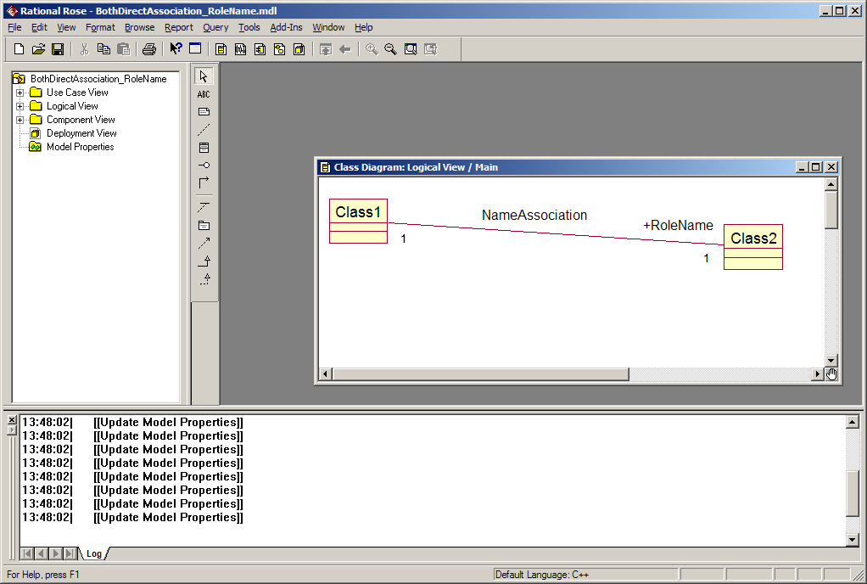
BothDirectAssociation_RoleName

Slide 14
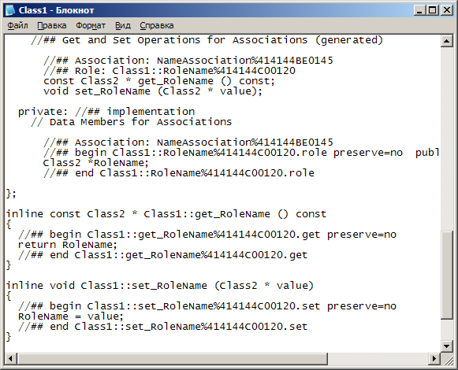
BothDirectAssociation_RoleName
Class1.h

Slide 15
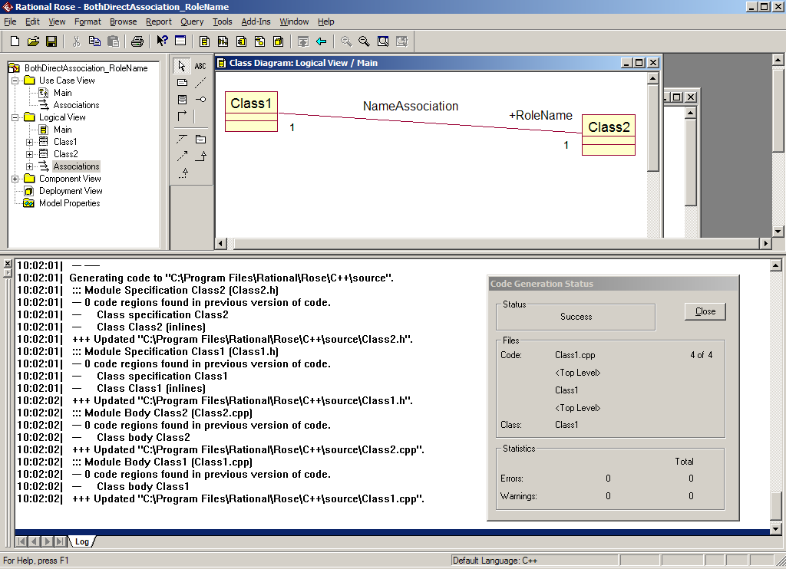
BothDirectAssociation_RoleName

Slide 16
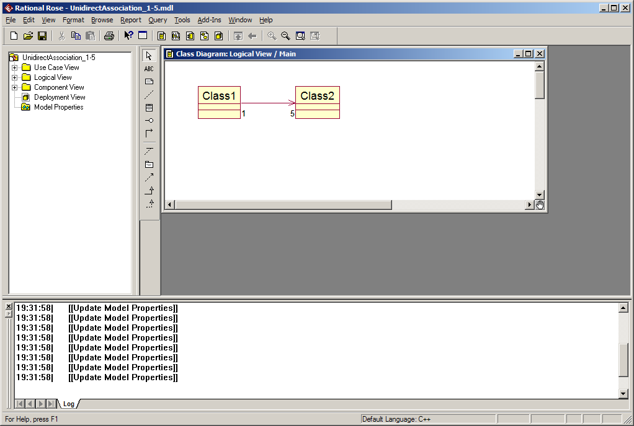
UnidirectAssociation_1-5

Slide 17
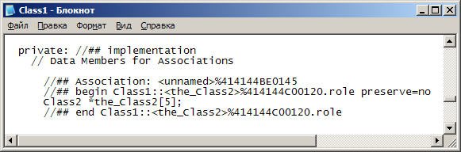
UnidirectAssociation_(1, 5)

Slide 18
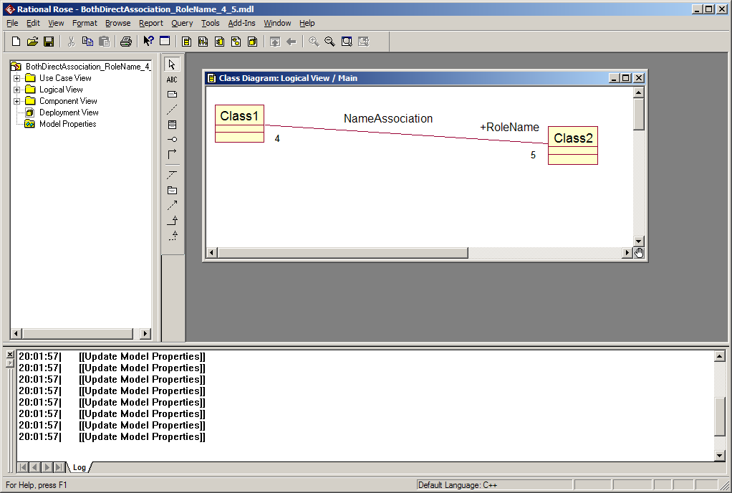
BothDirectAssociation_RoleName_(4, 5)

Slide 19
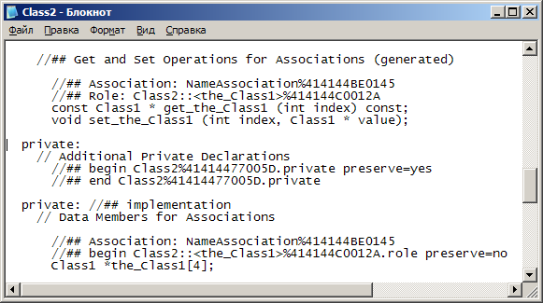
BothDirectAssociation_RoleName_(4, 5)

Slide 20
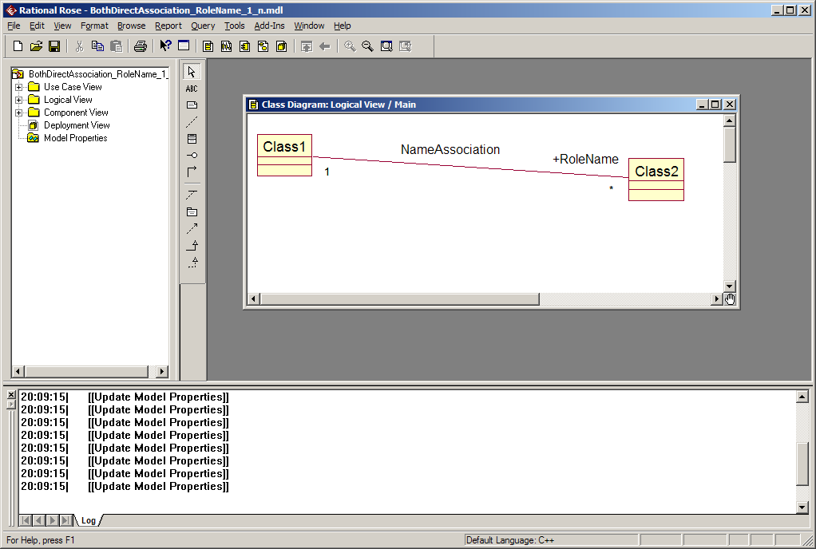
BothDirectAssociation_RoleName_(1, n)

Slide 21
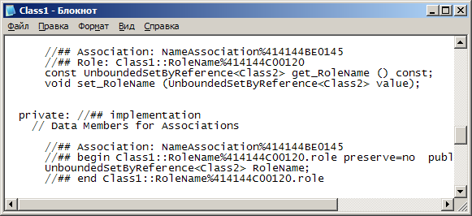
BothDirectAssociation_RoleName_(1, n)

Slide 22
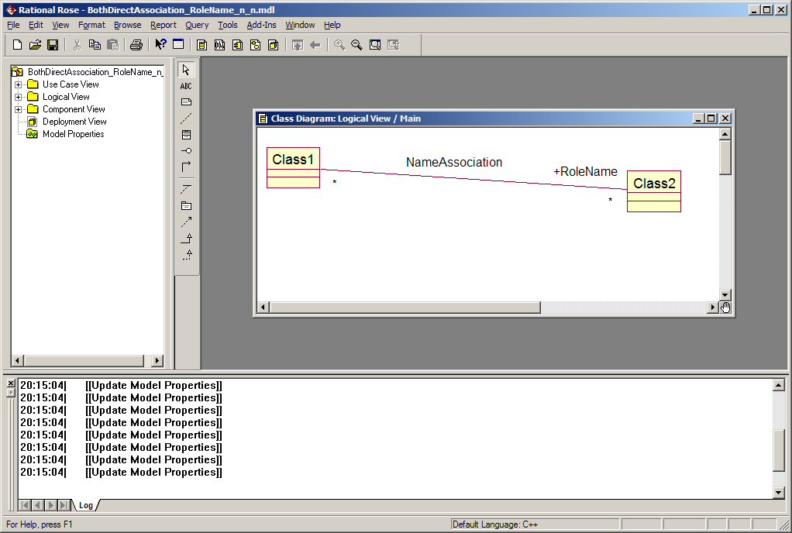
BothDirectAssociation_RoleName_(n, n)

Slide 23
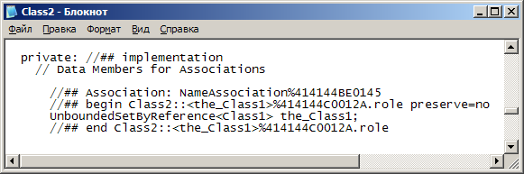
BothDirectAssociation_RoleName_(n, n)

Slide 24
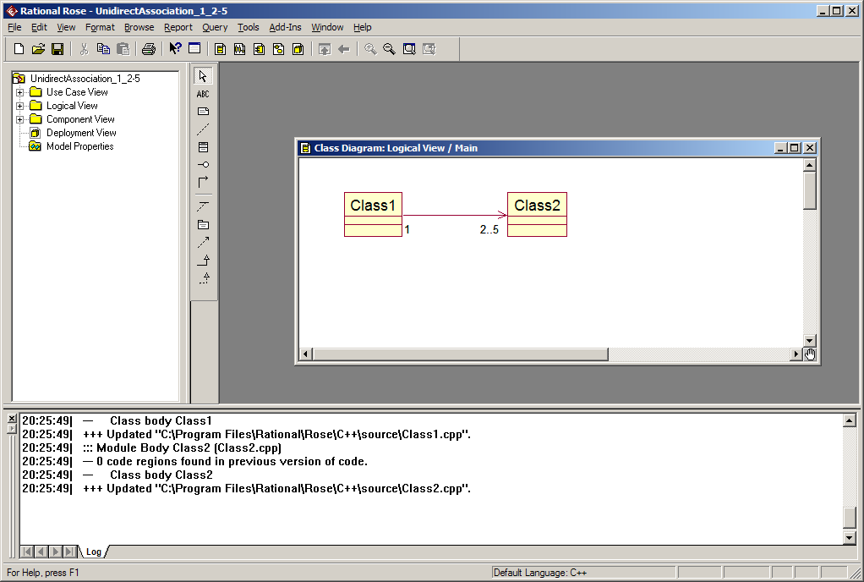
UnidirectAssociation_(1, 2..5)

Slide 25
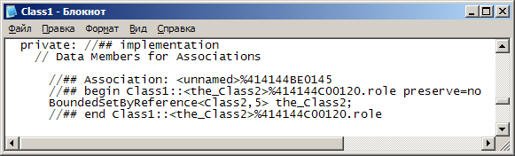
UnidirectAssociation_(1, 2..5)

Slide 26
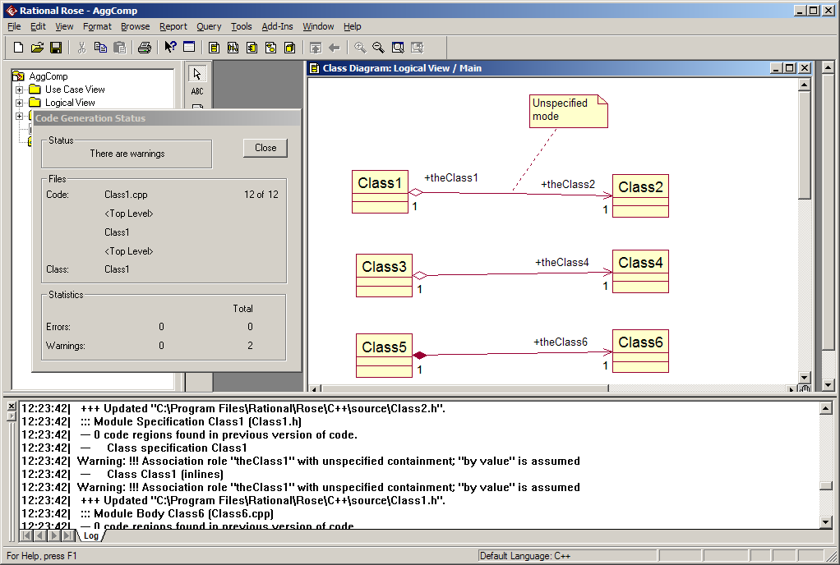
Aggregation, composition

Slide 27
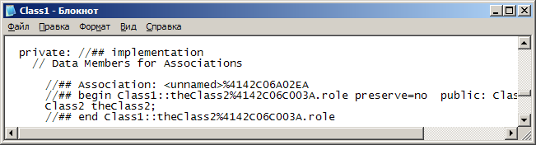
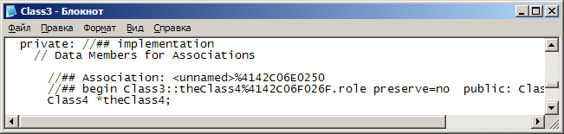

Aggregation, composition

Slide 28
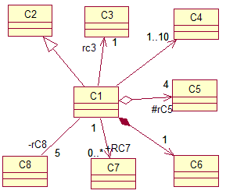
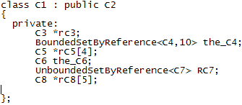
Результат генерації коду (C++)

