Slide 1
Веб-служби (Java) java2blog.com/2013/03/jaxws-web-service-eclipse-tutorial.html
2012
Notes:
2011-05-04 Add 41
59(58) --> 42

Slide 2
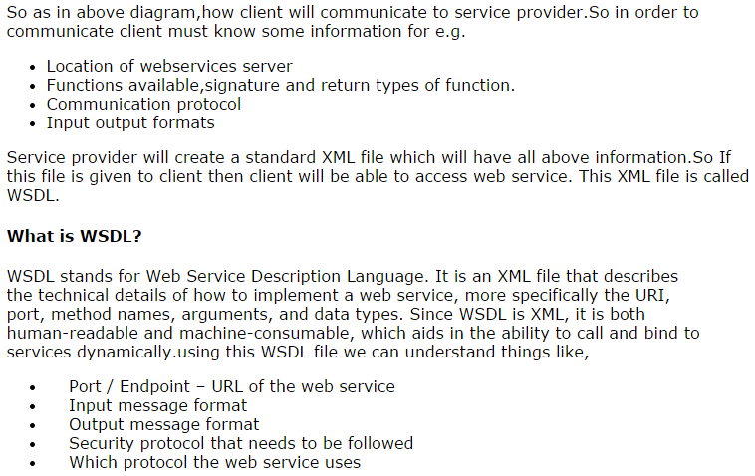

Slide 3
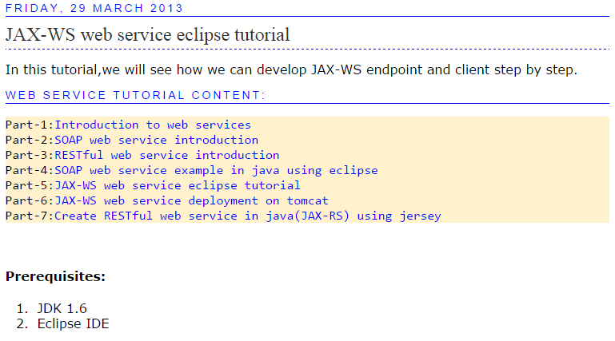

Slide 4
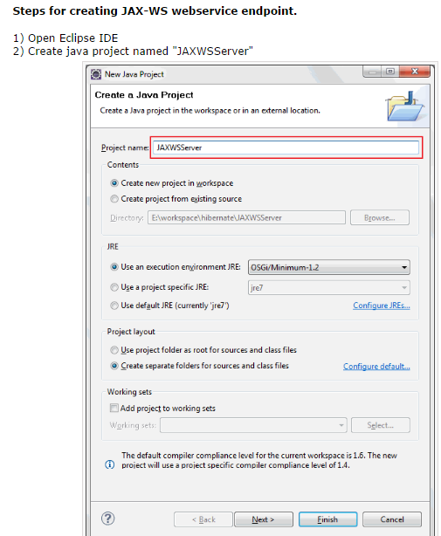

Slide 5
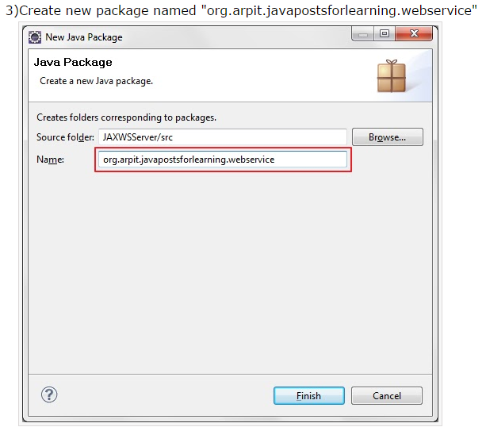

Slide 6
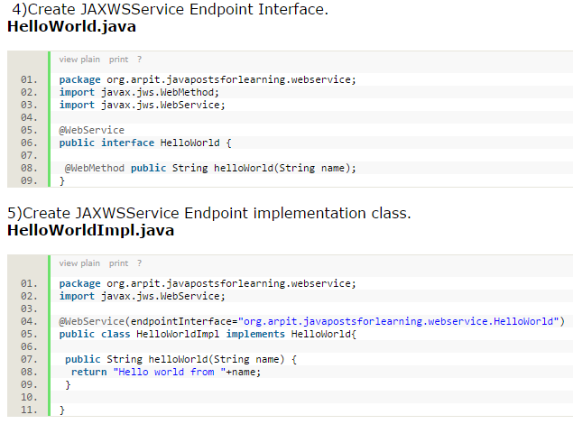

Slide 7
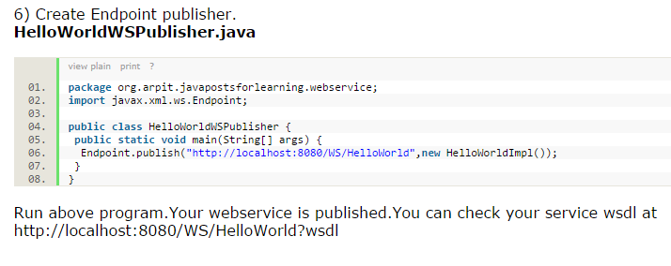

Slide 8
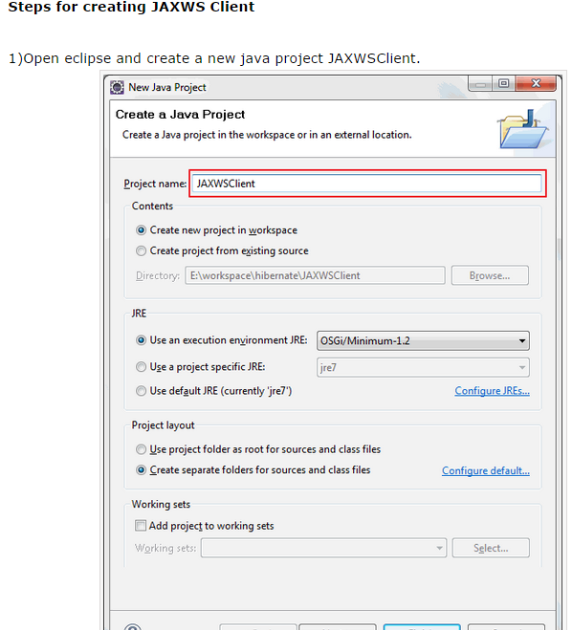

Slide 9
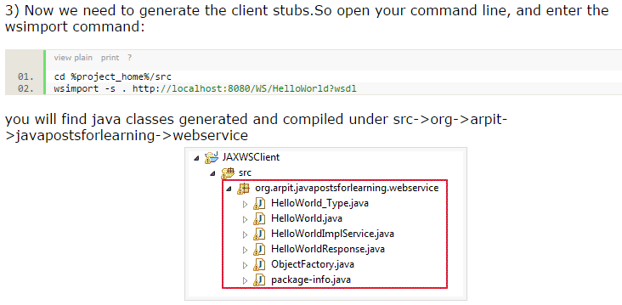

Slide 10
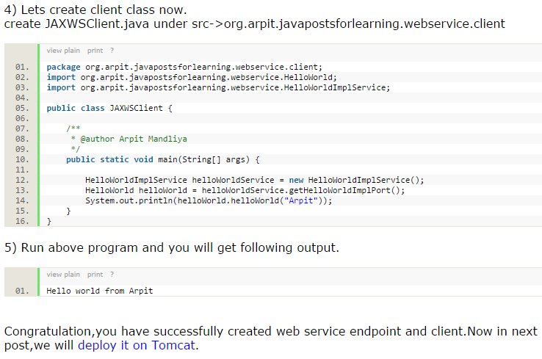

Slide 12
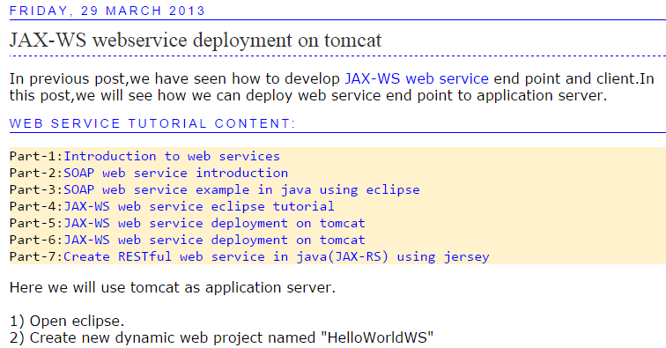

Slide 13
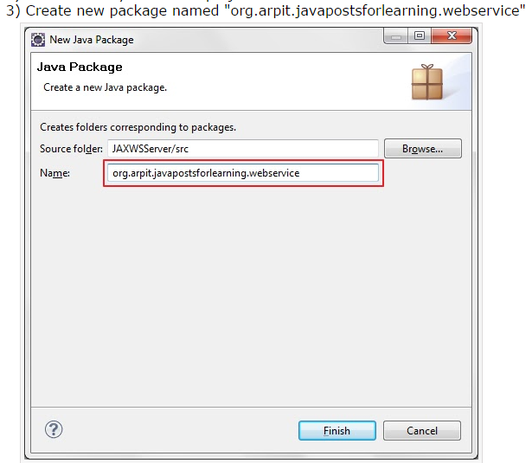

Slide 14
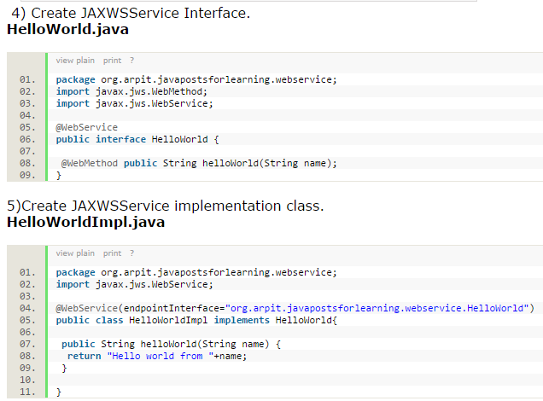

Slide 15
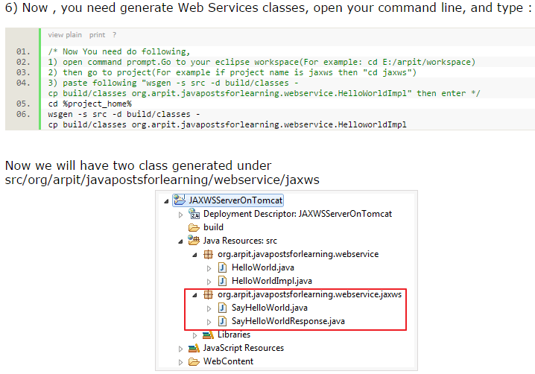

Slide 16
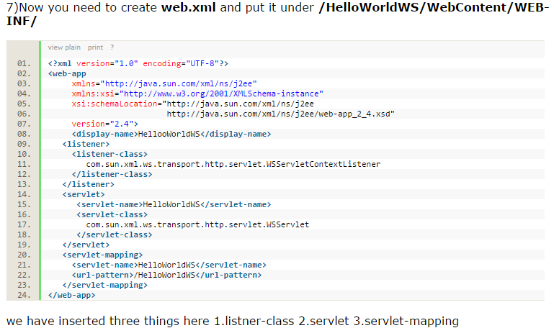

Slide 17
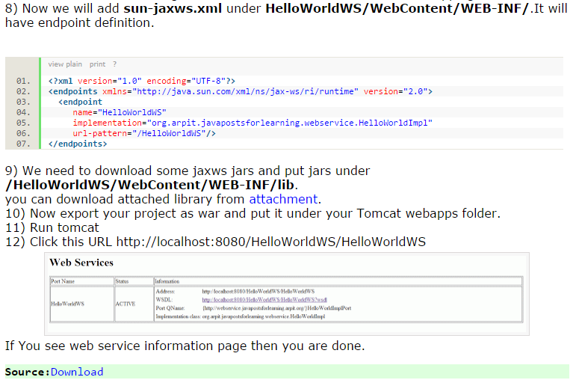

Slide 19
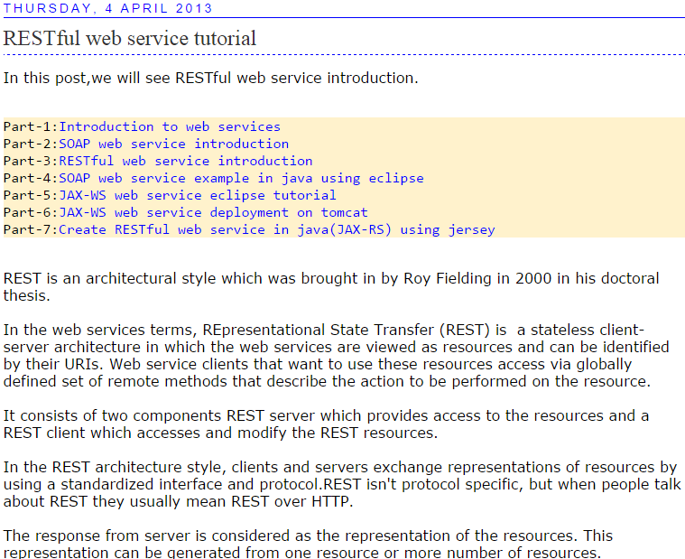
http://www.java2blog.com/2013/04/restful-web-service-tutorial.html

Slide 20
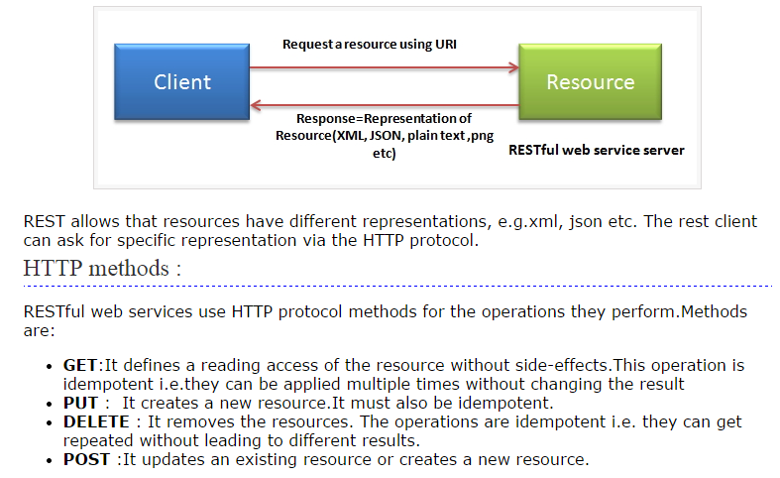

Slide 21
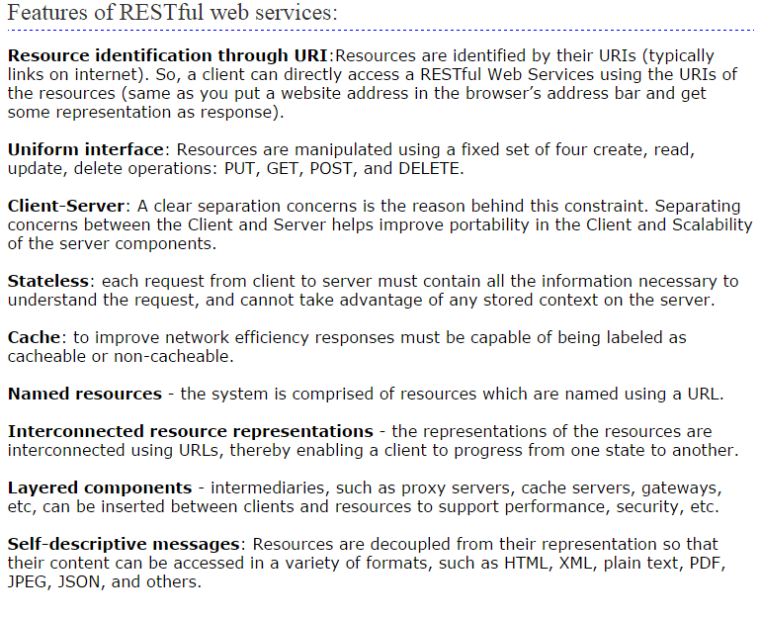

Slide 23
2. JAX-RS with Jersey
2.1. JAX-RS
Java defines REST support via the Java Specification Request (JSR) 311. This specification is called JAX-RS (The Java API for RESTful Web Services). JAX-RS uses annotations to define the REST relevance of Java classes.
2.2. Jersey
Jersey is the reference implementation for the JSR 311 specification.
The Jersey implementation provides a library to implement Restful webservices in a Java servlet container.
On the server side Jersey provides a servlet implementation which scans predefined classes to identify RESTful resources. In your web.xml configuration file your register this servlet for your web application.
The Jersey implementation also provides a client library to communicate with a RESTful webservice.
The base URL of this servlet is:
http://your_domain:port/display-name/url-pattern/path_from_rest_class
This servlet analyzes the incoming HTTP request and selects the correct class and method to respond to this request. This selection is based on annotations in the class and methods.
A REST web application consists, therefore, out of data classes (resources) and services. These two types are typically maintained in different packages as the Jersey servlet will be instructed via the web.xml to scan certain packages for data classes.
JAX-RS supports the creation of XML and JSON via the Java Architecture for XML Binding (JAXB).
JAXB is described in the JAXB Tutorial .

Slide 24
2.3. JAX-RS annotations
The most important annotations in JAX-RS are listed in the following table.
Table 1. JAX-RS annotations
Annotation Description
@PATH(your_path) Sets the path to base URL + /your_path. The base URL is based on your application name, the servlet and the URL pattern from the web.xml configuration file.
@POST Indicates that the following method will answer to an HTTP POST request.
@GET Indicates that the following method will answer to an HTTP GET request.
@PUT Indicates that the following method will answer to an HTTP PUT request.
@DELETE Indicates that the following method will answer to an HTTP DELETE request.
@Produces(MediaType.TEXT_PLAIN[, more-types]) @Produces defines which MIME type is delivered by a method annotated with @GET. In the example text ("text/plain") is produced. Other examples would be "application/xml" or "application/json".
@Consumes(type[, more-types]) @Consumes defines which MIME type is consumed by this method.
@PathParam Used to inject values from the URL into a method parameter. This way you inject, for example, the ID of a resource into the method to get the correct object.
The complete path to a resource is based on the base URL and the @PATh annotation in your class.
http://your_domain:port/display-name/url-pattern/path_from_rest_class

Slide 25
3. Jersey
Download the Jersey distribution as zip file from the Jersey download site.
The zip contains the Jersey implementation JAR and its core dependencies. It does not provide dependencies for third party JARs beyond those for JSON support and JavaDoc.
4. Web container
For this tutorial you can use any web container, for example Tomcat or the Google App Engine.
If you want to use Tomcat as servlet container please see Eclipse WTP and Apache Tomcat for instructions on how to install and use Eclipse WTP and Apache Tomcat.
Alternative you could also use the Google App Engine for running the server part of the following REST examples. If you use the Google App Engine, you do not have to install and configure Tomcat.

Slide 26
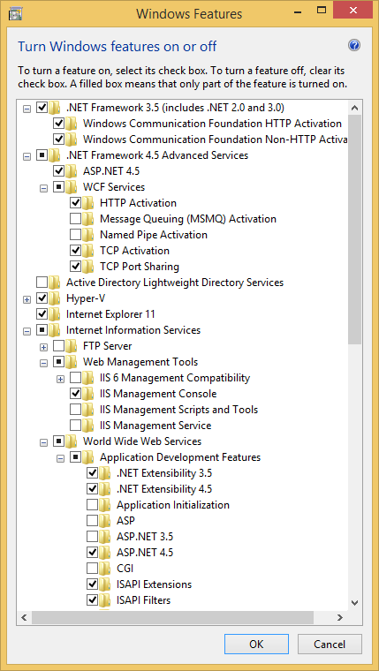
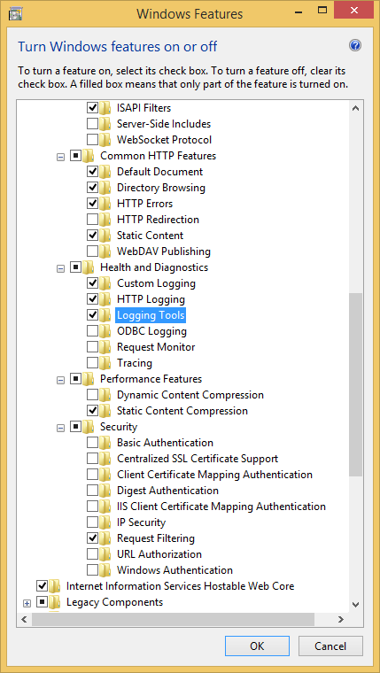

Slide 27
