Slide 1
H
A
T
E
O
A
S
Hypertext
As
The
Engine
Of
Application
State.
HATEOAS
2018

Slide 2
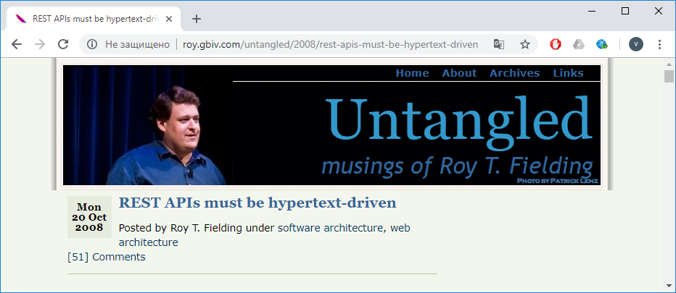
Roy T. Fielding: REST APIs must be hypertext-driven
http://roy.gbiv.com/untangled/2008/rest-apis-must-be-hypertext-driven
Web Services

Slide 3
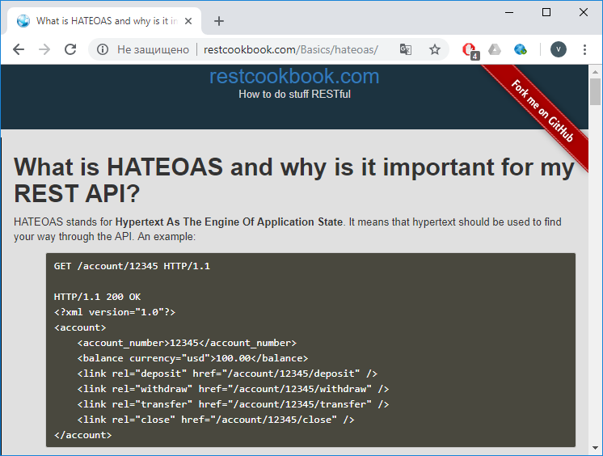
What is HATEOAS and why is it important for my REST API?
http://restcookbook.com/Basics/hateoas/
HATEOAS stands for Hypertext As The Engine Of Application State.
It means that hypertext should be used to find your way through the API.
Web Services

Slide 4
HATEOAS. Приклад
http://restcookbook.com/Basics/hateoas/
GET /account/12345 HTTP/1.1
HTTP/1.1 200 OK
<?xml version="1.0"?>
<account>
<account_number>12345</account_number>
<balance currency="usd">100.00</balance>
<link rel="deposit" href="/account/12345/deposit" />
<link rel="withdraw" href="/account/12345/withdraw" />
<link rel="transfer" href="/account/12345/transfer" />
<link rel="close" href="/account/12345/close" />
</account>
The hypertext is actually telling us what is allowed and what not: HATEOAS
GET /account/12345 HTTP/1.1
HTTP/1.1 200 OK
<?xml version="1.0"?>
<account>
<account_number>12345</account_number>
<balance currency="usd">-25.00</balance>
<link rel="deposit" href="/account/12345/deposit" />
</account>
Web Services

Slide 5
Модель Richardson Maturity визначає рівень зрілості Restful Web Service.
Нижче наведені різні рівні та їх характеристики.
Рівень 0. Надання сервісів, що базуються на діях, із використанням стилю REST, зокрема, у стилі REST можуть подаватись “звичайні” SOAP веб-служби.
Приклади запитів: http://server/getOrders, http://server/getOrders,
http://server/doThis, http: //server/doThat.
Рівень 1. Надаються ресурси із відповідними URI (вживаються іменники!), проте HTTP-методи або не використовуються взагалі, або ж використовуються не в стилі REST. Наприклад, http://server/accounts, http://server/accounts/10.
Рівень 2. Ресурси використовують URI + “правильні” HTTP методи. Наприклад, щоб оновити рахунок, потрібно виконати метод PUT. для створення рахунку - POST.
Рівень 3. HATEOAS. В результаті запиту отримуються не тільки ресурсні дані, але й інформація про наступні можливі дії, які є доступними для споживача послуг.
Richardson. Модель зрілості REST (Maturity Model REST)
Web Services

Slide 6
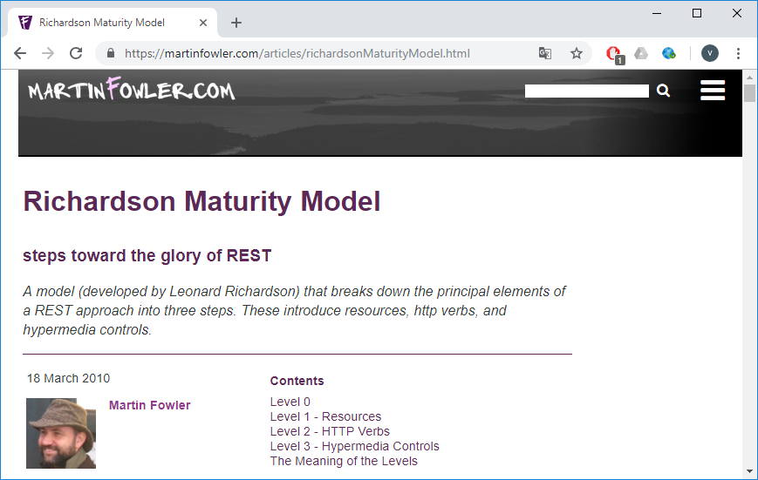
Richardson Maturity Model. Кроки до слави REST
https://martinfowler.com/articles/richardsonMaturityModel.html
https://martinfowler.com/articles/richardsonMaturityModel.html
Web Services

Slide 7
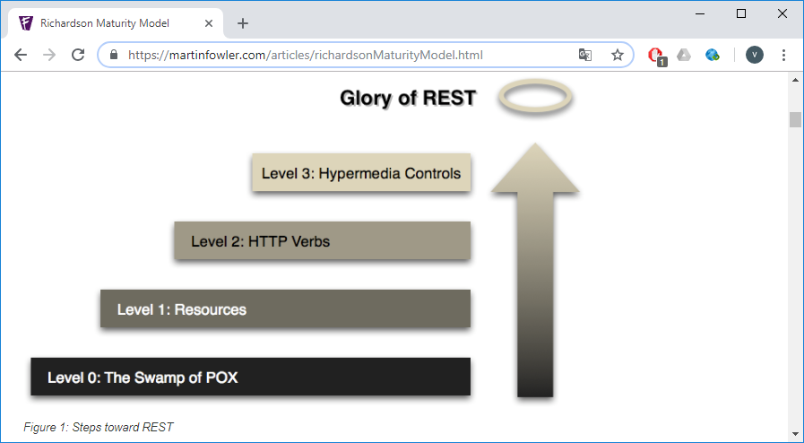
Кроки до слави REST
Болото Plain Old XML (POX)
Web Services

Slide 8
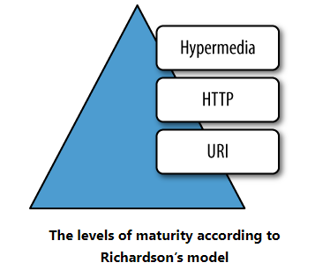
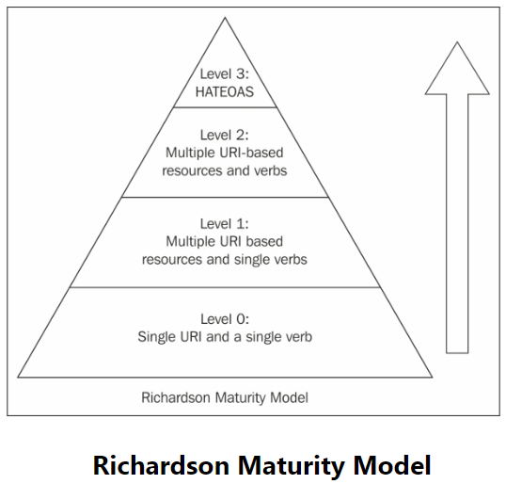
Richardson Maturity Model
Web Services

Slide 9
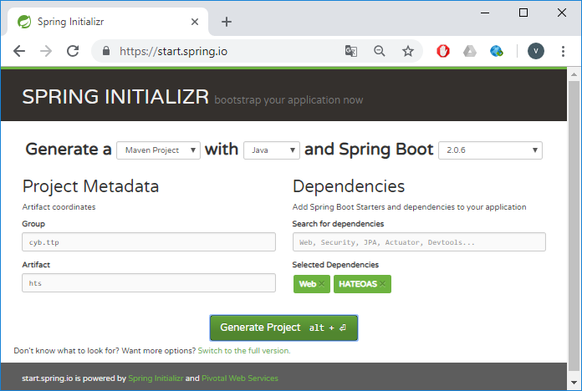
https://start.spring.io/
Web Services

Slide 10
Файл pom.xml (1/3)
<?xml version="1.0" encoding="UTF-8"?>
<project xmlns="http://maven.apache.org/POM/4.0.0" xmlns:xsi="http://www.w3.org/2001/XMLSchema-instance"
xsi:schemaLocation="http://maven.apache.org/POM/4.0.0 http://maven.apache.org/xsd/maven-4.0.0.xsd">
<modelVersion>4.0.0</modelVersion>
<groupId>cyb.ttp</groupId>
<artifactId>hts</artifactId>
<version>0.0.1-SNAPSHOT</version>
<packaging>jar</packaging>
<name>hts</name>
<description>Demo project for Spring Boot</description>
<parent>
<groupId>org.springframework.boot</groupId>
<artifactId>spring-boot-starter-parent</artifactId>
<version>2.0.6.RELEASE</version>
<relativePath/> <!-- lookup parent from repository -->
</parent>
GraphQL
GraphQL

Slide 11
Файл pom.xml (2/3)
<properties>
<project.build.sourceEncoding>UTF-8</project.build.sourceEncoding>
<project.reporting.outputEncoding>UTF-8</project.reporting.outputEncoding>
<java.version>1.8</java.version>
</properties>
<dependencies>
<dependency>
<groupId>org.springframework.boot</groupId>
<artifactId>spring-boot-starter-hateoas</artifactId>
</dependency>
<dependency>
<groupId>org.springframework.boot</groupId>
<artifactId>spring-boot-starter-web</artifactId>
</dependency>
<dependency>
<groupId>org.springframework.boot</groupId>
<artifactId>spring-boot-starter-test</artifactId>
<scope>test</scope>
</dependency>
</dependencies>
GraphQL
GraphQL

Slide 12
Файл pom.xml (3/3)
<build>
<plugins>
<plugin>
<groupId>org.springframework.boot</groupId>
<artifactId>spring-boot-maven-plugin</artifactId>
</plugin>
</plugins>
</build>
</project>
GraphQL
GraphQL

Slide 13
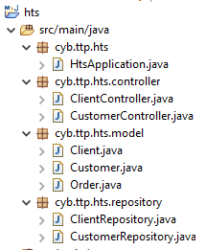
Склад проекту
GraphQL
GraphQL

Slide 14
Class HtsApplication
package cyb.ttp.hts;
import org.springframework.boot.SpringApplication;
import org.springframework.boot.autoconfigure.SpringBootApplication;
@SpringBootApplication
public class HtsApplication {
public static void main(String[] args) {
SpringApplication.run(HtsApplication.class, args);
}
}
GraphQL
GraphQL

Slide 15
Class Order
package cyb.ttp.hts.model;
public class Order {
private Long id;
private String name;
public Order(Long id, String name) {
this.id = id;
this.name = name;
}
public Long getId() {
return id;
}
public void setId(Long id) {
this.id = id;
}
public String getName() {
return name;
}
public void setName(String name) {
this.name = name;
}
}
GraphQL
GraphQL

Slide 16
Class Customer
package cyb.ttp.hts.model;
import java.util.ArrayList;
import java.util.List;
public class Customer{
private Long id;
private String name;
private List<Order> orders;
public Customer(Long id, String name, ArrayList<Order> orders) {
this.id = id;
this.name = name;
this.orders = new ArrayList<Order>(orders);
}
public List<Order> getOrders() {
return orders;
}
public void setOrders(List<Order> orders) {
this.orders = orders;
}
// інші геттери та сеттери
}
GraphQL
GraphQL

Slide 17
Class Client
package cyb.ttp.hts.model;
import java.util.ArrayList;
import java.util.List;
import org.springframework.hateoas.ResourceSupport;
public class Client extends ResourceSupport {
private Long id;
private String name;
private List<Order> orders;
public Client(Long id, String name, ArrayList<Order> orders) {
this.id = id;
this.name = name;
this.orders = new ArrayList<Order>(orders);
}
public List<Order> getOrders() {
return orders;
}
public void setOrders(List<Order> orders) {
this.orders = orders;
}
// інші геттери та сеттери
}
GraphQL
GraphQL

Slide 18
Class CustomerController (1/11)
package cyb.ttp.hts.controller;
import org.springframework.beans.factory.annotation.Autowired;
import org.springframework.hateoas.EntityLinks;
import org.springframework.hateoas.ExposesResourceFor;
import org.springframework.hateoas.Resource;
import org.springframework.hateoas.Resources;
import org.springframework.http.MediaType;
import org.springframework.web.bind.annotation.PathVariable;
import org.springframework.web.bind.annotation.RequestMapping;
import org.springframework.web.bind.annotation.RestController;
import static org.springframework.hateoas.mvc.ControllerLinkBuilder.*;
import java.util.List;
import cyb.ttp.hts.model.Customer;
import cyb.ttp.hts.model.Order;
import cyb.ttp.hts.repository.CustomerRepository;
@RestController
@ExposesResourceFor(Customer.class)
@RequestMapping("/customers")
public class CustomerController {
GraphQL
GraphQL

Slide 19
Class CustomerController (2/11)
Метод getAllCustomers() (1/2)
@RestController
@ExposesResourceFor(Customer.class)
@RequestMapping("/customers")
public class CustomerController {
@Autowired
private CustomerRepository repository;
@Autowired
private EntityLinks entityLinks;
@RequestMapping(produces = MediaType.APPLICATION_JSON_VALUE)
public Resources<Customer> getAllCustomers() {
Resources<Customer> resources = new Resources<>(this.repository.findAll());
resources.add(this.entityLinks.linkToCollectionResource(Customer.class));
return resources;
/*
"_links": {
"self": {
"href": "http://localhost:8080/customers"
}
}
*/
}
hateoas.EntityLinks;
hateoas.ExposesResourceFor;
hateoas.Resource;
hateoas.Resources;
//static
hateoas.mvc.ControllerLinkBuilder.*;
GraphQL
GraphQL

Slide 20
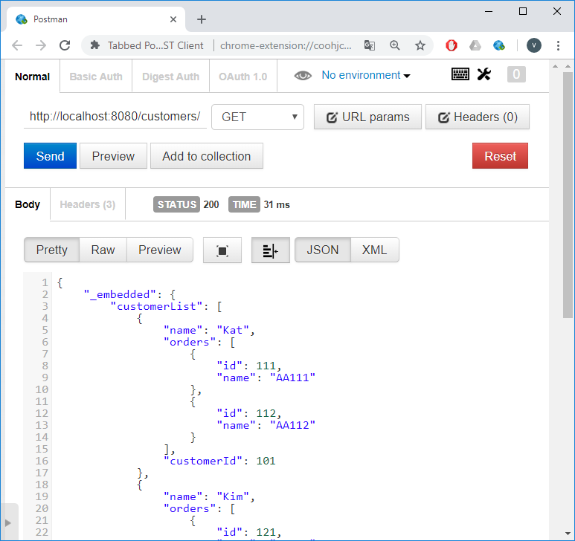
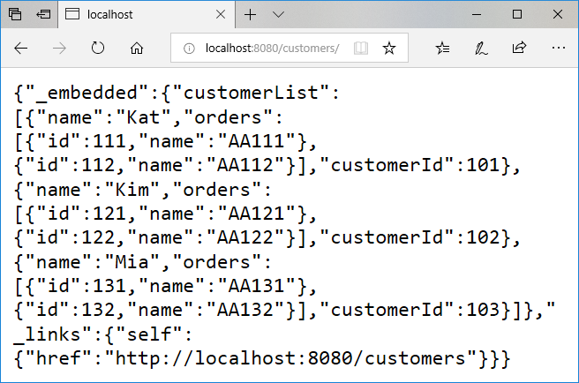
Class CustomerController (3/11)
Метод getAllCustomers() (2/2)
public Resources<Customer> getAllCustomers() {
Resources<Customer> resources = new Resources<>(this.repository.findAll());
resources.add(this.entityLinks.linkToCollectionResource(Customer.class));
return resources;
}
localhost:8080/customers/
GraphQL
GraphQL

Slide 21
Class CustomerController (4/11)
Метод getAllCustomers(). Більш простий варіант
@RestController
@ExposesResourceFor(Customer.class)
@RequestMapping("/customers")
public class CustomerController {
@Autowired
private CustomerRepository repository;
@Autowired
private EntityLinks entityLinks;
@RequestMapping(produces = MediaType.APPLICATION_JSON_VALUE)
public Resources<Customer> getAllCustomers() {
Resources<Customer> resources = new Resources<>(this.repository.findAll());
//resources.add(this.entityLinks.linkToCollectionResource(Customer.class));
resources.add(linkTo(CustomerController.class).withSelfRel());
return resources;
/*
"_links": {
"self": {
"href": "http://localhost:8080/customers"
}
} */
}
hateoas.EntityLinks;
hateoas.ExposesResourceFor;
hateoas.Resource;
hateoas.Resources;
//static
hateoas.mvc.ControllerLinkBuilder.*;
GraphQL
GraphQL

Slide 22

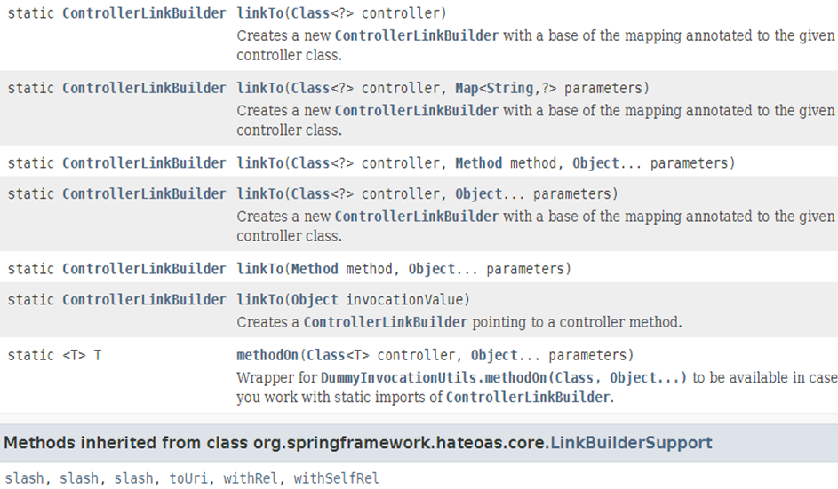
Class CustomerController (5/11)
Class ControllerLinkBuilder
hateoas.EntityLinks;
hateoas.ExposesResourceFor;
hateoas.Resource;
hateoas.Resources;
//static
hateoas.mvc.ControllerLinkBuilder.*;
GraphQL
GraphQL

Slide 23
Class CustomerController (6/11)
Метод getCustomer(@PathVariable Long id) (1/4)
@RequestMapping(path = "/{id}", produces = MediaType.APPLICATION_JSON_VALUE)
public Resource<Customer> getCustomer(@PathVariable Long id) {
Customer customer = this.repository.findOne(id);
Resource<Customer> resource = new Resource<>(customer);
resource.add(this.entityLinks.linkToSingleResource(Customer.class, id));
resource.add(linkTo(methodOn(CustomerController.class).
getOrdersForCustomer(id)).withRel("allOrders"));
return resource;
/* "_links": {
"self": { "href": "http://localhost:8080/customers/id"
},
"allOrders": { "href": "http://localhost:8080/customers/id/orders"
}
}
*/
}
hateoas.EntityLinks;
hateoas.ExposesResourceFor;
hateoas.Resource;
hateoas.Resources;
//static
hateoas.mvc.ControllerLinkBuilder.*;
GraphQL
GraphQL

Slide 24

Class CustomerController (7/11)
Метод getCustomer(@PathVariable Long id) (2/4)
Customer customer = this.repository.findOne(id);
Resource<Customer> resource = new Resource<>(customer);
resource.add(this.entityLinks.linkToSingleResource(Customer.class, id));
resource.add(linkTo(methodOn(CustomerController.class).
getOrdersForCustomer(id)).withRel("allOrders"));
return resource;
GraphQL
GraphQL

Slide 25
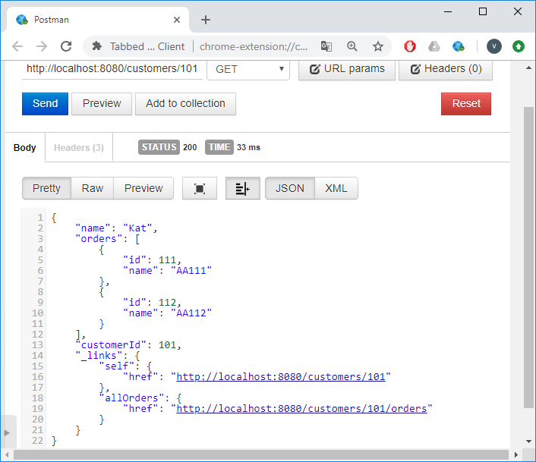
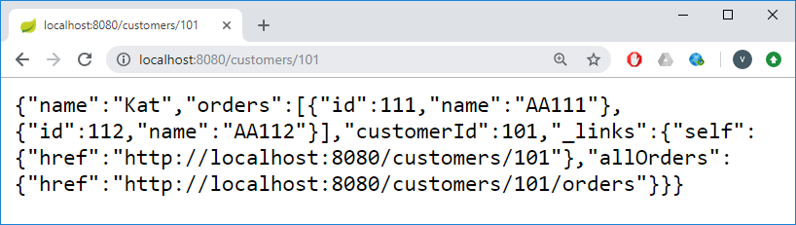
Class CustomerController (8/11)
Метод getCustomer(@PathVariable Long id) (3/4)
GraphQL
GraphQL

Slide 26
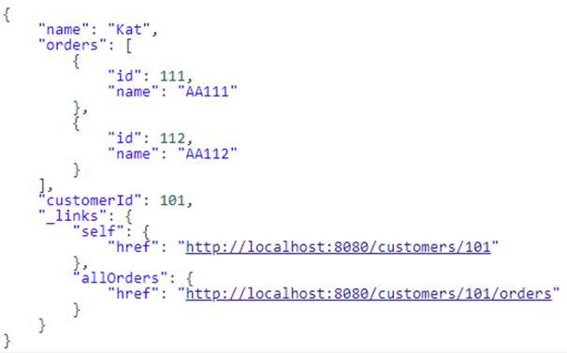
Class CustomerController (9/11)
Метод getCustomer(@PathVariable Long id) (4/4)
GraphQL
GraphQL

Slide 27
Class CustomerController (10/11)
getCustomer(@PathVariable Long id). Більш простий варіант
@RequestMapping(path = "/{id}", produces = MediaType.APPLICATION_JSON_VALUE)
public Resource<Customer> getCustomer(@PathVariable Long id) {
Customer customer = this.repository.findOne(id);
Resource<Customer> resource = new Resource<>(customer);
//resource.add(this.entityLinks.linkToSingleResource(Customer.class, id));
//resource.add(linkTo(methodOn(CustomerController.class).
// getOrdersForCustomer(id)).withRel("allOrders"));
resource.add(linkTo(methodOn(CustomerController.class).
getCustomer(id)).withSelfRel());
resource.add(linkTo(methodOn(CustomerController.class).
getOrdersForCustomer(id)).withRel("allOrders"));
return resource;
/* "_links": {
"self": {
"href": "http://localhost:8080/customers/id"
},
"allOrders": {
"href": "http://localhost:8080/customers/id/orders"
}
}
*/
}
@RequestMapping(path = "/{id}/orders")
public List<Order> getOrdersForCustomer(@PathVariable Long id) {
GraphQL
GraphQL

Slide 28
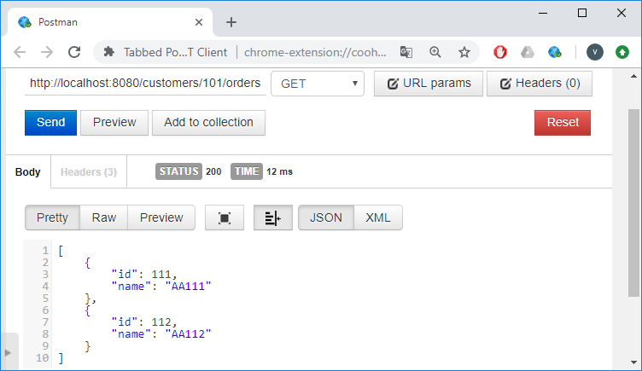
Class CustomerController (11/11)
Метод getOrdersForCustomer(@PathVariable Long id)
@RequestMapping(path = "/{id}/orders")
public List<Order> getOrdersForCustomer(@PathVariable Long id) {
return this.repository.findOne(id).getOrders();
}
}
GraphQL
GraphQL

Slide 29
Class ClientController (1/9)
package cyb.ttp.hts.controller;
import org.springframework.beans.factory.annotation.Autowired;
import org.springframework.web.bind.annotation.PathVariable;
import org.springframework.web.bind.annotation.RequestMapping;
import org.springframework.web.bind.annotation.RestController;
import static org.springframework.hateoas.mvc.ControllerLinkBuilder.*;
import java.util.List;
import cyb.ttp.hts.model.Order;
import cyb.ttp.hts.model.Client;
import cyb.ttp.hts.repository.ClientRepository;
@RestController
@RequestMapping("/clients")
public class ClientController {
@Autowired
private ClientRepository repository;
GraphQL
GraphQL

Slide 30
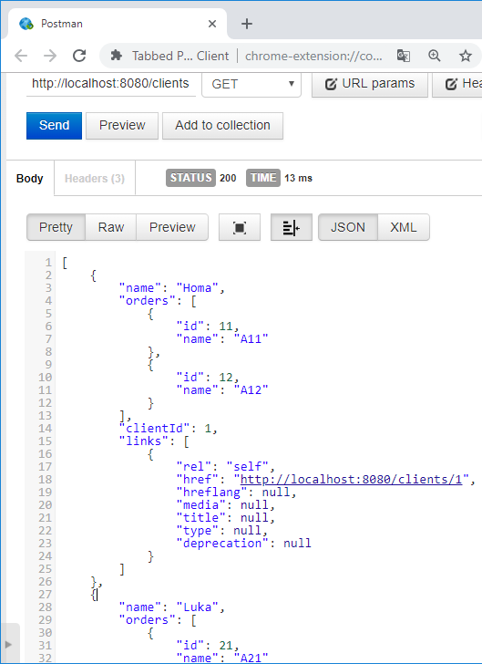
Class ClientController (2/9)
Метод getAllClients() (1/4)
@RequestMapping("")
public List<Client> getAllClients() {
List<Client> clients = this.repository.findAll();
clients.forEach(client -> {
client.removeLinks();
client.add(linkTo(ClientController.class).
slash(client.getClientId()).
withSelfRel());
});
return clients;
}
localhost:8080/clients
Для кожного клієнта (client)!
GraphQL
GraphQL

Slide 31
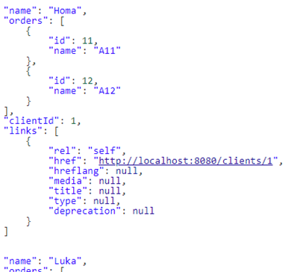
Class ClientController (3/9)
Метод getAllClients() (2/4)
client.add(linkTo(ClientController.class).
slash(client.getClientId()).
withSelfRel());
Для кожного клієнта (client)!
GraphQL
GraphQL

Slide 32
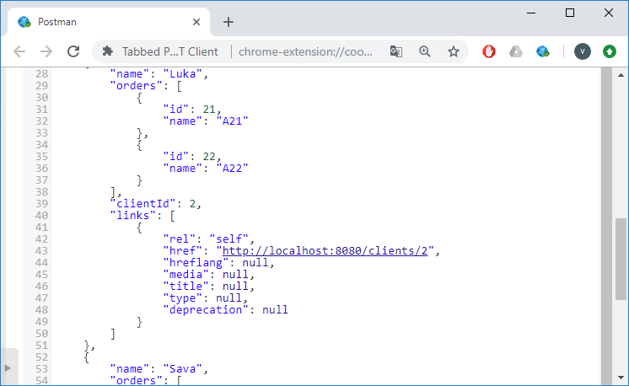
Class ClientController (4/9)
Метод getAllClients() (3/4)
client.add(linkTo(ClientController.class).
slash(client.getClientId()).
withSelfRel());
Для кожного клієнта (client)!
GraphQL
GraphQL

Slide 33
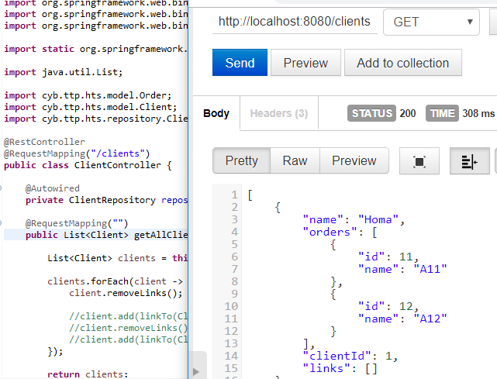
Class ClientController (5/9)
Метод getAllClients() (4/4)
GraphQL
GraphQL

Slide 34
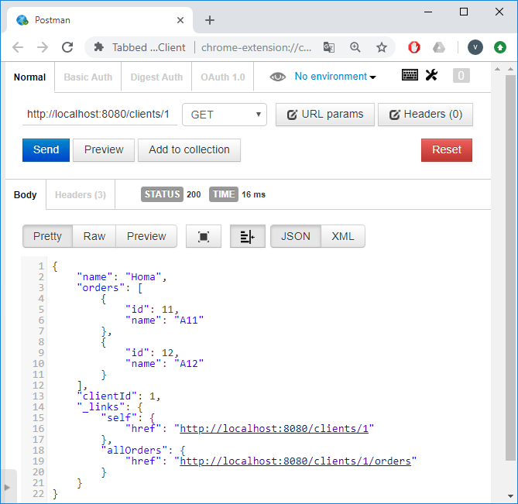
Class ClientController (6/9)
Метод getClient(@PathVariable Long id) (1/3)
@RequestMapping("/{id}")
public Client getClient(@PathVariable Long id) {
Client client = this.repository.findOne(id);
client.removeLinks();
client.add(linkTo(ClientController.class).
slash(client.getClientId()).withSelfRel());
client.add(linkTo(methodOn(ClientController.class).
getOrdersForClient(id)).withRel("allOrders"));
return client;
}
localhost:8080/clients/1
@RequestMapping("/{id}/orders") public List<Order>
getOrdersForClient(@PathVariable Long id) {
return this.repository.findOne(id).getOrders(); }

Slide 35
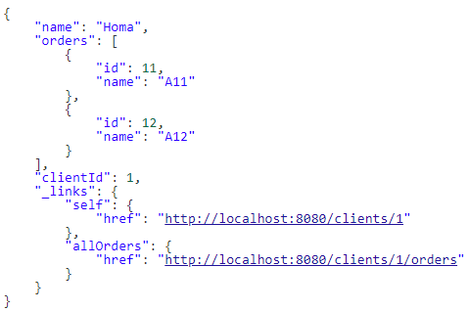
Class ClientController (7/9)
Метод getClient(@PathVariable Long id) (2/3)
localhost:8080/clients/1

Slide 36
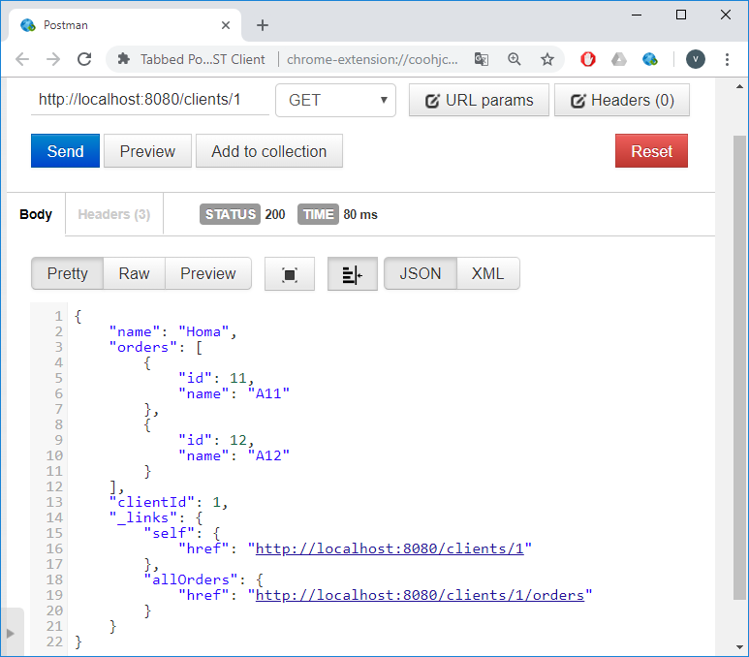
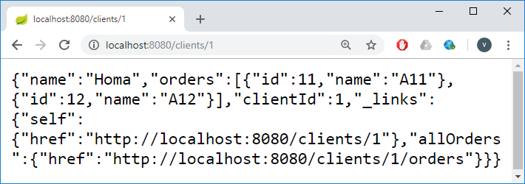
Class ClientController (8/9)
Метод getClient(@PathVariable Long id) (3/3)
http://localhost:8080/clients/1
GraphQL

Slide 37
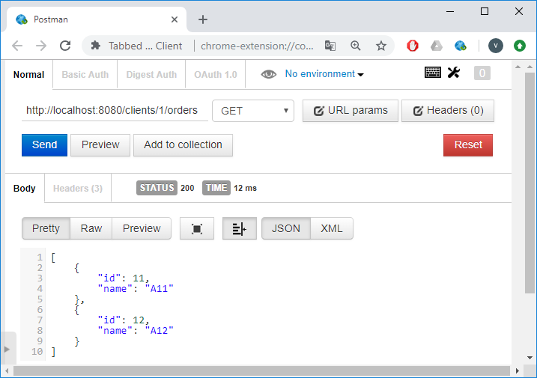
Class ClientController (9/9)
Метод getOrdersForClient(@PathVariable Long id)
@RequestMapping("/{id}/orders") public List<Order>
getOrdersForClient(@PathVariable Long id) {
return this.repository.findOne(id).getOrders();
}
localhost:8080/clients/1/orders

Slide 38
Class ClientRepository (1/2)
package cyb.ttp.hts.repository;
import java.util.ArrayList;
import java.util.Arrays;
import java.util.List;
import org.springframework.stereotype.Repository;
import cyb.ttp.hts.model.Order;
import cyb.ttp.hts.model.Client;
@Repository
public class ClientRepository {
private final List<Client> clients = new ArrayList<>();
public ClientRepository() {
clients.add(
new Client(1L, "Homa", new ArrayList<Order>(Arrays.asList(
new Order(11L, "A11"), new Order(12L, "A12")))));
clients.add(
new Client(2L, "Luka", new ArrayList<Order>(Arrays.asList(
new Order(21L, "A21"), new Order(22L, "A22")))));
clients.add(
new Client(3L, "Sava", new ArrayList<Order>(Arrays.asList(
new Order(31L, "A31"), new Order(32L, "A32")))));
}
GraphQL
GraphQL

Slide 39
Class ClientRepository (2/2)
public List<Client> findAll() {
return clients;
}
public Client findOne(Long id) {
for (Client client : this.clients) {
if (client.getClientId().equals(id)) {
return client;
}
}
return null;
}
}
GraphQL
GraphQL

Slide 40
Class CustomerRepository (1/2)
package cyb.ttp.hts.repository;
import java.util.ArrayList;
import java.util.Arrays;
import java.util.List;
import org.springframework.stereotype.Repository;
import cyb.ttp.hts.model.Customer;
import cyb.ttp.hts.model.Order;
@Repository
public class CustomerRepository {
private final List<Customer> customers = new ArrayList<>();
public CustomerRepository() {
customers.add( new Customer(101L, "Kat",
new ArrayList<Order>(Arrays.asList(
new Order(111L, "AA111"), new Order(112L, "AA112")))));
customers.add( new Customer(102L, "Kim",
new ArrayList<Order>(Arrays.asList(
new Order(121L, "AA121"), new Order(122L, "AA122")))));
customers.add( new Customer(103L, "Mia",
new ArrayList<Order>(Arrays.asList(
new Order(131L, "AA131"), new Order(132L, "AA132")))));
}
GraphQL
GraphQL

Slide 41
Class CustomerRepository (2/2)
public List<Customer> findAll() {
return customers;
}
public Customer findOne(Long id) {
for (Customer customer : customers) {
if (customer.getCustomerId().equals(id)) {
return customer;
}
}
return null;
}
}
GraphQL
GraphQL

Slide 42
Створення Link-об'єктів. Кілька простих шаблонів (1/2)
Link link = linkTo(Controller.class).withSelfRel();
/* "self": {
"href": "[controller’s uri]"
}
*/
Link link = linkTo(Controller.class).slash(id).withSelfRel();
/* "self": {
"href": "[controller’s uri]/id"
}
*/
Link link =
linkTo(methodOn(Controller.class).method(id)).withSelfRel();
/* "self": {
"href": "[method’s uri]/id"
}
*/
Web Services

Slide 43
Створення Link-об'єктів. Кілька простих шаблонів (2/2)
Link link = linkTo(Controller.class).slash(id).withRel("any_rel");
/* "any_rel": {
"href": "[controller’s uri]/id"
}
*/
Link link =
linkTo(methodOn(Controller.class).method(id)).withRel("any_rel");
/* "any_rel": {
"href": "[method’s uri]/id"
}
*/
Web Services

