Slide 1
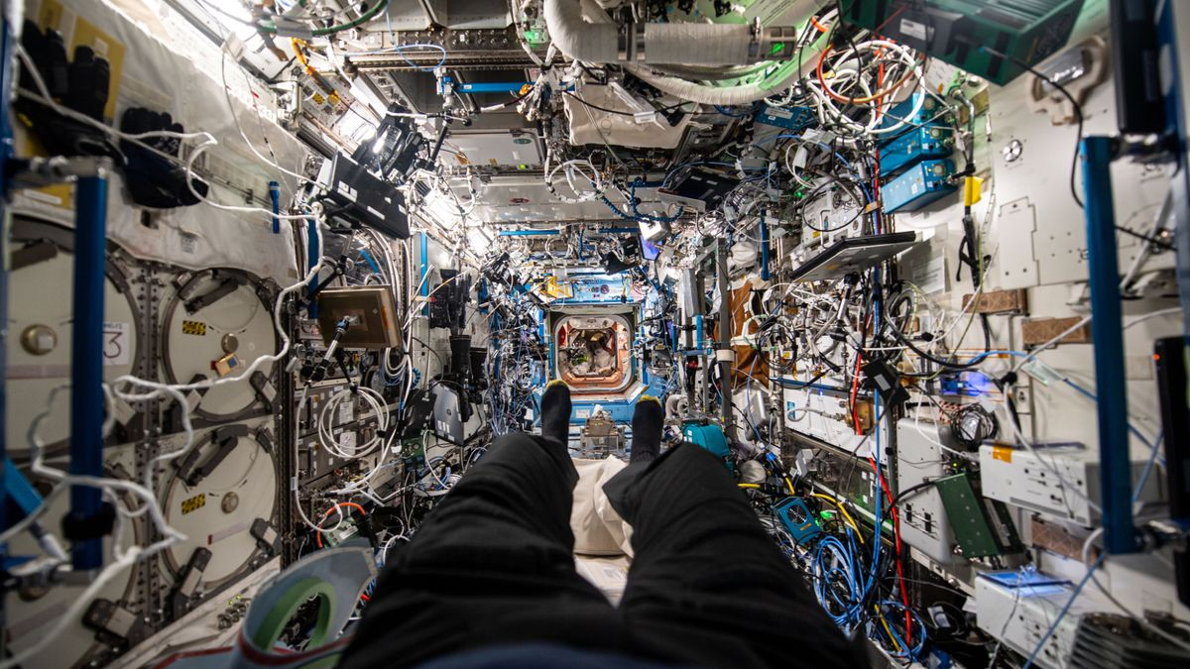


The Architect's Mind in Orbit
How space-station design shapes the crew's mind — and how we measure it
A classroom workshop · Orbital Architecture · KTH Royal Institute of Technology & ESERO Sweden
© ESA – M. Wandt
Notes:
Introduce the speaker. Today: how station design shapes the crew's mind.

Slide 2
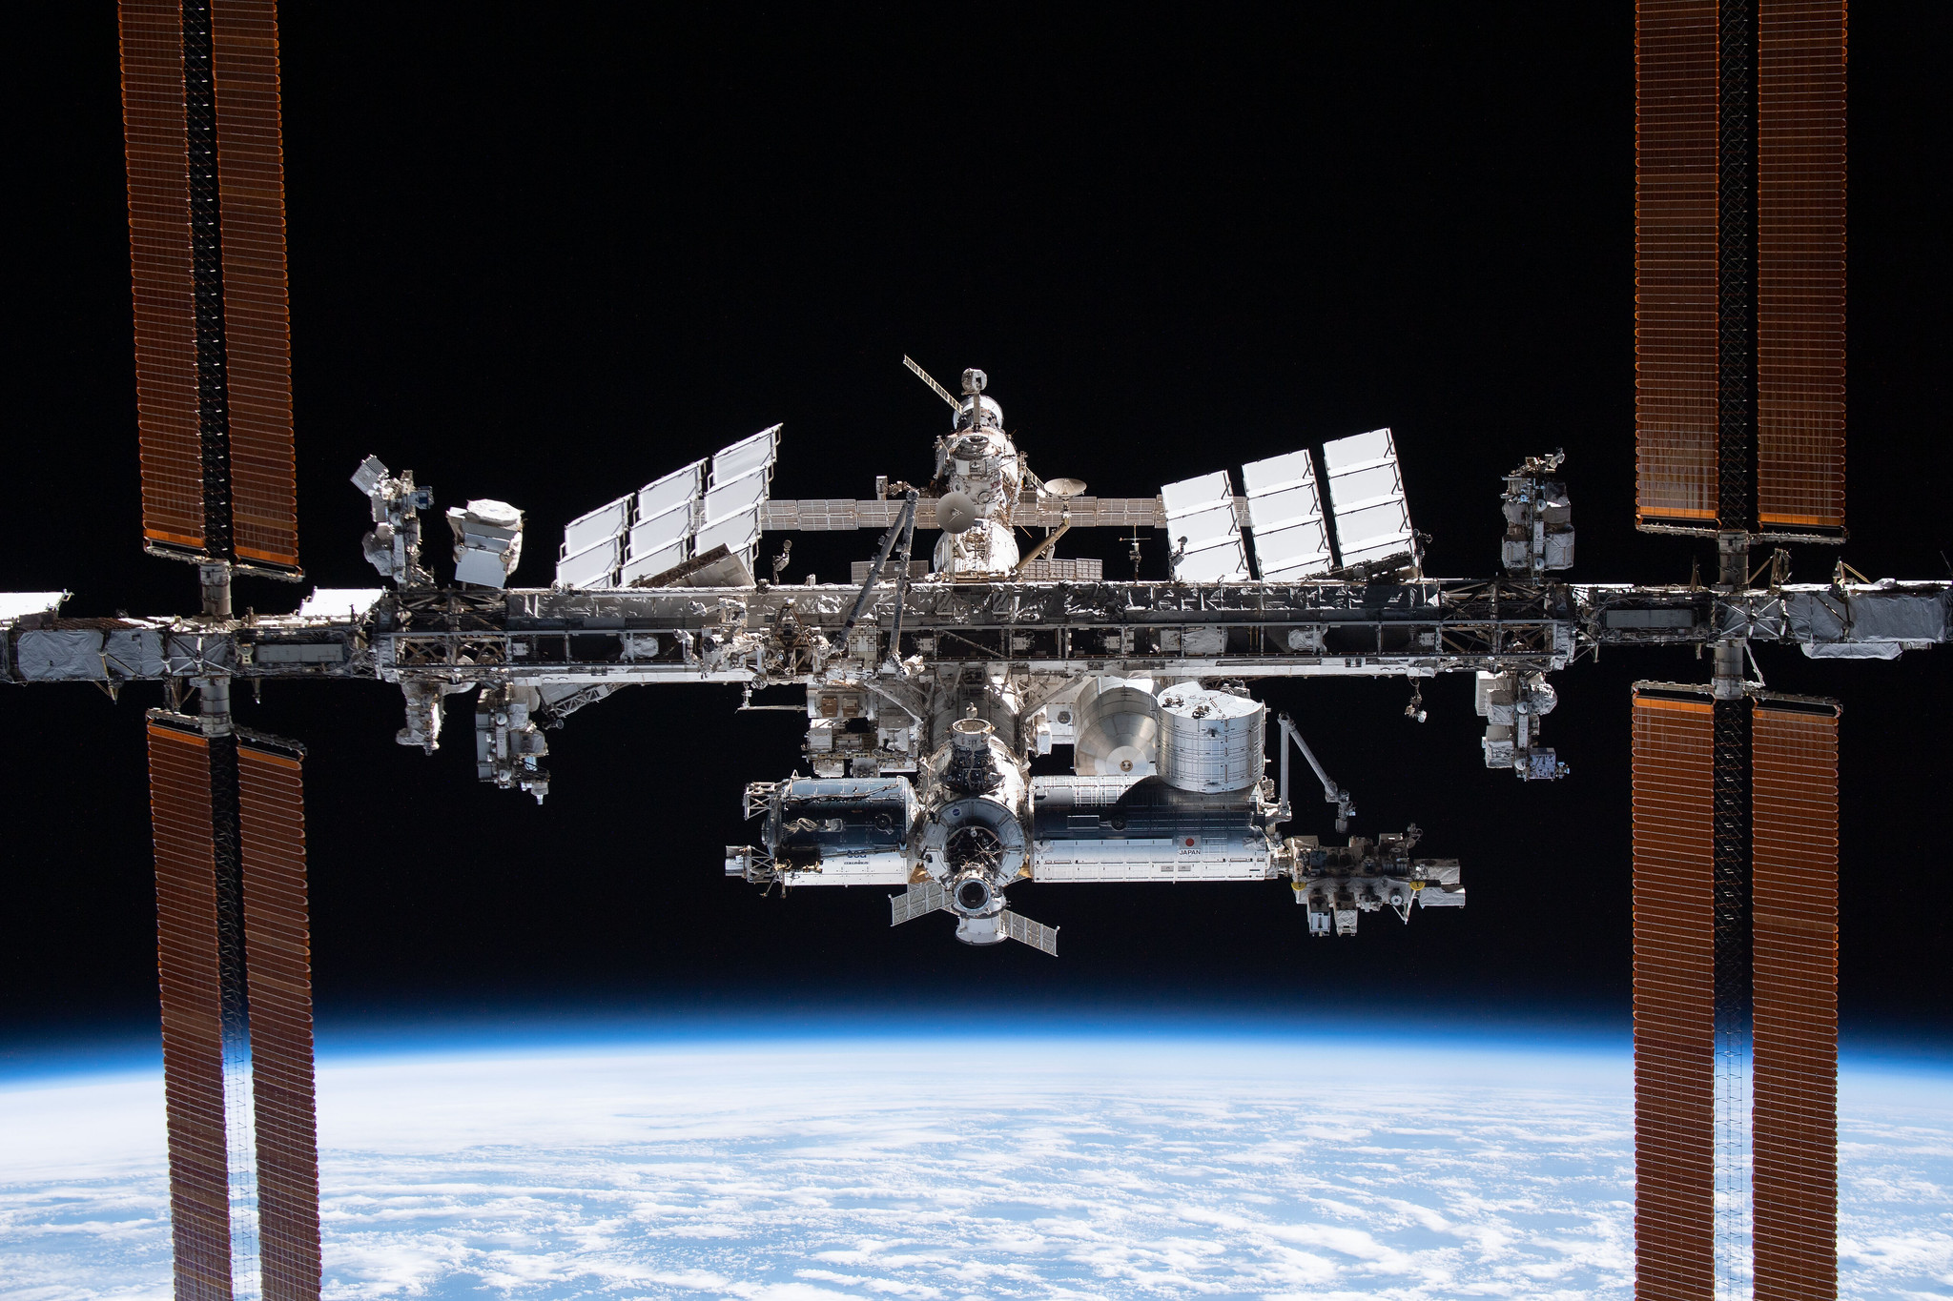
What is a space station?
A spacecraft that stays in orbit so crews can live and work there for weeks to months
A home and a workplace — the crew lives with the design every hour of the day
First station crew (Salyut 1, 1971): 24 days · ISS crews today: about 6 months
© NASA / SpaceX
Notes:
Not a brief visit; crews live with the design every hour. First station crew (Salyut 1, 1971): 24 days; ISS crews: ~6 months.

Slide 3
A short history of space stations
Salyut
Mir
Tiangong
1971
1986
2021
USSR
USSR / Russia
China
Skylab
ISS
1973
1998
USA
international
Ask the class where each one was built before revealing the labels.
Notes:
Messy, machine-centric evolution — equipment first, humans adapt.

Slide 4
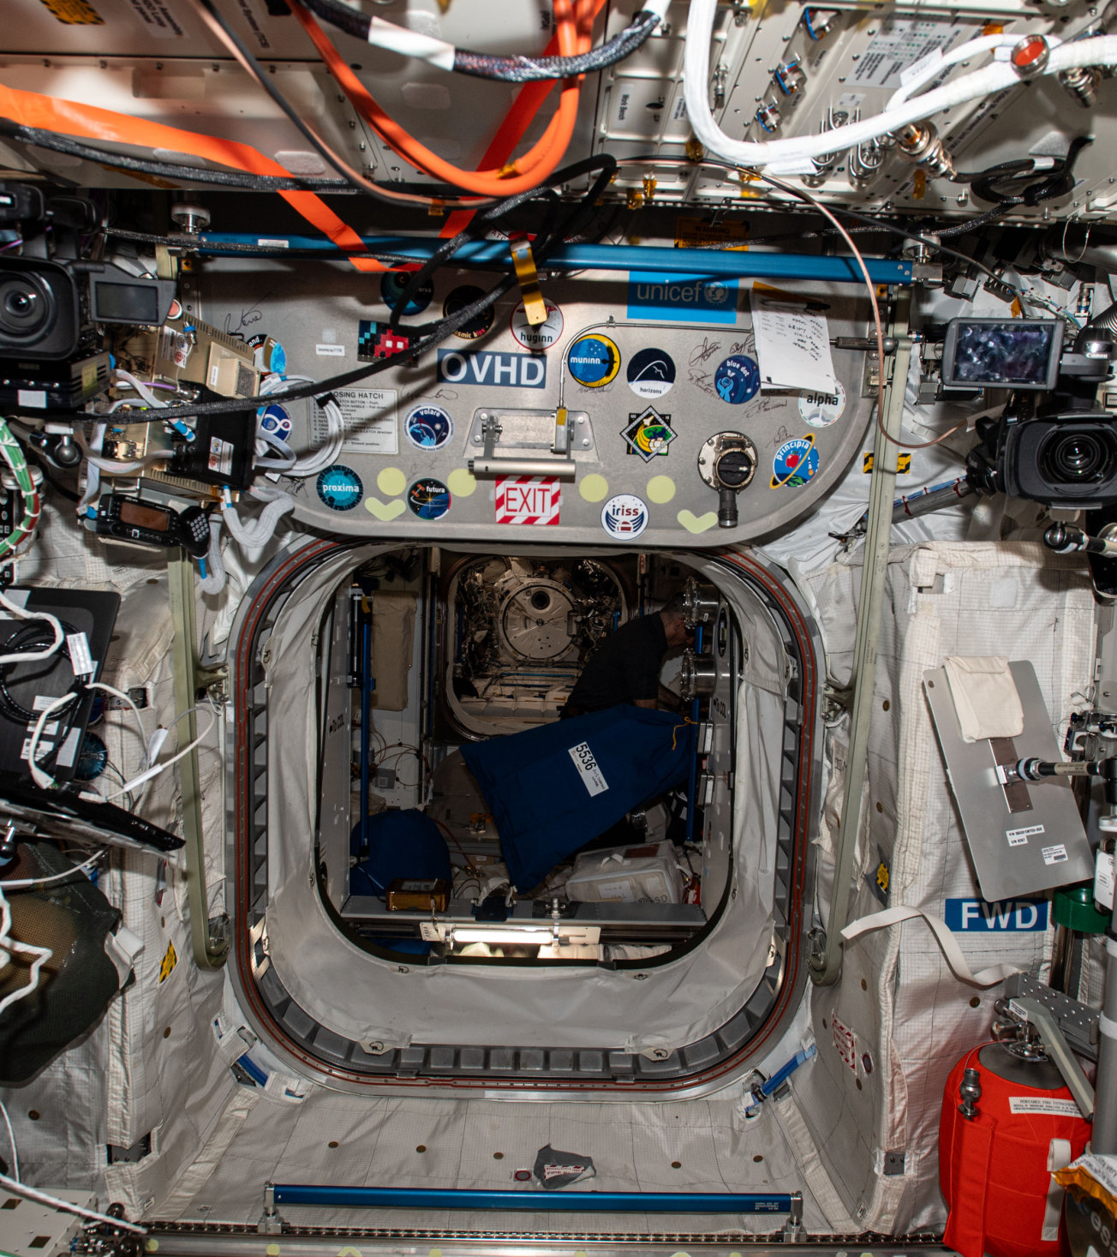
Machine-centric design
Cables everywhere
Cramped and loud
Complex to operate
Utilitarian interiors — equipment first, people adapt
© ESA – M. Wandt
Notes:
This pattern repeats across decades.

Slide 5
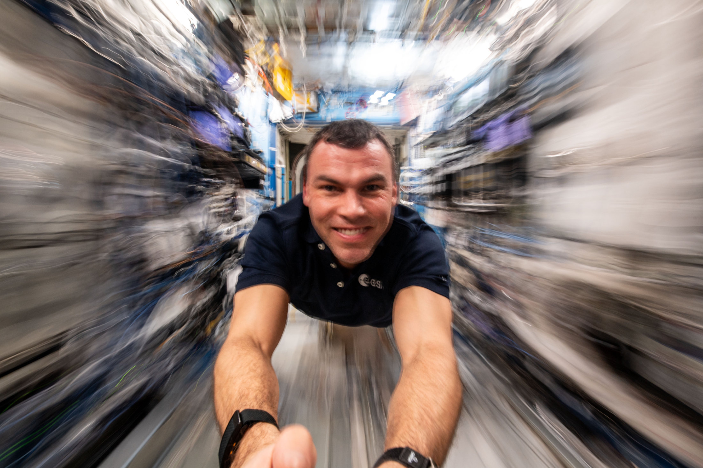
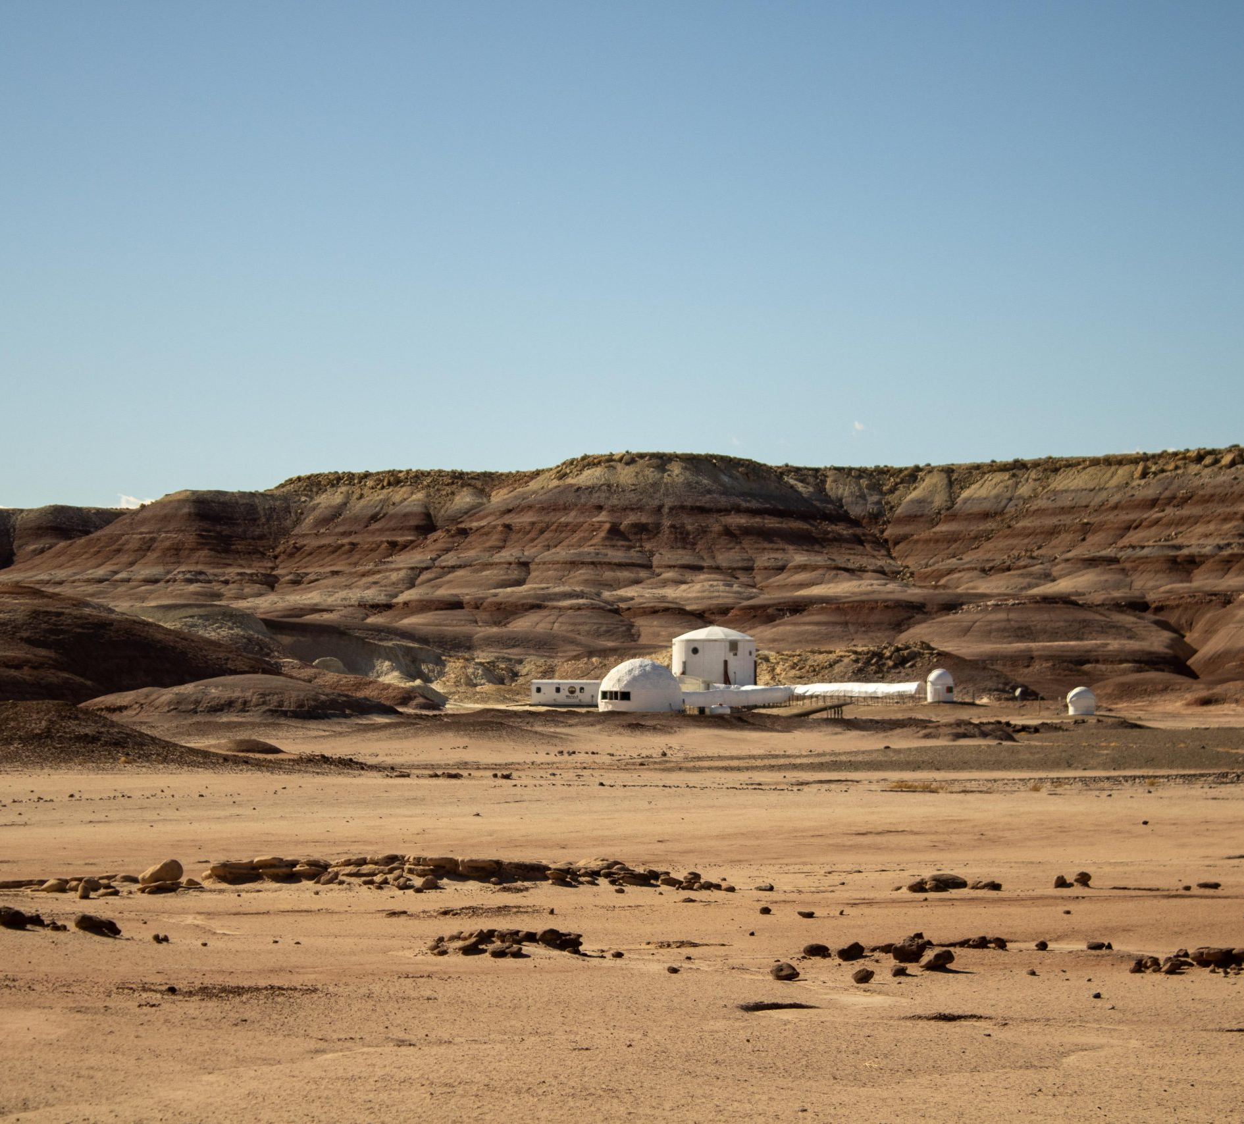
From the ground to orbit
The ISS — the international laboratory where the tools you will use today have flown
ESA astronaut Marcus Wandt ran these tests in orbit on the Muninn mission (2024)
Mars analogue missions — the same tests run in the Utah desert with ISAE-SUPAERO crews
© NASA / SpaceX · © ESA – M. Wandt · © ISAE-SUPAERO
Notes:
Research runs from ground analogues to orbit. SV/EL decks: use the national-connection slide.

Slide 6
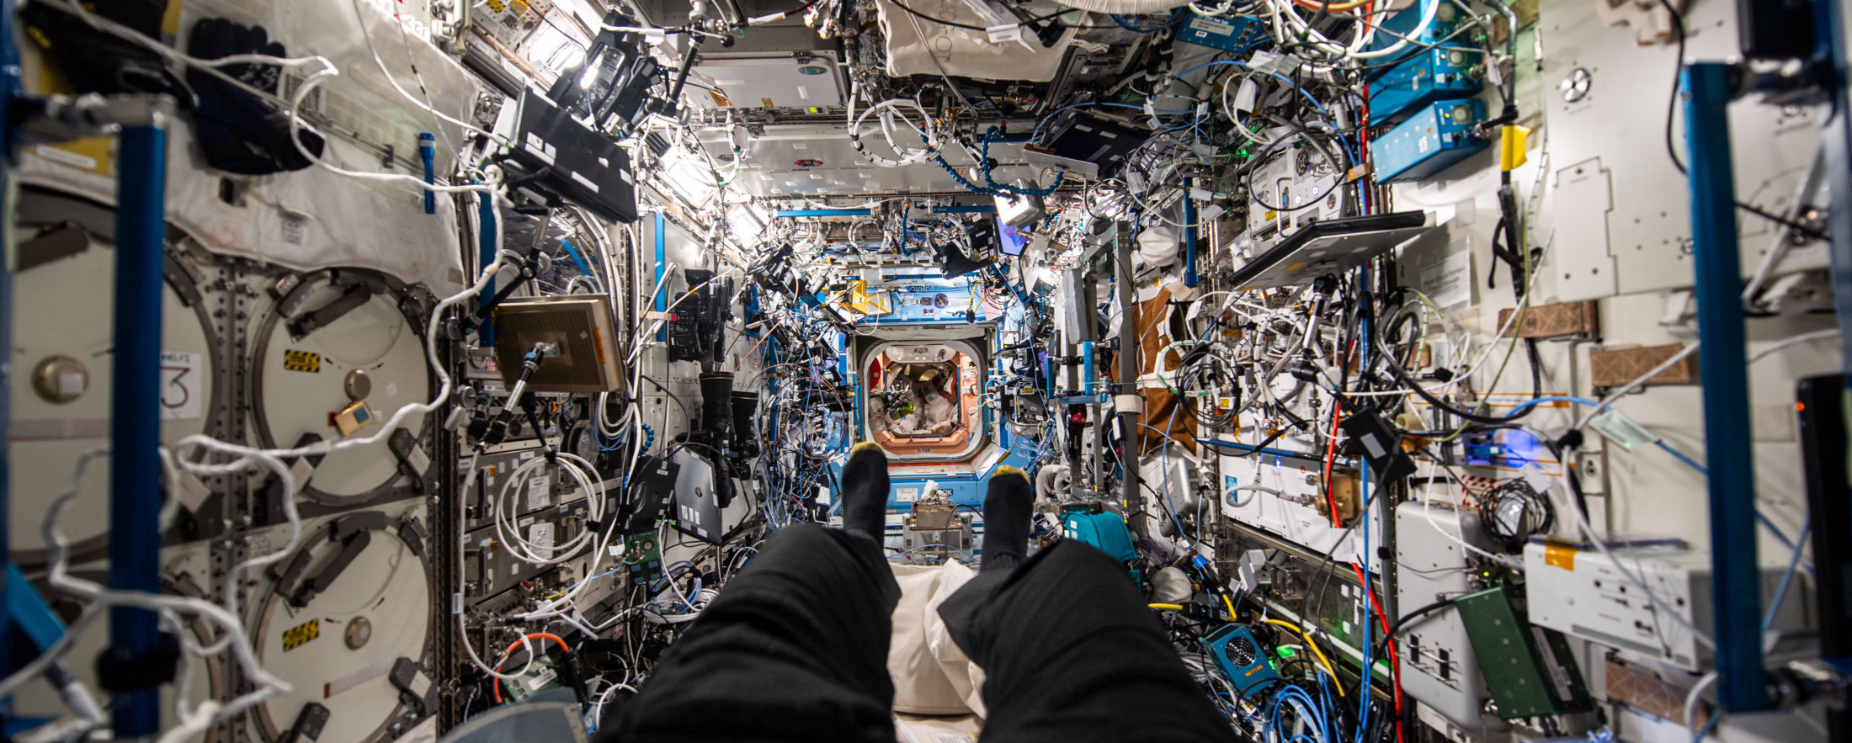
The state of the art today
© ESA – M. Wandt · ISS interior photographed by Marcus Wandt in the Destiny laboratory — cables everywhere
Notes:
Almost the best we have now — messy, loud, poor light, cramped.

Slide 7
What makes space stressful?
Space first · then school and home · then: what helps you relax?
© ESA – M. Wandt
Notes:
Open floor → whiteboard: space, then school/home, then what helps you relax. The board stays up all class.

Slide 8
The cognitive link
Environment
noise · light · clutter · greenery · space
Stress & recovery
how the body and mind react
Cognition
attention · memory · decisions
Examples from the board: a noisy cabin raises stress and lowers attention; a view of Earth, plants and good light help you recover.
Notes:
Guide students to name three link elements before showing this slide.

Slide 9
Better habitats need evidence, not guesswork
Opinions differ — measurements settle it. That is why we test.
Notes:
Tie to the whiteboard list.

Slide 10
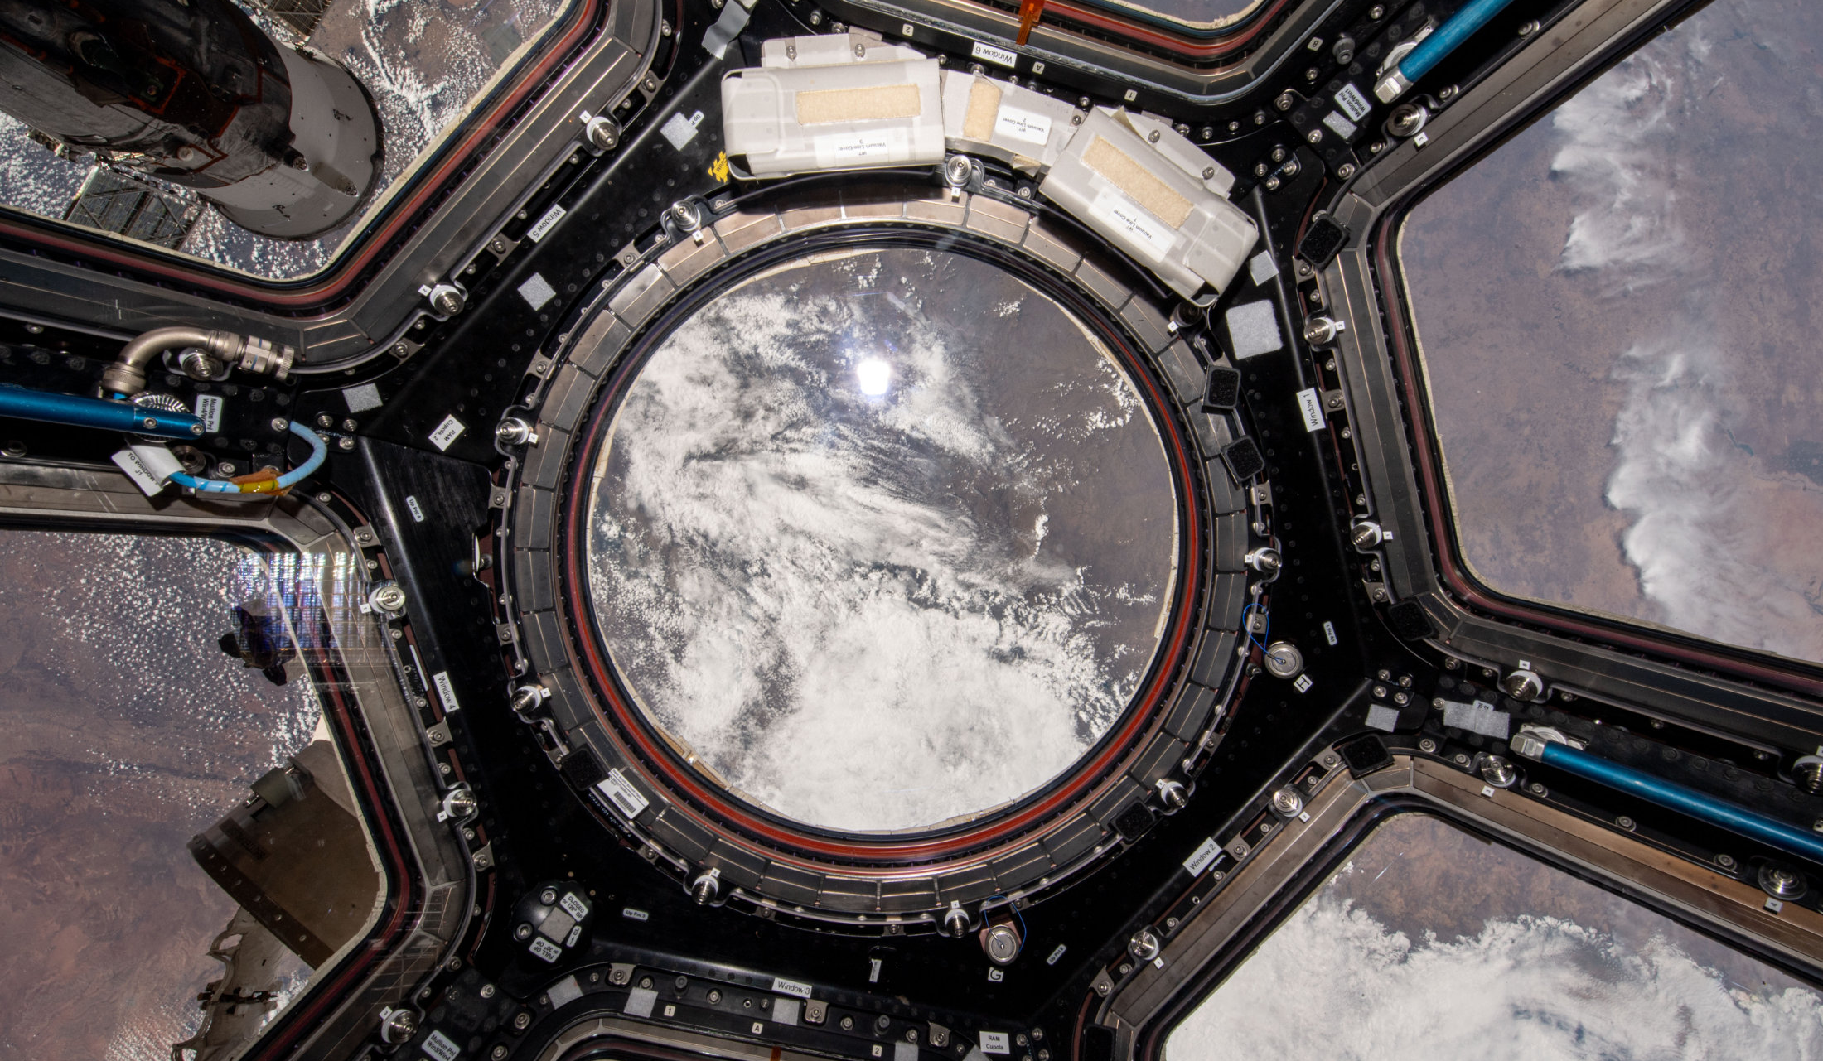
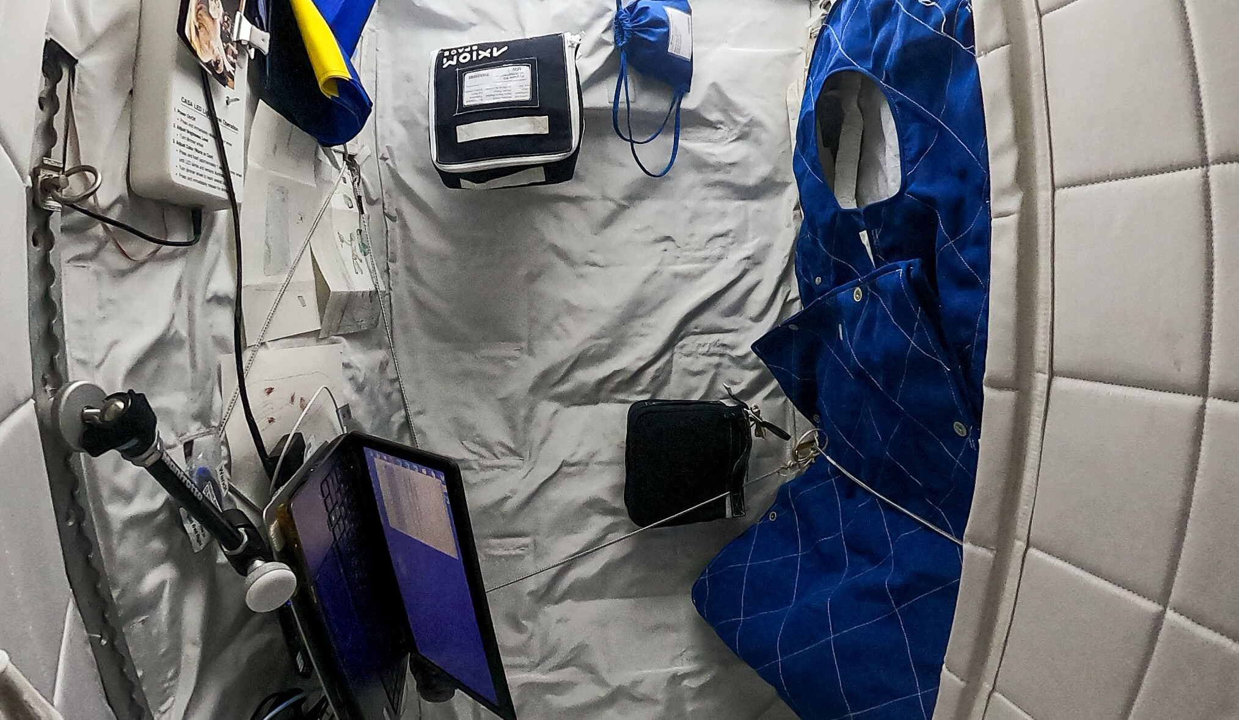
What crews live in today
The Cupola — the only window with a real view of Earth
Crew sleeping quarters — a phone-booth-sized private space
© ESA – M. Wandt
Notes:
Two real places astronauts spend time: the Cupola window and the phone-booth-sized sleeping quarters. Ask: where would you rather spend six months?

Slide 11
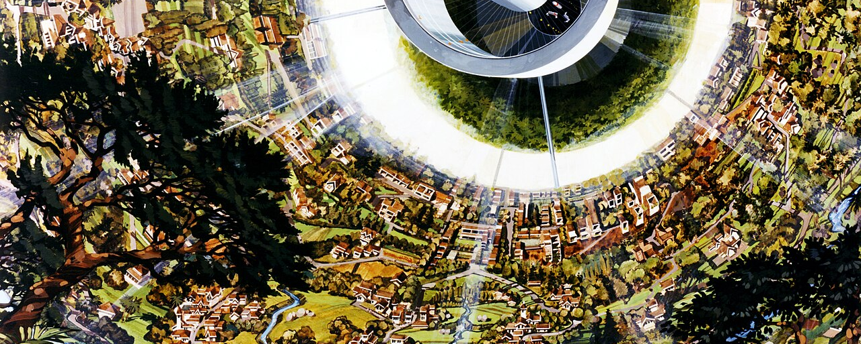
The future vision
© NASA – Rick Guidice, NASA Ames Research Center · Rotating habitats with greenery and windows — concept art from the 1970s
Notes:
Inspiring — but perhaps centuries away (the speaker's own estimate).

Slide 12
Small steps today
Small quantitative experiments
measure one thing at a time: noise, light, clutter…
Qualitative change over time
better-designed stations, happier and sharper crews
We are taking those steps now — and today, so are you.
Notes:
We are taking those steps now.

Slide 13
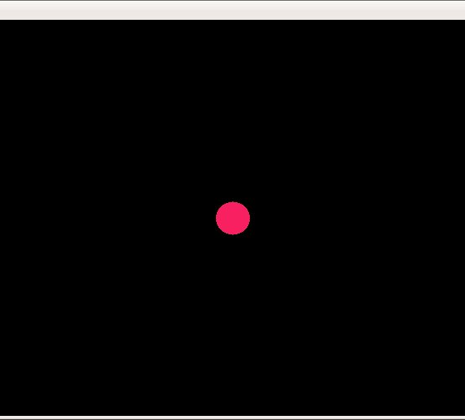
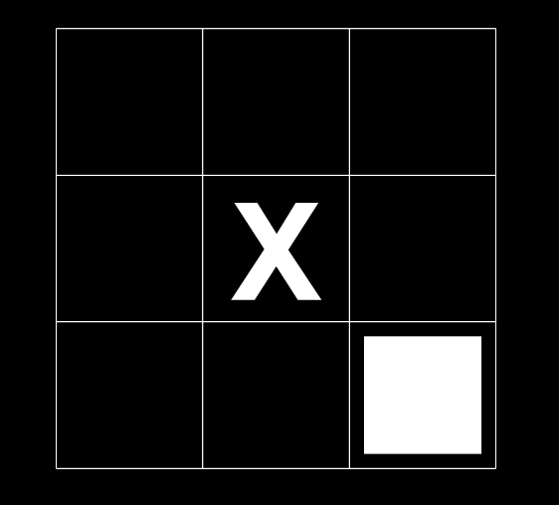
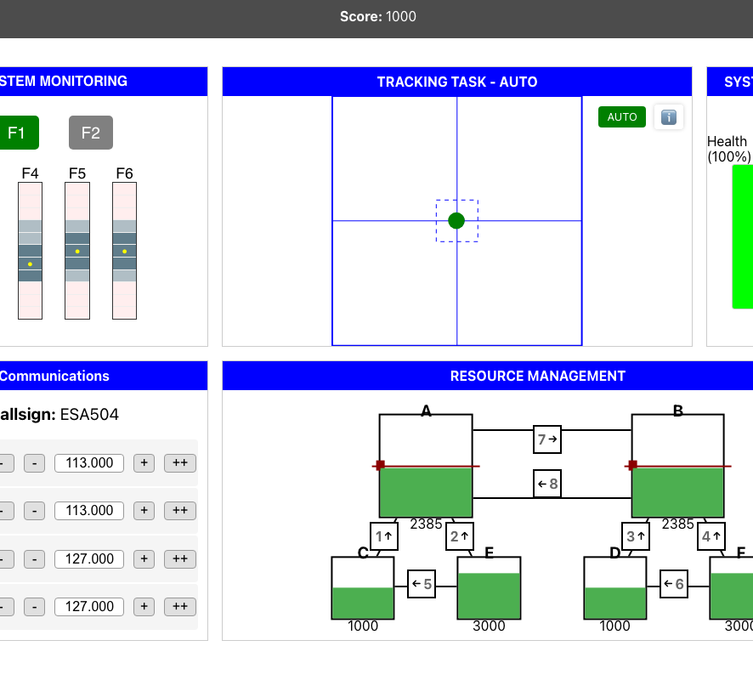
How we test cognition
Reaction Time (PVT-style) — alertness · everyone, as a warm-up
N-Back — working memory · ages 16–18
MATB — executive function · ages 14–15 focus
“How does your math teacher know if you're good at math?” → tests.
Notes:
Ask the class the question first. Three tests, three cognitive functions.

Slide 14
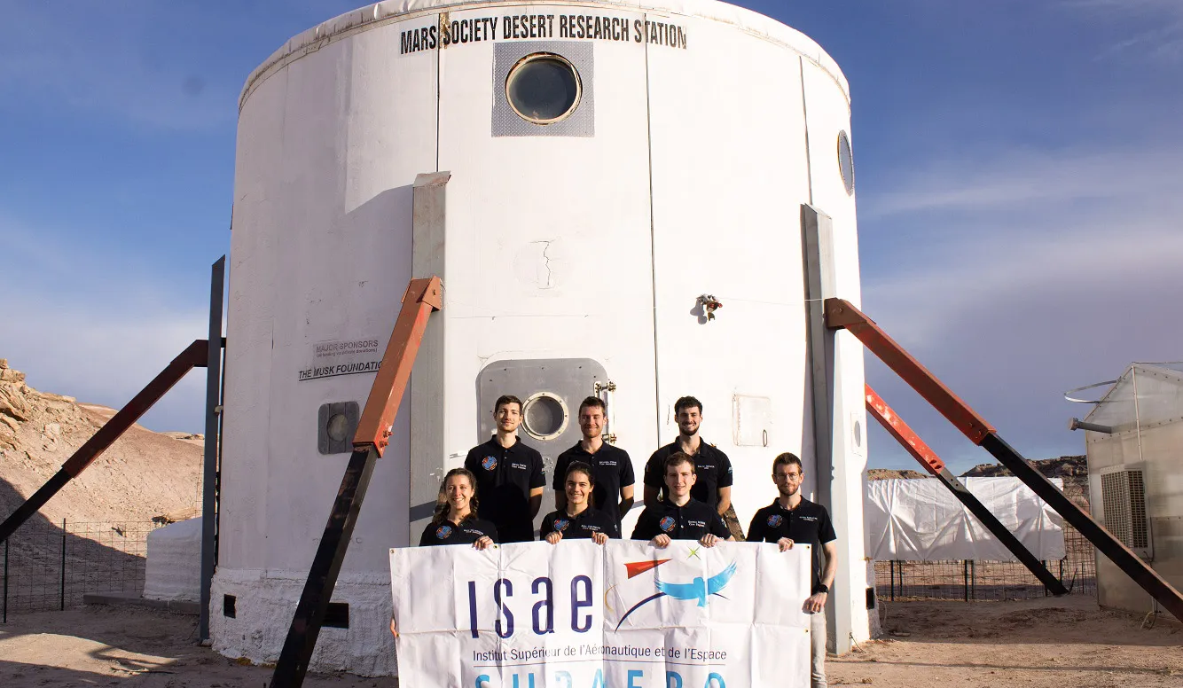
Where this research runs
MDRS, Utah — Mars Desert Research Station with ISAE-SUPAERO crews (MDRS 275, 293, 311, 330)
The ISS — Marcus Wandt, ESA Muninn mission, 2024
© ISAE-SUPAERO · © ESA – M. Wandt
Notes:
The same tests ran in the Utah desert with analogue crews and on the ISS with Marcus Wandt. Today the class joins that dataset.

Slide 15
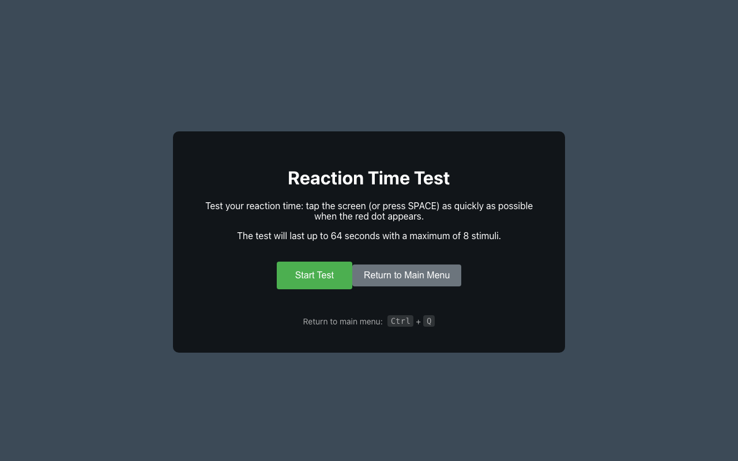
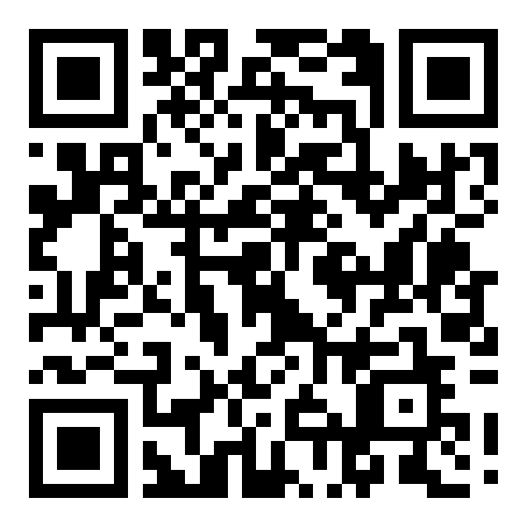
Reaction Time — one round
Tap the screen (or press SPACE) as fast as you can when the red dot appears
One round · 8 dots · about a minute
Everyone is different — confounders
You vs. you: the Condition Lab later compares you with yourself, as a % of your own score
Scan to open
/reaction-default
magkosm.github.io/orbarch-edu/reaction-default?lng=en
Start screen. Write your average and fastest time on the handout.
Notes:
Release the QR when ready. Show ONLY this QR.

Slide 16
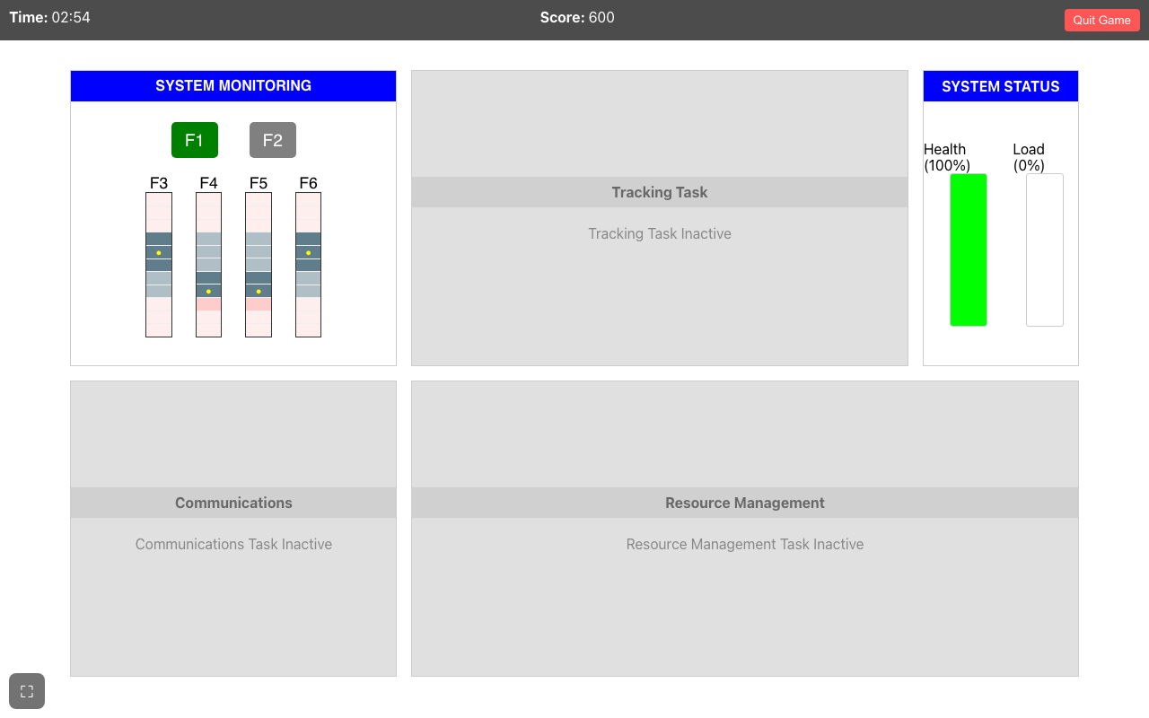
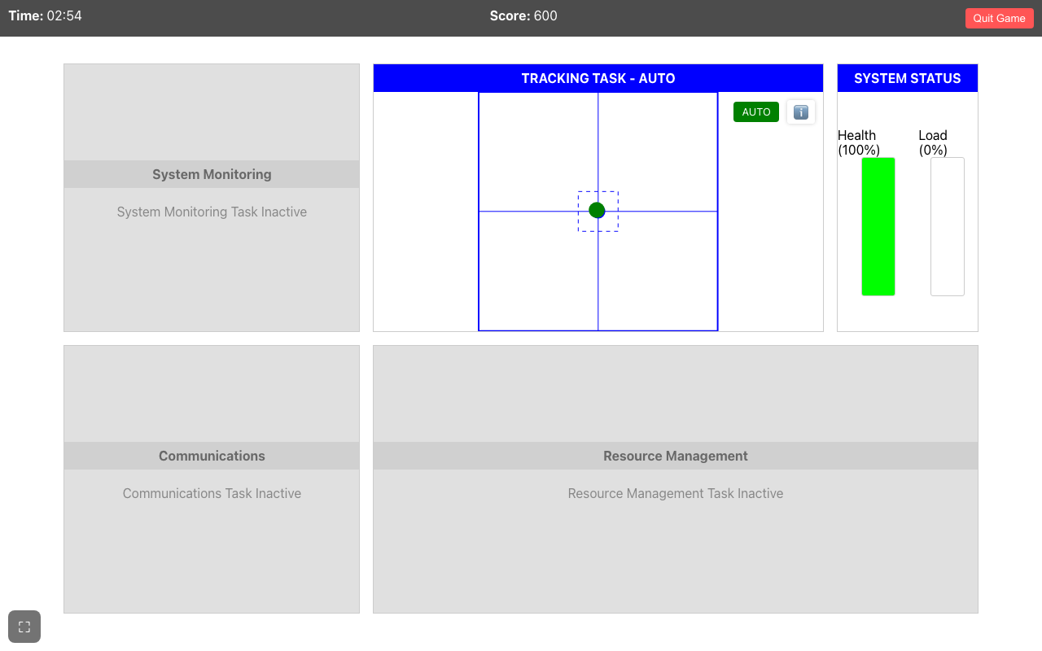
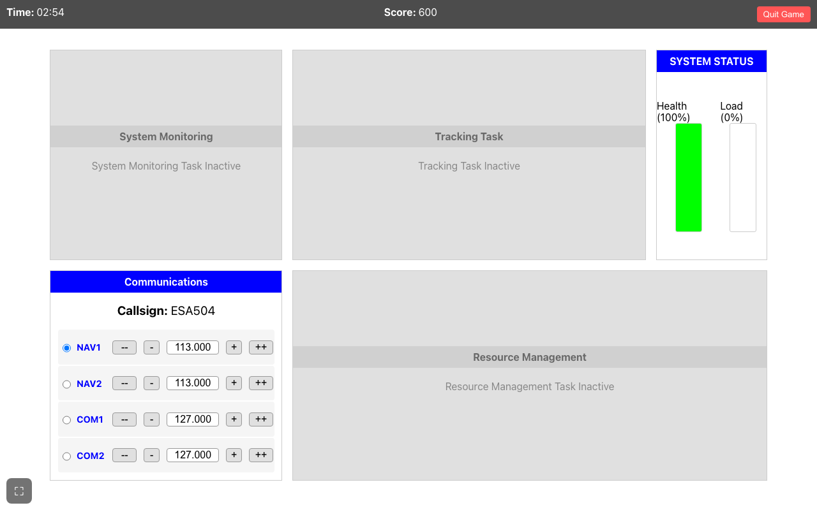
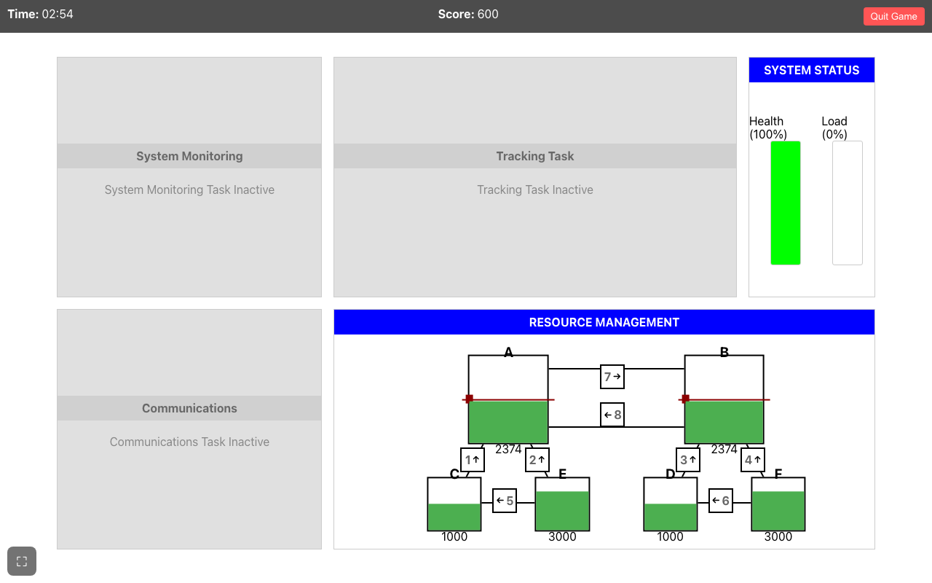
MATB — four tasks at once (teacher demo)
System Monitoring — tap the light or gauge that goes wrong
Tracking — keep the cursor in the square when it says MANUAL
Communications — answer only calls for your own callsign
Resource Management — keep tanks A and B at their target level
Presets → Training modes: one task at a time on the projector. No student QR yet.
Notes:
Projector only until the dry run. Read each instruction box aloud in your own words.

Slide 17
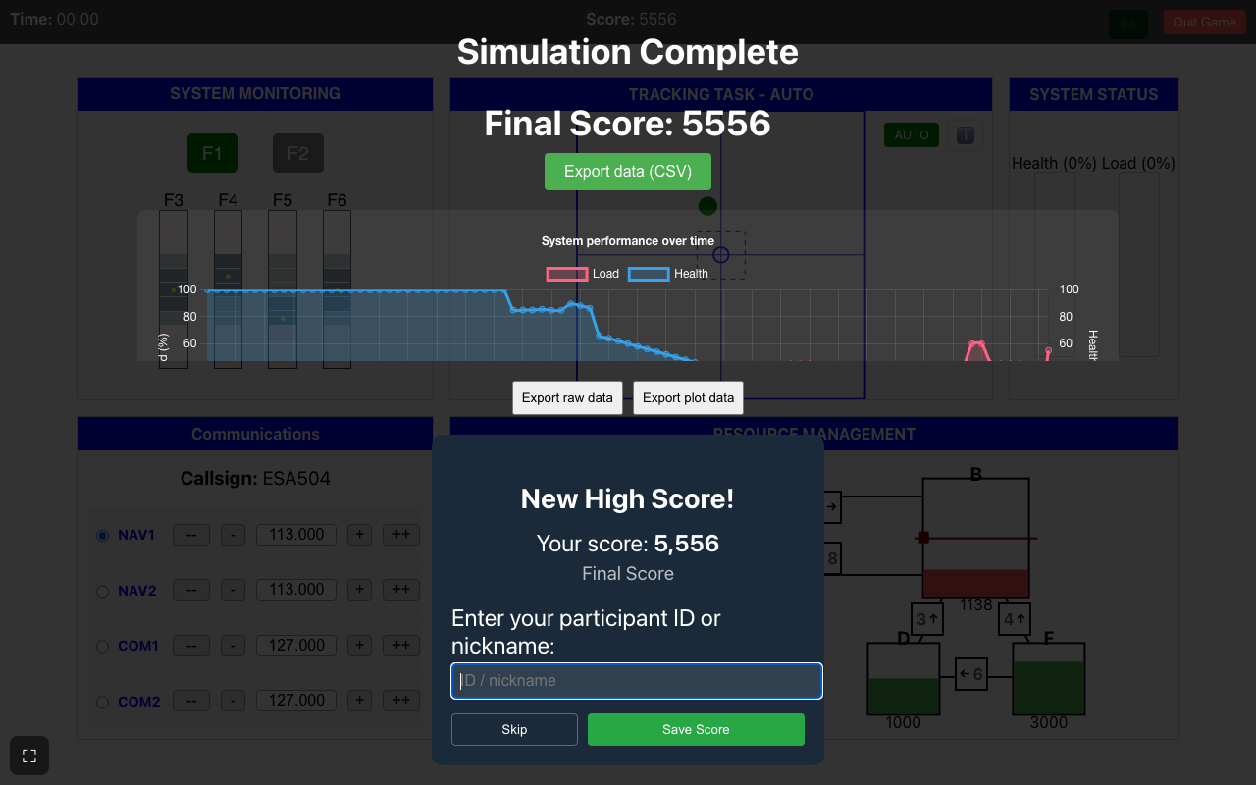
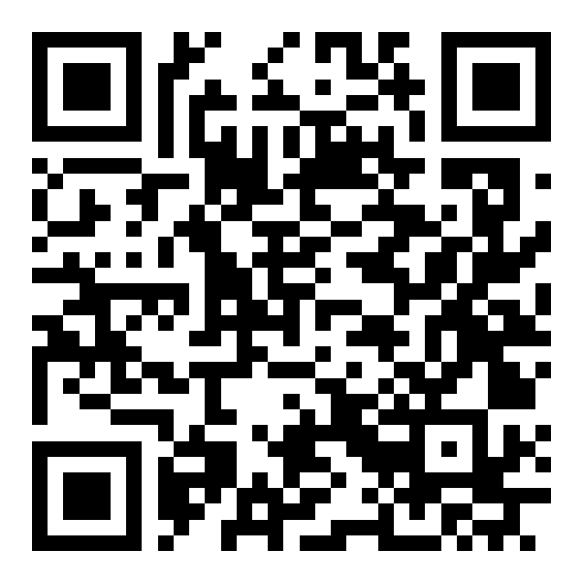
MATB dry run
Everyone: one practice run (2 minutes)
Don't quit — let the time run out
At the end: read the Final Score at the top
If a box asks for a name: tap Skip — no real names
Scan to open
/2min
magkosm.github.io/orbarch-edu/2min?lng=en
End screen: Final Score at the top; the high-score box can be skipped.
Notes:
Walk the room. Students who freeze usually forgot the AUTO/MANUAL rule or have no sound.

Slide 18
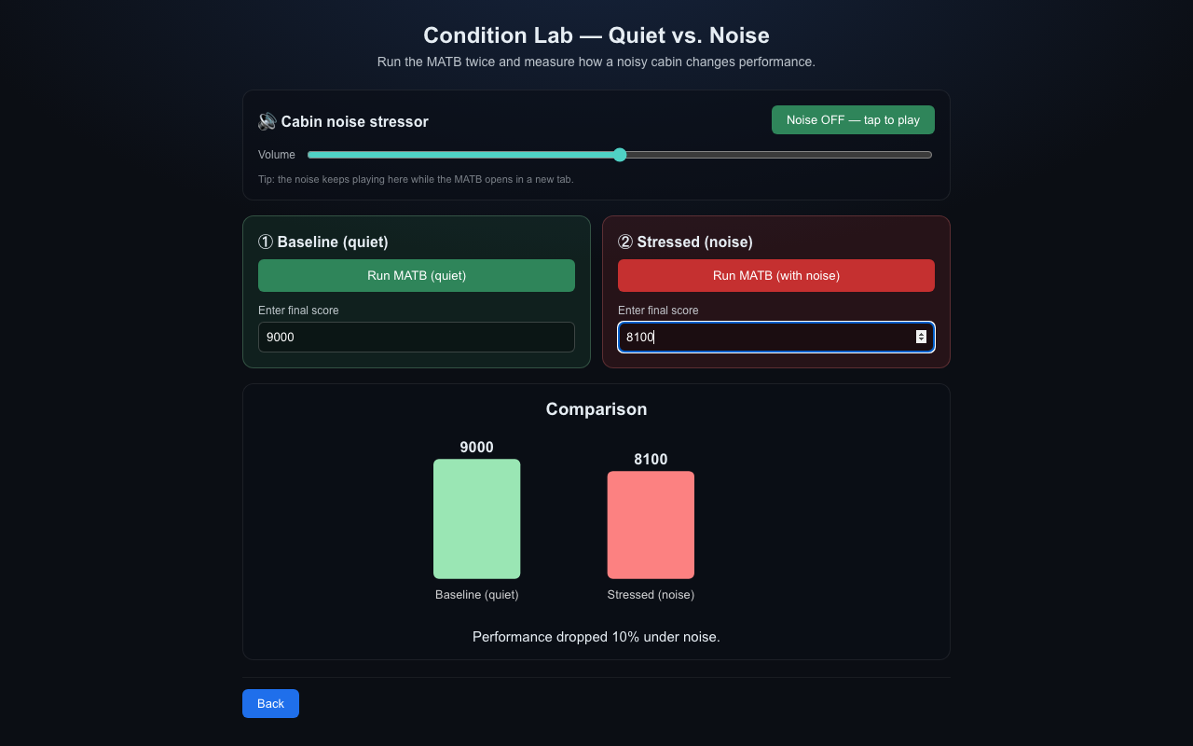
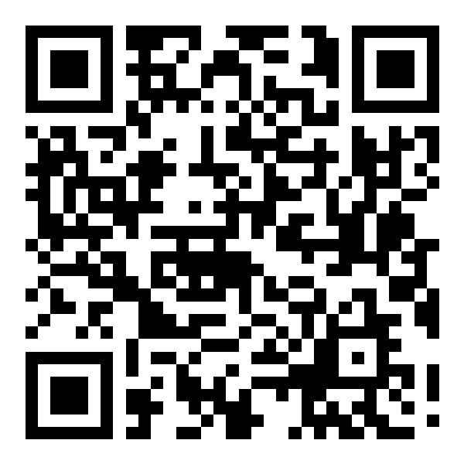
Condition Lab — quiet vs. noise
① Quiet run — all together, speakers off
② Cabin-noise run — all together, speakers on
Type both scores into the Condition Lab
Read the % change and copy it to the handout
Scan to open
/condition-lab
magkosm.github.io/orbarch-edu/condition-lab?lng=en
Both scores entered: the comparison and the % change appear.
Notes:
MATB opens in a new tab; come back to this tab to type the score. Expect mixed results — that is the discussion.

Slide 19
Learning and plateau
Like a new sport: you improve fast, then you reach a plateau
Daily swings remain — sleep, mood, food
Real studies repeat until scores are stable, then test conditions
Today is a taste of that protocol
Notes:
Draw on the whiteboard; real studies repeat until stable.

Slide 20
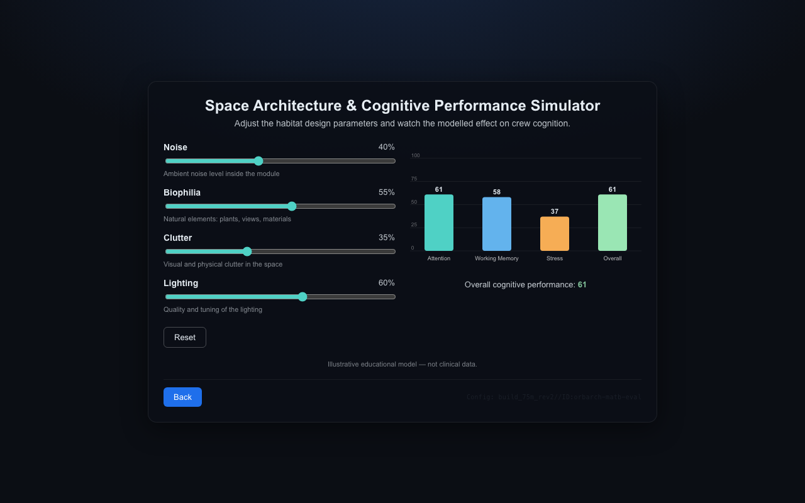
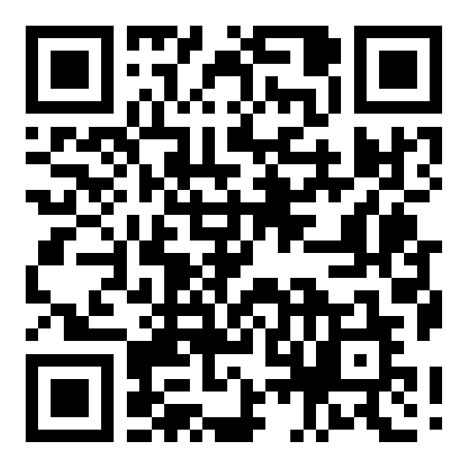
Architecture Simulator
An illustrative model inspired by research
Sliders: noise · light · clutter · biophilia
Watch attention, working memory and stress move
Find the best and the worst cabin
Scan to open
/simulator
magkosm.github.io/orbarch-edu/simulator?lng=en
Drag the sliders; the bars update live.
Notes:
Say clearly: an educational model, not measured data.

Slide 21
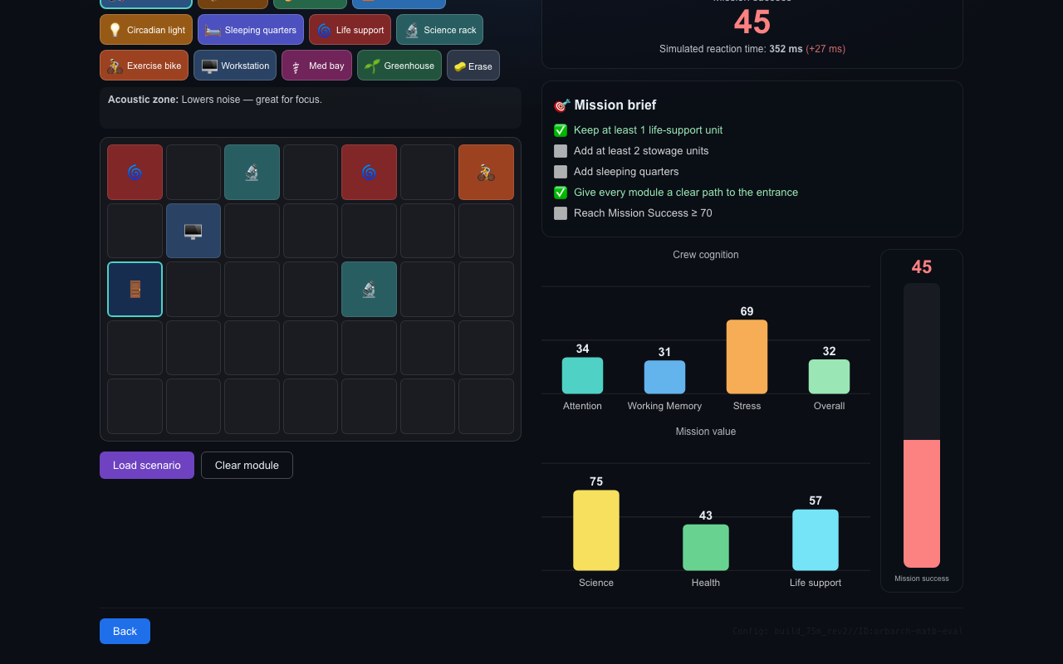
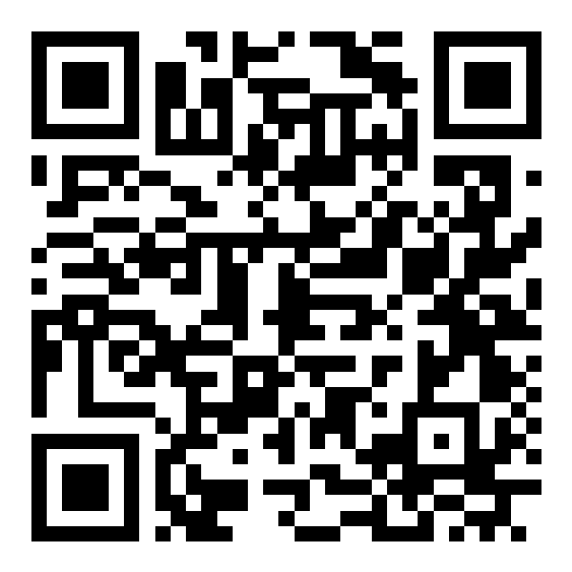
Blueprint Designer — mission brief
Design a station module on the grid
Crew cognition vs. science and engineering — every item is a trade-off
Every module needs a free corridor to the entrance
Target: Mission Success ≥ 70
Scan to open
/blueprint
magkosm.github.io/orbarch-edu/blueprint?lng=en
Load scenario gives a starting layout; the brief checklist turns green as you go.
Notes:
Repeat the corridor-to-entrance rule. Project a high-scoring student's layout.

Slide 22
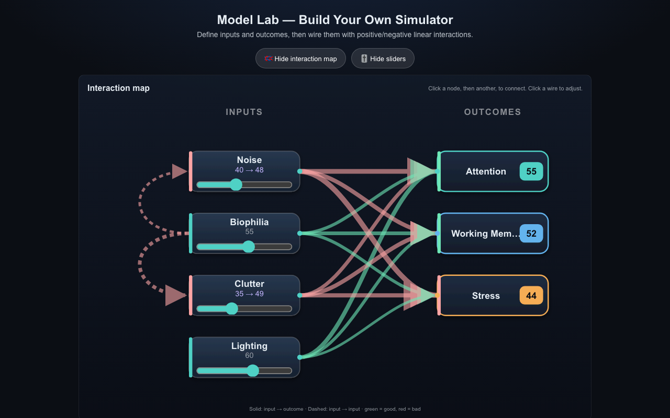
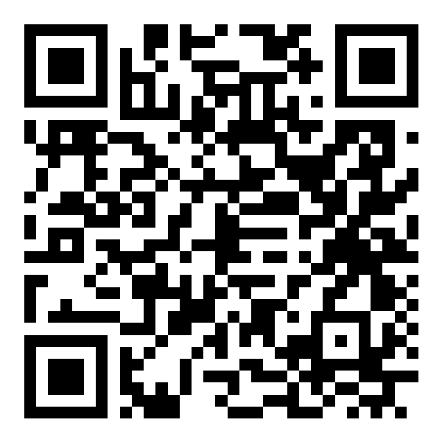
Model Lab (optional)
Build your own simulator
Add inputs and outcomes from the whiteboard list
Green wires help, red wires hurt
If this outcome matters, what should we design for?
Scan to open
/model-lab
magkosm.github.io/orbarch-edu/model-lab?lng=en
The interaction map shows every link in the model.
Notes:
Cut this block first if you are running late.

Slide 23
Exit ticket
Two sticky notes per student — write your name on each.
① Helps cognition
something in the architecture that helps the crew's mind
② Hurts cognition
something in the architecture that hurts it
Notes:
Collect the notes for a classroom display or teacher review.

Slide 24
Four things to take home
Space is for everyone.
Architecture is about people.
Design is a series of trade-offs.
You are the future of space exploration.
Notes:
Land the big ideas from today; thank them as future space architects.

Slide 25
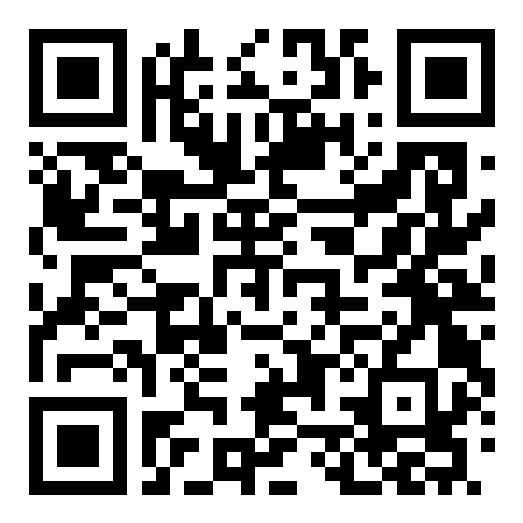
Thank you
Open the app at home
magkosm.github.io/orbarch-edu
Orbital Architecture · KTH Royal Institute of Technology · ESERO Sweden
Notes:
Show the hub QR so students can explore at home.

