Slide 1
BOKKEN · DESIGN THINKING RUN REPORT
ITERATE — Lanzadera is an on-demand commuter shuttle for Spanish suburbs whose core covenant is a +/-6-minute pickup window.
Session 'gallery' · 28 evidence items · 9 options · register 4/2/4 (supported/contradicted/untested) · ~$10.36
SIMULATED RUN — autonomous run against a governed synthetic persona panel; all persona contributions are simulated and evidence-bounded. Flagged decisions require validation with real users.

Slide 2
EXECUTIVE SUMMARY
The verdict is iterate — the whole story in one table
What | Result | So what
Problem chosen | Daily pass commuters (46%→38% of riders) plan their mornings around a ±6-minute promise the product no longer keeps (71% | selected on evidence + opportunity coverage
Top opportunity | O3: Increase trust that the app's on-time indicator reflects the promise made to the rider, not the re-planned route - o | Ulwick score drives the focus
Concept advanced | 'Ventana honesta': at 21:00, with the route already optimized, push the real pickup point and an honest window for tomor | won three firewalled lenses
Product tested | 4 features exercised, 1 broken | fix list in Next Actions
Register | 4 supported · 2 contradicted · 4 untested | verdict: iterate
Cost | $10.36 · 63 model calls | illustrative profile — charged $0.00
Validation guardrail: synthetic personas scored these hypotheses; they do not validate them. Final judgment needs real users.
Bokken · session gallery — generated from the Journal, no manual edits 01

Slide 3
HOW THIS RUN WORKED
Six stages, three panels, every actor journaled
EMPATHIZE
DEFINE
IDEATE
PROTOTYPE
TEST
COMPLETE
interviews + UI tests + Ulwick outcome ranking
insights -> problem statement, losers preserved
quota divergence; 3 firewalled lenses converge
web research; assumption register; artifacts
fresh panel scores register; verdict
dossier + handoff + this report
The cast (synthetic, labeled)
interview: skeptic-agent (skeptic); feasibility-agent (feasibility); viability-agent (viability); Tomas (64, Badajoz) (segment); Tomas (60, Zaragoza) (segment); Javier (44, Zaragoza) (segment)
ideation: skeptic-agent (skeptic); feasibility-agent (feasibility); viability-agent (viability); Marta (72, Zaragoza) (segment); Pablo (48, Zaragoza) (segment); Javier (24, Murcia) (segment)
test: skeptic-agent (skeptic); feasibility-agent (feasibility); viability-agent (viability); Carmen (28, Zaragoza) (segment); Ramon (36, Madrid) (segment); Carmen (52, Zaragoza) (segment)
System agents
• concept-researcher — sourced web research
• ui-walker + ui-tester — browser tests
• sidekick — cached reads (never judges)
• lenses + skeptic — challenge lane
Models
• claude-fable-5: 33 calls, $7.74
• claude-haiku-4-5: 9 calls, $0.07
• claude-opus-5: 12 calls, $2.16
• claude-sonnet-5: 9 calls, $0.39
Bokken · session gallery — generated from the Journal, no manual edits 02

Slide 4
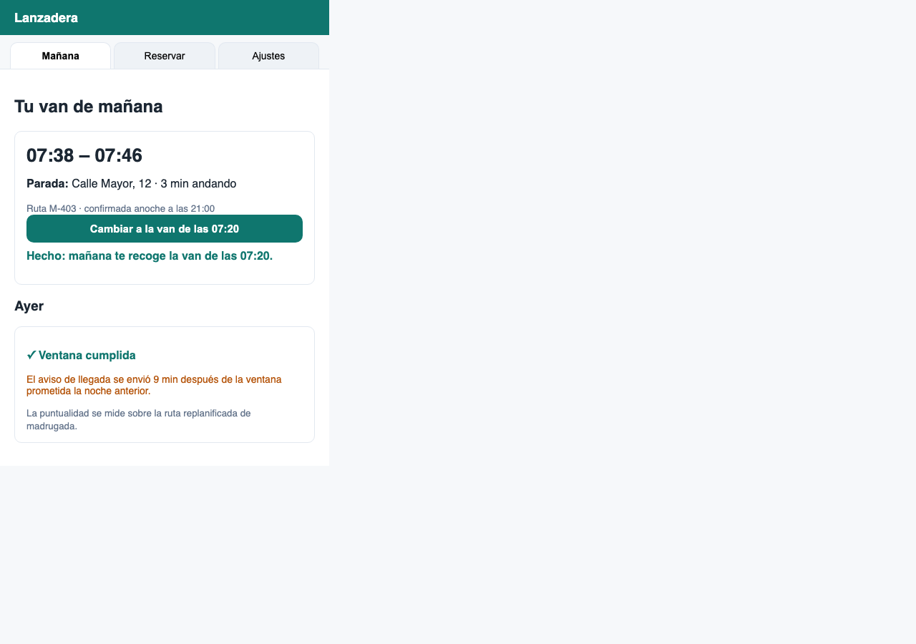
OBSERVED · FUNCTIONAL UI TESTS
4 features exercised in a real browser — 1 broken
Feature | Verdict | Finding (observed)
Cambiar a una van más puntual | works | The switch responds instantly and confirms inline ('mañana te recoge la van de las 07:20') without leaving the
Reservar un asiento | works | Day and van selectors plus one confirm tap; the confirmation promises the 21:00 notice, which is the right mom
Indicador de puntualidad de ayer | broken | The card shows a green 'Ventana cumplida' tick directly above a notice that the arrival alert went out 9 minut
Aviso de las 21:00 (ajustes) | unclear | The opt-in checkbox exists, but its state does not visibly persist when switching views, so whether the prefer
End state of a broken feature (observed)
Bokken · session gallery — generated from the Journal, no manual edits 03

Slide 5
EMPATHIZE · OUTPUT
Where the underserved demand is (Ulwick-scored)
# | Outcome | Opp | Band
1 | Increase trust that the app's on-time indicator reflects the promise made to the rider, not the re-planne | 16.0 | severely underserved
2 | Increase the likelihood that the pickup window promised at 21:00 is the window that actually happens the | 14.0 | underserved
3 | Minimize the surprise of a pickup point that moved overnight - the rider knows the point and the walk bef | 13.0 | underserved
4 | Minimize the cost of a missed pickup - a same-morning recovery option instead of a 90-minute gap | 11.3 | moderate
5 | Increase the perceived fairness of route optimization - riders understand why their pickup changed | 10.3 | moderate
6 | Minimize the door-to-van walk variance across weeks | 9.7 | served
7 | Minimize the money a 2-3 day rider wastes versus pay-per-use reality | 8.3 | served
Opp = Importance + max(Importance - Satisfaction, 0), mean across personas; >=15 severely underserved, 12-15 underserved.
Bokken · session gallery — generated from the Journal, no manual edits 04

Slide 6
THE CONCEPT
What advances, and why it won
'Ventana honesta': at 21:00, with the route already optimized, push the real pickup point and an honest window for tomorrow - including 'wide window (12 min) on your street tomorrow' - with a one-tap switch to an earlier van when the window is wide [serves: O0
Why it won (lens positions)
• verdict green, effort S, first slice: push tomorrow's point+window at 21:00, read-only (no van switching yet) - The route engine already commits a pla
• verdict red, effort L - A rider-voted pickup map fights the optimizer head-on; every vote becomes a constraint the engine must not break. Not honestly
• RICE 4.2: reach 9 (every active rider gets the 21:00 push), impact 3 (attacks the top-ranked outcome, opp 16.0), confidence 0.7, effort 4.5 pw
Dissent on record
• feasibility: red verdict on a5967a0c059c4f038a09f6fbeccaba6c: verdict red, effort L - A rider-voted pickup map fights the optimizer head-on; every vote becomes a c
Hypothesis: We believe daily pass holders will forgive wide windows they were warned about,
Bokken · session gallery — generated from the Journal, no manual edits 05

Slide 7
REPORTED · CONCEPT RESEARCH
The market, on the record (every claim sourced)
Competitor / prior art | What it does | Overlap with the concept
BusUp (demo data) | B2B commuter shuttles with contractual SLAs | partial - no consumer-facing window promise
Renfe Cercanias (demo data) | publishes real-time punctuality | the substitute riders defect to at 1.85 EUR
Market signals (sourced)
• DEMO: 62% of shuttle churners cite reliability communication, not reliability itself
Differentiation risks
• DEMO: honesty-forward messaging is easily copied; the moat is the nightly engine commitment, not the copy
Bokken · session gallery — generated from the Journal, no manual edits 06

Slide 8
TEST · OUTPUT
Register: 4 supported · 2 contradicted · 4 untested
Assumption | Impact | Verdict
Riders on wide-window days will switch vans rather than churn | high | contradicted
The 21:00 booking-change deadline is the right moment for the truth push | medium | contradicted
An honest 'wide window' warning reduces anger more than it reduces bookings | high | supported
The route engine can commit a next-morning window at 21:00 within +/-2 min accuracy | high | supported
Riders will read a 21:00 notification the night before commuting | high | supported
Marta's segment (daily pass holders) values honesty over raw punctuality | high | untested
Publishing real compliance numbers will not be weaponized by competitors | medium | supported
Support ticket volume drops when windows are honest (402/mo baseline) | medium | untested
Diego's segment will not abuse a free missed-pickup rescue | medium | untested
Bokken · session gallery — generated from the Journal, no manual edits 07

Slide 9
HOW THE AGENTS ARGUED
Three lenses, one skeptic, dissent preserved
feasibility (2 votes)
verdict green, effort S, first slice: push tomorrow's point+window at 21:00, read-only (no van switching yet) - The route engine already commits a plan nightly; surfacing it at 21:00 is exposure, not invention. The README confirms
viability (2 votes)
RICE 4.2: reach 9 (every active rider gets the 21:00 push), impact 3 (attacks the top-ranked outcome, opp 16.0), confidence 0.7, effort 4.5 pw
desirability (2 votes)
Directly serves the 16.0 outcome and Marta's exact words: 'I can plan around honesty'
The skeptic, verbatim
The weakest claim on the table is that honesty reduces churn: the record proves riders are angry about the lying tick, but no evidence shows a warned rider stays. A 'wide window' push at 21:00 might simply move the churn decision to bedtime. The cheapest test: measure switch-vs-cancel behavior on the one-tap van change before believing the retention story.
Kata interventions (8)
• stage_contract (empathize)
• stage_contract (define)
• hmw_reframe (define)
• stage_contract (ideate)
• timebox_pivot (ideate)
Bokken · session gallery — generated from the Journal, no manual edits 08

Slide 10
ACTION ORIENTED
What to do next, in order
# | Action
1 | Fix (Indicador de puntualidad de ayer): The card shows a green 'Ventana cumplida' tick directly above a notice that the arrival alert went out 9 minutes after the pr
2 | Address the test contradiction: A test result contradicts earlier work: the 'honesty reduces churn' assumption is contradicted by the same evidence that supports dem
3 | Recommendation is 'iterate': validate the supported assumptions with real users before building.
Bokken · session gallery — generated from the Journal, no manual edits 09

Slide 11
APPENDIX
Specifications handed off + the paper trail
honest-ontime-indicator — The on-time tick measures the 21:00 promise, never the dawn re-plan.
handoff/openspec/changes/build-mvp-gallery/specs/honest-ontime-indicator/spec.md
On file
• dossier/dossier.md
• dossier/dossier.json
• journal.jsonl (hash-chained)
• artifacts/ (hashed, journaled)
Bokken · session gallery — generated from the Journal, no manual edits 10

