Slide 1
SESSION 1 OF 4
From Prompts to Harnesses
Same model, two harnesses, 9.5 points apart. In six years the lever moved from the words you send to the runtime around the model. First the ideas, then one question answered three ways.
Harness Engineering - Module 5
Notes:
Welcome to Module 5. Four sessions, four notebooks, one idea: an agent is a model plus a harness, and the harness is where most of the engineering happens. Today: where the word comes from, what a harness is made of, and one question answered three ways in notebook 01. Class question to open: what do you think happens between your message and the model's answer in a tool like Claude Code or Codex?

Slide 2
01
Part 1 - The theory: from the prompt to the harness
Where the word comes from, what a harness is made of, and the evidence that it changes results.
M5 Session 1 - From Prompts to Harnesses
2
Notes:
Part 1 is ideas only, about 35 minutes: the timeline, three definitions, the car, the evidence, the eight pieces, workflows against agents, and the vocabulary. Class question: before we start, in one sentence, what is prompt engineering?

Slide 3
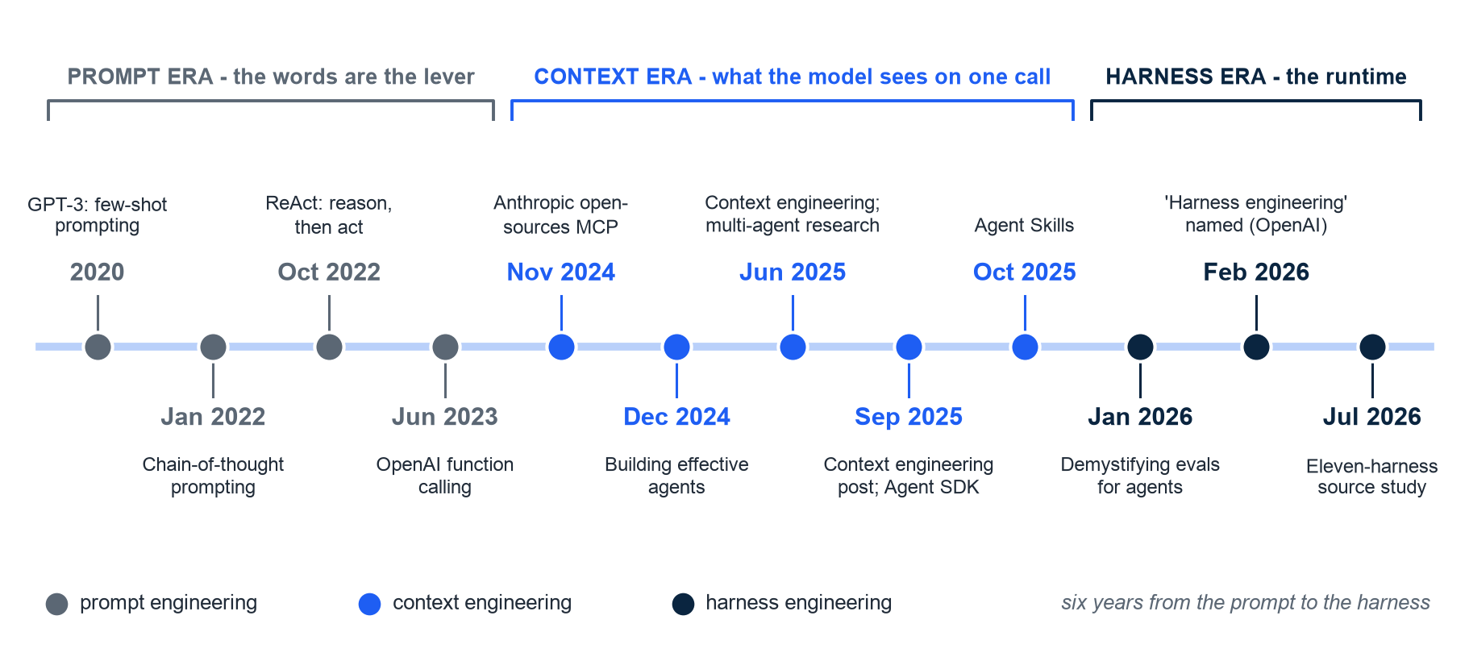
THE TIMELINE
Six years moved the lever from the words you send to the runtime around the model
How to read it: left to right in time, evenly spaced (not to scale). Gray = prompt era, blue = context era, navy = harness era. Dates from the cited papers and posts.
M5 Session 1 - From Prompts to Harnesses
3
Notes:
Walk the line left to right. 2020 to 2023 is the prompt era: few-shot prompting (Brown et al.), chain-of-thought (Wei et al., Jan 2022), ReAct (Yao et al., Oct 2022) which interleaves reasoning and actions and is the seed of the agent loop, and OpenAI function calling (13 Jun 2023) which made structured tool calls a product feature. 2024-2025 is the context era: MCP (25 Nov 2024), Building effective agents (19 Dec 2024), context engineering replacing prompt engineering in Jun 2025, Anthropic's context-engineering post and the Agent SDK (29 Sep 2025), Agent Skills (16 Oct 2025). 2026 is the harness era: evals (Jan), OpenAI names harness engineering (11 Feb), the eleven-harness source study (Jul). Class question: which of these twelve steps have you already used, knowingly or not?

Slide 4
WHY NOW
The field is young: most harnesses are less than a year old
21,500
'agent harness' repositories created in 2026; median harness age 8.7 months
Marmelab, The State of AI Harness Engineering 2026, 24 Sep 2026. In plain words: almost everyone building this is a beginner too - the discipline is being written now.
M5 Session 1 - From Prompts to Harnesses
4
Notes:
Two numbers to set expectations: 21,500 repositories in one year, and a median age of 8.7 months. Nobody has ten years of harness experience. The practices we teach in this module are the ones that survived the first two years. Class question: what does a median age of 8.7 months tell you about the tutorials you find online?

Slide 5
“An agent is a model plus a harness: the runtime that couples an LLM to the world through a loop, tools, context management, safety controls, orchestration, and extension surfaces. Harness engineering, named as a discipline in early 2026, is the design and evolution of that runtime.”
Barbaste, Darrigol, Vu and Wiltberger, Harness Engineering: Anatomy, Architecture, and Evolution of Coding Agents, arXiv 2609.00006, Jul 2026 - a source-code study of eleven coding agents
M5 Session 1 - From Prompts to Harnesses
5
Notes:
Read it aloud once, then unpack it: a loop, tools, context management, safety controls, orchestration, extension surfaces. Those six words are the table of contents of this module. The paper read the source code of eleven systems (Claude Code, Codex CLI, Gemini CLI, Aider, OpenHands, mini-SWE-agent, Hermes, Pi, OpenCode, OpenClaw, Mistral Vibe) and found that 'the field runs on hand-rolled async loops and deterministic retrieval'. Class question: which of the six words do you think is hardest to get right, and why?

Slide 6
THREE DEFINITIONS, ONE IDEA
Agent = Model + Harness: one equation, two framings
Agent = Model + Harness
OpenAI's framing, Feb 2026
Birgitta Bockeler's one-line canon, quoted in Marmelab, Sep 2026
In plain words: the model is the engine; the harness is the rest of the car
The model maps a context to the next message - nothing else
The harness decides what the model sees, what it may do, and when to stop
Swap the harness and the same model behaves differently (evidence in two slides)
Five-month experiment: about one million lines of production code, zero written by hand
The repository is the system of record: design docs, decision records, plans, quality scores
Constraints enforced mechanically: custom linters and structural tests in CI
Harness engineering = deterministic scaffolding around probabilistic model steps
Ryan Lopopolo, Harness engineering: leveraging Codex in an agent-first world, 11 Feb 2026
Sources: Marmelab, The State of AI Harness Engineering 2026, 24 Sep 2026; OpenAI, 11 Feb 2026; arXiv 2609.00006, Jul 2026.
M5 Session 1 - From Prompts to Harnesses
6
Notes:
Left: the shortest definition we have, and the plain-words version we will repeat all module - the model is the engine, the harness is the rest of the car. Right: OpenAI's experiment makes it concrete. When no human writes code by hand, everything that keeps quality up must live in the harness: documents in the repository that the agent reads, and checks in CI that the agent cannot skip. 'Deterministic scaffolding around probabilistic model steps' is the phrase to remember. Class question: if the model is probabilistic, which parts of the car must not be?

Slide 7
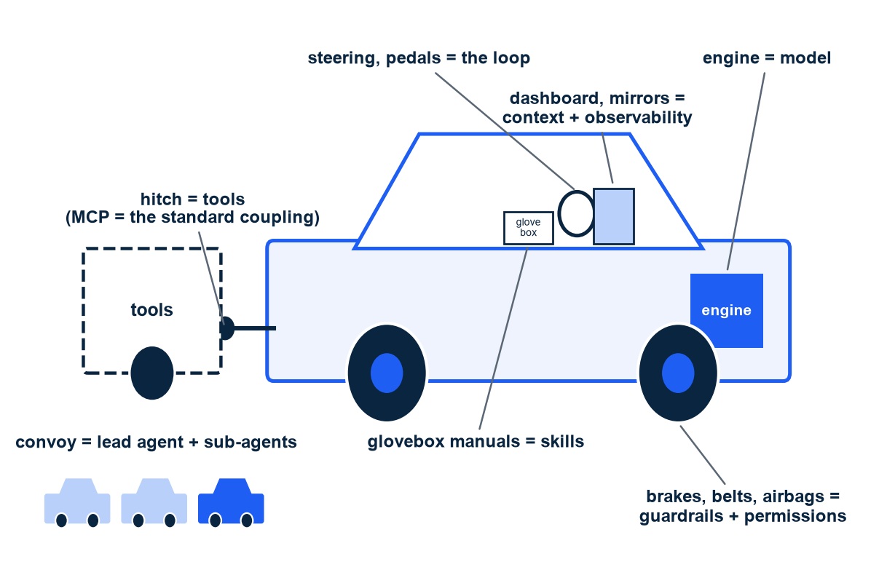
THE METAPHOR FOR THIS MODULE
Concretely: a model called in a loop, with tools and checks. In plain words: an engine inside a car
Concrete first: Claude Code is a program that calls a model in a loop, runs tools, and checks permissions
Engine = the model; steering and pedals = the loop that picks the next step
Dashboard and mirrors = context and observability: what the driver sees
Brakes, belts, airbags = guardrails and permissions, outside the model
Glovebox manuals = skills, opened only when needed; hitch = tools, MCP the standard coupling
Convoy with a lead car = orchestrator and sub-agents (Session 4)
Illustration. How to read it: each label pins one harness piece to one car part. The route on the GPS (the plan) and the drivers' job board (teams) come in Sessions 3 and 4.
M5 Session 1 - From Prompts to Harnesses
7
Notes:
Always the concrete thing first, then the picture. Claude Code, Codex CLI and Gemini CLI are all the same shape: a program calls a model, the model asks for a tool, the program runs it and pastes the result back, until the model says it is done. The car gives us one word per piece for the rest of the module. Class question: which car part is missing when an agent deletes a file it should not have touched?

Slide 8
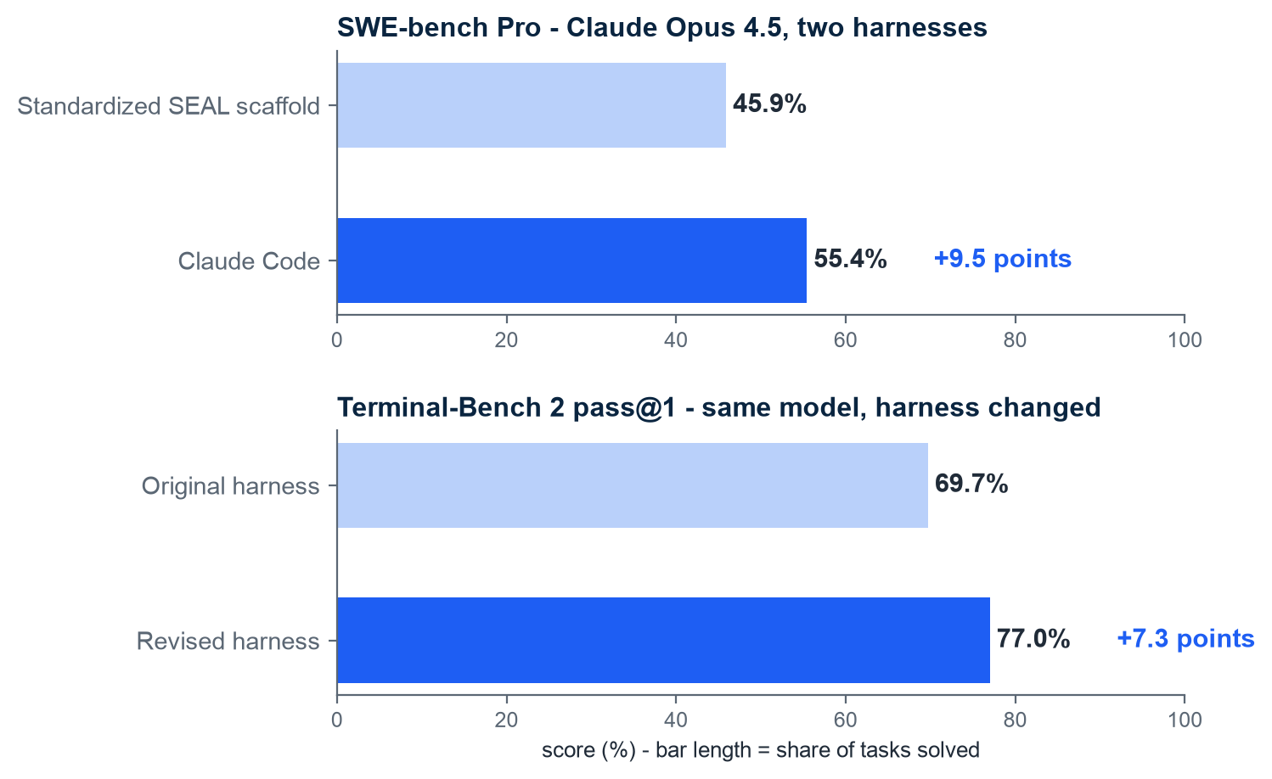
EVIDENCE
Same model, different harness: up to 9.5 points of harness-only variation on SWE-bench Pro
How to read it: each pair of bars is one model; only the harness around it changes
Claude Opus 4.5 on SWE-bench Pro: 45.9% under the SEAL scaffold, 55.4% under Claude Code
Three harnesses on that same model spanned 50.2% to 55.4%
Terminal-Bench 2 pass@1: 69.7% to 77.0% by changing only the harness
Third-party monitoring: up to 11 points for GPT-5, 15 points for Kimi K2 Thinking on SWE-bench Verified
Wording matters: harness-only variation, not 'the harness beats the model'
Sources: Stop Comparing LLM Agents Without Disclosing the Harness, arXiv 2605.23950, May 2026; Harness or Model? Isolating the Harness Effect, arXiv 2609.11987, Sep 2026.
M5 Session 1 - From Prompts to Harnesses
8
Notes:
This is the slide that justifies the module. The model is held fixed and the score moves by 7 to 15 points depending on the runtime around it. Be careful with the wording: the harness does not beat the model, it changes how much of the model's capability reaches the task. That is why the May 2026 paper asks every benchmark to disclose the harness. Class question: if two papers report different scores for the same model, what is the first question you now ask?

Slide 9
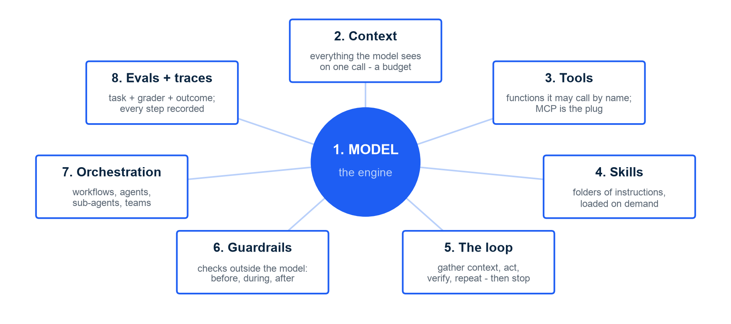
ANATOMY
A harness has eight pieces - the model is one of them, the other seven surround it
Illustration. How to read it: the numbered order is the canon order of every deck and of the harness package. Pieces 1-4: Session 2; 5, 6, 8: Session 3; 7: Sessions 3-4.
M5 Session 1 - From Prompts to Harnesses
9
Notes:
Read the ring clockwise from the top and give each piece its plain-words line: context is everything the model sees on one call; a tool is a function the model asks for by name with JSON arguments; a skill is a folder of instructions opened when the task matches; the loop is gather context, act, verify, repeat, with stop conditions; guardrails are checks that run outside the model; orchestration is workflows when the path is known and agents when it is not; evals are a task, a grader and an outcome, and a trace records every step. Class question: which of the eight would you build first if you had one afternoon?

Slide 10
TWO WAYS TO ORCHESTRATE
Workflows when the path is known, agents when it is not
Workflow
Agent
'LLMs and tools orchestrated through predefined code paths'
In plain words: a path you wrote in code, with model steps inside
Five patterns: prompt chaining, routing, parallelization, orchestrator-workers, evaluator-optimizer
Predictable cost and behavior; easy to test step by step
Use it when you can draw the flowchart before you start
'LLMs dynamically direct their own processes and tool usage'
In plain words: the model decides the path, step by step, until done
Needs stop conditions: done, max turns, budget
Higher cost and variance; needs guardrails and a trace
Use it when the steps depend on what the last step found
Anthropic, Building effective agents, 19 Dec 2024 - three principles: simplicity, transparency, invest in the agent-computer interface.
M5 Session 1 - From Prompts to Harnesses
10
Notes:
Anthropic's December 2024 post drew this line and it has held. Start with the simplest thing: a single model call with retrieval. Move to a workflow when you can draw the steps. Move to an agent only when the steps depend on what the previous step found, and then pay for it with stop conditions and traces. Class question: booking a flight from a fixed form - workflow or agent? Debugging a failing test - workflow or agent?

Slide 11
VOCABULARY
Three disciplines, one direction: from the words to the runtime
 | Prompt engineering | Context engineering | Harness engineering
What you control | The words of one message | Everything the model sees on one call: system prompt, files, history, tool results | The runtime: loop, tools, context, guardrails, orchestration, evals
What you measure | One answer, judged by eye | Tokens per call; does the right fact reach the model in time | Pass rate on an eval suite; cost and steps per task; traces
When it breaks | The task needs facts or actions the words cannot supply | The window fills; old or wrong material crowds out the relevant part | No stop condition, no check outside the model, no test - failures repeat
Named | 2020-2022 (few-shot, chain-of-thought) | Jun 2025 (Lutke; Karpathy) | 11 Feb 2026 (OpenAI)
In plain words | Choose the words well | Decide what goes in, what stays out, when to summarize | Build the car around the engine
Sources: Wei et al., arXiv 2201.11903, Jan 2022; Karpathy, 25 Jun 2025; OpenAI, 11 Feb 2026; Anthropic, Effective context engineering for AI agents, 29 Sep 2025.
M5 Session 1 - From Prompts to Harnesses
11
Notes:
Nothing here replaces the previous column; each contains the one before. Prompt engineering is still inside context engineering (the system prompt is words), and context engineering is inside harness engineering (the harness decides what enters the window). What changes is what you control and, above all, what you measure. Class question: which row would your current chatbot project fail on first?

Slide 12
GLOSSARY
The words of this session, in plain words
Term | In plain words | Where you will meet it today
Model | The text-in, text-out engine; anything that maps a context to the next message | client.messages.create(model='claude-opus-5'); client.models.retrieve for its real facts
Prompt | The words you send | The bare prompt and the careful system prompt
Context | Everything the model sees in one call | The system prompt, the messages list and every tool result; usage.input_tokens counts it
Tool | A function the model asks for by name, with JSON arguments; the harness runs it | list_files and read_file, once as Python and once as JSON (name, description, input_schema)
Harness | The runtime around the model: loop, tools, context, checks | The forty-line loop run_agent; then the SDK's tool_runner
Usage | The receipt the API returns with every response: input_tokens and output_tokens | response.usage after every call; cost_usd turns it into dollars; the bill at the end
Definitions follow the Module 5 course brief; the same lines appear in the notebooks the first time each word is used.
M5 Session 1 - From Prompts to Harnesses
12
Notes:
Say each line once and make the students say it back. These six words carry the whole practice part. Class question: in one sentence, what is the difference between a prompt and a context?

Slide 13
02
Part 2 - The practice: one question, three ways, on the raw SDK
Notebook 01: a bare prompt, a careful system prompt, and a forty-line loop with two tools answer the same question about this repository, on the real claude-opus-5.
M5 Session 1 - From Prompts to Harnesses
13
Notes:
Open notebook 01 now. It needs an ANTHROPIC_API_KEY in a git-ignored .env at the repository root, or a Colab secret; the setup cell stops with one sentence if it finds none. Everything in Part 2 is printed by the notebook from a real run, recorded on 30 Sep 2026. A live run today differs in wording, route and tokens, and the notebook says 'in the run recorded here' wherever it quotes a result. Class question: what do you expect the bare model to answer about a repository it has never seen, and why?

Slide 14
NOTEBOOK 01, SETUP AND SECTION 3
The setup: a real client, a real model, and a question no model can know from training
What we send
What came back, in the recorded run
The official Anthropic SDK 1.9.0; the key comes from .env through dotenv_values and goes to the client, nowhere else
client.models.retrieve: Claude Opus 5, a 1,000,000-token context window, 128,000 output tokens at most
Every call: max_tokens 2000 and effort medium, so only the machinery around the model changes
The question: which Python version does the notebook workflow use, and how many notebooks does its matrix run?
The file that settles it, .github/workflows/notebooks.yml: python-version 3.12 and 9 notebooks in the matrix
Bare prompt: 'I don't have access to the repository you're referring to ... Paste the workflow YAML and I'll give you the exact version and count.'
Careful system prompt: 'I can't answer that - I have no access to this repository's files', then the file name as a place to look
Harness, two tools and a loop: 'Python 3.12, and the execute job's matrix runs 9 notebooks ... Source: .github/workflows/notebooks.yml'
Same model, same effort, three times; only the third answer can be checked by opening the file
Recorded run on claude-opus-5, 30 Sep 2026; live runs vary in wording and route. Model facts from client.models.retrieve; the expected answer is parsed from the workflow file by the notebook itself, not typed by hand.
M5 Session 1 - From Prompts to Harnesses
14
Notes:
Three things to point at in the setup cell: the key never appears in an output, the client is created once, and the model facts come from the API, not from memory. The question is chosen so that no model can know it and one file in this repository settles it. Read the three answers aloud. The first two are honest about not knowing, which is good behaviour, but they contain no checkable fact. The third gives the version, the count and the path. Class question: the first two answers both mention notebooks.yml; does that mean the model knew the file, or guessed a conventional name?

Slide 15
NOTEBOOK 01, SECTION 3.3
The forty-line loop: messages in, tool_use out, tool_result back, until the model stops asking
The line, from run_agent in notebook 01 | In plain words
messages = [{"role": "user", "content": question}] | The context starts with the task; everything the model sees is in this list
for turn in range(1, max_turns + 1): | Stop condition 1: a ceiling on model calls, so an agent never runs forever
response = client.messages.create(model=model, max_tokens=2000, system=system, tools=tools, messages=messages, output_config={"effort": effort}) | One real API call; tools is the JSON list of names, descriptions and input schemas
messages.append({"role": "assistant", "content": response.content}) | Replay the whole reply verbatim: thinking, text and tool_use blocks
if response.stop_reason != "tool_use": break | Stop condition 2: end_turn means answered; max_tokens and refusal stop the loop too
for block in response.content: if block.type == "tool_use": output = functions[block.name](**block.input) | Your code runs the function the model asked for by name, with its JSON arguments
{"type": "tool_result", "tool_use_id": block.id, "content": output, "is_error": True} # is_error only on failure | Each result answers one request by id; a failure goes back as an error the model can read, not a crash
messages.append({"role": "user", "content": results}) | All results of one turn travel in one user message; then the loop goes round again
How to read it: left, the lines of run_agent (about forty with printing and bookkeeping, which are left out here); right, what each line does. The loop printed every tool_use and tool_result as it ran.
M5 Session 1 - From Prompts to Harnesses
15
Notes:
Walk the eight lines in order and name the four shapes the model and the harness exchange: the messages list, the tools parameter, the tool_use block the model returns, and the tool_result block you send back. Two stop conditions, both in your code: the ceiling on turns and the stop reason. Everything else in a production harness, permissions, budgets, traces, sub-agents, is added around these lines, never instead of them. Class question: which line would you change first to add a token budget, and which one to refuse a dangerous tool?

Slide 16
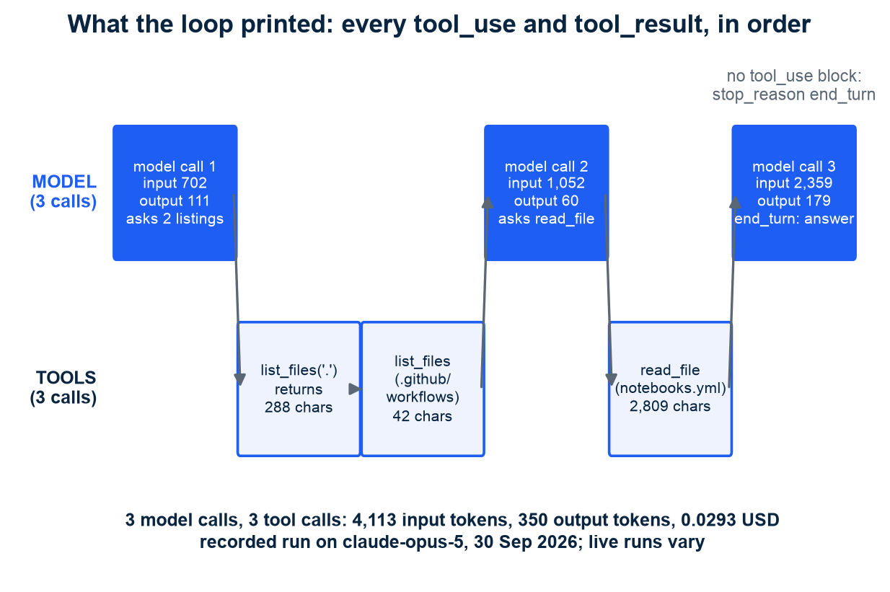
NOTEBOOK 01, SECTION 3.3, RECORDED RUN
What the loop printed: two listings, one read, then the answer, in 3 model calls
How to read it: top lane = model calls, bottom lane = tool calls, left to right in time
Call 1 asks for two listings at once; the loop runs both and returns both in one message
Call 2 asks to read notebooks.yml; 2,809 characters come back as one tool_result
Call 3 has no tool_use block: stop_reason end_turn, the loop stops. 3 model calls, 3 tool calls
Input tokens grow call by call: 702, then 1,052, then 2,359. Each call carries all of it
In plain words: the model never got smarter; it was given a way to look and a loop that kept asking
Recorded run on claude-opus-5, 30 Sep 2026; live runs vary in route and tokens. Total 4,113 input and 350 output tokens, 0.0293 USD.
M5 Session 1 - From Prompts to Harnesses
16
Notes:
Read it as a story. The model cannot know where the workflow file is, so it lists the root and the workflows folder in one turn; the loop runs both tools and sends both results back together. It then reads the one file that matters and answers with the fact and the path. Point at the input tokens: 702, 1,052, 2,359. Every call re-sends the whole conversation, including the 2,809-character file, which is where the cost of a harness goes and the subject of Session 2. Class question: what would the third call have cost if the README, at almost 17,000 characters, had been read instead of the workflow file?

Slide 17
NOTEBOOK 01, SECTION 3.4
Three ways side by side: only the harness gives the fact, and it pays for it in input tokens
Approach | Model calls | Tool calls | Input tokens | Output tokens | Cost (USD) | Gives the fact | Names the file
Bare prompt | 1 | 0 | 39 | 549 | 0.0139 | No | Yes
Careful prompt | 1 | 0 | 115 | 481 | 0.0126 | No | Yes
Harness: two tools, a loop | 3 | 3 | 4,113 | 350 | 0.0293 | Yes | Yes
Recorded run on claude-opus-5, 30 Sep 2026; live runs vary. 'Gives the fact': the answer holds 3.12 and 9, parsed from the workflow file by the notebook. 'Names the file': it mentions notebooks.yml. All three name it; only the harness read it.
M5 Session 1 - From Prompts to Harnesses
17
Notes:
This is the notebook's own table, checked mechanically: the checker parses notebooks.yml for the Python version and the matrix size, so the notebook cannot drift from the repository. The column that matters is 'gives the fact'. 'Names the file' is weaker evidence: the two prompt-only answers offer notebooks.yml as a typical name to go and look for, the harness cites it as the file it read. Class question: which column would you add to catch an answer that names the right file but quotes the wrong version?

Slide 18
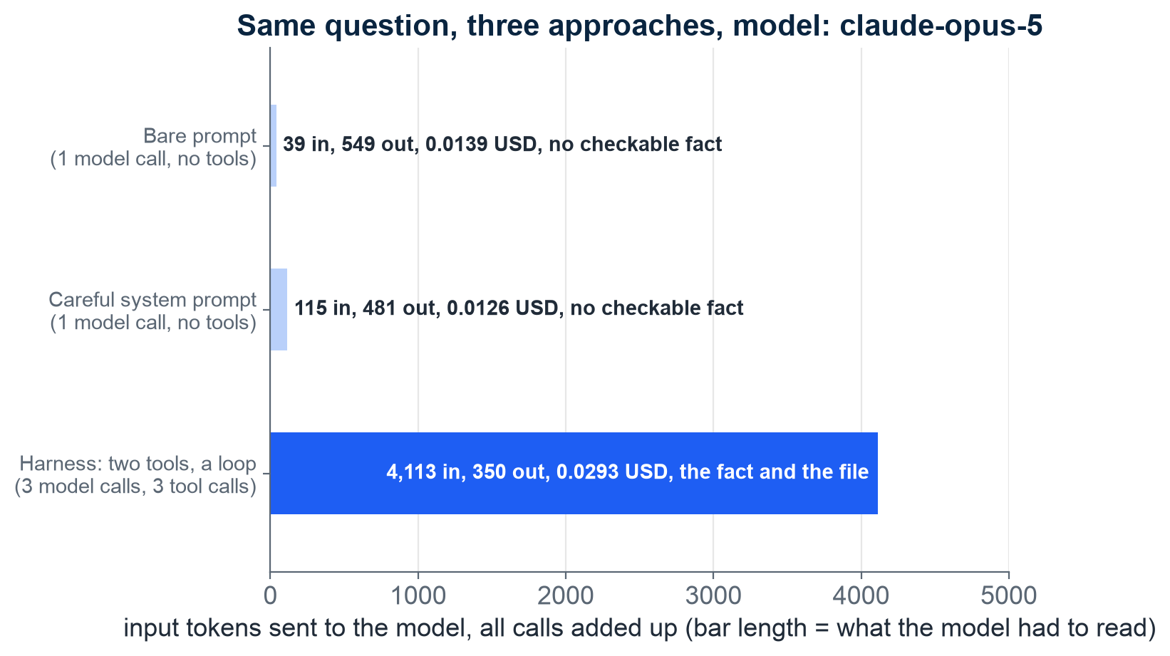
NOTEBOOK 01, SECTION 3.4
The fact cost 4,113 input tokens; the two prompts cost 39 and 115 and gave none
How to read it: bar length = input tokens one approach sent, all its calls added up
Bare prompt 39, careful prompt 115: one call each, almost no context, no checkable fact
Harness 4,113 over 3 calls: tool descriptions plus every tool result so far, on every call
Output went the other way: 549 and 481 tokens of hedging against 350 tokens of answer
Cost: 0.0139 and 0.0126 USD without the fact, 0.0293 USD with the fact and the file
In plain words: tokens are the currency of harness engineering; spend them where they buy facts
Recorded run on claude-opus-5, 30 Sep 2026; live runs vary. Prices from the Claude API reference: 5.00 USD per million input tokens, 25.00 per million output tokens.
M5 Session 1 - From Prompts to Harnesses
18
Notes:
Nothing is free. Every tool result is pasted into the context and the model reads it again on the next call. Note the surprise in the output column: the two prompt-only answers wrote more, because they spent their output explaining what they would need; the harness wrote less, because it had the fact. Session 2 is about keeping the input bill down: context budgets, compaction, notes outside the window. Class question: for which questions would you refuse to pay 0.03 USD, and for which would you happily pay 3 USD?

Slide 19
NOTEBOOK 01, SECTION 4
The SDK ships the loop: beta_tool and tool_runner do in ten lines what you wrote in forty
Ten lines on the SDK
What it produced in the recorded run
beta_tool(list_files), beta_tool(read_file): the JSON description is generated from the signature and the docstring
Same name, description and schema as the hand-written dicts, plus a title per argument and additionalProperties: false
client.beta.messages.tool_runner(model, max_tokens, system, tools, messages, max_iterations=8)
One iteration per model call; generate_tool_call_response() runs the requested tools and returns the tool_result message
Beta in the Python SDK, hence client.beta; the right default for a small agent
The same route as your loop: list the root and .github/workflows, read notebooks.yml, answer
3 model calls, 4,251 input tokens, 358 output tokens, 0.0302 USD (your loop: 4,113 and 350, 0.0293 USD)
The same answer: Python 3.12, 9 notebooks, source notebooks.yml; gives the fact = True for both loops
The same message shape: a user question, then assistant turns with tool_use blocks and user turns of tool_result blocks
In plain words: the runner saves the typing; it decides nothing about what surrounds the loop. That is the harness
Recorded run on claude-opus-5, 30 Sep 2026; live runs vary. The runner sent a conversation of the same shape and size as the hand-written loop; what it does not decide is which tools to offer, what to refuse, when to stop, what to measure, how to test.
M5 Session 1 - From Prompts to Harnesses
19
Notes:
Show the generated schema next to the hand-written one: the decorator kept the docstring, turned the type hint into the schema and added additionalProperties false. Then the runner: one for loop, one call to generate_tool_call_response per iteration, and the same three calls as before. This is the right default for a small agent, and it is also the point where the harness starts: tools, refusals, stop conditions, measurement and tests are yours to add. Session 3 builds them as a small package with a trace, a budget, hooks and an eval suite. Class question: name one thing the runner cannot decide for you.

Slide 20
NOTEBOOK 01, SECTION 5
The eight pieces and where each one lives in this module: SDK, harness package, Claude Code, CI
Piece | Anthropic SDK (Sessions 1-2) | harness package (Sessions 3-4) | Claude Code labs (Sessions 2, 4) | CI (Session 3)
1 Model | messages.create(model=...), models.retrieve; choose by capability, cost, latency | MAIN_MODEL opus-5, WORKER_MODEL sonnet-5 | - | -
2 Context | system, messages, usage.input_tokens; count_tokens, compaction, notes | max_input_tokens budget stop | CLAUDE.md in the project | -
3 Tools | raw tool dicts, tool_use, tool_result, beta_tool | @tool(risk=...), ToolRegistry | MCP servers: claude mcp add | -
4 Skills | a load_skill tool; SKILL.md measured on the real tokenizer | - | .claude/skills/<name>/SKILL.md | -
5 The loop | run_agent, tool_runner | Agent.run, stopped_because | the CLI's own loop | -
6 Guardrails | the .env refusal inside read_file | Hooks.before_tool, deny_risk | settings.json hooks, permission modes | unit job: pytest on the path guard
7 Orchestration | - | five workflow patterns; delegate, TaskBoard | .claude/agents/*.md, agent teams | -
8 Evals + observability | usage, the cost table, the ledger | Trace, evals/cases.yaml, run_evals | /cost | evals job, only with the secret: results.json
How to read it: one row per piece, in the canon order; each cell names the real artefact you will touch; a dash means none of its own there.
M5 Session 1 - From Prompts to Harnesses
20
Notes:
You have already met four pieces today on the raw SDK: the model behind one call, the context as a messages list, tools as JSON, and the loop. Read the other columns as the map of the module: Session 3 turns the loop into a package with hooks, a trace and evals; the labs show the same pieces inside Claude Code as files you can open; CI runs the unit tests always and the evals when the key is present. Class question: which of the eight would you build first if you had one afternoon, and which would you borrow?

Slide 21
TAKEAWAY
One number to keep: the same model, two harnesses, 9.5 points apart
9.5
points of harness-only variation on SWE-bench Pro for Claude Opus 4.5: 45.9% under SEAL, 55.4% under Claude Code
arXiv 2605.23950, May 2026; arXiv 2609.11987, Sep 2026. Notebook 01 shows the same effect at small scale: the same claude-opus-5 gave no checkable fact without a harness and the fact with its file inside one (recorded run, 30 Sep 2026).
M5 Session 1 - From Prompts to Harnesses
21
Notes:
Close the loop with the evidence slide. At benchmark scale the harness moves the score by 9.5 points; at notebook scale it moves the answer from 'I cannot know' to the fact and the file. Same lesson, two scales. Class question: if you could only change the model or only change the harness for your project, which would you pick and why?

Slide 22
You now know what a harness is - next session you build its pieces
Agent = Model + Harness: the model is the engine, the harness is the rest of the car
Six years moved the lever from the words (prompt) to the window (context) to the runtime (harness)
Same model, different harness: 9.5 points on SWE-bench Pro - harness-only variation
Eight pieces: model, context, tools, skills, loop, guardrails, orchestration, evals and traces
Workflows when the path is known; agents when the steps depend on the last result
Notebook 01: one question three ways on the raw SDK; only the forty-line loop gives the fact and the file, at 4,113 input tokens against 39
The SDK ships the loop (tool_runner); the harness is everything around it, and Session 3 builds it as a package
Harness Engineering - Module 5
M5 Session 1 - From Prompts to Harnesses
22
Notes:
Recap the seven lines, then point at the exercises at the end of notebook 01, all with executed solutions from the same recorded run: a third tool count_lines (the model called it straight away and got 49 lines in 2 model calls); max_turns=1 (the model asked for 2 listings, the tools ran, and the only answer was 'I'll explore the repository structure first.', stopped because max_turns); the trap question 'How many students took this course?' (3 model calls, 2 tool calls, 0.0562 USD, the most expensive run in the notebook, and a plain 'the repository doesn't contain that'); and claude-sonnet-5 on the same harness (3 model calls, 2 tool calls, 3,783 input tokens, 0.0106 USD against 0.0293, both give the fact). The whole notebook billed 17 model calls, 24,077 input tokens, 2,704 output tokens and 0.1720 USD. Next session opens the four pieces the model sees: models, context, tools and skills. Class question to close: which of the eight pieces did notebook 01's loop NOT have, and what could go wrong because of it?

