Slide 1
SESSION 2 OF 4
Models, Context, Tools and Skills
The four pieces the model sees: an engine behind one interface, a window with a budget, functions it may call, and manuals it opens only when needed. First the rules, then notebook 02 and lab 2.
Harness Engineering - Module 5
Notes:
Session 2 opens the first four pieces of the harness: the model, the context, the tools and the skills. These are the pieces the model sees; Session 3 builds the loop and the checks around them. Class question to open: what did the loop in notebook 01 put into the model's context that the bare prompt did not?

Slide 2
01
Part 1 - The theory: the four pieces the model sees
Pieces 1 to 4 of the harness: model, context, tools, skills. Each with its plain-words line and its design rules.
M5 Session 2 - Models, Context, Tools and Skills
2
Notes:
About 40 minutes of theory, one piece at a time, each with its plain-words line and the published rules behind it. Class question: which of the four do you think costs the most tokens in a long task?

Slide 3
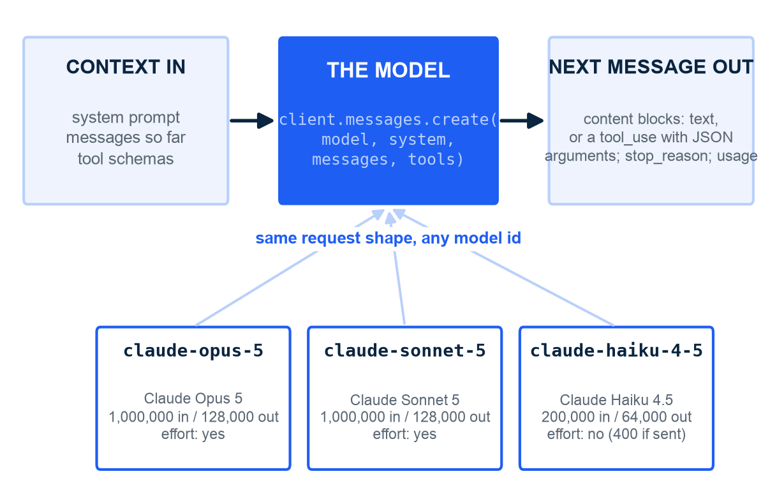
PIECE 1 - THE MODEL
The model sits behind one interface: context in, next message out
How to read it: the blue box is the whole contract; any model id that fits the request fills it
In plain words: the model is the text-in, text-out engine; it never runs a tool, it asks for one by name with JSON arguments
One request: model, max_tokens, system, messages, tools, output_config (effort) - nothing else reaches the model
One response: content blocks (text or tool_use), stop_reason (end_turn, tool_use, max_tokens, refusal) and usage
client.models.retrieve says what a model can do: read it before you send a parameter it may reject
The harness does not change when the model id does - that is the point of the interface
Illustration. Model facts from client.models.retrieve in notebook 02 (section 1.2). The key lives in .env, never in a cell, never committed.
M5 Session 2 - Models, Context, Tools and Skills
3
Notes:
Start with the contract, not the vendor. A model takes the system prompt, the messages so far and the tool schemas, and returns one message: text, or a request to call a tool. That is all a harness needs to know. On the Claude API the contract is one call, client.messages.create, and the response carries content, stop_reason and usage. The three plugs are the three models notebook 02 reads from the Models API: two with a million-token window, one smaller and cheaper that rejects the effort parameter. Class question: which of the three inputs would you expect to grow the most during a long task?

Slide 4
PIECE 1 - TIERS AND ROUTING
Choose a model by capability, cost and latency - and route cheap models to easy steps
Tier | Capability | Cost per token | Latency | Give it these steps
Frontier (e.g. Opus-class) | Highest: planning, synthesis, hard reasoning | Highest | Slowest | Lead agent: plan, delegate, write the final answer
Mid (e.g. Sonnet-class) | High: focused tasks with tools | Lower | Faster | Workers: search, read, summarize one sub-question
Small (e.g. Haiku-class) | Good at narrow, well-specified steps | Lowest | Fastest | Classify, route, extract fields, check a format
Anthropic, How we built our multi-agent research system, 13 Jun 2025: an Opus lead plans and spawns 3-5 Sonnet workers. Anthropic, Building effective agents, Dec 2024: routing sends each input to the specialized step.
M5 Session 2 - Models, Context, Tools and Skills
4
Notes:
The tiers are qualitative on purpose: prices and speeds change every quarter, the shape of the decision does not. The research system is the canonical example: the expensive model plans and synthesizes, cheaper models do the parallel legwork. Routing is the workflow pattern that makes this automatic: a small model labels the input, the harness picks the path. This module routes by role: claude-opus-5 for main agents, claude-sonnet-5 for workers, judges, routers and planners. Class question: which steps of notebook 01's loop would you hand to the cheapest tier?

Slide 5
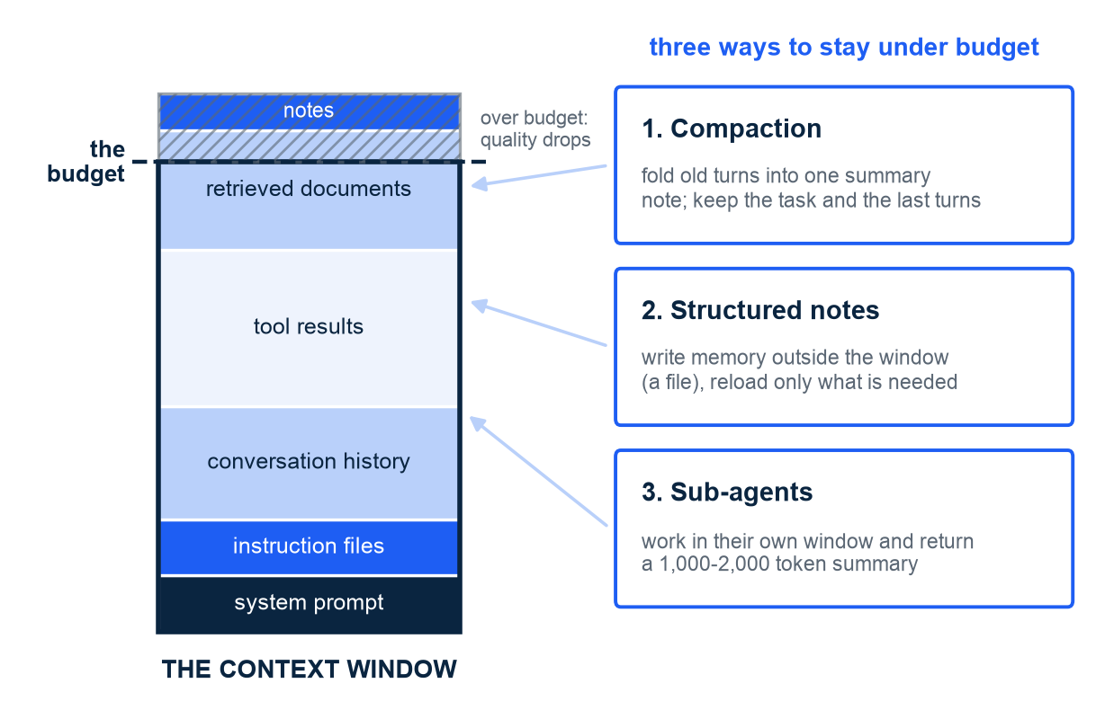
PIECE 2 - CONTEXT
Context is a finite budget: what goes in, what stays out, when to summarize
How to read it: the window fills from the bottom; the dashed line is the budget
In plain words: context is everything the model sees in one call
System prompt, instruction files, history, tool results, retrieved documents, notes - all compete
Compaction folds old turns into one note; structured notes move memory to a file
Sub-agents spend tens of thousands of tokens and return 1,000-2,000 token summaries
Karpathy, Jun 2025: 'filling the context window with just the right information for the next step'
Illustration; segment sizes not to scale. Anthropic, Effective context engineering for AI agents, 29 Sep 2025; Karpathy, 25 Jun 2025.
M5 Session 2 - Models, Context, Tools and Skills
5
Notes:
Everything the model sees competes for the same window, and attention gets worse as it fills. Anthropic's post names three techniques and we build all three in this module: compaction today, notes today, sub-agents in Session 4. Class question: in notebook 01's loop, which segment of this window was the largest?

Slide 6
PIECE 2 - INSTRUCTION FILES
Instruction files: short, human-written, and enforced - or not at all
What they are
What the evidence says
CLAUDE.md, AGENTS.md: a file the harness pastes into every call
In plain words: the standing orders the model reads before every task
63% of large projects ship one; only a handful enforce what it says
Only 4.4% of security rules in them are backed by a real control
A rule nobody checks is a wish, not a guardrail (Session 3)
Human-written instruction files: about +4% task success
Machine-generated ones: worse than having none
When everything is important, nothing is - long files dilute the rules that matter
Keep the file short, concrete, and about this repository only
Move procedures into skills (piece 4) so they load only when needed
Marmelab, The State of AI Harness Engineering 2026, 24 Sep 2026. Anthropic, Effective context engineering for AI agents, 29 Sep 2025: system prompts at 'the right altitude'.
M5 Session 2 - Models, Context, Tools and Skills
6
Notes:
Two findings and one rule. Findings: a short, human-written file helps a little; a long, generated one hurts, because it buries the three rules that matter under fifty that do not. Rule: when everything is important, nothing is. The 4.4% number connects to Session 3: a rule in a markdown file is not a guardrail until something outside the model checks it. The lab folder ships a CLAUDE.md of about twenty lines. Class question: what are the three lines you would put in your project's instruction file?

Slide 7
PIECE 3 - TOOLS
Tool design is prompt engineering for machines
Anthropic's rules, Sep 2025
One anecdote
In plain words: a tool is a function the model asks for by name; the harness runs it
The description says when to use the tool and what it returns
Name tools as verb phrases the model can reason with: list_files, read_file, write_note - not 'lookup' with an argument 'q'
Token-efficient results: filter, truncate, paginate; return ids, not whole documents
Errors that teach: say what went wrong and what to try next
A web-search tool kept appending '2025' to every query
The model had learned the habit from the tool's vague description
The fix was not code: a better description of the query argument
Lesson: the model reads the description before every call - write it as a prompt
Anthropic, Writing effective tools for agents, Sep 2025
Anthropic, Building effective agents, Dec 2024: 'invest as much effort in the agent-computer interface as in the human one.'
M5 Session 2 - Models, Context, Tools and Skills
7
Notes:
The model never sees your code; it sees the name, the description and the argument schema. Those are a prompt, and the same care applies: say when to use the tool, what it returns, and what the arguments look like. The '2025' story is the best illustration: a behavior bug fixed by rewriting a sentence. Class question: how would you rewrite the description 'lookup: Searches.' in one sentence?

Slide 8
PIECE 3 - HOW MANY TOOLS
Fewer, better tools beat many tools
80%
of its tools removed by Vercel: task success rose from 80% to 100%, tokens halved, latency fell from 724 s to 141 s
Vercel's agent, as reported in Marmelab, The State of AI Harness Engineering 2026, 24 Sep 2026. In plain words: every extra tool is another schema in the context and another wrong choice to make.
M5 Session 2 - Models, Context, Tools and Skills
8
Notes:
Every tool schema is pasted into the context on every call, and every extra tool is one more way to pick the wrong one. Vercel cut 80% of theirs and got faster, cheaper and more reliable at once. Class question: notebook 02's agents carry two to five tools - which one would you remove, and what would break?

Slide 9
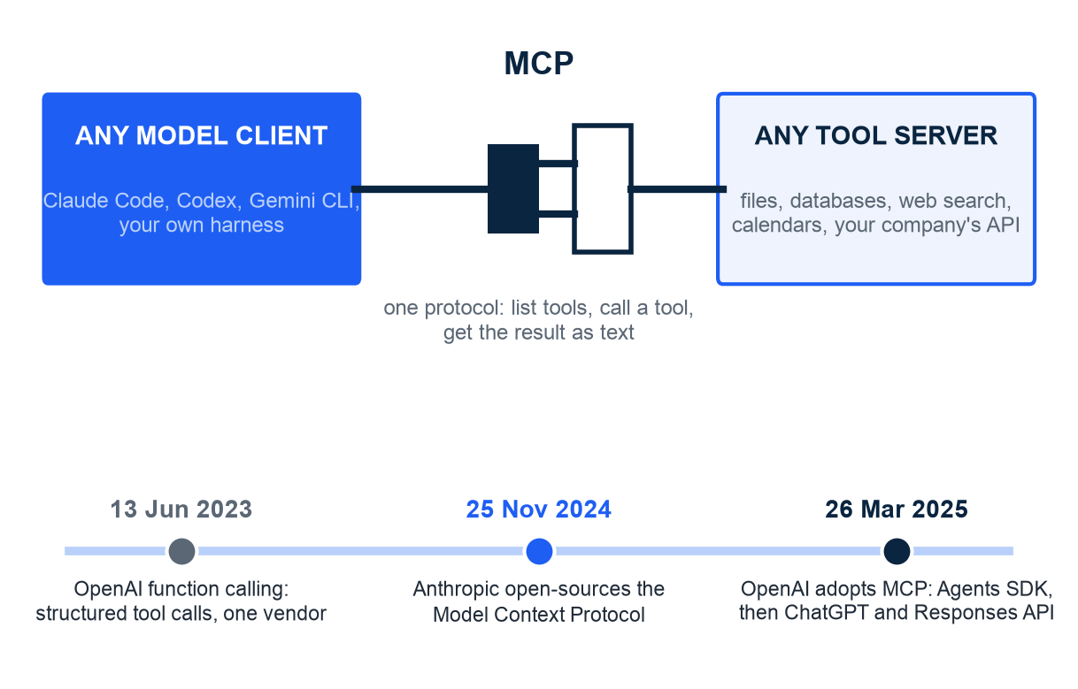
PIECE 3 - THE PLUG
MCP is the standard plug: any tool server fits any model client
How to read it: top, the plug between clients and servers; bottom, the dates
In plain words: MCP is a standard plug, so any tool server fits any model client
Before: each product wrote its own adapter for each tool (function calling, Jun 2023)
25 Nov 2024: Anthropic open-sources the Model Context Protocol
26 Mar 2025: OpenAI adopts it - Agents SDK, then ChatGPT and the Responses API
One protocol: list the tools, call a tool, get the result as text - lab 2 plugs one in with claude mcp add
Illustration. Dates: Anthropic, Introducing the Model Context Protocol, 25 Nov 2024; OpenAI Agents SDK release notes, 26 Mar 2025.
M5 Session 2 - Models, Context, Tools and Skills
9
Notes:
Function calling gave us structured tool calls in 2023, but every vendor and every tool needed its own adapter. MCP standardizes the socket: a server lists its tools, a client calls them, results come back as text. When the second big vendor adopted it four months later, it became the plug. An MCP tool is still a name, a description and a JSON schema, so everything on the tools slides applies over the plug. Class question: what is the USB of your daily life, and what did the world look like before it?

Slide 10
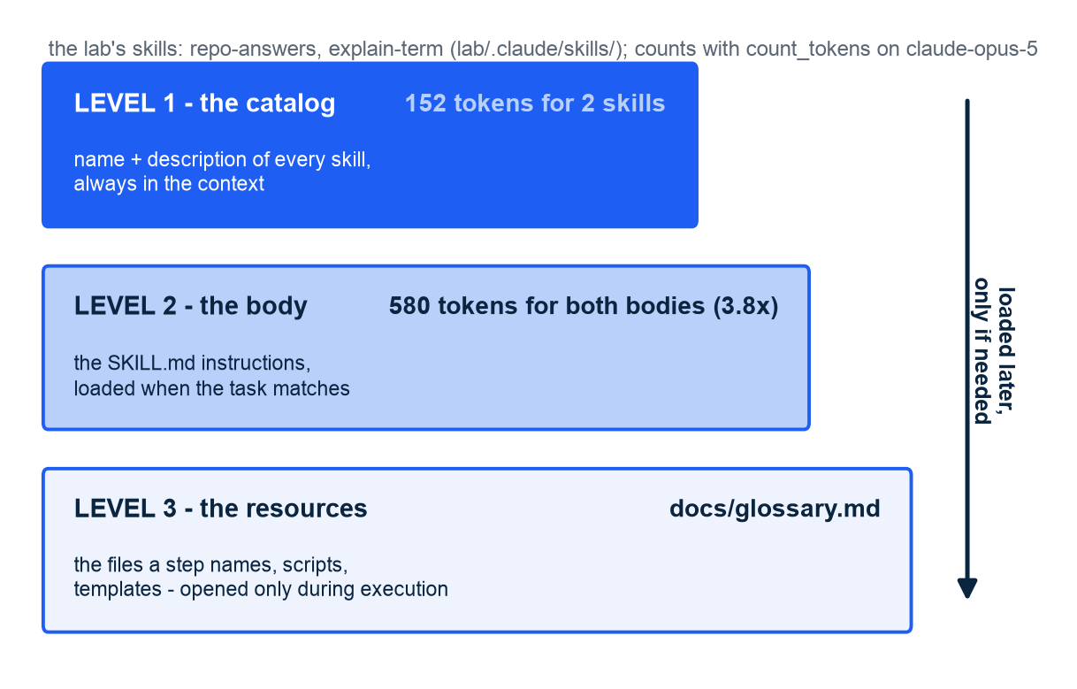
PIECE 4 - SKILLS
Skills load in three levels - the catalog is always there, the manual opens on demand
How to read it: each step down is loaded later and costs more; numbers from the two lab skills on the real tokenizer
In plain words: a skill is a folder with a SKILL.md and optional files; read the description first
Level 1: name + description of every skill, 152 tokens for the two skills
Level 2: the body of the one that matches, 580 tokens if both were loaded (3.8x)
Level 3: docs/glossary.md and the other files a step names - opened only while executing
Skills teach procedures; tools give abilities; prompts give the task
Token counts with count_tokens on claude-opus-5 (notebook 02, section 4.2). Anthropic, Agent Skills, 16 Oct 2025; open standard 18 Dec 2025, 40+ platforms.
M5 Session 2 - Models, Context, Tools and Skills
10
Notes:
Progressive disclosure is the context-budget idea applied to instructions. The agent always sees the catalog, a few tens of tokens per skill; it opens the body when the task matches, and the resources only while executing. The two skills live in lab/.claude/skills/, where Claude Code looks for them, and notebook 02 measures them with the API's token counter. Skills became an open standard in December 2025 and are supported by more than forty platforms. Class question: which of your own recurring procedures would you write as a SKILL.md first?

Slide 11
PIECE 4 - THE THREE COMPARED
Prompts give the task, tools give abilities, skills teach procedures
 | Prompt | Tool | Skill
What it is | The words you send for this task | A function the model may call by name, with JSON arguments | A folder: SKILL.md (name, description, steps) plus scripts and references
What the model gets | The goal and the constraints | An ability: list, read, calculate, check | A procedure: which tools, in which order, with which checks
When it loads | Every call | Schema on every call; result when called | Description always; body when the task matches; resources during execution
In this module | 'Which licence does this repository use?' | list_files, read_file, write_note, read_notes, load_skill | repo-answers, explain-term in lab/.claude/skills/
Who writes it | The user, each time | A developer, once | A domain expert, once - reused across tasks and platforms
Anthropic, Agent Skills, 16 Oct 2025; Anthropic, Writing effective tools for agents, Sep 2025.
M5 Session 2 - Models, Context, Tools and Skills
11
Notes:
Students mix these three up for weeks, so draw the line hard. A prompt is the task. A tool is an ability the harness executes. A skill is a procedure: which tools, in which order, with which checks. Class question: 'always end with a Source: line naming the file' - prompt, tool or skill?

Slide 12
02
Part 2 - The practice: notebook 02 and lab 2
Three models read from the API, a session that grows and gets compacted, a vague tool against a clear one, skills measured on the real tokenizer - then Claude Code loading a skill and an MCP server.
M5 Session 2 - Models, Context, Tools and Skills
12
Notes:
Open notebook 02; it needs the ANTHROPIC_API_KEY in the repository .env or the Colab secret, and it stops with one sentence if none is found. Every number that follows is from the run recorded in the notebook on 30 September 2026: 49 model calls, 0.4797 USD in total (section 9). Live runs vary; say so whenever a student's number differs. Class question: which of the four pieces do you expect to be the easiest to get wrong in your own project?

Slide 13
NOTEBOOK 02 - THE MODEL
Three models, read from the API and priced on the same question
Model | Context window | Max output | Effort parameter | Input tokens | Output tokens | Seconds | Cost USD
claude-opus-5 | 1,000,000 | 128,000 | yes | 1,321 | 50 | 1.7 | 0.00785
claude-sonnet-5 | 1,000,000 | 128,000 | yes | 1,321 | 37 | 1.2 | 0.00301
claude-haiku-4-5 | 200,000 | 64,000 | no (400 if sent) | 945 | 29 | 0.9 | 0.00109
Left: client.models.retrieve (1.2). Right: the same workflow file and question to all three; all answered Python 3.12 and 9 notebooks (1.3). Haiku 4.5 rejects effort, so the notebook reads capabilities first. Recorded run of 30 Sep 2026; live runs vary.
M5 Session 2 - Models, Context, Tools and Skills
13
Notes:
Two tables from the notebook on one slide. The left half is read from the Models API, not remembered: display name, window, maximum output, and a capability tree. The smallest model does not accept the effort parameter at all, the API answers 400 if you send it, and it has no adaptive thinking or server-side compaction; all three support structured outputs. That is why the notebook builds each request from the capability table. The right half is the same document and question on all three: identical answers, three prices, and note that the two large models count 1,321 input tokens while Haiku counts 945 for the same text, because each family has its own tokenizer. Class question: when would the cheapest row be the wrong choice even though it answered correctly here?

Slide 14
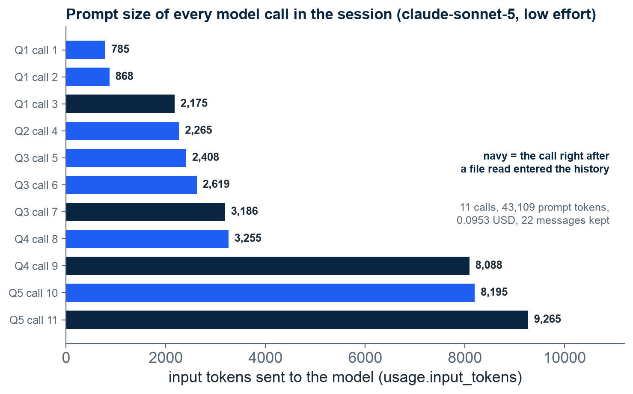
NOTEBOOK 02 - CONTEXT
Every call re-sends everything before it: five questions, 11 model calls, 43,109 prompt tokens
How to read it: one bar per model call, in order; each bar is the whole conversation so far, navy bars follow a file read
Counted first with count_tokens: system prompt 87 tokens, the two tool schemas 609, README.md as read_file returns it 4,777
Five questions on claude-sonnet-5 at low effort: 11 model calls, 43,109 prompt tokens, 0.0953 USD, 22 messages in the history
Question 1 took 3 calls and 3,828 input tokens; question 5 took 2 calls and 17,460, because every earlier file read rode along
The same README counts 4,777 tokens on opus-5 and sonnet-5 but 3,557 on haiku-4-5: always count with the model you will call
In plain words: a file you read once is paid for again on every later call of the session
Notebook 02, sections 2.1 and 2.2, values as printed by the notebook; recorded run of 30 Sep 2026; live runs vary.
M5 Session 2 - Models, Context, Tools and Skills
14
Notes:
Run this section live if you can: the loop prints every tool call and the answer to each question, and the chart shows the real input tokens of each call. The steps are file reads entering the conversation and staying there: after the README read during question 4 the prompt jumps from 3,255 to 8,088 tokens. Point out the first table too: the first tool you add costs 438 tokens because the API prepends its tool-use preamble, both tools 609, and one README read costs more than fifty system prompts. Class question: what would the eleventh bar look like after fifty questions, and what would you do about it?

Slide 15
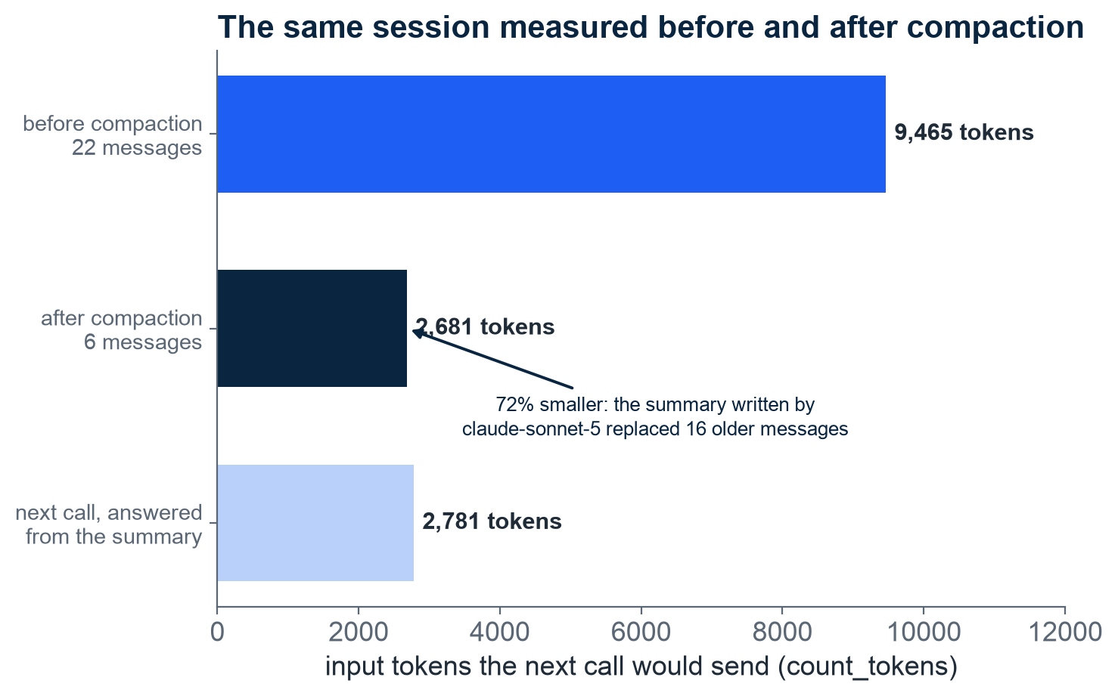
NOTEBOOK 02 - CONTEXT
Compaction cuts the next prompt from 9,465 to 2,681 tokens; notes survive a fresh session
How to read it: the same session counted twice; bar 2 keeps the last question plus a summary
The summary by claude-sonnet-5: 1,296 in, 586 out, 0.0085 USD; 22 messages became 6, 72% smaller
A sixth question answered from the summary alone: 1 model call, 0 tool calls, 2,781 input tokens
Lossy on purpose: what the summary drops is gone; the summarizing prompt is context engineering
Notes are two ordinary tools, write_note and read_notes; the agent saved 2 facts with their sources
A fresh session read them back: 2 model calls, 1 tool call, 2,096 input tokens, 0.0156 USD
Notebook 02, section 2.3 (compaction) and 2.4 (notes); recorded run of 30 Sep 2026; live runs vary. Anthropic, Effective context engineering, 29 Sep 2025.
M5 Session 2 - Models, Context, Tools and Skills
15
Notes:
Compaction done the real way, in three visible steps: split the history at the last question, ask the worker model for a summary that keeps facts, sources and files read but drops raw file contents, and rebuild the message list with the summary in front. Read the summary the model wrote aloud: it lists the three files and every fact. Then the sixth question proves the session still works. Notes are the second technique: two plain tools and a file in the temporary folder; a brand-new context reads both facts back. That is the mechanism behind CLAUDE.md and auto-memory in coding agents. Class question: what would you lose if the compaction summary were just 'earlier conversation omitted'?

Slide 16
NOTEBOOK 02 - TOOLS
Five recorded runs on the same tools: the description, the error text and the gate decide the outcome
Run (section) | Model calls | Tool calls | Failed or denied | Input tokens | Output tokens | Cost USD | Time (s) | What happened
vague lookup: 'Searches.', argument q (3.2) | 5 | 5 | 1 failed | 6,474 | 399 | 0.0423 | 19.1 | First call sent a search phrase, not a path; the error text taught it; answered 3.12 and named the file
clear read_file (3.2) | 3 | 3 | 0 | 4,207 | 284 | 0.0281 | 5.4 | Listed the folder, read the file, answered 3.12 and named the file
error recovery: read docs/README.md (3.3) | 4 | 4 | 1 failed | 9,176 | 626 | 0.0615 | 10.4 | Error said 'call list_files'; it listed docs/, said the file does not exist, answered from docs/index.html
strict tools, claude-sonnet-5 (3.4) | 3 | 2 | 0 | 3,158 | 170 | 0.0080 | 4.7 | Arguments guaranteed to match the schema; quoted anthropic, python-dotenv, pyyaml from requirements.txt
gated: deny the docs/ folder (3.5) | 4 | 7 | 1 denied | 14,407 | 523 | 0.0851 | 15.8 | DENIED on list_files('docs'); kept searching other files; max_turns=4 stopped it with no answer
One row per run on the repository; rows 1-3 and 5 on claude-opus-5, row 4 on claude-sonnet-5. The two tool schemas add 609 tokens to every call, 438 for the first alone (3.1). Recorded run of 30 Sep 2026; live runs vary.
M5 Session 2 - Models, Context, Tools and Skills
16
Notes:
Read the rows as five experiments on the same two tools. Rows one and two are the vague-tool experiment as it actually went: both runs reached the right answer and named the file, so the vague description did not break the agent, it made it pay: the first lookup call sent 'python-version notebook workflow' as q and failed, and the guess cost 2 extra model calls, 2,267 extra input tokens and 0.0142 USD more. Row three: the error message named the next step, so the model listed the folder and answered honestly that the file does not exist. Row four: strict tools guarantee the arguments, not the choice of tool. Row five is the honest one: the gate denied docs/ as designed, but our denial text offered 'use other files', the model took the offer and kept searching until max_turns stopped it with no answer. A gate should say exactly what to do instead, and max_turns is itself a brake. Class question: rewrite the denial message so the model stops and reports instead of searching on.

Slide 17
NOTEBOOK 02 - SKILLS
Skills on the real tokenizer: 152 tokens of catalog on every call, 580 of bodies opened on demand
Skill (lab/.claude/skills/) | Level 1 - catalog line (tokens) | Level 2 - full body (tokens) | What the description triggers on
repo-answers | 68 | 306 | what the project, its docs or its configuration say; a fact to look up rather than remember
explain-term | 84 | 274 | what a term means, a plain-words explanation, how a concept fits the car metaphor
both skills | 152 | 580 (3.8x) | the catalog rides along on every call; a body only when a task matches its description
count_tokens on claude-opus-5 (4.2). The load_skill run (4.3): turn 1 load_skill('repo-answers'), then list, read, cite; 3 model calls, 5,007 input tokens, 0.0303 USD, answer ends 'Source: LICENSE'. Recorded run of 30 Sep 2026; live runs vary.
M5 Session 2 - Models, Context, Tools and Skills
17
Notes:
The skills are real files in the lab folder, parsed with plain Python and counted with the API's token counter. Level 1 is one line per skill, level 2 the body: 152 against 580 tokens for the two, 3.8 times more. Then the notebook appends the catalog to the system prompt and adds a load_skill tool: on the licence question the model's first action was load_skill for repo-answers, and it followed the procedure it had just read, ending with a Source line. Exercise 1's count-things skill measured 54 and 112 tokens. Class question: which of the two descriptions would you rewrite, and why?

Slide 18
LAB 2 - SKILLS IN CLAUDE CODE
Lab 2: Claude Code loads the same skill from lab/.claude/skills/ - watch it happen in stream-json
What you type, from the lab/ folder
What you see (observed on 30 Sep 2026)
claude --version -> 2.1.278 (Claude Code); claude auth status -> "loggedIn": true (Claude Code does not read the repository .env)
The project: CLAUDE.md, .claude/skills/repo-answers/SKILL.md, .claude/skills/explain-term/SKILL.md, docs/ with three files
claude -p "Which two Claude models does this module use, and for which roles?" --max-turns 3 --output-format stream-json --verbose
Interactively: /explain-term compaction invokes a skill by name; /skills and /context show what each one costs
system/init lists both project skills by name: the level-1 catalog
First action: the Skill tool with {"skill": "repo-answers"} -> 'Launching skill: repo-answers' - the level-2 load, Claude Code's load_skill
Then the procedure: grep over docs/ through Bash, an answer naming claude-opus-5 and claude-sonnet-5, two Source: lines
result: num_turns 4, total_cost_usd 0.4069 on claude-fable-5-1 with about 82,000 cached tokens of plugins; --model sonnet costs cents
Nothing forced the load: the description matched, so it opened the manual
Lab guide: lab/02-lab-claude-code-skills-and-mcp.md, parts 0 to 2. Every claude -p run costs real money on the student's own login; the recorded runs cost 0.04 to 0.41 USD each.
M5 Session 2 - Models, Context, Tools and Skills
18
Notes:
Switch from the notebook to the terminal. The lab folder is a complete Claude Code project: an instruction file, two skills, three documents. The json output format hides the steps, so the lab uses stream-json with verbose to see one event per line, the way run_agent printed the loop. The first event the model produced was the Skill tool call for repo-answers, which is exactly the load_skill call of section 4.3; then it followed the procedure and cited two files. The 0.41 USD is honest and worth a minute: the author's default model was the most expensive tier and the machine carried many plugins whose tool descriptions sat in the context; a fresh install on sonnet pays cents. Class question: what in the description of repo-answers made this question match it?

Slide 19
LAB 2 - MCP IN CLAUDE CODE
Lab 2: one command adds an MCP server; approval and permissions still gate every call
What you type
What you see (observed, claude-sonnet-5)
claude mcp add -s project filesystem -- npx -y @modelcontextprotocol/server-filesystem docs -> writes .mcp.json (type stdio; only docs/ is exposed)
claude mcp list -> 'filesystem: ... Pending approval (run claude to approve)': a project server never starts until you approve it once
claude -p "Using only the filesystem MCP server's tools, list the docs folder and tell me the first heading of each file." --max-turns 4 --output-format stream-json --verbose --mcp-config .mcp.json --strict-mcp-config --model sonnet
Second run adds --allowedTools mcp__filesystem__list_directory mcp__filesystem__read_text_file
init: mcp_servers filesystem connected; 14 new tools named mcp__filesystem__<tool>, schemas fetched with ToolSearch
Run 1: list_directory denied twice ('you haven't granted it yet'); the model stopped and asked - num_turns 4, 0.1132 USD
Run 2: the listing came through the plug (faq.md, glossary.md, module-overview.md); read_multiple_files denied, read_text_file with head 5 allowed
--max-turns 4 cut run 2 one turn before the answer: error_max_turns, num_turns 5, 0.0406 USD; --max-turns 6 lets it finish
In plain words: the trailer hitch fits, and the brakes still work on whatever is towed
Lab guide parts 3 and 4. Reference server: @modelcontextprotocol/server-filesystem. Undo with claude mcp remove filesystem -s project.
M5 Session 2 - Models, Context, Tools and Skills
19
Notes:
One command writes a JSON entry, and the server's tools appear next to the built-in ones with the mcp__server__tool naming. Three harness behaviours show themselves in the recorded runs. Project servers wait for a one-time approval, because a .mcp.json arrives with a clone and could start anything. Tool calls wait for permission: in print mode nobody answers, so the first run was denied and the model asked instead of guessing. And max-turns stopped the second run one turn before the final sentence, the same brake as the gated run in the notebook. Class question: which of the fourteen filesystem tools would you never pre-approve, and why?

Slide 20
LAB 2 - THE BILL
Lab 2: read the bill from the JSON result (total_cost_usd, usage, modelUsage) or type /usage
Run | Model | Turns | Input tokens | Cache write tokens | Cache read tokens | Output tokens | Cost USD
JSON key | modelUsage key | num_turns | input_tokens | cache_creation_input_tokens | cache_read_input_tokens | output_tokens | total_cost_usd
Part 2, skill question | claude-fable-5-1 | 4 | 37 | 29,201 | 52,521 | 567 | 0.4069
Part 4, first MCP run (denied) | claude-sonnet-5 | 4 | 8 | 34,451 | 101,472 | 672 | 0.1132
Part 4, second MCP run (approved) | claude-sonnet-5 | 5 | 8 | 1,406 | 135,182 | 1,006 | 0.0406
Claude Code 2.1.278: the result event carries total_cost_usd, usage and modelUsage (per model, with costUSD), plus num_turns and duration_ms; there is no cost object. In a session type /usage. Row 3 read almost everything from cache, at a tenth of the input price.
M5 Session 2 - Models, Context, Tools and Skills
20
Notes:
Two places show what a session cost. Interactively, /usage prints a session block with the total at list price and one line per model; some documents still call it /cost, but on 2.1.278 the listed command is /usage. Non-interactively, every json and stream-json result carries the same numbers, and a script pulls them with jq -r '.total_cost_usd'. Read row three against row two: almost the whole prompt came from the cache because the second run repeated the first run's prefix within five minutes; that is the caching the notebook's cost_usd function priced at one tenth. Class question: which of the four token counts would you watch to catch a runaway agent, and why not the cost alone?

Slide 21
You now know the four pieces the model sees - next session you build the loop around them
Model: one request, one response; read capabilities first, choose by capability, cost and latency
Context is a budget: compaction cut the next prompt by 72%; notes outside the window outlive a session
Instruction files: short and human-written help; when everything is important, nothing is
A tool is its description: the vague one paid 2 extra calls; errors and gates belong to the interface
Skills load in three levels: 152 tokens of catalog for two skills, 580 of bodies on demand
MCP is the plug: claude mcp add, approval, permissions; read the bill via total_cost_usd and /usage
Practice now: notebook 02 with your key in .env, then lab 2 from lab/; exercises before solutions
Harness Engineering - Module 5
M5 Session 2 - Models, Context, Tools and Skills
21
Notes:
Recap the seven lines and point at notebook 02's exercises: write a skill, tune the vague description, make an error message helpful, count what a long tool result costs. Then the lab's three tries: a third skill, a trap question, the MCP run with max-turns 6. Next session: the harness package, hooks and permissions, the five workflow patterns, and evals. Class question to close: if you could add one tool and one skill to notebook 02's agent, which would they be?

