Slide 1
SESSION 4 OF 4
Sub-agents, Teams and the Discipline
One agent runs out of context; several agents multiply the cost. This session shows how to split work between agents without losing control, where multi-agent systems fail, and what harness engineering asks of you as a discipline. Then notebook 04 runs a lead with sub-agents, a team, a handoff and a runaway loop.
Harness Engineering - Module 5
Notes:
Last session we built one harness and measured it. Today the question is what happens when one agent is not enough: the context fills up, the task has independent parts, or a specialist is needed. We cover the shapes - sub-agents, teams, handoffs - the failure modes, and then step back to what the discipline demands. Part 2 is notebook 04. Ask the class: when you split a job between people, what usually goes wrong first?

Slide 2
01
Part 1 - The theory: many agents, one harness
Why to isolate context, three shapes of multi-agent work, how they fail, and what the discipline of harness engineering looks like.
M5 Session 4 - Sub-agents, Teams and the Discipline
2
Notes:
Part 1 moves from one agent to many: why to isolate context, the three shapes, the failure modes, and then the discipline itself. Ask the class: what is the most agents you have seen cooperate on one task, and did it help?

Slide 3
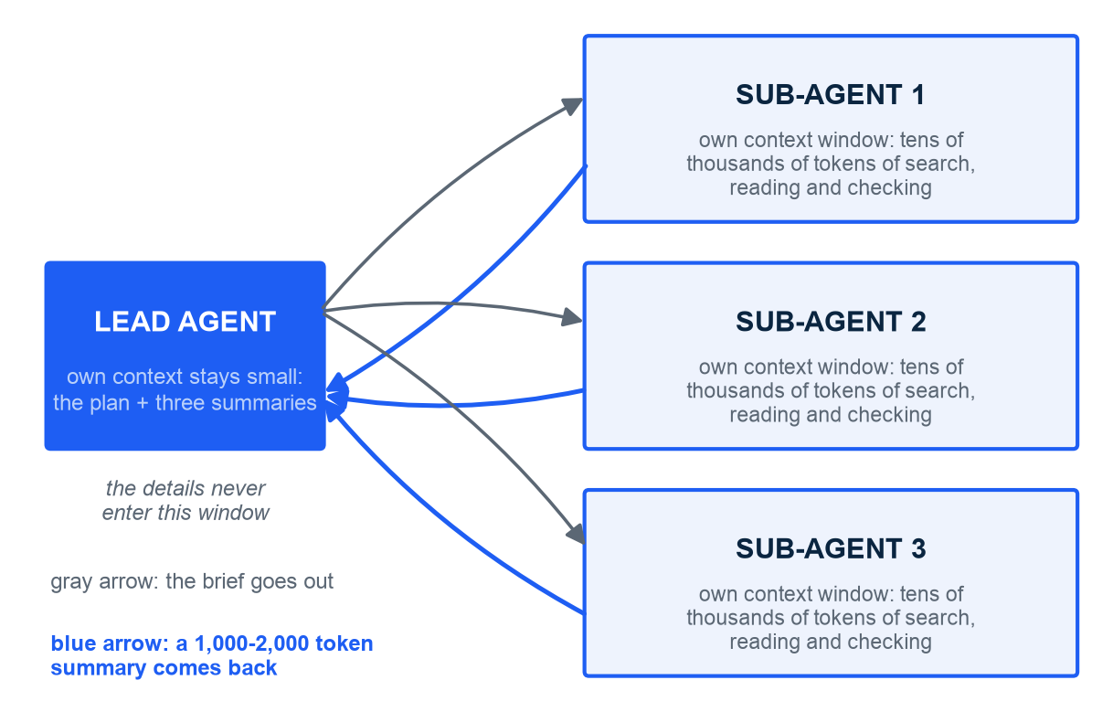
WHY ISOLATE CONTEXT
Sub-agents exist to keep the lead's context small
In plain words: a sub-agent is a fresh agent with a clean context, one task, a short report back
Context is a finite budget; search results and long documents burn it fast
A sub-agent spends tens of thousands of tokens exploring in its own window
It returns a 1,000-2,000 token summary; only that enters the lead's context
The lead keeps the plan; the details never pollute it
The car: a convoy - the lead car reads the map, scouts drive the side roads
Illustration. Sub-agent architectures and the 1,000-2,000 token summaries: Anthropic, Effective context engineering for AI agents, 29 Sep 2025.
M5 Session 4 - Sub-agents, Teams and the Discipline
3
Notes:
Start from the problem, not the pattern: in Session 2 the context window was a budget, and compaction was the emergency brake. Sub-agents are the structural fix - the expensive exploration happens in a window you throw away, and only a short summary comes back. Point at the arrow widths: gray brief out, blue summary back, nothing else crosses. Ask the class: what would you lose if the sub-agent returned its whole transcript instead of a summary?

Slide 4
THE RESEARCH SYSTEM
Splitting the work beat one big agent - at a price
90.2%
better than a single Opus 4 agent on Anthropic's internal research eval - at about 15x the tokens of a chat
A lead agent (Opus) plans and spawns 3-5 Sonnet sub-agents in parallel, each with its own context; a separate citation pass at the end. Anthropic, How we built our multi-agent research system, 13 Jun 2025.
M5 Session 4 - Sub-agents, Teams and the Discipline
4
Notes:
The number that made multi-agent systems respectable: a lead Opus with parallel Sonnet sub-agents beat a lone Opus by 90.2% on breadth-first research questions. Then say the second half of the label louder than the first: fifteen times the tokens of a normal chat. The gain came from parallel exploration across separate context windows - exactly the isolation from the previous slide. Ask the class: which kinds of task would NOT benefit from splitting - and why?

Slide 5
ORCHESTRATOR-WORKERS IN PRODUCTION
The research system's lessons: teach delegation, scale the effort
What the lead agent must learn
What the harness must provide
Teach delegation: each sub-agent gets an objective, output format, tools and boundaries
Vague briefs made sub-agents duplicate work or wander off
Scale effort to complexity: a simple fact needs one agent; a survey needs ten or more
Explicit rules for how many sub-agents and how many tool calls
In plain words: the lead writes a good ticket, not a vague wish
Parallel execution: sub-agents run at once and the wall clock drops sharply
External memory: the lead saves its plan before context nears the limit
A separate citation pass: one agent checks sources after the research
Evals with calibrated LLM judges to compare versions
Cost awareness: at ~15x tokens the task must be worth it
Anthropic, How we built our multi-agent research system, 13 Jun 2025.
M5 Session 4 - Sub-agents, Teams and the Discipline
5
Notes:
Two columns, two owners. The left is prompt work for the lead: it must brief its workers like a good manager - objective, format, tools, boundaries - and decide how much effort a question deserves. The right is harness work: parallelism, memory, a citation pass, evals. Notice that the fix for wandering sub-agents was not a smarter model; it was a better brief. Ask the class: write a one-line brief for a sub-agent that should find when function calling shipped - what would you include?

Slide 6
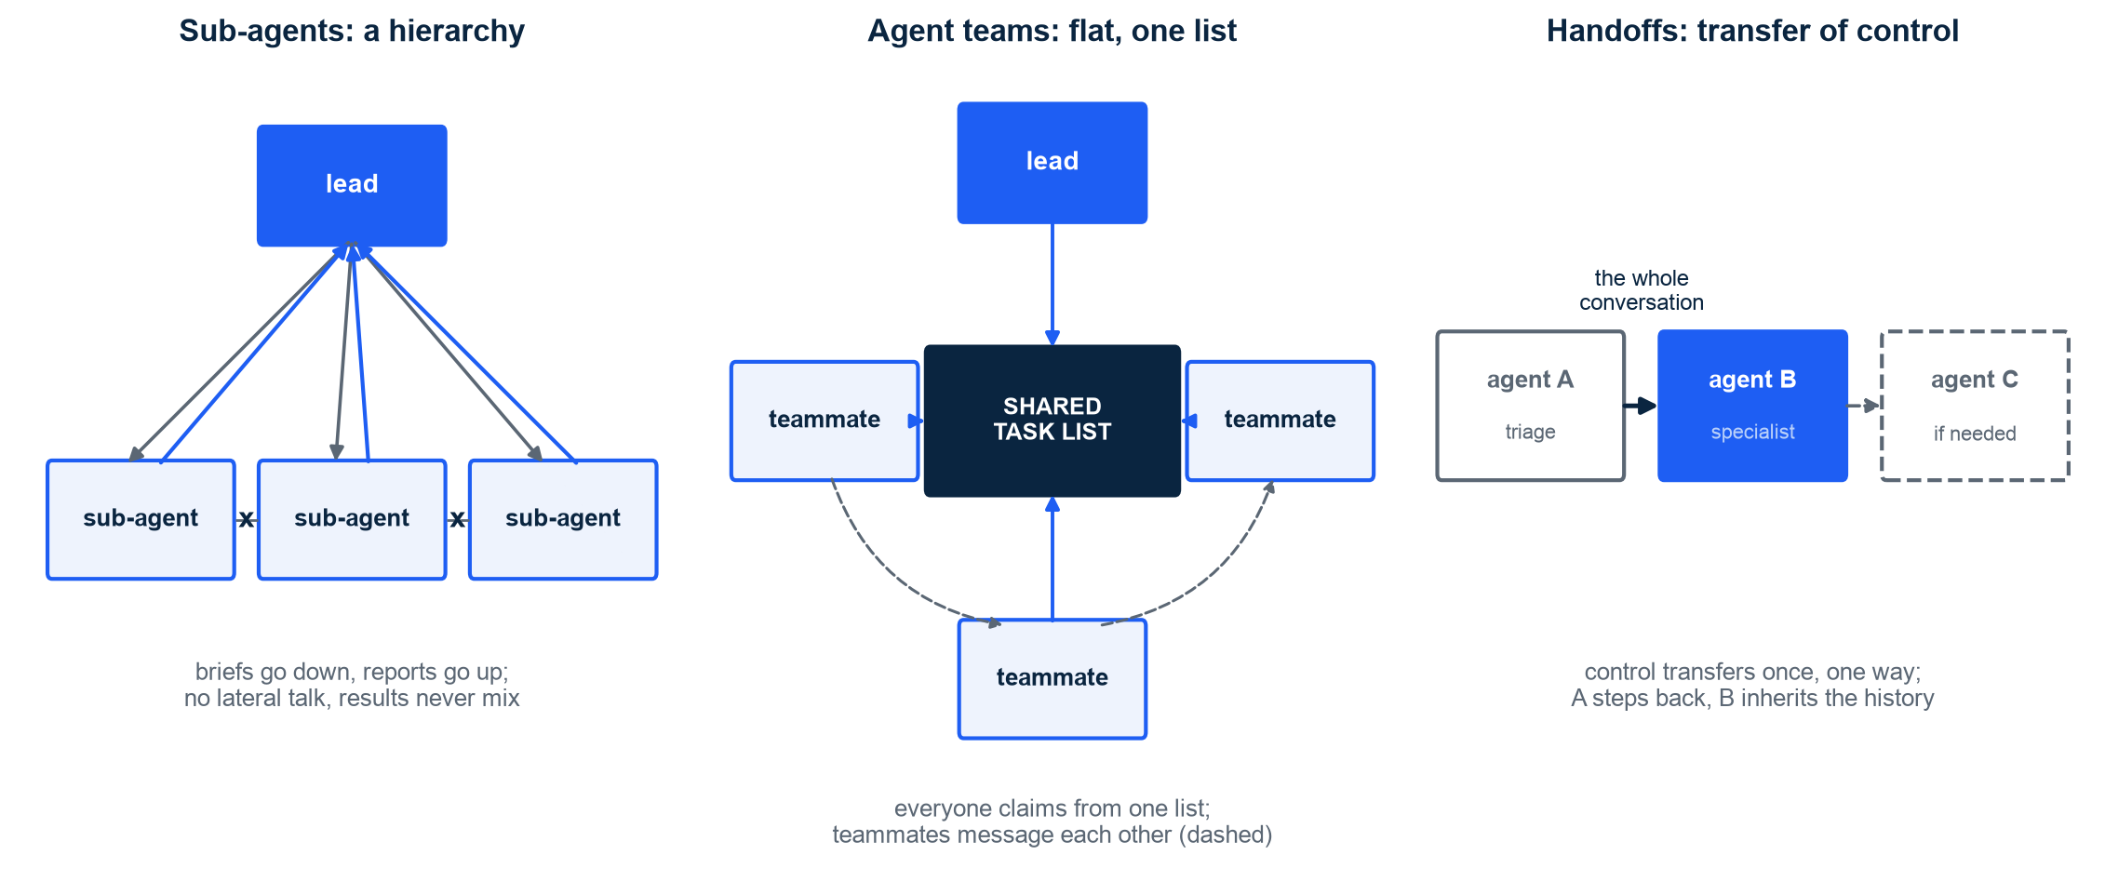
SUB-AGENTS, TEAMS, HANDOFFS
Three shapes of multi-agent work: hierarchy, flat team, handoff
Illustration. Sub-agents: Claude Code, GA 2025. Agent teams: Claude Code research preview, Feb 2026. Handoffs: OpenAI, A practical guide to building agents, Apr 2025.
M5 Session 4 - Sub-agents, Teams and the Discipline
6
Notes:
Same three pictures every time you design a multi-agent system. Hierarchy: one lead, workers that report up and never talk sideways - simple and predictable. Flat team: a shared task list, teammates that claim work and message each other, a lead that assigns and synthesizes - more parallel, harder to reason about. Handoff: the conversation itself moves to a specialist and the first agent steps back. In plain words: a convoy, a crew with one job board, a change of drivers. Ask the class: which shape is a hospital triage desk?

Slide 7
SUB-AGENTS, TEAMS, HANDOFFS
Which shape when: sub-agents, agent teams and handoffs compared
 | Sub-agents | Agent teams | Handoffs
Shape | Hierarchy: a lead spawns workers | Flat: peers share one task list | Chain: one agent replaces another
Communication | Results flow up only; no lateral talk | Direct messages between teammates; a shared board | The whole conversation moves, once
Who decides | The lead assigns and synthesizes | The lead assigns; teammates claim and coordinate | The current agent picks the next one
Context | Each worker has its own clean window | Each teammate has its own window; the board is shared | The receiver inherits the full history
When to use | Isolation: research, review, long reads | Parallel work on many independent tasks | Specialists: triage to billing, research to calculator
Source | Claude Code sub-agents, GA 2025 | Claude Code agent teams, Feb 2026 | OpenAI, Apr 2025: the decentralized pattern
OpenAI's manager pattern = sub-agents used as tools; its decentralized pattern = handoffs. OpenAI, A practical guide to building agents, Apr 2025.
M5 Session 4 - Sub-agents, Teams and the Discipline
7
Notes:
Use the table as a decision aid, row by row. The communication row is the one students miss: sub-agents cannot talk to each other by design, which is a feature - no cross-contamination - until two of them need the same fact. Teams fix that with a board and a mailbox at the price of coordination. Handoffs are different in kind: nothing is summarized, the receiver gets everything. Ask the class: you have 40 independent documents to summarize - which column, and what is the risk?

Slide 8
ORCHESTRATION
Who orchestrates: your code, or the lead model?
As code: patterns.orchestrate(...)
As a model decision: a delegate tool
A planner agent splits the task; code loops over the sub-tasks
Code spawns one worker per sub-task and collects the results
A synthesizer agent writes the final answer
You see and test every step; the structure cannot drift
Use when the shape of the work is known: split, solve, merge
Notebook 04: ~6,021 tokens for 3 workers plus the synthesizer
The lead has one tool, delegate(task), that spawns a sub-agent
The model decides when, how many, and with what brief
Flexible: it can delegate twice, or not at all
Harder to test; needs max_turns and a token budget
Use when the sub-tasks only appear as you go
Notebook 04: ~6,333 tokens for lead plus sub-agents; same subtasks, same final text
Both live in the course library: harness.patterns.orchestrate and harness.multi.SubAgentPool.delegate_tool(); token figures from the notebook 04 reference run on the stand-in. Anthropic, Building effective agents, Dec 2024.
M5 Session 4 - Sub-agents, Teams and the Discipline
8
Notes:
This is Session 3's workflow-versus-agent choice, one level up. On the left, orchestration is a Python function: the plan is a list, the loop is a for-loop, the merge is a call. On the right, orchestration is a tool the lead may call, and the structure lives in the model's head. Notebook 04 runs both on the same three-part question. Ask the class: which side would you pick for a nightly report that must look the same every day? The figures on this slide are the notebook's reference run on the deterministic stand-in; the notebook then repeats the comparison live on Claude, which varies and prints real token usage.

Slide 9
FAILURE MODES
Six ways multi-agent systems fail - and the guard for each
Failure mode | What it looks like | The guard
Context pollution | Sub-agent details and tool dumps flood the lead's window | Isolation: summaries in, details stay out
Runaway loops | An agent repeats the same tool call and never says done | max_turns, a token budget, a validator that fails loudly
Cost multiplication | Multi-agent ~15x the tokens of a chat; teams multiply again | Trace every run; scale the number of agents to the task
Too many handoffs | Problems needing more than four handoffs almost always failed | Fewer, clearer specialists; a router instead of a chain
The extra reviewer | Adding a reviewer agent lowered success by 8% | Evals before adding an agent; more agents is not more quality
Unbounded delegation | The lead keeps spawning sub-agents until the budget is gone | A before_tool hook caps delegations: at 2, the third is denied; ~4,300 vs ~6,333 tokens (notebook 04)
Handoffs and reviewer findings: Marmelab, The State of AI Harness Engineering 2026, Sep 2026. 15x tokens: Anthropic, Jun 2025. Delegation cap: notebook 04 reference run on the stand-in, 2 started, 1 denied.
M5 Session 4 - Sub-agents, Teams and the Discipline
9
Notes:
Every row is a real incident type; the last one is the notebook's own demo - a before_tool hook that denies the third delegation and saves a third of the tokens. The two survey findings deserve emphasis: chains of more than four handoffs almost always failed - each handoff loses intent - and adding a reviewer agent made things worse by eight points, probably because the reviewer second-guessed correct answers. The lesson is not 'never add agents'; it is 'never add an agent without an eval that shows it helped'. Ask the class: which of these five would a trace catch first? The figures on this slide are the notebook's reference run on the deterministic stand-in; the notebook then repeats the comparison live on Claude, which varies and prints real token usage.

Slide 10
HARNESS ENGINEERING AS A DISCIPLINE
The discipline: six things every harness needs, few have them
The checklist
The field in 2026
Instruction files in the repo (CLAUDE.md, AGENTS.md): what the agent must know
Executable guards: linters, structural tests, hooks - rules the agent cannot skip
Permission design: a risk level per tool; deny danger by default
Evals in CI: a suite with a pass rate, re-run on every change
Observability: a trace of every call, token and second
Cost budgets: max turns, token caps, alarms
63% of large projects ship instruction files; only a handful enforce them
4.4% of security rules are backed by a real control
60% of harnesses have no tests or evals
93% of permission prompts get approved
Eleven harnesses studied: 'hand-rolled async loops and deterministic retrieval'
In plain words: most harnesses are cars with the brakes drawn on paper
Marmelab, The State of AI Harness Engineering 2026, Sep 2026; Barbaste, Darrigol, Vu and Wiltberger, Harness Engineering: Anatomy, Architecture, and Evolution of Coding Agents, arXiv 2609.00006, Jul 2026.
M5 Session 4 - Sub-agents, Teams and the Discipline
10
Notes:
Left column is the course in six lines; right column is the gap. Read them as pairs: instruction files exist but are not enforced; security rules exist but 4.4% have a control; permission prompts exist but 93% are waved through; and 60% of harnesses could not tell you whether their last change helped. The eleven-harness study found the same thing from the code side: the loops are hand-rolled and the retrieval is deterministic - engineering, not magic. Ask the class: which of the six did your notebook 03 harness already have?

Slide 11
The field runs on hand-rolled async loops and deterministic retrieval.
Barbaste, Darrigol, Vu and Wiltberger - Harness Engineering: Anatomy, Architecture, and Evolution of Coding Agents (arXiv 2609.00006, Jul 2026), a source-code study of eleven coding-agent harnesses.
M5 Session 4 - Sub-agents, Teams and the Discipline
11
Notes:
Read it twice. It is the most reassuring sentence in the module: the systems students read about - Claude Code, Codex CLI, Gemini CLI, Aider, OpenHands and the rest - are loops, tool registries and file search, written by hand. The 300 lines of harness in this course are the same species, smaller. Ask the class: after four sessions, which line of the course library would you now want to read in one of those eleven?

Slide 12
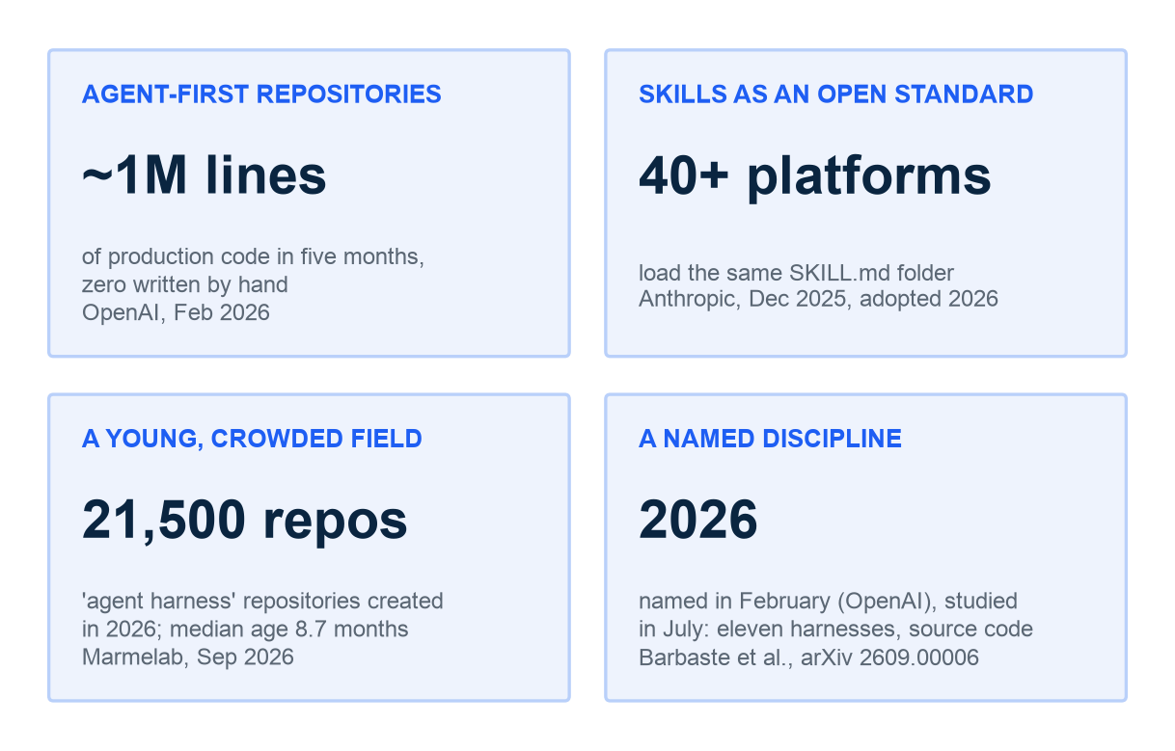
THE FUTURE
Where this is going: agent-first repositories and shared standards
Agent-first repositories: about one million lines in five months, zero by hand
The repo becomes the system of record: docs, decisions and plans written for agents
Skills are an open standard since Dec 2025; 40+ platforms load the same SKILL.md
21,500 harness repositories created in 2026, median age 8.7 months: a young field
The job moves from writing prompts to engineering the runtime around the model
In plain words: the engine is bought; the car is what you build
Illustration. OpenAI, Harness engineering, Feb 2026; Anthropic, Agent Skills open standard, Dec 2025; Marmelab, Sep 2026; Barbaste et al., Jul 2026.
M5 Session 4 - Sub-agents, Teams and the Discipline
12
Notes:
Four signposts, all dated, none speculative. Repositories are being rewritten for agent readers; skills let one folder work across forty platforms; twenty-one thousand harness repos in one year says everyone is building the same car; and the discipline now has a name and a first anatomy paper. The closing line of the module: models are bought, harnesses are built. Ask the class: which of the eight pieces do you think will be standardized next, after tools (MCP) and skills?

Slide 13
02
Part 2 - The practice: notebook 04
A lead with sub-agents against a solo agent, a team of three on a six-task board, a handoff, a runaway loop - and the eight pieces you built.
M5 Session 4 - Sub-agents, Teams and the Discipline
13
Notes:
Open notebook 04. Same library, same ScriptedModel, no API key; the runs are deterministic so the numbers match the slides. Ask the class: which of the three shapes do you expect to cost the most tokens, and why?

Slide 14
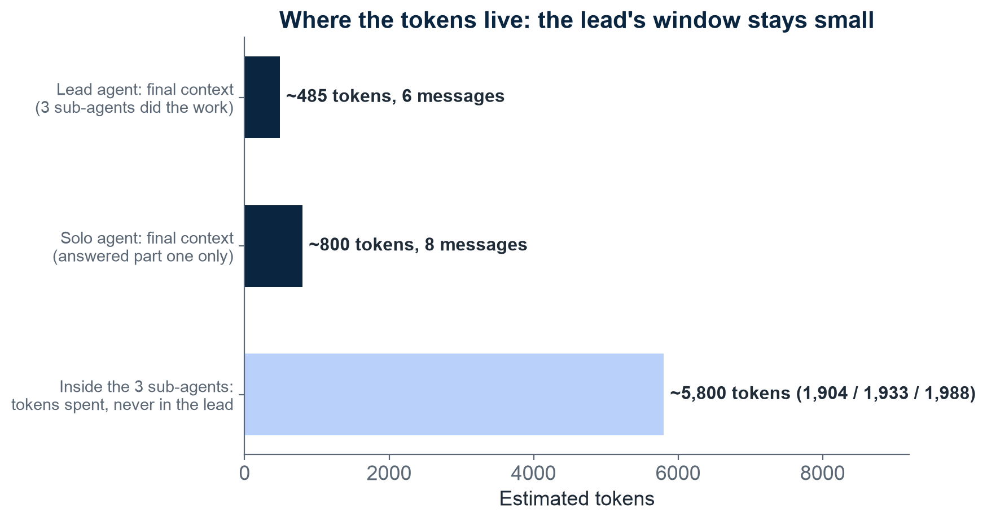
NOTEBOOK 04 - SUB-AGENTS
Lead window ~485 tokens; its sub-agents spend ~5,800 elsewhere
How to read it: navy bars = what one agent's window holds at the end; sky bar = work done elsewhere
The lead ends with 6 messages, ~485 tokens: its plan and three short reports
Its three sub-agents spent ~5,800 tokens searching and reading; none of it in the lead
A solo agent on the same compound question holds ~800 tokens and answers part one only
Total work went up roughly eightfold; the lead's window shrank. That is the trade
Notebook 04 reference run on the deterministic stand-in (live Claude varies, real tokens): lead with delegate tool vs solo agent; tokens via harness.multi.context_size.
M5 Session 4 - Sub-agents, Teams and the Discipline
14
Notes:
The chart has two kinds of bar on purpose. The navy bars are context sizes - what one agent was carrying at the end. The sky bar is total work done by the three sub-agents, which never touched the lead's window. The solo agent is the control: on the same three-part question it filled its window and still only answered the first part. Ask the class: the sub-agent version costs roughly eight times more in total - for which question is that obviously worth it, and for which is it not? The figures on this slide are the notebook's reference run on the deterministic stand-in; the notebook then repeats the comparison live on Claude, which varies and prints real token usage.

Slide 15
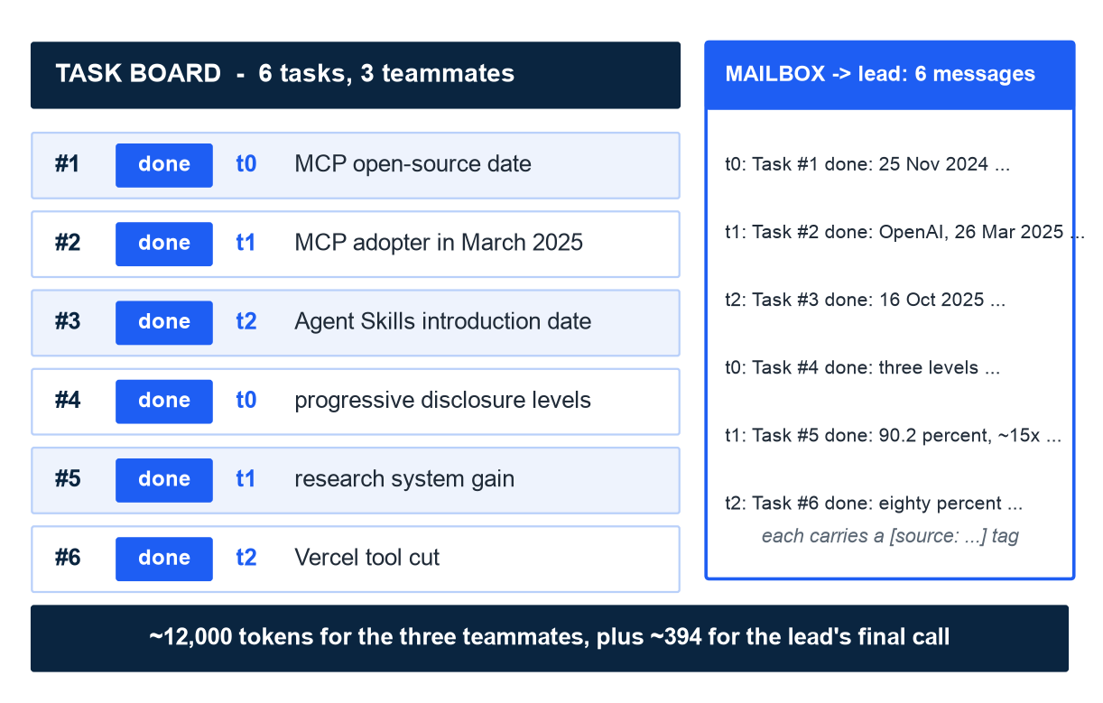
NOTEBOOK 04 - AGENT TEAMS
Three teammates clear a six-task board and mail the lead six times
How to read it: one row per task; the tag shows which teammate claimed it
3 teammates, 6 tasks: each claims the next open task, works, marks it done
6 mailbox messages to the lead: 'Task #n done: ...' with a cited answer
~12,000 tokens for the three teammates, plus ~394 for the lead's final call
A 4-teammate run gives the identical total: more hands, same work, same cost
In plain words: a team of drivers sharing one job board
Notebook 04 reference run on the stand-in (live Claude varies, real tokens): harness.multi.Team with TaskBoard and Mailbox, six tasks. Agent teams: Claude Code, Feb 2026.
M5 Session 4 - Sub-agents, Teams and the Discipline
15
Notes:
Walk the board top to bottom: tasks one to six, owners t0, t1, t2 in rotation because each teammate claims the next open task when it finishes. The mailbox on the right is the only channel to the lead - six short messages, each carrying a source tag. Compare with the sub-agent slide: here the lead did not even plan; the board did. The four-teammate run costs exactly the same: the board holds six tasks whoever claims them. Ask the class: what breaks first if two teammates claim the same task at the same time, and which piece of the harness should prevent it? The figures on this slide are the notebook's reference run on the deterministic stand-in; the notebook then repeats the comparison live on Claude, which varies and prints real token usage.

Slide 16
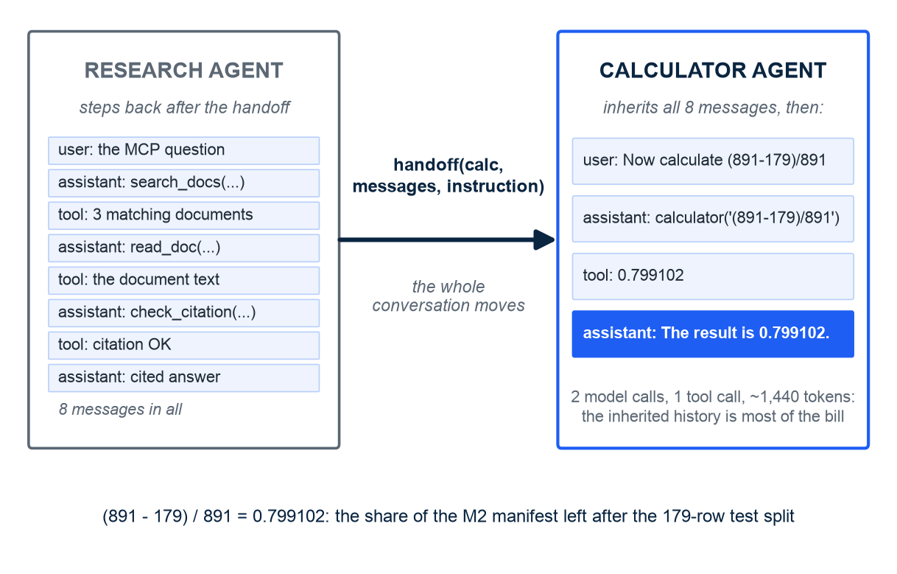
NOTEBOOK 04 - HANDOFF
A handoff moves the whole conversation to a specialist
How to read it: the conversation moves right; the research agent steps back
handoff(to_agent, history, instruction): 8 messages plus one new user message
The calculator agent calls its tool once and answers 0.799102 in 2 turns
Its first call sees ~715 tokens of inherited history; a fresh calculator agent sees ~36
Whole run ~1,440 tokens: routing sent only the question; a handoff sends everything
In plain words: change drivers, keep the passengers - useful, not free
Notebook 04 reference run on the stand-in (live Claude varies): harness.multi.handoff; (891 - 179) / 891 = 0.799102, the M2 train share. Handoffs: OpenAI, Apr 2025.
M5 Session 4 - Sub-agents, Teams and the Discipline
16
Notes:
The handoff is the simplest of the three shapes and the easiest to overuse. The calculator agent gets the entire research conversation and one new instruction; it needs only the instruction, but pays for everything. That is why the survey found chains of more than four handoffs almost always fail: the history grows and the intent blurs. Ask the class: when is inheriting the full history actually necessary, and what would a summary lose in that case? The figures on this slide are the notebook's reference run on the deterministic stand-in; the notebook then repeats the comparison live on Claude, which varies and prints real token usage.

Slide 17
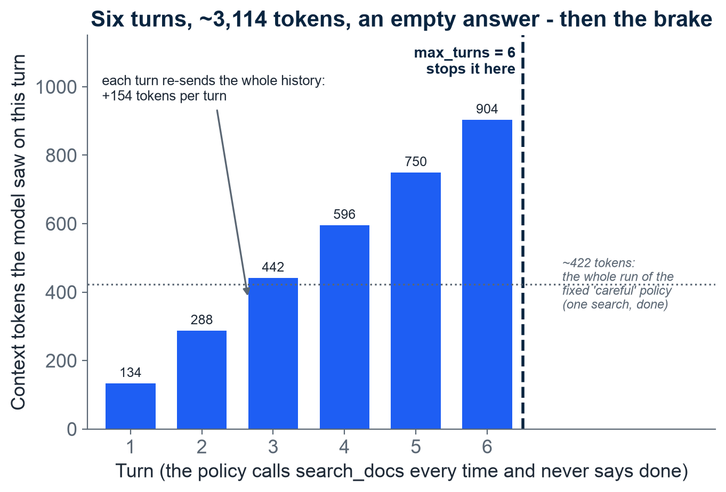
NOTEBOOK 04 - STOP CONDITIONS
A runaway loop costs more every turn - max_turns is the brake
How to read it: one bar per turn; height = context tokens the model saw on that turn
A policy that always calls search_docs never says done
Every turn re-sends the whole history, so cost grows: 134 to 904 tokens, +154 per turn
Six turns cost ~3,114 tokens and return an empty answer
max_turns = 6 stops it: stopped_because = 'max_turns', not 'done'
The fixed 'careful' policy searches once and finishes for ~422 tokens
Notebook 04: a looping policy that always calls search_docs, max_turns=6; tokens per turn from the trace. Kept on the stand-in on purpose: a real model would simply stop.
M5 Session 4 - Sub-agents, Teams and the Discipline
17
Notes:
This is Session 3's third exit made visible. The policy is deliberately broken: it calls the same search on every turn. Because the loop re-sends the full history each time, the per-turn cost climbs by 154 tokens each time and the total reaches about 3,114 for an empty answer. The dashed line is max_turns doing its job, and the result reports stopped_because equal to 'max_turns' so the caller knows it did not finish. The dotted line is the fix: a policy that searches once and answers costs about 422 tokens for the whole run. Ask the class: what would a smarter guard look at, so it could stop this loop at turn three instead of turn six? This demo is kept on the stand-in on purpose: a real model would simply stop calling the tool, so the runaway would never show.

Slide 18
ANATOMY, REVISITED
The eight pieces of a harness - and what you built for each
Piece | In the car | What you built (harness/ folder)
1. Model | the engine | ScriptedModel and ModelView; optional Anthropic or OpenAI adapters (models.py)
2. Context | dashboard and mirrors | ContextWindow budget and compaction, Notes (context.py)
3. Tools | the trailer hitch | @tool to JSON schema, ToolRegistry, risk levels (tools.py)
4. Skills | the glovebox manuals | SKILL.md loader, three-level progressive disclosure (skills.py)
5. The loop | steering wheel and pedals | Agent.run: gather, act, verify; exits done, max_turns, budget (agent.py)
6. Guardrails | brakes, seatbelts, airbags | Hooks before_tool, after_tool, validate_answer; permissions (agent.py)
7. Orchestration | convoy and job board | chain, route, parallel, orchestrate, evaluate_optimize; SubAgentPool, Team, handoff (patterns.py, multi.py)
8. Evals and observability | the logbook | EvalCase, graders, compare; Trace, show, cost (evals.py, trace.py)
Canon order from the course brief (Session 1). Every module lives in the harness/ folder next to the notebooks and runs without an API key.
M5 Session 4 - Sub-agents, Teams and the Discipline
18
Notes:
Close the loop with Session 1's anatomy slide: the same eight pieces, now with a file name each. Students have run every one of them. The point of the middle column is that the car metaphor was never decoration - each piece answers one question a driver would ask. Ask the class: which piece would you replace first if this harness went to production, and with what?

Slide 19
What you can now build
A harness: model + loop + tools + skills + guardrails + traces, with no API key needed
A workflow when the path is known; an agent when it is not
Sub-agents to keep the lead small; teams for parallel tasks; handoffs for specialists
An eval suite that puts a pass rate and a price on every change
Guards that run in code: risk levels, validators, max turns, budgets
The discipline: instruction files, executable guards, evals in CI, observability
Two engines, one harness: model_for(role) gives Claude when a key is present (.env, never in a cell, never committed), the stand-in otherwise
Harness Engineering - Module 5
M5 Session 4 - Sub-agents, Teams and the Discipline
19
Notes:
End on capability, not theory. Every line is something they ran this module. The last line is the invitation: the notebooks' optional section connects a real model through the same interface, and nothing else in the harness changes - which is the whole argument of the module. Ask the class: what is the first agent you would build with this, and which of the eight pieces would you spend most of your time on? model_for(role) picks the engine: Claude when ANTHROPIC_API_KEY is present in the git-ignored .env, the deterministic stand-in otherwise - the harness code is identical either way.

