Slide 1
SESSION 3 OF 4
Which Titanic model deserves our trust?
Several models can learn from the same passenger records. A fair comparison gives every candidate the same challenge. We will compare their predictions with a simple baseline. The strongest training score may not be the strongest evidence.
Machine Learning - Module 2
Notes:
Imagine choosing a model to predict which Titanic passengers survived. One candidate looks excellent on the records it studied. Another makes fewer mistakes on passengers held back from training. Which evidence would you trust? Today we will make that comparison fair rather than choose by reputation. Six models enter, including a deliberately simple reference model. They face the same validation rounds and the same scoring rule. Our job is to understand what those scores support and what they do not. Ask students to predict whether the most complicated model must win. Keep their answers in mind for the results.

Slide 2
THE MAP FOR TODAY
Choosing a model and evaluating it are different jobs
Compare candidates inside the 712 training rows.
The notebook makes the first course evaluation on the 179-row holdout.
Opening it teaches metrics, but ends its fresh status.
Later reuse cannot provide a fresh estimate.
01
CHOOSE
Compare candidates with cross-validation inside 712 training rows.
02
REPORT
The notebook opens the 179-row holdout to teach evaluation metrics.
03
STATUS
After opening, later reuse is instructional evidence, not a fresh estimate.
The one bar that rules Module 2 (it returns in every session). Harvard CS109A / ISLR ch. 5 (model selection vs model assessment).
M2 Session 3 - Model Selection and Evaluation
2
Notes:
Start with the passenger bar. The full table contains 891 passengers and 18 features, meaning input columns available to the model. Point to the 712 training rows. We use portions of these rows to compare candidates. That job is model selection. Now point to the 179 holdout rows, kept separate from fitting and selection. Evaluating the chosen model there is model assessment. In this session, the companion notebook makes the first course evaluation on that holdout to teach metrics. After that opening, it is no longer fresh. Reusing it later must be described as reuse, not another untouched final exam. Ask students which side should decide the tournament winner.

Slide 3
01
Part 1: What makes a comparison fair?
Begin with what training scores can and cannot tell us.
M2 Session 3 - Model Selection and Evaluation
3
Notes:
Before we meet the contestants, we need to agree on the rules. Imagine allowing one model to see the answers before a round while another has to predict unseen passengers. Their scores would not be comparable. The next few pictures explain why that problem can happen even without anyone intending to cheat. We will begin with the score a model improves during training, then examine why that score may not carry over to new rows. You do not need to memorize the terminology immediately. First, try to explain what you notice in each picture using ordinary language.

Slide 4
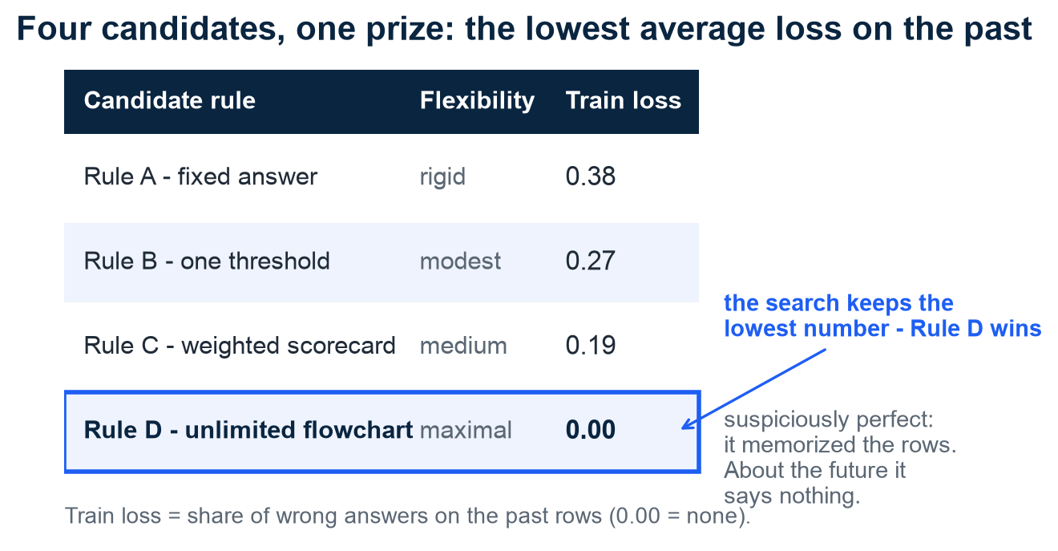
EMPIRICAL RISK MINIMIZATION
A perfect training score is not enough
Notice which rule makes the fewest training mistakes.
Rule D reaches 0.00 on the rows it studied.
Loss means how wrong a prediction is.
Minimizing average training loss is called empirical risk minimization.
Illustration - invented rules and loss values. MIT 6.390, ch. 1 and appendix C (empirical risk minimization).
M2 Session 3 - Model Selection and Evaluation
4
Notes:
Look first at the candidate table, not the technical label. Each row represents a possible prediction rule. Lower loss means less prediction error under the chosen scoring rule. In this illustration, Rule D reaches 0.00 because it can reproduce the training answers. That makes it the winner on those particular rows, but we have not yet asked it to predict a new passenger. Choosing a rule by minimizing average loss on observed training examples is called empirical risk minimization. Empirical simply means measured from examples we have. Ask students what evidence is still missing before we can trust Rule D. Emphasize that these are invented rules and values, not Titanic results.

Slide 5
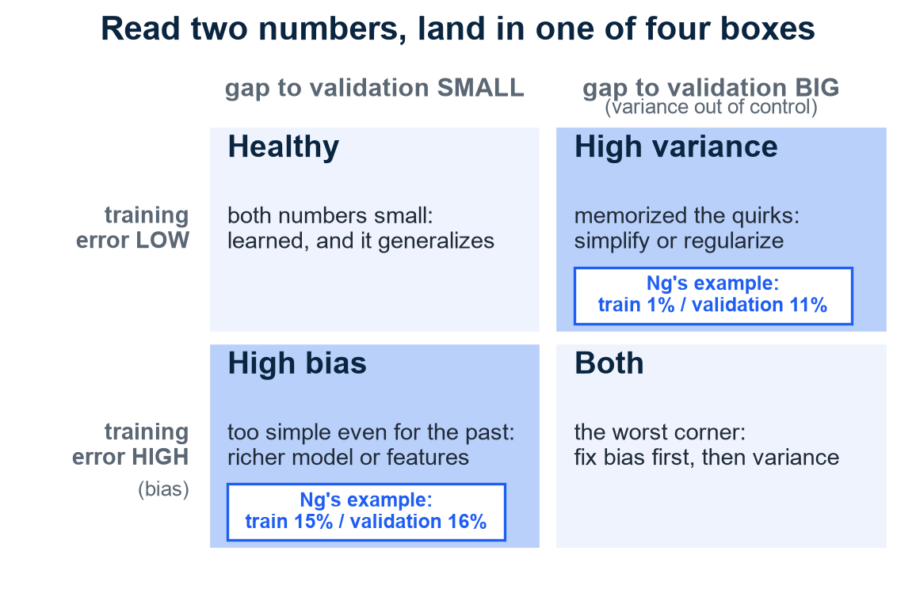
GENERALIZATION
Compare training error with error on unseen rows
Start with how often the model misses during training.
Then notice how much worse it does on held-back rows.
High training error can suggest bias, a systematic limitation.
A large gap can suggest variance, sensitivity to training data.
Grid cards: Ng's teaching examples, not course numbers. Ng, Machine Learning Yearning chs. 20-21.
M2 Session 3 - Model Selection and Evaluation
5
Notes:
Use the example cards to enter the grid. A model with train 1% and validation 11% does well on familiar rows but much worse on held-back rows. That gap suggests sensitivity to the training sample, which we call variance. Now compare train 15% with validation 16%. Both errors are high in this teaching example, suggesting bias, or a systematic limitation in what the model learns. These are diagnostic clues, not complete diagnoses. Whether an error is high depends on the task and a reasonable reference level. Doing well on new rows is called generalization. Ask students to explain the difference between the cards without using either technical term.

Slide 6
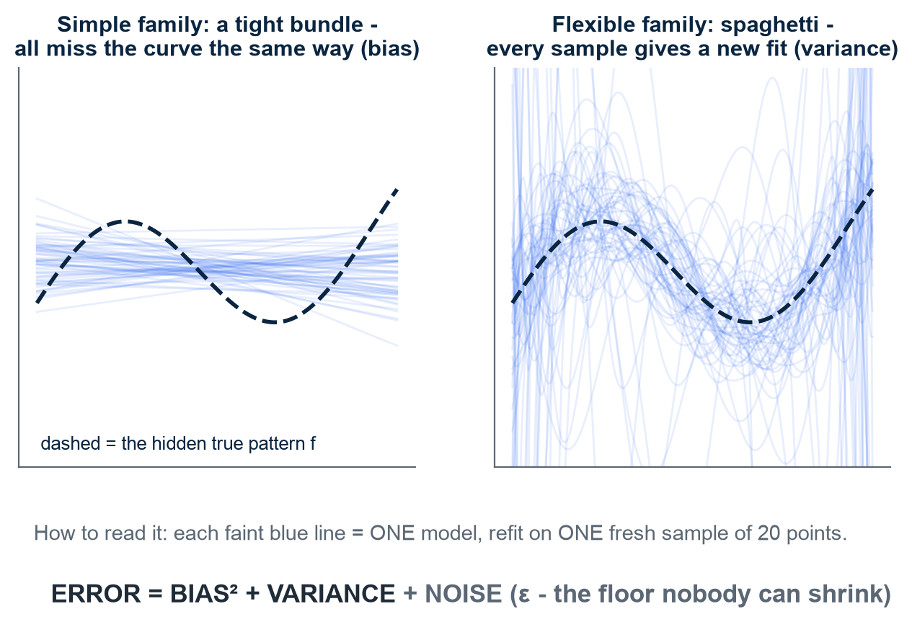
BIAS-VARIANCE DECOMPOSITION
Consistent mistakes or unstable fits?
Each faint line comes from a different training sample.
A tight bundle can still miss the underlying pattern.
A scattered bundle changes strongly with the sample.
These pictures illustrate systematic error, called bias, and instability, called variance.
Regression illustration: expected squared prediction error = bias² + variance + noise
Illustration - synthetic data, 60 refits per panel. Device from Harvard CS109A L6 / ISLR §2.2.
M2 Session 3 - Model Selection and Evaluation
6
Notes:
Follow the dashed pattern first. Now look at the fitted lines around it. On the left, the lines agree with one another but consistently miss the curve. Their agreement does not make them correct. On the right, the fitted lines change substantially when the training sample changes. The shared miss illustrates bias. The changing answers illustrate variance. These panels use synthetic data with 60 refits per panel, not Titanic passengers. The displayed decomposition applies to expected squared prediction error under the usual assumptions, not directly to our classification accuracy. Later, variation across validation folds will show another kind of sample sensitivity, although those folds overlap rather than being independent fresh samples.

Slide 7
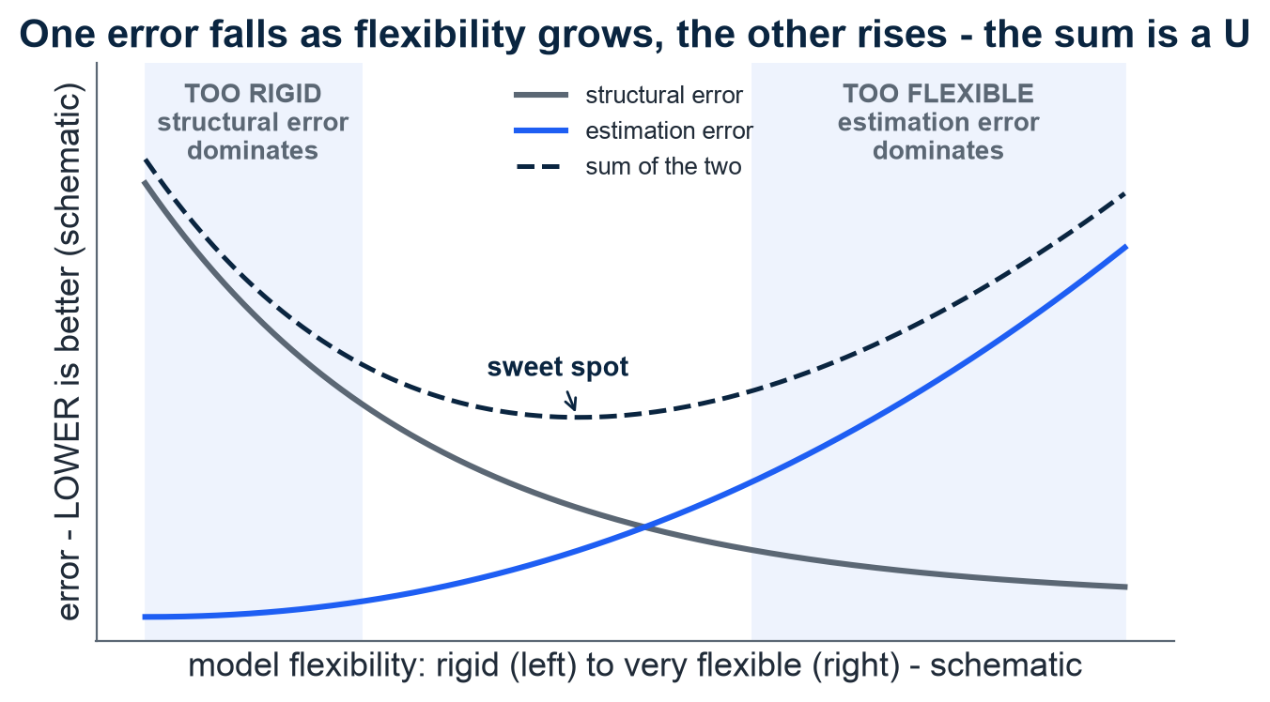
STRUCTURAL VS ESTIMATION ERROR
More flexibility can solve one problem and worsen another
A rigid model family may miss the pattern entirely.
A flexible family offers more possible rules to choose from.
Limited data can make that choice unreliable.
Notice where the combined error is lowest in this schematic.
Illustration - schematic curves, no real data. MIT 6.390, ch. 2 and ch. 5 (structural vs estimation error).
M2 Session 3 - Model Selection and Evaluation
7
Notes:
Read the horizontal axis as increasing flexibility and the vertical axis as error, where lower is better. A very rigid family may not contain a rule that follows the pattern well. That limitation is structural error. Adding flexibility can reduce it. But with only a limited sample, we may choose a poor member of the larger family. That difference from the family's best possible member is estimation error. Our Titanic training table has 712 rows, so extra flexibility needs evidence rather than automatic approval. These curves illustrate a possible trade-off, not a law requiring every dataset to form this shape. Ask which limitation more representative data is most likely to reduce.

Slide 8
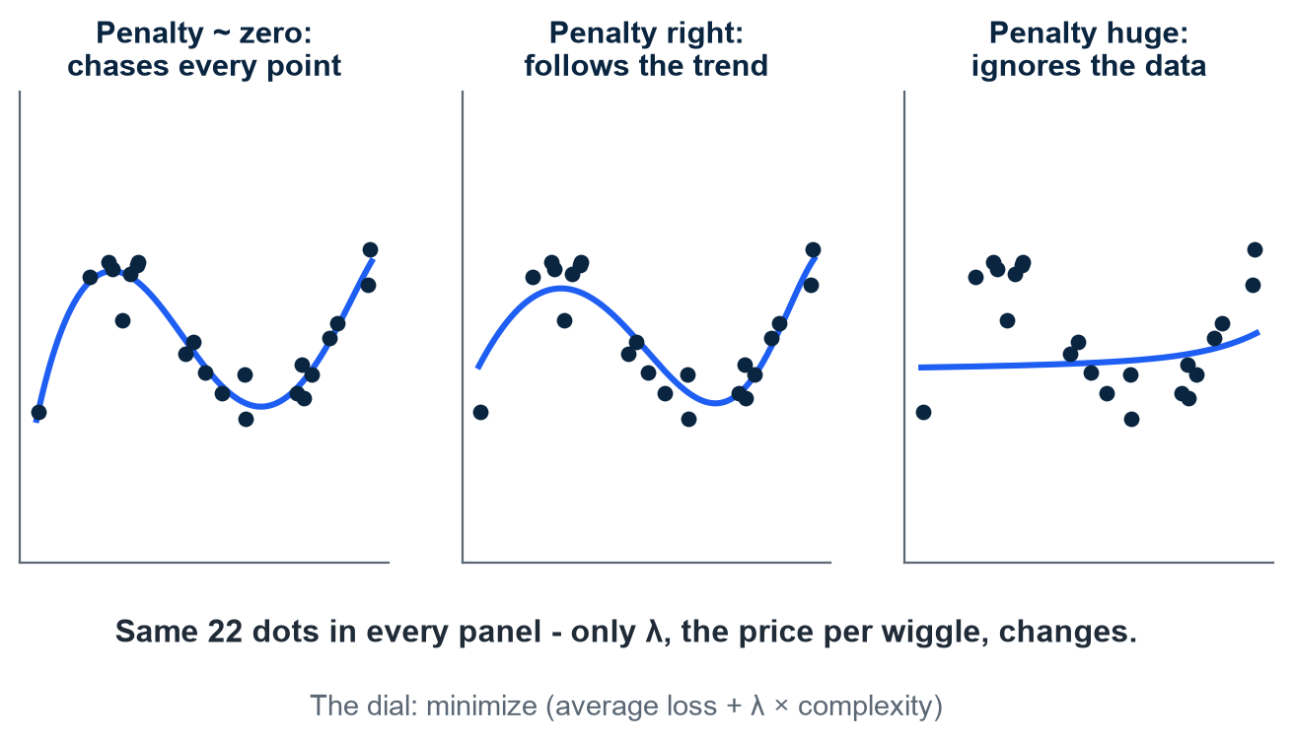
COMPLEXITY ON A LEASH
Can we discourage unnecessary complexity?
The points stay the same while the fitted curve changes.
Notice which curve follows the trend without chasing every point.
A complexity penalty discourages unnecessary bends.
This is regularization, a way to limit what training can fit.
Illustration - synthetic points, same data in all panels. MIT 6.390 ch. 2 (penalty framing); Harvard CS109A / ISLR ch. 6 (ridge).
M2 Session 3 - Model Selection and Evaluation
8
Notes:
Compare the curves while keeping your eyes on the same 22 points. The left fit follows small changes closely. The middle fit follows the broader pattern. The right fit is heavily constrained. We have changed the strength of a complexity penalty, not supplied different observations. The symbol λ, pronounced lambda, controls that strength. Adding such a penalty is one form of regularization. Ridge regression, for example, penalizes large model weights. A tree depth limit also restricts complexity, although it is not the same mathematical penalty. The middle panel is the intended balance in this illustration, not a setting we can choose by appearance alone. Ask students which fit might react most to a slightly different sample.

Slide 9
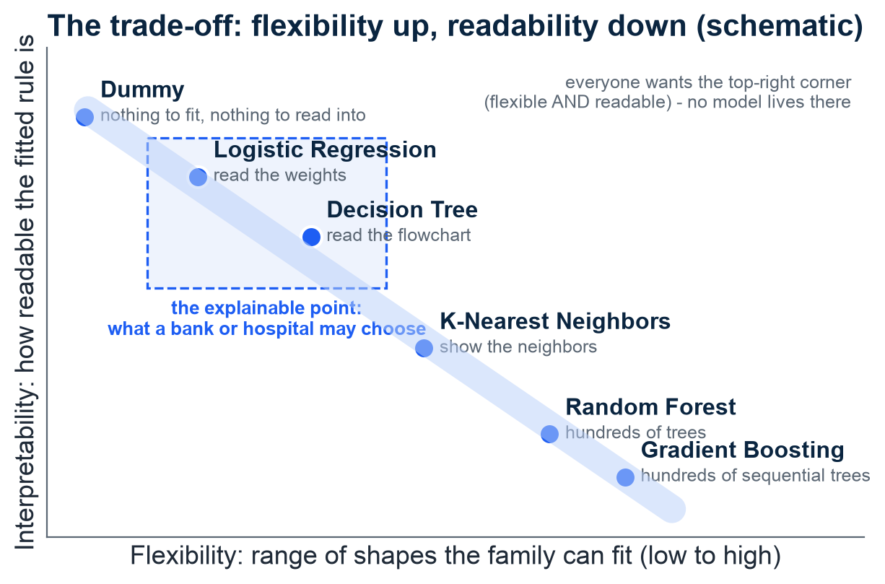
THE TRADE-OFF CHART
A useful model may also need to be explainable
Moving right means the model family can fit more shapes.
Moving up means its fitted rule is easier to inspect.
These positions are teaching judgments, not measured scores.
Consider whether someone must understand the reason for a prediction.
Choose within training data. Use the holdout for instructional evaluation. Harvard CS109A / ISLR ch. 5.
M2 Session 3 - Model Selection and Evaluation
9
Notes:
Read the axes before comparing the dots. The horizontal direction represents flexibility, while the vertical direction represents how easily a person can inspect the fitted rule. A small weighted scorecard may be easier to discuss than a large collection of trees. These placements are schematic judgments, not measured Titanic results, and they do not prove that flexibility and readability can never coexist. Imagine a passenger asking which recorded information influenced a prediction. Being able to answer may matter alongside predictive performance. This property is called interpretability, meaning how understandable the model's behavior is. Ask students what explanation they would want if a model rejected their loan application.

Slide 10
ESTIMATING THE TRUE ERROR
Give every training row a turn at validation
Each round holds back a different group of training rows.
Fit the model without that group, then score its predictions.
Repeat across 5 folds, meaning groups.
This cross-validation procedure compares candidates without using the 179-row holdout.
5-fold cross-validation: every training row validates once
Fold 1
Fold 2
Fold 3
Fold 4
Fold 5
Round 1
VALIDATE
TRAIN
TRAIN
TRAIN
TRAIN
Round 2
TRAIN
VALIDATE
TRAIN
TRAIN
TRAIN
Round 3
TRAIN
TRAIN
VALIDATE
TRAIN
TRAIN
Round 4
TRAIN
TRAIN
TRAIN
VALIDATE
TRAIN
Round 5
TRAIN
TRAIN
TRAIN
TRAIN
VALIDATE
The 179-row course holdout is outside this loop
5-fold cross-validation, the referee used throughout Part 2. MIT 6.390, Appendix C; Harvard CS109A / ISLR §5.1.
M2 Session 3 - Model Selection and Evaluation
10
Notes:
Trace the highlighted block as it changes position. Each block is a fold, a group of rows. During a round, that group is excluded from fitting and used for validation. Across 5 rounds, every row receives a held-back prediction. This is 5-fold cross-validation. It compares a modeling procedure, including its settings and preprocessing, rather than repeatedly scoring one already fitted model. The 712 training rows supply these rounds, with each fold containing approximately the ~142 rows shown. Every contestant must use the same folds and scoring rule. Learned preprocessing must also be fitted without the validation group. The separate 179-row holdout is opened later in this session, not during this comparison.

Slide 11
02
Part 2: Run the Titanic tournament
Compare every candidate under the same validation rules.
M2 Session 3 - Model Selection and Evaluation
11
Notes:
We now have enough language to judge the contestants without relying on their names. Watch for the same question throughout the results. Did each model get a comparable opportunity to learn and a comparable challenge when scored? The tournament stays inside the training rows. We will first compare the candidates with cross-validation, then use the chosen model's holdout predictions to learn about different kinds of mistakes. That later step opens the holdout for the first course evaluation. It does not leave an untouched test set for the next session. Ask students to name one rule that would make the comparison unfair if we changed it for only one model.

Slide 12
THE MODEL ZOO
Different models, the same evaluation rules
Model | Intuition in one line | Needs scaling | Interpretability
Dummy | Ignores the data, always predicts "died" - our floor | No | Nothing to read
Logistic Regression | A weighted scorecard summed into a probability | Yes | High - read the weights
K-Nearest Neighbors | Ask the 5 most similar passengers, then let them vote | Yes | Medium - show the neighbors
Decision Tree | A flowchart of yes/no questions | No | High - read the flowchart
Random Forest | Hundreds of trees voting; the vote averages mistakes away | No | Low - too many trees to read
Gradient Boosting | Trees that learn from the previous tree's mistakes | No | Low
Use the same validation folds and evaluation metric for all six models. Fit preprocessing inside each fold. MIT 6.390, Appendix C.
A model = a function with adjustable knobs ("parameters"). "Needs scaling" = wants all features on one ruler first: Fare runs 0-512, Age 0-80 - Fare would shout, Age whisper.
M2 Session 3 - Model Selection and Evaluation
12
Notes:
Start with the table's plain-language descriptions. The Dummy model ignores passenger features. Logistic Regression acts like a weighted scorecard for class probabilities. Nearest neighbors looks for similar passengers, while tree methods use questions about their recorded features. We do not need implementation details to compare them fairly. A parameter is an adjustable value learned during training. Scaling means putting input columns on comparable numerical ranges. Here Fare runs 0-512 and Age 0-80, which can matter for distance-based or penalized methods. Use the same validation splits and evaluation metric, with appropriate preparation learned inside each fold. Do not claim that every algorithm minimizes the same training loss. Ask students which description sounds easiest to explain to a passenger.

Slide 13
PART 1'S WARNING, LIVE
The tree scores better on training rows
The tall bar scores predictions on familiar training rows.
The lower bar summarizes predictions on held-back validation rows.
Training accuracy is 0.985, compared with 0.751 in cross-validation.
This gap warns against selecting a model by training accuracy.
One unlimited decision tree, two very different scores
1.0
0.985
0.233 gap
0.8
0.751
0.6
0.4
0.2
0.0
Training accuracy
(on familiar rows)
5-fold CV accuracy
(on held-back folds)
Unlimited decision tree, training vs 5-fold CV accuracy. Module 2, notebook 2.
M2 Session 3 - Model Selection and Evaluation
13
Notes:
Compare the bars before interpreting them. Accuracy means the fraction of predictions that are correct. The unlimited tree reaches 0.985 when evaluated on its training rows, but its cross-validation accuracy is 0.751. These are different evaluation conditions, so the contrast warns us that training performance does not transfer directly to unseen rows. This pattern is consistent with overfitting, where the fitted rule captures training-specific details that do not generalize well. The source reports a gap of 0.233. Check that annotation against unrounded notebook outputs, because the displayed scores are rounded. Ask students which result should guide the tournament ranking and what useful diagnostic information the training bar still provides.

Slide 14
BASELINE FIRST
How well can a model do without passenger features?
0.617
Dummy baseline, 5-fold CV accuracy (+/- 0.003). It always predicts "died" - and 61.7% of training passengers did die, so it is right 61.7% of the time.
On accuracy, a model that does not beat this baseline has not demonstrated an improvement. Build a simple first system, then iterate. Ng, Machine Learning Yearning ch. 13.
M2 Session 3 - Model Selection and Evaluation
14
Notes:
Let the large number sit for a moment. This model reaches 0.617 without using Age, Fare, or any other passenger feature. It always predicts died. Because 61.7% of the training passengers died, the common answer is often correct. A baseline is a simple reference method that helps us interpret another model's score. The reported cross-validation spread is +/- 0.003. That stability does not make the model useful for finding survivors, since it never predicts survived. Ask students whether a model just above this accuracy has necessarily solved the task. The answer depends on the size and reliability of the improvement, and on which mistakes matter.

Slide 15
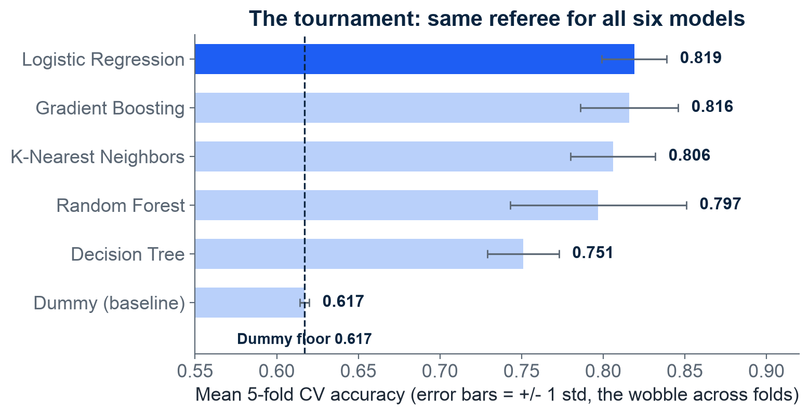
SIX MODELS, ONE REFEREE
Logistic Regression leads narrowly
Compare each bar with the baseline before comparing candidates.
Logistic Regression reaches 0.819, with Gradient Boosting close at 0.816.
Whiskers show variation across validation folds.
The small lead does not establish a clearly superior model.
Mean 5-fold CV accuracy, +/- 1 std; axis starts at 0.55 to magnify the differences. Module 2, notebook 2.
M2 Session 3 - Model Selection and Evaluation
15
Notes:
Start at the dashed baseline, then compare the bar endpoints. Logistic Regression has the highest mean at 0.819, with Gradient Boosting at 0.816. All feature-using candidates beat the baseline here. The whiskers show one standard deviation, a measure of score spread across folds, not confidence intervals proving which model is best. Among those candidates, Random Forest has the largest reported spread, +/- 0.054, and Logistic Regression the smallest, +/- 0.020. The axis starts at 0.55, so differences look larger than on a full accuracy scale. Shared folds and fold-fitted preprocessing make this comparison fairer. Ask students to justify a provisional choice without claiming that the narrow lead settles every question.

Slide 16
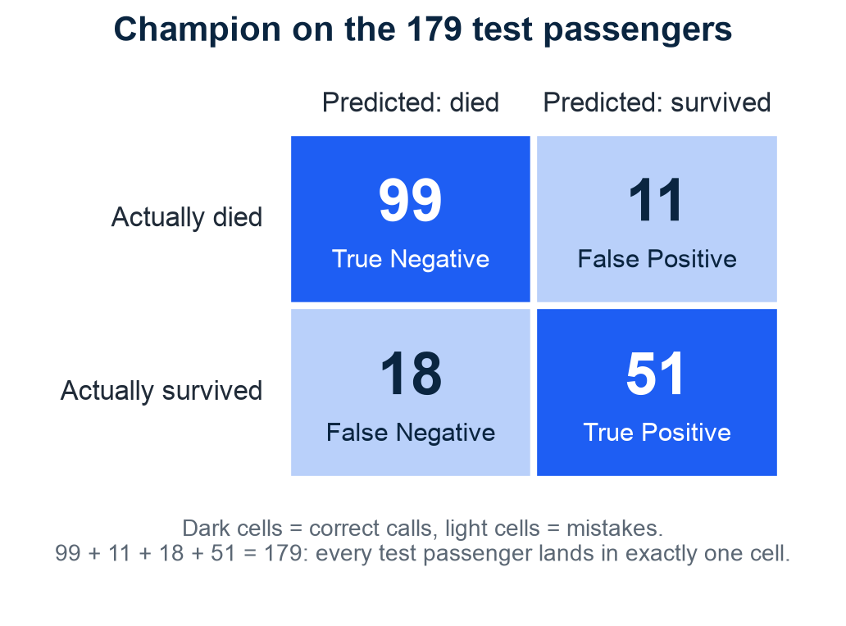
THE 99% TRAP
Which mistakes does accuracy hide?
Read actual outcomes by row and predictions by column.
This confusion matrix counts correct calls and mistakes.
The notebook makes the first course evaluation on this 179-row holdout.
Later reuse is not a fresh estimate.
Logistic Regression, confusion matrix on the test set. Module 2, notebook 2. Harvard CS109A, Classification Metrics lecture.
M2 Session 3 - Model Selection and Evaluation
16
Notes:
Point to the row and column labels before reading any counts. The diagonal contains 99 correct died predictions and 51 correct survived predictions. The other cells contain 11 false alarms for survived and 18 missed survivors. This table is a confusion matrix, a count of predicted classes against actual classes. It reveals what accuracy can hide. In the separate teaching example, a disease affecting 1 in 100 allows an always-negative rule to achieve 99% accuracy while missing every case. Here the companion notebook makes the first course evaluation on the same 179-row holdout. The candidate was chosen using training-row cross-validation. Once we inspect these results, later reuse of this holdout is not fresh assessment.

Slide 17
TWO KINDS OF MISTAKES
Precision and recall count different groups
Precision 0.823 - trust our alarms
Recall 0.739 - catch them all
Of predicted survivors, how many survived?
51 / (51 + 11) = 0.823
High precision means fewer false alarms.
Of actual survivors, how many did we find?
51 / (51 + 18) = 0.739
High recall means fewer missed cases.
TP, FP, FN are the confusion-matrix cells from the last slide. F1 = a strict average (harmonic mean) of precision and recall = 0.779 - high only when both are decent. Metric pairing after Ng's ML Specialization (C2, W3).
M2 Session 3 - Model Selection and Evaluation
17
Notes:
Start with the shared count of 51 correctly predicted survivors. Precision compares those passengers with everyone predicted to survive, including the 11 false alarms. That gives 0.823. Recall compares them with everyone who actually survived, including the 18 missed survivors. That gives 0.739. The abbreviation TP means a correct survived prediction, FP means a false survived prediction, and FN means a missed survivor. F1 is the harmonic mean of precision and recall, an average that is pulled down when either is low. Here it is 0.779. The Dummy's F1 is 0.000 under the notebook's reporting convention. Ask which denominator changes if we become especially concerned about missed survivors. These metrics describe the same opened holdout.

Slide 18
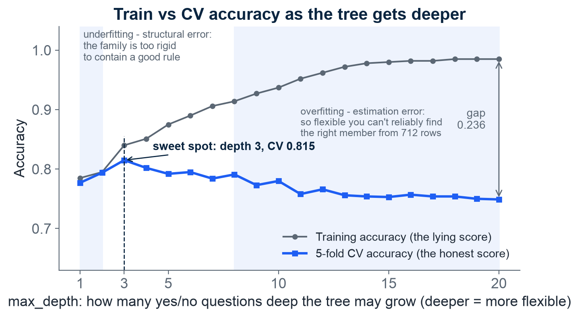
TREE DEPTH AND OVERFITTING
Deeper trees can overfit
Follow the validation curve as tree depth increases.
Its observed peak is 0.815 at depth 3.
Training accuracy continues upward toward 0.985.
The growing separation is evidence of overfitting, not a reason to prefer deeper trees.
Decision tree, max_depth 1-20, train vs 5-fold CV accuracy. Module 2, notebook 2. MIT 6.390, ch. 2 & ch. 5; Harvard CS109A / ISLR ch. 2.
M2 Session 3 - Model Selection and Evaluation
18
Notes:
Read depth as the maximum number of successive questions a tree can ask along a path. Increasing it allows a more detailed rule. The grey training curve rises toward 0.985, while the blue validation curve reaches its observed peak of 0.815 at depth 3. At depth 20, the source reports a gap of 0.236. This illustrates overfitting as flexibility increases. It resembles the earlier trade-off picture, but accuracy is better when higher, so we look for a peak rather than a trough. Do not interpret 0.815 as an established limit caused only by unavoidable noise. Model limitations and missing information may also matter. Ask students which depth they would investigate further using training-row validation.

Slide 19
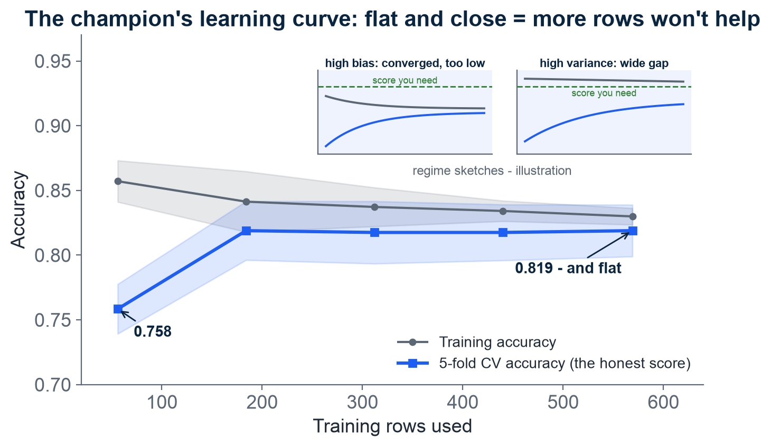
WOULD MORE DATA HELP?
What does this curve suggest about adding more data?
The validation score improves, then appears to level off.
It rises from 0.758 with 56 rows to 0.819 with 569 rows.
This suggests smaller gains within the observed range.
It does not prove additional data cannot help.
Logistic Regression learning curve: gains flatten in the observed range
Main panel: real curve, Module 2, notebook 2. Insets: regime sketches - illustration. Ng, Machine Learning Yearning chs. 28-32.
M2 Session 3 - Model Selection and Evaluation
19
Notes:
Follow the blue curve from 56 training rows to 569. Its reported score rises from 0.758 to 0.819, then appears relatively flat near the end. This is a learning curve, a plot of performance against training-set size. The shaded band shows variation across folds. The small sketches illustrate possible patterns, while the main panel contains our Titanic evidence. A flattening curve suggests that simply adding similar rows may yield smaller gains, but it cannot settle what happens far beyond the observed range or with more representative data. Better settings are another hypothesis to test, not a guaranteed improvement. Ask students what evidence they would request before deciding whether collecting more passenger records is worthwhile.

Slide 20
DECISION AND NEXT STEP
Carry the result forward, with its limits
The checklist
Verdict & handoff
Beat the 0.617 baseline.
Choose the metric before ranking.
Prefer the simpler model when results are close.
CV leader: Logistic Regression, 0.819 (+/- 0.020).
Instructional holdout accuracy: 0.838.
Previewed in Session 2, opened here, reused in Session 4.
A real launch needs new external data or a newly reserved holdout.
Why interpretability can matter: a pneumonia model associated asthma with lower risk because those patients received more intensive care. Inspecting the model exposed this potentially dangerous association. Source: Caruana et al., KDD 2015.
M2 Session 3 - Model Selection and Evaluation
20
Notes:
Our provisional choice is Logistic Regression, based on training-row cross-validation and its understandable weighted rule. The first course holdout evaluation gives accuracy 0.838. Precision is 0.823, recall 0.739, and F1 0.779 for survived. AUC is 0.878, a ranking measure that describes how often a randomly chosen survivor receives a higher score than a randomly chosen non-survivor, with ties given partial credit. These describe the same holdout evaluation, not new independent checks. Random Forest scored 0.797 in cross-validation. Next session uses it to learn tuning, but improvement and deployment are not guaranteed. Keep tuning decisions inside training-row validation. The pneumonia example reminds us that a readable association can reveal effects of care rather than biological protection.

Slide 21
Can you explain why this comparison is fair?
Compare candidates on shared validation folds, not training accuracy.
Use the baseline and a metric chosen before ranking.
The holdout has been opened, so reuse is not fresh.
Practice in notebook 02-model-selection in Colab.
Machine Learning - Module 2
M2 Session 3 - Model Selection and Evaluation
21
Notes:
Before opening the notebook, ask a partner to explain why the tallest training bar does not decide the winner. A good explanation should mention predictions on rows excluded from fitting. Then connect the results. The baseline was 0.617, Logistic Regression's mean validation accuracy was 0.819, and the first course holdout accuracy was 0.838. Those scores answer different questions and should not be treated as interchangeable. In notebook 02-model-selection, follow the comparison procedure and inspect the same holdout predictions to understand metrics. Re-running that evaluation does not create a fresh estimate. For later experiments, keep model choices within training-row validation and clearly label any reuse of the opened holdout. Finish by explaining the fairness rule in plain language.

