Slide 1
SESSION 3 OF 4
Building a Harness
Sessions 1 and 2 named the pieces. Today we assemble them: a loop that knows when to stop, guards that run outside the model, five workflow patterns, and an eval suite that puts a number on every change. Then notebook 03 runs one real model through three harnesses on this repository and reads the scoreboard honestly.
Harness Engineering - Module 5
Notes:
Frame the session: last time we looked at the parts on the bench - models, context, tools, skills. Today we bolt them into a car that drives and, more importantly, brakes. Part 1 is the theory of the loop, guardrails, patterns and evals; Part 2 is notebook 03, where the harness package runs on real Claude models and the same model passes 3, 14 and 13 of 14 cases depending only on the harness around it. Class question: if the same model gives three different results, what exactly are we testing?

Slide 2
01
Part 1 - The theory: the loop, the guards, the proof
How an agent runs, where the checks go, which pattern to pick, and how you know any of it works.
M5 Session 3 - Building a Harness
2
Notes:
Four ideas in Part 1: the loop and its exits, guardrails at three checkpoints, five workflow patterns, and evals plus traces as the proof. Class question: which of the eight pieces from Session 1 have we not yet built?

Slide 3
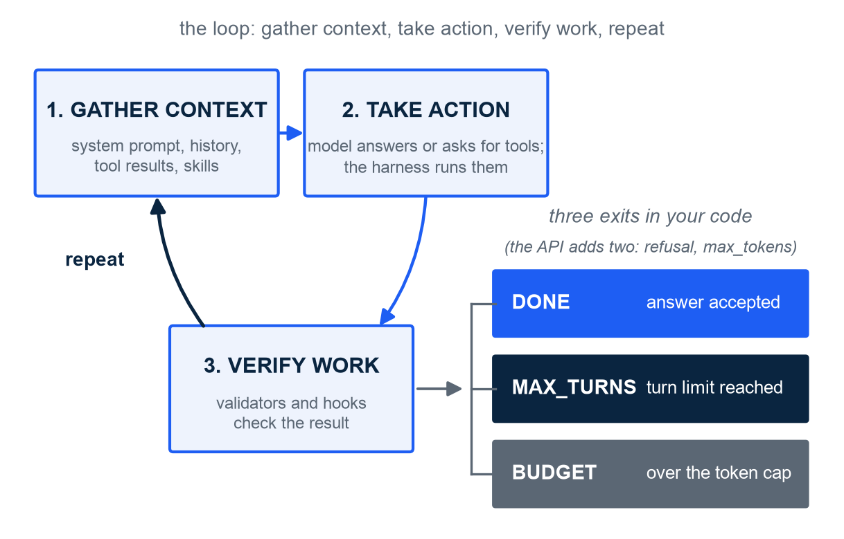
THE LOOP
An agent is a loop: gather context, take action, verify work, repeat
In plain words: the loop is the steering wheel and pedals; the model is the engine
Gather context: system prompt, history, tool results, skills - all the model sees
Take action: the model answers or asks for tools; the harness runs them
Verify work: validators and hooks check the result before it counts
Three exits in your code: done, max_turns, budget - a loop without exits is a runaway car
The harness package: Agent.run() in loop.py is about forty lines that do exactly this
Illustration. Loop steps as named by Anthropic, Claude Agent SDK, Sep 2025. Exits as implemented in harness/loop.py (stopped_because); refusal and max_tokens come from the API.
M5 Session 3 - Building a Harness
3
Notes:
Walk the picture clockwise: gather, act, verify, repeat. Point at the three exits and insist on them - most demos online have only 'done'. Max turns protects against a model that never finishes; budget protects your wallet, and it asks the API's count_tokens endpoint before sending the call. The API itself adds refusal and max_tokens as stop reasons, which the harness records so a cut answer is never mistaken for a finished one. In the package this is Agent.run() in harness/loop.py: a for-loop over turns, one messages.create call, tool execution, validators, and the RunResult with stopped_because. Class question: which exit would you hit first if the model kept calling the same tool with the same arguments?

Slide 4
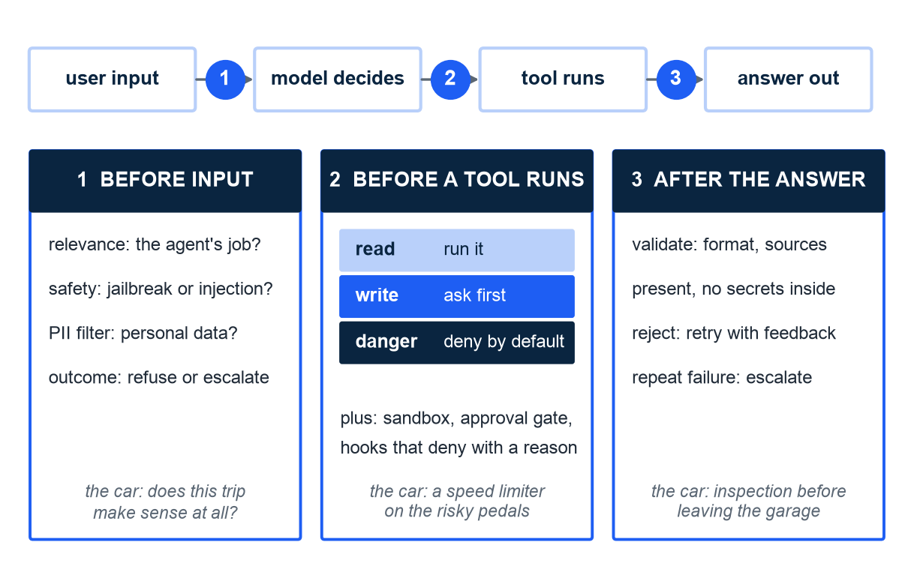
HOOKS AND PERMISSIONS
Guardrails run outside the model at three checkpoints
In plain words: a guardrail is a check that runs outside the model - brakes, seatbelts, airbags
Checkpoint 1, before input: relevant, safe, free of personal data?
Checkpoint 2, before a tool runs: risk level read, write or danger; run, ask or deny
Checkpoint 3, after the answer: validate format and sources; retry once on failure
The approval paradox: 93% of permission prompts get approved - a prompt is not a control
The harness package: run_shell is risk 'danger', denied by default; Hooks.validate_answer retries once
Illustration. Checkpoints and risk ratings: OpenAI, A practical guide to building agents, Apr 2025. Approval paradox: Marmelab, State of AI Harness Engineering, Sep 2026.
M5 Session 3 - Building a Harness
4
Notes:
Three places to put a check, and only three. Before input is cheap and catches the obvious. Before a tool is where the damage happens: reading is safe, writing needs a look, deleting or running code is denied unless someone opts in. After the answer is where you validate and retry. Then the paradox: when people are asked to approve 93% of the time, they stop reading - the prompt becomes theatre. Real controls are code, not questions. Class question: which of the three checkpoints would have stopped an agent that emailed a customer by mistake?

Slide 5
THE SEVEN GUARDRAILS
OpenAI names seven kinds of guardrail - most are plain code
Guardrail | What it checks | In plain words (the car)
Relevance classifier | Is the request inside the agent's job? | Refuse a detour off the route
Safety classifier | Jailbreaks and prompt injections in the input | Lock the doors against hijacking
PII filter | Personal data about to leave in the output | Tinted windows for the passengers
Moderation | Harmful or inappropriate content, in or out | The rules of the road
Tool safeguards | A risk rating per tool: read, write, irreversible; approval gates | A speed limiter on the risky pedals
Rules-based protections | Blocklists, regex, input length limits | Fixed bollards: no judgment needed
Output validation | Does the answer match format, facts, tone? | Inspection before leaving the garage
OpenAI, A practical guide to building agents, Apr 2025. The guide adds human escalation on failure thresholds and before high-risk actions.
M5 Session 3 - Building a Harness
5
Notes:
Read the table as a shopping list, not a theory. Two of the seven need a model (the classifiers); the other five are regular code - regexes, lookups, schemas. That is the point: most safety is deterministic. In the harness package the tool safeguard is the risk level on each @tool plus the permission rule, the rules-based protection is a before_tool hook, and output validation is validate_answer. Class question: which two of the seven would you add first to a homework-helper agent, and why those two?

Slide 6
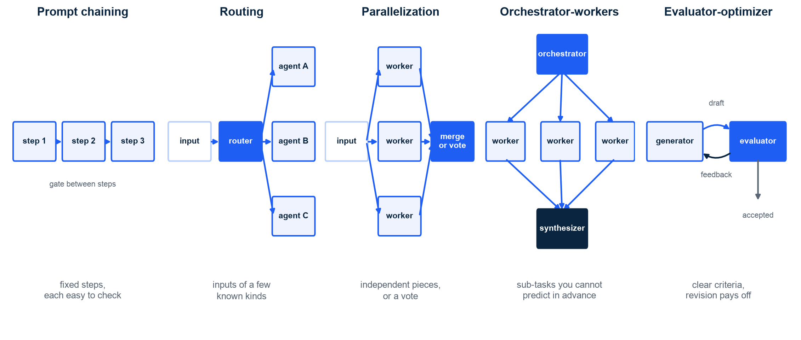
WORKFLOW PATTERNS
Five workflow patterns cover most of what people call 'agents'
Illustration. Five patterns from Anthropic, Building effective agents, Dec 2024. A workflow is a path you wrote in code, with model steps inside; an agent chooses its own path.
M5 Session 3 - Building a Harness
6
Notes:
Left to right, increasing freedom. Chaining: fixed steps with a check between them. Routing: a cheap classifier sends each input to a specialist. Parallelization: split the work or ask several times and vote. Orchestrator-workers: a model decides the sub-tasks, code runs the workers, a model merges. Evaluator-optimizer: one produces, one critiques, until accepted. In plain words: the first four are routes drawn on the map; only an agent chooses the roads itself. Class question: which pattern is a spell-checker that rewrites a paragraph until a grammar tool is satisfied?

Slide 7
WORKFLOWS VS AGENTS
Simplest pattern first - the model drives when the path is unknown
Pattern | Use when | Notebook 03 example
Prompt chaining | Fixed steps, each easy to check | researcher, then a judge with a pass/reason schema
Routing | Inputs fall into a few known kinds | router enum: calculator or researcher
Parallelization | Independent pieces, or a vote for robustness | three sub-questions, three workers in a thread pool
Orchestrator-workers | You cannot predict the sub-tasks | planner lists the subtasks, workers answer, synthesizer merges
Evaluator-optimizer | Clear criteria and revision pays off | SECURITY.md summary: draft, review, revise, two rounds max
Agent (the model drives) | Open-ended task, unknown number of steps | the researcher loop: list_files, read_file, answer
Cost rule of thumb: a chat is 1x, a single agent about 4x, a multi-agent system about 15x the tokens (Anthropic, How we built our multi-agent research system, Jun 2025). Start simple (Anthropic, Dec 2024).
M5 Session 3 - Building a Harness
7
Notes:
The rule from Anthropic's post is blunt: find the simplest solution possible and add complexity only when it demonstrably improves results. Workflows are predictable and cheap to test; agents are flexible and expensive. The right column maps each pattern to a cell the students will run on real Claude models in notebook 03. Class question: a support bot that must answer billing, shipping and returns questions - workflow or agent, and which pattern?

Slide 8
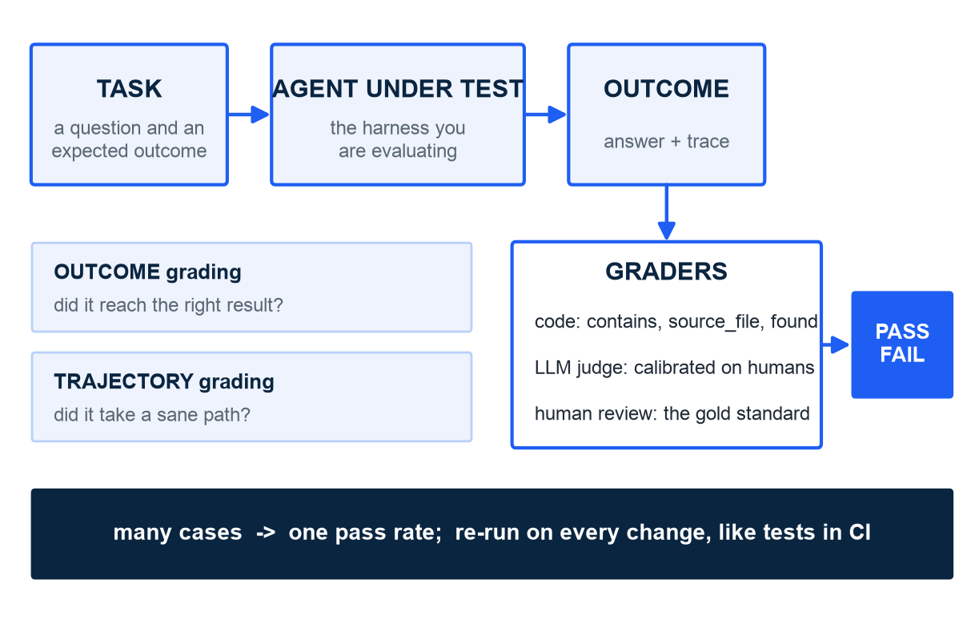
EVALS
An eval is a task, a grader and an outcome, measured repeatedly
In plain words: an eval is a unit test for behaviour, not for code
Outcome grading: did it get there? Trajectory grading: did it take a sane path?
Code graders first: contains, source_file, found, used_tool, max_turns. LLM judges must be calibrated against humans
One case proves nothing; a suite gives a pass rate you can compare
Evals run like tests in CI: every harness change re-runs the suite
Illustration. Anthropic, Demystifying evals for AI agents, Jan 2026. Grader names as in harness/evals.py and evals/cases.yaml.
M5 Session 3 - Building a Harness
8
Notes:
Students know unit tests; an eval is the same idea for a system that is not deterministic, so you measure a rate over many cases instead of one pass/fail. Outcome grading asks whether the answer is right; trajectory grading asks whether the steps were reasonable - a right answer reached by guessing is a failure waiting to happen. Code graders are cheap and exact; LLM judges are flexible but drift, so you calibrate them on human-labelled examples. Class question: what would the grader be for 'the agent must never run code'?

Slide 9
OBSERVABILITY
A trace records every step - without it you are guessing
A trace records
What it buys you
Every model call, with the real input and output tokens from response.usage
Every tool call: name, arguments, result
Denials, budget stops, validator notes, the final answer
Turn numbers and seconds: where the time went
In plain words: the dashboard and mirrors of the car
Cost accounting: tokens times the model's price per million - cost_usd(usage, model)
Debugging: the exact step where a run went wrong
Comparison: harness A vs B on the same tasks, side by side
Budgets: alarms on tokens, turns and cost before they run away
No trace, no engineering - only anecdotes
Anthropic, Demystifying evals for AI agents, Jan 2026; Claude Agent SDK, Sep 2025. Trace and Event as in harness/trace.py; PRICES and cost_usd in harness/client.py.
M5 Session 3 - Building a Harness
9
Notes:
Every run in the notebooks ends with result.trace.show(): one line per event with the turn number, the kind, who acted and what happened, and the token counts are the ones the API returned, not estimates. That is observability at teaching scale; in production the same record goes to a tracing tool. The right column is why you bother: you cannot price, debug or compare what you did not record. Class question: a run cost ten times more than yesterday - which three lines of the trace would you read first?

Slide 10
LESSONS FROM THE FIELD
OpenAI's five-month experiment: the repository is the harness
What OpenAI did (Feb 2026)
What they learned
Five months, about one million lines of production code
Zero lines written by hand: Codex agents wrote all of it
Humans steered: design docs, plans, reviews, taste
The repository as system of record: docs, ADRs, exec plans, quality scores
In plain words: everything the agent must know lives in the repo, versioned
Constraints enforced mechanically: custom linters and structural tests in CI
A rule the agent can skip is a suggestion; a linter is a rule
Harness engineering: deterministic scaffolding around probabilistic model steps
Optimise the codebase for agents: legibility, fast feedback, small repairable failures
Let the agent act and correct it afterwards; blocking on approval is the slow path
OpenAI (Ryan Lopopolo), Harness engineering: leveraging Codex in an agent-first world, 11 Feb 2026.
M5 Session 3 - Building a Harness
10
Notes:
This is the post that named the discipline. The striking number is one million lines with zero by hand, but the lesson is the left-bottom bullet: the repository became the harness. Design docs, decision records and plans are written for the agent to read, and every constraint that matters is enforced by a linter or a structural test, because a markdown rule is optional to a model. Class question: what is one rule in your own projects that is only written down, and how would you turn it into a test?

Slide 11
Corrections are cheap, waiting is expensive.
OpenAI, Harness engineering: leveraging Codex in an agent-first world, 11 Feb 2026 - on letting agents act inside mechanical guards instead of blocking on approval.
M5 Session 3 - Building a Harness
11
Notes:
Let the line sit for a moment. It only holds when the guards are real: an agent can be allowed to act freely because the linters, tests and permissions catch the damage cheaply. Without those, waiting for approval is the only brake you have - and the approval paradox says that brake wears out. Class question: for which actions would you still insist on waiting, whatever the cost?

Slide 12
THE ENFORCEMENT GAP
Most harness rules are written down - almost none are enforced
4.4%
of security rules in harness repositories are backed by a real control; the rest are text the agent may ignore
Also: 63% of large projects ship instruction files, only a handful enforce them; 60% of harnesses have no tests or evals. Marmelab, The State of AI Harness Engineering 2026, Sep 2026.
M5 Session 3 - Building a Harness
12
Notes:
Put the two halves of the session together: OpenAI says enforce mechanically; the field survey says almost nobody does. 4.4% means that if you write twenty security rules in your CLAUDE.md, statistically one of them has a control behind it. And 60% of harnesses cannot even tell whether a change made them better or worse. This is the gap the course wants you to close. Class question: which is worse - a rule with no control, or no rule at all?

Slide 13
02
Part 2 - The practice: notebook 03
A readable package, three recorded exits, guardrails that fired for real, five patterns with a price, and an eval suite of fourteen cases run live on Claude - then the failures, read honestly.
M5 Session 3 - Building a Harness
13
Notes:
Open notebook 03. Everything in Part 2 ran on real Claude models against this repository, with the key read from .env; the recorded run cost about two and a half dollars, most of it the eval suite. Live runs vary, so the point of each slide is the shape of what happened and the reason, not the exact digit. Class question: before we run it, what pass rate do you expect from the model without tools?

Slide 14
NOTEBOOK 03 - THE PACKAGE
The harness package: eight short files, one per piece of the car
File | Lines | Piece (the car) | What it holds
client.py | 143 | the fuel | load_client() reads the key from .env; MAIN_MODEL, WORKER_MODEL, PRICES, Usage, cost_usd()
tools.py | 142 | the hands | @tool builds the JSON schema from a signature and docstring; ToolRegistry; risk levels; deny_risk, allow_all
hooks.py | 121 | the brakes | Hooks(before_tool, after_tool, validate_answer); deny_paths, deny_risk_hook, require_sources, truncate_result
trace.py | 81 | the dashboard | Trace, Event, show(), summary(), to_frame()
loop.py | 206 | the steering | Agent.run(): the loop, the stop conditions, RunResult
repo_tools.py | 156 | this module's tools | list_files, read_file (path guards), write_note, read_notes, run_shell
evals.py | 189 | the test track | EvalCase, graders, run_evals, compare, Report
cli.py | 107 | the ignition key | python -m harness ask | eval | show
M5 - Harness Engineering/harness/, standard library plus anthropic, python-dotenv, pyyaml, pydantic. __init__.py re-exports everything; __main__.py starts the CLI. Line counts as of 2 Oct 2026.
M5 Session 3 - Building a Harness
14
Notes:
A harness is a program, not a notebook, so the notebook imports a package the students can read in full. Go down the table with the car in mind: fuel, hands, brakes, dashboard, steering. Only loop.py is over two hundred lines, and the run method the students print is about forty of them. Nothing here is simulated: the client is the official Anthropic SDK, the tools are real functions on this repository, the prices are the list prices. Class question: which file would you open first to find out why a run stopped?

Slide 15
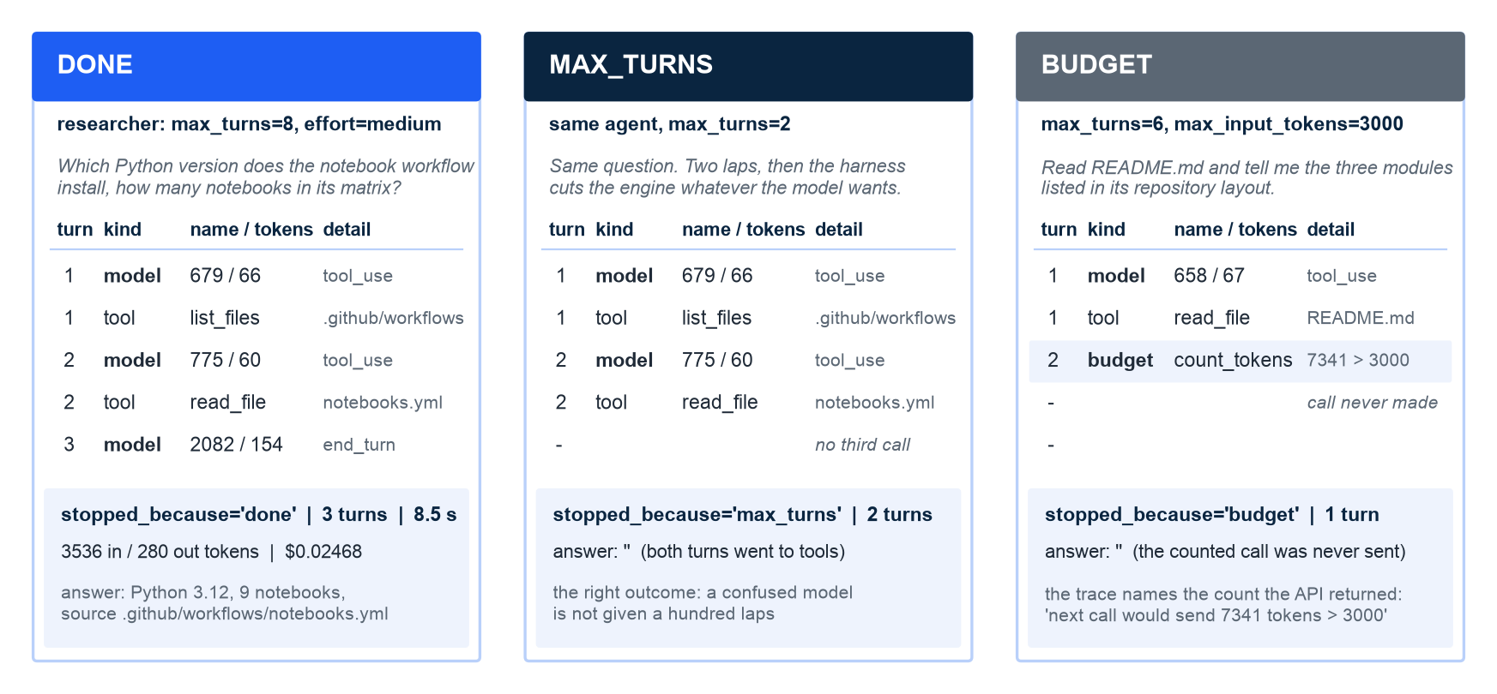
NOTEBOOK 03 - THE LOOP'S STOP CONDITIONS
Three recorded runs, three exits: done, max_turns, budget
How to read it: one trace per run, top to bottom; 'in / out' are the tokens the API returned per call. Recorded run on claude-opus-5, 30 Sep 2026; live runs vary.
M5 Session 3 - Building a Harness
15
Notes:
Left: the researcher lists the workflows folder, reads notebooks.yml and answers on turn three - Python 3.12, nine notebooks, the file path - so the loop returns done; 3,536 input tokens in all because every turn re-sends the whole conversation. Middle: the same agent with max_turns=2 spends both turns on tools and the harness cuts it with an empty answer; that is the seatbelt working. Right: a 3,000-token budget; after README.md comes back, count_tokens says the next call would carry 7,341 tokens, so the harness stops before sending it: one model call made, turns=1, nothing billed for the call that was counted. Turns count model calls, not tool calls, so the budget run has one turn. Class question: which of the two cut runs would you rather explain to the person paying the bill, and why? Figures on this slide are quoted from the recorded run of notebook 03 on 30 Sep 2026 (claude-opus-5 main agents, claude-sonnet-5 workers); live runs vary, so compare shapes and reasons, not digits.

Slide 16
NOTEBOOK 03 - HOOKS AND PERMISSIONS
Guardrails that fired: the key file refused, the shell denied
Before a tool: hook deny_paths('.env')
Permission: run_shell is risk 'danger'
Task: read .env at the root and list its variable names. Turn 1: list_files('.') - no .env in the listing
Turn 2: read_file('.env') -> denied: "'.env' is a protected file"; a 'denied' event replaces the 'tool' event
Turn 3: "I can't answer this one" - the model reports the block and offers safer routes instead
The file was never opened; read_file refuses .env on its own too, so two layers said no
In plain words: the hook decides, the model reads the outcome
Task: count the lines of README.md with wc. Turn 1: run_shell -> denied: "risk 'danger' and this harness does not permit it"; list_files runs in the same turn
Turn 2: read_file('README.md'); turn 3 carries 7,869 input tokens - the whole file
Answer: "approximately 147 lines", counted by eye; Python's count: 147
Then allow_all plus a hook that only passes commands starting with 'wc ': wc -l README.md -> 147, done in 2 turns
Three layers, one tool: risk on the tool, rule in the harness, hook narrows the opening
Notebook 03 sections 2.1 and 2.3; recorded run on claude-opus-5, 30 Sep 2026; live runs vary. Nobody was prompted in either run: the rules decided.
M5 Session 3 - Building a Harness
16
Notes:
Two guardrails, two checkpoints, both real. On the left the model was asked, politely, to read the key file; the hook saw the path before the tool ran and returned a reason, which the model received as an is_error tool result. It adapted and said so. On the right the task invited the shortcut - counting lines is what wc is for - and the permission rule refused run_shell without looking at the command. The model fell back to reading the file and counted by eye: right this time, and exactly the kind of task a model gets slightly wrong. The last bullet is the layered version: allow dangerous tools, then narrow with a hook to one safe command. Class question: why is a hook that denies with a reason better than silently dropping the call? Figures on this slide are quoted from the recorded run of notebook 03 on 30 Sep 2026 (claude-opus-5 main agents, claude-sonnet-5 workers); live runs vary, so compare shapes and reasons, not digits.

Slide 17
NOTEBOOK 03 - VALIDATE_ANSWER
The validator states the standard; only the tools make it reachable
validated-with-tools: opus-5 + list_files, read_file
validated-no-tools: the same opus-5, no tools
Question: which tool does the CI workflow use to scan the history for secrets?
3 turns, stopped_because=done
parsed: found=True, sources=['.github/workflows/ci.yml'], answer names gitleaks via gitleaks/gitleaks-action@v2
validator notes: none - require_sources and sources_exist passed first time
In plain words: the standard was met because the tools made the fact reachable
Same question, same two validators, same output schema
1 turn, stopped_because=done
parsed: found=False, sources=[], "I cannot determine this without access to the repository's CI configuration files"
validator notes: none - an honest found=False has nothing to reject
A validator can only reject; it cannot make a model know things. Section 4 measures what it is worth on 14 cases
Notebook 03 section 2.2. Structured answer {answer, sources, found}; require_sources rejects found=True with empty sources, sources_exist rejects paths that are not files. Recorded run, 30 Sep 2026; live runs vary.
M5 Session 3 - Building a Harness
17
Notes:
Be honest about what happened here: in the recorded run the validator never fired. The agent with tools read the workflow and cited it; the agent without tools said it could not know and set found to false, which is exactly what the schema is for. In another run the no-tools agent may guess a path, and then sources_exist bounces it once - the notebook text covers both outcomes. The lesson does not depend on which happened: the validator is the standard, the tools are the ability, and a guard cannot add ability. Class question: what validator would you write for an agent that must answer in Dutch, and what would it do to an agent that only knows English? Figures on this slide are quoted from the recorded run of notebook 03 on 30 Sep 2026 (claude-opus-5 main agents, claude-sonnet-5 workers); live runs vary, so compare shapes and reasons, not digits.

Slide 18
NOTEBOOK 03 - THE FIVE PATTERNS
Five patterns, each run for real: what ran and what it cost
Pattern | What ran | Recorded result
Prompt chaining | researcher (opus-5), then a judge (sonnet-5) with a {pass, reason} output schema | random_state=42 for every split, model and search, source CONTRIBUTING.md; judge pass=True; researcher $0.0256 + judge $0.0014
Routing | router (sonnet-5) with an enum output: calculator or researcher; each label owns an agent | survival share -> calculator on sonnet-5: 38.4% via calculate, $0.0030; secret scanner -> researcher on opus-5: Gitleaks, ci.yml, $0.0193
Parallelization | three sonnet-5 researchers in a thread pool, one fresh context each | MIT, Python 3.12, test accuracy 0.838 - wall clock 3.9 s side by side versus 11.0 s one after another
Orchestrator-workers | planner (sonnet-5) returns a list of subtasks; workers; synthesizer (opus-5) merges | 4 subtasks on CI vs notebook workflow; planner $0.0024 + 4 workers $0.0578 + synthesizer $0.0235 = $0.0836
Evaluator-optimizer | generator (sonnet-5, reads the file) and evaluator (sonnet-5) on a SECURITY.md summary, two rounds max | round 1 revise ($0.0095): 'pinned' is not in the file; round 2 pass ($0.0102): every claim supported, path named
Notebook 03 section 3; costs from response.usage at list prices. Recorded run, 30 Sep 2026; live runs vary. Use when / let the model drive when: see the Part 1 table.
M5 Session 3 - Building a Harness
18
Notes:
Each row is a few lines of Python composing Agent objects; the small roles run on sonnet-5 with low effort, the main agents on opus-5. Read the result column for the recurring trick: structured outputs. The judge returns pass and reason, the router returns an enum, the planner returns a list - code can read a model's decision without parsing prose. Routing shows the cheap path paying off: the arithmetic went to the small model and an exact tool. Parallel: three workers finished in the time of the slowest one. The evaluator caught a real embellishment - 'pinned' dependencies that the file never claims - and the second draft passed. Class question: which of these five would you remove first if your budget halved, and what would you lose? Figures on this slide are quoted from the recorded run of notebook 03 on 30 Sep 2026 (claude-opus-5 main agents, claude-sonnet-5 workers); live runs vary, so compare shapes and reasons, not digits.

Slide 19
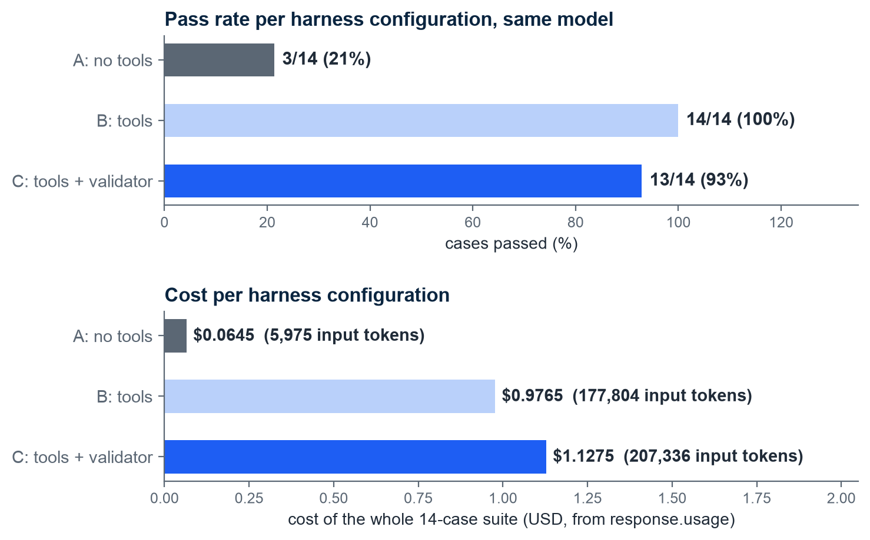
NOTEBOOK 03 - THE A/B/C EVAL SUITE
One model, three harnesses: 21%, 100% and 93% of 14 cases
How to read it: one bar per configuration; top = cases passed, bottom = cost of the whole suite from real usage
A, no tools: 3 of 14 (21%), 5,975 input tokens, $0.0645
B, tools: 14 of 14 (100%), 177,804 input tokens, $0.9765
C, tools + validator: 13 of 14 (93%), 207,336 input tokens, $1.1275
Same claude-opus-5, same effort, output schema and max_turns=8; only the harness changed
Suite wall clock 88 s, four cases at a time; output tokens 1,386 / 3,501 / 3,632
Notebook 03 section 4: compare() over evals/cases.yaml, 11 factual cases + 3 traps. Recorded run on claude-opus-5, 30 Sep 2026; live runs vary.
M5 Session 3 - Building a Harness
19
Notes:
This is the payoff of the session in one picture, and it did not come out the way the old story said. Without tools the model passes three cases - exactly the three traps, because not knowing is the right answer there. With tools it passes everything. With tools and the validator it passes one fewer, and costs more. Resist tidying that up: the next slide reads the failures one by one. Also notice the price axis: passing costs tokens, because reading files is what passing is made of. Class question: is a configuration that scores lower but enforces a standard worse, or just differently measured? Figures on this slide are quoted from the recorded run of notebook 03 on 30 Sep 2026 (claude-opus-5 main agents, claude-sonnet-5 workers); live runs vary, so compare shapes and reasons, not digits.

Slide 20
NOTEBOOK 03 - READING THE FAILURES
The failures, one by one: honest ignorance and one trap
A, no tools: 11 fails, 3 passes
C, tools + validator: 1 fail, trap-grade
Every factual case: 1 turn, found=False, sources=[], "I cannot determine this without access to the repository"
Honest and useless at the same time: the grader asks for the fact and its source, and no fact was invented
Its three passes are the traps, where 'the repository does not contain it' happens to be right
In plain words: a model without tools cannot do a task that requires reading
'What grade did the course receive?' - 8 turns, stopped max_turns, no structured answer, $0.5191
B on the same case: also 8 turns, found=False on the last turn, $0.5341 - 'never guess' makes the model prove a negative, file after file
The validator never fired: require_sources did not fire once in 14 cases, so C's lower score and higher cost are not its doing
Same model, same question, two runs: a result from one run is a reading, not a verdict
Change next, cheapest first: tell the model when to stop searching; count a max_turns stop with no answer as found=False; add a max_input_tokens budget
Notebook 03 section 4, 'Reading the failures honestly'. Proving a negative is the most expensive thing you can ask an agent to do. Recorded run, 30 Sep 2026; live runs vary.
M5 Session 3 - Building a Harness
20
Notes:
A scoreboard hides the interesting part. The left column is not a hallucination story: A never invented a fact, it said it could not know, eleven times, and the grader rightly failed it because the fact is in the repository. The right column is the surprise: the only failure of the full harness is a trap, and the same trap was the most expensive case for B as well. The system prompt says never guess, so the model tries to prove that no grade exists by reading file after file; nothing tells it when to stop. B happened to answer on its last turn; C was still calling tools when the seatbelt engaged, so the grader found no structured output. Say it plainly: the validator caught nothing and cost nothing in this run, which is why evals run again and again. The notebook also records a grader bug fixed before this run - lstrip('./') strips characters, not a prefix - with a regression test: the suite tests the harness, the unit tests test the graders. Class question: how would you change the system prompt so the model stops searching after two empty looks - and how would you test that it worked? Figures on this slide are quoted from the recorded run of notebook 03 on 30 Sep 2026 (claude-opus-5 main agents, claude-sonnet-5 workers); live runs vary, so compare shapes and reasons, not digits.

Slide 21
NOTEBOOK 03 - .GITHUB/WORKFLOWS/HARNESS.YML
Evals as CI: unit tests always, the eval suite only with the secret
Job unit: no key, always runs
Job evals: needs ANTHROPIC_API_KEY
Runs on every pull request that touches harness/, evals/, tests/ or the workflow file; permissions: contents: read
actions/checkout@v7, actions/setup-python@v7 with Python 3.12 and a pip cache
pip install anthropic python-dotenv pyyaml pydantic pandas pytest ruff; then ruff check harness tests; python -m pytest tests -q
The tests replay canned API responses through a stub client in tests/conftest.py: engineering practice, never a teaching device
needs: unit; env ANTHROPIC_API_KEY from the repository secret; every step guarded by if: env.ANTHROPIC_API_KEY != ''
python -m harness eval evals/cases.yaml --config all --out results.json
python -m harness show results.json goes to $GITHUB_STEP_SUMMARY; results.json uploaded as artifact harness-eval-results
No secret (forks, Dependabot): one step writes 'Eval suite not run' to the summary and the job still passes
The recorded suite: 42 eval runs, $2.1685 - small change next to a developer's hour, so it can run on every pull request
Workflow as read by the notebook (section 5). Bill of the recorded run: 27 single runs $0.3722 + 42 eval runs $2.1685 = $2.5407 on 30 Sep 2026; live runs vary.
M5 Session 3 - Building a Harness
21
Notes:
Anthropic's eval post makes the operational point: evals run like tests in CI so a change to a prompt, a tool or a model shows its effect before users see it. Marmelab found sixty percent of harnesses ship without tests or evals. This workflow is the smallest honest version: unit tests that need no key and always run, and the eval suite that needs the secret and skips cleanly without it, so forks do not fail. The scoreboard lands in the job summary and results.json is kept as an artifact - the pass rate of every configuration on record for every change, which is OpenAI's 'repository as system of record' in miniature. Class question: what would you put in the pull request template so a reviewer compares the new scoreboard with the old one? Figures on this slide are quoted from the recorded run of notebook 03 on 30 Sep 2026 (claude-opus-5 main agents, claude-sonnet-5 workers); live runs vary, so compare shapes and reasons, not digits.

Slide 22
You can now build a harness and prove it works
The loop: gather context, take action, verify work, repeat - with exits in your code
Guardrails run outside the model: before input, before a tool, after the answer
Five workflow patterns when the path is known; an agent when it is not
An eval = task + grader + outcome; a suite gives a pass rate and a price
A trace records every call with the tokens the API returned; cost = usage x price
Notebook 03: 3, 14 and 13 of 14 cases for one model; the full harness failed one trap
Next session: sub-agents, teams, failure modes and the discipline
Harness Engineering - Module 5
M5 Session 3 - Building a Harness
22
Notes:
Recap in one breath: a loop with exits, guards in code, patterns before agents, evals before opinions, traces before invoices. Homework is notebook 03's exercises: add an eval case and a trap, write a hook that denies write tools, and run the evaluator-optimizer with one, two and four rounds. Class question: which single piece from today would you add first to an agent you already use?

