Slide 1
3

Slide 2
2

Slide 3
1

Slide 4



Slide 5
4주차
Study

Slide 6











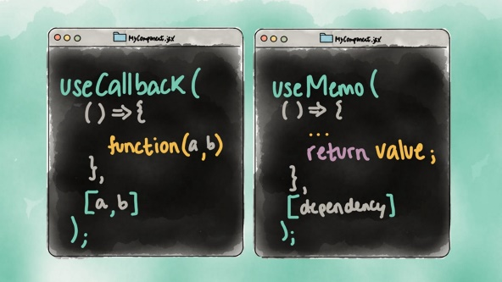
LifeCycle

Slide 7

https://www.apple.com/airpods-pro/

Slide 8


Slide 12


