Slide 1
get_user_pages & ZONE_DEVICE

Slide 2
ZONE_DEVICE Background
ZONE_DEVICE holds many interesting page types for RDMA
MEMORY_DEVICE_PRIVATE aka on-GPU memory
MEMORY_DEVICE_FS_DAX/DEVDAX
MEMORY_DEVICE_PCI_P2PDMA
ZONE_DEVICE pages are an alternative to VM_IO | VM_PFNMAP
Injects a ‘struct page’

Slide 3
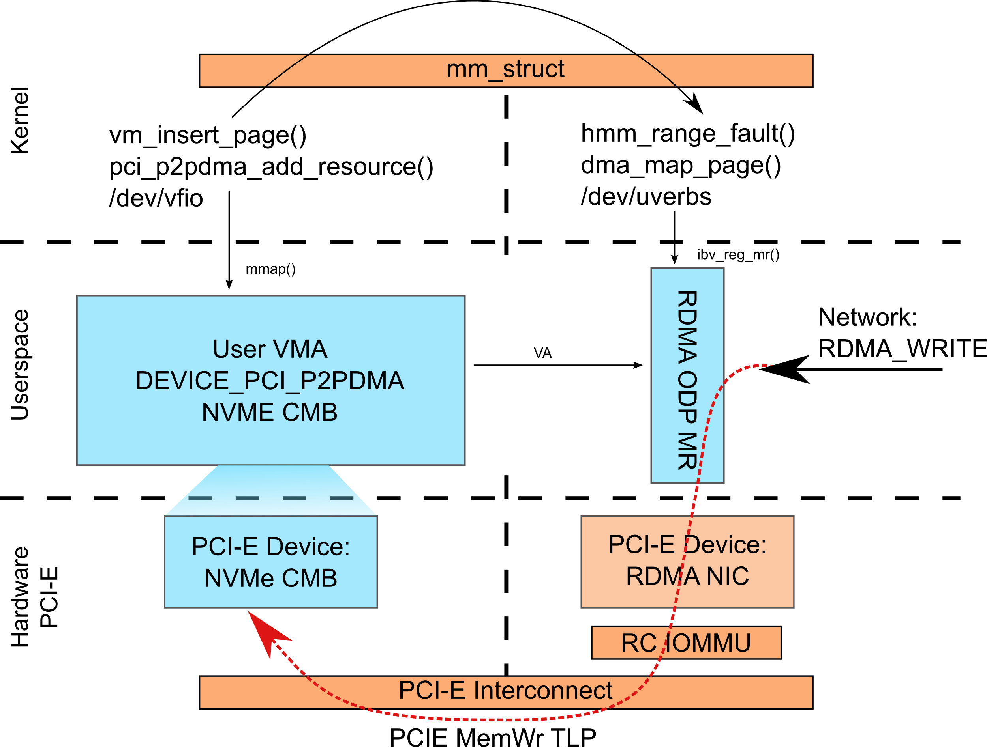

Slide 4
VFIO to RDMA P2P
Enable various interesting SPDK based solutions with NVMe and NVMe over Fabrics
Be the first kernel user of user space mapped DEVICE_PCI_P2PDMA pages
Use RDMA ODP MR’s (like DAX) and extended hmm_range_fault()
More drivers map their BAR memory as PCI_P2PDMA, ie RDMA BAR, RDMA on-chip memory, pinned GPU BAR memory
Support non-ODP, pinned page mappings
VFIO DMA mapped transfer Remove ugly hack in VFIO for P2P

Slide 5
Wide ranging effort
Enable VFIO to create and insert DEVICE_PCI_P2PDMA pages
RDMA to use hmm_range_fault() for ODP
hmm_range_fault() to know how to handle PCI_P2PDMA pages
RDMA to know what to do with the result of hmm_range_fault() to get a dma_addr_t
IOMMU drivers to understand PCI_P2PDMA pages and BAR backed physadd_t’s
PCI layer to provide information if P2P is even possible

Slide 6
hmm_range_fault()

Slide 7
Background
Quite a lot like get_user_pages(), but different API, different implementation
Returns something like phys_addr_t or’d with flags per page (but all users currently still need struct page in the end)
Does not pin pages
Can avoid faulting pages and return NULL pages
Understands more of ZONE_DEVICE than GUP
Users are coming, nouveau and amdgpu are merged already
RDMA ODP is in progress
Lots of collaboration & polishing right now Mellanox/Nvidia/RedHat/HCH

Slide 8
DMA Fault for ZONE_DEVICE
hmm_range_fault() will eventually know about the requesting ‘struct pci_device’
Will only return phys_addr_t’s that device can DMA to
Logically, if the page is not CPU memory we want it to trigger ‘DMA fault’ to create a DMA address
For GPU drivers that need to make DEVICE_PRIVATE pages accessible
May also be relevant to PCI_P2PDMA?
Details are unclear

Slide 9
Pinned Pages version
A key difference between hmm_range_fault() and get_user_pages() is the former does not pin pages
Need a page pinning API that understands these new ZONE_DEVICE schemes
Enhance GUP? ‘get_user_pages_dma()’ ?
Enhance hmm_range_fault? ‘FLAG_PIN_PAGES’ ?
Something else?

Slide 10
Future?
Unify get_user_pages() and hmm_range_fault()?
Driver focused APIs more directly designed for the GUP -> SGL -> DMA_MAP work flow?

Slide 11
get_user_pages(): details
For: LPC 2019: RDMA microconference session:
“get_user_pages() & ZONE_DEVICE”

Slide 12
Background: get_user_pages (“gup”)
Proposed new gup behavior for: p2p, HMM, ZONE_DEVICE, file-backed pages
gup is already large and complex
~100 callers
17+ FOLL_* flags that alter behavior (and interact with each other)
10-15+ API calls (several of which call each other), and growing fast
Originally mm-centric
unaware of file systems pages
unaware of device pages
*especially* unaware of device-to-device memory: p2p
gup APIs are misleading and widely misunderstood
No way to identify gup’d pages

Slide 13
get_user_pages
follow_page
get_user_bvec ??
get_user_sgl ??
vaddr_pin_pages ??
hmm_range_fault
open-coded ...
RDMA: long-term pin
migrate
mlock
touch
HMM, ODP: no pin
p2p?
populate
DIO: short-term pin
split
DAX...

Slide 14
Missing (maybe) from gup
File system awareness
Peer mappings
Should we allow get_user_pages on ZONE_DEVICE pages?
Interaction with HMM
API optimizations
SGL: struct scatterlist API?
bvec: struct bio_vec API?
wrapper functions, FOLL_* flags
Clarity on which API calls “pin” pages
Differentiate between “hard pin” and “soft pin”?

Slide 15
Ideas, solutions in progress
File system awareness: vaddr_pin/unpin_pages (Ira Weiny, later today)
FOLL_PIN | FOLL_LONGTERM
Peer mappings:
Should we allow get_user_pages on ZONE_DEVICE pages?
Interaction with HMM: how should this work?
API optimizations
SGL (struct scatterlist) callers: get_user_sgl()?
bvec: struct bio_vec: get_user_bvec() / put_user_bvec()?
wrapper functions, FOLL_* flags
release_pages()-like batched release
Clarity on which API calls “pin” pages
Differentiate between “hard pin” and “soft pin” (and no pin)
Use FOLL_PIN to increment a separate “pin count” (separate from FOLL_GET)

Slide 16
vaddr_pin_pages
Ira Weiny will cover this in detail, but…
vaddr_pin_pages (vaddr_pin_user_pages? Naming is in progress…)
Includes a “pinned by” context: mm, fd
Must be paired with vaddr_unpin_pages
Which calls put_user_page
Solves the connection to user space, to file system: file leases

