Slide 1
Improving Northwind Sales Performance
Module 3 Final Project
by Matthew E. Parker

Slide 2

Introduction
The Northwind database:
91 customers in 21 countries
77 food products from 29 global suppliers
2,155 product sales spanning 18 months
9 Northwind salespersons
51,317 units sold
$1,265,793 in revenue

Slide 3
Formulating Questions
Q1: Does discount amount affect the product quantity in an order?
Q2: Does the salesperson impact value of a sale? If so, can this be correlated to the reporting structure within the company?
Q3: Do certain products sell better/worse in different regions?
Q4: Does the time of year affect the amount of each category that is ordered?

Slide 4
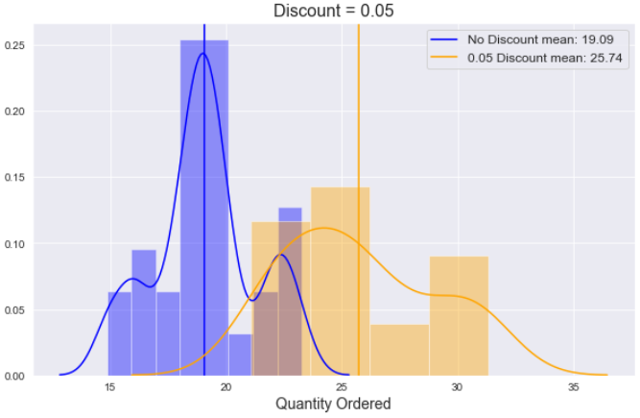
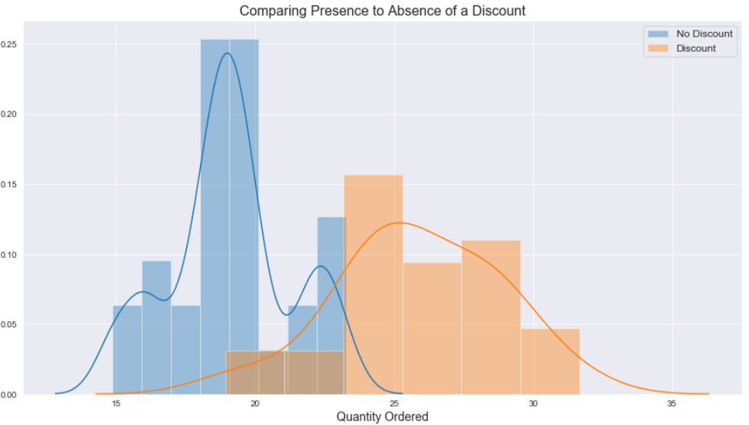
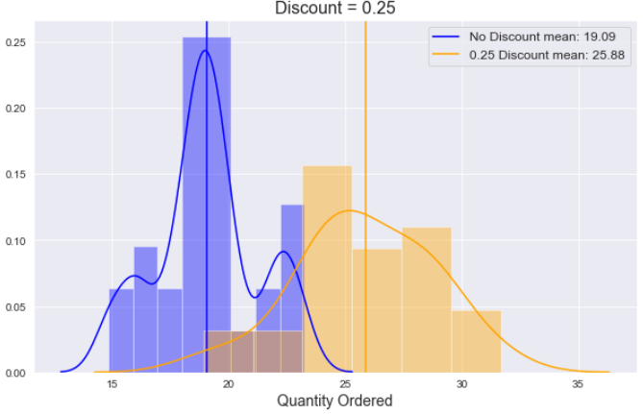
Q1: Does discount amount effect the product quantity in an order?

Slide 5
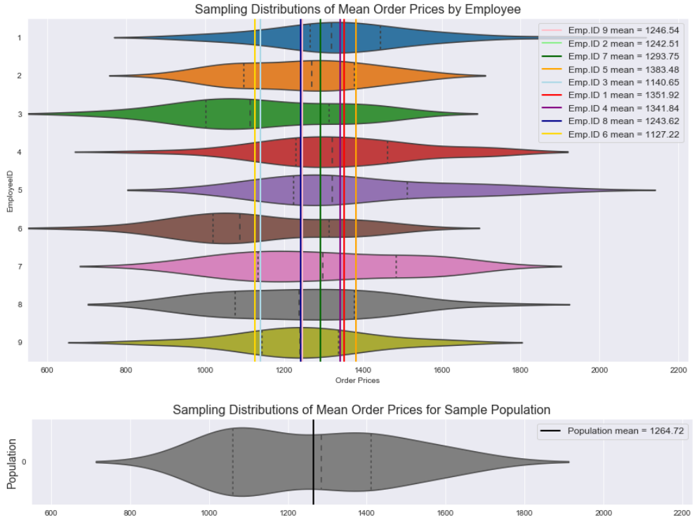
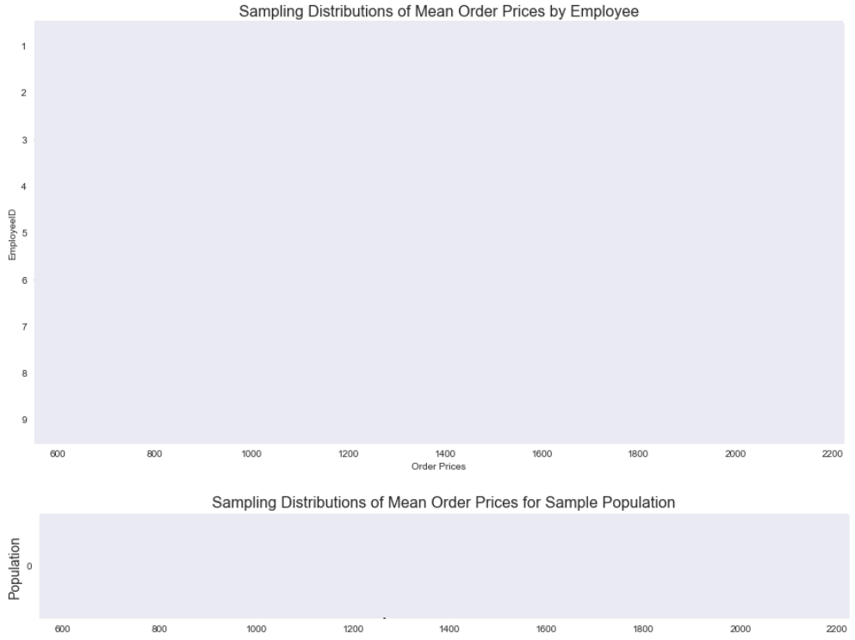
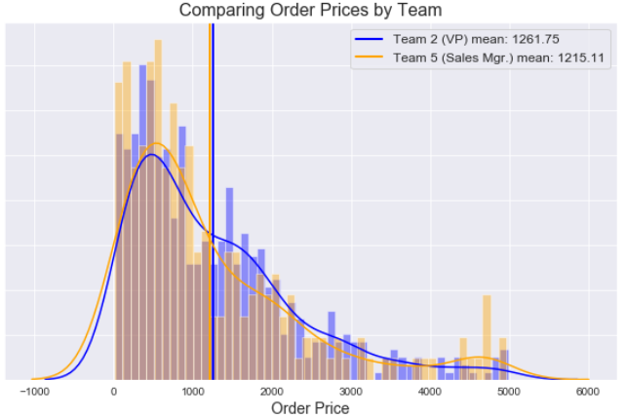
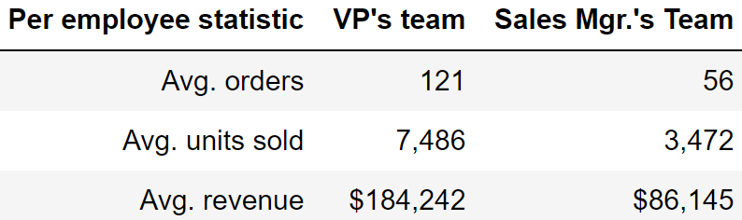
Q2: Does the salesperson impact value of a sale? If so, can this be correlated to the reporting structure within the company?

Slide 6
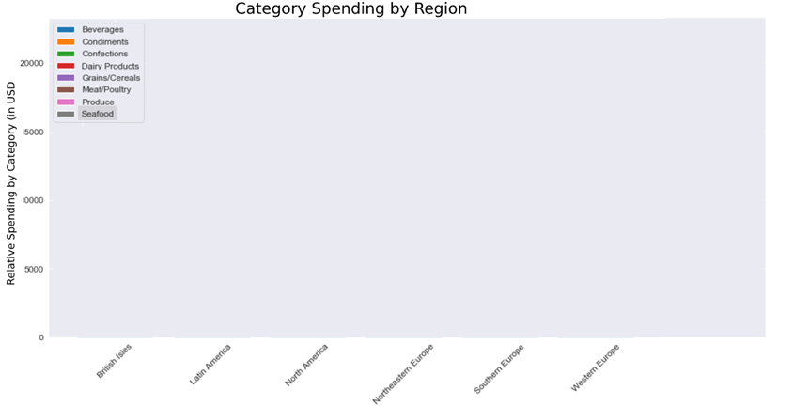
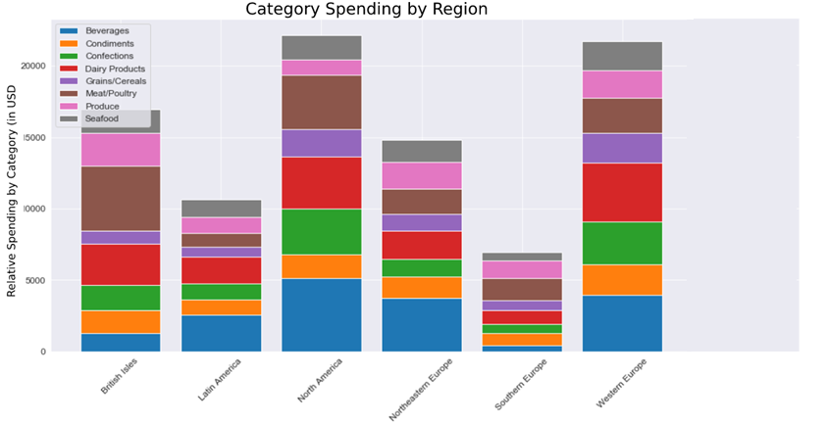

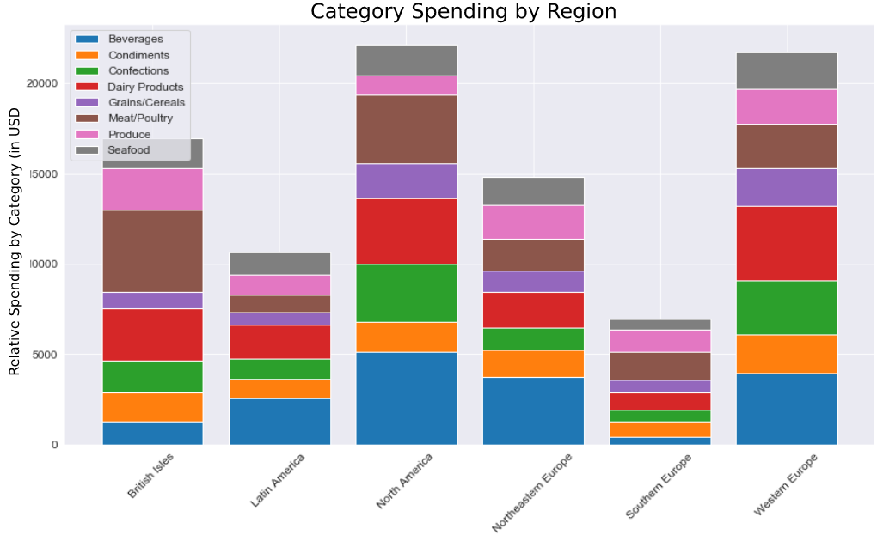
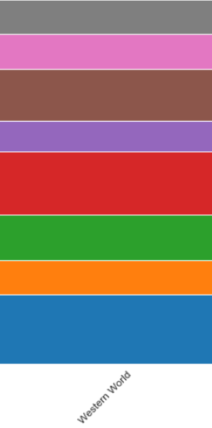

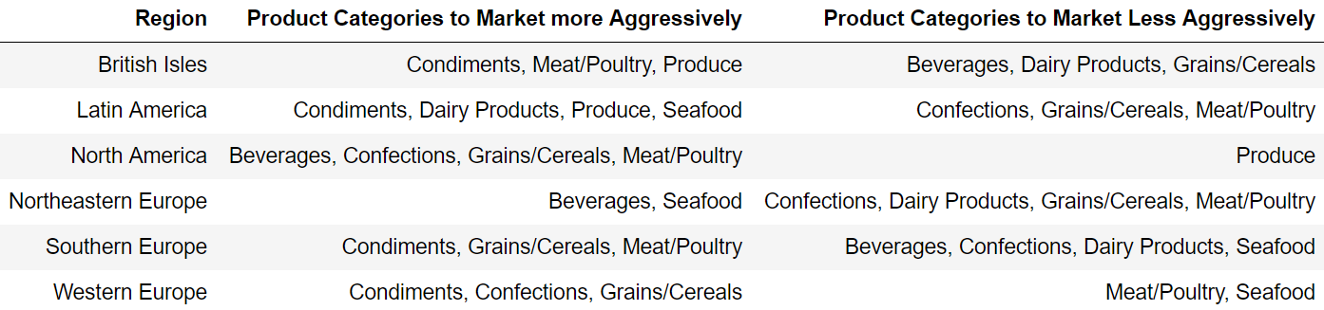
Q3: Do certain products sell better/worse in different regions?

Slide 7
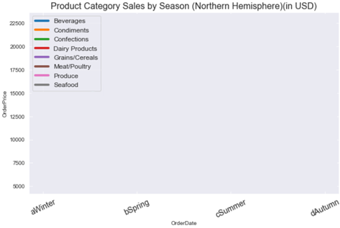
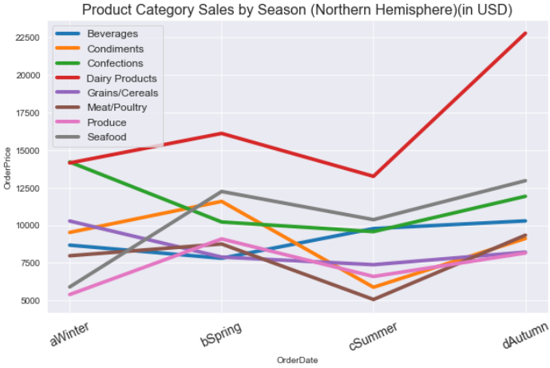
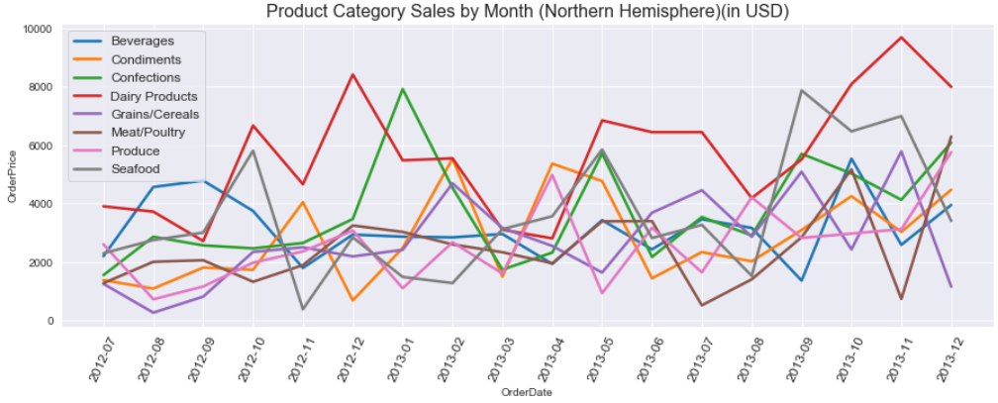
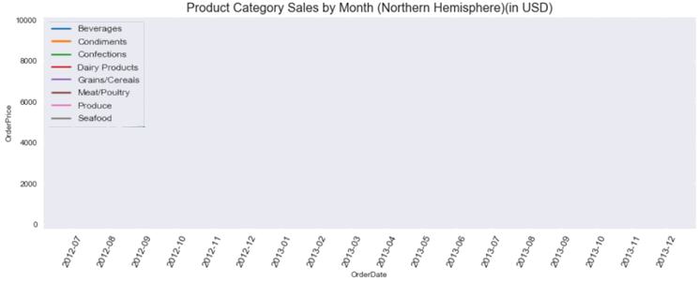
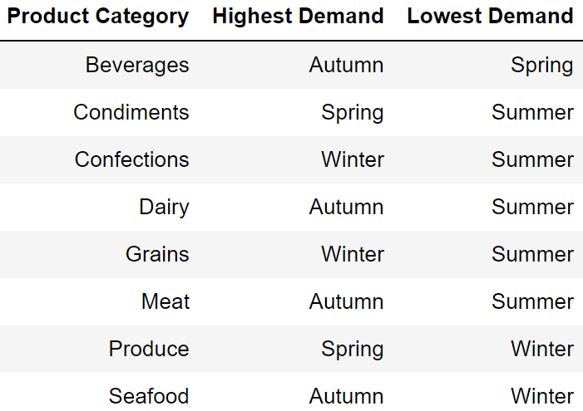
Q4: Does the time of year affect the amount of each category that is ordered?

Slide 8
Recommendations
Offer a 5% discount (no more, no less) on all items to increase sales by 6-7 units per order
Have the sales manager consult with the VP about his team’s strategy. Focus on generating highest number of sales, not price per sale.
Refocus regional marketing of products according to table:
Refocus seasonal product marketing by demand:

Slide 9
Thank You!
Future Investigation
Examine sales performance of all product lines
Examine role of supplier location on sales by region
Examine whether shipping costs influences customer spending
Improve data collection by including new variables.
Potentially informative variables include ProductWeight, ProductDimensions, and WholesalePrice (assuming that UnitPrice refers to the customer price).
These three additional variables would enable a wide range of analyses regarding profitability and how the choice of shipping company impacts sales and profit (especially if information can be gained on how shipping companies determine their rates).

