Slide 1
Improving Northwind Sales Performance
Module 3 Final Project
by Matthew E. Parker

Slide 2
Introduction
The Northwind database:
91 customers in 21 countries
77 food products from 29 suppliers
2,155 product sales spanning 18 months
9 Northwind sales employees
51,317 units sold, generating $1,265,793 in revenue

Slide 3
Formulating Questions
???

Slide 4
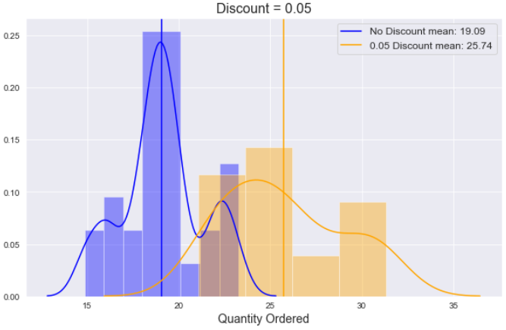
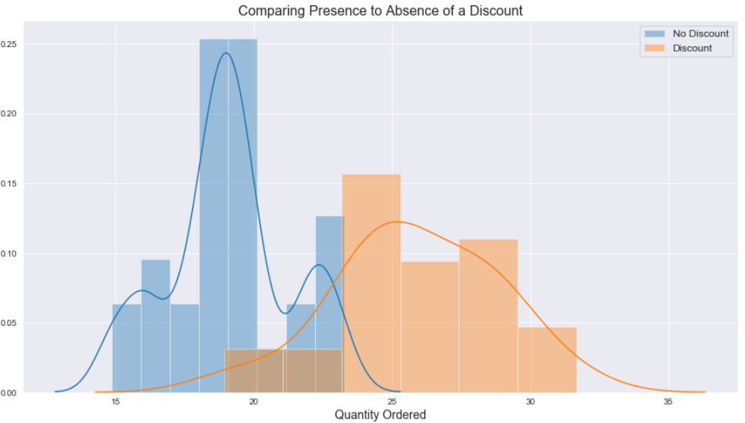
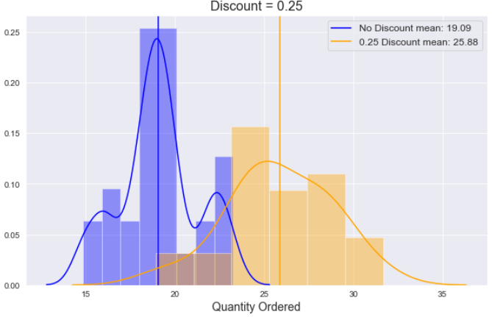
Q1: Does discount amount effect the product quantity in an order?

Slide 5
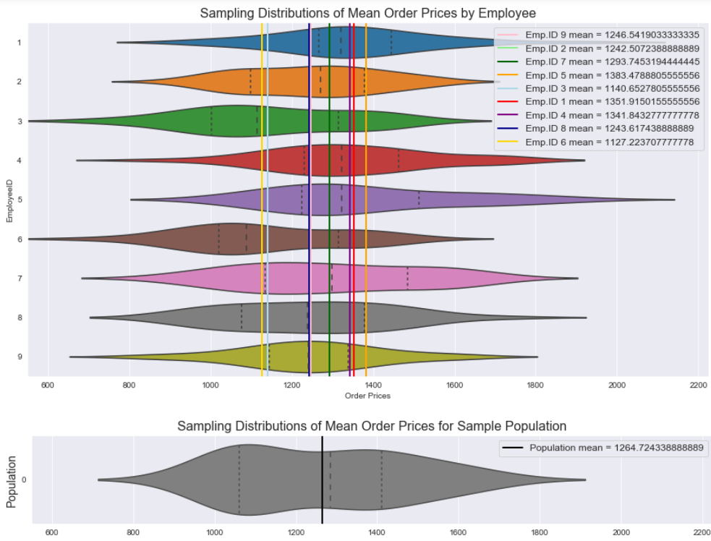
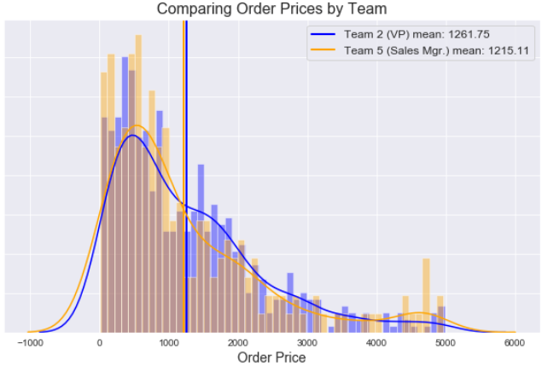
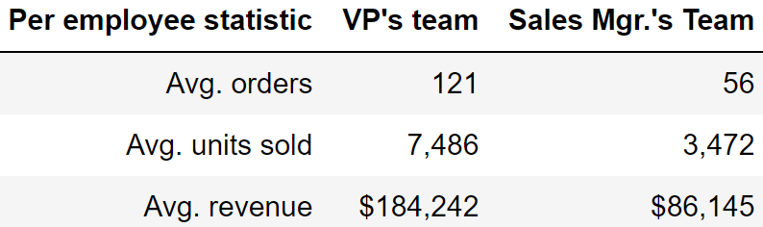
Q2: Does the salesperson impact value of a sale? If so, can this be correlated to the reporting structure within the company?

Slide 6
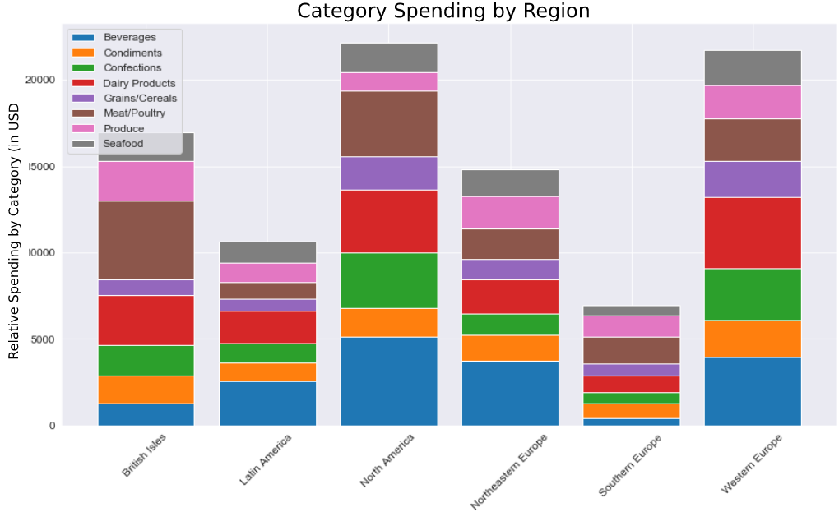
Q3: Do certain product categories sell better/worse depending on customer region?)

Slide 7
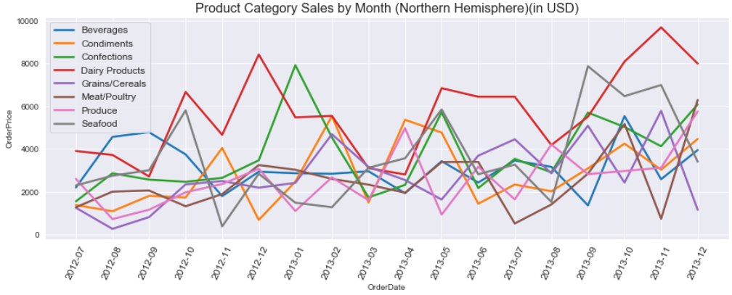
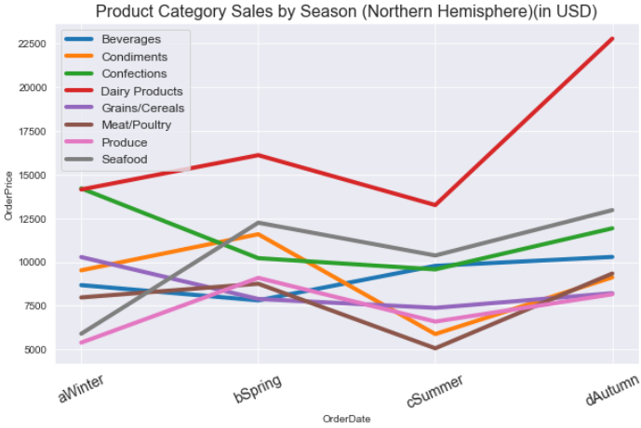
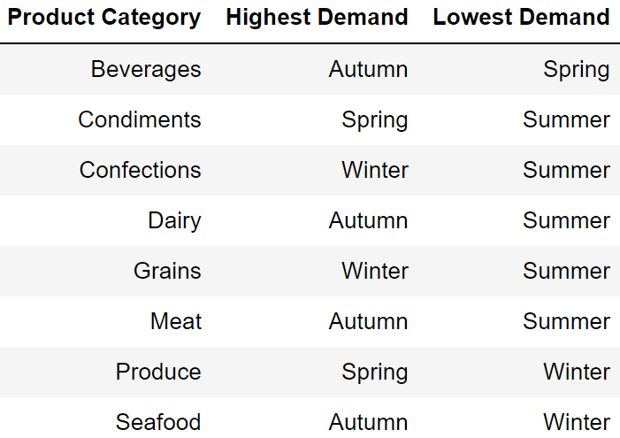
Q4: Does the time of year affect the amount of each category that is ordered?

