Slide 1
Modeling Seattle Housing Prices
by Matthew E. Parker

Slide 2
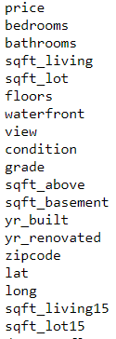
Inputs
Our approach to constructing a model:
Clean the data
Explore and analyze the data
Identify significant variables and build model around them
Test and Validate model accuracy
Starting dataset:
> 21,500 house sales
19 variables per sale
variables list:

Slide 3
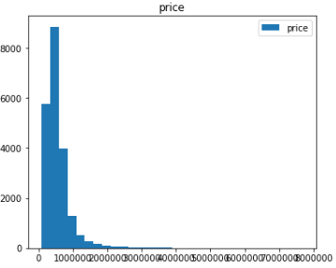
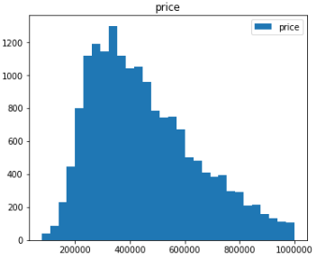
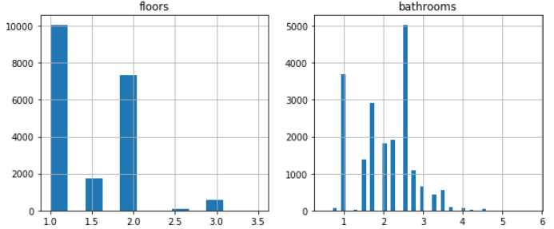
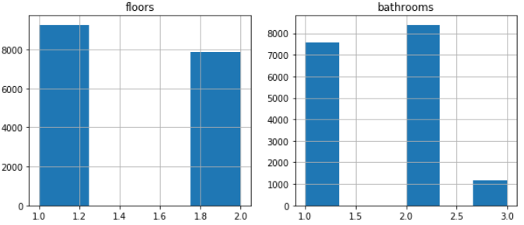
Cleaning the Data
Removing outliers from the dataset
Improving irregular data through grouping

Slide 4
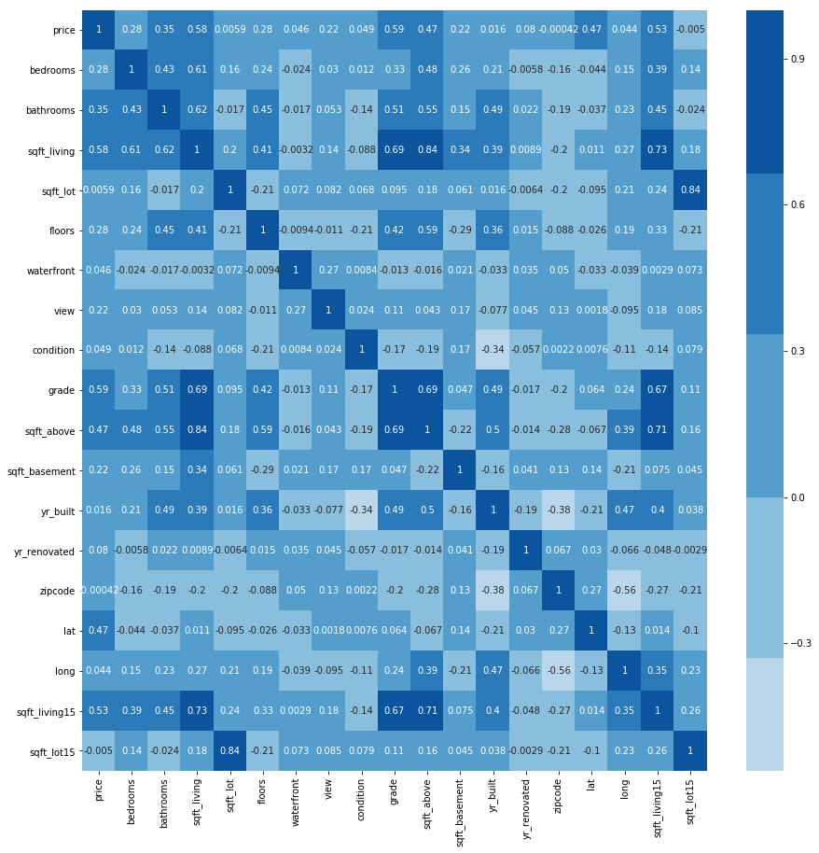
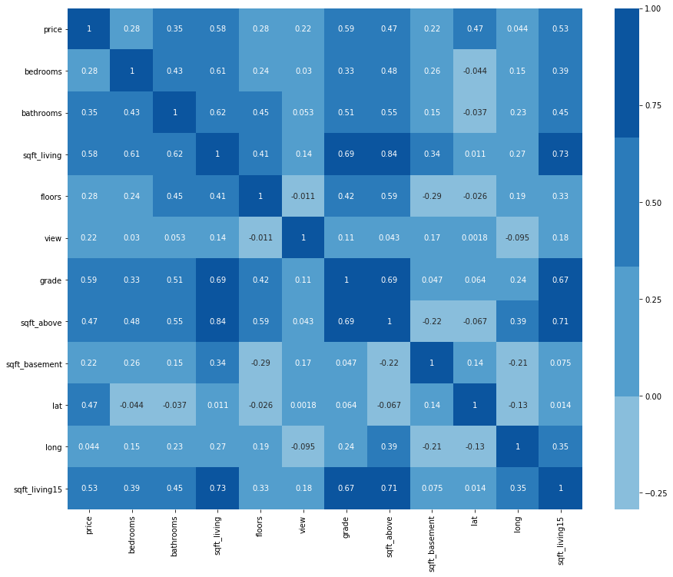
Exploring the Data
Correlation Heatmap
dark blue = high correlation
light blue = low correlation

Slide 5
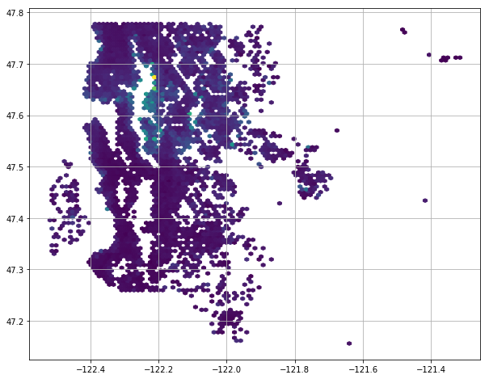

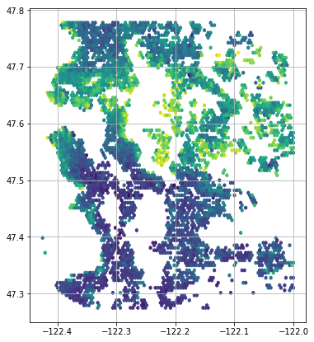
Handling Geography

Slide 6
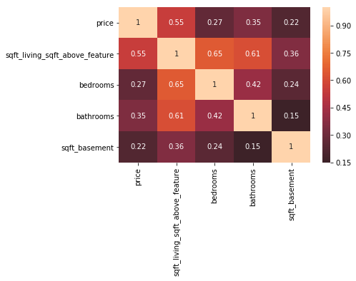
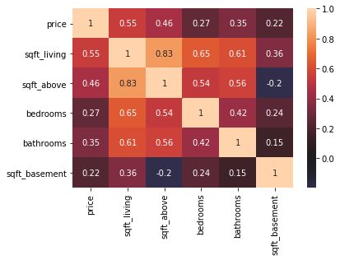
Building Custom Features
Reduced collinearity
When several variables are collinear, changing one has a change in the others.
This is bad for modeling since changes get multiplied in the model output.
For instance, you can’t change a house’s total living space without also changing it’s total above-ground living space as well.
To solve this, we can build features that weight the variables proportional to their influence.
Heatmap of highly co-related variables

Slide 7


Training & Validating the Model
Our model
Trained by
10,000 testing
cycles

Slide 8
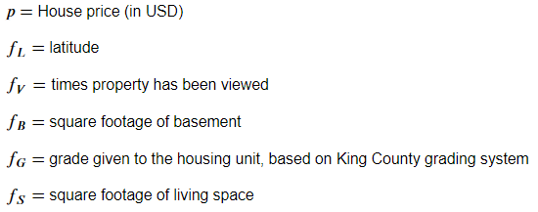
Model Summary
If you know a house’s latitude, basement ft², living space ft², King County grade, and the number of times it has been viewed, then you can estimate it’s sale price within a margin of $126,700.⁰⁰.

Slide 9
Further Investigation
Recommendations
If you can purchase a house for $126,700 less than the price predicted by our model, you will definitely make a profit.
Houses in the northern half of Kings County fetch higher prices, try to sell northern properties
The more times a house has been viewed, the higher it’s final selling price is likely to be. Invest in advertising your properties.
The current model could likely be enhanced by the addition of more variables.
In particular, information on crime rates, transportation accessibility, school district ratings, etc. would be useful as these factors have in the past been shown to influence real estate pricing.

Slide 10
Thank you

