Slide 1
Modeling Seattle Housing Prices
by Matthew E. Parker

Slide 2

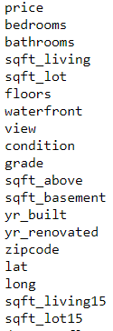



Inputs
Our approach to constructing a model:
Clean the data
Explore and analyze the data
Identify significant variables and build a model around them
Test and Validate model accuracy
Starting dataset:
> 21,500 house sales
19 variables per sale
variables list:

Slide 3

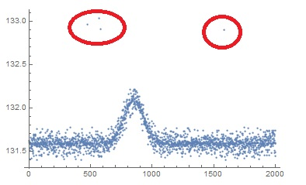
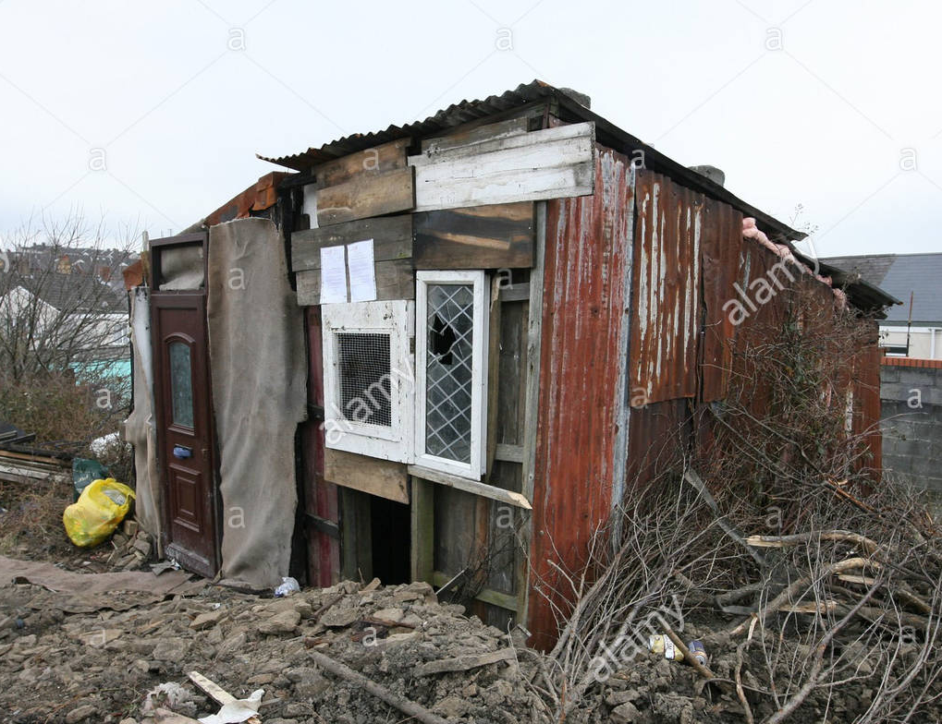

Cleaning the Data
Removing outliers from the dataset

Slide 4
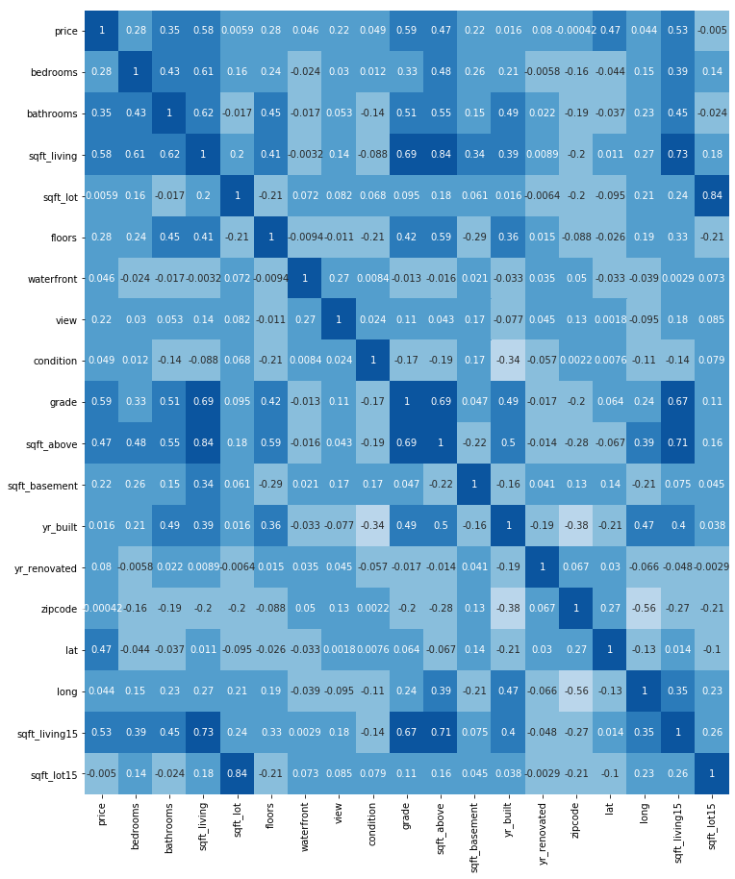

Exploring the Data Making Connections
Example of correlation matrix
Price
Variables
Using statistics to identify the variables with the greatest influence upon housing prices

Slide 5
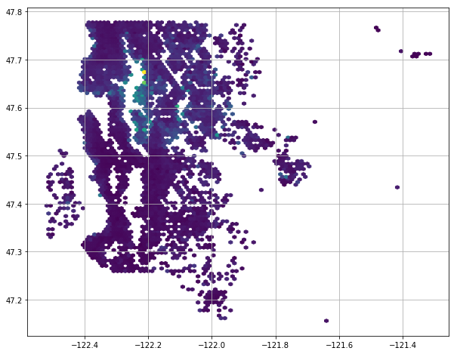

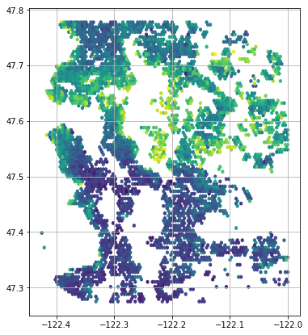
Handling Geography

Slide 6
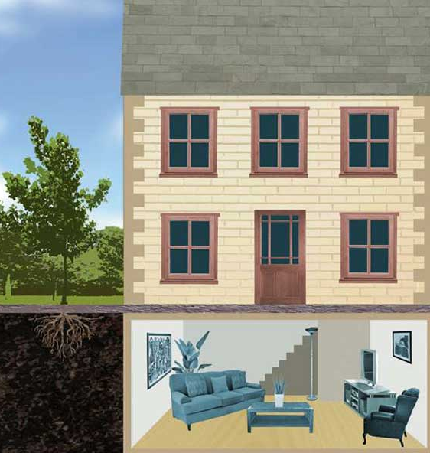
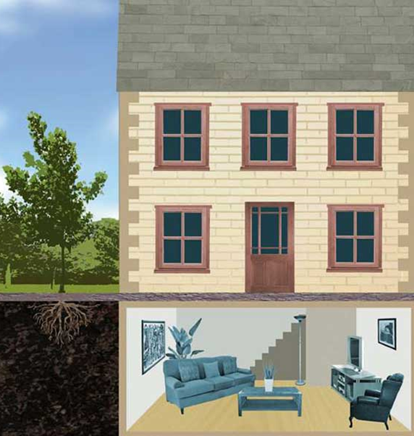
Potential Problems
Total sq ft
Above sq ft
Below
sq ft
PRICE of a single HOUSE
Many variables are closely related, like total sq ft, above-ground sq ft, and below-ground sq ft.
Changing one variable can often impact another. This is bad for modeling as it produces a multiplied effect.

Slide 7
70%
20%
10%
Total sq ft
Above sq ft
Below
sq ft
PRICE of a single HOUSE
We don’t want to just remove variables, as the presence or absence of a basement may influence pricing.
To solve this, we can build features that weight the variables proportionally to their influence.
Building Custom Features

Slide 8


Training & Validating the Model
Our
model

Slide 9
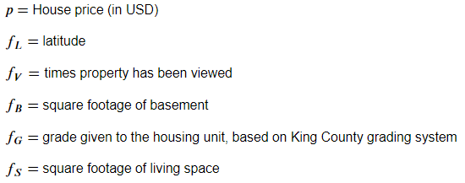
Model Summary
Price =
Latitude +
Views +
Basement sq ft +
King County grade +
Total sq ft
If you know a house’s latitude, basement ft², living space ft², King County grade, and the number of times it has been viewed, then you can estimate it’s sale price within an error margin of $126,700.⁰⁰.

Slide 10
Further Investigation
Recommendations
If you can purchase a house for $126,700 less than the price predicted by our model, you will definitely make a profit.
Houses in the northern half of Kings County fetch higher prices, try to sell northern properties
The more times a house has been viewed, the higher it’s final selling price is likely to be. Invest in advertising your properties.
The current model could likely be enhanced by the addition of more variables.
In particular, information on crime rates, transportation accessibility, school district ratings, etc. would be useful as these factors have in the past been shown to influence real estate pricing.

Slide 11
Thank you

