Slide 1
CAT Investigation :)
By: Dylan K
Carbon: carbon.now.sh

Slide 2
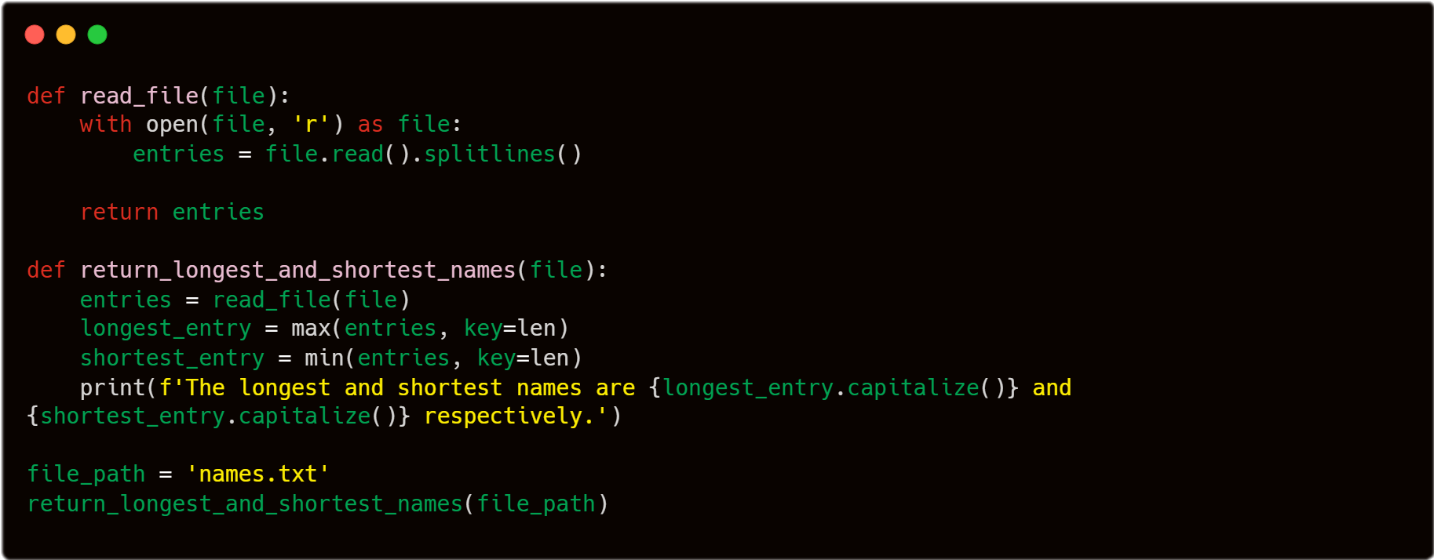
1.1 Dataset
The dataset of names has 32033 entries with 29494 being unique names. To find the longest and shortest names, we can use Python’s inbuilt min and max sorting functions and use the key len.
Result: The longest and shortest names are Muhammadibrahim and An respectively.

