Slide 1
Ansys Fluent Simulation Report

Slide 2
Header
Analyst | HenriqueResende
Date | 10/20/2024 09:42 PM
Table of contents

Slide 3
Table of Contents
System Information
Geometry and Mesh
Mesh Size
Mesh Quality
Orthogonal Quality
Simulation Setup
Physics
Models
Material Properties
Cell Zone Conditions
Boundary Conditions
Reference Values
Solver Settings
Run Information
Solution Status
Report Definitions
Plots
Residuals
Report Plots
Mesh
Contours
Vectors
Pathlines

Slide 4
System Information
Application | Fluent
Settings | 3d, double precision, pressure-based, standard k-epsilon
Version | 24.2.0-10192
Source Revision | 149ed7492d
Build Time | May 13 2024 11:22:47 EST
CPU | 13th Gen Intel(R) Core(TM) i9-13900HX
OS | Windows
System Information
Table of contents

Slide 5
Geometry and Mesh
Geometry and Mesh
Table of contents

Slide 6
Mesh Size
Cells | Faces | Nodes
756473 | 4118544 | 2942400
Geometry and Mesh / Mesh Size
Table of contents

Slide 7
Mesh Quality
Name | Type | Min Orthogonal Quality | Max Aspect Ratio
solid | Poly Cell | 0.36135828 | 12.308166
Geometry and Mesh / Mesh Quality
Table of contents

Slide 8
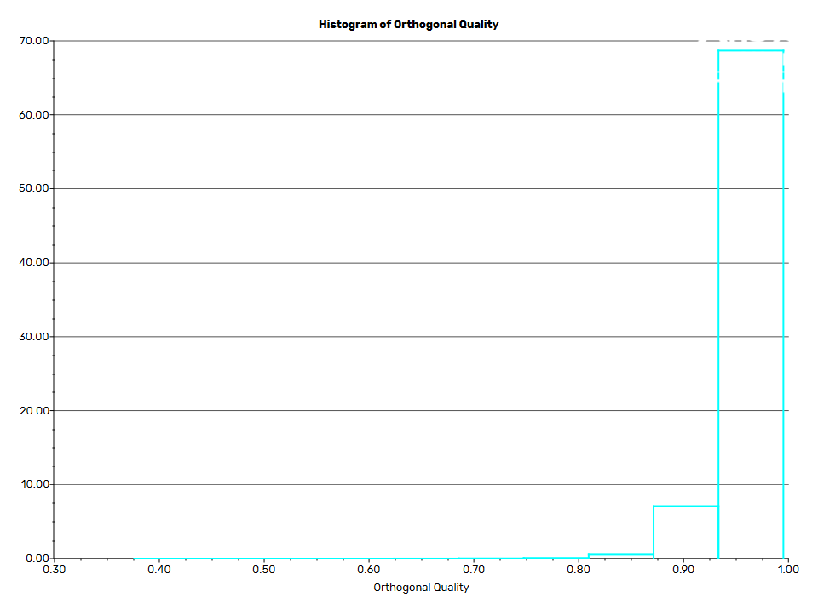
Orthogonal Quality
Geometry and Mesh / Orthogonal Quality
Table of contents

Slide 9
Simulation Setup
Simulation Setup
Table of contents

Slide 10
Physics
Simulation Setup / Physics
Table of contents

Slide 11
Models
Model | Settings
Space | 3D
Time | Steady
Viscous | Standard k-epsilon turbulence model
Wall Treatment | Standard Wall Functions
Heat Transfer | Enabled
Simulation Setup / Physics / Models
Table of contents

Slide 12
Material Properties
- Fluid
- air
Density | 1.225 kg/m^3
Cp (Specific Heat) | 1006.43 J/(kg K)
Thermal Conductivity | 0.0242 W/(m K)
Viscosity | 1.7894e-05 kg/(m s)
Molecular Weight | 28.966 kg/kmol
- Solid
- aluminum
Density | 2719 kg/m^3
Cp (Specific Heat) | 871 J/(kg K)
Thermal Conductivity | 202.4 W/(m K)
Simulation Setup / Physics / Material Properties
Table of contents

Slide 13
Cell Zone Conditions
- Fluid
- solid
Material Name | air
Specify source terms? | no
Specify fixed values? | no
Frame Motion? | no
Laminar zone? | no
Porous zone? | no
3D Fan Zone? | no
Simulation Setup / Physics / Cell Zone Conditions
Table of contents

Slide 14
Boundary Conditions
- Inlet
- inlet_a
Velocity Specification Method | Magnitude, Normal to Boundary
Reference Frame | Absolute
Velocity Magnitude [m/s] | 10
Supersonic/Initial Gauge Pressure [Pa] | 0
Temperature [K] | 323.15
Turbulence Specification Method | Intensity and Viscosity Ratio
Turbulent Intensity [%] | 5
Turbulent Viscosity Ratio | 10
- inlet_b
Velocity Specification Method | Magnitude, Normal to Boundary
Reference Frame | Absolute
Simulation Setup / Physics / Boundary Conditions (1 of 4)
Table of contents

Slide 15
Boundary Conditions
Velocity Magnitude [m/s] | 5
Supersonic/Initial Gauge Pressure [Pa] | 0
Temperature [K] | 298.15
Turbulence Specification Method | Intensity and Viscosity Ratio
Turbulent Intensity [%] | 5
Turbulent Viscosity Ratio | 10
- Outlet
- outlet
Gauge Pressure [Pa] | 0
Pressure Profile Multiplier | 1
Build artificial walls to prevent reverse flow? | yes
Radial Equilibrium Pressure Distribution | no
Average Pressure Specification? | no
Simulation Setup / Physics / Boundary Conditions (2 of 4)
Table of contents

Slide 16
Boundary Conditions
Specify targeted mass flow rate | no
- Wall
- wall
Wall Thickness [m] | 0
Heat Generation Rate [W/m^3] | 0
Material Name | aluminum
Thermal BC Type | Heat Flux
Heat Flux [W/m^2] | 0
Enable shell conduction? | no
Wall Motion | Stationary Wall
Shear Boundary Condition | No Slip
Wall Roughness Height [m] | 0
Wall Roughness Constant | 0.5
Simulation Setup / Physics / Boundary Conditions (3 of 4)
Table of contents

Slide 17
Boundary Conditions
Convective Augmentation Factor | 1
Simulation Setup / Physics / Boundary Conditions (4 of 4)
Table of contents

Slide 18
Reference Values
Area | 1 m^2
Density | 1.225 kg/m^3
Enthalpy | 0 J/kg
Length | 1 m
Pressure | 0 Pa
Temperature | 288.16 K
Velocity | 1 m/s
Viscosity | 1.7894e-05 kg/(m s)
Ratio of Specific Heats | 1.4
Yplus for Heat Tran. Coef. | 300
Reference Zone | solid
Simulation Setup / Physics / Reference Values
Table of contents

Slide 19
Solver Settings
- Equations
Flow | True
Turbulence | True
Energy | True
- Numerics
Absolute Velocity Formulation | True
- Pseudo Time Explicit Relaxation Factors
Density | 1
Body Forces | 1
Turbulent Kinetic Energy | 0.75
Turbulent Dissipation Rate | 0.75
Turbulent Viscosity | 1
Energy | 0.75
Simulation Setup / Solver Settings (1 of 3)
Table of contents

Slide 20
Solver Settings
Explicit Momentum | 0.5
Explicit Pressure | 0.5
- Pressure-Velocity Coupling
Type | Coupled
Pseudo Time Method (Global Time Step) | True
- Discretization Scheme
Pressure | Second Order
Momentum | Second Order Upwind
Turbulent Kinetic Energy | First Order Upwind
Turbulent Dissipation Rate | First Order Upwind
Energy | Second Order Upwind
- Solution Limits
Minimum Absolute Pressure [Pa] | 1
Simulation Setup / Solver Settings (2 of 3)
Table of contents

Slide 21
Solver Settings
Maximum Absolute Pressure [Pa] | 5e+10
Minimum Static Temperature [K] | 1
Maximum Static Temperature [K] | 5000
Minimum Turb. Kinetic Energy [m^2/s^2] | 1e-14
Minimum Turb. Dissipation Rate [m^2/s^3] | 1e-20
Maximum Turb. Viscosity Ratio | 100000
Simulation Setup / Solver Settings (3 of 3)
Table of contents

Slide 22
Run Information
Number of Machines | 1
Number of Cores | 4
Case Read | 19.383 seconds
Iteration | 797.101 seconds
AMG | 600.159 seconds
Virtual Current Memory | 5.3658 GB
Virtual Peak Memory | 6.80931 GB
Memory Per M Cell | 6.67702
Run Information
Table of contents

Slide 23
Solution Status
Iterations: 220
 | Value | Absolute Criteria | Convergence Status
continuity | 9.63814e-07 | 1e-06 | Converged
x-velocity | 1.992128e-09 | 1e-06 | Converged
y-velocity | 2.439718e-09 | 1e-06 | Converged
z-velocity | 7.720948e-09 | 1e-06 | Converged
energy | 9.06973e-10 | 1e-06 | Converged
k | 1.33841e-07 | 1e-06 | Converged
epsilon | 4.253611e-07 | 1e-06 | Converged
Solution Status
Table of contents

Slide 24
Report Definitions
pressure_outlet | 147.3942 | Pa
pressure_inlet_b | 197.119 | Pa
pressure_inlet_a | 244.2427 | Pa
outlet_flow_rate | -0.01298025 | kg/s
inlet_b_flow_rate | 0.004326582 | kg/s
inlet_a_flow_rate | 0.00865367 | kg/s
max_velocity | 23.51774 | m/s
outlet_velocity | 15.00256 | m/s
force_z | -0.008059379 | N
force_y | -0.1511134 | N
force_x | -1.793232e-05 | N
outlet_temp | 313.7026 | K
mass_flow_rate | -1.239611e-10 | kg/s
Report Definitions
Table of contents

Slide 25
Plots
Plots
Table of contents

Slide 26
Residuals
Plots / Residuals
Table of contents

Slide 27
Report Plots
Plots / Report Plots
Table of contents

Slide 28
mass_flow_rate-rplot
Plots / Report Plots / mass_flow_rate-rplot
Table of contents

Slide 29
outlet_temp-rplot
Plots / Report Plots / outlet_temp-rplot
Table of contents

Slide 30
force_x-rplot
Plots / Report Plots / force_x-rplot
Table of contents

Slide 31
force_y-rplot
Plots / Report Plots / force_y-rplot
Table of contents

Slide 32
force_z-rplot
Plots / Report Plots / force_z-rplot
Table of contents

Slide 33
report-def-0-rplot
Plots / Report Plots / report-def-0-rplot
Table of contents

Slide 34
max_velocity-rplot
Plots / Report Plots / max_velocity-rplot
Table of contents

Slide 35
report-plot-0
Plots / Report Plots / report-plot-0
Table of contents

Slide 36
inlet_b_flow_rate-rplot
Plots / Report Plots / inlet_b_flow_rate-rplot
Table of contents

Slide 37
outlet_flow_rate-rplot
Plots / Report Plots / outlet_flow_rate-rplot
Table of contents

Slide 38
pressure_a-rplot
Plots / Report Plots / pressure_a-rplot
Table of contents

Slide 39
pressure_inlet_b-rplot
Plots / Report Plots / pressure_inlet_b-rplot
Table of contents

Slide 40
pressure_outlet-rplot
Plots / Report Plots / pressure_outlet-rplot
Table of contents

Slide 41
Mesh
Mesh
Table of contents

Slide 42
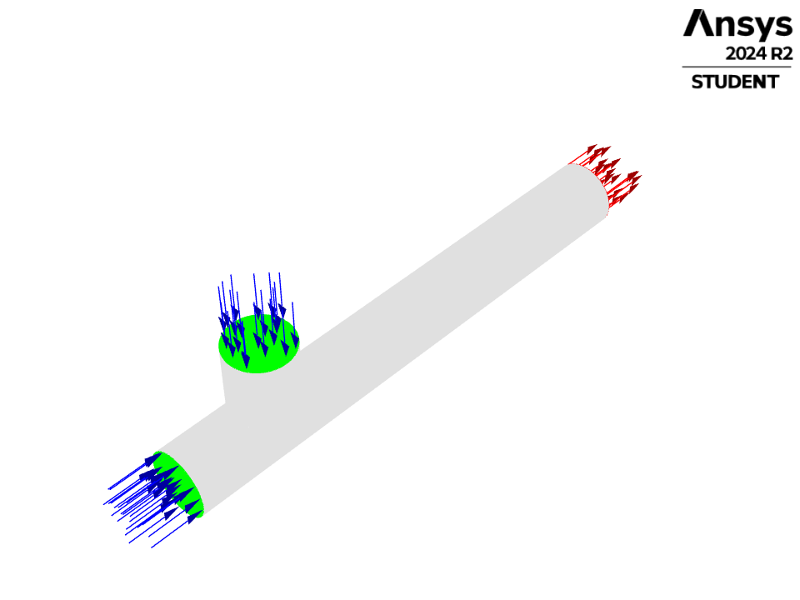
mesh-1
Mesh / mesh-1
Table of contents

Slide 43
Contours
Contours
Table of contents

Slide 44
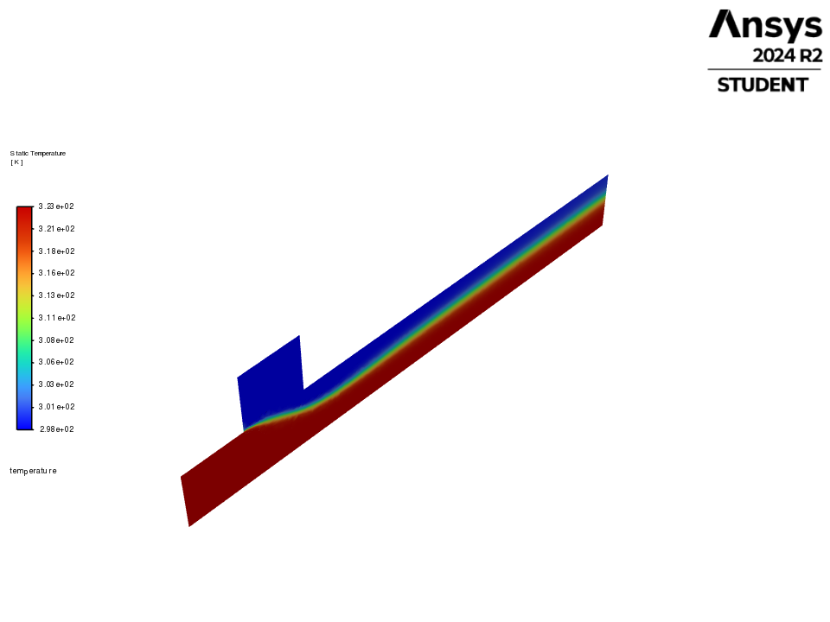
temperature
Contours / temperature
Table of contents

Slide 45
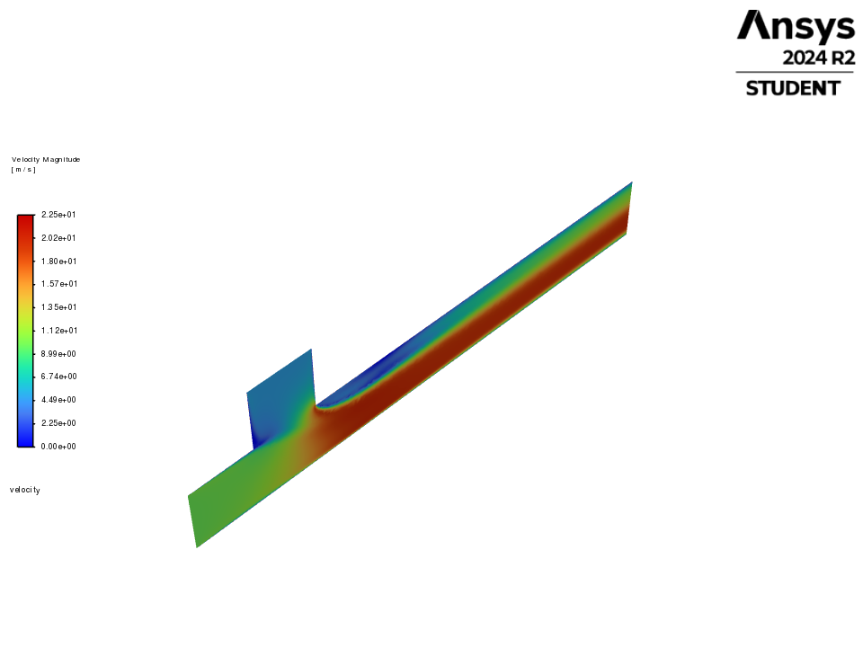
velocity
Contours / velocity
Table of contents

Slide 46
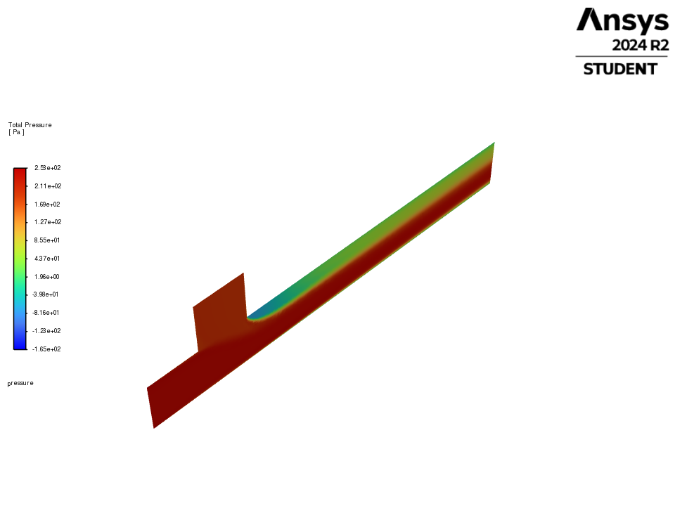
pressure
Contours / pressure
Table of contents

Slide 47
Vectors
Vectors
Table of contents

Slide 48
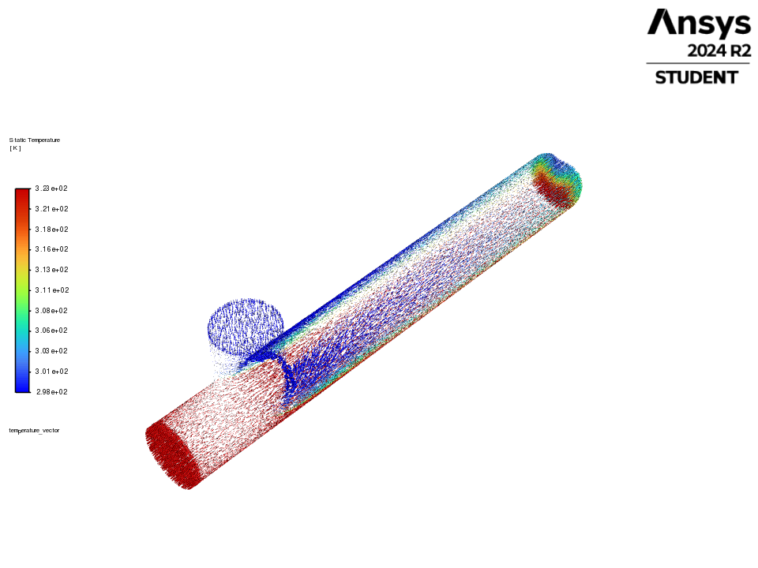
temperature_vector
Vectors / temperature_vector
Table of contents

Slide 49
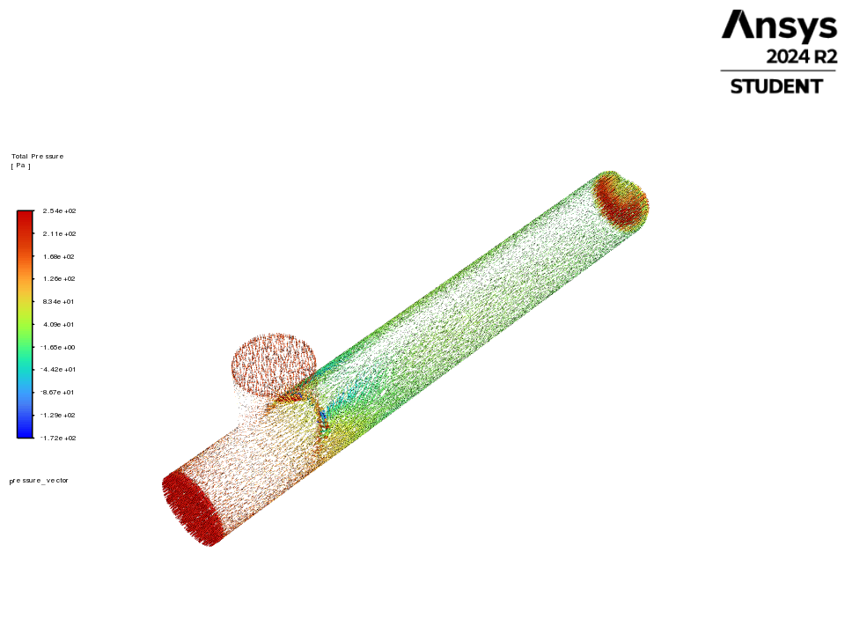
pressure_vector
Vectors / pressure_vector
Table of contents

Slide 50
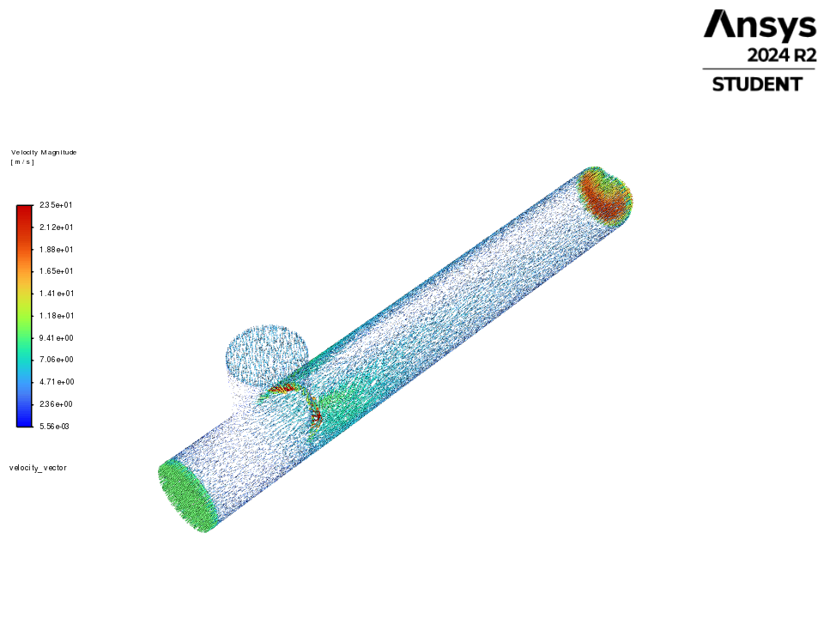
velocity_vector
Vectors / velocity_vector
Table of contents

Slide 51
Pathlines
Pathlines
Table of contents

Slide 52
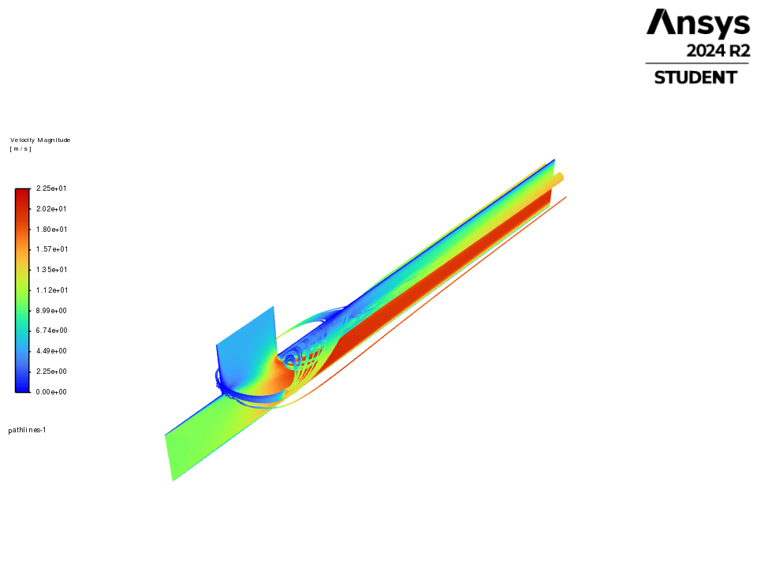
pathlines-1
Pathlines / pathlines-1
Table of contents

