Slide 1


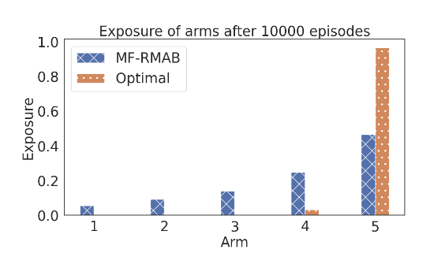
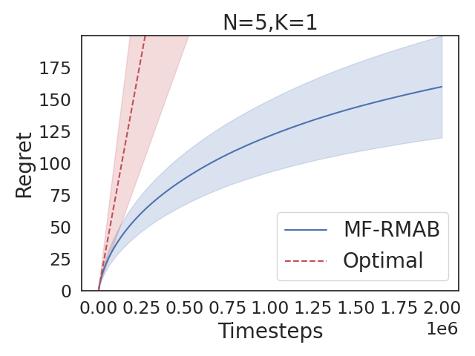
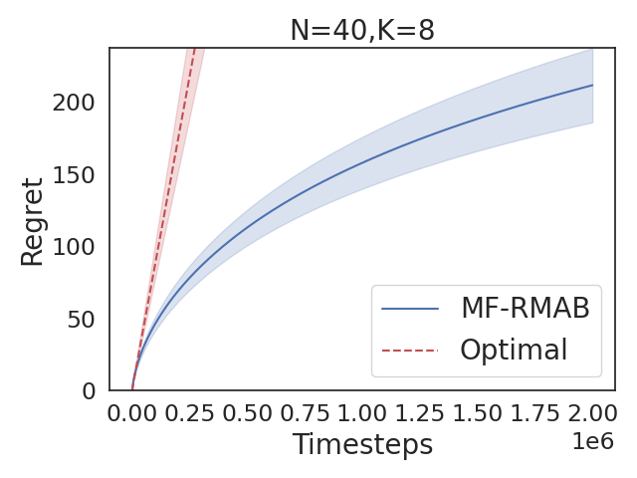
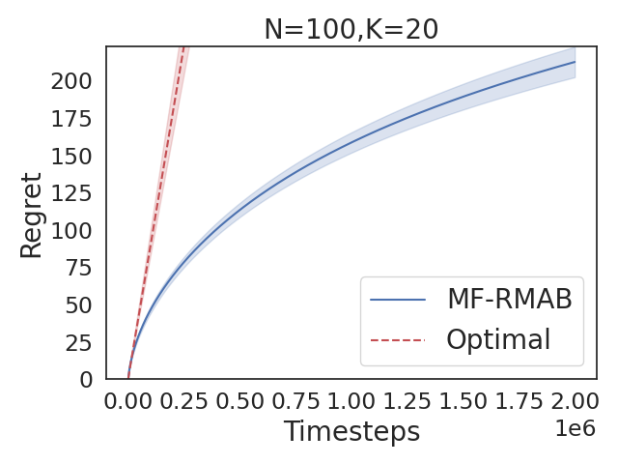
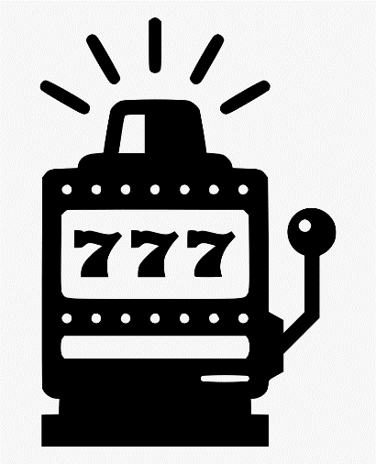







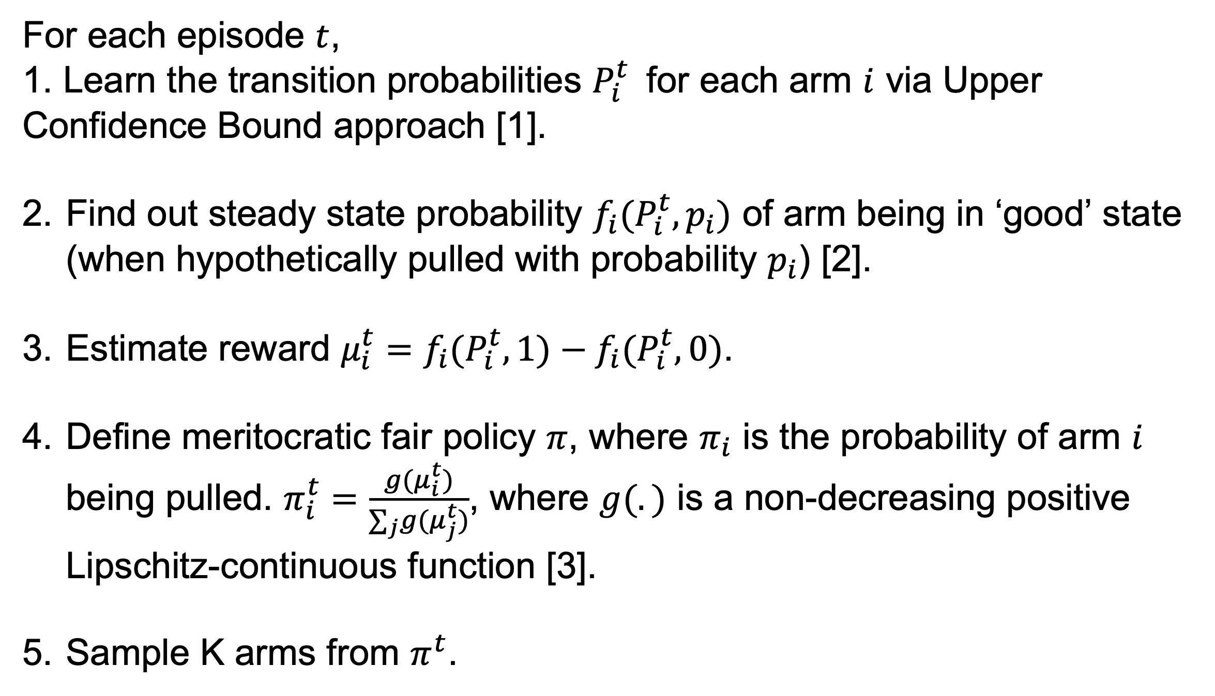
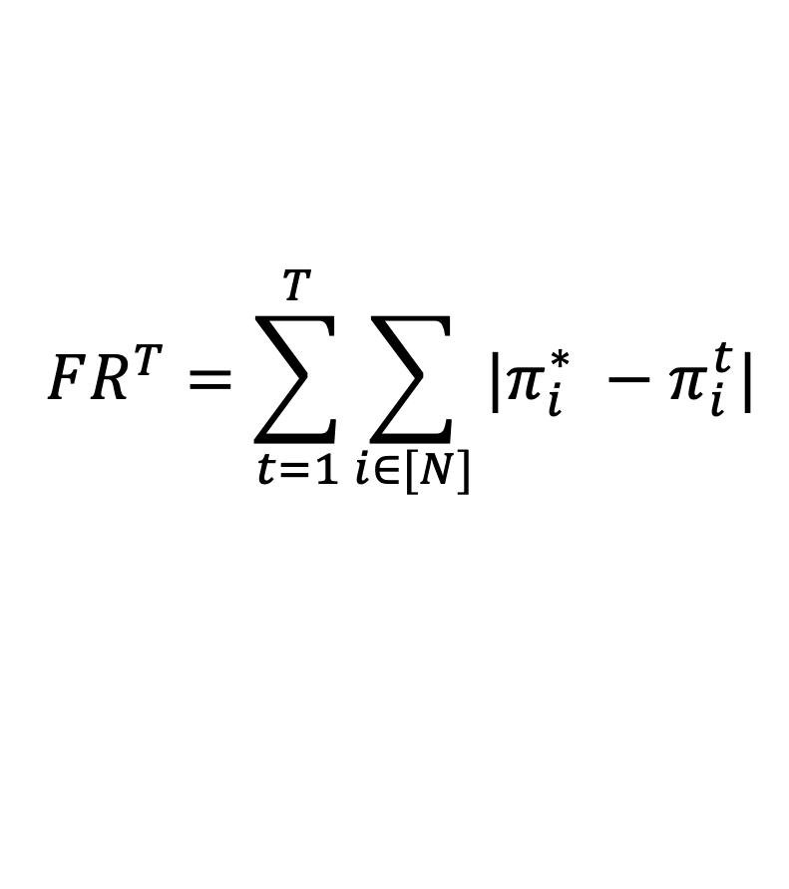
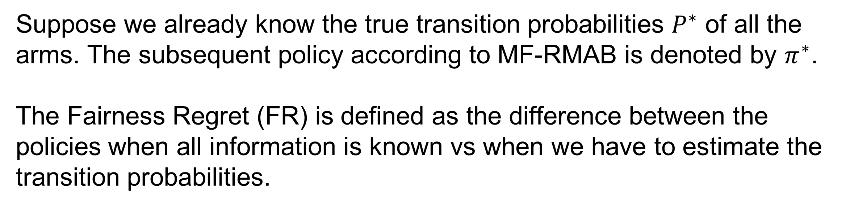
Fairness of Exposure in Online Restless Multi-armed Bandits
Archit Sood¹, Shweta Jain¹ , Sujit Gujar²
1 IIT Ropar, India ; 2 IIIT Hyderabad, India
2020mcb1230@iitrpr.ac.in shwetajain@iitrpr.ac.in sujit.gujar@iiit.ac.in
Healthcare Intervention
Proposed Algorithm: MF-RMAB
Need to provide medical intervention to patients, but only have a limited budget to do so (number of doctors, number of available rooms, etc.). There are many things to consider for any potential solution.
The patient’s condition may change.
The doctor may not have a good estimate of how a patient’s condition might evolve.
The limited budget.
For each episode $t$,
1. Learn the transition probabilities $P_{i}^{t}$ for each arm $i$ via Upper Confidence Bound approach [1].
Find out steady state probability $f_{i}(P_{i}^{t},p_{i})$ of arm being in ‘good’ state (when hypothetically pulled with probability $p_{i}$) [2].
Estimate reward $μ_{i}^{t}=f_{i}(P_{i}^{t},1)−f_{i}(P_{i}^{t},0)$.
Define meritocratic fair policy $π$, where $π_{i}$ is the probability of arm $i$ being pulled. $π_{i}^{t}=\frac{g(μ_{i}^{t})}{∑_{j}g(μ_{j}^{t})}$, where $g(.)$ is a non-decreasing positive Lipschitz-continuous function [3].
Sample K arms from $π^{t}$.
Restless Multi-armed Bandit
Each patient is modelled as an ‘arm’. Total number of arms = N
Providing intervention to a patient is called ‘pulling’ that arm.
Each arm has two states: ‘good’ and ‘bad’.
Arms transition from one state to another based on their ‘transition probabilities’ P.
We run our algorithm (policy) for total T episodes.
We can only pull K (< N) arms at one-time step.
Ideally, we want to pull the arm which will go from bad to good state due to our intervention.
We can define the ‘reward’ of an arm as the benefit the arm receives from getting pulled.
Fairness Regret
Suppose we already know the true transition probabilities $P^{∗}$ of all the arms. The subsequent policy according to MF-RMAB is denoted by $π^{∗}$.
The Fairness Regret (FR) is defined as the difference between the policies when all information is known vs when we have to estimate the transition probabilities.
The Optimal Policy need not be fair!
$$FR^{T}=\sum_{t=1}^{T}{\sum_{i∈[N]}{|π_{i}^{∗} −π_{i}^{t}|}}$$
Meritocratic Fairness
Pulling arms with the highest reward leads to some arms getting starved of attention.
In healthcare, this would imply that some patients barely receive medical help!
There is a need for policies that provide fair exposure to each arm.
Theoretical Results
Theorem: MF-RMAB incurs $O(\sqrt{Tln T }$) fairness regret for sufficiently large $T$ and $K=1$.
Experimental Results
Pull each arm with probability proportional to their reward.
Motivation
0.1
0.8
0.9
Optimal Allocation: Arm 3 with reward 0.9
References
Fair Allocation: Pulling probabilities of 0.055, 0.44, and 0.5 respectively
[1] Kai Wang, Lily Xu, Aparna Taneja, and Milind Tambe. Optimistic whittle index policy: Online learning for restless bandits. (AAAI 2023)
[2] Christine Herlihy, Aviva Prins, Aravind Srinivasan, and John P Dickerson. Planning to fairly allocate: Probabilistic fairness in the restless bandit setting. (ACM SIGKDD 2023)
[3] Lequn Wang, Yiwei Bai, Wen Sun, and Thorsten Joachims. Fairness of exposure in stochastic bandits. (ICML 2021)
Acknowledgment:

