Slide 1
A look at the Dynamics of Ultrafast Magnetization Reversal
C.K. Rodgers, G.P. Zhang

Slide 2
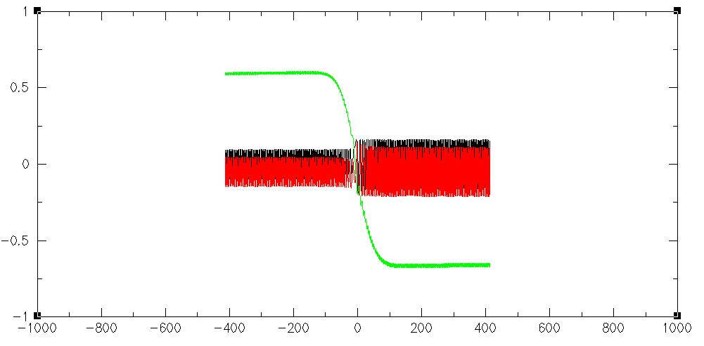
Purpose
Ultrafast spin reversal
Hamiltonian and the External Field
Dependence of spin on different properties of the system
Future endeavors

Slide 3
What is ultrafast spin reversal?
Spin is flipped about the z-axis
Femtosecond time scale
C.D. Stanciu et al. PRL 99,217204 (2007)
Only circularly polarized light works
Not well understood at this time
Photon interaction
Spin flip observed
Circular Polarization
Linear Polarization

Slide 4
The Hamiltonian
Describes the energy of the system
Heisenberg term
Spin orbit coupling term
Anisotropic term
Heisenberg
Spin orbit interaction
Anisotropic uniaxial term

Slide 5

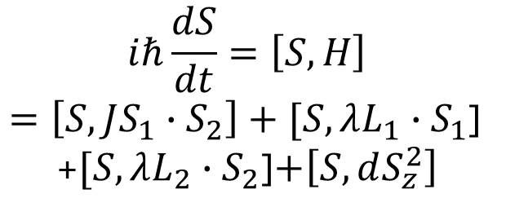
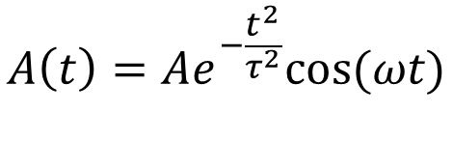
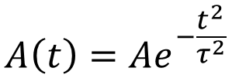
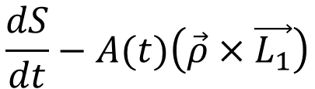
Dynamics of the System and the Effective Field
Equation of motion describes the spin behavior
Effective field behaves like a magnetic field
Occurs due to polarization of laser interaction with orbital momentum of electron
Equation of motion
Effective Field
$$iℏ\frac{dS}{dt}=\left[S,H\right]$$
$=\left[S,JS_{1}∙S_{2}\right]+[S,λL_{1}∙S_{1}$]
+$[S,λL_{2}∙S_{2}$]$+\left[S,dS_{z}^{2}\right]$
$$−A(t)(\vec{ρ}×\vec{L_{1}})$$
$$A\left(t\right)=Ae^{−\frac{t^{2}}{τ^{2}}}$$
Resulting dynamics
Normally
$$A\left(t\right)=Ae^{−\frac{t^{2}}{τ^{2}}}cos⁡(ωt)$$
$$\frac{dS}{dt}−A(t)\left(\vec{ρ}×\vec{L_{1}}\right)$$
But assumed angular frequency to be zero
Relationship will be looked at later

Slide 6
Effect of Polarization Angle
Circular Polarization induces spin flip
Graph looks at region of angles where spin flip is present
Very much a non-linear trend
Between 19.5 and 19.75 degrees there is a step in the values.
Same thing between 26.6875 and 27 degrees

Slide 7
Changing polarization characteristics
Z
Originally polarization along x,z-plane
New polarization along y,z-plane
Blue line is with positive y values
Orang is with negative y values
Symmetric about 90 degrees
Y

Slide 8
Effects of photon energy
Photon energy is related to the angular frequency
Once again highly non-linear
Stop observing spin flip around 0.2eV

Slide 9
Effects of orbital momentum magnitude
Simply took the magnitude of the orbital momentum and varied until spin flip observed
Spin flip was observed around 0.015 hbar

Slide 10
Effects of orientation of orbital momentum
Found all orientations related to orbital magnetudes
Looked at final spin state for patterns
Final state highly dependent on the orientation of the orbital magnitude

Slide 11
Future Goals
Look at physical origins of effective field
Compare with experimental interpretations
Increase the size of the sample of spin particles
See if effects are still present

Slide 12
Acknowledgments
Dr. Guo-ping Zhang
Dr. Joseph West
Department of Energy Grant DE-FG02-06er46304
Dr. Zhang’s research group: Dr. Yong Xue, HuiPing, Kyle Drake, Tanner Latta, Nicole Hostetter, Mariam Houston
SURE program
ISU Department of Chemistry and Physics

