Slide 1
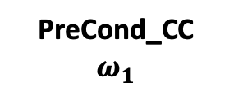








Frequency Independent
Frequency Dependent
Forward_DC
$$ω_{1}$$
Solver_QMR
$$ω_{1}$$
PreCond_CC
$$ω_{1}$$
ModelOperator
Forward_DC
$$ω_{2}$$
Solver_QMR
$$ω_{2}$$
PreCond_CC
$$ω_{2}$$
Divergence Correction
Solver_PCG
Precond_DC
Forward_DC
$$ω_{N}$$
Solver_QMR
$$ω_{N}$$
PreCond_CC
$$ω_{N}$$
All Solvers, and PreConditioners also point to ModelOperator

