Slide 1
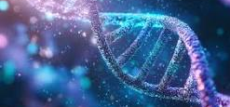
Protein analysis project
the4bytes

Slide 2
Our Goal
Analyze different proteins and their structures
1
Find their weaknesses and how to denature them.
2
Render 3D models of the chosen proteins
3

Slide 3

How We Got There
Data management with Python
Page structure with HTML
Formatting with CSS and JS Bootstrap
Some of the libraries we used:
  Pandas
  Flask
  Bio
  … and more

Slide 4
Accomplishments
Flask linking python (back-end) and HTML/CSS (front-end)
New Libraries such as mastery of pandas, Bio and Flask
Understanding of protein behavior

Slide 5
More than 1 000 000 models supported!

Slide 6
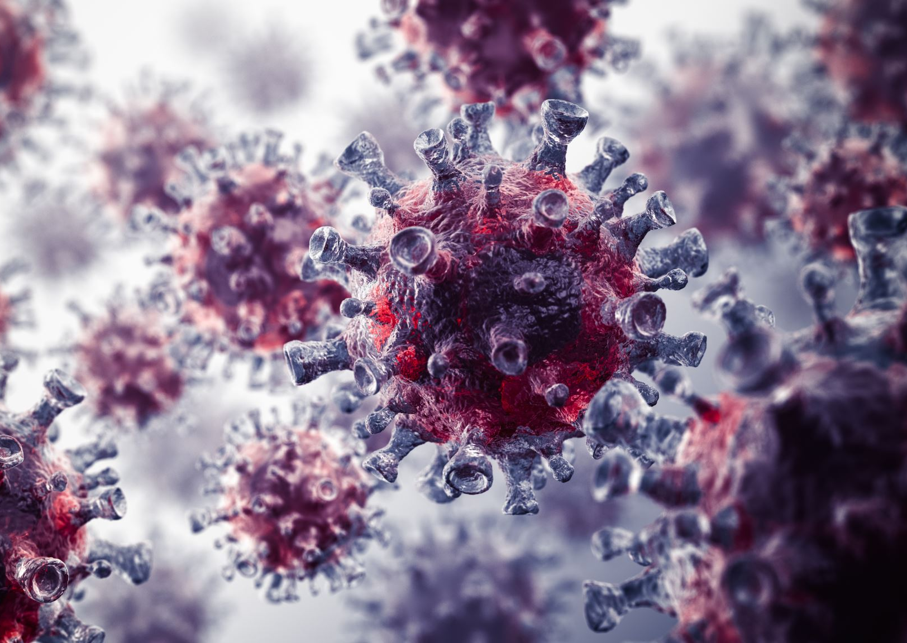
Real life impacts
Could potentially be used to destroy bacteria and Viruses
Could cure diseases!

Slide 7
Time for some Demos
1CE0 – HIV surface marker protein
1A3N - Human Hemoglobin
1YPY - Vaccinia Virus L1 protein
3IGC - Smallpox virus topoisomerase-DNA

Slide 8
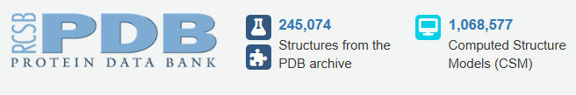
Online database
https://www.rcsb.org : RCSB Protein Data Bank (RCSB PDB) uses Alphafold and other tools to provide to the world tools to innovate in biology.

