Slide 1
Diaphyseal fractures were predominant among operators across all long bones, especially in the lower limbs, with the tibia, femur, and fibula being the most frequently injured.
tibial fractures were observed in 37.5% of patients, with operators accounting for 33.3% of these injuries, primarily in the diaphyseal segment. Pedestrians showed a predisposition to diaphyseal wedge fractures of the tibia, with 8.3% of tibial fractures being wedge-type.
In the humerus, simple diaphyseal fractures were the most common pattern, observed in 12.5% of cases. Both operators and passengers were affected, with operators accounting for 6.2% of these fractures and passengers for 12.5%.
Notes:
The rider and the injuries mostly involve long bone fractures. Diaphyseal fractures were predominant in the riders in all the long bones but predominated in the lower limb bones with the femur, tibia and fibula being the most injured in the diaphyseal segment. Pedestrians show a predisposition to getting diaphyseal wedge fracture of the tibia in motorcycle collisions
In the humerus, the pattern was simple diaphyseal fractures. Both the rider and the pillion riders were equally affected, but no pedestrian was found to have suffered a humerus fracture.

Slide 2
 | Multifragmented | Simple | Wedged | All Patients
11 | 3 (18.8%) | 2 (12.5%) | 0 (0.0%) | 5 (31.2%)
12 | 1 (6.2%) | 2 (12.5%) | 0 (0.0%) | 3 (18.8%)
13 | 5 (31.2%) | 2 (12.5%) | 1 (6.2%) | 8 (50.0%)

Slide 3
 | Passenger | Pedestrian | Operator | All Patients
11 | 3 (18.8%) | 1 (6.2%) | 1 (6.2%) | 5 (31.2%)
12 | 2 (12.5%) | 0 (0.0%) | 1 (6.2%) | 3 (18.8%)
13 | 1 (6.2%) | 2 (12.5%) | 5 (31.2%) | 8 (50.0%)

Slide 4
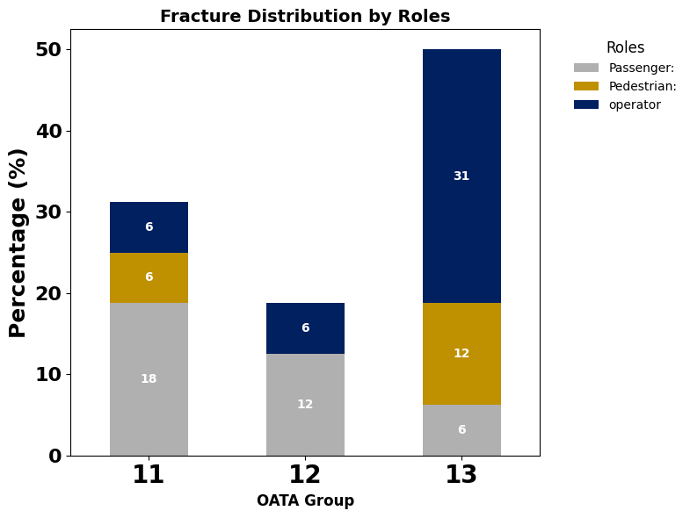
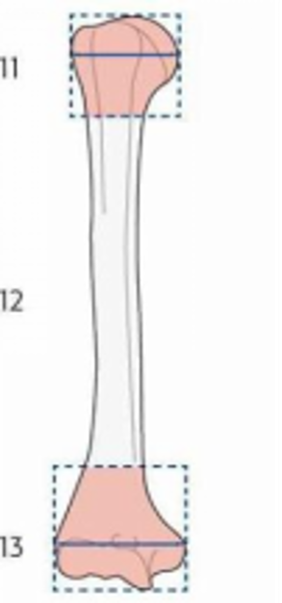
 |  | A | B | C | Patient Roles and number of fractures under AO/OTA
 | Proximal | 3 | 2 | 0
 | Diaphyseal | 1 | 2 | 0
 | Distal | 5 | 2 | 1

Slide 5
Fracture Type | Multifragmented | Simple | Wedged | All Patients
2r1 | 2 (6.5%) | 5 (16.1%) | 2 (6.5%) | 9 (29.0%)
2r2 | 0 (0.0%) | 6 (19.4%) | 3 (9.7%) | 9 (29.0%)
2r3 | 3 (9.7%) | 5 (16.1%) | 5 (16.1%) | 13 (41.9%)

Slide 6
Roles | Passenger | Pedestrian | Operator | All Patients
2r1 | 4 (12.9%) | 1 (3.2%) | 4 (12.9%) | 9 (29.0%)
2r2 | 6 (19.4%) | 1 (3.2%) | 2 (6.5%) | 9 (29.0%)
2r3 | 6 (19.4%) | 2 (6.5%) | 5 (16.1%) | 13 (41.9%)

Slide 7
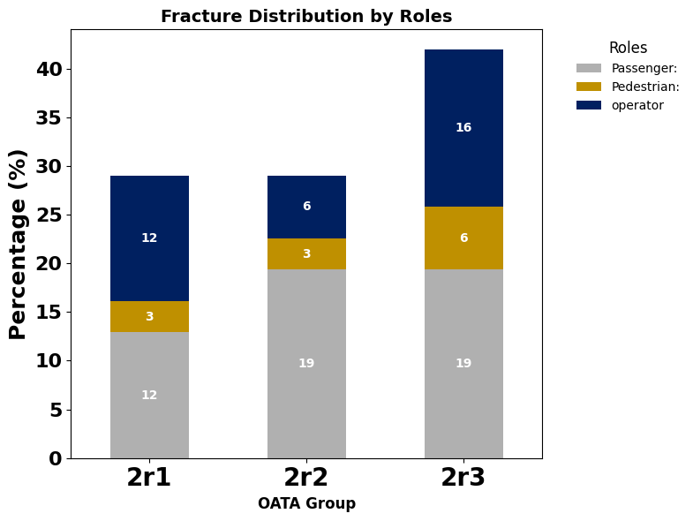
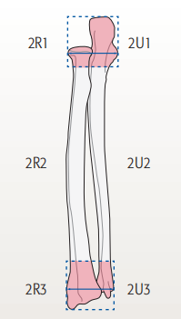
 |  | A | B | C | Patient Roles and number of fractures under AO/OTA
 | Proximal | 5 | 2 | 2
 | Diaphyseal | 6 | 3 | 0
 | Distal | 3 | 5 | 1

Slide 8
Fracture Type | Simple | Wedged | All Patients
2u1 | 0 (0.0%) | 1 (14.3%) | 1 (14.3%)
2u2 | 1 (14.3%) | 0 (0.0%) | 1 (14.3%)
2u3 | 4 (57.1%) | 1 (14.3%) | 5 (71.4%)

Slide 9
Roles | Passenger | Pedestrian | Operator | All Patients
2u1 | 0 (0.0%) | 0 (0.0%) | 1 (14.3%) | 1 (14.3%)
2u2 | 0 (0.0%) | 1 (14.3%) | 0 (0.0%) | 1 (14.3%)
2u3 | 1 (14.3%) | 1 (14.3%) | 3 (42.9%) | 5 (71.4%)

Slide 10
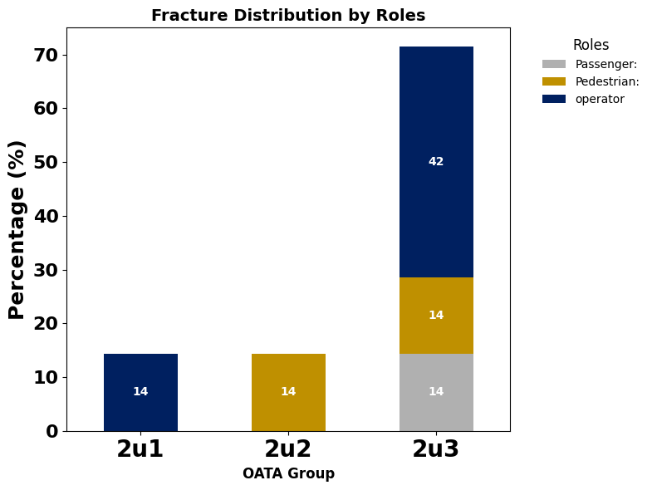
 |  | A | B | C | Patient Roles and number of fractures under AO/OTA
 | Proximal | 0 | 1 | 0
 | Diaphyseal | 1 | 0 | 0
 | Distal | 4 | 1 | 0

Slide 11
Fracture Type | Multifragmented | Simple | All Patients
78 | 1 (25.0%) | 2 (50.0%) | 3 (75.0%)
79 | 0 (0.0%) | 0 (0.0%) | 1 (25.0%)

Slide 12
Roles | Pedestrian | Operator | All Patients
78 | 2 (50.0%) | 1 (25.0%) | 3 (75.0%)
79 | 0 (0.0%) | 1 (25.0%) | 1 (25.0%)

Slide 13
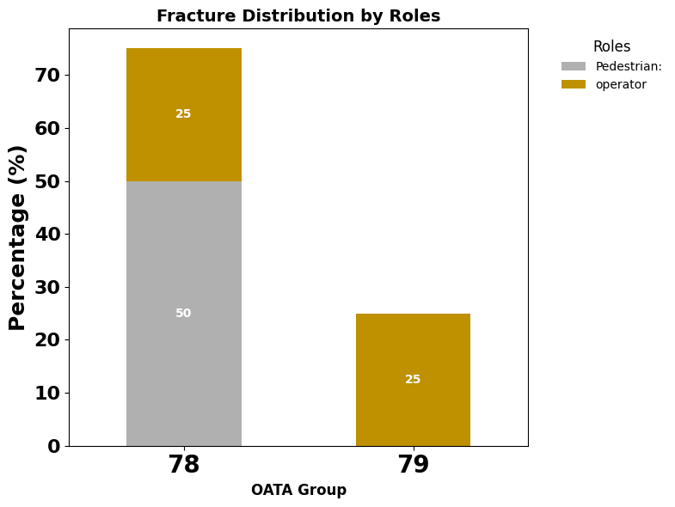
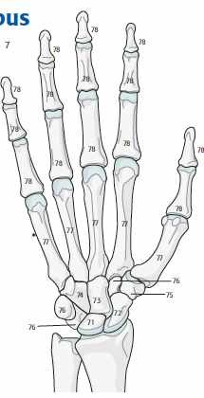
 |  | A | B | C | Patient Roles and number of fractures under AO/OTA
 | 78 | 2 | 2 | 0
 | 79 | 1 | 2 | 1

Slide 14
Fracture Type | Multifragmented | Simple | Wedged | All Patients
31 | 3 (16.7%) | 3 (16.7%) | 0 (0.0%) | 6 (33.3%)
32 | 2 (11.1%) | 1 (5.6%) | 2 (11.1%) | 5 (27.8%)
33 | 5 (27.8%) | 0 (0.0%) | 2 (11.1%) | 7 (38.9%)

Slide 15
Roles | Passenger | Pedestrian | Operator | All Patients
31 | 3 (16.7%) | 0 (0.0%) | 3 (16.7%) | 6 (33.3%)
32 | 2 (11.1%) | 1 (5.6%) | 2 (11.1%) | 5 (27.8%)
33 | 2 (11.1%) | 3 (16.7%) | 2 (11.1%) | 7 (38.9%)

Slide 16
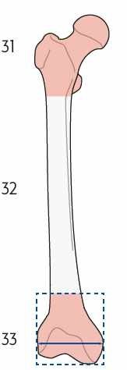
 |  | A | B | C | Patient Roles and number of fractures under AO/OTA
 | Proximal | 3 | 0 | 3
 | Diaphyseal | 1 | 2 | 2
 | Distal | 0 | 2 | 5

Slide 17
Fracture Type | Multifragmented | Simple | Wedged | All Patients
4t1 | 13 (27.1%) | 1 (2.1%) | 4 (8.3%) | 18 (37.5%)
4t2 | 6 (12.5%) | 8 (16.7%) | 4 (8.3%) | 18 (37.5%)
4t3 | 5 (10.4%) | 5 (10.4%) | 2 (4.2%) | 12 (25.0%)

Slide 18
Roles | Passenger | Pedestrian | Operator | All Patients
4t1 | 8 (16.7%) | 5 (10.4%) | 5 (10.4%) | 18 (37.5%)
4t2 | 2 (4.2%) | 0 (0.0%) | 16 (33.3%) | 18 (37.5%)
4t3 | 8 (16.7%) | 2 (4.2%) | 2 (4.2%) | 12 (25.0%)

Slide 19
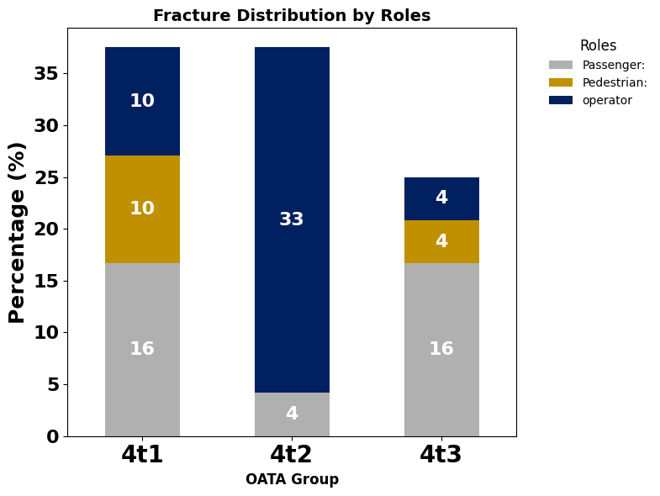
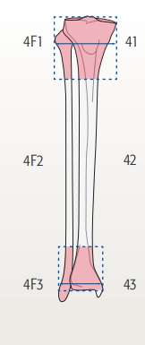
 |  | A | B | C | Patient Roles and number of fractures under AO/OTA
 | Proximal | 1 | 4 | 13
 | Diaphyseal | 8 | 4 | 6
 | Distal | 5 | 2 | 5

Slide 20
Fracture Type | Multifragmented | Simple | Wedged | All Patients
4f1 | 4 (18.2%) | 1 (4.5%) | 0 (0.0%) | 5 (22.7%)
4f2 | 2 (9.1%) | 6 (27.3%) | 3 (13.6%) | 11 (50.0%)
4f3 | 3 (13.6%) | 3 (13.6%) | 0 (0.0%) | 6 (27.3%)

Slide 21
Roles | Passenger | Pedestrian | Operator | All Patients
4f1 | 3 (13.6%) | 0 (0.0%) | 2 (9.1%) | 5 (22.7%)
4f2 | 4 (18.2%) | 2 (9.1%) | 5 (22.7%) | 11 (50.0%)
4f3 | 1 (4.5%) | 1 (4.5%) | 4 (18.2%) | 6 (27.3%)

Slide 22
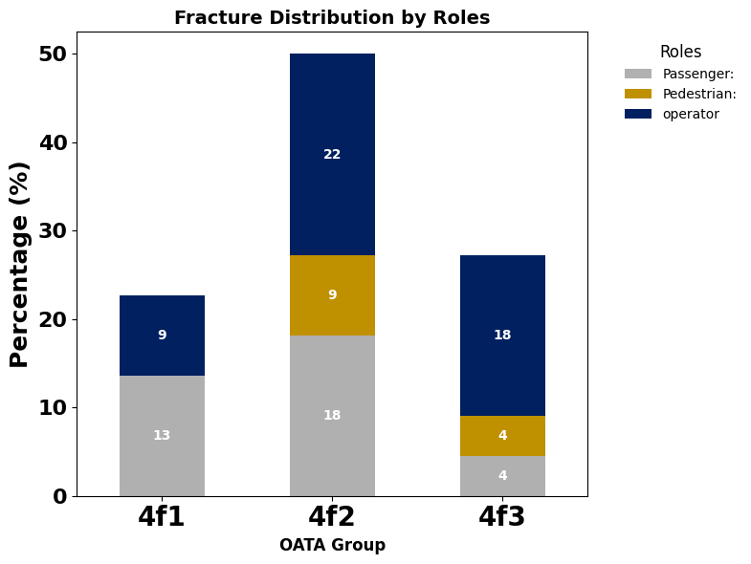
 |  | A | B | C | Patient Roles and number of fractures under AO/OTA
 | Proximal | 1 | 0 | 4
 | Diaphyseal | 6 | 3 | 2
 | Distal | 3 | 0 | 3

Slide 23
Fracture Type | Multifragmented | Simple | All Patients
81 | 2 (33.3%) | 0 (0.0%) | 2 (33.3%)
87 | 2 (33.3%) | 0 (0.0%) | 2 (33.3%)
88 | 1 (16.7%) | 1 (16.7%) | 2 (33.3%)

Slide 24
Roles | Passenger | Operator | All Patients
81 | 1 (16.7%) | 1 (16.7%) | 2 (33.3%)
87 | 2 (33.3%) | 0 (0.0%) | 2 (33.3%)
88 | 1 (16.7%) | 1 (16.7%) | 2 (33.3%)

Slide 25
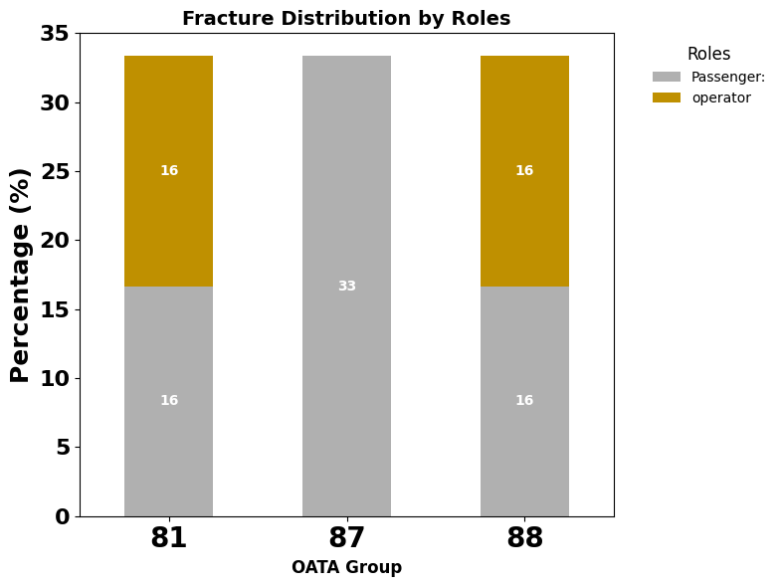
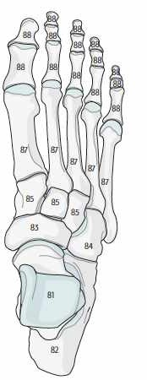
 |  | A | B | C | Patient Roles and number of fractures under AO/OTA
 | Proximal | 2 | 0 | 2
 | Diaphyseal | 2 | 0 | 2
 | Distal | 1 | 0 | 1

Slide 26
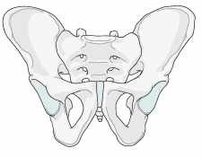
 |  |  |  |  | Patient Roles and number of fractures under AO/OTA
 | Anteroposterior Compression | 1
 | Vertical shear | 0
 | Lateral compression

Slide 27
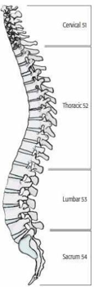
 |  |  |  |  | Patient Roles and number of fractures under AO/OTA
 | Cervical | 3
 | Thoracic
 | Lumbar

Slide 28






