Slide 1
visualization

Slide 2
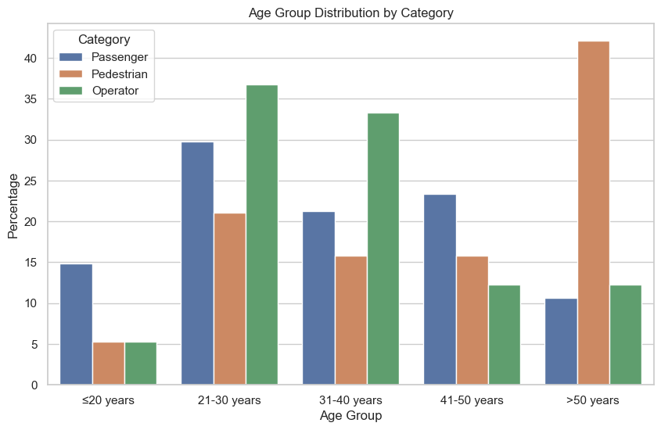

Slide 3
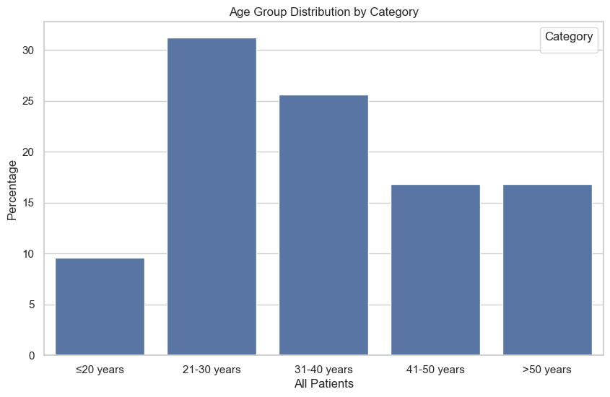

Slide 4
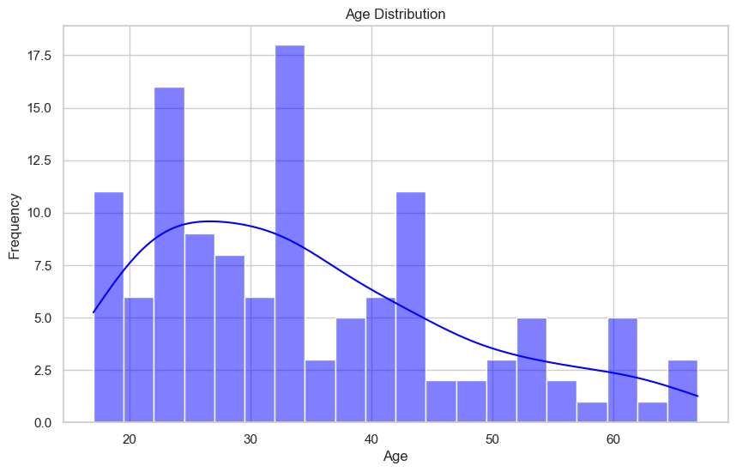

Slide 5
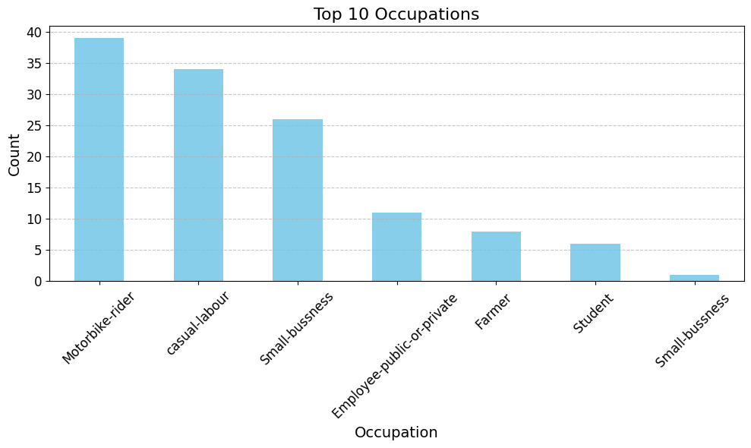

Slide 6
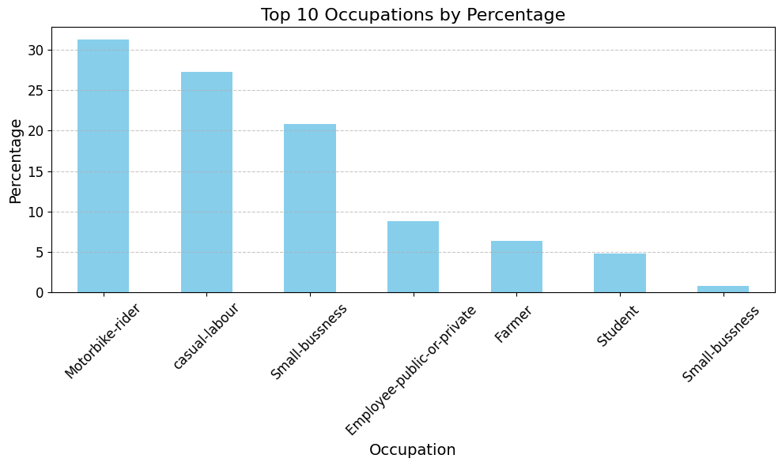

Slide 7
Occupation | Passenger | Pedestrian | Operator | All Patients
Employee (Public/Private) | 6 (12.8%) | 0 (0.0%) | 5 (8.8%) | 11 (8.8%)
Farmer | 3 (6.4%) | 2 (9.5%) | 3 (5.3%) | 8 (6.4%)
Motorbike Rider | 7 (14.9%) | 2 (9.5%) | 30 (52.6%) | 39 (31.2%)
Small-business | 16 (34.0%) | 6 (28.6%) | 4 (7.0%) | 26 (20.8%)
Small-business (second row) | 0 (0.0%) | 1 (4.8%) | 0 (0.0%) | 1 (0.8%)
Student | 2 (4.3%) | 1 (4.8%) | 3 (5.3%) | 6 (4.8%)
Casual Laborer | 13 (27.7%) | 9 (42.9%) | 12 (21.1%) | 34 (27.2%)

Slide 8
Education Level | Passenger | Pedestrian | Operator | All Patients
Primary | 17 (36.2%) | 15 (71.4%) | 28 (50.0%) | 60 (48.4%)
No School | 4 (8.5%) | 0 (0.0%) | 0 (0.0%) | 4 (3.2%)
Secondary | 16 (34.0%) | 4 (19.0%) | 21 (37.5%) | 41 (33.1%)
Tertiary | 10 (21.3%) | 2 (9.5%) | 7 (12.5%) | 19 (15.3%)

Slide 9
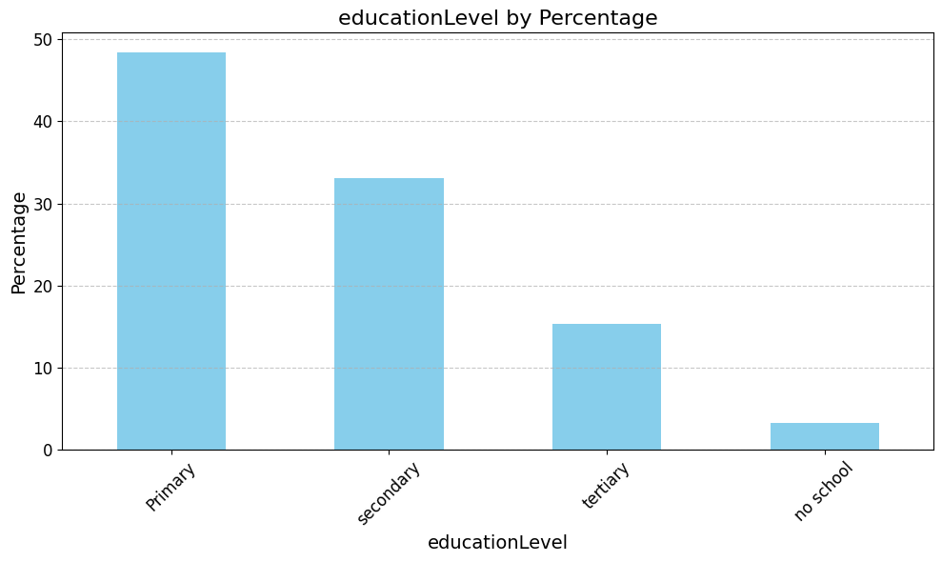

Slide 10
Referral Status | Passenger | Pedestrian | Operator | All Patients
No | 22 (46.8%) | 8 (38.1%) | 26 (45.6%) | 56 (44.8%)
Yes | 25 (53.2%) | 13 (61.9%) | 31 (54.4%) | 69 (55.2%)

Slide 11
 | Passenger | Pedestrian | Operator | All Patients Evacuation
Ambulance | 15 | 3 | 12 | 30
Motorbike | 2 | 1 | 4 | 6
Police vehicle | 0 | 1 | 6 | 7
Private motorbike | 0 | 2 | 0 | 2
Private vehicle | 30 | 14 | 35 | 79

Slide 12
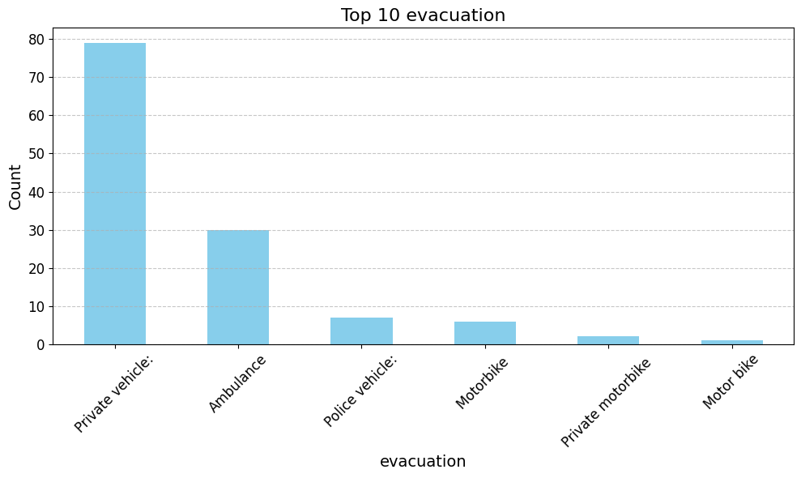

Slide 13
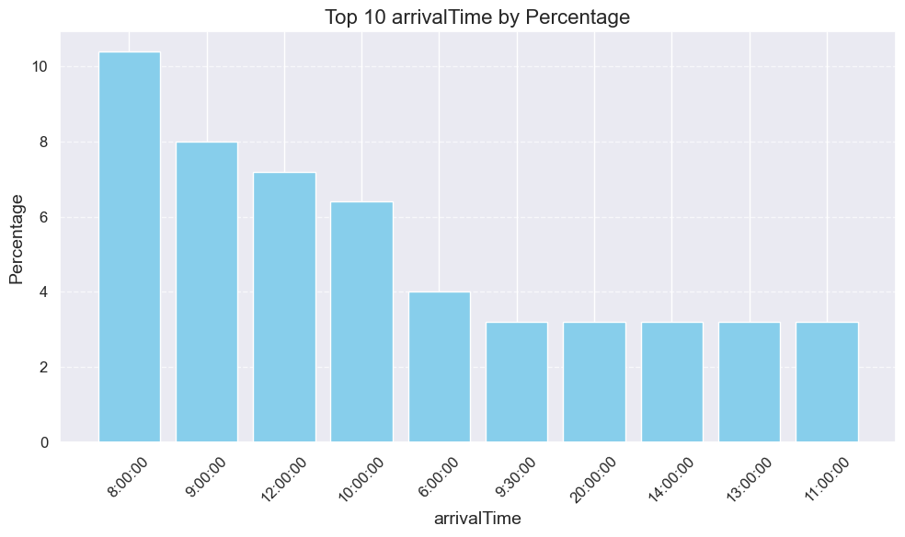

Slide 14
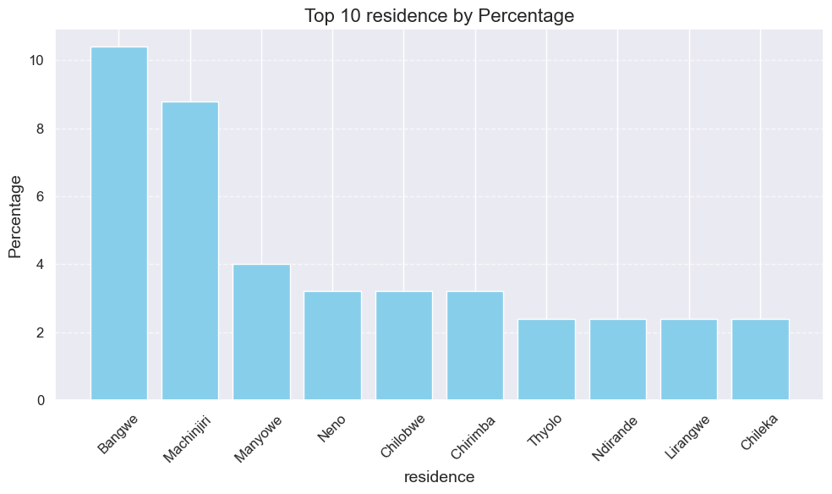

Slide 15
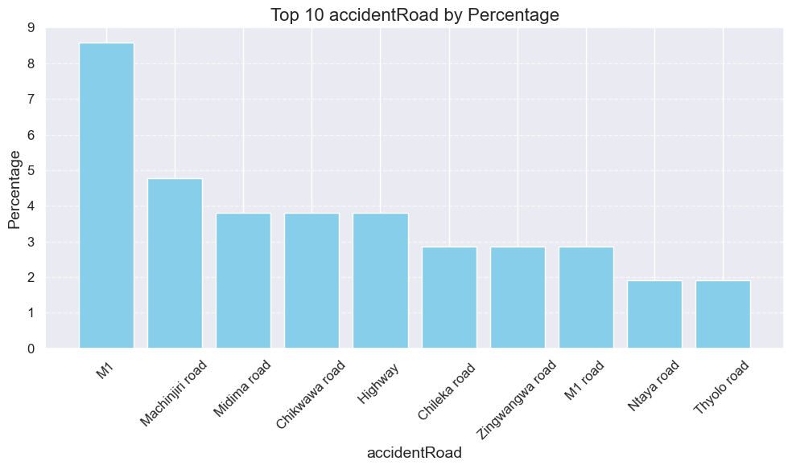

Slide 16
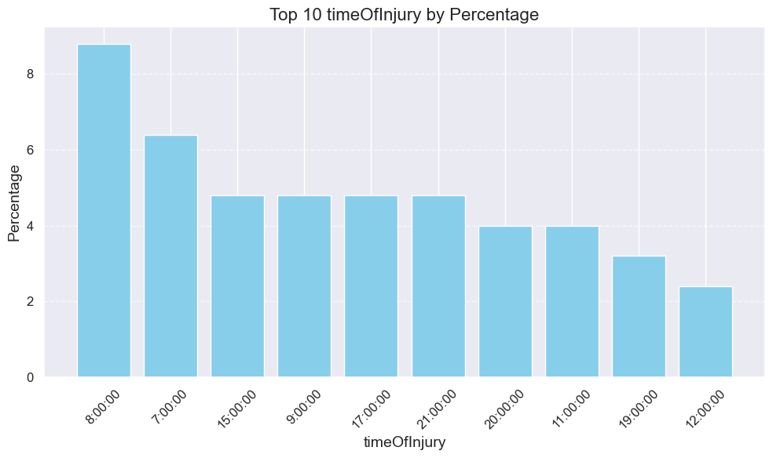

Slide 17
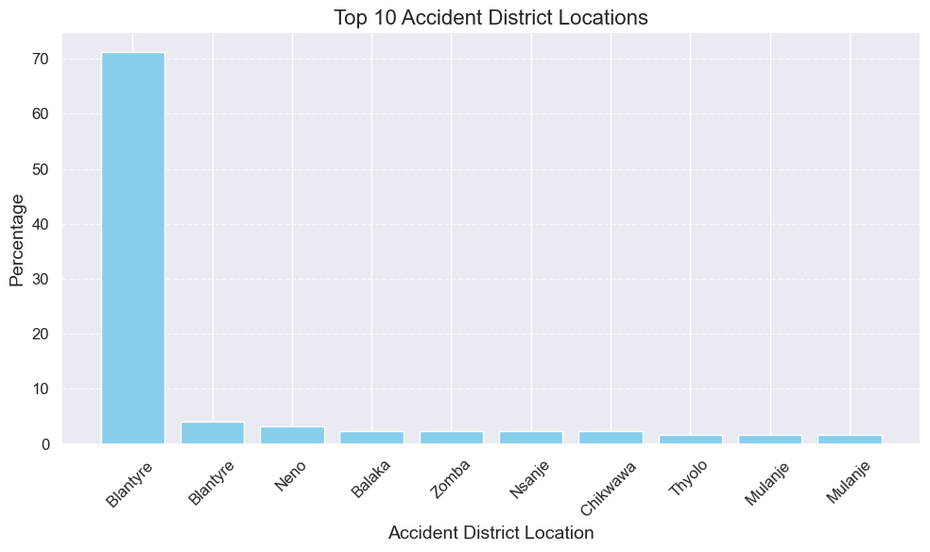

Slide 18
Licensed | Passenger: | Pedestrian: | operator | All Patients
no | 47 (100.0%) | 20 (95.2%) | 45 (78.9%) | 112 (89.6%)
yes | 0 (0.0%) | 1 (4.8%) | 12 (21.1%) | 13 (10.4%)

Slide 19
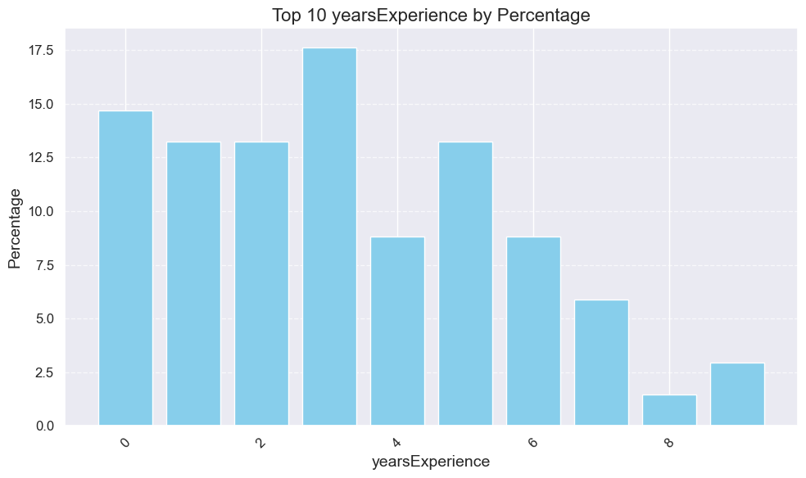

Slide 20
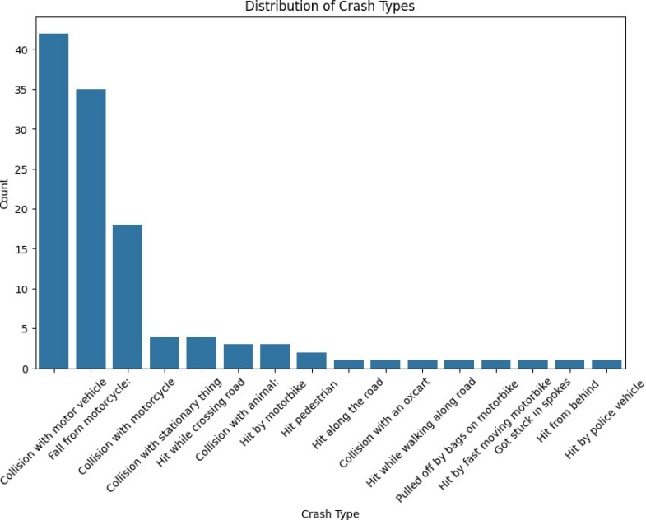

Slide 21
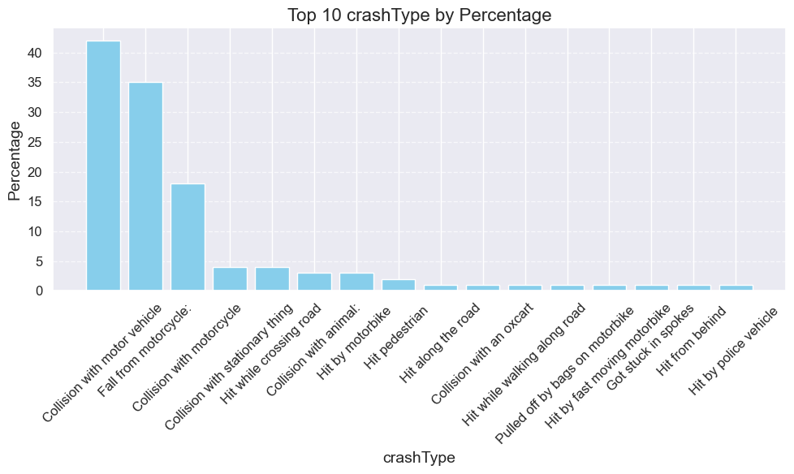

Slide 22
Age Group | ≤20 years | 21-30 years | 31-40 years | 41-50 years | >50 years
crashType
Collision with an oxcart | 0 | 0 | 1 | 0 | 0
Collision with animal: | 0 | 0 | 1 | 2 | 0
Collision with motor vehicle | 2 | 18 | 12 | 7 | 3
Collision with motorcycle | 2 | 4 | 8 | 2 | 2
Collision with stationary thing | 0 | 1 | 2 | 1 | 0
Fall from motorcycle: | 6 | 9 | 6 | 6 | 8
Got stuck in spokes | 0 | 1 | 0 | 0 | 0
Hit along the road | 0 | 0 | 0 | 0 | 1
Hit by fast moving motorbike | 0 | 1 | 0 | 0 | 0
Hit by motorbike | 0 | 0 | 0 | 1 | 2
Hit by police vehicle | 0 | 0 | 1 | 0 | 0
Hit from behind | 0 | 0 | 0 | 0 | 1
Hit pedestrian | 0 | 2 | 0 | 0 | 0
Hit while crossing road | 1 | 1 | 0 | 1 | 1
Hit while walking along road | 0 | 0 | 1 | 0 | 0
Pulled off by bags on motorbike | 0 | 0 | 0 | 1 | 0

Slide 23
Fracture? | Count | Percentage
No | 34 | 27.2%
Yes | 91 | 72.8%
Grand Total | 125 | 100%

Slide 24
Category | Count
Multiple | 52
Single | 58
Closed | 66
Open | 49

Slide 25
Gustilo Type | Count
Type 1 (or 1) | 4
Type 2 (or 2) | 18
Type 3A (or 3A, 3a) | 9
Type 3B (or 3B, 3b) | 3
G2 (assuming same as Type 2) | 1
Unspecified (just Open: but missing grade) | 14

Slide 26
Region | Count | Percentage
Lower-limb | 97 | 60.25%
Upper-Limb | 59 | 36.65%
Spine | 4 | 2.48%
Pelvis | 1 | 0.62%

Slide 27
Region | Bone | No. of fractures (%) | Overall No. of fractures (%)
Lower-limb | Femur | 18 (18.6%) | 97 (60.2%)
 | Fibula | 22 (22.7%)
 | Foot | 8 (8.2%)
 | Patella | 1 (1.0%)
 | Tibia | 48 (49.5%)
Pelvis | Pelvis | 1 (100.0%) | 1 (0.6%)
Spine | C-Spine | 4 (100.0%) | 4 (2.5%)
Upper-Limb | Hand | 5 (8.5%) | 59 (36.6%)
 | Humerus | 16 (27.1%)
 | Radius | 31 (52.5%)
 | Ulna | 7 (11.9%)

Slide 28
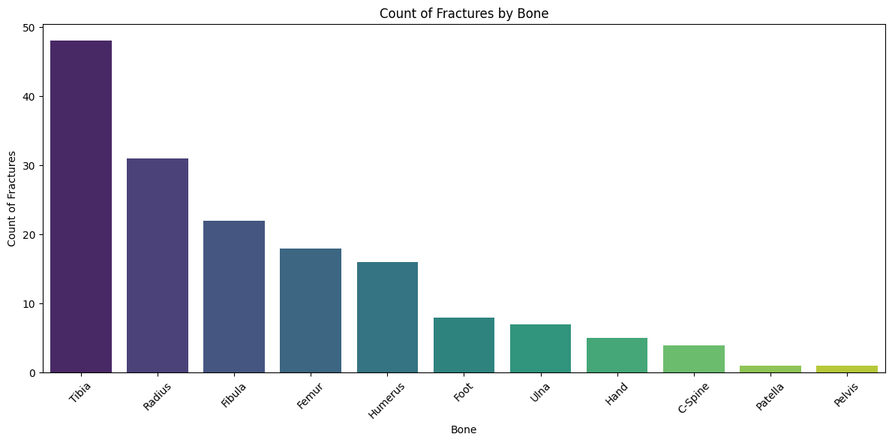

Slide 30
Region | Both | Left | Right | All Bones
Lower-limb | 4 (4.1%) | 39 (40.2%) | 54 (55.7%) | 97 (100.0%)
Pelvis | 1 (100.0%) | 0 (0.0%) | 0 (0.0%) | 1 (100.0%)
Spine | 3 (75.0%) | 0 (0.0%) | 1 (25.0%) | 4 (100.0%)
Upper-Limb | 7 (11.9%) | 32 (54.2%) | 20 (33.9%) | 59 (100.0%)

Slide 31
Region | Passenger: | Pedestrian: | Operator | All Bones
Lower-limb | 38 (39.2%) | 15 (15.5%) | 44 (45.4%) | 97 (100.0%)
Pelvis | 1 (100.0%) | 0 (0.0%) | 0 (0.0%) | 1 (100.0%)
Spine | 3 (75.0%) | 0 (0.0%) | 1 (25.0%) | 4 (100.0%)
Upper-Limb | 23 (39.0%) | 11 (18.6%) | 25 (42.4%) | 59 (100.0%)

Slide 32
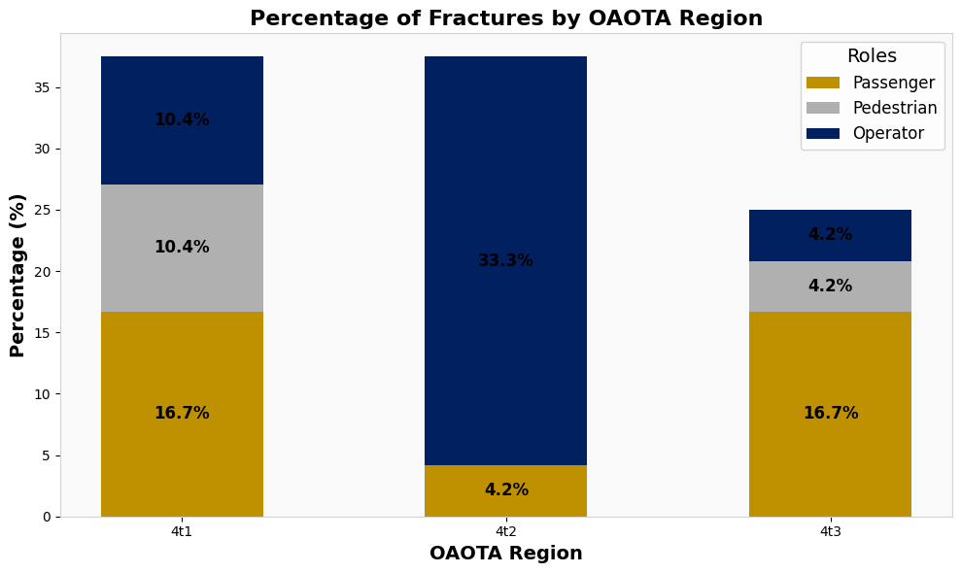

Slide 34
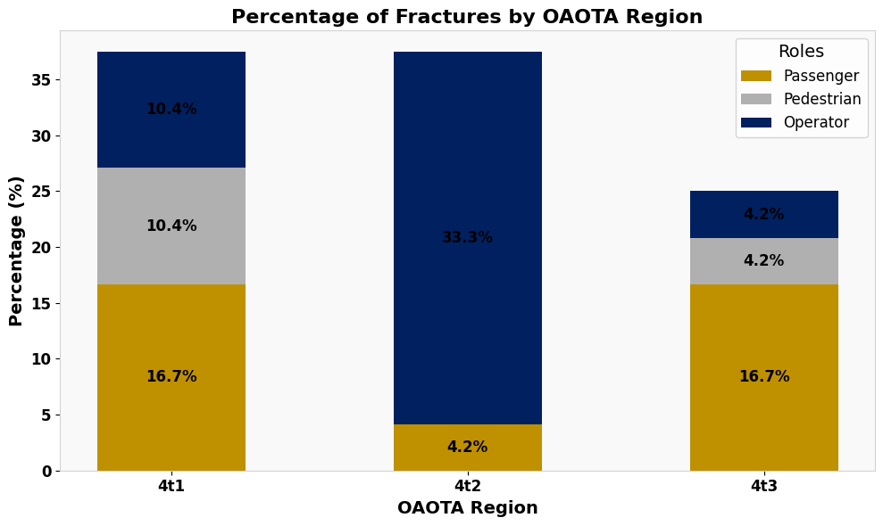
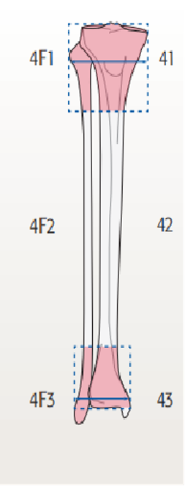
 |  | A | B | C | Patient Roles and number of fractures under AO/OTA
 | Proximal | 18 | 3 | 3
 | Diaphyseal | 34 | 3 | 3
 | Distal | 35 | 3 | 3

Slide 35
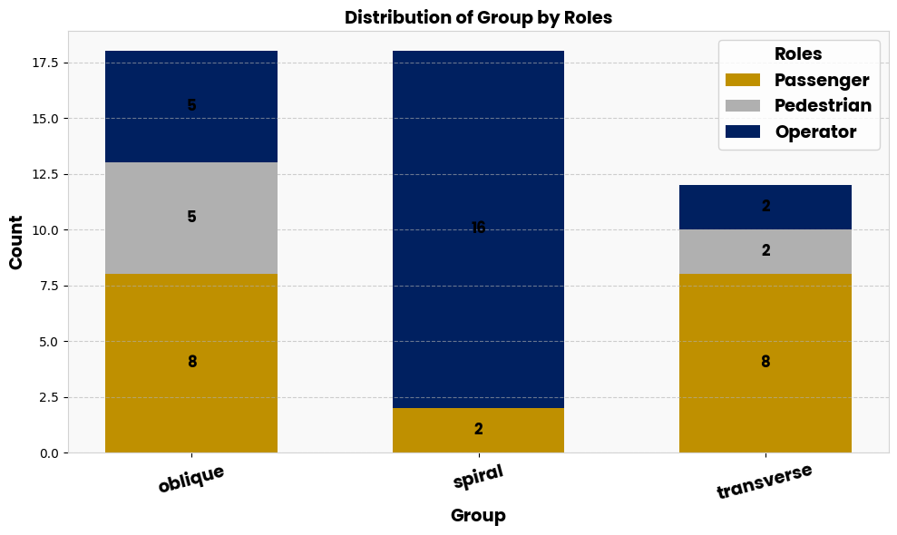
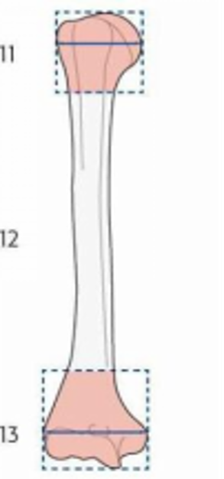
 |  | A | B | C | Patient Roles and number of fractures under AO/OTA
 | Proximal | 18 | 3 | 3
 | Diaphyseal | 34 | 3 | 3
 | Distal | 35 | 3 | 3

