Slide 1
SEMEVAL-2026 TASK 3 · TRACK A SUBTASK 3
LEADER-DimASQP
A Language-Specific System for Dimensional ASQP
Language-Specific Encoder and Data-Aware Ensemble Refinement
CORE MESSAGE
No universal recipe works best for every language: stable ensembling and validated encoder selection determine final performance.
Presenters: Hongzhen Qin · Yoshimi Suzuki · Fumiyo Fukumoto · Renjie Zhou
Hangzhou Dianzi University · University of Yamanashi

Slide 2
TALK ROADMAP
02
A question-driven story of the paper
01
02
03
04
05
What is the task?
Why is it hard?
How does it work?
What is the evidence?
What remains?
Structure extraction + continuous affect regression
Exact matching, data imbalance, regression shrinkage
Rethink, set matching, per-language recipes
Baselines, per-dataset results, and ablations
Negative results, errors, and limitations
Narrative: start from task constraints, motivate each design choice, and then test it with evidence.
LEADER-DimASQP · paper presentation

Slide 3
TASK & METRIC
03
DimASQP: structure must match before affect distance counts
Illustrative input
Two gates in cF1
“The food was excellent, but the service was cold.”
Gate 1 · categorical exact match
Gate 2 · V–A distance discount
Aspect + Category + Opinion must match
Output set: each item is (a, c, o, (V, A))
Quad 1
Quad 2
a: food
c: FOOD#QUALITY
o: excellent · V–A: 8.2, 6.4
a: service
c: SERVICE#GENERAL
o: cold · V–A: 2.8, 4.1
After Gate 1, credit is discounted by V–A distance
cTP = 1 − distance / Dmax
Therefore, a span or category error loses the match; V–A error reduces credit continuously.
Metric definition: paper §3 · example values are illustrative

Slide 4
DATA & CHALLENGES
04
Eight language–domain datasets differ in size and bottlenecks
Training sentences
Challenge 1 · exact structural matching
Zho-R
6,050
A 1–2 token shift in an Aspect or Opinion span can invalidate the categorical match.
Eng-L
4,076
Zho-L
3,490
Challenge 2 · low-resource variation
Eng-R
2,284
Training size ranges from 1,240 to 6,050; tokenization, morphology, and label distributions differ.
Jpn-H
1,600
Rus-R
1,240
Challenge 3 · V–A centralization
Tat-R
1,240
Point regression tends to shrink toward neutral values, weakening separation at the extremes.
Ukr-R
1,240
Largest / smallest ≈ 4.9×
Dataset sizes: paper Table 1

Slide 5
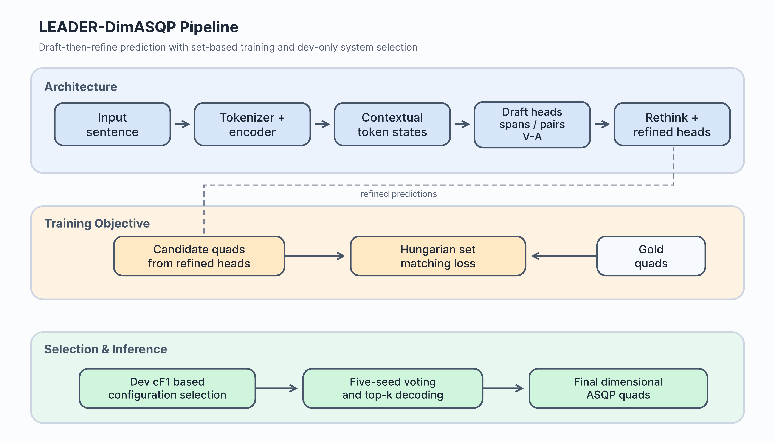
SYSTEM OVERVIEW
05
LEADER-DimASQP = stable base + per-dataset selection
A. Architecture base
Draft predictions → feed structural/V–A cues into token states → refine; train quad sets with Hungarian matching.
B. Data and transfer
Keep BT, paraphrasing, COMET filtering, and warm starts only where dev results support them.
C. Selection & inference
Select encoders and thresholds by dev cF1; use five-seed voting and top-k decoding for stability.
Architecture figure: paper Figure 1

Slide 6
ARCHITECTURE
06
Two structural designs: Rethink feedback and set-level matching
1 · Lightweight Rethink
2 · Hungarian set matching
Token states
Draft heads
Cues
Refined heads
Pred set
Gold
set
Cost = class + span + Huber(V–A)
● Embed draft BIO, category, pair, and V–A predictions
● Fuse them with token states, then refine with a second-stage head
● Find the optimal one-to-one assignment at set level
● Reduce instability from candidate order and duplicate pairings
Training stabilizers: FGM ε=0.1 · EMA 0.999 · top-3 checkpoints
Method details: paper §4.1–4.3

Slide 7
PER-DATASET SELECTION
07
The final system is eight validated configurations—not one model
Eng-R
DeBERTa-v3-large
Eng-L
BT dual-layer ensemble
0.6949
0.3304
Strong extraction base
Retain validated best
Jpn-H
Japanese DeBERTa
Rus-R
XLM-R-large
0.4500
0.5267
MeCab trimming; no para
Better than ruRoberta
Tat-R
XLM-R-large
Ukr-R
mDeBERTa-base
0.4821
0.5068
No paraphrase retained
BT + paraphrase
Zho-R
validated source model
Zho-L
Chinese RoBERTa-large
0.5669
0.4487
Five-seed ensemble
top-k = 0.10
Principle: language-specific ≠ automatically better; validate every choice by dev cF1.
Best validated per-dataset configuration · hidden-test labels not used

Slide 8
DATA-AWARE AUGMENTATION
08
Augmentation quality interacts with model capacity
Japanese paraphrase + COMET (mDeBERTa stage)
sweet spot
Finding 1 · inverted-U effect
0.3565
At this stage, 0.96 is optimal; raising the threshold to 0.965 removes too much data and causes underfitting.
0.3523
0.3418
Finding 2 · model-specific recipes
With Japanese DeBERTa and five-seed voting, no paraphrase is better: 0.4500 vs 0.4466.
0.3317
Finding 3 · validate transfer
0.92
0.95
0.96
0.965
Cross-lingual warm starts help early low-resource settings; the final Russian/Tatar systems use XLM-R-large, while Ukrainian keeps BT + paraphrase.
COMET threshold
COMET ablation: paper §6.4 · final Japanese recipe uses no paraphrase

Slide 9
MAIN RESULTS
09
Mean dev cF1 = 0.5008, well above the official baselines
LEADER-DimASQP
0.5008
+11.46
Shared-task average
0.4056
pp vs Llama
Llama-3.3 70B
0.3862
+9.52
GPT-OSS 120B
0.3727
pp vs task avg.
Kimi K2 0-shot
0.2542
0.2254
8 / 8
GPT-5 mini 0-shot
beats official
best baseline
Development-set comparison · official baselines from DimABSA paper

Slide 10
PER-DATASET EVIDENCE
10
Gains are uneven: three reported tops, but four remaining gaps
Eng-R
0.6949
strong
What the paper can claim
Eng-L
0.3304
below reported best
• Beats all official dev baselines
• +11.46 pp vs Llama mean
• Reported tops: Jpn / Tat / Zho-R
Jpn-H
0.4500
reported top ↑
Rus-R
0.5267
below reported best
Tat-R
0.4821
reported top ↑
Unsupported claims
Ukr-R
0.5068
below reported best
• ‘Best on every dataset’
• ‘Absolute dominance’
• Hidden-test rank from dev scores
Zho-R
0.5669
reported top ↑
Zho-L
0.4487
below reported best
Keep official baselines, reported systems, and hidden-test results distinct.
External scores are reference comparisons, not hidden-test claims

Slide 11
ABLATION STUDIES
11
Ensembling is the most robust final gain; other effects depend on scale
5-seed ensemble
Rethink
Native encoder
+4.76 pp
+11.29
Japanese
+5.04
versus the five-seed single-model mean
pp · early base
Chinese-L
+5.83
● Improves all eight datasets
● Per-dataset gain: +1.43 to +7.74 pp
● Boundary voting + V–A averaging reduce variance
+0.36
Russian
−1.15
pp · large + ensemble
The gain shrinks with stronger encoders and ensembles
Conclusion: language-specific ≠ automatically better
The paper should emphasize validation-driven selection—not present every component as a universal gain.
Ablations: paper §6.1–6.3

Slide 12
NEGATIVE RESULTS & ERROR ANALYSIS
12
What do failed experiments teach us, and what bottlenecks remain?
What did not work
Four remaining error types
CRF
0.6278 → 0.6249
Extra transition parameters may overfit
Span boundaries
Category confusion
Japanese and laptop spans often over-expand
Large entity–attribute inventories cause confusion
COMET filter
0.3565 → 0.3418
A high threshold removes useful data
Low-resource false negatives
V–A shrinkage
X-encoder fusion
0.3962 → 0.3721
Inconsistent candidates introduce noise
Russian, Tatar, and Ukrainian still miss quads
Extreme affect values regress toward the center
Weighted vote
0.5008 → 0.4901
Confidence is not a reliable quality proxy
Limitations: the final system is a dataset-specific mixture; comparisons remain dev-based; augmentation relies on near-exact span alignment.
Negative results, error analysis and limitations: paper §7–§8

Slide 13
CONCLUSION
LEADER-DimASQP in three takeaways
01
02
03
Stabilize structure first
Then select by language
Finally, reduce variance
Rethink + Hungarian matching provide a reliable extraction and regression base.
Tokenization, pretraining, augmentation, and thresholds require per-dataset validation.
Five-seed ensembling adds +4.76 pp on average—the most robust final gain.
0.5008 mean dev cF1 · +11.46 pp vs Llama-3.3 70B · reported top on Jpn / Tat / Zho-R
Thank you · Questions?

Slide 14
BACKUP
14
Key references
[1] Lee et al. (2026). DimABSA: Building multilingual and multidomain datasets for dimensional ABSA. arXiv:2601.23022.
[2] Yu et al. (2026). SemEval-2026 Task 3: Dimensional aspect-based sentiment analysis. arXiv:2604.07066.
[3] Carion et al. (2020). End-to-end object detection with transformers. ECCV.
[4] He et al. (2023). DeBERTaV3. ICLR.
[5] Kuhn (1955). The Hungarian method for the assignment problem.
[6] Sennrich et al. (2016). Improving NMT with monolingual data. ACL.
[7] Rei et al. (2022). COMET-22 / COMETKiwi. WMT.
See paper_iconip_current.tex for the full method, ablations, error analysis, and limitations.
LEADER-DimASQP · paper presentation

