Slide 1

Microsoft Stock Price Prediction https://github.com/magnusaghe/ANA500
Magnus Aghe
20 August 2023

Slide 2

Problem Statement
A common feature of the stock market is its volatility and dynamism. For an individual stock, volatility represents the measure of the frequency and magnitude of movements in its price. These fluctuations are often used by investors to gauge risk and to help in the prediction of future price movements.
In this project, a Microsoft stock price dataset (from April 1, 2015, to March 31, 2021) is analyzed to interrogate which features have the largest effect on its price. Additionally, machine learning models will be used to predict Microsoft stock price movement.

Slide 3

Objectives
To know the features that have the greatest effect on the Microsoft stock price.
To decompose the stock price as a time series data in terms of trend, seasonality, and residuals.
To measure the volatility in terms of percentage change of daily returns in the price.
To use deep learning regression methods like recurrent neural networks (RNN) implemented with Long Short Term Memory (LSTM) building blocks for forecasting the stock price.
To use autocorrelation and ARIMA models.

Slide 4
Hypothesis Formulation
Null Hypothesis (H₀):
Alternative Hypothesis (H₁):
There is no significant association between the closing price of the stock (close) and the attributes:- opening price (open), highest daily price (high), lowest daily price (low), and number of daily traded shares (volume).
There is significant association between the closing price of the stock (close) and the attributes:- opening price (open), highest daily price (high), lowest daily price (low), and number of daily traded shares (volume).

Slide 5

Top-Down Program Design
The overall task is to develop a Python program that takes a Microsoft stock price dataset and outputs a predicted closing price.
The program will be implemented using Jupyter notebook and will use libraries such as NumPy, Pandas, matplotlib, seaborn, scikit-learn, and other packages.
The steps that will be taken to perform the task (Data Science Process) are:
Acquire – Identify and load the dataset
Prepare – Explore and pre-process the data
Analyze – Select analytical techniques, and build models
Report – Communicate results
Act – Apply results, connect results with the chosen business question and objective(s).

Slide 6
Hierarchy Chart
[closing_price] = Microsoft_Stock_dataset(Open, High, Low, Volume)
Main Program:
Output: Close
Input: Microsoft_Stock Dataset

Slide 7
Flow Chart
Start
Load Data
Preliminary Analysis
Identify the dataset’s features, size, and descriptive statistics
Visualize the Data
Plot each feature against the desired output variable (Close) to understand the nature of the data
Clean the Data
Handle any missing data
Select Analytical Technique
Multiple Linear Regression
Trend Analysis
RNN with LSTM
ARIMA Model
Select Estimators
Import LinearRegression from Scikit-learn
Import ARIMA, seasonal_decompose from statsmodels
Import LSTM from tensorflow
Improve Model Performance
Standardize dataset
Split Data for Training & Testing
Split dataset into two
Train the Estimator
Train using training data
Test the Estimator
Predict using test data
Assess Model’s Performance
Visualize expected vs predicted closing price
Prediction accuracy metrics:r2, mean_squared_error
OLS, Regression summary
Communicate Results
Apply Results
Color code changes progressively from Step 1 to Step 5.
Step 1 – Acquire
Step 2 – Prepare
Step 3 – Analyze
Step 4 – Report
Step 5 - Act

Slide 8

Acquire
The dataset used in this study was acquired through Kaggle.com, the world’s largest online community of data scientists and machine learning practitioners, owned by Google. Here, people can participate in data science competitions, post projects, and acquire open-source datasets. The dataset contains Microsoft stock price over a six-year period from April 1, 2015, to March 31, 2021.
Data source: https://www.kaggle.com/datasets/vijayvvenkitesh/microsoft-stock-time-series-analysis

Slide 9
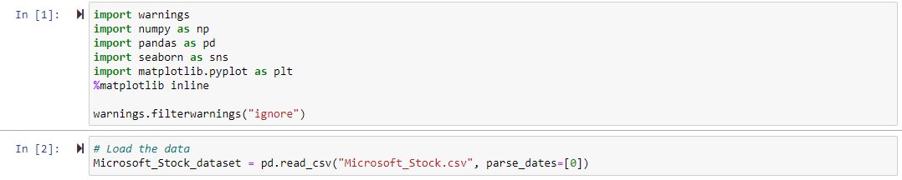
Acquire, cont.
Import NumPy, pandas.
# Load the data
Microsoft_Stock_dataset = pd.read_csv("Microsoft_Stock.csv", parse_dates=[0])

Slide 10
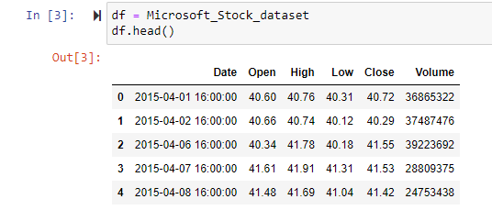
Prepare
‘df.head()’ function outputs the column headers and the first five rows of the dataset.

Slide 11
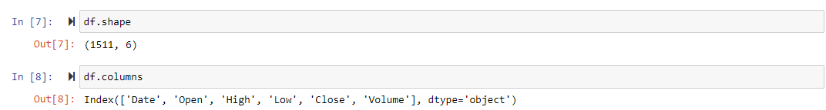
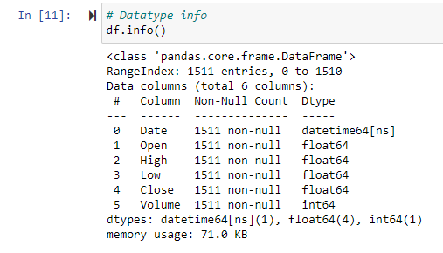
Prepare, cont.
Shape & Features: The dataset has 1511 rows and 6 features/attributes.
Datatype:

Slide 12
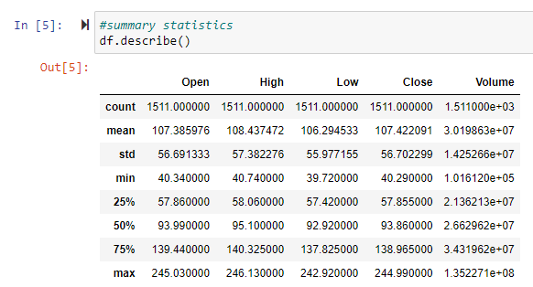
Prepare, cont.
Summary Statistics:

Slide 13
End of Micro-Project 1

Slide 14
Start of Micro-Project 2

Slide 15
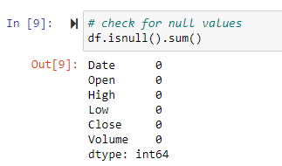
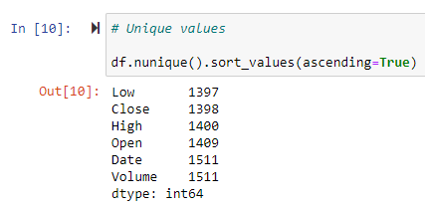
Prepare, cont.
Checking for missing values.
There are no missing values in the dataset.
Checking for unique values.
The values in every variable are very diverse.

Slide 16
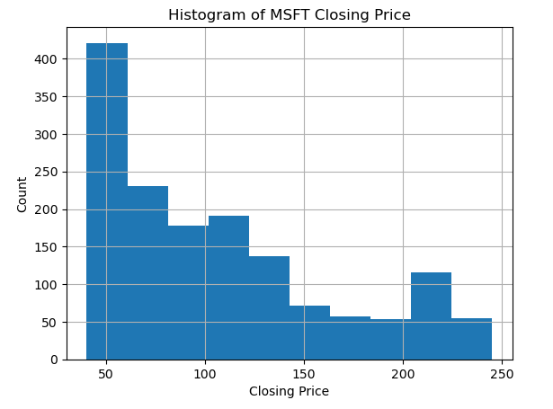
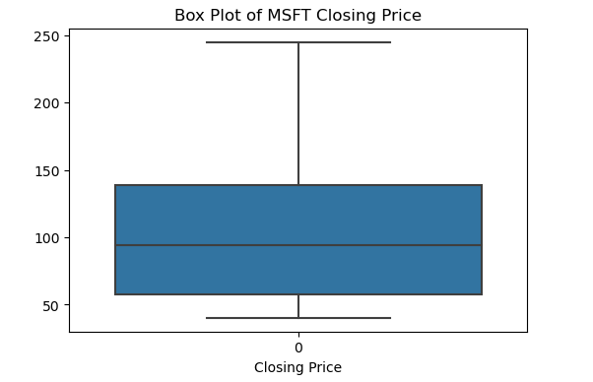
Analyze
Exploratory Data Analysis – Visualizing the Data
Box plot to visualize the distribution of closing price
The stock price closed at about 50 dollars more than 400 times, almost double the nearest closing price.

Slide 17
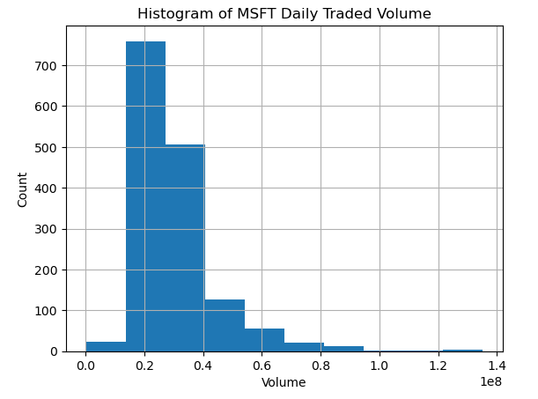
Analyze, cont.
Distribution of Daily Traded Volume of MSFT Stock
The mean daily traded volume was 30.198 million shares.
Minimum was 101,612 shares while maximum daily traded volume was 135.227 million shares.

Slide 18
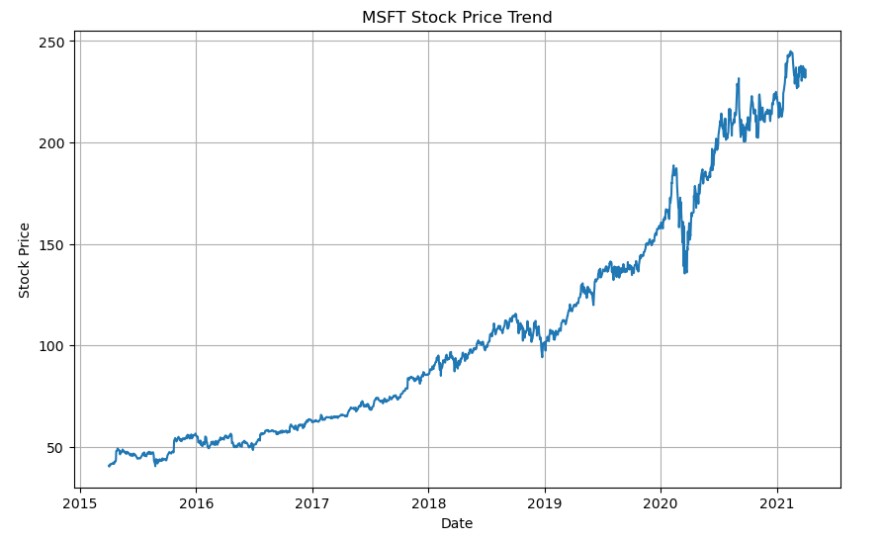
Analyze, cont.
Time Series Plot of MSFT Closing Price
We see an overall upward trend of MSFT stock price in the period under review (2015 - 2021).

Slide 19
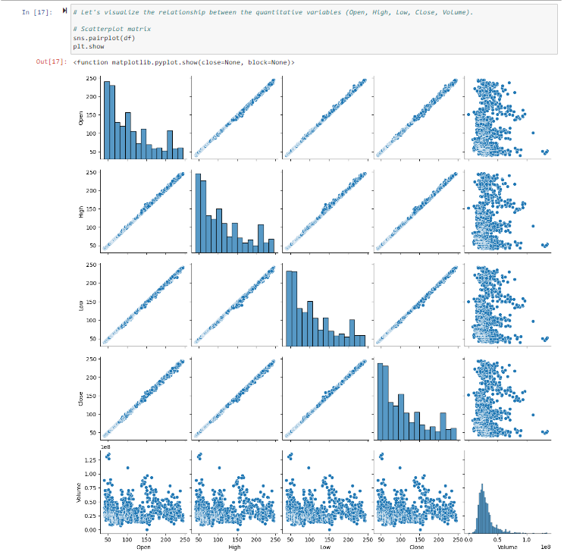
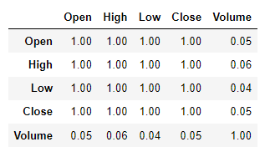
Analyze, cont.
Scatterplot & Correlation Matrix

Slide 20
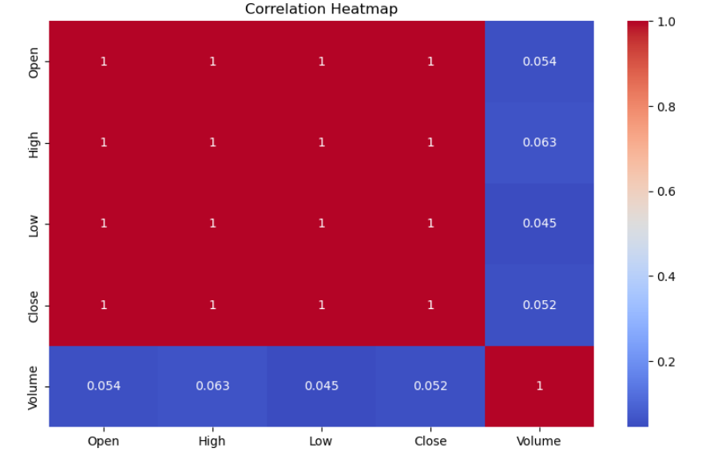
Analyze, cont.
Correlation Heatmap
There is a perfect correlation between the opening, high, low, and closing prices of MSFT.
Between these prices and the volume traded, the correlation is much smaller.
The correlation between trading volume and closing stock price movements is 0.052 = 5.2%

Slide 21
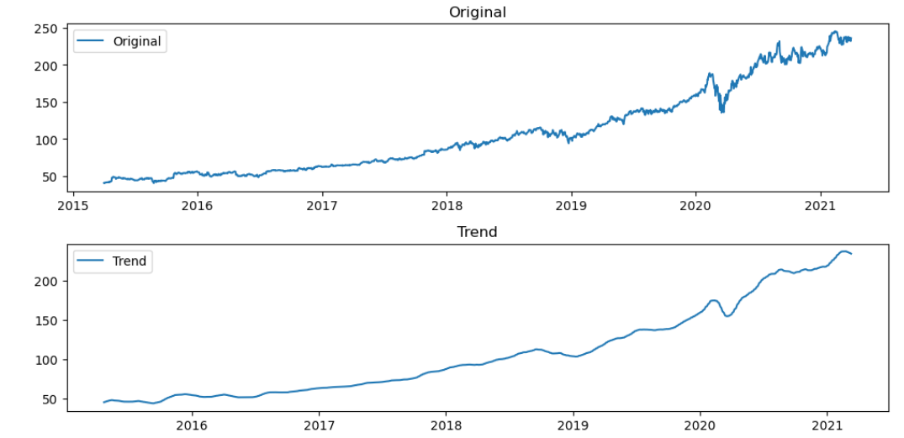
Analyze, cont.
Seasonal Decomposition of the Time Series - Trend

Slide 22
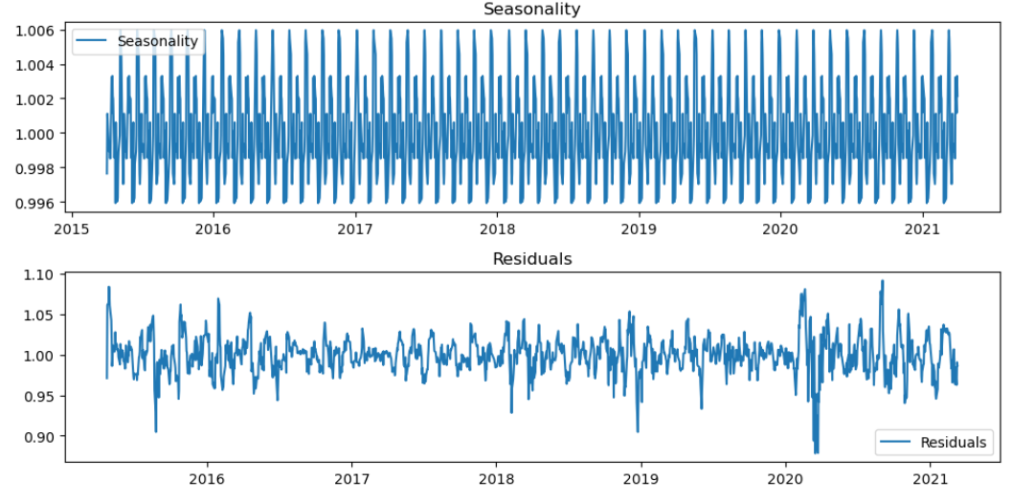
Analyze, cont.
Seasonal Decomposition of the Time Series – Seasonality and Residuals

Slide 23
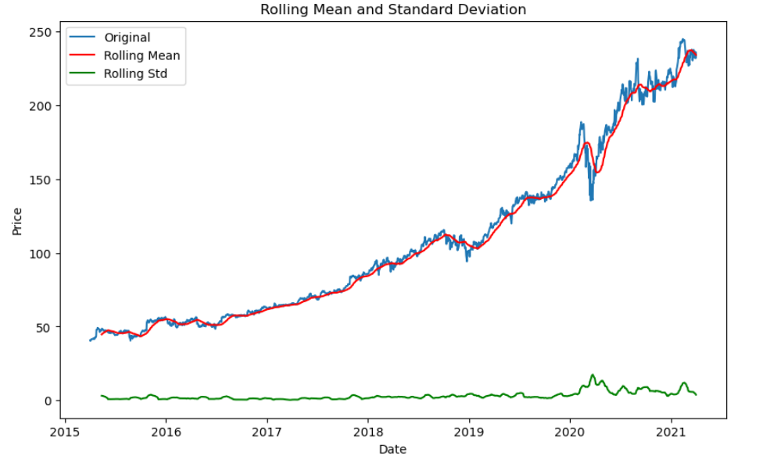
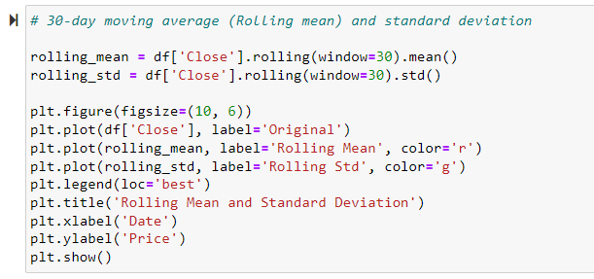
Analyze, cont.
Plotting the 30-day moving average (Rolling Mean) for MSFT

Slide 24
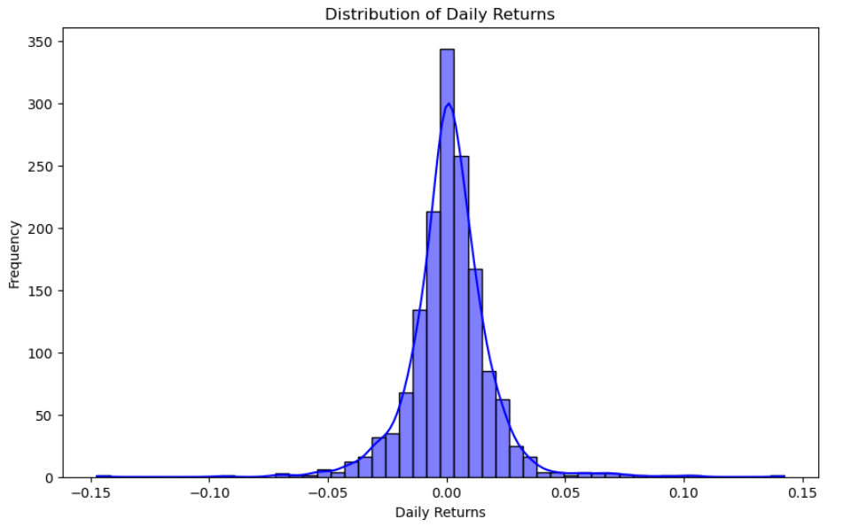

Analyze, cont.
Average Daily Return and Volatility (Standard Deviation)
The average daily return of MSFT stock price is 0.132%.
The volatility of daily returns is at 1.75%.

Slide 25
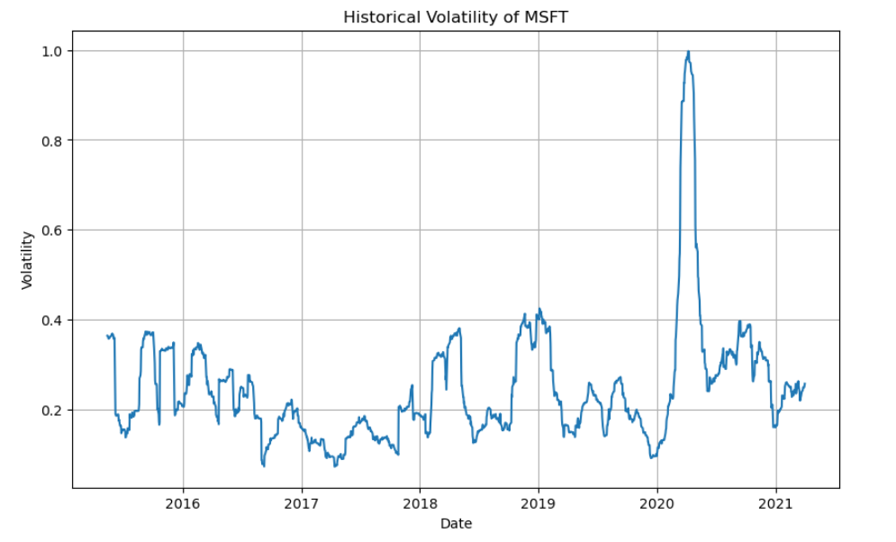
Analyze, cont.
Historical Volatility of MSFT
2020/2021 witnessed unusual volatility compared to other years.

Slide 26

Report
The year 2020/2021 witnessed undue volatility in the closing price of MSFT compared to other years under review.
With an average daily return of 0.132%, and average volatility of 1.75%, it is easier to predict how much MSFT stocks can swing.
There is an overall yearly upward trajectory of MSFT stock price in the year under review (2015 – 2021).
The closing stock price is perfectly correlated with opening price, high and low daily prices.

Slide 27
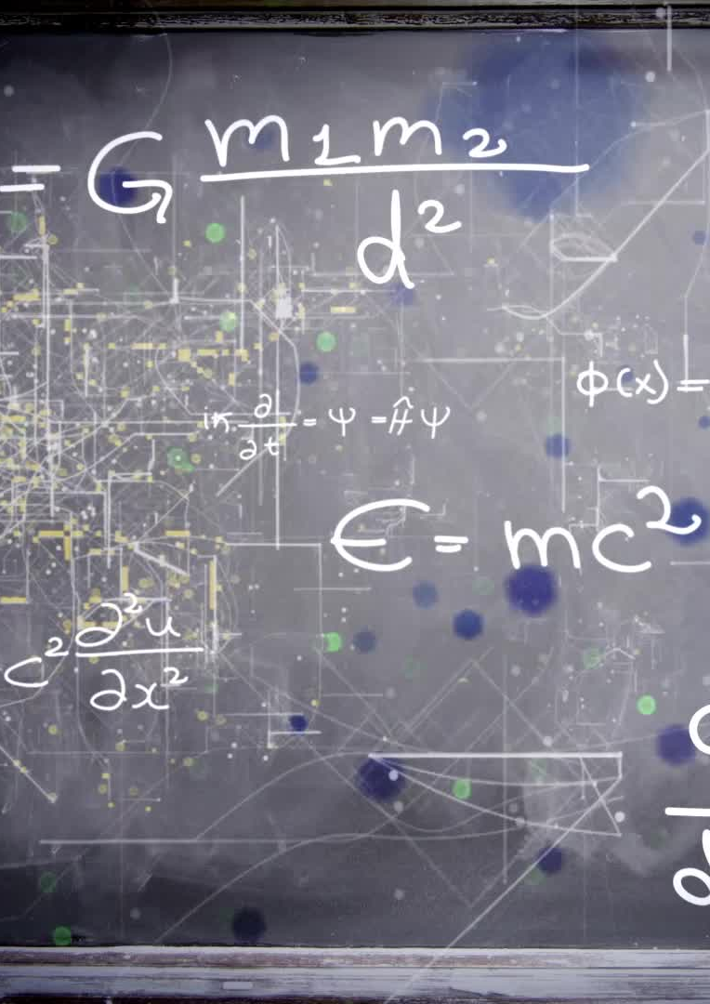
Report, cont.
Multiple linear regression would not be suitable for predicting the closing MSFT price, due to high collinearity with the predictor variables.
Other machine learning models (such as RNNs, LSTM, Autocorrelation and ARIMA) will be explored next for predictive modeling.

Slide 28
End of Micro-Project 2

Slide 29
Start of Micro-Project 3

Slide 30

Micro-Project 3 Objectives
To use Moving Average to predict the closing price of Microsoft stock.
To use Linear Regression to predict the closing price of Microsoft stock using one predictor variable in the time series (Date).
To use another machine learning regression technique - Autoregressive Integrated Moving Average (ARIMA) to predict the closing price of Microsoft stock.

Slide 31
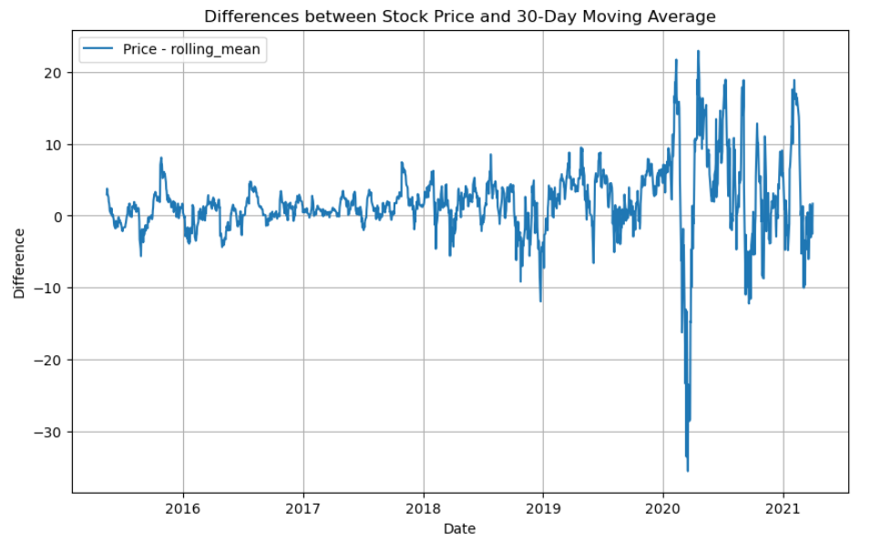
Analyze
This reveals the difference between the daily closing price of Microsoft stock and the 30-day moving average from 2015 to 2021. The biggest differences occurred in 2020.

Slide 32
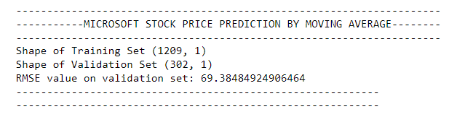
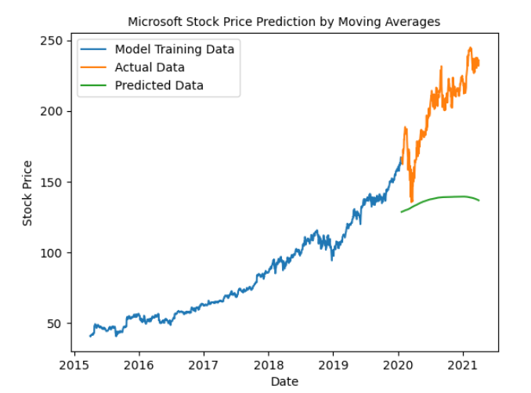
Analyze, cont.
Moving Average Predictive Model
With the moving average predictive model, the RMSE value is 69.38. As seen from the plot, the predicted data is away from the actual data.
Training and Validation data is split in the ratio 80:20.

Slide 33
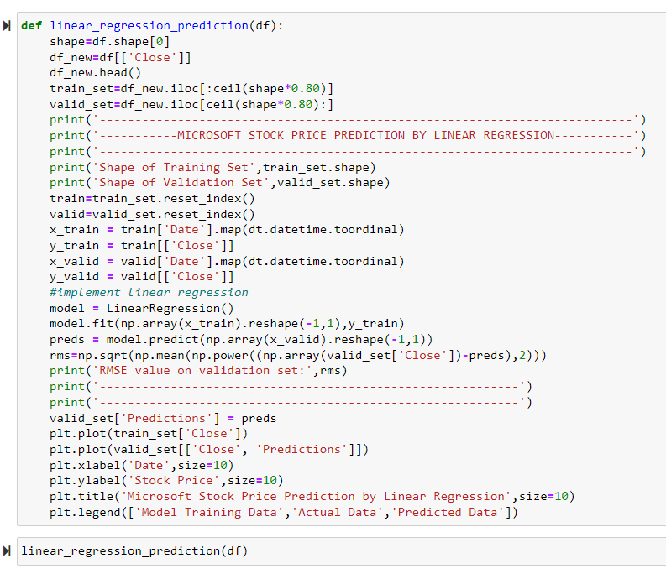
Analyze, cont.
Linear Regression Predictive Model
Target variable = Close
Predictor variable = Date
Training and Validation data is split in the ratio 80:20.

Slide 34
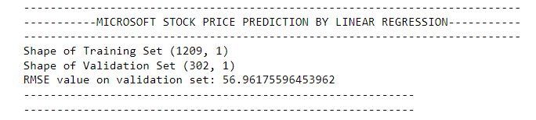
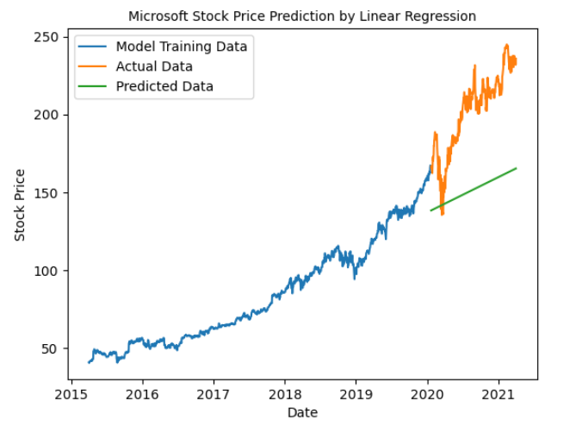
Analyze, cont.
Linear Regression Predictive Model
With linear regression, the RMSE value is 56.96.
This is better than the moving average prediction in terms of accuracy and as seen from the plot, the predicted data is a bit closer to the actual data.

Slide 35
Analyze, cont.
ARIMA Predictive Model
ARIMA is a popular method for time series forecasting. The models use past values to predict future values, and has three important parameters namely, p (past values used to forecast the next value), q (past forecast errors used to predict future values), and d (order of differencing).
Analyzing autocorrelation and partial autocorrelation plots to determine p, d, and q.

Slide 36
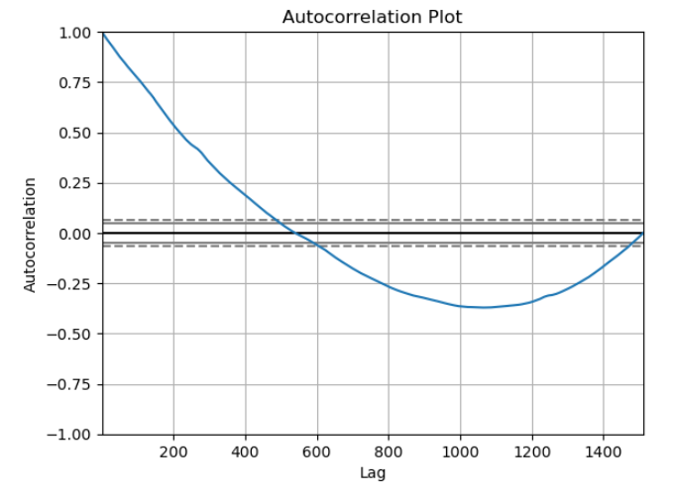
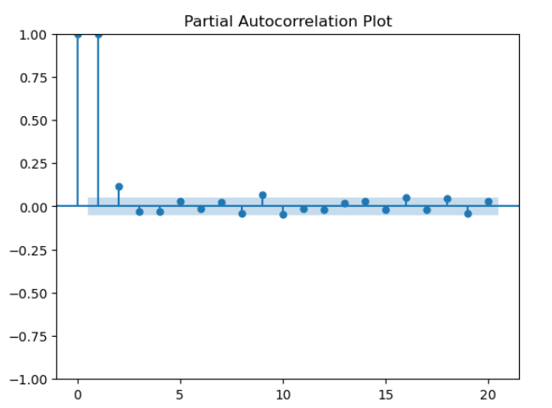
Analyze, cont.
Autocorrelation
This is the correlation between values of a time series in neighborhood periods. It describes a relationship between the series and itself.

Slide 37
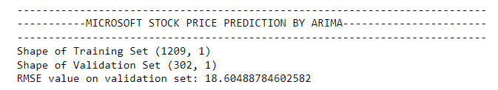
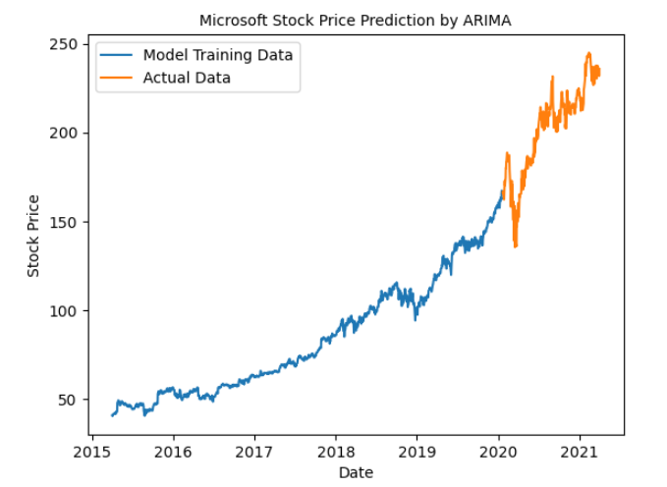
Analyze, cont.
ARIMA Predictive Model
With ARIMA, for an arbitrary (p, d, q) order of (1, 2, 3), the RMSE value is 18.60.
This is much better than both linear regression models and the moving average predictive model.
Training and Validation data is split in the ratio 80:20.

Slide 38
Analyze, cont.
ARIMA Predictive Model
However, we can find the best ARIMA model, based on the order of p,d, q.
The best ARIMA model has an RMSE of 17.09.
The p,d,q order is (5, 2, 1)
This is a better model than the ones we have explored so far.

Slide 39
Report
Of the three machine learning techniques that we used to develop models to predict the price of Microsoft stock, ARIMA model was the best as it had the lowest root mean square error (RMSE) value of 17.09.
This makes it suitable to use for prediction compared to Moving Average or Linear Regression.
However, in the next micro-project, we shall explore Long Short Term Memory (LSTM) method of recurrent neural networks to see if predictive accuracy can be improved upon.

Slide 40

Act
Our first objective was to know the features which had the greatest effect on the closing Microsoft stock price. The closing stock price was perfectly correlated with opening price, high and low daily prices (value = 1), and so all three had equal effect on the closing price.
We therefore reject the null hypothesis (H₀) of no significant association between the closing price of Microsoft stock and the attributes, open, high, low, and volume.
We decomposed the Microsoft stock price in terms of trend, seasonality and residuals and plotted the series.
We measured volatility in terms of percentage change of daily returns in the price. The average daily return was 0.132% and volatility of daily returns was 1.75%.
2020/2021 witnessed unusual volatility compared to the other years in the series.
Our best model thus far, is the ARIMA model for predicting the price of Microsoft stock. It had the least RMSE (17.09) and would be deployed for future forecast, unless there is a better model. We shall explore the LSTM model to see if it would give us better prediction.

Slide 41
End of Micro-Project 3

Slide 42
Start of Micro-Project 4

Slide 43
Objective
To use deep learning regression methods like recurrent neural networks (RNN) implemented with Long Short-Term Memory (LSTM) building blocks for forecasting the stock price.

Slide 44
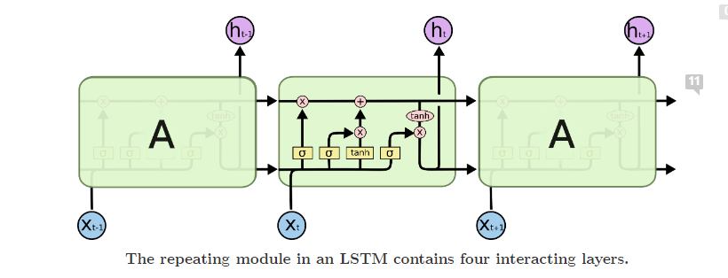
Analyze
Long Short-Term Memory (LSTM)
LSTM is a popular recurrent neural network (RNN) infrastructure which addresses the vanishing gradient problem of RNNs.
It has cells which has three (3) gates namely, the input gate, the output gate, and the forget gate.
These gates control the flow of information which is needed to predict the output in the network.

Slide 45
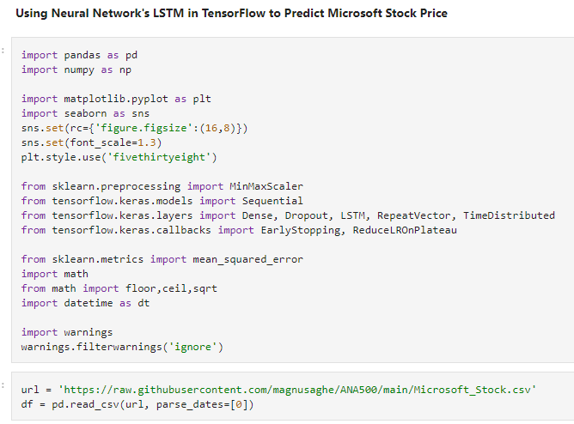
Analyze, cont.
Long Short-Term Memory (LSTM)
The input gate adds information to the cell state.
The forget gate removes the information that is no longer required by the model.
The output gate selects the information to be shown as output.
Implementing LSTM as a black-box:-

Slide 46
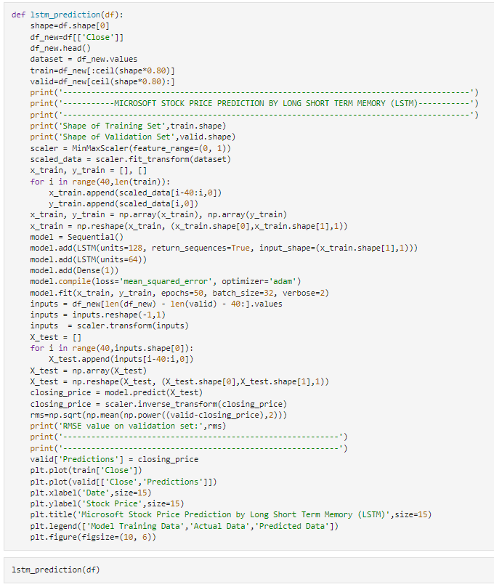
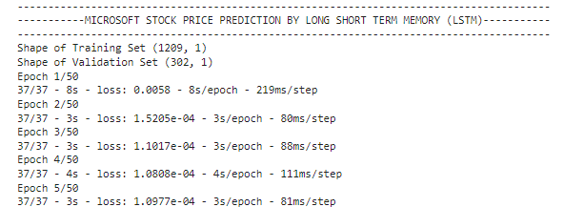
Analyze, cont.
Long Short-Term Memory (LSTM)
The model is trained with 50 epochs and batch size of 32.
Training and Validation data is split in the ratio 80:20.

Slide 47
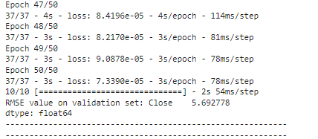
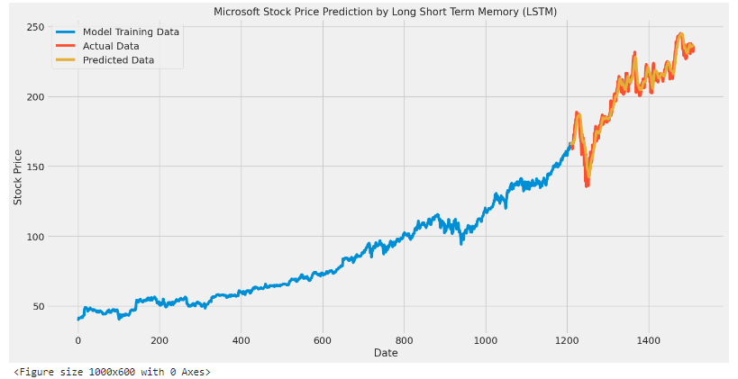
Analyze, cont.
Long Short-Term Memory (LSTM)
With LSTM, the RMSE value is 5.69
This is so far the best model!
We can see the predicted data (in orange) fitting well on the actual data (in red).

Slide 48
Report
Of all predictive machine learning techniques that we used to develop models to predict the price of Microsoft stock, LSTM is the best model as it has the least root mean square error (RMSE) value of 5.69.
The next best was ARIMA model with an optimal RMSE of 17.09.
Linear regression had an RMSE of 56.96; and…
Moving Average had the least RMSE of 69.38.

Slide 49
Act
Our first objective was to know the features which had the greatest effect on the closing Microsoft stock price. The closing stock price was perfectly correlated with opening price, high and low daily prices (value = 1), and so all three had equal effect on the closing price.
We therefore reject the null hypothesis (H₀) of no significant association between the closing price of Microsoft stock and the attributes, open, high, low, and volume.
We decomposed the Microsoft stock price in terms of trend, seasonality and residuals and plotted the series.
We measured volatility in terms of percentage change of daily returns in the price. The average daily return was 0.132% and volatility of daily returns was 1.75%.
2020/2021 witnessed unusual volatility compared to the other years in the series.
Our overall best model is the LSTM model for predicting the price of Microsoft stock. It had the least RMSE (5.69) and would be deployed.
It is important to note that other external factors such as media reports of Microsoft’s performance, and general news on the economy can add to speculative effects which can also contribute to the volatility of the stock.

Slide 50
THANK YOU!

