Slide 1
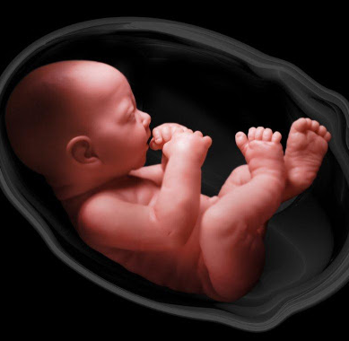
Fetal Health Classification
BY Magnus Aghe
ANA680 FINAL PROJECT

Slide 2
Problem Statement
The well-being and development of an unborn child during pregnancy remains very important, as it plays a significant role in determining the child’s future and overall health outcomes.
More than just fetal mortality which refers to the intrauterine death of a fetus that is not an induced termination of pregnancy, the overall health of a fetus needs to have the right development foundation in order to lead to successful birth and long-term health outcomes.
In 2022, the United States recorded 20,091 fetal deaths, representing a fetal mortality rate of 5.45 per 1,000 live births at 20 weeks of gestation or more (National Center for Health Statistics, 2022). This was a 5% improvement over 2021 figures (5.73 deaths per 1,000 live births).
However, amongst the 38 high-income countries – members of the Organization for Economic Cooperation Development (OECD), the US had the highest rate of infant and maternal deaths (5.4 deaths per 1,000 live births versus the OECD average of 4.1). In contrast, there were 1.6 deaths per 1,000 live births in Norway (OECD Health Statistics, 2022).
This implies a lot can still be done to improve fetal health and infant well being in the United States, and globally (especially in developing countries).

Slide 3

The Fetal Health Classification Dataset
In addition to clinical judgment and other diagnostic measures, cardiotocograms (CTGs) are used in obstetrics to monitor the well-being of the fetus during pregnancy and labor, by providing valuable information about the fetal heart rate patterns, fetal movement, uterine contractions and other metrics.
The aim of this project is to develop and deploy a machine learning model that will help healthcare practitioners classify the health of a fetus.
The dataset used can be found on Kaggle at https://www.kaggle.com/datasets/andrewmvd/fetal-health-classification/data.
It contains 2126 records of features extracted from cardiotocogram exams, which were classified by three expert obstetricians into three classes:- ‘normal’, ‘suspect’, or ‘pathological’.

Slide 4
Advantages of Deploying a ML Model for Classifying Fetal Health
Developing and deploying a machine learning model for classifying fetal health into either ‘normal’, ‘suspect’ or ‘pathological’ will help health practitioners in some of the following ways:-
1. Automation and Efficiency
2. Adaptability and Flexibility (to changing data, and model selection)
3. Speed and Real-time processing (Real-time decision-making)
4. Consistency (Consistent decision-making)
5. Predictive analytics (Future prediction)
6. Cost-effectiveness and improved accessibility
7. Objectivity (Reduced bias)
8. Pattern recognition (Identifying complex patterns)

Slide 5
Feature Selection
To select our final predictor variables out of 21 possible ones, Variance Inflation Factor selection technique was used to remove high multicollinearity features.
A correlation analysis was then carried out to select the five most correlated features with fetal health.
Our predictor variables are
1. prolongued_decelerations
2. percentage_of_time_with_abnormal_long_term_variability
3. accelerations
4. histogram_variance
5. uterine_contractions.
Our target feature is fetal_health

Slide 6
Building the Classification Models
Data was split into 75% for training and 25% for testing.
Eight (8) classification models were built. Random Forest model had the highest accuracy of 87.78% and was therefore selected as our model.
Model | Accuracy
Random Forest | 87.78%
XGBoost | 86.47%
Decision Tree | 83.65%
Naïve Bayes | 80.26%
Kernel SVM | 80.07%
KNN | 79.88%
Logistic Regression | 78.57%
Linear SVM | 76.5%

Slide 7

Model Deployment – Heroku, Docker Container, DockerHub, GitHub, & AWS EC2

Slide 8
Model Deployment – GitHub & Heroku
The GitHub repository of the Fetal Health Classification project and all relevant files can be found below at:
https://github.com/magnusaghe/Fetal-Health-Classification
The Heroku URL of the deployed app can be found here at:
https://mag-fetalhealth-d60b9f71f8d4.herokuapp.com/

Slide 9
Model Deployment – Docker, DockerHub & Heroku
The DockerHub repository for the Fetal Health Classification can be pulled from:-
docker pull magnusaghe/fetalhealth2:latest
port address: 5000
docker container run –t –dp 5000 magnusaghe/fetalhealth2:latest
https://hub.docker.com/repository/docker/magnusaghe/fetalhealth2/general
The model is deployed on Heroku from its docker container. The Heroku url can be found here:
https://fetalhealth2-4a46f0fc9dcb.herokuapp.com/

Slide 10
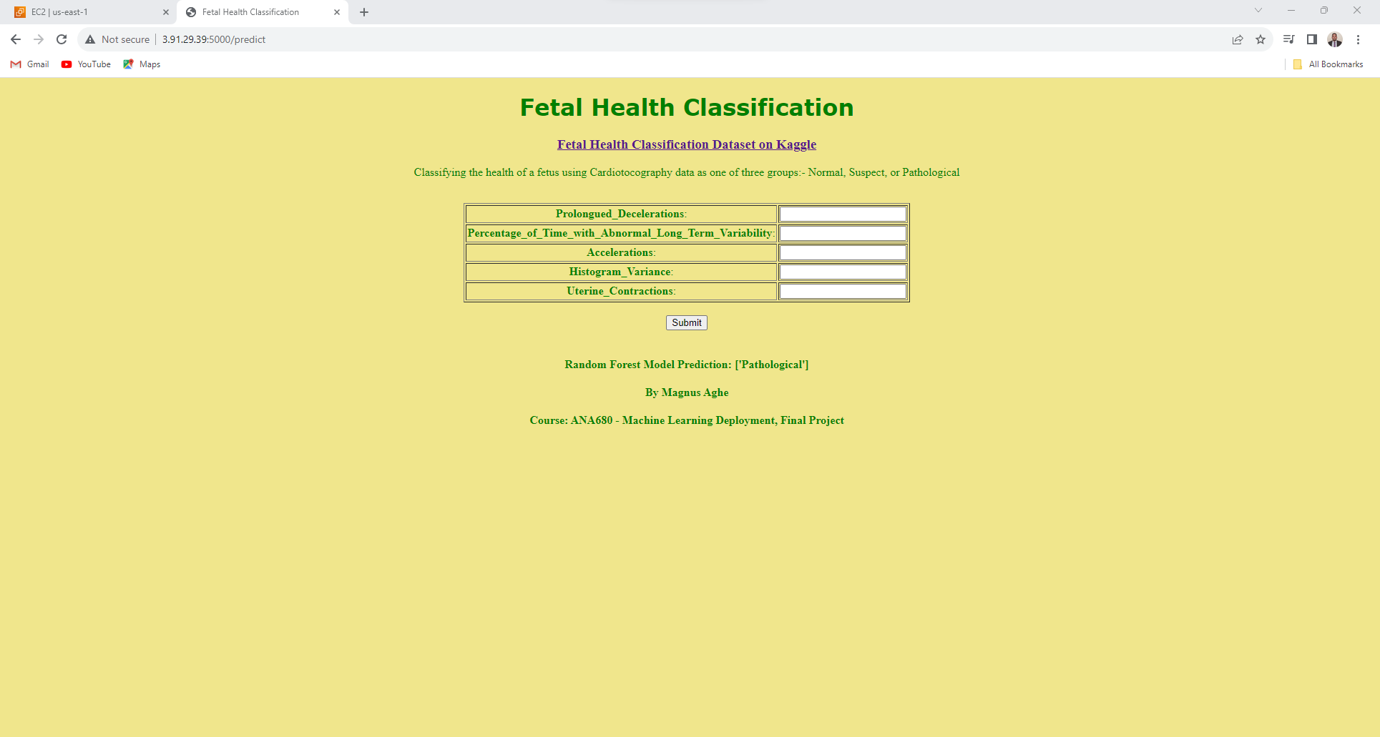
Model Deployment – AWS EC2
The model was also deployed on AWS EC2. The screenshot of the Fetal Health Classification deployed model is found here:-

Slide 11
Thank you

