Slide 1
Recommending A Restaurant Location

Slide 2
Why is a restaurant’s location important?
The following aspects of a restaurant’s location can determine its success.
How many restaurants are already in the are, and how many sell similar food?
Competition makes things harder for a new restaurant because they already have an established customer base and you may have to fight for some of it.
Is the type of restaurant you want to open popular in the area?
It can be difficult to successfully open a new restaurant if the type of food you provide isn’t particularly popular in the area.
Cost of commercial property in the area.
The cheaper the area is, the less you will rely on creating a large customer base in the beginning.
*NOTE: Due to lack of available pricing data this was not considered in the analysis.

Slide 3
Analysis
A customer wants to open a new Restaurant
Where: Austin, TX USA
What type of restaurant: Asian restaurant

Slide 4
Getting data & cleaning it
Venue data was pulled from Foursquare’s Places API.
The search and explore endpoints were used
After retrieving the data it was condensed down to the name, venue category, latitude, longitude, and postal code
Then the data was put through a filter to produce a set of venues that only contained Asian Restaurants as detailed in the Categories page of the Foursquare documentation.

Slide 5
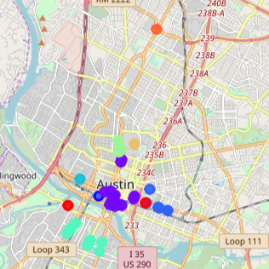
Asian Restaurants in Austin,TX
The map shown, has circle markers for every restaurant, within 2000 meters of the center of Austin, that is classified as an Asian restaurant in Foursquare’s database.
The markers are color coded based on the restaurant’s given postal code.
There are a total of 41 restaurants listed.

Slide 6
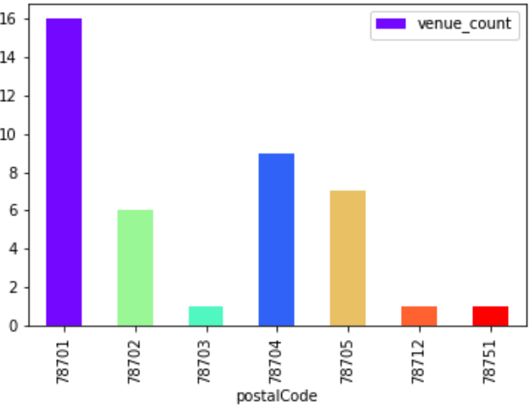
An easier look
This bar graph shows the distribution of Asian Restaurants in each postal code.

Slide 7
Recommedation
Based on the distribution of venues I would recommend that prospective business owner look into building his new restaurant in the postal code 78702. This area has existing restaurants in the area which means there is some demand for them. At the same time it doesn't have the highest concentration which means that there won't be as much competition.

Slide 8
Conclusion
While using only the postal code provides enough information to make a suggestion on where to physically place a new restaurant within an area. That suggestion is not as concrete as it could be, if it were backed by pricing data, and what venues were trending in thee area.

