Slide 1

Azure + NodeJS = true
NodeConf OneShot Oslo

Slide 2

var name = magnusGreen;
Travelling
Movies
Rock n’ Roll
Coffee
www
JavaScript
Consultant
.NET
NodeJS
Beer
Agile
Internet of things
New York
Master of Information Technology
Notes:
Magnus Green
Jobber i Microsoft-avdelingen

Slide 3
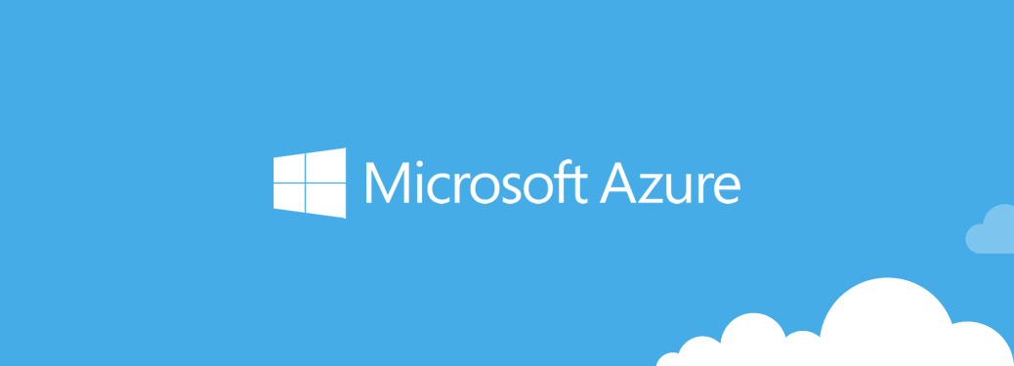


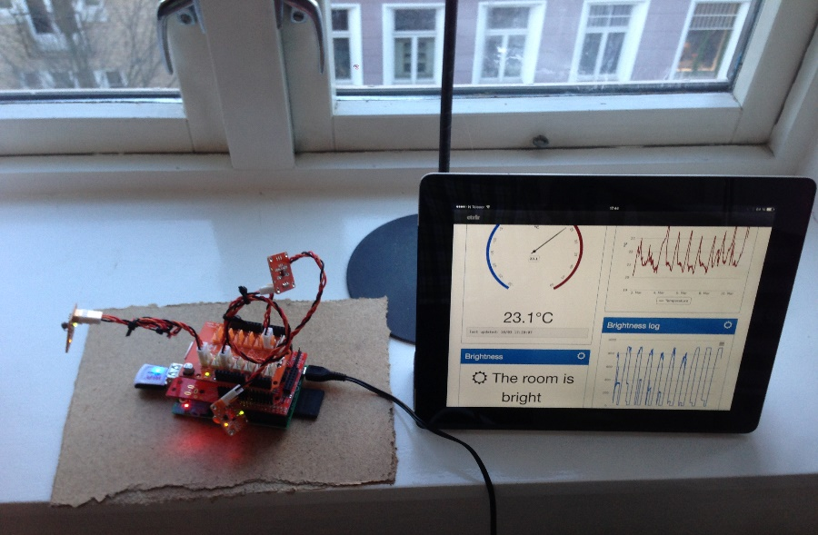
NodeJS @home
Notes:
Introduce Johnny-five for controlling Arduino with JavaScript

Slide 4


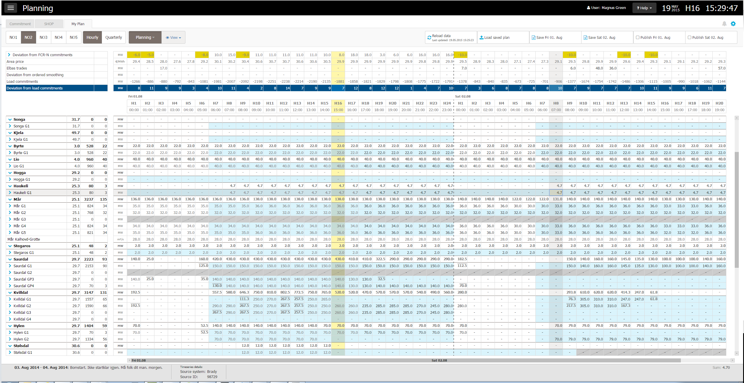


NodeJS @work
Notes:
Introduce Johnny-five for controlling Arduino with JavaScript

Slide 5
NodeJS + Azure
Supported since 2011
Deploy and run NodeJS applications
Use Azure services from NodeJS applications
Visual Studio NodeJS tools are awesome
Visual Studio code
Notes:
Introduce Johnny-five for controlling Arduino with JavaScript

Slide 6
DEMO Set up and deploy application to Azure

Slide 7
DEMO Connecting to Azure services

Slide 8
get started
Sign up for free trial, http://azure.microsoft.com/
10 free apps in shared environment
Free IDEs
Visual Studio Code
Visual Studio Community 2013
Check out http://azure.microsoft.com/en-gb/pricing/calculator/
Notes:
Introduce Johnny-five for controlling Arduino with JavaScript

Slide 9
DEMO Debugging NodeJS in VS Code

Slide 10

want more?
Code available at github, https://github.com/magnushg/NodeConfOneShotOslo
Contact me at magnus.green@bouvet.no or @magnusg
https://github.com/magnushg/automatr

